Slide 1
Dependability evaluation of two solutions implementing a publisher-subscriber primitive
Marco Alberti, Cristian Andrei Mai Mihai

Slide 2
The task
To implement two pub/sub primitives using different solutions:
The first one is with Rabbitmq
The second one is with Zeromq

Slide 3
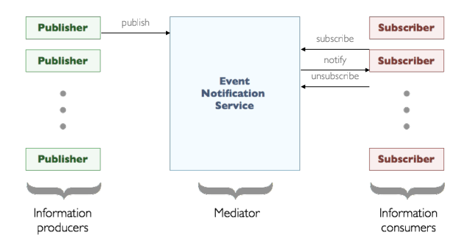
What is publisher-subscriber primitive
First of all: how does a pub/sub paradigm work?

Slide 4


Rabbitmq vs Zeromq
Rabbimq:
Uses a broker
Topic based and fanout
Zeromq:
Brokerless!!!
Only topic based

Slide 5
How did we use them
For Rabbitmq we created a cluster of nodes
For Zeromq we created multiple instances of the ‘‘broker’’

Slide 6
Our implementation
Creates pubs/subs as indipendent processes in both a statical and a dynamical way
Closes pubs/subs in the same manner
Simulates crashes of pubs/subs and Rabbitmq nodes or Zeromq brokers

Slide 7
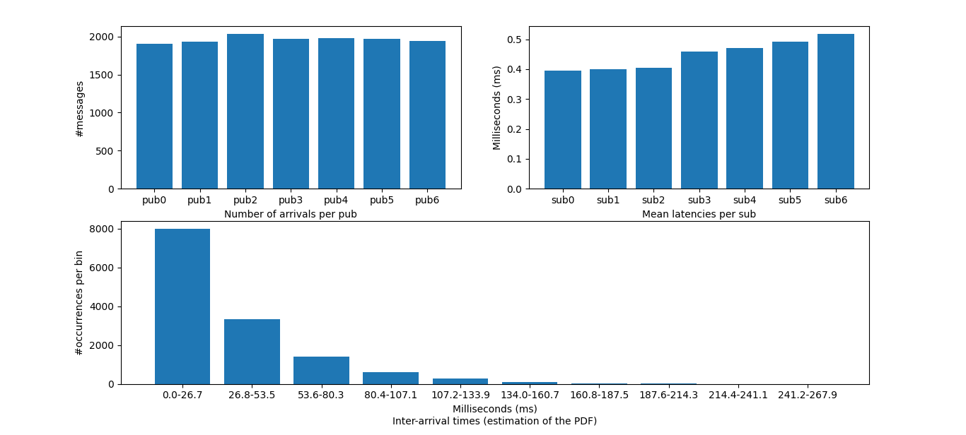
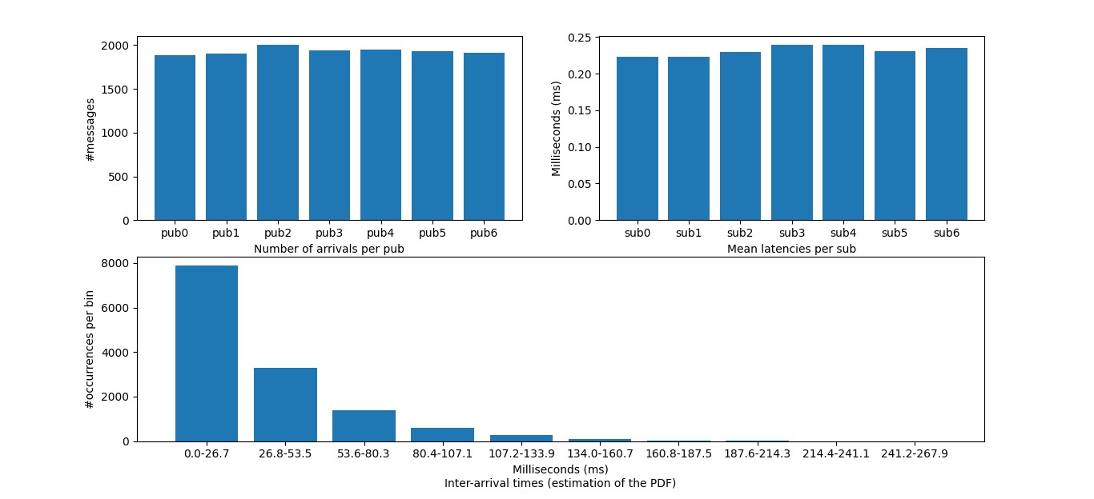
Now let’s look at some numbers
Case examinated: 7 pubs and 7 subs where there’s no creation or closure
TO NOTICE: the only difference is in the latencies!

Slide 8
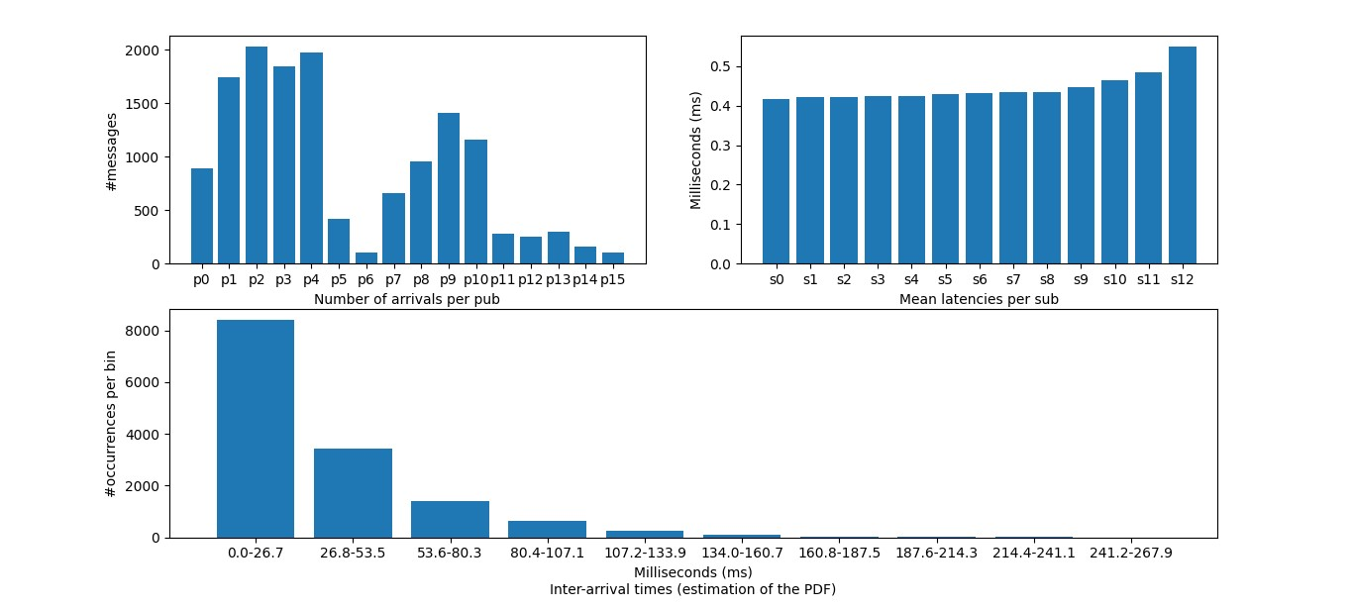
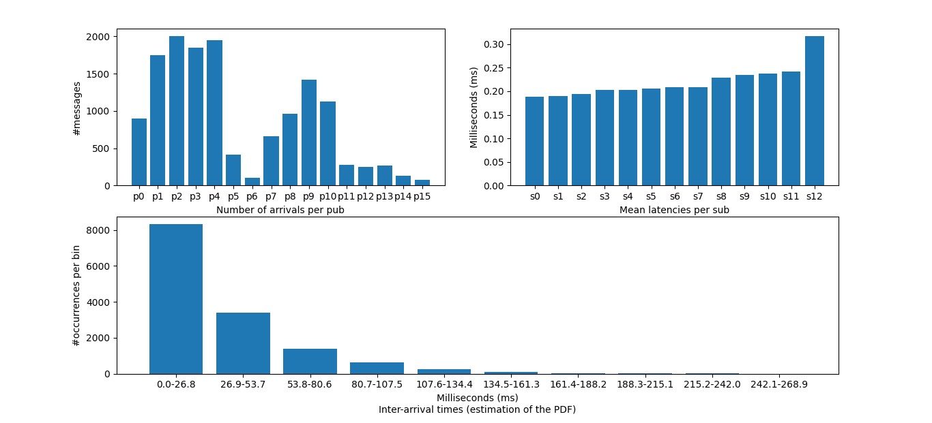
Case examinated: 7 pubs and 7 subs by default, but they can be closed and created

Slide 9
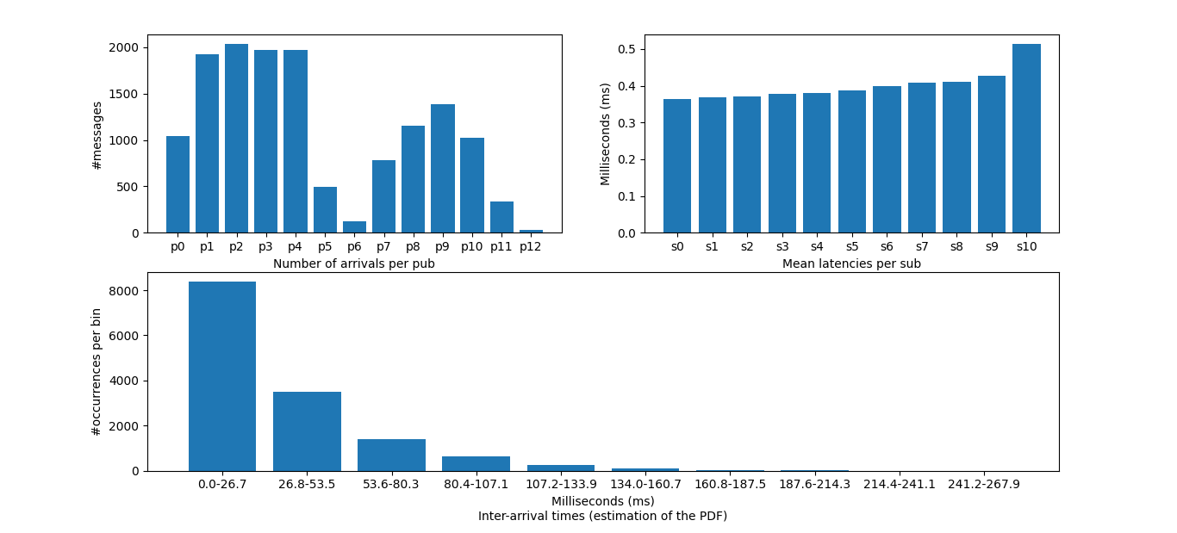
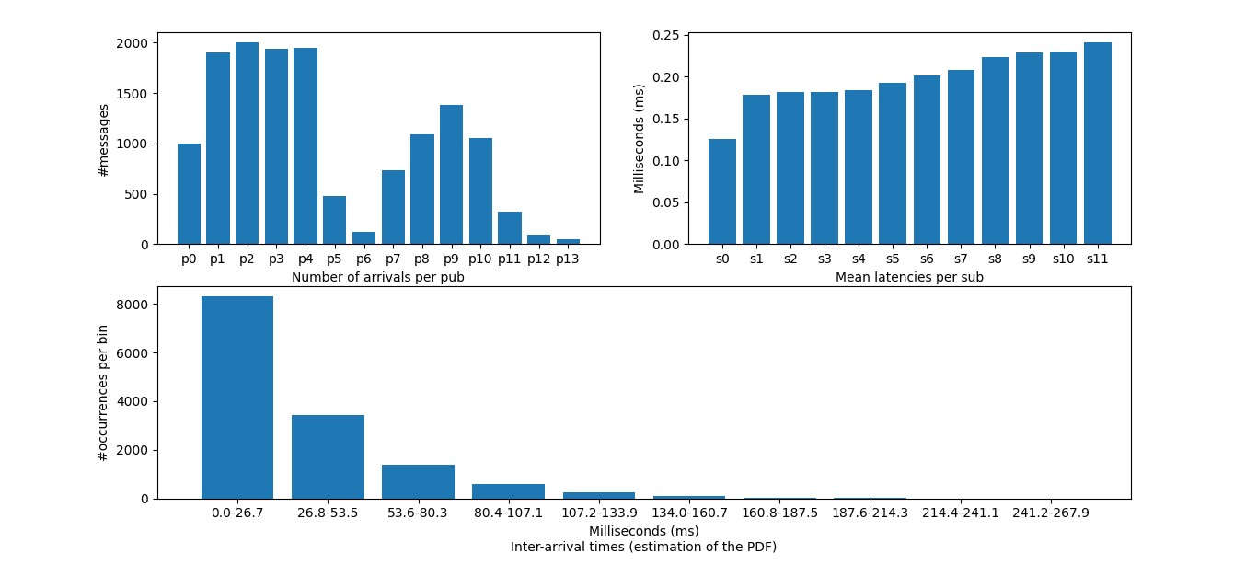
Case examinated: 7 pubs and 7 subs by default, but they can be closed and created and 2 out of 3 brokers crash during the execution
TO NOTICE: in this case there is a total of 6 message lost in the Rabbitmq setup, while 0 losses in Zeromq

Slide 10

Conclusions: which one is better?
Well, it depends:
Rabbitmq has more functionalities and better monitoring
Zeromq has better performances, but there’s a big trade-off between availability and overhead

