Slide 1

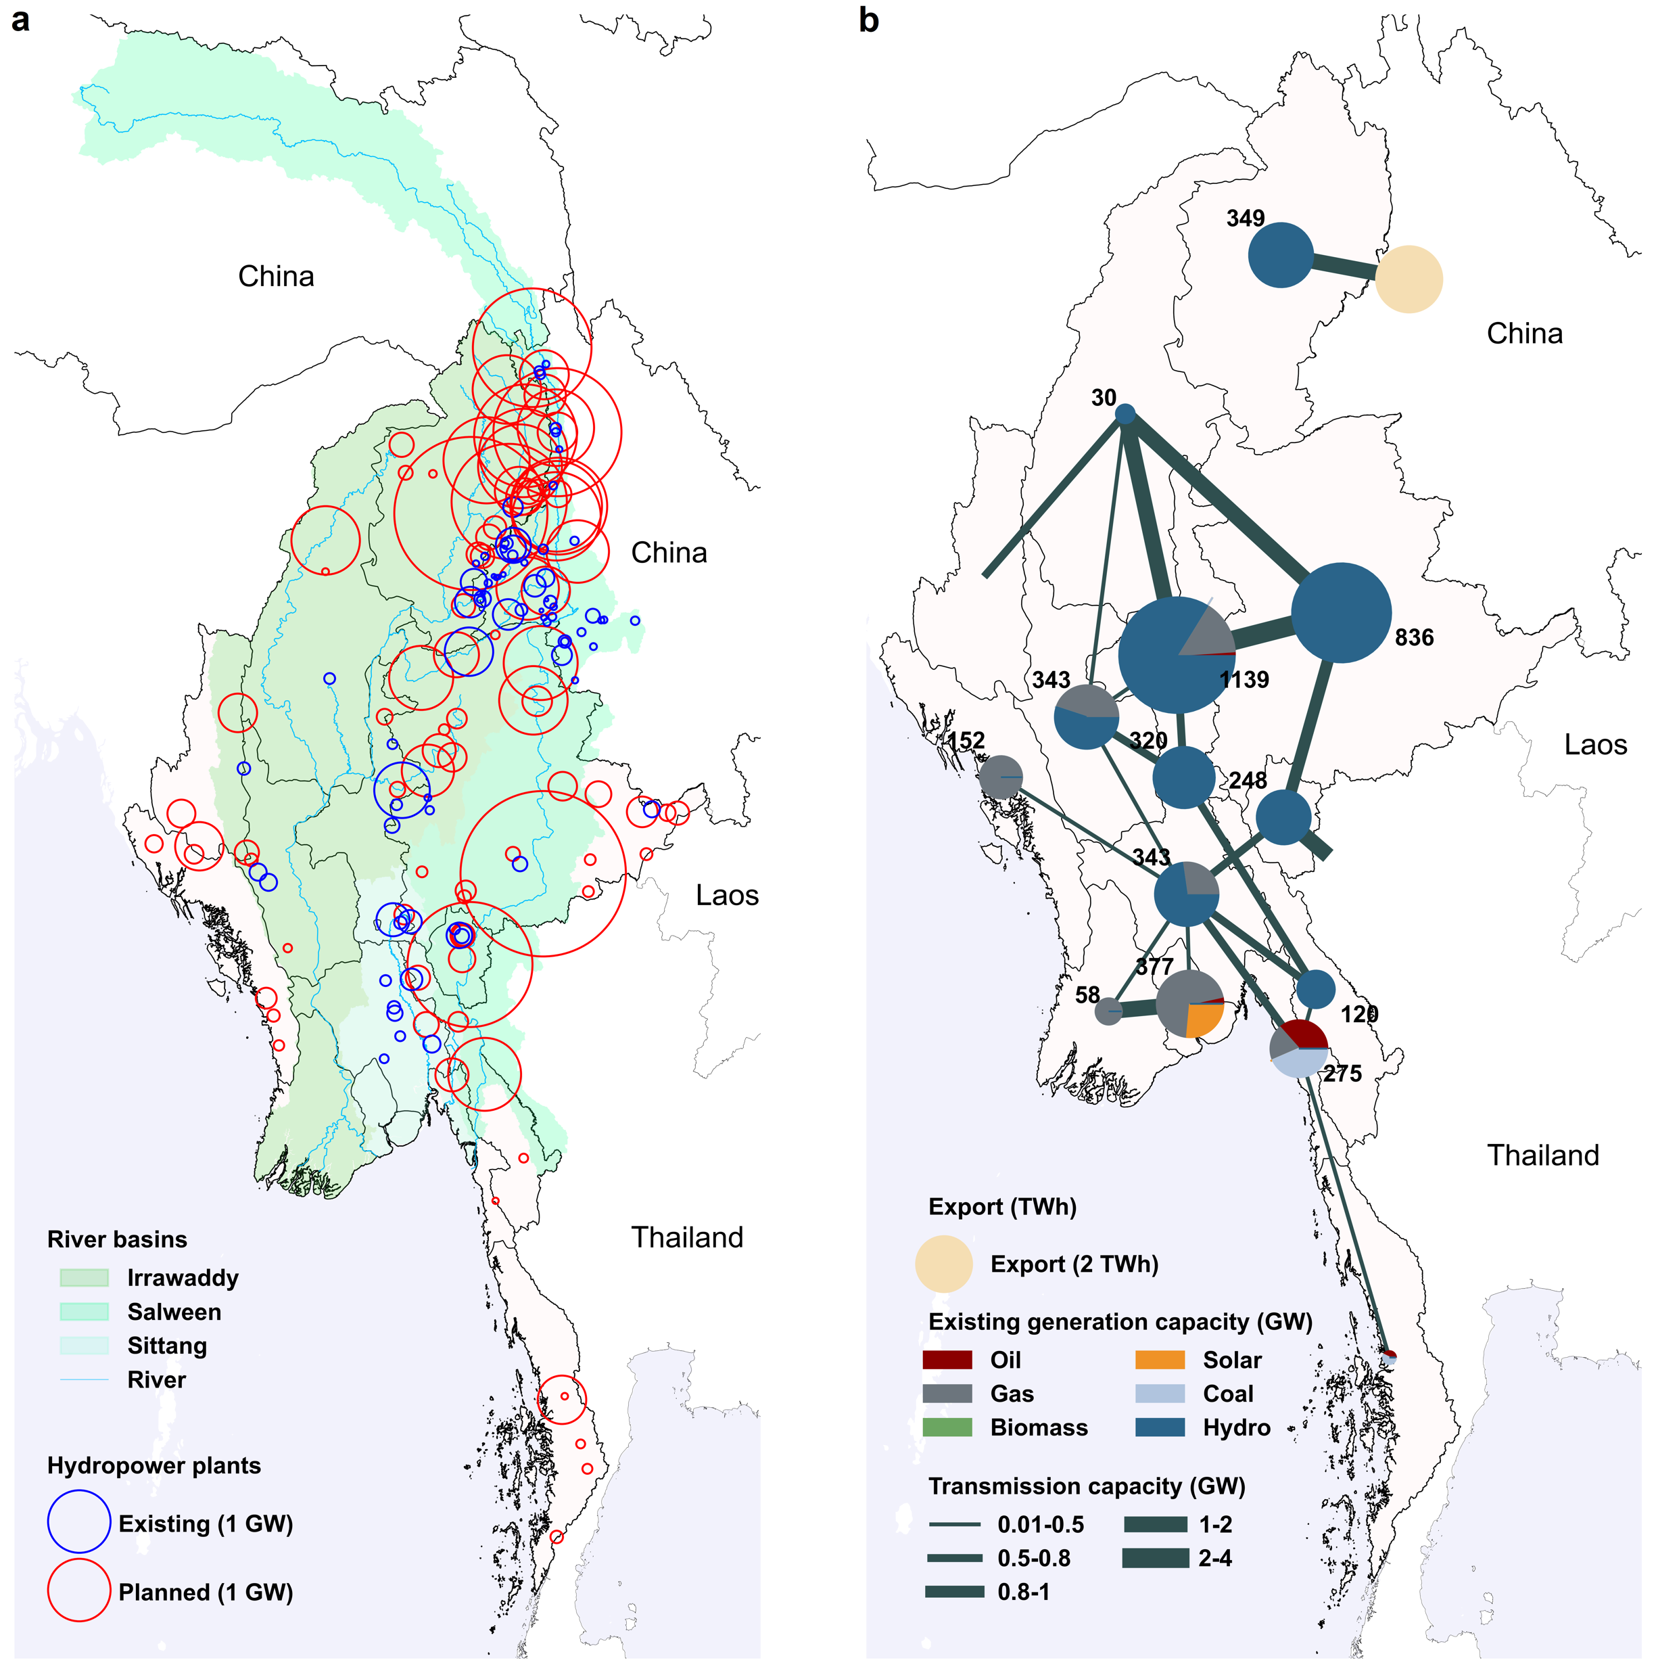


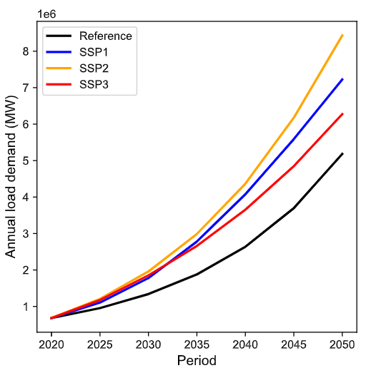
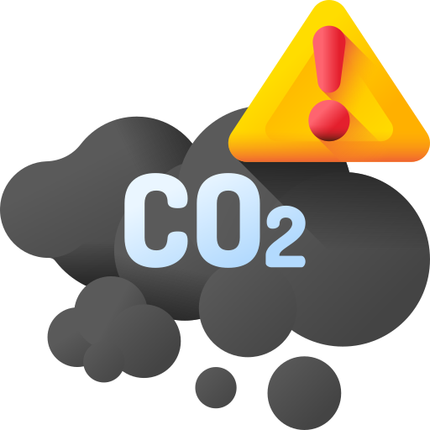
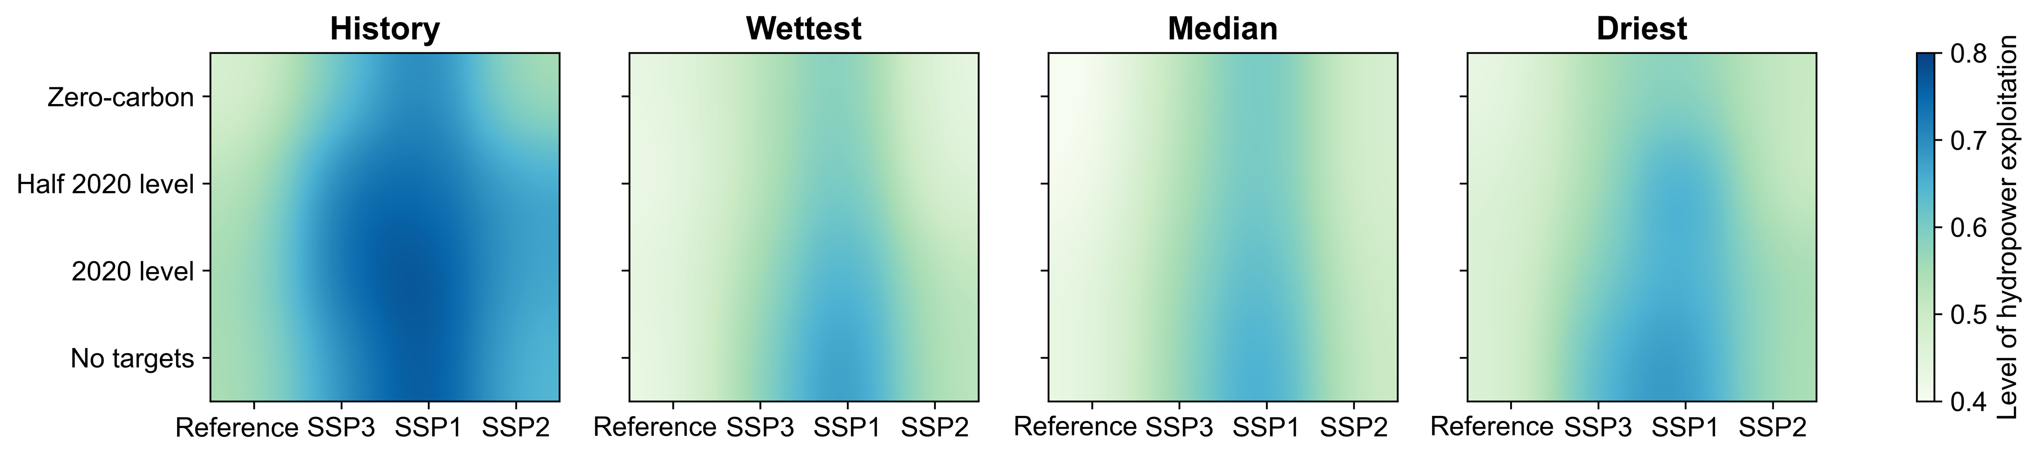
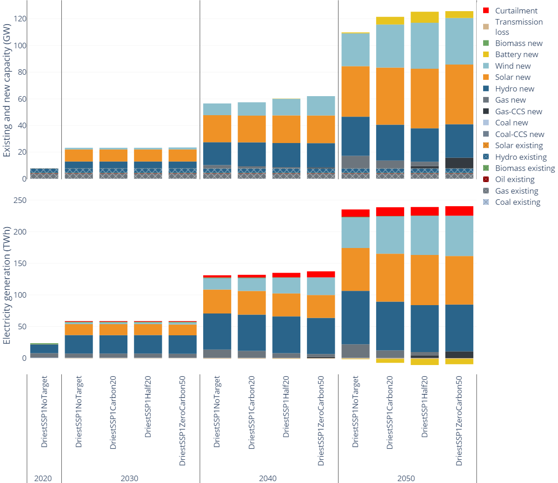

GC33K-1284
Will history repeat itself? A quantitative analysis of Myanmar’s
future energy pathways and their impact on free-flowing rivers
Xiaoyu Jin¹, Kamal Chowdhury², Thanh Duc Dang³, Ranjit Deshmukh⁴, Stefano Galelli⁵
¹ Dalian University of Technology; ² University of Maryland; ³ University of South Florida; ⁴ University of California Santa Barbara; ⁵ Cornell University
1. Background
4. Experimental setup
Several river basins in Southeast Asia have recently witnessed the construction of new hydropower dams. This is the result of energy policies hinged on the exploitation of cheap and locally-available energy resources.
We hypothesize that future hydropower development (over the period 2020-2050) could be influenced by three main drivers, namely future hydrological conditions, electricity demand, and decarbonization policies.
The Irrawaddy and Salween rivers, however, represent an exception: their vast hydropower potential (about 100 GW) has, so far, seen limited hydropower development, making them the main free-flowing rivers of Southeast Asia.
Characterizing the conditions under which Myanmar could expand its grid without damaging these rivers is therefore necessary to avoid repeating past mistakes, like the ones characterizing the nearby Mekong River basin.
For the hydrological conditions, we consider four scenarios, one representing ‘Historical’ conditions and three representing ‘Minimum’, ‘Maximum’, and ‘Median’ future conditions. The latter are derived from an an ensemble of 10 global climate models and three carbon emission scenarios.
Four decarbonization policies based on:
Imposing no decarbonization targets
Limiting the 2050 emissions to the 2020 level
Reducing annual emissions to 50% of the 2020 level (in 2050)
Reaching carbon neutrality in 2050
Future electricity demand is modelled with four scenarios, illustrated in the figure below.
Annual load projections. The ‘Reference’ scenario is based on technical reports, while the scenarios corresponding to SSP 1, 2, and 3 are produced by an integrated assessment model (GCAM).
5. Results
x
We have a total of 64 scenarios, or states of the world, w.r.t. which we study the expansion of Myanmar’s power system, including its future hydropower fleet. The figure below illustrates the Level of Hydropower Development (LHD) at the end of the planning period.
(a) River basins supporting Myanmar’s power grid. Existing and planned dams are denoted in blue and red, respectively. (b) Graphical representation of Myanmar’s power generation and transmission fleet operated in 2020.
Level of hydropower development in 2050, defined as the ratio between constructed and planned dams. The circles illustrated in the rightmost panel correspond to specific scenarios that are further analyzed in the plot below.
2. Research questions
Key takeaways:
The impact of electricity demand on the LHD is substantial, but the demand-LHD relationship is non-linear.
The decarbonization policy does not strongly affect hydropower development.
Both points are due to the concomitant expansion of other generation sources (e.g., solar, gas).
Drier conditions reduce the dam capacity factor, in turn requiring the construction of more dams.
What are the key drivers of future hydropower development in the Irrawaddy and Salween rivers?
Could decarbonization policies further push hydropower development?
Is there any potential conflict between water and other natural resources (e.g., land)?
3. Modelling framework
REZoning + Renewables.ninja
Solar and wind availability
Electricity demand
GridPath
RENEWABLE ENERGY POTENTIAL MODEL
Electricity generation mix across the period 2020-2050 for four selected scenarios.
Meteorological forcings
CAPACITY EXPANSION MODEL
Power generation fleet, costs, emissions
HYDROLOGICAL MODEL
Code
Contact us
VIC-Res
Hydropower availability
Climate policies
REZoning: https://rezoning.energydata.info
GridPath: https://www.gridpath.io
Renewables.ninja: https://www.renewables.ninja
VIC-Res: https://github.com/Critical-Infrastructure-Systems-Lab/VICRes
Web: https://galelli.cee.cornell.edu
Email: galelli@cornell.edu

