Slide 1
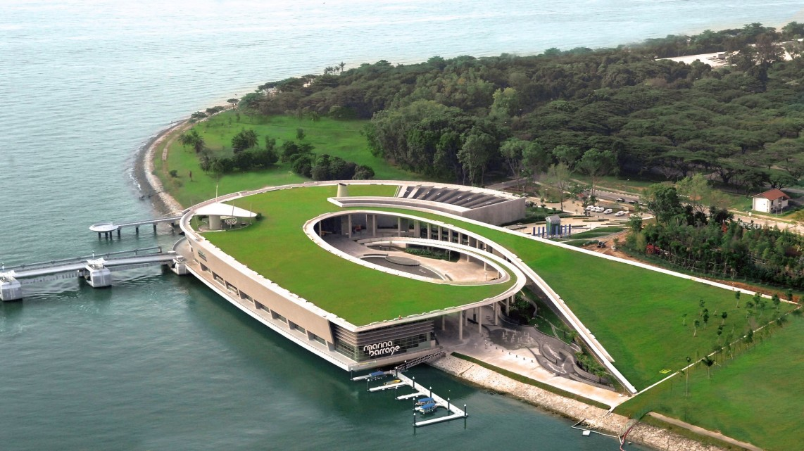


Robust optimal design of urban drainage systems
Advisors:
Assoc. Prof. Stefano Galelli
Dr. Samira Fazlollahi
August 11, 2020
Notes:
good afternoon everyone it’s my pleasure to be able to present my PhD research to you today. My work is on the robust optimal design of urban drainage systems and it is carried out under the guidance of my advisors, Stefano and Samira

Slide 2

EDB-IPP with Veolia
Veolia is the global leader in optimized resource management, providing innovative waste, water and energy management solutions
168,800 employees worldwide
300 researchers & scientists
PhD funded under EDB-IPP with Veolia
Objectives
Design efficient urban drainage systems
Applicable at large urban scales
Good balance between overflow risks and investment costs
PhD deliverable: Methodology and user-friendly computational tool
Notes:
A lil background on my Phd, it is funded by Veolia under the EDB-Industrial postgraduate program. Veolia operates drainage system in many cities worldwide, hence they are interested in this research topic. Veolia’s objectives is to design efficient urban drainage systems, applicable at large urban scales, and striking a good balance between overflow risks and investment costs. Through my Phd, I will deliver a metholody and user-friendly computational tool that produces urban drainage designs.

Slide 3
Contents
Introduction
Challenges
Research questions
Part 1:
Do design storms yield robust drainage systems? How rainfall duration, intensity, and profile can affect drainage performance
Part II:
Designing robust urban drainage systems: a data-driven approach
Conclusions and future directions
Notes:
The outline of my presentation is as follows: I will introduce this subject, telling you about the challenges in urban drainage design and the research questions I aim to answer. The main body is divided into two parts, first I will answer the question ‘do…performance’. Following that I will explain how we design robust urban drainage systems using a data-driven approach. Finally, I will conclude the presentation and discuss the future directions.

Slide 4
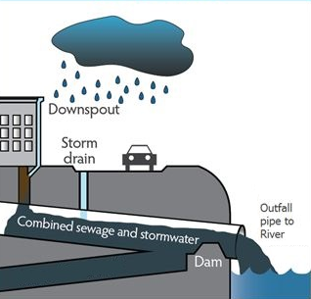
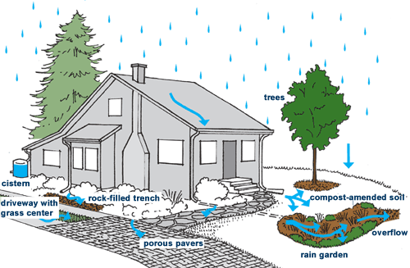
Introduction
From US Environmental Protection Agency
From Seattle Public Utilities
Illustration of Low Impact Development (LID)
Notes:
Let us first take a look at what is urban drainage system. Urban drainage systems are critical infrastructures for cities to minimize flood damages during heavy rainstorms. During heavy storms, runoff is generated and when large volumes collect above ground, it forms a fast flowing front of water and debris, which is what we call flash floods. One component of drainage system is the drainage network that consists of underground pipes or canals. It prevents floods by conveying large volumes of runoff to outlets of the catchment, discharging the runoff into rivers. Another component of drainage system that complements the pipe network is the low impact developments (LIDs). They slow down runoff entering the pipe network by promoting infiltration and retention. They slow down runoff generation such that capacity of pipe network is not overloaded, thus reducing flood risks.

Slide 5
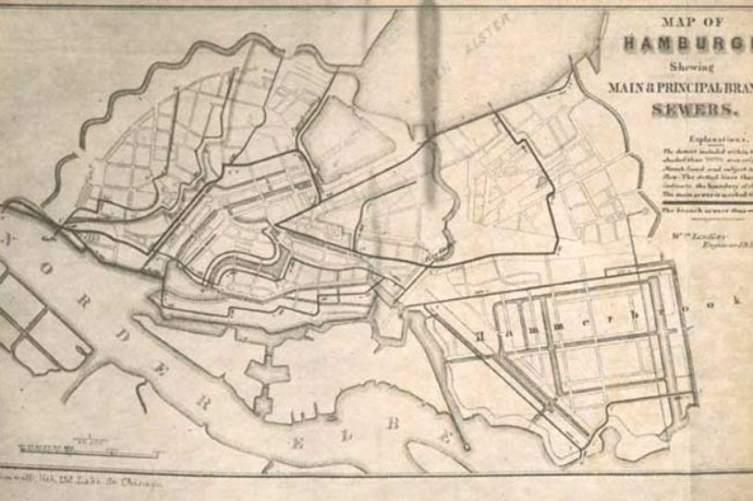
Introduction
First comprehensively designed drainage system was installed in Hamburg in 1843
Success was emulated in America and other European countries
Designs based on empirical equations or look-up tables
Outline of the main sewage system, Hamburg, Germany, 1857
Source: We Are Water Foundation
Notes:
Historical overview of design storm + how design has been done
https://www.wearewater.org/en/sewage-the-trace-of-our-history_281141
Sizing the pipes based on sewer slope and basin area

Slide 6
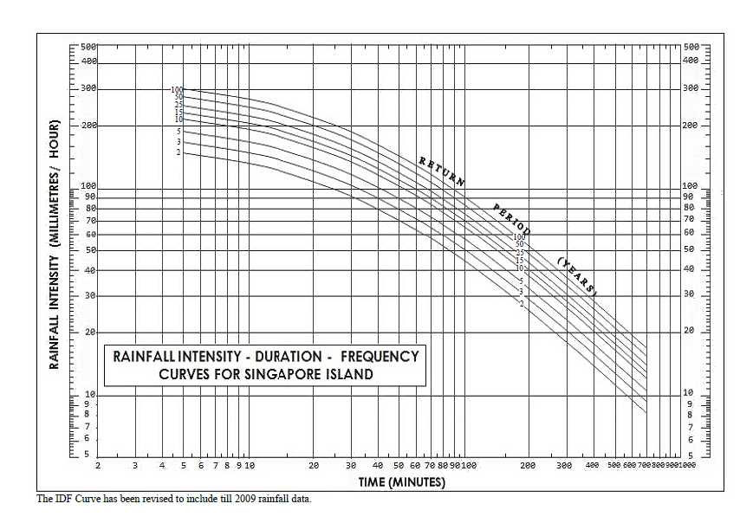
Introduction
IDF curves (intensity-duration-frequency) first derived in 1930s
Marked the beginnings of ‘design storms’
From PUB
Notes:
IDF curve from https://www.pub.gov.sg/Lists/AppendicesDrawings/Attachments/5/app2.pdf
If we take a look at rainfall of duration 3 hours, we see that an event with 2 year return period has an intensity of 30mm/hr. Rainfall events with higher intensity corresponds to higher return periods as they are less likely to occur. The IDF curves thus marked the beginnings of design storms which are critical events of given intensity, duration, and return period, used to test the endurance of hydraulic systems. Until today, design storms remain an essential part of the design of urban drainage systems.

Slide 7
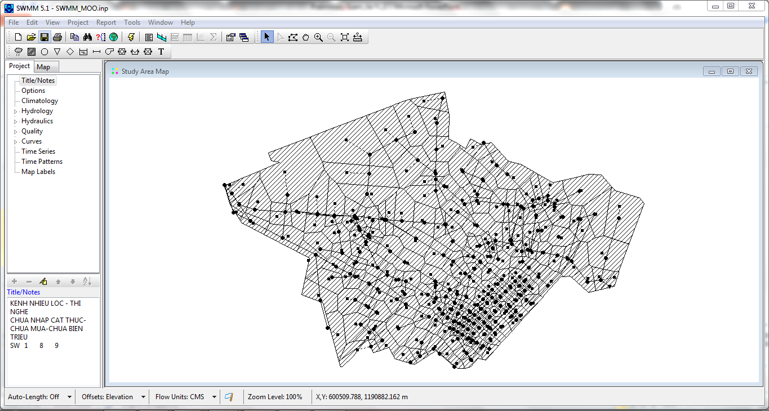
Introduction
Early optimization techniques in 1960s: LP, NLP, DP
Oversimplification and inaccurate hydrological and hydraulic evaluations
Curse of dimensionality
Hydrological and hydraulic process-based simulation models developed in 1970s
Current commonly used optimization technique: Metaheuristics
Allow for precise hydraulic evaluations using simulation
Computationally expensive
Rossman, L. A. (2015). Storm water management model user's manual, version 5.1. Cincinnati: National Risk Management Research Laboratory, Office of Research and Development, US Environmental Protection Agency.
Wang, Q., Zhou, Q., Lei, X., & Savić, D. A. (2018). Comparison of Multiobjective Optimization Methods Applied to Urban Drainage Adaptation Problems. Journal of Water Resources Planning and Management, 144(11), 04018070.
Mays, L. W., & Wenzel Jr, H. G. (1976). Optimal design of multilevel branching sewer systems. Water Resources Research, 12(5), 913-917.
Notes:
Optimization, emphasize they all use design storms
To allow problem formulation to take on a specific structure that can be solved by such optimization techniques, oversimplification, neglecting time of peak flows or assuming rainfall is uniformly distributed across time

Slide 8
Challenges
Not robust
Drainage solutions may only work well against design storms
Optimization-based design is computationally expensive
Large decision space
Challenging simulation runtime
Poor scalability:
may prevent application to large watersheds

Slide 9
Objectives
To develop a methodology and a tool for the
robust optimal design of urban drainage systems
Features:
Able to provide optimal configuration (location, type, size, operations) of LID and sewer systems (pipes, pumps, valves, storage tanks)
Able to handle multiple objectives
Can be applied to various test cases readily for urban rehabilitation plan or master planning of new systems
Scalable (large catchment area, reasonable computation time)
User-friendly
Notes:
Veolia
GUI

Slide 10
Research questions
Do design storms yield robust urban drainage systems?
How can we design robust optimal urban drainage systems at large urban scales within reasonable computational requirements?
Robust drainage systems are solutions that perform consistently under a broad range of rainfall events

Slide 11
Do design storms yield robust drainage systems? How rainfall duration, intensity, and profile can affect drainage performance

Slide 12
Case study

Slide 13
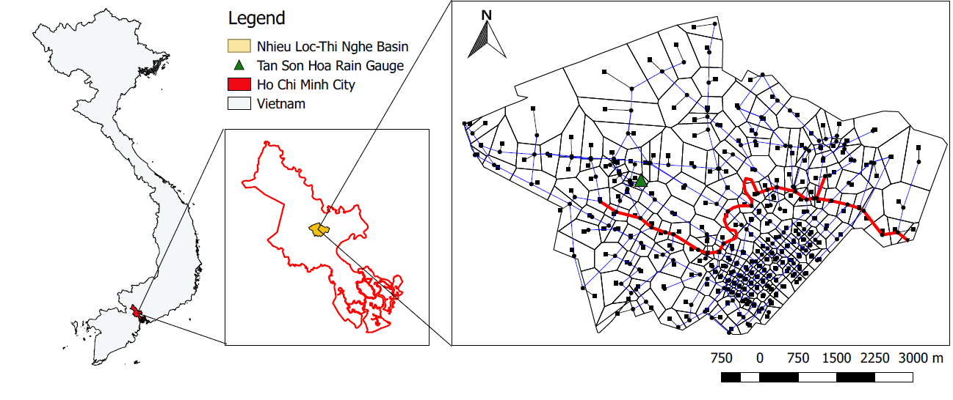
Nhieu Loc-Thi Nghe (NL-TN) Basin
Loc, H. H., Babel, M. S., Weesakul, S., Irvine, K. N., & Duyen, P. M. (2015). Exploratory Assessment of SUDS Feasibility in Nhieu Loc-Thi Nghe Basin, Ho Chi Minh City, Vietnam. International Journal of Environment and Climate Change, 91-103.

Slide 14
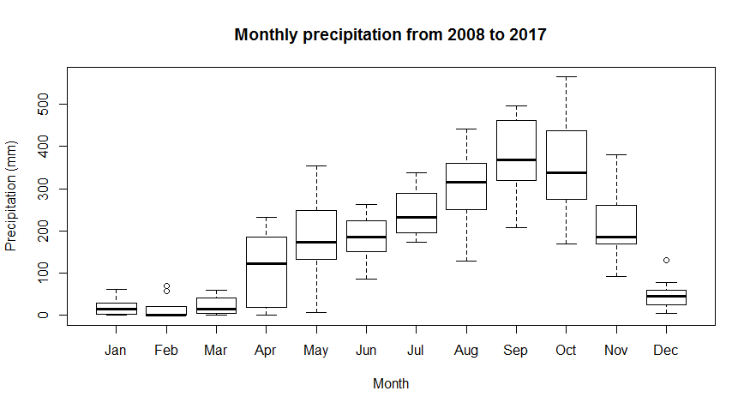
Precipitation for NL-TN Basin
Notes:
Ho Chi Minh City is characterized by two distinct seasons: the rainy season lasting from May to October and the dry season lasting from November to April

Slide 15
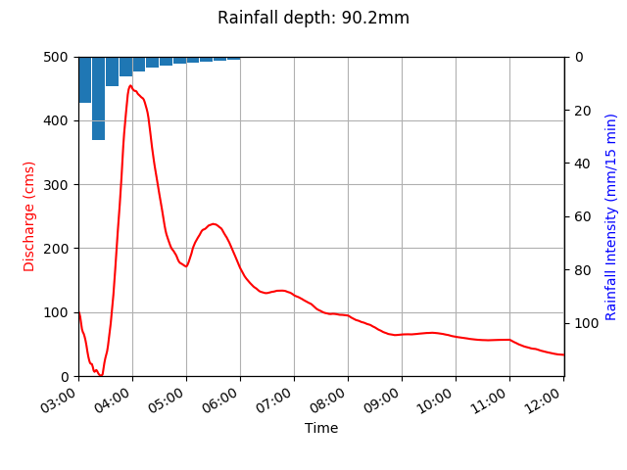
Design storm for NL-TN Basin
2-year 3 hours
design storm
Notes:
Rainfall-discharge curve (discharge at outlet, tide peaks at 4pm)

Slide 16
Computational framework
Set of all decision variables
Rainfall data
Robust solutions
Design storm
Rainfall events obtained from 10 years rainfall series
I. Sensitivity Analysis
III. Statistical analysis and
simulation of rainfall events
IV. Robustness Analysis
Model joint distribution of rainfall intensity and duration using copula
Model storm profile by Huff’s method
Reduced set of decision variables
Solutions’ performance under different rainfall conditions
Likelihood of rainfall events
II. Simulation-optimization
Pareto-efficient solutions
Simulation under different rainfall conditions
Notes:
Sensitivity analysis reduces the complexity of the problem, takes in the set of all decision variables and selects decision variables that contribute to overflow reduction during the design storm. It gives us a reduced set of decision variables which we use in the simulation-optimization step to find a set of solutions that minimize costs and maximize overflow reduction under the design storm. We then move on to the rainfall analysis, in which we use model the rainfall characteristics of events obtained from 10 year rainfall series and simulation Pareto-efficient solutions under different rainfall conditions that are different from those of the design storm. Finally, we assess the robustness of these solutions in the robustness analysis.

Slide 17
Computational framework
Set of all decision variables
Rainfall data
Robust solutions
Design storm
Rainfall events obtained from 10 years rainfall series
I. Sensitivity Analysis
III. Statistical analysis and
simulation of rainfall events
IV. Robustness Analysis
Model joint distribution of rainfall intensity and duration using copula
Model storm profile by Huff’s method
Reduced set of decision variables
Solutions’ performance under different rainfall conditions
Likelihood of rainfall events
II. Simulation-optimization
Pareto-efficient solutions
Simulation under different rainfall conditions

Slide 18
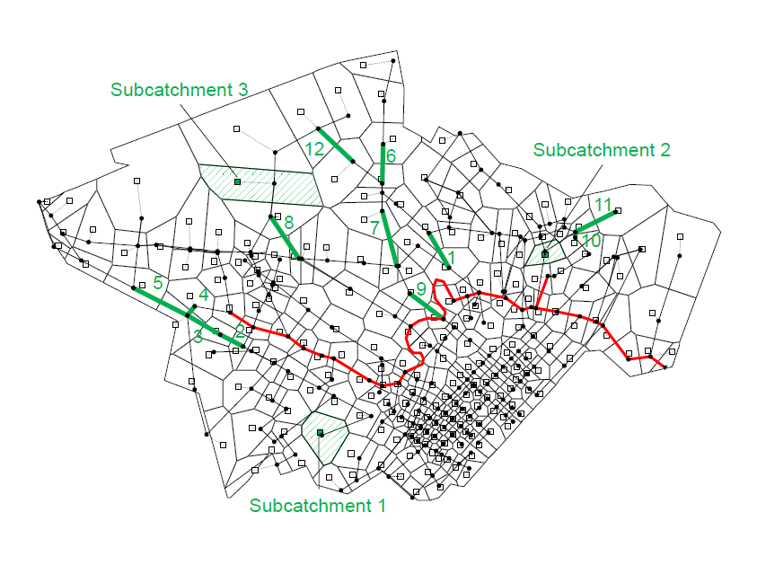
Sensitivity Analysis
Input: diameter of 308 pipes and area of 12 LIDs
Output: overflow reduction
EET and eFAST to reduce decision space from 320 variables to 12 pipe variables and 8 LID variables
EET: Elementary effect test
eFAST: extended Fourier amplitude sensitivity test
Pianosi, F., Beven, K., Freer, J., Hall, J. W., Rougier, J., Stephenson, D. B., & Wagener, T. (2016). Sensitivity analysis of environmental models: A systematic review with practical workflow. Environmental Modelling & Software, 79, 214-232.
Saltelli, A., Tarantola, S., & Chan, K. S. (1999). A quantitative model-independent method for global sensitivity analysis of model output. Technometrics, 41(1), 39-56.
Notes:
LIDs: green roofs, pervious pavements, urban green spaces, rwh

Slide 19
Computational framework
Set of all decision variables
Rainfall data
Robust solutions
Design storm
Rainfall events obtained from 10 years rainfall series
I. Sensitivity Analysis
III. Statistical analysis and
simulation of rainfall events
IV. Robustness Analysis
Model joint distribution of rainfall intensity and duration using copula
Model storm profile by Huff’s method
Reduced set of decision variables
Solutions’ performance under different rainfall conditions
Likelihood of rainfall events
II. Simulation-optimization
Pareto-efficient solutions
Simulation under different rainfall conditions

Slide 20
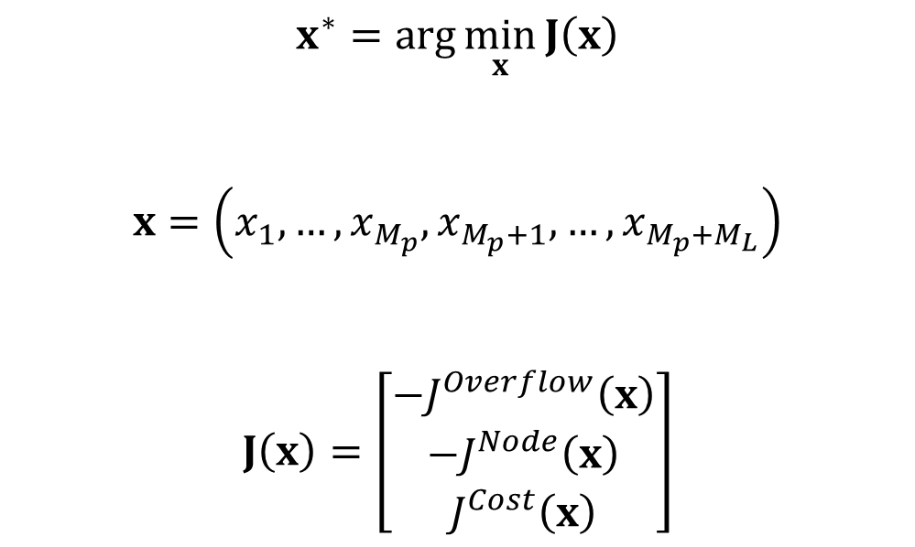
Optimization problem -- formulation
$$x^{∗}=arg\min_{x}{J\left(x\right)}$$
$$x=\left(x_{1},…,x_{M_{p}},x_{M_{p}+1},…, x_{M_{p}+M_{L}}\right)$$
$$J\left(x\right)=\left[\begin{matrix}{−J}^{Overflow}\left(x\right) \\ −J^{Node}\left(x\right) \\ J^{Cost}\left(x\right)\end{matrix}\right]$$
Diameter of pipes
Numbers of LID units
Decision variables
Total # of LIDs
Total # of pipes
Reduction in total overflow volume
Reduction in # of flooded nodes
Notes:
We want to find a set of non-dominated solution x* that minimizes the vector J
Where x are the decision variables

Slide 21
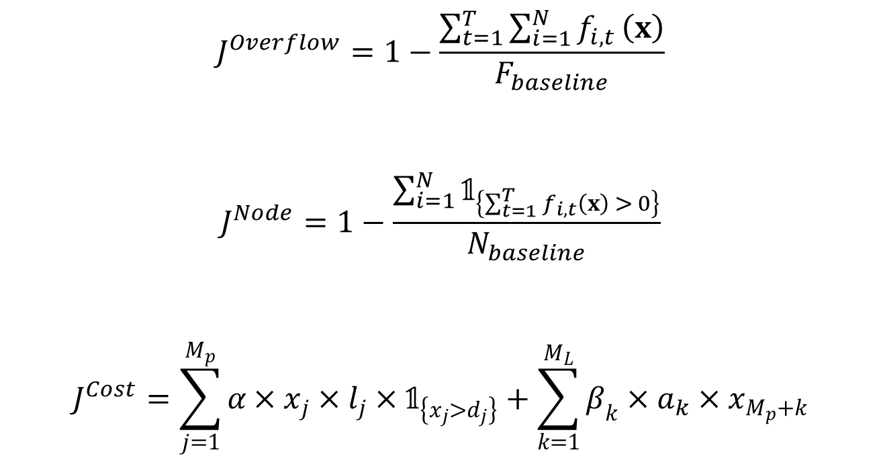
Optimization problem -- formulation
Total # of nodes
Total time instances
Overflow volume at i-th node at time t (SWMM)
$$J^{Overflow}=1−\frac{\sum_{t=1}^{T}{\sum_{i=1}^{N}{f_{i, t}}}\left(x\right)}{F_{baseline}}$$
$$J^{Node}=1−\frac{\sum_{i=1}^{N}{𝟙_{\left\{\sum_{t=1}^{T}{f_{i,t}\left(x\right) > 0}\right\}}}}{N_{baseline}}$$
$$J^{Cost}=\sum_{j=1}^{M_{p}}{α×x_{j}}×l_{j}×𝟙_{\left\{x_{j}>d_{j}\right\}}+\sum_{k=1}^{M_{L}}{β_{k}×a_{k}×x_{M_{p}+k}}$$
Total overflow volume for existing drainage system (SWMM)
Total # of flooded nodes for existing drainage system (SWMM)
Original diameter of pipe j
Area of LID k
Unit cost of LID k (per area)
Length of pipe j
Unit cost of pipe (per diameter per length)
Notes:
Only design storm used here

Slide 22
Optimization problem -- algorithm
NSGA-II (Nondominated sorting genetic algorithm) + SWMM
Set-up
Population size: 200
# of generations: 250
# of function evaluations: 50,000
# of random seeds: 10
CPU time taken per random seed: 72 hours
Deb, K., Pratap, A., Agarwal, S., & Meyarivan, T. A. M. T. (2002). A fast and elitist multiobjective genetic algorithm: NSGA-II. IEEE transactions on evolutionary computation, 6(2), 182-197.
Notes:
Initiated with 10 different random seeds to account for the variability of the stochastic search process and to ensure a wider Pareto front

Slide 23
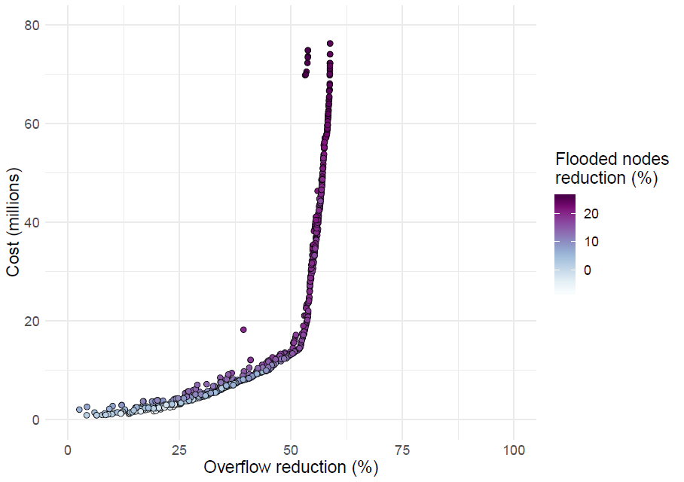
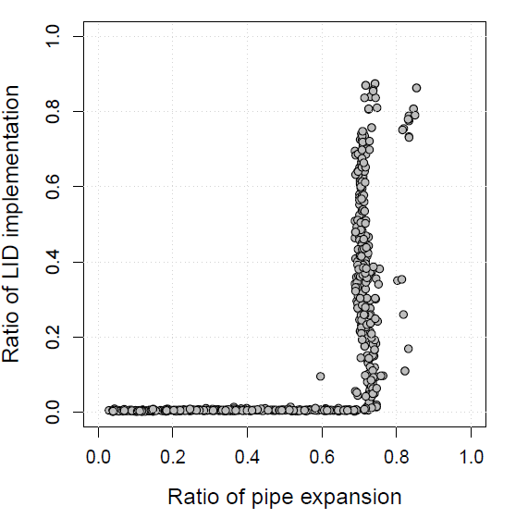
Performance of Pareto-efficient solutions
Pipe expansions are more effective than LIDs at controlling pluvial flood in the NL-TN basin
Notes:
We obtain 669 solutions from the optimization step. This is the pareto front with the 3 objectives on the x, y axis, and color bar. Increasing investments increasing overflow reduction.

Slide 24
Computational framework
Set of all decision variables
Rainfall data
Robust solutions
Design storm
Rainfall events obtained from 10 years rainfall series
I. Sensitivity Analysis
III. Statistical analysis and
simulation of rainfall events
IV. Robustness Analysis
Model joint distribution of rainfall intensity and duration using copula
Model storm profile by Huff’s method
Reduced set of decision variables
Solutions’ performance under different rainfall conditions
Likelihood of rainfall events
II. Simulation-optimization
Pareto-efficient solutions
Simulation under different rainfall conditions

Slide 25
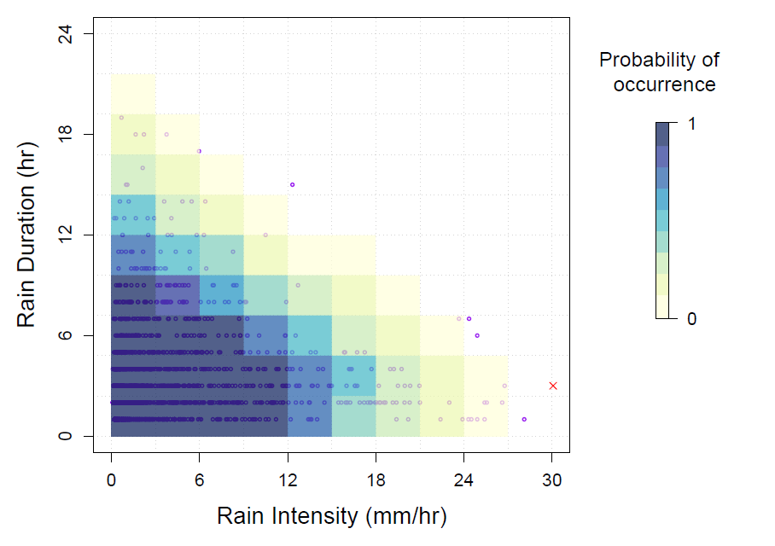
Analysis and generation of rainfall events
Duration fitted to lognormal distribution
Intensity fitted to gamma distribution
Joint probability distribution modeled by a Frank copula
49 events selected with varying duration and intensity
Design storm
Genest, C., & Favre, A. C. (2007). Everything you always wanted to know about copula modeling but were afraid to ask. Journal of hydrologic engineering, 12(4), 347-368.
Notes:
rainfall duration (in hours) is fitted to a lognormal distribution (mean = 0.961, standard deviation = 0.709), while rainfall intensity (in mm/hour) is fitted to a gamma distribution (shape = 0.746, rate = 0.217). In addition to modeling their marginal distributions, we use a Frank copula to model their joint probability distribution: the rationale behind using a copula function is that it allows capturing the dependence structure of two random variables independently of their marginal distributions

Slide 26
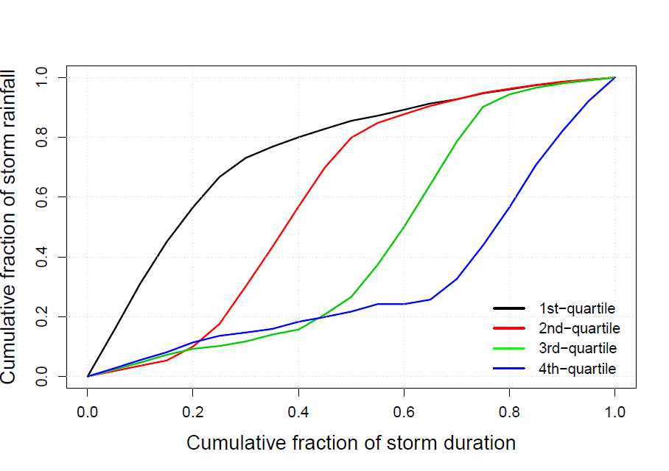
Analysis and generation of rainfall events
Design storm
Huff, F. A. (1990). Time distributions of heavy rainstorms in Illinois. Circular no. 173.

Slide 27
Computational framework
Set of all decision variables
Rainfall data
Robust solutions
Design storm
Rainfall events obtained from 10 years rainfall series
I. Sensitivity Analysis
III. Statistical analysis and
simulation of rainfall events
IV. Robustness Analysis
Model joint distribution of rainfall intensity and duration using copula
Model storm profile by Huff’s method
Reduced set of decision variables
Solutions’ performance under different rainfall conditions
Likelihood of rainfall events
II. Simulation-optimization
Pareto-efficient solutions
Simulation under different rainfall conditions

Slide 28
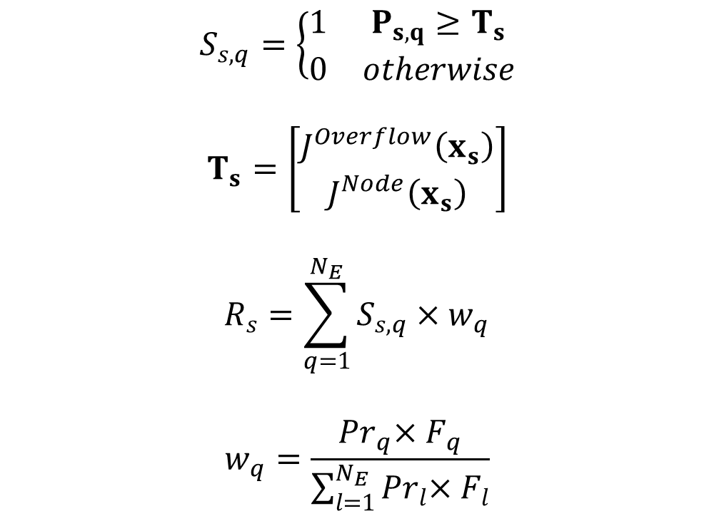
Robustness metric
Performance of solution s in event q
$$S_{s,q}=\left\{\begin{matrix}1 & P_{s,q}≥T_{s} \\ 0 & otherwise\end{matrix}\right.$$
$$T_{s}=\left[\begin{matrix}J^{Overflow}\left(x_{s}\right) \\ J^{Node}\left(x_{s}\right)\end{matrix}\right]$$
$$R_{s}=\sum_{q=1}^{N_{E}}{S_{s,q}×w_{q}}$$
$$w_{q}=\frac{Pr_{q}{×F_{q}}}{\sum_{l=1}^{N_{E}}{Pr_{l}{×F_{l}}}}$$
Success of solution s in event q
Solution-specific
performance threshold
# of rainfall events that have overflow in existing drainage system
Robustness of solution s
Probability of event q
Weight of event q
Overflow volume in existing drainage system in event q
Herman, J. D., Reed, P. M., Zeff, H. B., & Characklis, G. W. (2015). How should robustness be defined for water systems planning under change?. Journal of Water Resources Planning and Management, 141(10), 04015012.
Notes:
For each solution s, we first compute the score of the solution for each rainfall event q, represented by Ss,q. It takes on value 1 if its performance is better or equal to the solution-specific threshold Ts. In other words, it is a success in event q if solution s has an equal or better performance in event q than it has for the design storm. This measure of robustness is a satisficing metric, counting the number of times a solutions exceeds a performance threshold. Calculate robustness of solution s by taking the weighted sum of these successes across the sampled rainfall events that have overflow in the existing drainage system. The weights are proportional to the likelihood of occurrence of the event and the overflow volume in the existing drainage system for the event.

Slide 29
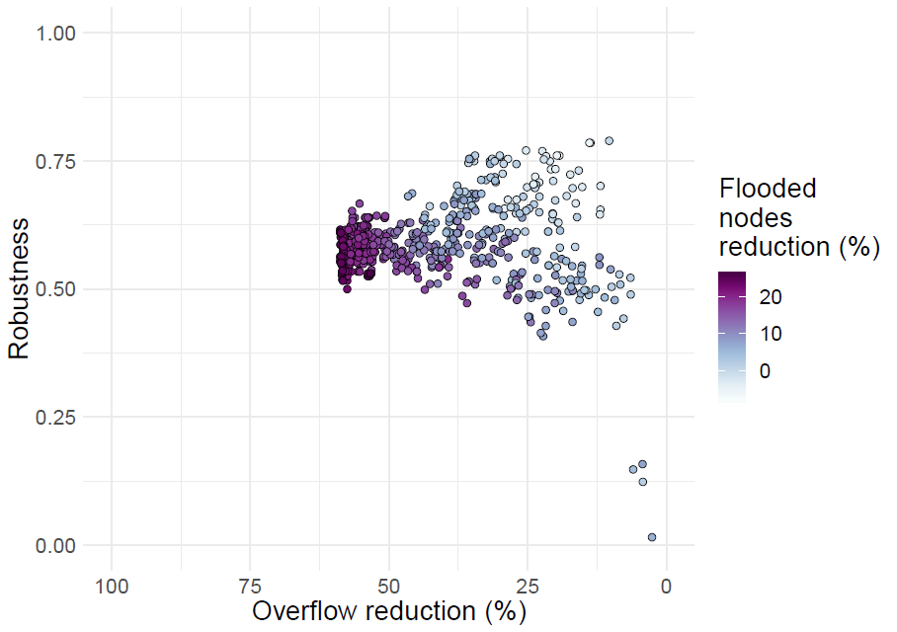
Robustness of solutions
None of the Pareto-efficient solutions are perfectly robust!
Notes:
Range from 0.4 - 0.8 (none all perfectly robust)
Lower variance for more expensive solutions

Slide 30
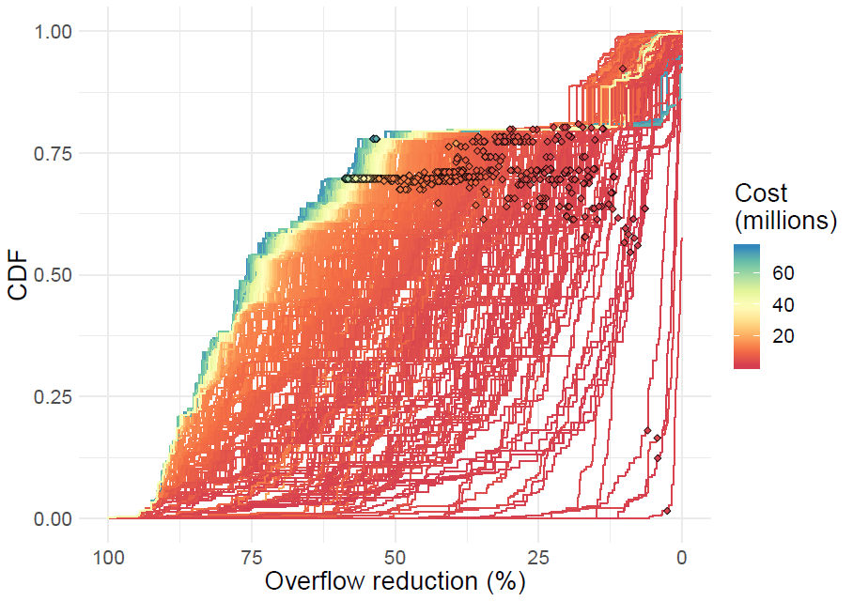
Performance of each solution
All solutions underperformed in some rainfall events
Robustness is primarily determined by pipe expansions
Notes:
Alternative design have varied performance, selecting solutions from opt is not that straightforward
LIDs play a smaller role (robustness is primarily determined by pipes)
All solutions underperformed in some events (sudden drop at y = 0.8)

Slide 31
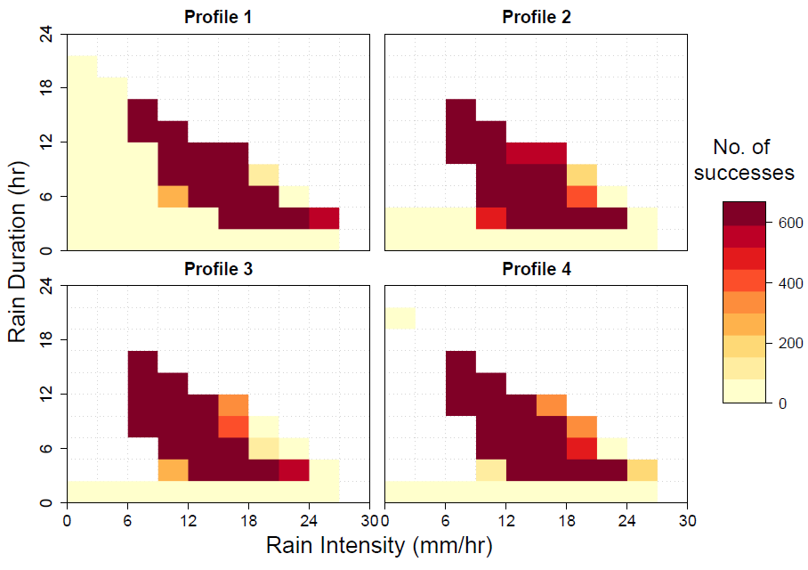
No. of successes for each rainfall event
Many solutions underperformed in intense events
All solutions underperformed in small events
Notes:
Moderate events -> success
Intense events -> difference between expensive and inexpensive solutions, single design storm not enough
Small events -> poor selection of pipe variables

Slide 32
Conclusions
Pipe expansions in NL-TN Basin are more effective than LIDs to reduce flood and increase robustness
None of the drainage solutions are completely robust
Solutions are not robust for 2 types of rainfall events:
Less intense but longer rainfall events which have greater depth than the design storm
Small, yet frequent, rainfall events
Stochastic rainfall events need to be included within the design process

Slide 33
Designing robust urban drainage systems: a data-driven approach

Slide 34
Computational framework
Set of all decision variables
Rainfall data
Robust solutions
Design storm
Rainfall events obtained from 10 years rainfall series
I. Sensitivity Analysis
III. Statistical analysis and
simulation of rainfall events
IV. Robustness Analysis
Model joint distribution of rainfall intensity and duration using copula
Model storm profile by Huff’s method
Reduced set of decision variables
Solutions’ performance under different rainfall conditions
Likelihood of rainfall events
II. Simulation-optimization
Pareto-efficient solutions
Simulation under different rainfall conditions

Slide 35
Computational framework
Set of all decision variables
Rainfall data
Robust solutions
Design storm
Rainfall events obtained from 10 years rainfall series
I. Sensitivity Analysis
III. Statistical analysis and
simulation of rainfall events
IV. Robustness Analysis
Model joint distribution of rainfall intensity and duration using copula
Model storm profile by Huff’s method
Reduced set of decision variables
Solutions’ performance under different rainfall conditions
Likelihood of rainfall events
II. Simulation-optimization
Pareto-efficient solutions
Simulation under different rainfall conditions

Slide 36
Surrogate-assisted computational framework
Rainfall data
Set of all decision variables
Robust solutions
Rainfall events obtained from 10 years rainfall series
II. Modified
sensitivity analysis
I. Statistical analysis and
simulation of rainfall events
V. Robustness Analysis
(validation)
Reduced set of decision variables
Model joint distribution of rainfall intensity and duration using copula
Model storm profile by Huff’s method
III. Design of emulators
Solutions’ performance
under independent set
Emulator
Likelihood of rainfall events
Set of stochastic rainfall events
Pareto-efficient solutions
Selection of rainfall events
IV. Surrogate-assisted optimization
Simulation under independent set of stochastic rainfall events
Independent set of stochastic rainfall events
Notes:
Emulators, also known as surrogates, response surfaces, reduced-order models, are computationally efficient alternatives to higher-fidelity simulation models (such as SWMM). The emulator we are using is an empirically data-driven models that use Gaussian process regression to approximate the response of the original SWMM simulation model for different values of input variables.

Slide 37
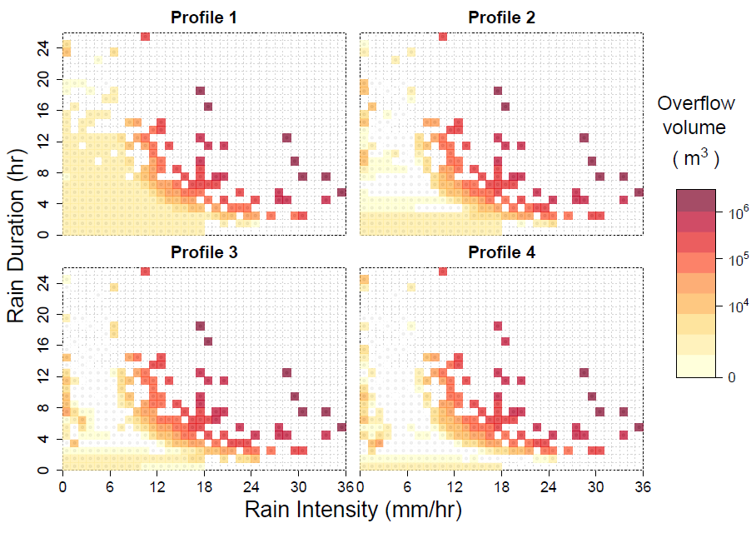
Analysis and generation of rainfall events
1,036 rainfall events sampled for a 25-year period
Rainfall events clustered according to overflow conditions using k-means clustering

Slide 38
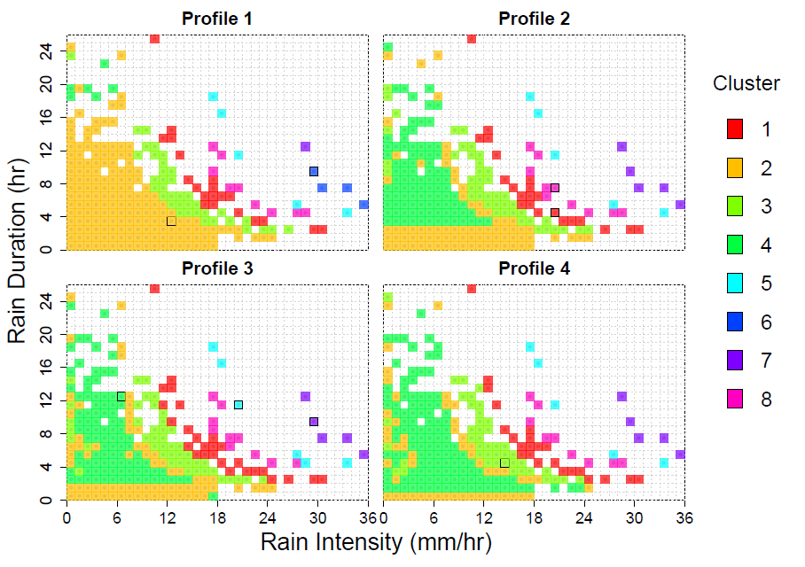
Analysis and generation of rainfall events
8 clusters of rainfall events selected
8 representative rainfall events (centroid of cluster) selected

Slide 39
Surrogate-assisted computational framework
Rainfall data
Set of all decision variables
Robust solutions
Rainfall events obtained from 10 years rainfall series
II. Modified
sensitivity analysis
I. Statistical analysis and
simulation of rainfall events
V. Robustness Analysis
(validation)
Reduced set of decision variables
Model joint distribution of rainfall intensity and duration using copula
Model storm profile by Huff’s method
III. Design of emulators
Solutions’ performance
under independent set
Emulator
Likelihood of rainfall events
Set of stochastic rainfall events
Pareto-efficient solutions
Selection of rainfall events
IV. Surrogate-assisted optimization
Simulation under independent set of stochastic rainfall events
Independent set of stochastic rainfall events

Slide 40
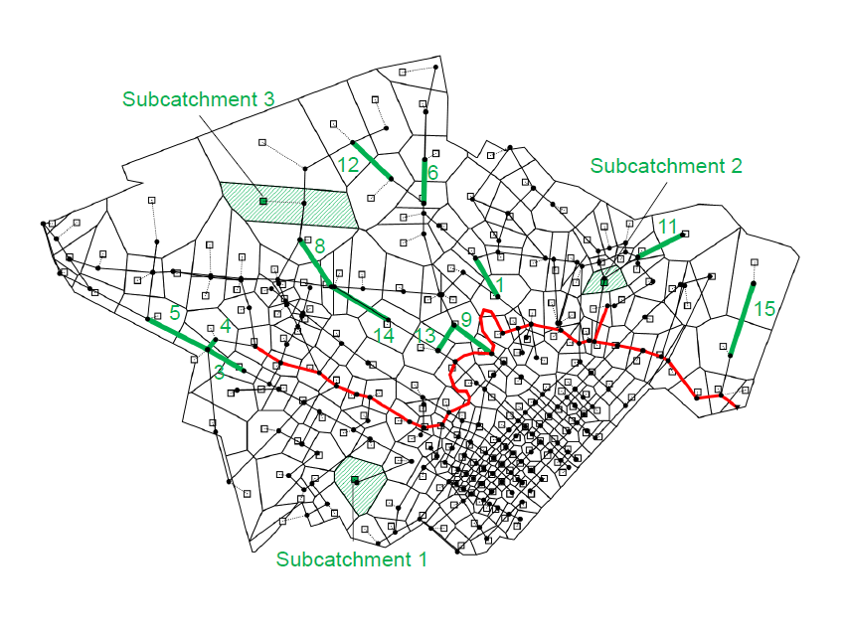
Modified Sensitivity Analysis
Input: diameter of 308 pipes and area of 12 LIDs
Output: overflow reduction in 8 representative rainfall events
12 pipe variables and 8 LID variables selected
3 new pipe variables
Notes:
20 variables again to be benchmark

Slide 41
Surrogate-assisted computational framework
Rainfall data
Set of all decision variables
Robust solutions
Rainfall events obtained from 10 years rainfall series
II. Modified
sensitivity analysis
I. Statistical analysis and
simulation of rainfall events
V. Robustness Analysis
(validation)
Reduced set of decision variables
Model joint distribution of rainfall intensity and duration using copula
Model storm profile by Huff’s method
III. Design of emulators
Solutions’ performance
under independent set
Emulator
Likelihood of rainfall events
Set of stochastic rainfall events
Pareto-efficient solutions
Selection of rainfall events
IV. Surrogate-assisted optimization
Simulation under independent set of stochastic rainfall events
Independent set of stochastic rainfall events

Slide 42

Design of emulators
Inputs, $\overset{⃑}{γ}$
Size of 12 pipe variables and area of 8 LID variables
Output, $\overset{⃑}{y} \left(\overset{⃑}{γ}\right)$
Overflow time series for the 8 rainfall events
Carbajal, J. P., Leitão, J. P., Albert, C., & Rieckermann, J. (2017). Appraisal of data-driven and mechanistic emulators of nonlinear simulators: The case of hydrodynamic urban drainage models. Environmental Modelling & Software, 92, 17-27.

Slide 43
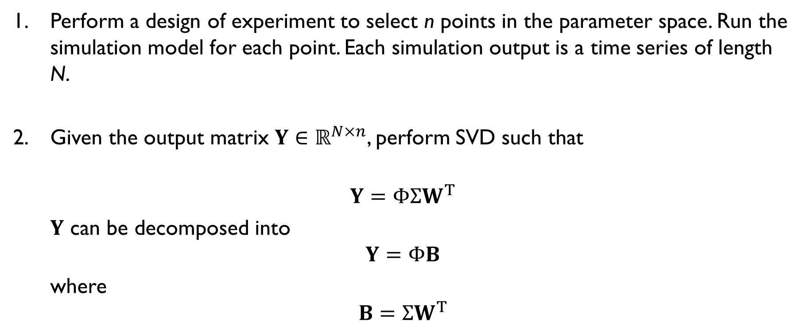
Gaussian process emulator
Perform a design of experiment to select n points in the parameter space. Run the simulation model for each point. Each simulation output is a time series of length N.
Given the output matrix $Y∈ℝ^{N×n}$, perform SVD such that
$$Y=Φ{ΣW}^{T}$$
$Y$ can be decomposed into
$$Y=ΦB$$
where
$$B={ΣW}^{T}$$
Columns are the time varying basis (or dynamic features) of the model response
Columns are the coefficients of the linear combinations of the features for each point

Slide 44
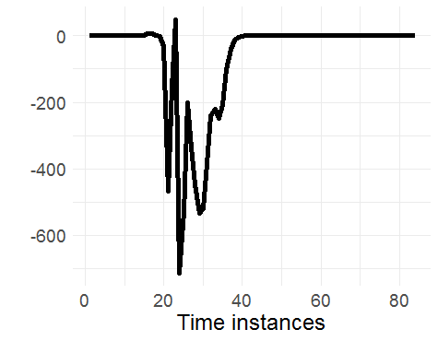
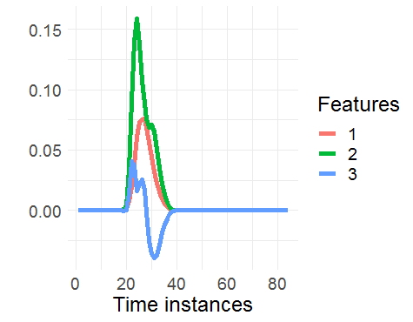
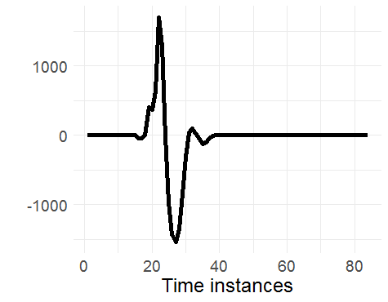





Gaussian process emulator
Extract only the first $q≤n$ features $Φ′∈ℝ^{N×q}$ from $Φ$ (first q columns). We also obtain matrix $B′∈ℝ^{q×n}$ (first q rows) of coefficients where there are q coefficients for each point.
$$\overset{⃑}{y} \left(\overset{⃑}{γ_{1}}\right)$$
$$B_{∙1}^{′}$$
$$\overset{⃑}{y} \left(\overset{⃑}{γ_{2}}\right)$$
$$B_{∙2}^{′}$$
Notes:
475*370

Slide 45
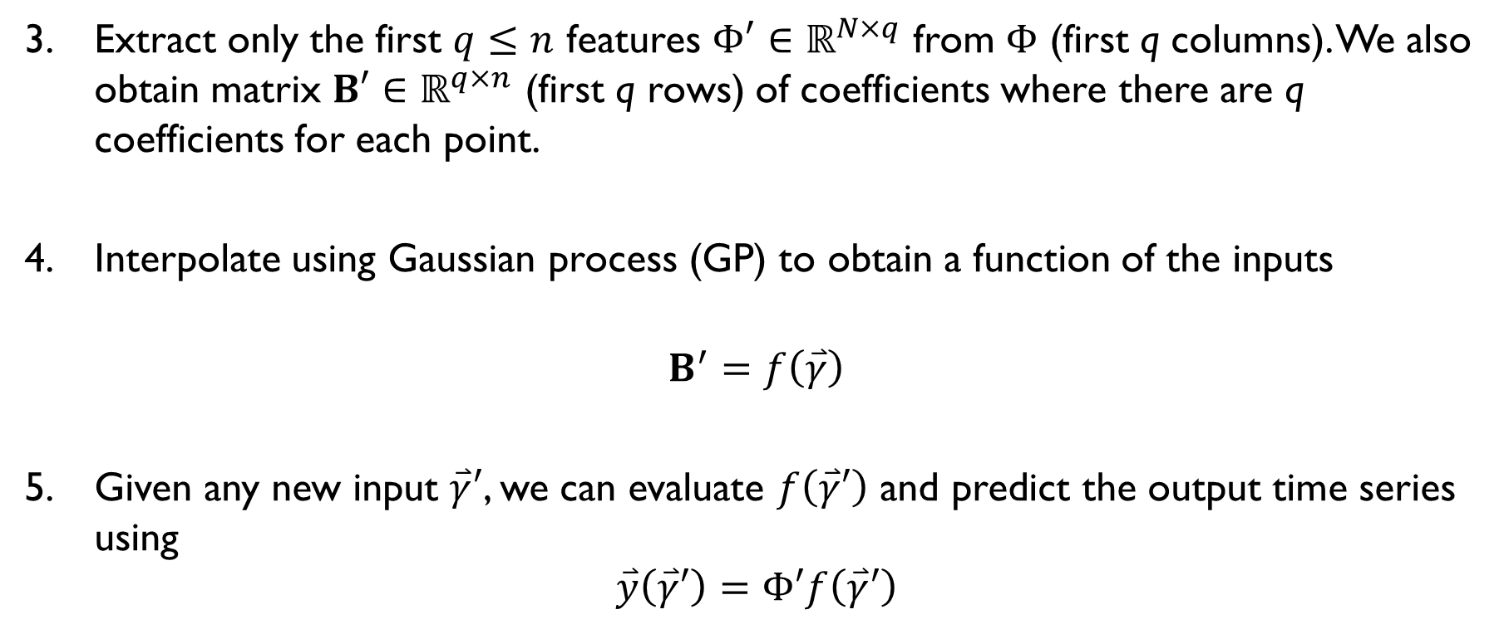
Gaussian process emulator
Extract only the first $q≤n$ features $Φ′∈ℝ^{N×q}$ from $Φ$ (first q columns). We also obtain matrix $B′∈ℝ^{q×n}$ (first q rows) of coefficients where there are q coefficients for each point.
Interpolate using Gaussian process (GP) to obtain a function of the inputs
$$B^{′}=f\left(\overset{⃑}{γ}\right)$$
Given any new input $\overset{⃑}{γ}′$, we can evaluate $f\left(\overset{⃑}{γ}′\right)$ and predict the output time series using
$$\overset{⃑}{y}\left(\overset{⃑}{γ}′\right)=Φ′f\left(\overset{⃑}{γ}′\right)$$

Slide 46
Emulator setup
Number of training points, n
50, 100, 150, 200, 250, 300, 400, 500
Number of features of system response, q
1, 2, 3, 4, 5, 7, 10, 15, 20, 25

Slide 47
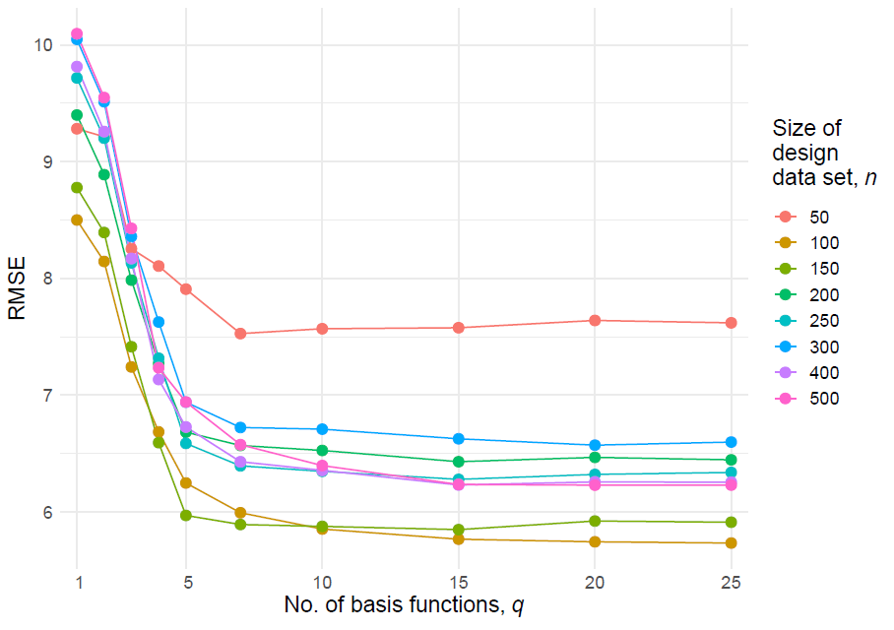
Emulator error
Selected n = 250
q = 7

Slide 48
Surrogate-assisted computational framework
Rainfall data
Set of all decision variables
Robust solutions
Rainfall events obtained from 10 years rainfall series
II. Modified
sensitivity analysis
I. Statistical analysis and
simulation of rainfall events
V. Robustness Analysis
(validation)
Reduced set of decision variables
Model joint distribution of rainfall intensity and duration using copula
Model storm profile by Huff’s method
III. Design of emulators
Solutions’ performance
under independent set
Emulator
Likelihood of rainfall events
Set of stochastic rainfall events
Pareto-efficient solutions
Selection of rainfall events
IV. Surrogate-assisted optimization
Simulation under independent set of stochastic rainfall events
Independent set of stochastic rainfall events

Slide 49
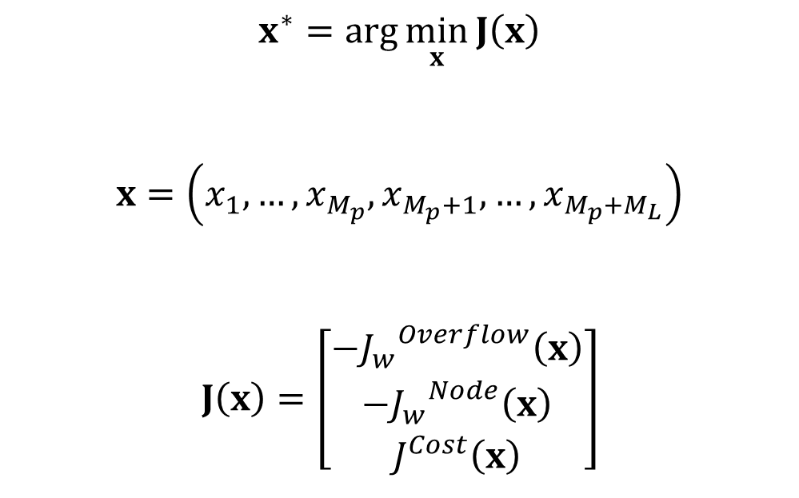
Optimization problem -- formulation
$$x^{∗}=arg\min_{x}{J\left(x\right)}$$
$$x=\left(x_{1},…,x_{M_{p}},x_{M_{p}+1},…, x_{M_{p}+M_{L}}\right)$$
$$J\left(x\right)=\left[\begin{matrix}{−J_{w}^{}}^{Overflow}\left(x\right) \\ −{J_{w}}^{Node}\left(x\right) \\ J^{Cost}\left(x\right)\end{matrix}\right]$$
Diameter of pipes
Numbers of LID units
Decision variables
Total # of LIDs
Total # of pipes
Weighted reduction in overflow volume
Weighted reduction in # of flooded nodes

Slide 50
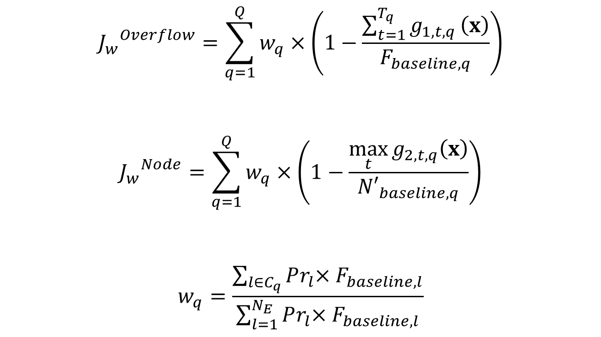
Optimization problem -- formulation
Overflow volume at time t for rainfall event q (emulator)
$${J_{w}}^{Overflow}=\sum_{q=1}^{Q}{w_{q}×\left(1−\frac{\sum_{t=1}^{T_{q}}{g_{1,t,q}}\left(x\right)}{F_{baseline,q}}\right)}$$
$${J_{w}}^{Node}=\sum_{q=1}^{Q}{w_{q}×\left(1−\frac{\max_{t}{g_{2,t,q}\left(x\right)}}{{N′}_{baseline,q}}\right)}$$
$$w_{q}=\frac{\sum_{l∈C_{q}}{Pr_{l}{×F_{baseline, l}}}}{\sum_{l=1}^{N_{E}}{Pr_{l}{×F_{baseline,l}}}}$$
# of flooded nodes at time t for rainfall event q (emulator)
Peak # of flooded nodes for existing drainage system (SWMM)
Rainfall events in q^{th} cluster
Weight of event q
Notes:
Only design storm used here

Slide 51
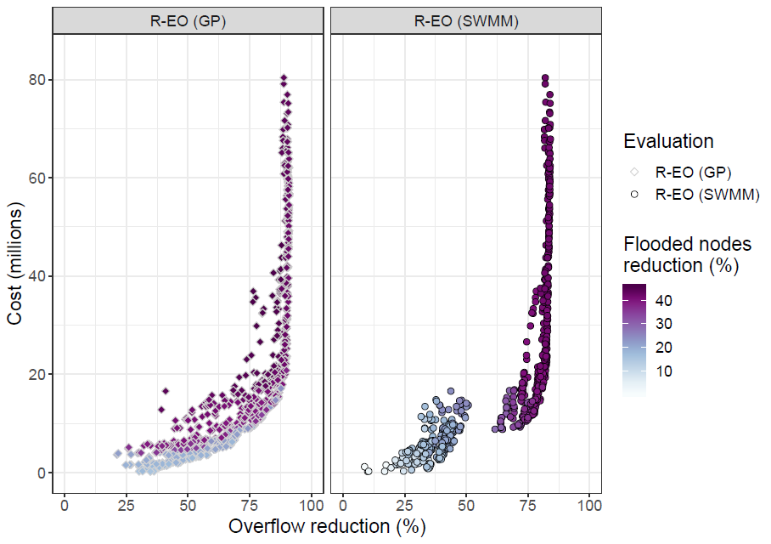
Performance of Pareto-efficient solutions
Positive bias due to surrogate-assisted optimization

Slide 52
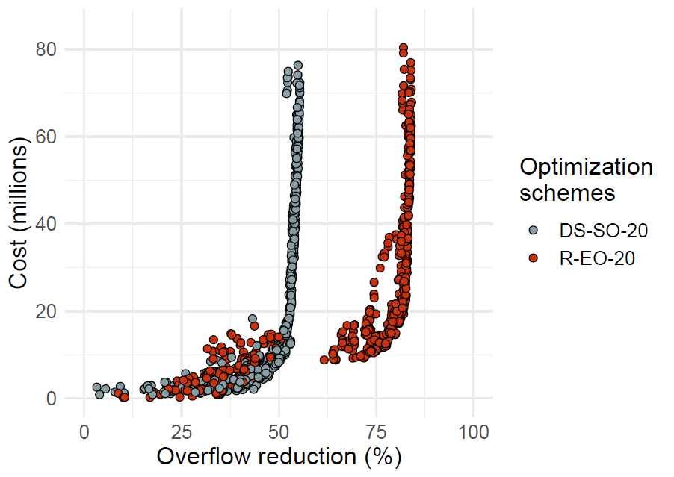
Comparison between the proposed method and the design storm method
Better performance in expensive solutions
Moderate cost solutions that achieve higher performance
Comparable performance in less costly solutions
Notes:
An important set of solutions lies here which are the moderate cost solutions that achieve higher performance than solutions of the same cost range. This set represents solutions that have attain an optimal configuration of pipe sizes that performs well for the 8 rainfall events used, which differentiate them from other solutions. Notice that the gap between the two sets of solutions remain roughly constant beyond this point, which means LIDs do not result in better performance across the rainfall events, the advantage was provided by the pipe network configuration attained by solutions in this region.

Slide 53
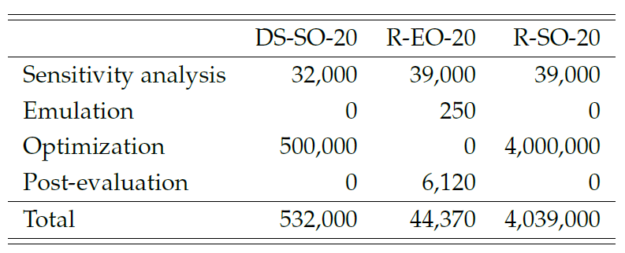
Computational requirements
Number of simulations needed for each method
Our proposed method (R-EO-20) calls the simulator 12 times less than the design storm method (DS-SO-20), saving at least 600 hours

Slide 54
Surrogate-assisted computational framework
Rainfall data
Set of all decision variables
Robust solutions
Rainfall events obtained from 10 years rainfall series
II. Modified
sensitivity analysis
I. Statistical analysis and
simulation of rainfall events
V. Robustness Analysis
(validation)
Reduced set of decision variables
Model joint distribution of rainfall intensity and duration using copula
Model storm profile by Huff’s method
III. Design of emulators
Solutions’ performance
under independent set
Emulator
Likelihood of rainfall events
Set of stochastic rainfall events
Pareto-efficient solutions
Selection of rainfall events
IV. Surrogate-assisted optimization
Simulation under independent set of stochastic rainfall events
Independent set of stochastic rainfall events

Slide 55
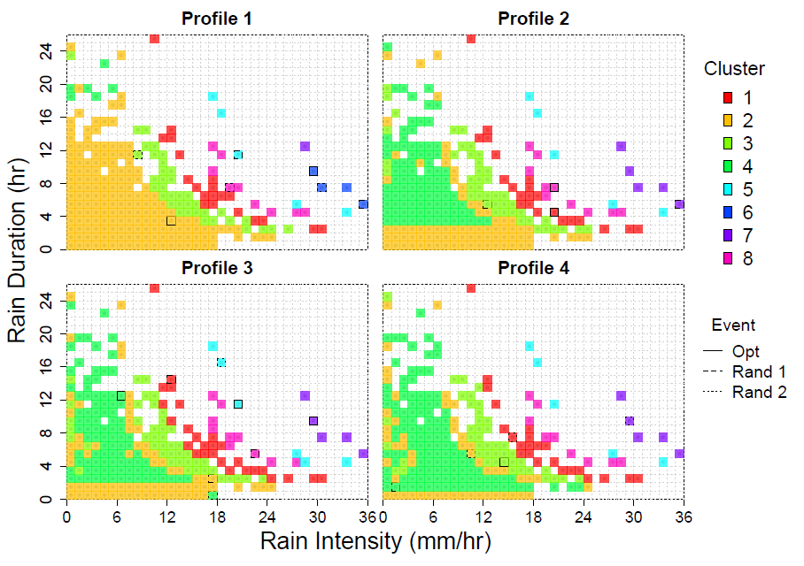
Robustness analysis
2 rainfall events sampled from each of the 8 rainfall clusters
Pareto-efficient solutions simulated under these 16 rainfall events

Slide 56
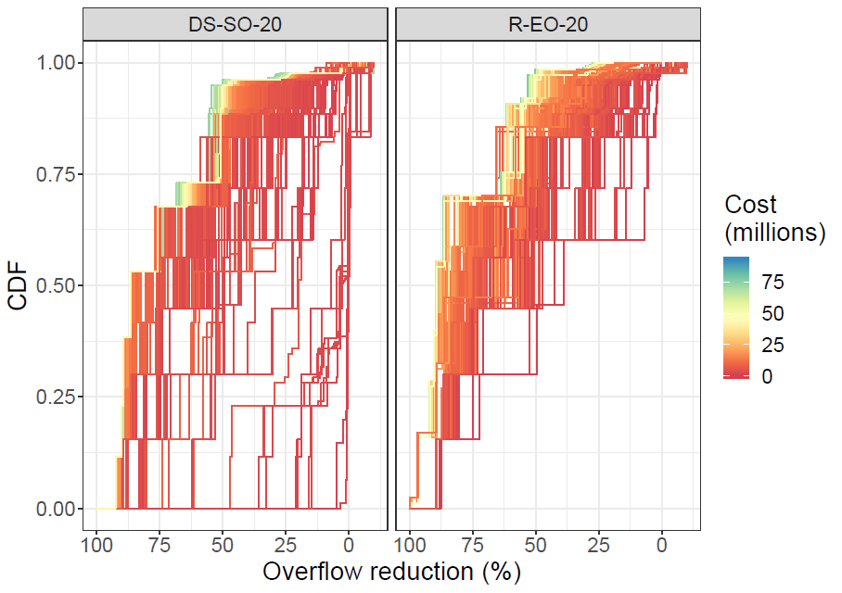
Performance of each solution
Solutions from the design storm method underperforming in some rainfall events

Slide 57
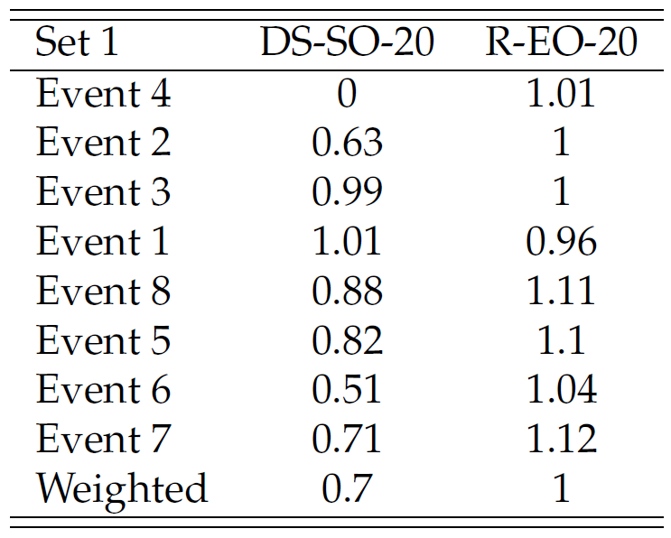
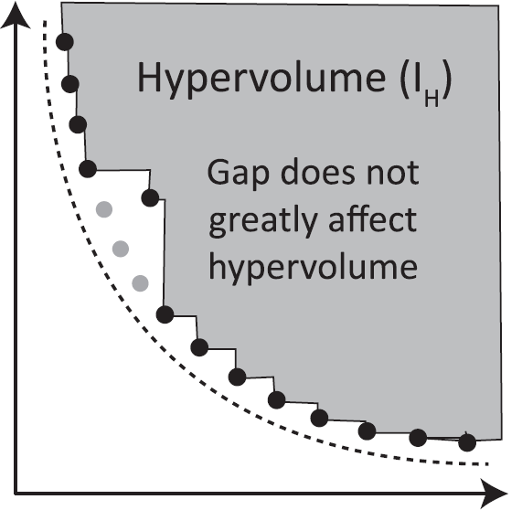
Hypervolume of solution set
Solutions from design storm method work well in rainfall events similar to the design storm
Increasing severity of flood
Solutions from the proposed method outperforms solution from the design storm method as rainfall conditions deviate from those of the design storm
Reed, P. M., Hadka, D., Herman, J. D., Kasprzyk, J. R., & Kollat, J. B. (2013). Evolutionary multiobjective optimization in water resources: The past, present, and future. Advances in water resources, 51, 438-456.
Notes:
Hypervolume measures the volume of objective space dominated by a solution set

Slide 58
Conclusions
Expensive solutions produced by the proposed method outperform the solutions from the design storm method
Computational requirements of the proposed method are sharply reduced by the use of emulators
Proposed method yields drainage solutions more robust than the design storm method
Performance gap extends as rainfall conditions deviate from those of the design storm

Slide 59
Summary of results
Do design storms yield robust urban drainage systems?
Not necessarily. Solutions underperform when rainfall conditions deviate from those of the design storm
How can we design robust optimal urban drainage systems at large urban scales within reasonable computational requirements?
Including multiple rainfall events into the design process
Using emulator to cope with the corresponding increase in computational demands

Slide 60
Future directions
Improving the emulators for surrogate-assisted optimization
Designing drainage systems robust against climate change and urban developments
Adopting proposed method for real time control of drainage systems
Notes:
Updating emulators or making use of uncertainty of emulators for greater exploration during optimization
Here, we only consider variability in current rainfall conditions. Since drainage systems usually last more than decades, it will be worthwhile to consider climate-driven changes in rainfall behaviour and adapt our proposed framework to factor in such changes.
Another application is in the real time control of drainage systems, which is also an computationally intensive task requiring iterated simulation runs that can benefit from the use of a surrogate-assisted optimization approach

Slide 61
Publications
Journals
Ng, J.Y., Fazlollahi, S., & Galelli, S. (2020). Do Design Storms Yield Robust Drainage Systems? How Rainfall Duration, Intensity, and Profile Can Affect Drainage Performance. Journal of Water Resources Planning and Management, 146(3), 04020003. Selected as Editor’s Highlight.
Ng, J.Y., Fazlollahi, S., Dechesne, M., Soyeux, E., & Galelli, S. (2020). Robust optimal design of urban drainage systems using surrogate-assisted optimization. Manuscript in preparation.
Conferences
Ng, J.Y., Fazlollahi, S., & Galelli, S. (2018). A surrogate-based optimization framework for the deployment of low impact development solutions in large watersheds. EWRI Congress 2018, Minneapolis, MN, June 3-7, 2018
Ng, J.Y., Fazlollahi, S., & Galelli, S. (2019). A surrogate-based optimization framework for the robust design of stormwater drainage systems. EWRI Congress 2019, Pittsburgh, PA, May 19-23, 2019
Ng, J.Y., Fazlollahi, S., & Galelli, S. (2020). Designing robust stormwater drainage systems with data-driven emulators. iEMSs 2020, Brussels, Belgium, September 14-18, 2020

Slide 62
Thank you!

Slide 63
Acknowledgements
This research is supported by VE City Modelling Centre through the Singapore Economic Development Board’s Industrial Postgraduate Programme. We would also like to acknowledge Veolia Recherche et Innovation (VERI) for their support.

Slide 64
References

Slide 65
Mays, L. W., & Wenzel Jr, H. G. (1976). Optimal design of multilevel branching sewer systems. Water Resources Research, 12(5), 913-917.
Rossman, L. A. (2015). Storm water management model user's manual, version 5.1. Cincinnati: National Risk Management Research Laboratory, Office of Research and Development, US Environmental Protection Agency.
Wang, Q., Zhou, Q., Lei, X., & Savić, D. A. (2018). Comparison of Multiobjective Optimization Methods Applied to Urban Drainage Adaptation Problems. Journal of Water Resources Planning and Management, 144(11), 04018070.
Loc, H. H., Babel, M. S., Weesakul, S., Irvine, K. N., & Duyen, P. M. (2015). Exploratory Assessment of SUDS Feasibility in Nhieu Loc-Thi Nghe Basin, Ho Chi Minh City, Vietnam. International Journal of Environment and Climate Change, 91-103.
Pianosi, F., Beven, K., Freer, J., Hall, J. W., Rougier, J., Stephenson, D. B., & Wagener, T. (2016). Sensitivity analysis of environmental models: A systematic review with practical workflow. Environmental Modelling & Software, 79, 214-232.
Saltelli, A., Tarantola, S., & Chan, K. S. (1999). A quantitative model-independent method for global sensitivity analysis of model output. Technometrics, 41(1), 39-56.
Deb, K., Pratap, A., Agarwal, S., & Meyarivan, T. A. M. T. (2002). A fast and elitist multiobjective genetic algorithm: NSGA-II. IEEE transactions on evolutionary computation, 6(2), 182-197.
Genest, C., & Favre, A. C. (2007). Everything you always wanted to know about copula modeling but were afraid to ask. Journal of hydrologic engineering, 12(4), 347-368.
Huff, F. A. (1990). Time distributions of heavy rainstorms in Illinois. Circular no. 173.
Herman, J. D., Reed, P. M., Zeff, H. B., & Characklis, G. W. (2015). How should robustness be defined for water systems planning under change?. Journal of Water Resources Planning and Management, 141(10), 04015012.
Carbajal, J. P., Leitão, J. P., Albert, C., & Rieckermann, J. (2017). Appraisal of data-driven and mechanistic emulators of nonlinear simulators: The case of hydrodynamic urban drainage models. Environmental Modelling & Software, 92, 17-27.
Reed, P. M., Hadka, D., Herman, J. D., Kasprzyk, J. R., & Kollat, J. B. (2013). Evolutionary multiobjective optimization in water resources: The past, present, and future. Advances in water resources, 51, 438-456.

