Slide 1
Tutorial 1 combinational logic circuit

Slide 2
Overview
We will review the following concept in this tutorial:
Combinational logic circuit
No memory, output(s) solely determined by input(s)
Truth table and logic function
Two-level logic and PLA
Simplification with Boolean Algebra and K-map
Circuit design
Work with two practical examples
Bit comparator
Encoder

Slide 3
Digital Logic Circuit
Two types of digital logic circuits inside a computer:
Combinational logic circuits
Logic circuits that do not have memory
The output depends only on the current inputs and the circuit
They can be specified fully with a truth table or a logic equation
Sequential logic circuits
Logic circuits that have memory
The output depends on both the current inputs and the value stored in memory (called state)

Slide 4
Circuit Design Process
A simple logic design process involves
Problem specification
Truth table derivation
Derivation of logical expression
Simplification of logical expression
Implementation

Slide 5
Review of Boolean Algebra
Boolean algebra consists of
Boolean variables (with values equal to either ‘0’ or ‘1’ )
Binary operators: AND (∙), OR (+), NOT ( ‘ )
Any logic function can be expressed as a two-level logic expression, either as
Sum-of-Products (SoP) representation, or
Product-of-Sums (PoS) representation
The AND, OR, and NOT operations form a functionally complete set (namely, universal gates), as they can specify any logic function.

Slide 6
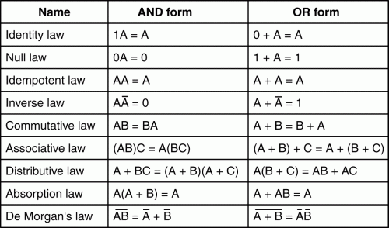
Basic Laws of Boolean Algebra

Slide 7
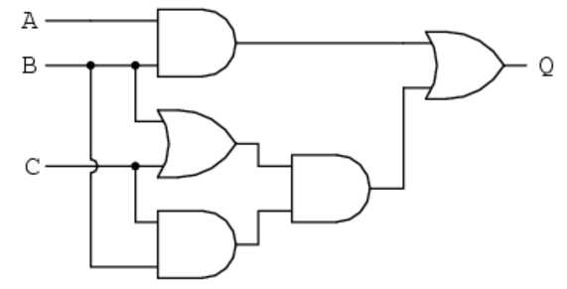
Boolean Algebra Exercise 1
Find the direct Boolean expression for the following circuit
Simplify the Boolean expression using Boolean algebra
Draw the new circuit for the simplified Boolean expression

Slide 8
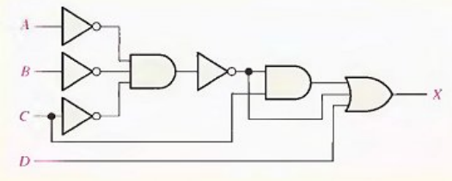
Boolean Algebra Exercise 2
Simplify the combinational logic circuit shown below to a minimum form

Slide 9

Boolean Algebra Exercise 3
Simplify the following Boolean expression $AB+ \overline{AB}CD+ \overline{CD}EF$

Slide 10
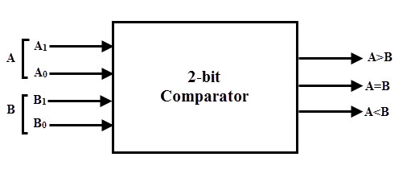
2-bit Comparator Exercise
Here we’ll be designing circuits to compare 2-bit binary numbers.
Suppose we have two 2-bit numbers A & B at the inputs, and three outputs as A>B, A==B, A<B
Only one of the three outputs would be true accordingly if A is greater than or equal to or less than B.
We’ll practice the circuit design for f(A==B), try to work on f(A>B) and f(A<B) by yourself

Slide 11
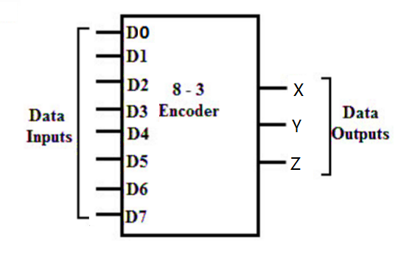
8-to-3 Encoder Exercise
An encoder (2^{N}-to-N encoder) is a logical block with 2^{N} 1-bit inputs and a N-bit output, which performs the inverse function of a decoder.
Example (8-to-3 encoder)
8 inputs (D₀, D₁, …, D₇) and 3 outputs (X, Y, Z)
Let’s design the circuits for X, Y, Z

Slide 12
8-to-3 Encoder Truth Table
D₀ | D₁ | D₂ | D₃ | D₄ | D₅ | D₆ | D₇ | X | Y | Z
1 | 0 | 0 | 0 | 0 | 0 | 0 | 0 | 0 | 0 | 0
0 | 1 | 0 | 0 | 0 | 0 | 0 | 0 | 0 | 0 | 1
0 | 0 | 1 | 0 | 0 | 0 | 0 | 0 | 0 | 1 | 0
0 | 0 | 0 | 1 | 0 | 0 | 0 | 0 | 0 | 1 | 1
0 | 0 | 0 | 0 | 1 | 0 | 0 | 0 | 1 | 0 | 0
0 | 0 | 0 | 0 | 0 | 1 | 0 | 0 | 1 | 0 | 1
0 | 0 | 0 | 0 | 0 | 0 | 1 | 0 | 1 | 1 | 0
0 | 0 | 0 | 0 | 0 | 0 | 0 | 1 | 1 | 1 | 1

Slide 13
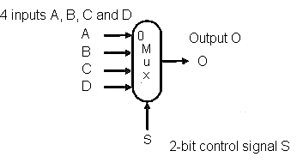
Extra Exercise: Multiplexor
A multiplexor is a devices that given the control signal, selects one of the inputs to be forwarded to the output. The following figure shows a 4-input multiplexor.
4-to-1 multiplexor

Slide 14
Questions
If the inputs A/B are 32-bit in width, what is the data width of the Output O?
What is the maximum number of inputs if the control signal is 10-bit in width?
What is the bit-width of the control signal for the multiplexor if there are 9 inputs?

