Slide 1
Using App-only Authentication with Power BI Embedding

Slide 2
Agenda
Intro to App-only Authentication in Power BI
Understanding Azure AD Service Principals
Configuring App-only Authentication Support
Developing with App-only Authentication

Slide 3
First Party Embedding vs Third Party Embedding
First Party Embedding
Known as User-Owns-Data Model
All users require a Power BI license
Useful in corporate environments
App authenticates as current user
Your code runs with user’s permissions
User’s access token passed to browser
Third Party Embedding
Known as App-Owns-Data Model
No users require Power BI license
Useful for commercial applications
App authenticates with app-only identity
Your code runs with admin permissions
Embed token passed to browser
First Party Embedding for use within Organization
Third Party Embedding for use by ISVs
Browser
Power BI Service
Browser
Power BI Service
iFrame
iFrame
Azure AD
Access Token
for the current user
Power BI
Embed Token
for specific report

Slide 4
Power BI Embedding – The Big Picture
User launches your app using a browser
App authenticates with Azure Active Directory and obtains access token
App uses access token to call to Power BI Service API
App retrieves data for embedded resource and passes it to browser.
Client-side code uses Power BI JavaScript API to create embedded resource
Embedded resource session created between browser and Power BI service
5
Power BI Service
Browser
iFrame
6
4
4
3
1
Your App
2
Azure AD

Slide 5
App-only Auth for Power BI Embedding
Legacy technique for third-party embedding
App authenticates as master user account
Master user account added as admin to app workspace
Master user account requires Power BI Pro license
App must authenticate with user-based identity
New best practice in third-party embedding
App authenticates as itself with app-only identity
App service principal added as admin to app workspace
No Azure AD application permissions required

Slide 6
App-only Access Control
Service Principal used to configure access control
Requires the use of v2 app workspaces
Service principal added to app workspaces as admin
Access control NOT based on Azure AD permissions
App Workspace 1
Admins
User 1
User 2
App 1 Service Principal
Power BI Service
App 1 Service Principal
App-only Access Token
App Workspace 2
Admins
User 1
App 1 Service Principal
App 2 Service Principal

Slide 7
Agenda
Intro to App-only Authentication in Power BI
Understanding Azure AD Service Principals
Configuring App-only Authentication Support
Developing with App-only Authentication

Slide 8
AAD Service Principals
Azure AD creates service principal(s) for each application
Service principle created once per tenant
Service principle acts as first-class AAD security principal
Host Tenant
Tenant 2
Tenant 3
Application
Application ID
Service Principal
Object ID
Service Principal
Object ID
Service Principal
Object ID
Permission Grants
User1
User2
Permission Grants
User1
User2
Permission Grants
User1
User2

Slide 9
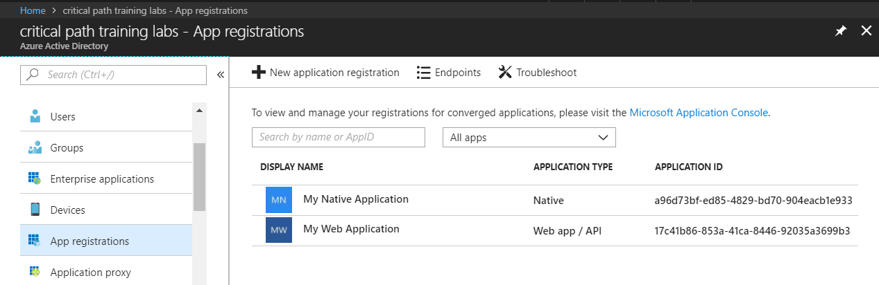
Azure AD Applications
Creating applications required for AAU authentication
Applications are as Native application or Web Applications
Application identified using GUID known as application ID
Application ID often referred to as client ID or app ID

Slide 10
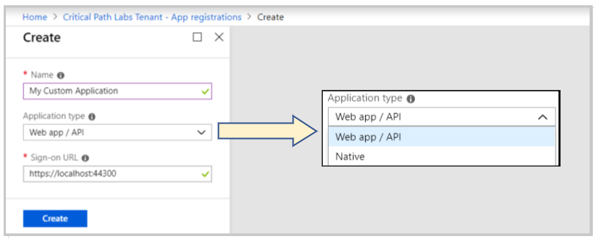
Application Types
Azure AD Application Types
Native clients
Web app / API client

Slide 11
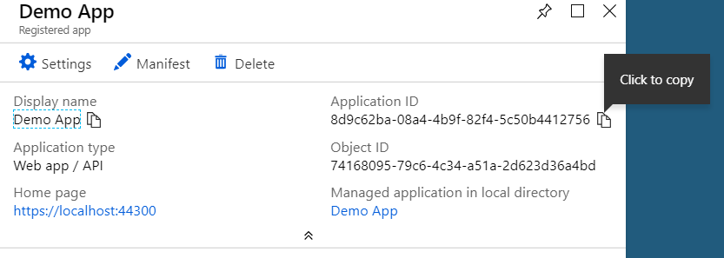
Creating a New Azure AD Application

Slide 12
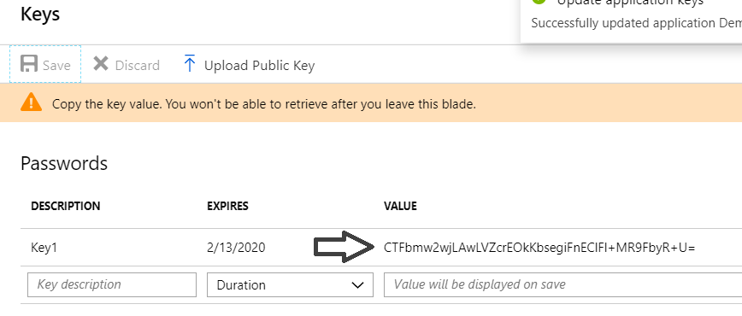
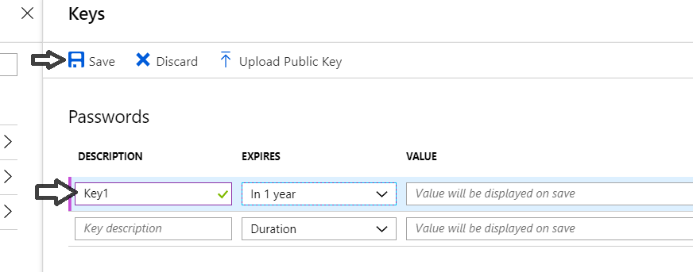
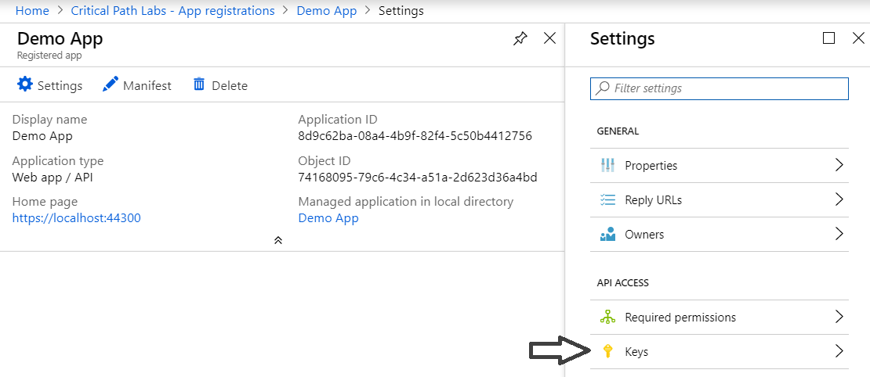
Creating the App Secret

Slide 13
Agenda
Intro to App-only Authentication in Power BI
Understanding Azure AD Service Principals
Configuring App-only Authentication Support
Developing with App-only Authentication

Slide 14
User APIs versus Admin APIs
Power BI User APIs (e.g. GetGroupsAsync)
provides users with access to personal workspace
provides users with access to app workspaces
provides service principal (SP) with access to app workspaces
Power BI Admin APIs (e.g. GetGroupsAsAdminAsync)
provides users with tenant-level access to all workspaces
does not currently support app-only authentication

Slide 15
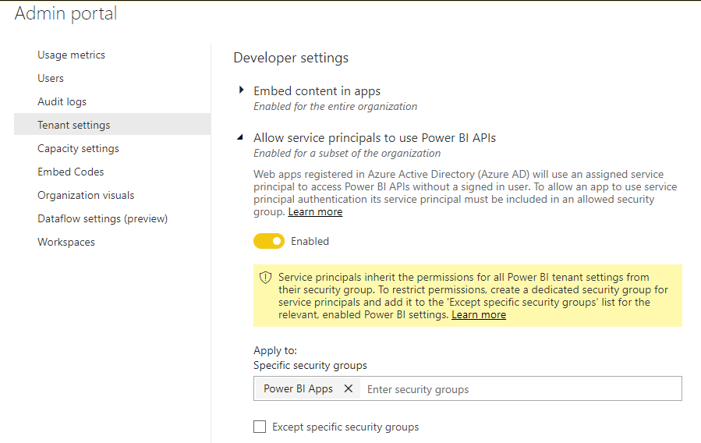
Tenant Setup
Your Power BI Tenant
These serviced principals now have access to the User APIs
Power BI Enabled
Service Principals
Service Principal
Application 1
Security Group
Power BI Apps
Service Principal
Application 2
Service Principal
Application 3

Slide 16
Agenda
Intro to App-only Authentication in Power BI
Understanding Azure AD Service Principals
Configuring App-only Authentication Support
Developing with App-only Authentication

Slide 17
Authentication Flows
User Password Credential Flow (public client)
Requires registering Azure AD application as native app
Requires passing user name and password across network
Implicit Flow (public client)
Used in SPAs built with JavaScript and AngularJS
Authorization Code Flow (confidential client)
Client first obtains authorization code for user
Access token acquired in server-to-server call
Client Credential Flow (confidential client)
Used to obtain app-only access token
Authentication based on app secret or app certificate

Slide 18
App-Only Access Token
Token contains service principal ID and roles
Subject is Object OID of service principal
App roles are for application permissions
App roles not supported in Power BI Service API

Slide 19
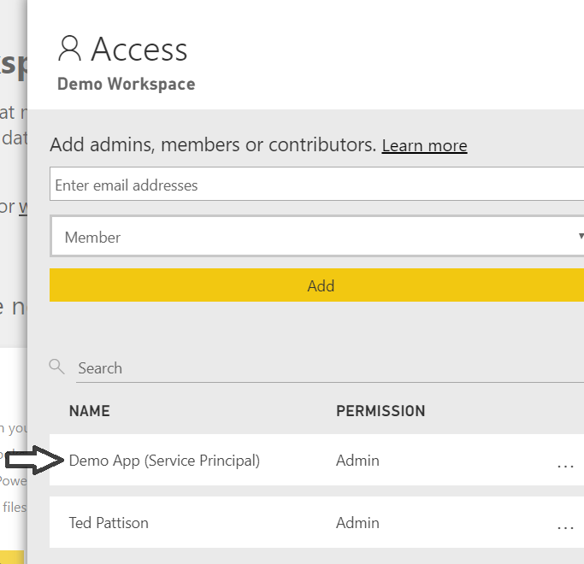
App-only Access with PBI Service API
Service Principal added to workspace as admin
Only works with v2 app workspaces
Provides full workspace access to service principal
App Workspace 1
Admins
User 1
User 2
App 1 Service Principal
App Workspace 2
Admins
User 1
App 1 Service Principal
App 2 Service Principal

Slide 20
What Can You Do with an App-only Token?
Common operations possible through User APIs
Create new app workspaces
Clone content between app workspaces
Enumerate thru list of datasets, reports & dashboards
Retrieve embedding data for reports and dashboards
Generate embed tokens for App-Owns-Data model
Upload PBIX files to create datasets and reports
Update connection strings and dataset credentials
Create/populate streaming datasets and push datasets

Slide 21
What Did You Learn Today?
App-only auth support now in preview for Power BI APIs
Application acquires app-only access token using client credentials
Application takes on the identity of service principal
Access to Power BI resources based on workspace membership
Access to Power BI resources not based on AAD permissions
App-only token provides access to User APIs but not Admin APIs

Slide 22
Call to Action
Why app-only authentication support important?
Eliminates need to create/license master user account
Eliminates need for using User Password Credential flow
Eliminates need to authenticate app with user-based identity
Recommendations for Developers using App-Owns-Data
Migrate from Master User to App-only auth as soon as possible
Authenticate with App Secret while in development phase
Authenticate with App Certificate when moving to production
Keep your secrets secret

Slide 23
Summary
Intro to App-only Authentication in Power BI
Understanding Azure AD Service Principals
Configuring App-only Authentication Support
Developing with App-only Authentication

Slide 24

Education Through Critical Path Training
Hands-on Training Classes
Developing with Power Embedding Workshops
Power BI Developer Bootcamp (4 days)
Power BI Certification Bootcamp (3 days)
Mentoring and Consulting Services
Assistance with Power BI embedding development
Assistance with custom visual development for Power BI
Assistance getting started with development of POC application
More info at https://www.criticalpathtraining.com/

