Slide 1
Documents and Document Libraries
Notes:
In this module, you will learn the fundamentals of working with documents and document libraries in SharePoint Online. You will learn how to create document libraries and to configure them to take advantages of the SharePoint’s document-centric features. You will learn several techniques for uploading documents to a document library. The module will also discuss popular techniques for maintaining order and structure within a document library that has 100s or 1,000s of documents. You will learn how to configure a document library to support major versioning, minor versioning and a custom document template.

Slide 2
Agenda
Intro to Document Libraries
Working with Document Libraries
Managing Files in Libraries
Customizing Document Libraries
Versioning for Co-Authoring
Adding Document Library Types

Slide 3
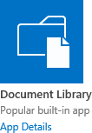
Document Libraries
Use to store and manage different file types
Documents, spreadsheets, presentations, text files, and other types of files
Each library has a unique web address
http://intranet.wingtip.com/HR%20Forms
http://intranet.wingtip.com/HRForms/
Security
Can apply security to library, folders, or individual files
Notes:
Document libraries are used to store and manage a collection of different file types. These files include documents, spreadsheets, presentations, text files, and other types of files. These files (such as Word or Excel files) can be shared with users of the site. Unlike file shares, SharePoint document libraries provide a better way to manage files because of built-in advanced document management features.
Each document library has a unique web address. When a document library is created the web address is generated off of the Name. Therefore it is recommended when creating libraries to first name the library based on the URL you want it to have. Keep the name clean and short then go back and change the Display Name. For example:
If a library is created with a space in the name “HR Forms” the URL would be http://intranet.wingtip.com/HR%20Forms
If a library is created with the name “HRForms” the URL would be http://intranet.wingtip.com/HRForms
You can change the Display Name after the initial creation which does not affect the URL.
Security
Another benefit to using document libraries is the ability to apply security to the library, folders, or to individual files. If the user does not have access to any of the items that the security is applied to then they would not see the library, folder, or individual file.

Slide 4
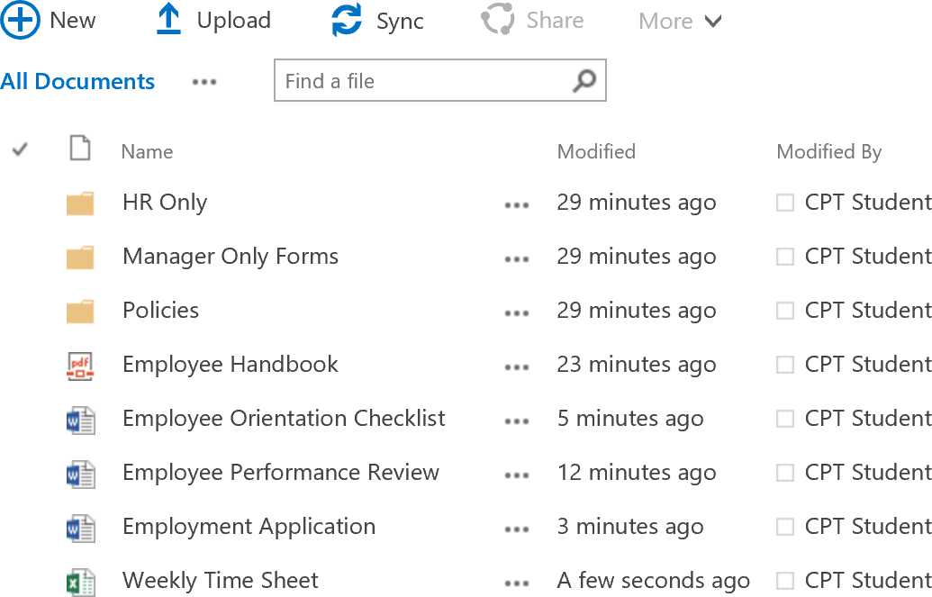
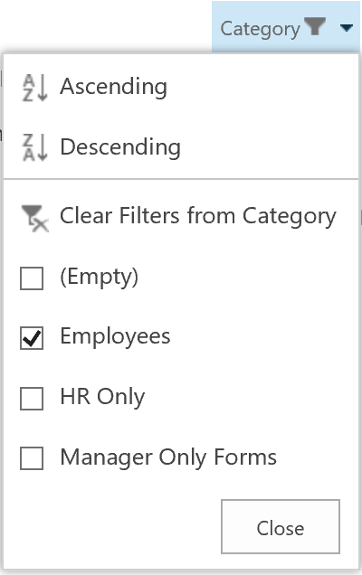
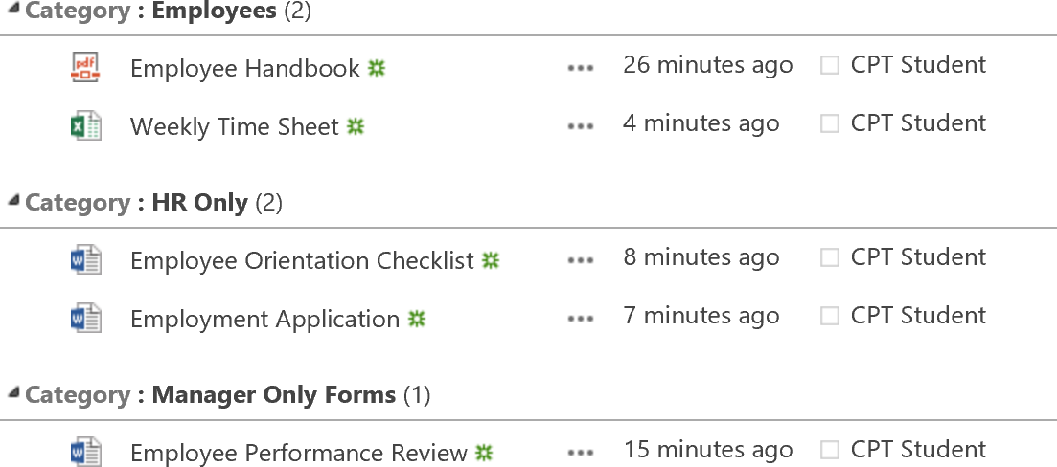
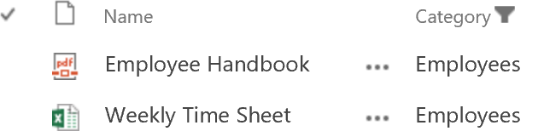
Document Library Benefits
Better than file shares because
Documents are treated as content
Content inside documents searchable
Documents can be tagged with SharePoint metadata
Columns and Metadata
Add to Document Libraries to provide betting organization of files and folders
Use columns for sorting, grouping, filtering
Notes:
Document libraries are better than using files shares because documents in SharePoint are treated as content. One of the big benefits that differs from file shares is the ability to search the content inside documents. When search is enabled and configured, SharePoint will build an index off of the documents and contents inside the documents.
Columns and Metadata
Another benefit to using document libraries to store files is the ability to use metadata to tag documents. Documents can be tagged with SharePoint metadata by using columns. Adding columns to document libraries makes it easier to apply sorting, grouping, and filtering. Also, by combining metadata with search, the metadata tagged to documents becomes part of the index which makes it easier to refine search results.

Slide 5
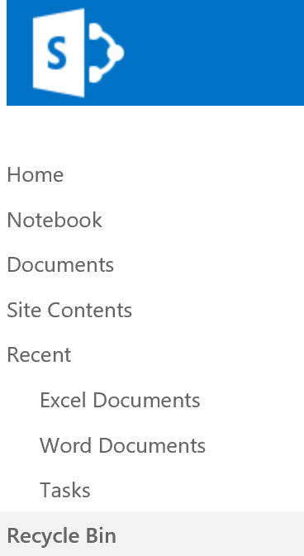
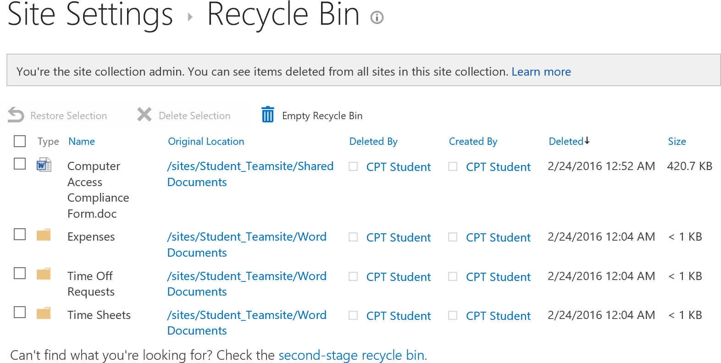
Document Libraries Benefits
2-Stage Recycle Bin
Deleted files can be restored from recycle bin
Notes:
2-Stage Recycle Bin
Have you ever accidentally deleted a file on a network file share and had to start over again? This is something that is not a problem with using document libraries because SharePoint has a 2-stage recycle bin. So even if a file is deleted it can be recovered from the recycle bin.
SharePoint Online sites offer end-user and site collection administrator views to the Recycle Bin. The end user can see any items he or she deleted and a site collection administrator can see all items deleted by any user within the site collection.
Site collection administrators have access to two recycle bin stages which is a first-level Recycle Bin and a Second-Stage Recycle Bin. This gives site collection administrators greater control when users delete files, versions of files, list items, libraries, lists, and folders from a SharePoint site by providing a two-stage safety net before an item is permanently deleted from a site. When a user deletes an item from the team site, it goes to the site Recycle Bin. A user can restore an item he or she deleted from the Recycle Bin, but only a site collection administrator can restore items deleted by any user.

Slide 6
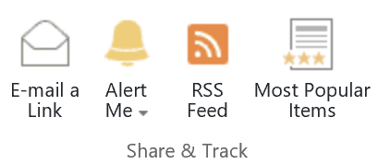

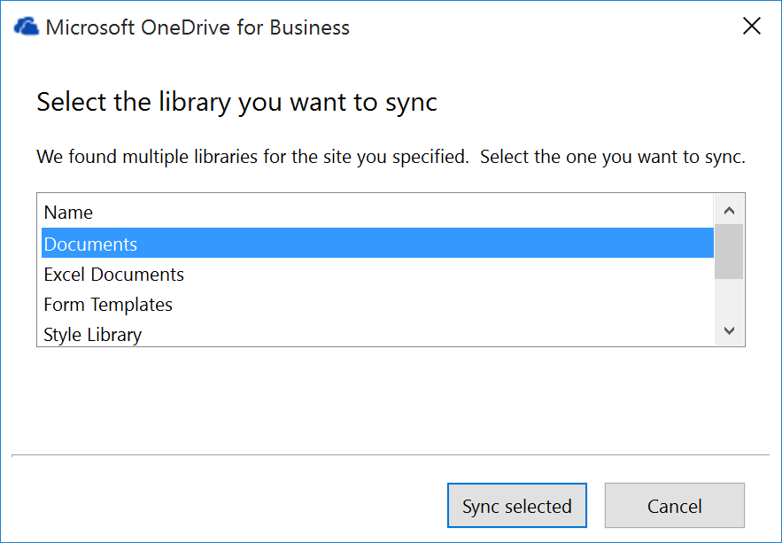
Document Libraries Benefits
Alerts and RSS feeds
Receive alerts on modifications of files
Subscribe to RSS feeds to receive updates
Working Offline
OneDrive for Business provides the ability to work offline
Document Library files synchronize to local hard drive
When online, SharePoint syncs updates made to files automatically
Notes:
Alerts and RSS Feeds
SharePoint has an alert feature that allows you to keep up-to-date with changes to files by receiving modification alerts. You can also subscribe to RSS feeds to receive updates on documents.
Working Offline
OneDrive is a program that can be used to work offline with SharePoint. Document library files will synchronize to your local hard drive using OneDrive for Business. You can then make changes to the documents offline and when you are connected back online, OneDrive will automatically sync the updates to SharePoint.

Slide 7
Agenda
Intro to Document Libraries
Working with Document Libraries
Managing Files in Libraries
Customizing Document Libraries
Versioning for Co-Authoring
Adding Document Library Types

Slide 8
Working with Document Libraries
Store documents in one or multiple libraries
Storing documents in one library
Use when set of files need same versioning and workflow settings
When using you can organize files by
Adding columns, views, and folders
Storing documents in multiple libraries
Use when set of files have distinct differences
When needing to apply different versioning and workflow settings
Notes:
The way you organize files in a library depends on the needs of your group and how you prefer to store and search for the information.
Storing documents in one library
You may want one library to serve diverse needs. Consider using a single library when:
Your group needs to see summary information about, or different views of, the same set of files. For example, a manager may want to see all files grouped by department or by due date.
People want to search for the files in the same location on a site.
You want to apply the same versioning and workflow settings or require approval.
To work efficiently with documents in one library, you can organize files in a library by adding columns, defining views, or creating folders.
Storing documents in multiple libraries
You may want to create multiple libraries when there are distinct differences among the files you want to store and manage, or among the groups of people who work with the files. Use multiple libraries when:
The types of files you want to store and manage are distinct, and you don't expect people to frequently view summaries of the files or search the files together.
The groups of people who are using the files are distinct and have distinctly different permission levels.
You need to apply different versioning or workflow settings.

Slide 9
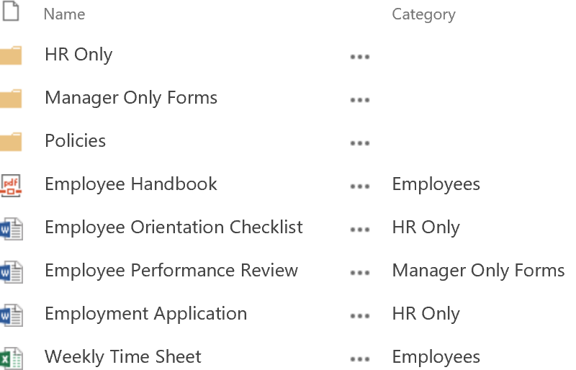
Organizing Files in Library
Files can be organized by:
Folders
Metadata without folders
Folders with metadata
Folders
Provide a way to group and manage content based on permission requirements
When creating folders in libraries an internal index is created
Notes:
Files in document libraries can be organized by using folders, metadata without folders, or using a combination of folders with metadata. The question is which one should you use. In the SharePoint community, the debate to use folders versus metadata has been going on for some time. Some oppose using folders and other support using folders. Whether or not you should use folders depends on your organizational needs.
Using Folders
Folders provide a way to group and manage content based on permission requirements. When creating folders in a document library, and internal index is being created. When using folders SharePoint appends folders into the URL. Folders are a linear structure which requires drilling down to the sub-folders.
Using Folders with Metadata
The image on this slide is an example of using folders with metadata. The folder can be tagged and the files within the folder can be tagged.

Slide 10
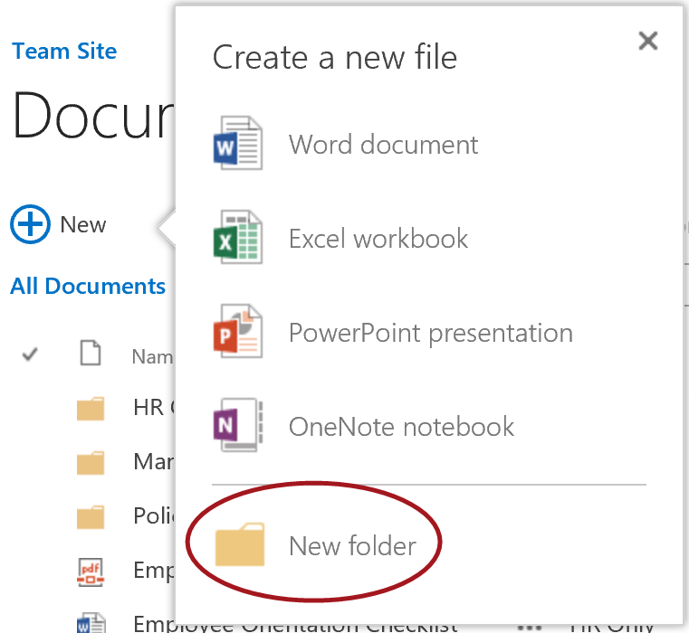
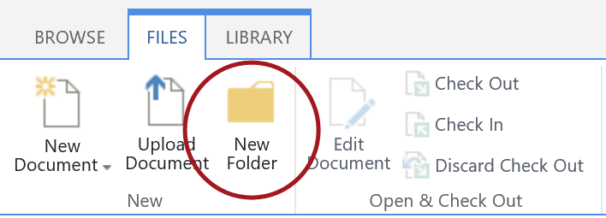

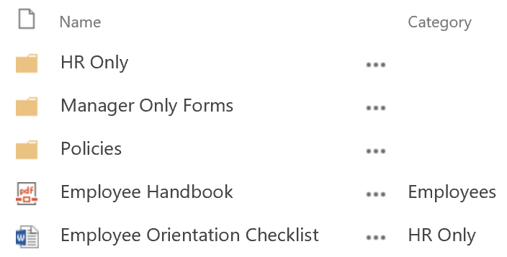

Organizing with Folders
By default, New Folder command appears in document libraries
Can enable/disable in Library Settings
By default, library with folders enabled displays folders in default view
Folders or Flat setting available in View settings
Notes:
By default, the New Folder command is enabled and appears in the ribbon for document libraries. This setting however can be disabled/enabled in the Library Settings > Advanced Settings of a document library. When folders are enabled, the default view of the document library displays the folders. This setting can be changed from folders to flat in the settings for the view. When the New Folder command is disabled on a library, the user cannot create folders in the document library. If Folders setting for the view is set to Flat instead of Folders, all of the items will display in the view without the folders.

Slide 11
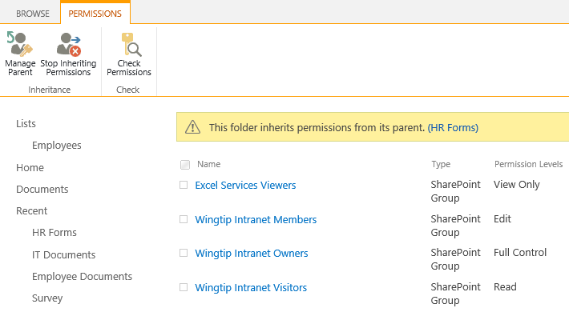
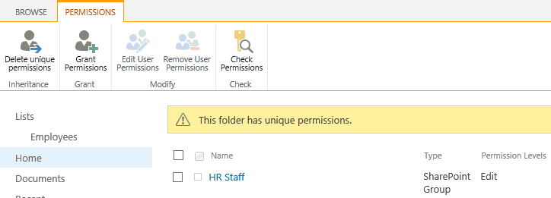
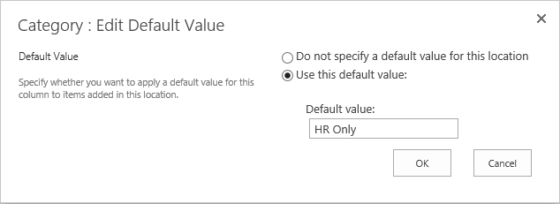
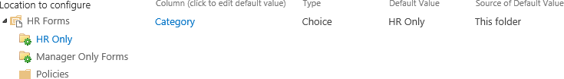
Folder Advantages
Apply permission more effectively
Use location based default metadata properties
Set default metadata values for every folder
Folders work better in Windows Explorer Views
Notes:
There are some advantages to using folders with document libraries.
Advantages include:
Being able to set permissions on each of the folders.
Use location based default metadata properties by setting the default value for every folder. This can be configured in the Library Settings > Column Default Value settings.
You can use folders and metadata together.
Folders work better in Windows Explorer View.
Folders can be used but hidden from the view as mentioned in the previous slide.
To save time migrating from file shares to SharePoint, you can copy directly from the file share into SharePoint and the folders will copy with the files.

Slide 12
Folder Disadvantages
Consider the following when using folders:
If folder structure is unknown by user, finding info is easier using metadata based navigation
Changing metadata is easier than changing folders
If a folder contains subfolders, each subfolder name is counted as an item but not items in that subfolder
If using the Show all items without folders option in a view:
You must use a filter based on simple or compound index to ensure you’re not over the List View Threshold (typically 5000 items in a view)
Notes:
There are also some disadvantages to using folders with document libraries.
Disadvantages include:
Finding info is harder if the folder structure is unknown to the user.
If too many folders are used, such as subfolders within subfolders, this can make navigating to get to a file very cumbersome as it is on file shares.
Changing metadata for documents is easier than changing folders in a document library. Maintenance can be cumbersome.

Slide 13
Agenda
Intro to Document Libraries
Working with Document Libraries
Managing Files in Libraries
Customizing Document Libraries
Versioning for Co-Authoring
Adding Document Library Types

Slide 14
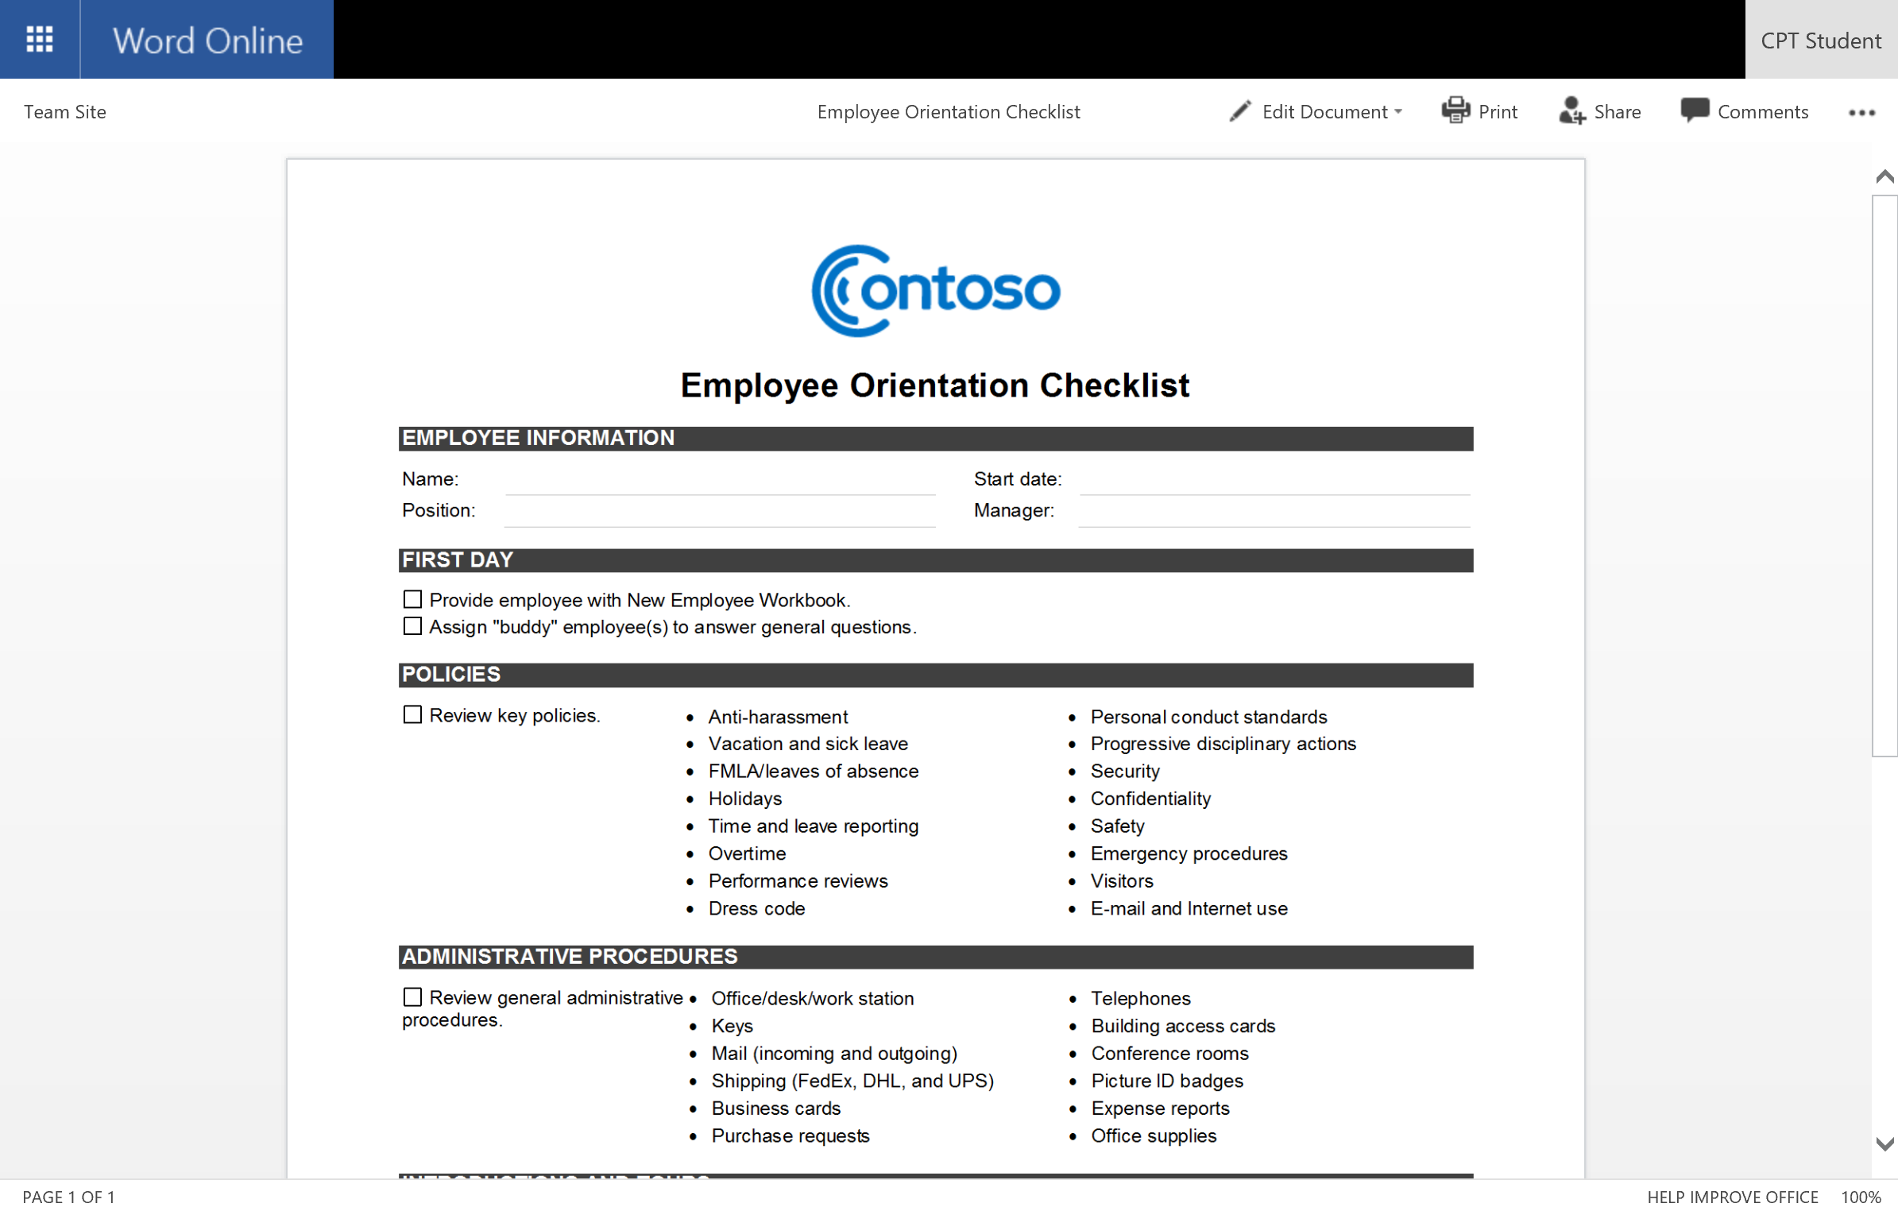
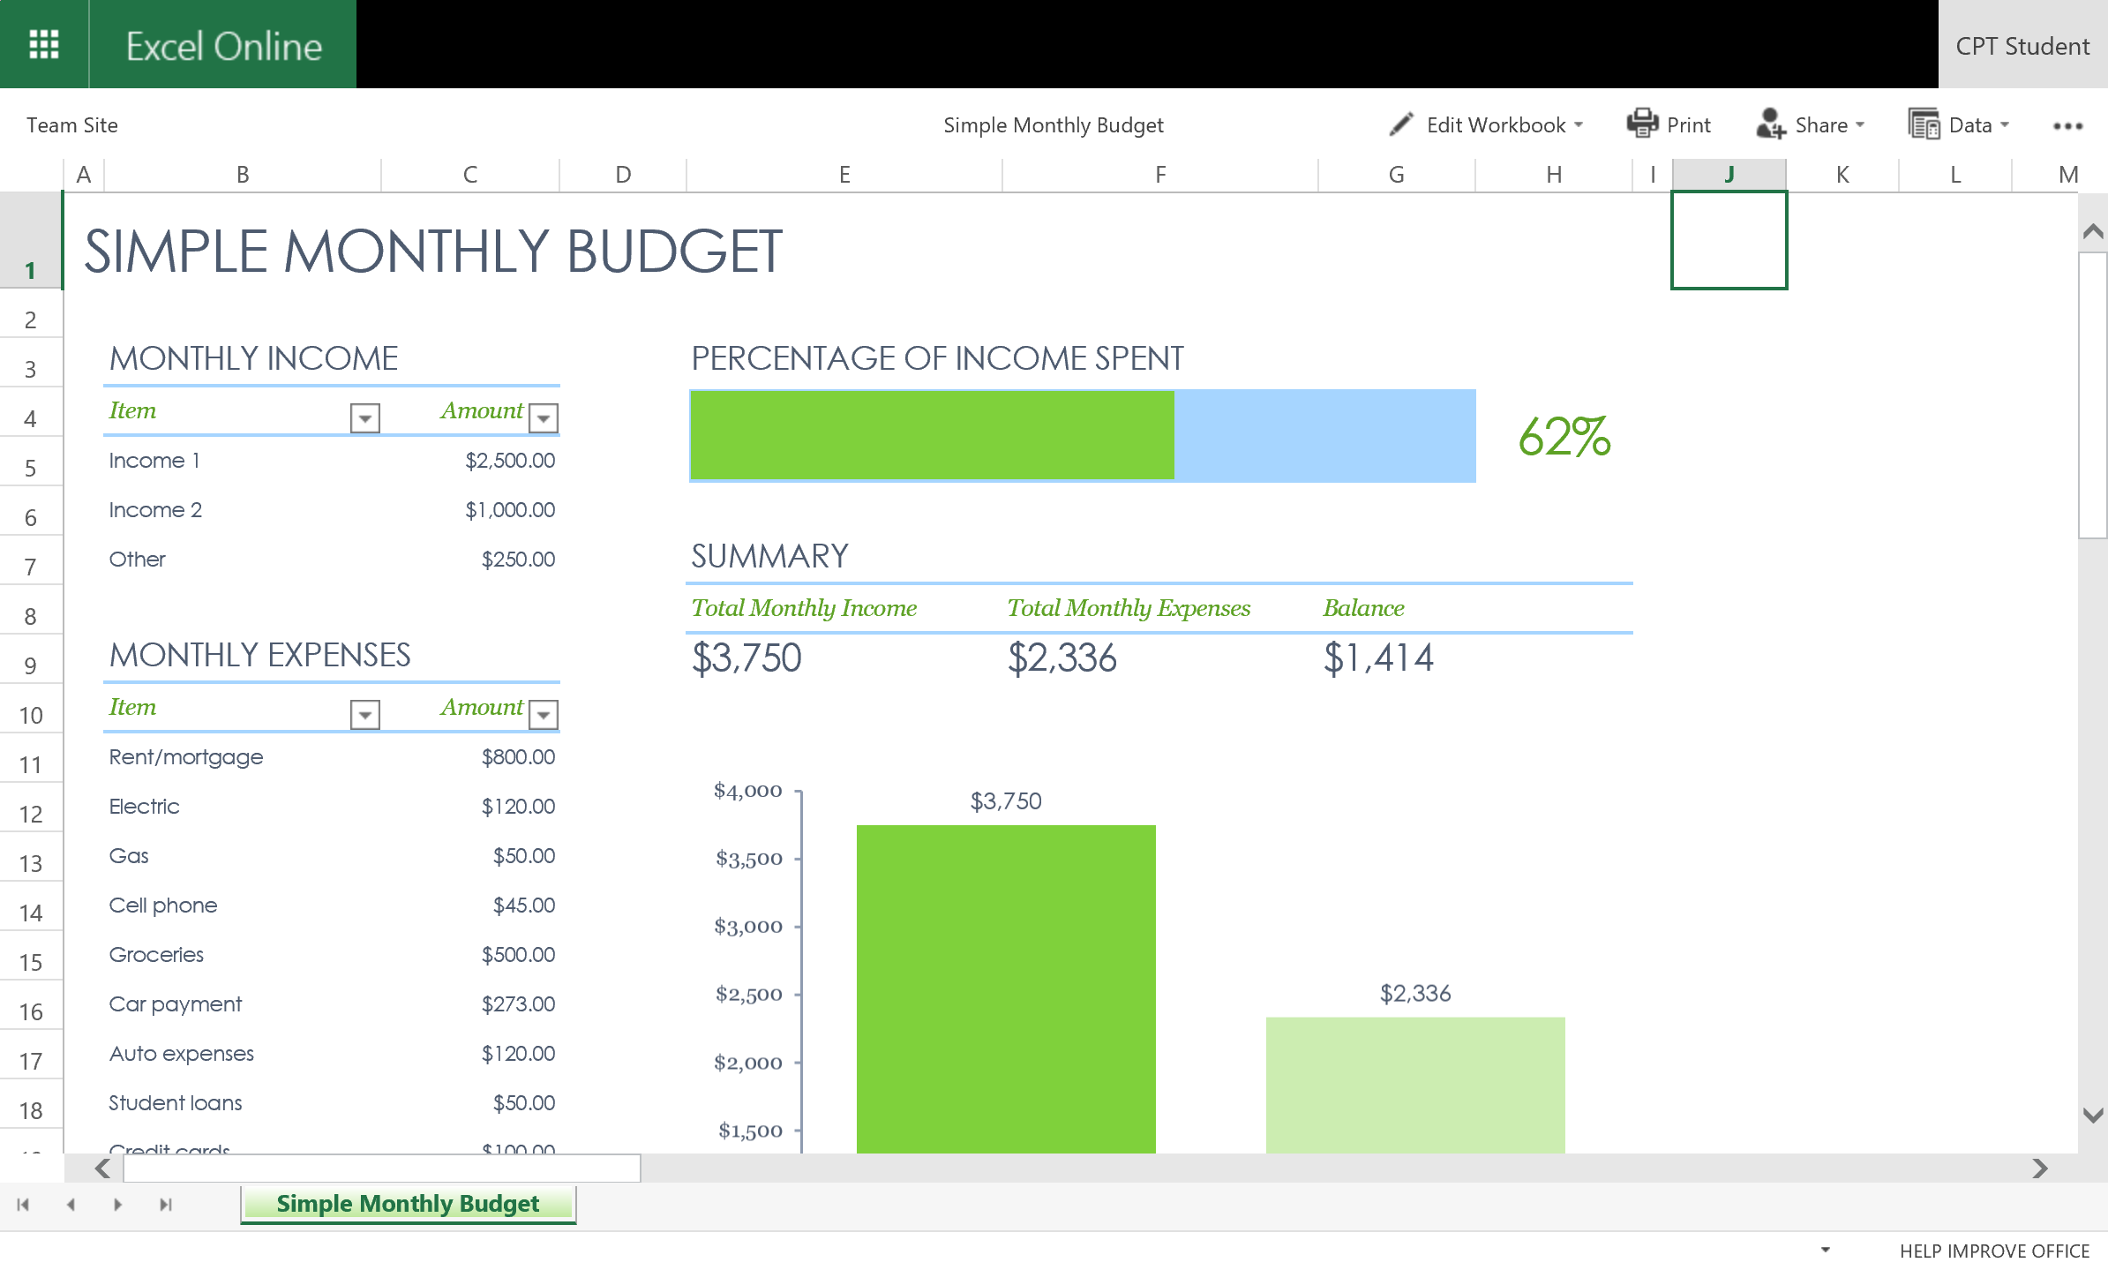
Office Online in O365
Microsoft Office Online programs are a part of most Office 365 plans
Provides the ability to work with documents in the cloud through the browser using Word, Excel, PowerPoint, OneNote, and PDFs

Slide 15
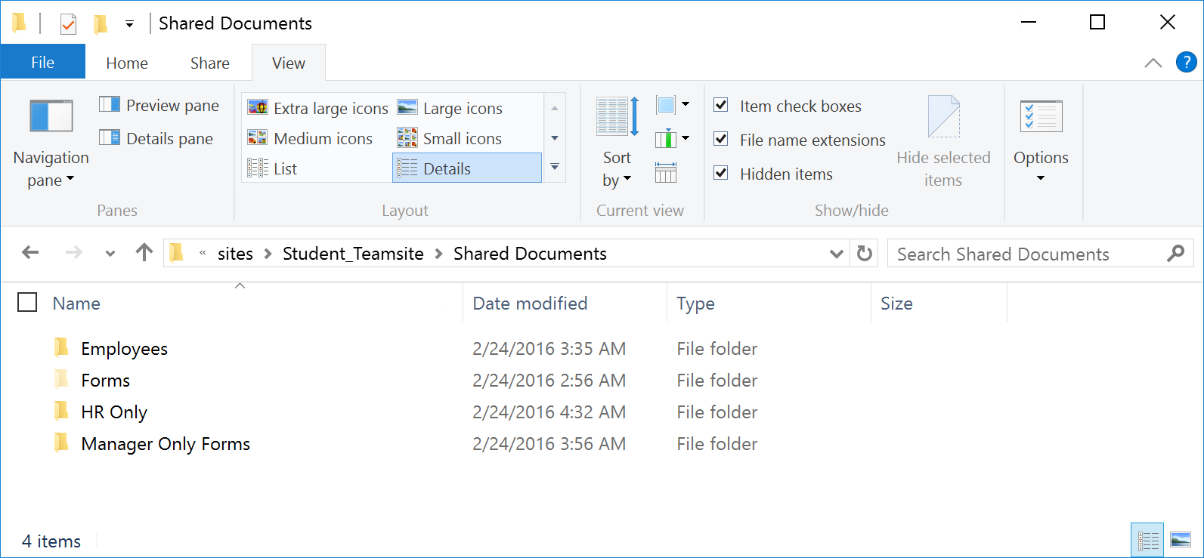
Managing Files in Libraries
Explorer View
Use to copy or move one or more documents in a library to another library
Use to manipulate files and folders such renaming, deleting, or moving files in the same library
When copying or moving files between libraries
Document properties are preserved
Library-specific information (such as views and settings) are not preserved
Notes:
Explorer View can be used to copy or move one or more documents in a library on site collection to another library within the same site collection or a different site collection. You can also use explorer view to manipulate files and folders to rename, delete, or move files within the library.
Copying or Moving Files
When copying or moving files between libraries the document properties are preserved. However, library-specific information (such as views and settings) are not preserved. If you have custom columns on a library and want to preserve the column data, you must have the columns created in the destination library before copying or moving the files to the library.

Slide 16
Uploading Large Files or Many Files
There are some limitations to uploading large files or many files to SharePoint Online.
Multiple document upload limit is 100 files at a time
10GB is the default maximum file size
On-premises default is 250GB but can be increased up to a maximum of 10GB
OneDrive for Business client app recommended for uploading large files or many files.
Notes:
If you are uploading large files or many files that exceed 100 files to a library, you may get errors due to the file size limit in SharePoint or timeout errors in your version of Internet Explorer. Steps you can take to get around these errors include:
Upload 100 or fewer files. The SharePoint limit is 100 files at a time.
If you are an Office 365 customer, avoid uploading files larger than 10 GB. The default maximum file size in O365 is 10GB.
If your organization maintains an on-premises deployment of SharePoint, ask the server administrator to verify or increase the maximum file size limit to accommodate the size of the files you are uploading. The default size limit is 250 MB however it can be increased up to a maximum of 10GB. For file sizes exceeding 10 GB, if you see a "Working on it" message that never goes away, follow the instructions in Microsoft Support: Internet Explorer error "connection timed out" when server does not respond.
If you have the OneDrive for Business sync client available, use it to upload large files or multiple files. The 100-file limit still applies, but sync will automatically upload them in the background when you’re online. For more information, see Sync a library to your computer.

Slide 17
Agenda
Intro to Document Libraries
Working with Document Libraries
Managing Files in Libraries
Customizing Document Libraries
Versioning for Co-Authoring
Adding Document Library Types

Slide 18
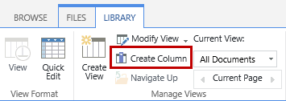
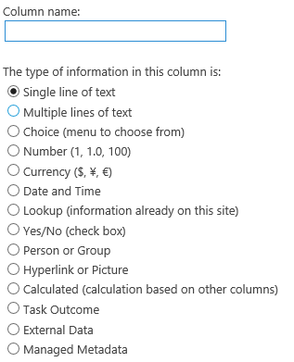
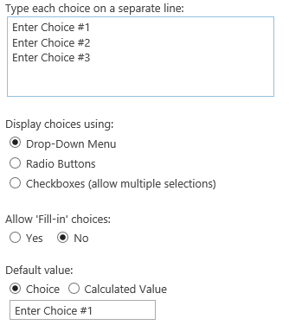
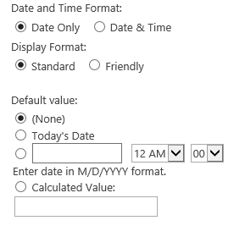
Customizing Document Libraries
Create Custom Columns to
Group, categorize, track information
Column headers make it easy to sort/filter documents
Column Names must be unique
Column Properties
Vary based on data type selected
Notes:
You can improve the user experience of a document library by using custom columns and custom views with document libraries. Custom columns help to group, categorize, and track information in a document library. For example, additional columns can be added to group files such as Project Category or Department Name. Columns provide column headers that make it easy for users to sort and filter documents. In SharePoint Online, managed metadata columns can also be used with document libraries.
When creating custom columns you must use a unique column name. The column properties will vary based on the data type selected for the column being created.

Slide 19
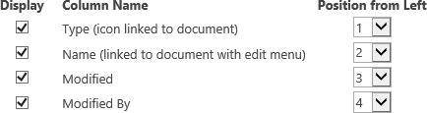
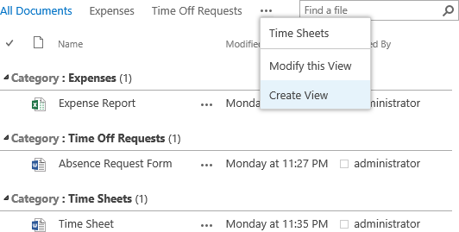
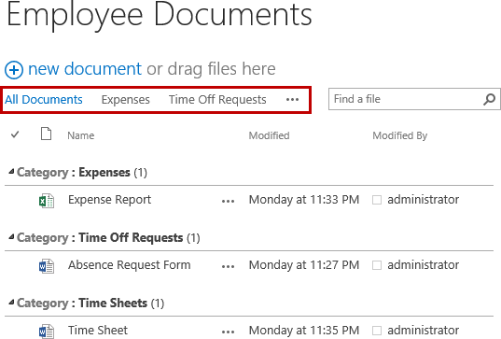
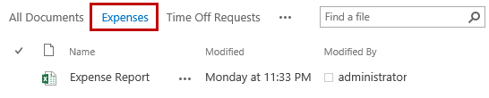
Customizing Document Libraries
Use Views on Document Libraries
Provide selection of columns on page that displays items in library
Often defines specific sort order, filtering, grouping, custom column layout
Notes:
Creating views for document libraries provides a way to display a selection of columns on a page that displays the items in the library. Views often defines a specific sort order, filtering, grouping, and custom column layout.

Slide 20
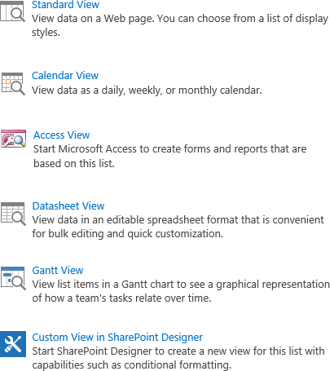
Document Library Views
Document libraries can contain
Multiple views
Various types of views
Creating Custom Views
Choose a view format (ie. Standard View)
Can set as default view
Set Audience
Show/hide columns
Set sort, filter, and group by settings
Set style and item limit
Notes:
SharePoint views provide a quick and easy way to enhance the user experience for document libraries. Document libraries can contain multiple views as well as contain various types of views.
When creating custom views you choose a view format:
Standard View - This view displays files like a traditional list on a Web page. Standard view is the default for document libraries however you can customize it in several different ways.
Calendar View - This view displays your calendar items in a visual format that is similar to a desk or wall calendar. You can apply daily, weekly, or monthly views in this format.
Access View – This view starts Microsoft Access to create forms and reports based on the library.
Datasheet View - This view provides data in an editable spreadsheet format that is convenient for bulk editing and quick customization. Datasheet view requires a ActiveX control support and a compatible program such as Access 2013.
Gantt View – This view displays the documents in a Gantt chart to see a graphical representation of how a team's tasks relate over time. This view is not common for document libraries.
Custom View in SharePoint Designer – This view starts SharePoint Designer 2013 to create a new view for the library with capabilities such as conditional formatting.
Depending on the view format selected determines what customizations you can make to the view.

Slide 21
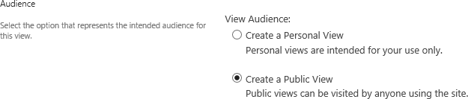
Personal and Public Views
Audience setting provides ability to set the view as public or personal
Public View
Available when anyone (with appropriate permissions) looks at the library
Personal View
Only available to you when you look at the library
Anyone with contribute rights can create personal view
Notes:
The Audience setting is used to set the View Audience to Personal or Public. A personal view is available only to you when you look at a list or library. A public view is available when anyone views the library. To create a public view, you must have permission to change the design of the library. You can make a public view the default view for a document library.

Slide 22
Agenda
Intro to Document Libraries
Working with Document Libraries
Managing Files in Libraries
Customizing Document Libraries
Versioning for Co-Authoring
Adding Document Library Types

Slide 23
Versioning for Co-Authoring
Version control allows content authors and approvers to track changes to documents
Settings available for versioning on libraries
Disable versioning
No history is tracked
Track only major versions
Everyone can see the current version of each item
Track major and minor versions
Draft versions can only be seen by those who can edit and approve the item
Limit number of versions is available in settings
Notes:
SharePoint includes the ability to use version control on document libraries. Version control provides the ability for content authors and approvers to track changes on each individual document. By default, versioning is turned off on all document libraries. When enabled, each time a document is saved with changes a new version is created automatically. Comments (optional) can be added with each version to describe the changes made. From the version history, older versions can be viewed, restored, and deleted. There is also the ability to limit the amount of versions you want to keep in the version history.
When using versioning you can:
Track only major versions – When only tracking major versions, all visitors who have the permissions to the library can see the current version of each document.
Track major and minor versions – The key benefit to tracking both major and minor versions is being able to configure SharePoint to only show the most recent major version to the visitors. All draft (minor versions) will only show for those who can edit and approve the document.
You can also limit the number of major and minor versions you want to keep. When the limit is reached, SharePoint discards the oldest versions.
Check out Documents
All document libraries provide the ability to check out documents before making edits. This feature prevents users from making changes to documents while someone else is working on them. Also, users with appropriate permissions can override check outs if needed. By default, document libraries do not require files to be checked out however this can be changed by updating the properties of the library.
It is recommended when using version control to set the library to require check out. This helps prevent users from creating divergent versions with conflicting changes. As long as the document is checked out by a user, no other user can edit the document until it is checked in or until someone with sufficient permissions can override the check out.

Slide 24
Agenda
Intro to Document Libraries
Working with Document Libraries
Managing Files in Libraries
Customizing Document Libraries
Versioning for Co-Authoring
Adding Document Library Types

Slide 25
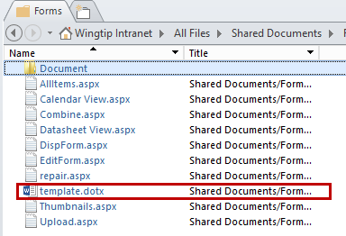
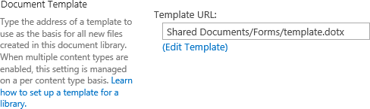
Document Library Templates
Document Libraries use a Default Template
When user creates file in document library, default template opens program with blank template
Default template stored in Forms folder of library
Edit Template
If multiple content types not used template can be modified from Library Settings > Advanced Settings or from SharePoint Designer 2013
Notes:
Document libraries use a default template so when a user creates a new file in the library, the default template opens the program with a blank template. The default template is stored in the Forms folder of a library and default templates can be blank or pre-defined.
Edit Template
If multiple content types are not being used on a document library, then the default template can be modified from the Advanced Settings of the document library or through SharePoint Designer 2013.
If multiple content types are enabled and templates are specified for the content types, the library uses the templates specified by the content types. Instead of changing the template settings for the library, you must change the content types instead.

Slide 26
Adding Document Library Types
You can use multiple document types and templates on a document library
Multiple content types must be enabled on the library
Templates must be specified for the content types
Document library will use the templates specified by each content type configured on the library
Notes:
You can add multiple document library types and templates to a document library. To use multiple templates, the content types must be created and the content types must be enabled on the document library. Templates must be specified for each of the content types so the library will use the templates specified for the content types configured for the library.
Instead of modifying the template in the document library settings you modify the template for each of the content types.

Slide 27
Summary
Intro to Document Libraries
Working with Document Libraries
Managing Files in Libraries
Customizing Document Libraries
Versioning for Co-Authoring
Adding Document Library Types

