Slide 1
Getting Started with SharePoint Online
Notes:
This module provides an overview of SharePoint Online in O365 and explains how SharePoint Online provides value to the companies and organizations that use it. You will learn how to navigate around within the new user interface of a SharePoint Online team site. You will also learn about the many features that SharePoint Online makes available to business users and other types of information workers. By the end of this module you will understand the big picture of how a company or organization makes use of the SharePoint Online in the O365 platform.

Slide 2
Agenda
Overview of O365 & SharePoint Online
Sites and Site Collections
Navigating around SharePoint
Adding & Managing Content
SharePoint Apps

Slide 3
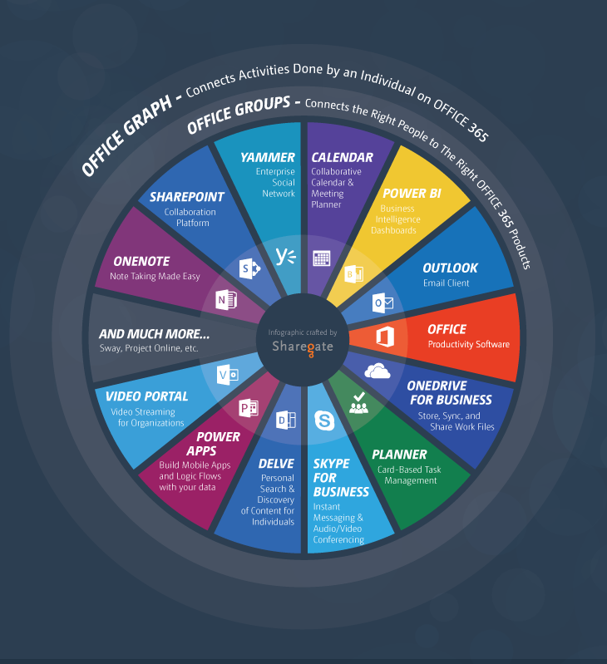
What is O365?
Office 365 is a collection of apps and cloud services
Use to be productive across variety of devices
Several different subscriptions available to suit different needs

Slide 4
SharePoint Versions
SharePoint Server
Organizations can deploy and manage SharePoint server on-premises
Overhead of self-managed infrastructure
SharePoint Online
Cloud-based service hosted by Microsoft
Eliminates overhead
Offered as a part of the O365 Suite or standalone

Slide 5
SharePoint Online
SharePoint Online is divided in three hubs:
Newsfeed, OneDrive and Sites
Microblogging
New microblogging allows to you to engage in conversations
Easily create team sites and portals
Discover, share and collaborate on content with from any device
Allows collaboration with external users such as vendors and customers

Slide 6
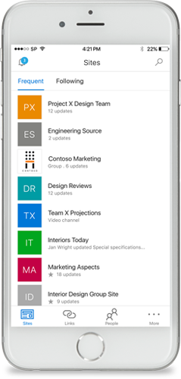
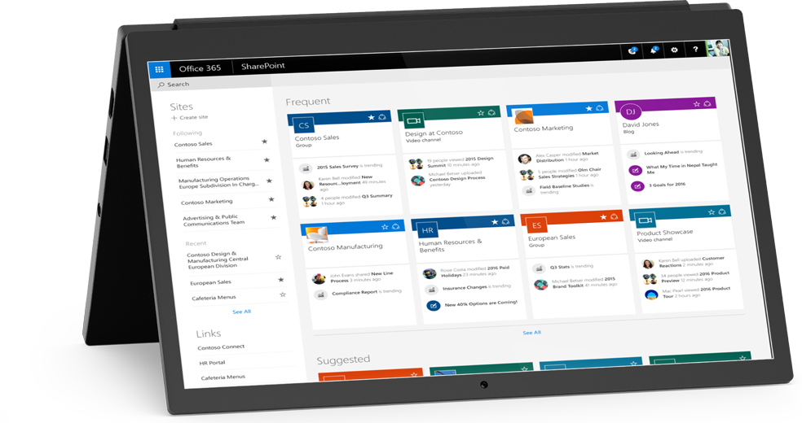
SharePoint Online
Anywhere Access
New App (coming Q2 2016)
Seamless Collaboration
Collaborate with both inside and outside your organization
Intelligence and Insights
Office Graph
New SharePoint home (coming Q2 2016)
Enterprise-grade Security and Compliance

Slide 7
Future of SharePoint
Changes Coming Soon
Microsoft recently announced changes to O365 and SharePoint Online
New innovations are being implemented by Microsoft to the O365 platform to help:
Simplify the User Interface (UI)
Better integrate O365 features together
Interface Changes
Some of the elements you see in the training could be different in the near future

Slide 8
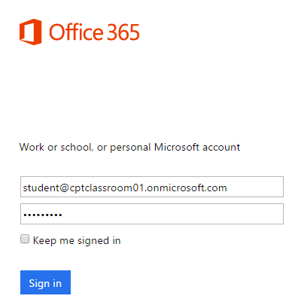
Accessing O365
O365 is web-based
Recommend Internet Explorer
Chrome can be used however some features may be disabled
For Windows 10 Users
Do not recommend Edge Browser

Slide 9



Connected Experiences
Get Connected
Share Knowledge
Work Together
Engage in conversations to stay informed and make better decisions.
Use community knowledge to gain insight and find answers.
Make it easier to work as a team and manage your projects.
Notes:
Get Connected
SharePoint Online provides ways to help connect people inside the organization to help people work better together. Use newsfeeds to share content, connect with people, and stay up to date with what’s going on within your organization
Share Knowledge
Use SharePoint to take the effort out of making knowledge and people discoverable. Share ideas, discover answers to questions, and keep track of what colleagues are working on by using the new social features throughout SharePoint.
Work Together
Use SharePoint Online to provide your team with a single place to get work done and sync together to help keep everyone on the same page. For example, use a team site to track meeting notes, schedules, bring together team’s emails and documents in once place. Quickly loop in colleagues to work together on content—even at the same time—while everyone’s changes to a document are automatically tracked.

Slide 10
Social
Use feeds to stay on top of relevant content and collaborate with coworkers
Microblogging
Share content, links, and media
Follow people, sites, content, and conversations
Newsfeeds
Provides view into recent activity related to content, links, media, and people
Notes:
Social isn’t just about a features, it’s about the ability help users stay up-to-date with information they care about within the organization. It also helps people get to know each other and share information that is important.
Microblogging
SharePoint has finally gone social with it’s new microblogging features. A microblog is abbreviated content which according to Microsoft “allows users to quickly broadcast information to a location while enabling other users to create public dialog by responding to comments. Important information and news can be shared quickly among peers while keeping conversations in context.“ In essence, a microblog is something that is too long to be a tweet but too short to be a traditional blog. It allows users to post items of interest in a newsfeed and participate in conversations.
Newsfeeds
The heart of the social experience in SharePoint Online is the newsfeed which is a place to post information and reply to other posts. Newsfeeds displays a summary of all your social interactions from your microblogs and community conversations, to the sites, content, and people you follow.

Slide 11
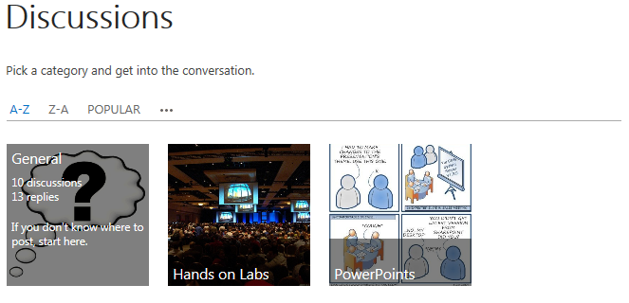
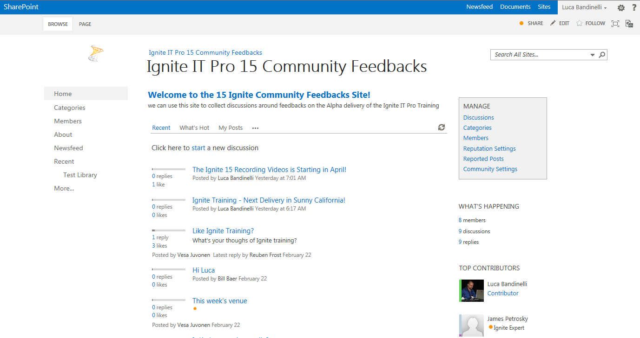
Social
Communities
Community sites with self-service administration and moderation
Modern community features such as achievements and reputation
Discussions
Modern discussion boards
Engage in discussions with experts and find answers
Blogs
Client application integration
Categories, comments, moderation
Notes:
Communities
SharePoint Online introduces a new features called Community Sites. A Community Site, which is a new site template, provides a forum experience that enables community members to contribute information and to ask for help from others.
Discussions
One of the features that was lacking in previous versions of SharePoint was the discussion boards. Now in SharePoint Online, the discussion boards experience has greatly improved with a modern UI experience.
Blogs
Blogs in SharePoint Online, can enable an organization to quickly share information among employees, partners, or customers. Use SharePoint Online to create a full-featured blog site that includes necessary components to enhance collaboration and share knowledge. It is common to use blog sites for publishing corporate news and company updates. Posts can be categorized, users with contribute permissions can comment on the blogs posts, and posts can be moderated.

Slide 12



Connected Platform
Secure Information
Manage Identities
Integrate Business Apps
Ensure information communicated via internal social networks is secure and compliant with centralized IT policies
Provide single view of the people in organization and bring together identity-based information from many sources
Build new social apps and bring important information from your LOB applications directly into newsfeed
Notes:
We’ve shown you how users EXPECT that social should follow them where they work with consistent Connected Experiences – but what does this mean for IT? It’s not a question of IF organizations will become more social, but a matter of WHEN. This means that IT has to figure out:
This means that IT has to figure out how to
-manage the environment, and all the users;
-how to ensure that information is being shared securely to the right people without jeopardizing propriety information;
-how to ensure that corporate governance – how to handle eDiscovery of information contained within social.
-how to extend and develop to bring new solutions that continue to add business value.
Office and SharePoint are the place where social across a company meets, and already offers many platform capabilities that IT departments will be looking for including:
-Securing information – not just securing ACCESS to downloading information, but having the ability to control that actual information itself and avoiding compliance issues before they arise.
-Managing identities
SharePoint’s user profile allows organizations to take many identities from Active Directory to HR systems and bring them together in one place. This means social applications can go to one place, and get the information they need.
-Integrating business applications
Most organizations have many different systems that offer(or will offer) social experiences, how do you make it so that users don’t have to check several newsfeeds to get the information they need? SharePoint offers the ability to make existing LOB applications more social and to bring the social capabilities of applications directly into the newsfeed.

Slide 13
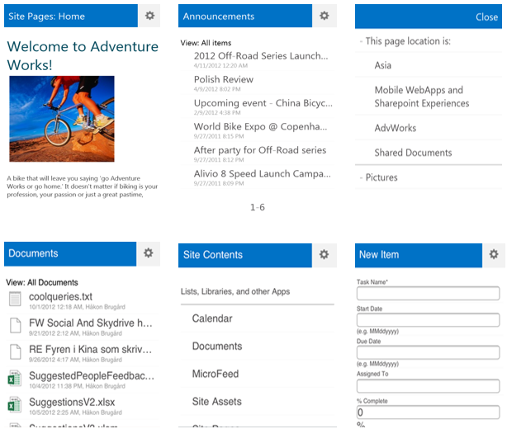
Mobile
Mobile Views
Classic and Contemporary views for mobile browsers
Automatic Mobile Browser Redirection
Device Channels
Target different designs
Office Mobile Web Apps
Excel
PowerPoint
Word
Push notifications
Notes:
Mobile Views
SharePoint Online offers new, optimized view experiences for mobile platforms. With the introduction of a new contemporary view, users experience an more enriched optimized view that renders in HTML 5.
Automatic Mobile Browser Redirection
In order for a site to use the optimized mobile browser experience, a new featured named Mobile Browser View must be activated on the site. When activated, if a mobile device accesses the site, the feature checks to see if the mobile browser supports HTML5. If it’s supported the contemporary view is rendered otherwise the classic view is rendered.
Device Channels
Another new mobile support feature introduced in SharePoint Online is called Device Channels. With device channels, a single publishing site can be rendered in multiple ways by using different designs which target difference devices based on the user agent string.
Office Mobile Web Apps
Office Mobile Web Apps enables users to open documents in the mobile browsers using Word, Excel, and PowerPoint Mobile Viewers.
Push Notifications
SharePoint Online supports push notifications on mobile devices from SharePoint sites.

Slide 14


Publishing Sites
Design
Publish
Engage
Use familiar tools to design rich and beautiful sites that represent your brand
Create, reuse and consume content for any device and language
Surface the right content to the right user with adaptive experiences
Notes:
Design
Designing eye-catching sites in previous versions of SharePoint required a certain level of skills and knowledge of SharePoint Designer. Today designers can build dynamic sites using design tools they are familiar with (such as Dreamweaver or Expression Blend).
Publish
With the new search driven publishing model, organizations can break down content into silos while making it easier to re-use content across devices and multilingual sites. Cross-site publishing enables you to reuse content stored in one publishing site collection across one or more site collections. With simple taxonomy based navigation controls non-technical users can create targeted user experiences that drive action without having to write a single line of code.
Engage
Search in SharePoint Online is like Bing for any information within your company. SharePoint Online introduces a new dimension to adaptive personalized experiences. Get personalized results based on your intent and past behavior.

Slide 15
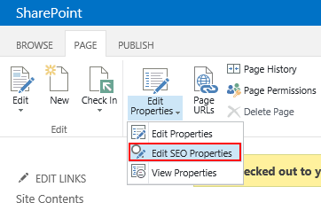
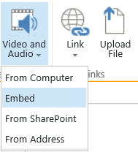
Web Content Management
Support tools and workflows designers use
SharePoint knowledge needed has been minimized
Variations & Content Translation
Search Engine Optimization
Cross Site Publishing
Video & Embedding
Image renditions
Metadata Navigation
Clean Urls
Notes:
Web Content Management (WCM) in SharePoint Online has been completely revamped. With SharePoint Online organizations can deliver engaging, adaptive and cross-channel customer experiences to drive online business success. In this release, the SharePoint knowledge needed to successfully design and brand a SharePoint site has been minimized with new simplified markups, style sheets and the snippet gallery.
SharePoint Online introduces a new feature for multilingual sites that supports content translation to other languages. Search Engine Optimization (SEO) features has also been added which provides a number of fields dedicated to SEO. You can also easily embed videos into SharePoint pages and use image renditions to display different sized versions of an image on different pages.
Use the new Managed Navigation in SharePoint Online to drive the navigation elements on your site using the term tagged within your content. This makes it easier to manage your site navigation and ensures the user experience is consistent. Managed navigation also lets you create friendly URLs without changing the structure of your site which provides a clean URL structure.

Slide 16


Search
Get Find
Answer
Extend
Find what you’re looking for with intelligent results tailored to you
Get answers and take action with an experience that’s always a step ahead
Build smarter applications that can scale for any need
Notes:
Microsoft has invested heavily in search in the past several years and in SharePoint Online’s brings together SharePoint Search with FAST Search in a next generation of search providing the best of both worlds.
Search in SharePoint Online focuses not just on technology. It focuses on the core belief that search should help users find what they are looking for and get answers to questions they ask. This new experience is dedicated to the users intent that can analyze user interactions while having the flexibility to draw information from across the enterprise and from the outside web.
The search experience in SharePoint Online is beyond just a great user experience, as it will allow anyone looking to leverage the extensible engine to build their own experiences that can benefit much of the richness that SharePoint provides.

Slide 17
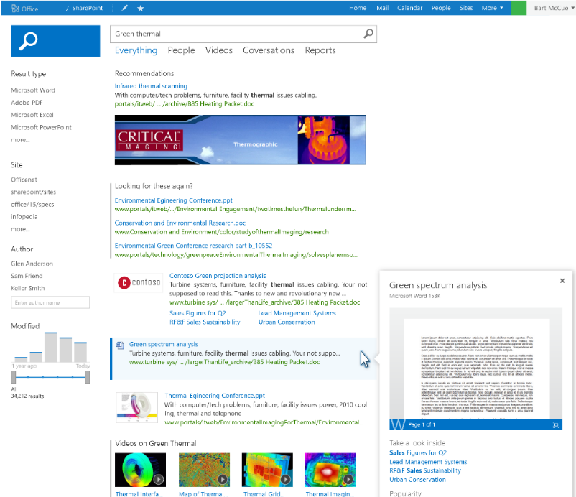
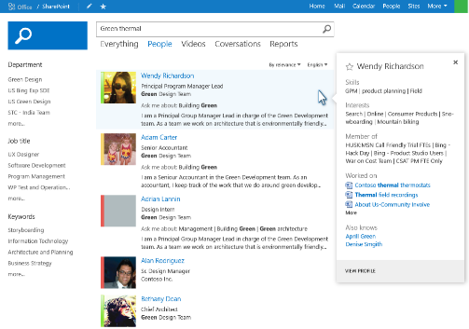
Search
New Search architecture with one unified search
Personalized search results based on search history
Rich contextual previews with meaningful actions
Intelligent and customized search results experience
Search latest documents as soon as they are added with Continuous Crawl
Notes:
Search in SharePoint Online includes many new capabilities and enhancements, from a re-designed architecture that is highly scalable to a customizable end-user experience that provides targeted results. With an all new search experience, the redesigned engine and UX makes it easier than ever for users to find what they are looking for by combining personal history, highly relevant results, and rich graphical navigators in a single highly usable interface.
Personalized search results based on search history
Makes re-finding information easier by promoting content you’ve searched for in the past. This aides to navigation than just being about finding documents.
Rich contextual previews with meaningful actions
Finding the right document is simpler by providing a variety of previewing capabilities to ensure you have the right document. The previews combined with contextual actions empower you to complete your task.
Intelligent and customized search results experience
SharePoint Online enhances results relevance out-of-box with an ability to alter the layout and ranking based on what you’re looking for and what you’ve found. This takes relevance to a new level and gives administrators powerful tools for improving the search experience.

Slide 18


Business Intelligence
Explore
Visualize
Control
Easily combine data from any source to create fully interactive reports and insights with guided exploration
Visually discover and share insights for collaborative decision making across the organization
Manage self-service BI with control and compliance for end user created assets
Notes:
Microsoft offers a Business Intelligence platform that helps organizations capitalize on trends and opportunities—and discover answers to new questions that help drive business value—in a way that no other vendor does. We believe Business intelligence should empower all users with self-service capabilities through familiar tools and experiences. Microsoft enables immersive insights to all users through self-service, data exploration and collaboration delivered through Office and SharePoint, the tools users know and love. At the same time, Microsoft offers the IT department the tools and capabilities they need to ensure that Self-Service BI can be easily managed. This is the strategy we are on to help our customers maximize their business opportunities and we are confident there is no other vendor in the industry with the vision or the assets necessary to deliver on it.

Slide 19
BI Capabilities in Excel & Office 365
SharePoint
Get, sort, and organize data
Create powerful visualizations
Share workbooks
View and interact with workbooks in a browser
Get, sort, and organize data
Create powerful visualizations
Excel
Power BI
Notes:
Business intelligence (BI) is essentially the set of tools and processes that people use to gather data, turn it into meaningful information, and then make better decisions. In Office 365 Enterprise, you have BI capabilities available in Excel, SharePoint Online, and Power BI. These services enable you to gather data, visualize data, and share information with people in your organization across multiple devices.

Slide 20
Agenda
Overview of SharePoint Online
Sites and Site Collections
Navigating around SharePoint
Adding & Managing Content
SharePoint Apps

Slide 21
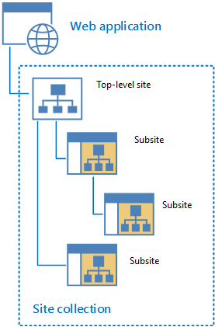
Sites and Site Collections
Site collection
Site to host a collection of sites
Made up of one top-level site and all sites below
Every SharePoint site belongs to one site collection
Sites
Create sites in your site collection to partition content
Configure sites for - templates, language, security, navigation, web pages, site layouts, themes, regional settings, search, content types, workflows, apps
Notes:
All user-generated content resides in SharePoint sites. The primary types of content within sites include items within lists and documents inside document libraries.
Sites are grouped into site collections. Whenever a site is created, it is always created within a scope of a specific site collection. Each site collection must have exactly one site referred to as the “top-level” or “root” site. The URL of the top-level site is always the same as the URL of the site collection. A site collection may additionally contain child sites below the root site. Child sites can be nested within other child sites within a site collection resulting in the creation of a site hierarchy. While SharePoint supports nested child sites more than 10 levels in depth, experience has taught the SharePoint community that creating deep site hierarchies can be very hard to manage and to scale.

Slide 22
Sites and Site Collections

Slide 23
Agenda
Overview of SharePoint Online
Sites and Site Collections
Navigating around SharePoint
Adding & Managing Content
SharePoint Apps

Slide 24
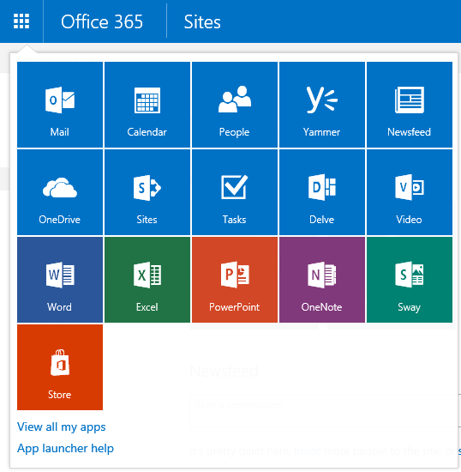
O365 Navigation
Suite Bar
App Launcher
Always visible in suite bar
Tiles
The tiles you see in your app launcher depend on your O365 subscription

Slide 25



Global Navigation
Top Link Bar
Displays links to sites one level below current site
Default - All sites one level below current site are added to top navigation
Settings
Inherit top navigation from parent site or use unique
Move or rearrange links by clicking on EDIT LINKS
Notes:
Site navigation are the sets of controls and links in your site collections, sites and pages that help users easily get to other relevant locations. Navigation controls can be displayed on master pages, page layouts, and pages by using Web Part zones directly in a page's content.
Top Link Bar
The Top link bar control displays links to sites that are one level below the current site in a site hierarchy. It is common for the top link bar to appear at the top of each page in a site. By default, all sites one level below the current site are added to the top navigation and each site has its own unique top navigation.
Site owners can customize the top navigation for a specific site or inherit top navigation from parent site. From the top-level site, the links can be moved and rearranged by clicking on EDIT LINKS. You can also use Design Manager to customize the appearance and functionality of the top link bar.
Navigation configuration features:
Link to sites that are on the same level of the site hierarchy as the current site (SharePoint Server 2013 and O365 only).
Link to specific external sites or to pages in the current site.
Organize links under headings.
Manually sort items.
Restrict the maximum number of items to show at the navigation level (SharePoint Server 2013 and O365 only).

Slide 26
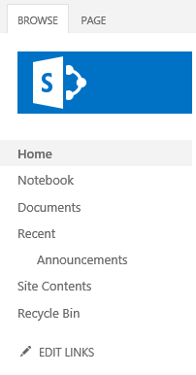
Quick Launch
Typically
Highlights important content in current site such as list and libraries
Customize links
Move or rearrange by clicking on EDIT LINKS in vertical navigation
Add, remove, rearrange, and create new headings in Site Settings
Site Settings > Look and Feel > Quick Launch
Notes:
The quick launch typically highlights important content in the current site, such as lists and libraries. It is common for the quick launch to appear on the left of each page in a site.
You can add, remove, or rearrange links by clicking EDIT LINKS in the vertical navigation. Or you can also add, remove, rearrange links or create new headings in Site Settings for the site. The Quick Launch can be disabled/enabled in the Site Settings > Look and Feel > Navigation Elements by updating the Enable Quick Launch check box. Just as you customize top navigation using Design Manager, you can also customize the appearance and functionality of vertical navigation the same way. The Design Manager is only available when the Publishing features are activated.
Navigation configuration features:
Link to sites that are on the same level of the site hierarchy as the current site (SharePoint Server 2013 and O365 only).
Link to specific external sites or to pages in the current site.
Organize links under headings.
Manually sort items in Quick Launch.
Restrict the maximum number of items to show at the navigation level (SharePoint Server 2013 and O365 only).

Slide 27
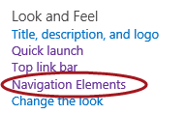
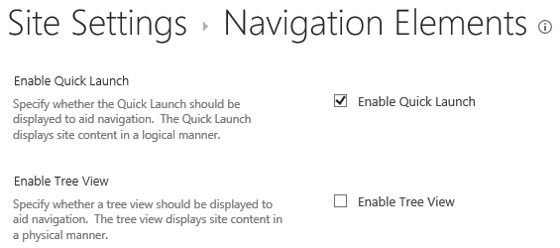
Quick Launch
Enable/Disable
Site Settings > Look and Feel > Navigation Elements

Slide 28
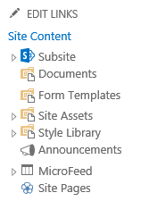
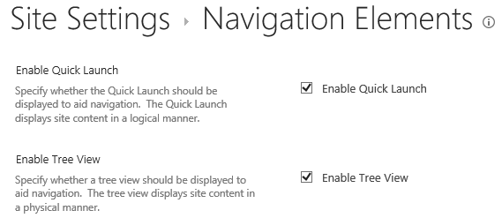
Tree View
Appears in left side of page
Tree view displays below Quick launch
Displays site content such as lists, libraries, and sites of current site’s hierarchical structure
Enable/Disable
Site Settings > Look and Feel > Navigation Elements
Notes:
The Tree view appears on the left side of the page and displays site content, such as lists, libraries, and sites that are in the current site, in a hierarchical structure.
By default, tree view navigation is turned off. If you have enabled Quick launch and Tree view, Tree view will appear below Quick launch. The Tree view can be enabled/disabled in the Site Settings > Look and Feel > Navigation Elements settings by updating the Enable Tree View check box.

Slide 29
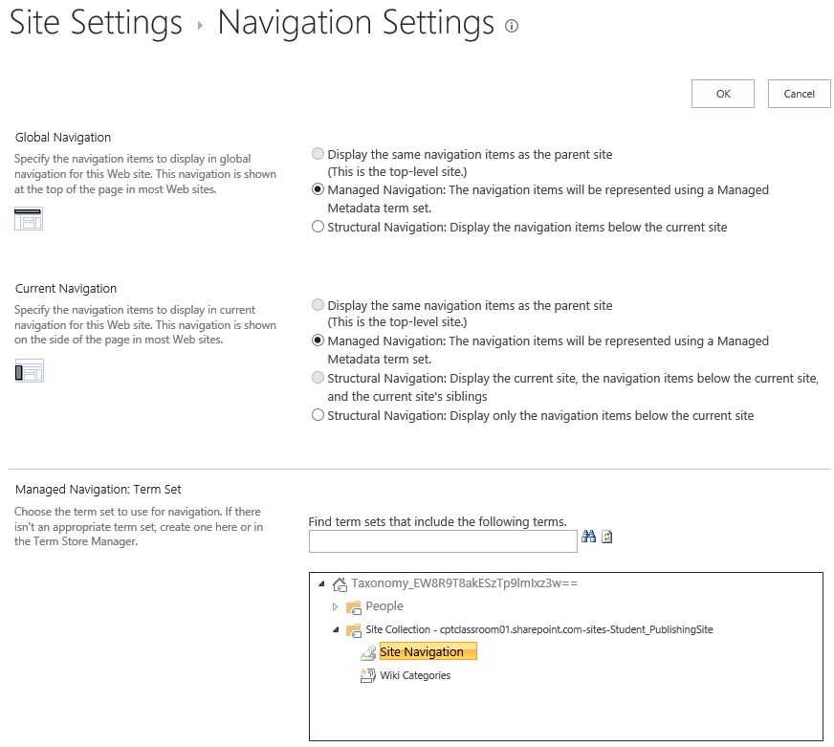
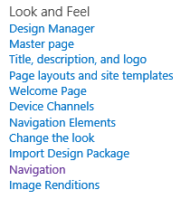
Publishing Navigation Settings
Notes:
The navigation on a Publishing Site is different than the navigation on a Team Site. Instead of the Top Link Bar link under Look and Feel, there’s a link for Navigation. This links takes you to the Navigation Settings page that allows you to customize the Global Navigation and Current Navigation (Quick Launch) in one place.
The available options are:
Display the same navigation as the parent site
Managed Navigation: The navigation items will be representing using a Managed Metadata term set
Structural Navigation: Display the navigation items below the current site
Show subsites
Show pages
Maximum number of dynamic items to show within this level of navigation

Slide 30
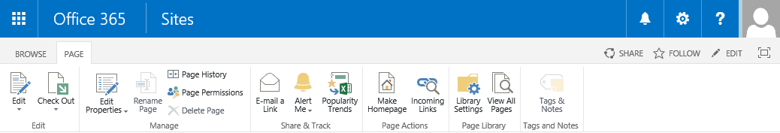
SharePoint Ribbon
Ribbon introduced in Office 2007
Used to edit contents in SharePoint
Ribbon Tabs (varies based on current page type)
Page tab
Automatically enables ribbon
Provides commands to edit page
Browse tab
Return to standard header
Notes:
The ribbon was introduced in Office 2007 and is a convenient way to display many menu items in a small amount of screen space. The ribbon in SharePoint Online is similar to the UI in products like Microsoft Word 2013. The ribbon is a toolbar that appears across the top of each page (otherwise known as the page header). It displays many of the most commonly-used tools, controls, and commands used in SharePoint.
The SharePoint ribbon is used to edit contents of a SharePoint page and can be accessed by clicking on the Page tab. You can also switch back to the standard header easily by clicking on the Browse tab. The number and types of controls that appear in the ribbon vary according to the context and type of page you are viewing. It also depends on the level of control your administrator has granted to users and the permission level you have been assigned to.

Slide 31
Navigation and SharePoint Ribbon

Slide 32
Agenda
Overview of SharePoint Online
Sites and Site Collections
Navigating around SharePoint
Adding & Managing Content
SharePoint Apps

Slide 33
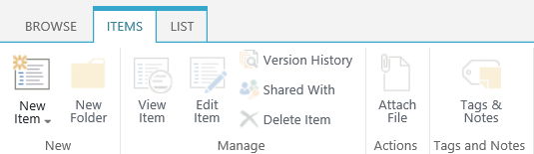
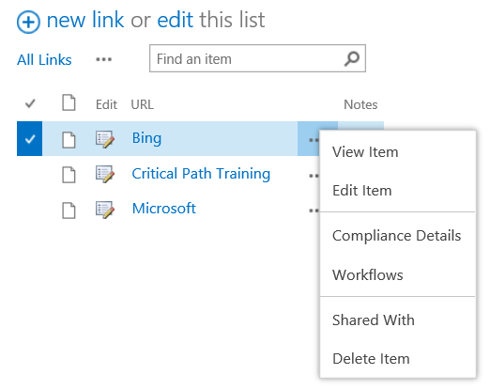
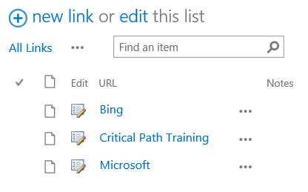
Managing Lists
List Ribbon Tabs
ITEM
Manage List content
LIST
Manage List library settings

Slide 34
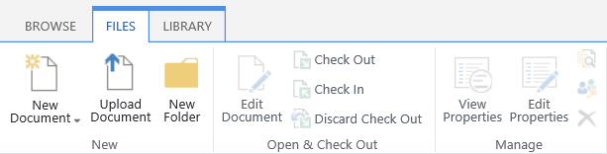
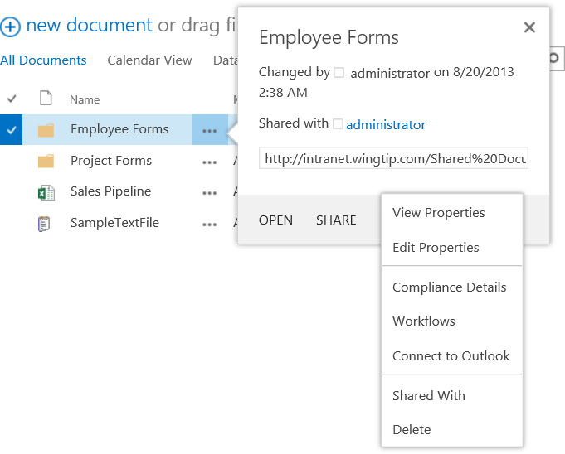
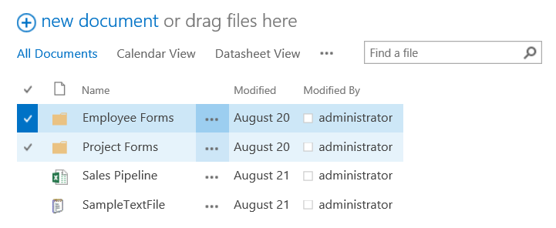
Managing Libraries
Library Ribbon Tabs
FILES
Manage Library content
LIBRARY
Manage Library settings

Slide 35
Managing Lists and Libraries

Slide 36
Agenda
Overview of SharePoint Online
Sites and Site Collections
Navigating around SharePoint
Adding & Managing Content
SharePoint Apps

Slide 37
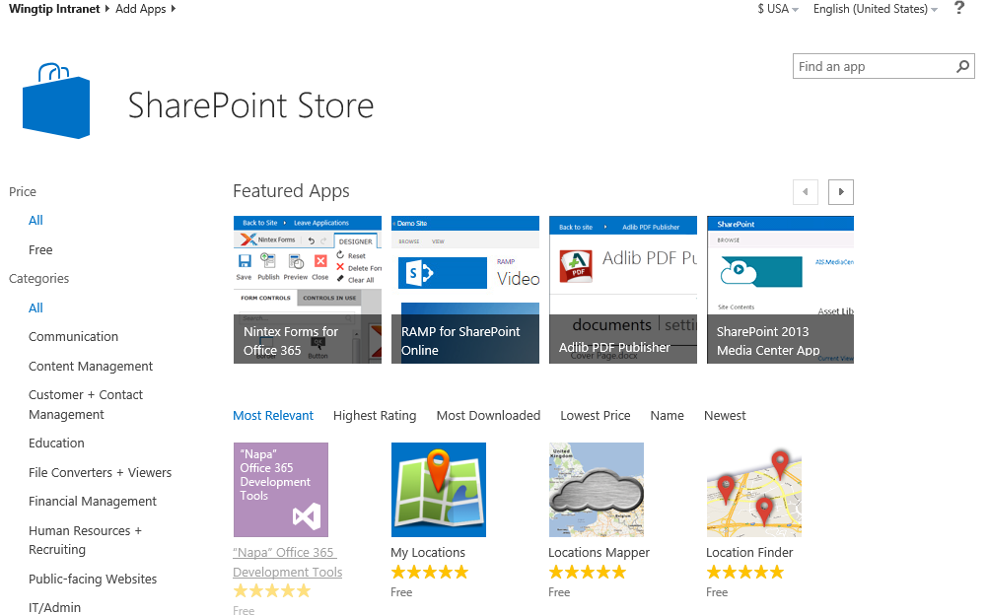
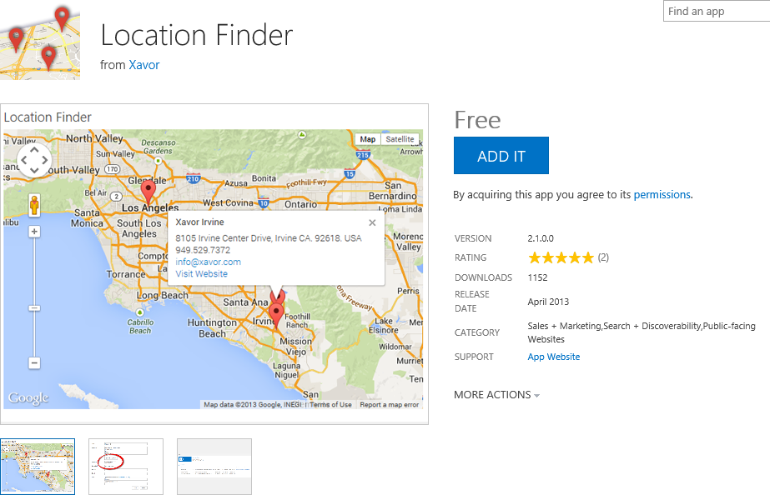
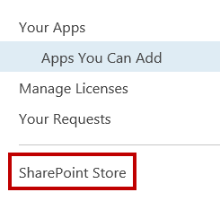
SharePoint Apps
Notes:
The new Cloud App Model in SharePoint Online enables you to add and use apps on SharePoint Online and on-premise sites. Apps are mini applications that extend what you can do with SharePoint Online such as perform tasks or solve user needs. You can add apps to your site to customize it with specific functionality or to display information. You can browse for SharePoint apps in the Office Store on Office.com, but you can only get the apps from the SharePoint Store. The SharePoint Store is essentially a version of the Office Store accessible only from a SharePoint Online site. You can customize your site using third-party apps, custom apps, or a combination of both.
Third-party apps
Site users (with Site Owner permissions or greater) can browse and acquire third-party apps from the SharePoint Store. Admins can also buy licenses for specific apps for all users in an organization.
Custom apps
Your organization can also develop its own apps for SharePoint Online or on-premise and make them available to users through the App Catalog site. You can use any language (such as HTML, JavaScript, PHP, or .NET) and your favorite web development tools to create apps for SharePoint.

Slide 38
SharePoint Apps

Slide 39
Summary
Overview of SharePoint Online
Sites and Site Collections
Navigating around SharePoint
Adding & Managing Content
SharePoint Apps

