Slide 1
Working with Lists
Notes:
In this module, you will learn how to store your content in SharePoint Online using both standard lists and custom lists. You will learn how and when to use standard SharePoint list types to create lists which track various types of business data such as announcements, contacts, calendar events, links and tasks. You will also learn how to customize a list by configuring its properties and adding custom columns and validation rules. You will also see how to import content into a SharePoint list using an Excel workbook.

Slide 2
Agenda
Intro to SharePoint Lists
List Templates
Creating SharePoint Lists
Customizing List Settings
Adding Columns and Validation Rules

Slide 3
Intro to SharePoint Lists
Lists are a key feature of a SharePoint site
A list is a collection of information used to track information
Similar to an Excel spreadsheet or Access table
SharePoint provides various kinds of lists:
Communication lists (announcements, contacts, discussion boards)
Tracking lists (links, calendars, tasks, issues, surveys)
Custom lists (starting template used to build on)
Notes:
Overview of lists
Lists are a key feature in SharePoint that is a collection of information used to track information. A list is a collection of data that you can share with team members and other site users. Similar to an Excel spreadsheet or a table in Access, lists have columns and forms that make it possible to track everything from contacts to tasks. Unlike a spreadsheet that is blank when you first create it, SharePoint provides several pre-defined lists that can be created depending on your needs. In many cases, these default lists can provide quick, effective solutions with little or no modifications.
You can use a number of ready-to-use lists and list templates, which provide a good starting point for organizing list items. These lists include:
Communications lists are used to track announcements, contacts, and discussion boards.
Tracking lists are used to track information such as links, calendars, tasks, issues, and surveys.
Custom lists provide a starting template that you can build on to create a list with the exact columns you need.
For example, you can use:
Surveys for employee and customer satisfaction assessments which include conditional branching and page breaks.
Issue Tracking for deeper analysis of workgroup projects and common work tasks which has versioning and version-history storage.

Slide 4
Agenda
Intro to SharePoint Lists
List Templates
Creating SharePoint Lists
Customizing List Settings
Adding Columns and Validation Rules

Slide 5



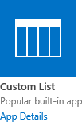
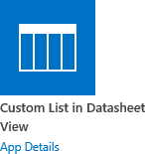


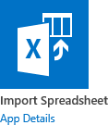


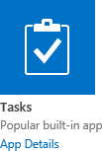


Out-of-the-Box List Templates
SharePoint Online provides many out-of-the-box list templates
List templates contain pre-defined columns and views
Notes:
SharePoint Online provides various out-of-the-box list templates. List templates contain pre-defined columns and views that provide an easy way to create SharePoint lists for your business. These default lists range from a discussion board to a calendar list. You can customize the default lists in many ways, or you can create custom lists with the columns that you choose.
Lists can also take advantage of e-mail features, if incoming or outgoing mail is enabled on your site. Some lists, such as calendars, announcements, blogs, and discussion boards, can be set up so that people can add content to them by sending e-mail. Other lists, such as tasks and issue-tracking lists, can be set up to send e-mail to people when items are assigned to them. Lists can include many types of data, ranging from dates or pictures to calculations based on other columns.

Slide 6
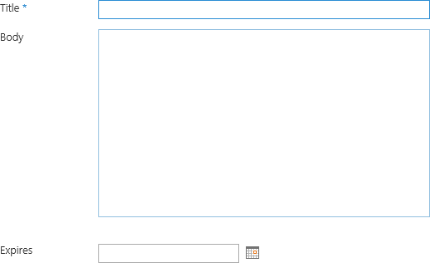
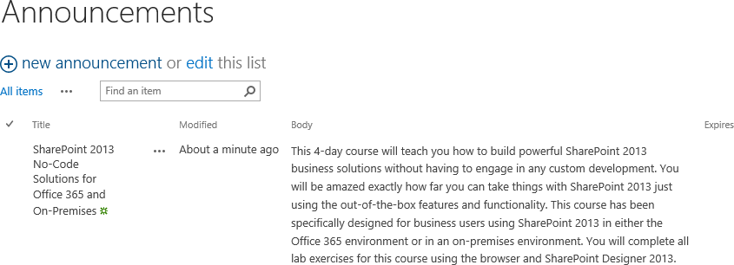
Announcements List
A list of news items, statuses and other short bits of information
Notes:
All collaborative site templates include an announcements list that can be used to share news, statuses, and other short bits of information you want to share to the users of the site. By default, an announcements list includes a Title, Body, and Expires field. You can set an expiration date for an announcement and when the expiration date is reached, the announcement disappears from the home page automatically. Announcements are displayed with the new item first however that can be changed in the view setting of the list.

Slide 7
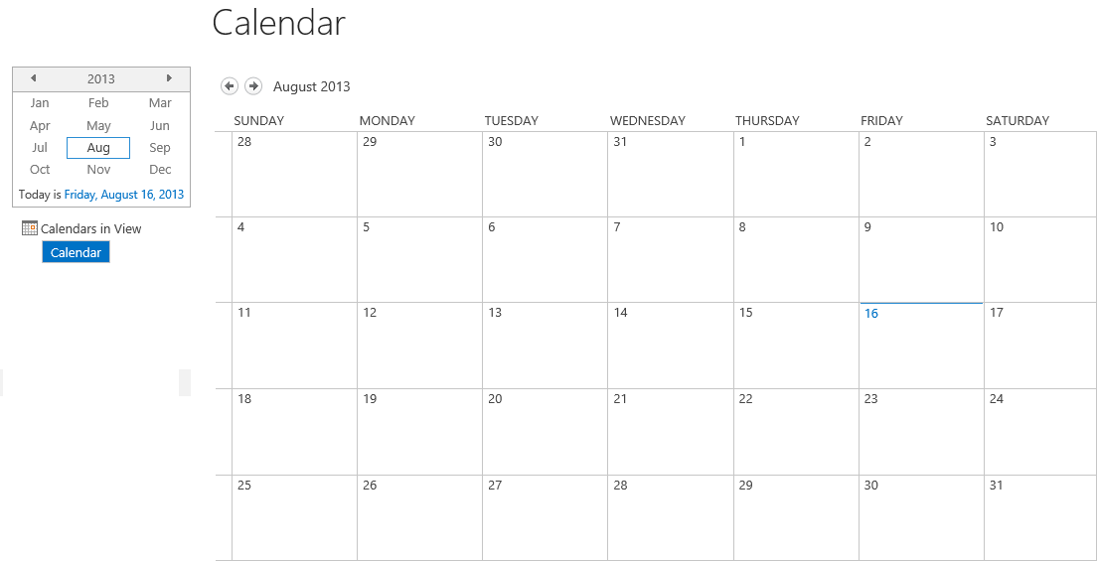
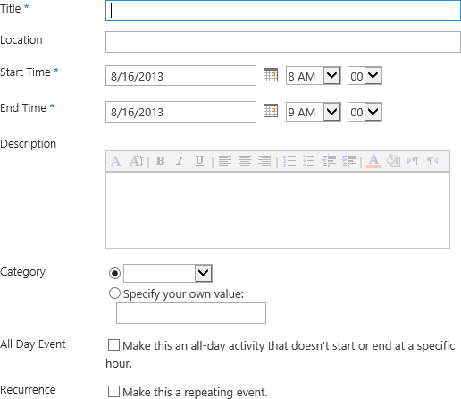
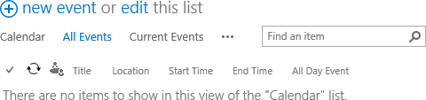
Calendar List
Calendar of upcoming meetings, deadlines or other events
Calendar information can synchronize with Outlook or other compatible programs
Notes:
SharePoint calendars can be used to track and store events such as meetings, social events, and team milestones. The calendars are stored in SharePoint but can be connected to Outlook 2013 or a program compatible with SharePoint Online. The Connect to Outlook button is located in the Connect & Export group of the Calendar tab.
Calendar Overlays
SharePoint Online also provides a feature called Calendar Overlays. Calendar overlays provides the ability to overlay a SharePoint calendar on another SharePoint calendar or overlay an Exchange calendar on a SharePoint calendar. Calendar Overlays can be accessed for a calendar by clicking on the Calendar Overlays ribbon button located in the Manage Views group of the Calendar tab.
Group Calendar
A group calendar allows you to see multiple calendars at the same time. The Group Calendar Options settings can be enabled on a calendar by going to List Settings | Title, description and navigation and check the Use this calendar to share member's schedule? option. Unfortunately if you are on O365 this feature has been deprecated however it is still available with on-premise SharePoint environments.

Slide 8
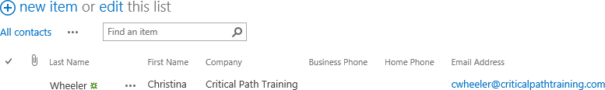
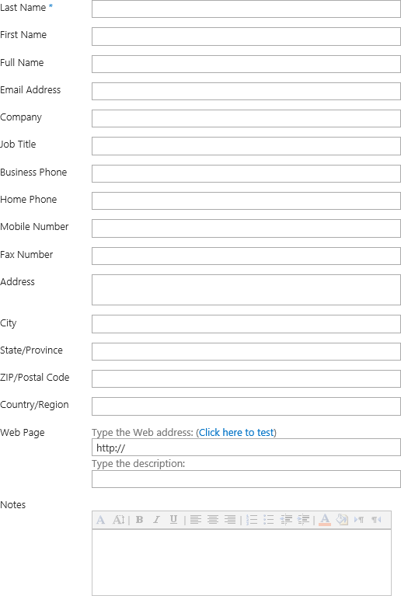
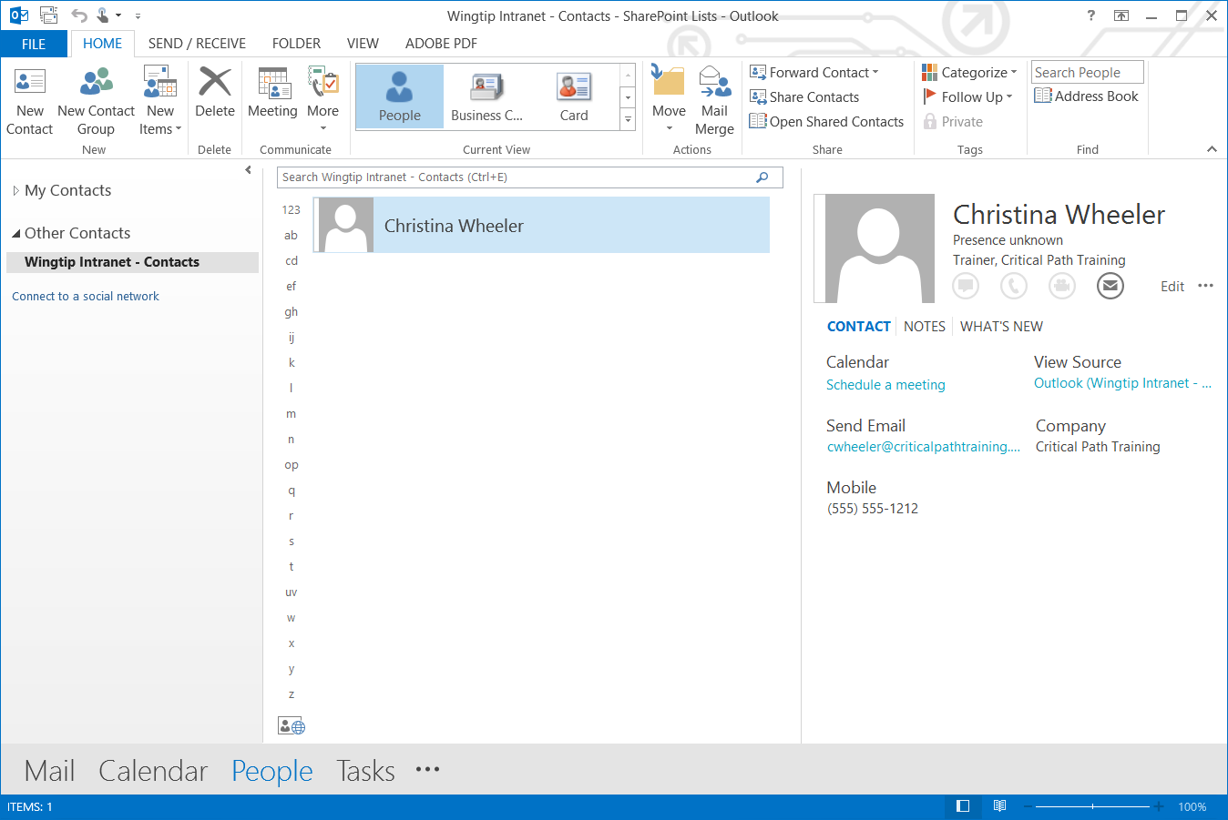
Contacts List
List of people (customers or partners)
Synchronize with Outlook or other compatible programs
Notes:
A contacts list can be used to store information about people, colleagues, vendors, or partners. A contacts list does not actually manage the members of your site, but it can be used to store and share contacts for your organization, such as a list of external vendors. If you are using an e-mail or contact management program (such as Outlook 2013), you can view and update your contacts from your SharePoint site in the other compatible program. For example, you can update a list of all your organization's suppliers from Outlook instead of SharePoint and the changes are saved to the SharePoint contacts list.

Slide 9
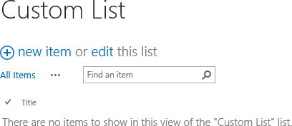
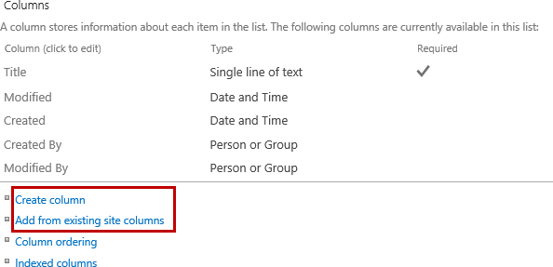
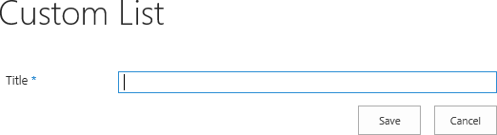
Custom List
Create your own list from scratch, add any other columns you need, and add items individually, or bulk edit data with Quick Edit.
Notes:
Custom lists are the most commonly used list because it’s the most basic starting template you can use to build on to a create a list with the exact columns you need. Unlike the other list templates, a custom list contains a pre-defined Title column and the essential Modified, Modified By, Created, and Created By columns. The Title column is a required field so most people will either leave the Title column as is or change the display name to something else and then add additional columns to the list.

Slide 10
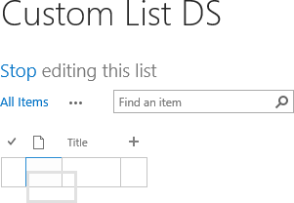
Custom List in Datasheet View
A blank list (same as custom list) displayed as a spreadsheet in order to allow easy data entry.
You can add your own columns and views.
This list type requires a compatible list datasheet ActiveX control, such as the one provided in Microsoft Office.
Notes:
A Custom list in Datasheet View is used to create a blank list similar to a custom list but to display the list by default in datasheet view. Datasheet view provides a data grid for viewing and editing data as rows and columns similar to using Excel or Access. You can add and edit rows and columns, apply filters and sort orders, display calculated values and totals, and conveniently edit data in the grid cells. Datasheet view requires Office 2013 installed on a client computer and a browser that supports ActiveX controls.

Slide 11
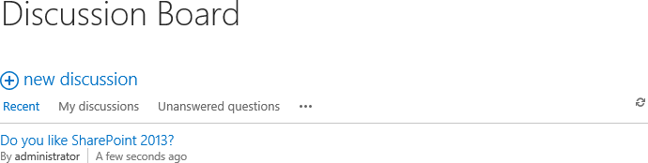
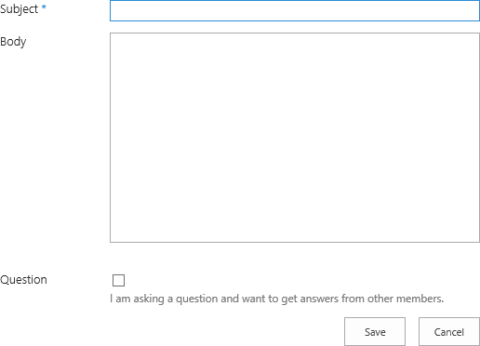
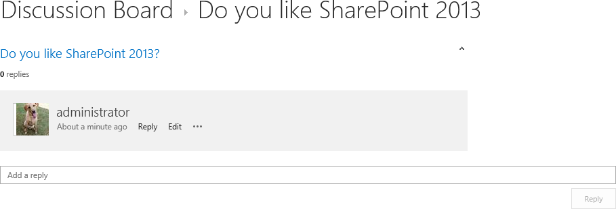
Discussion Board
Newsgroup-style discussions
Easily manage discussion threads
Can be configured to require approval for posts
Notes:
The discussion board template is good to provide a central place to record and store team discussions that is similar to the format of newsgroups. You can easily manage the discussion threads and the list can be configured to require approval for all posts. If your administrator has enabled lists on your site to receive e-mail messages, discussion boards can store e-mail discussions from most common e-mail programs. For example, you can create a discussion board for your organization's new product release. If you are using an e-mail program such as Outlook 2013, you can view and update your discussion board directly from Outlook.

Slide 12
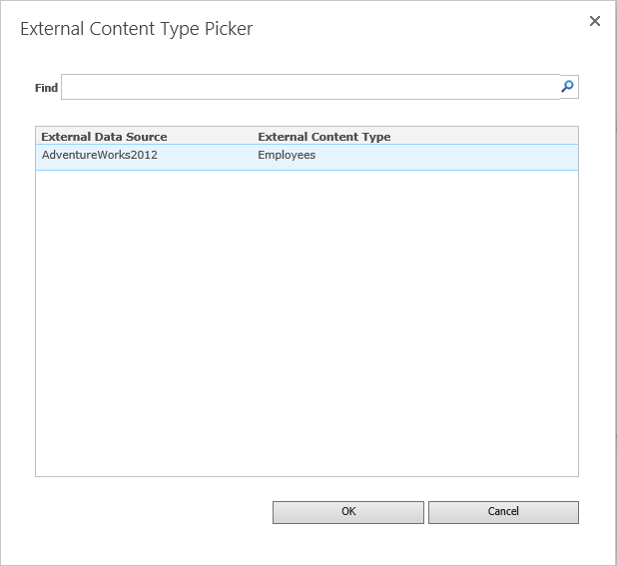
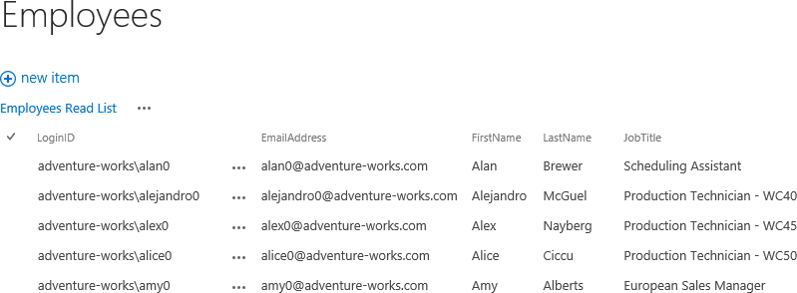
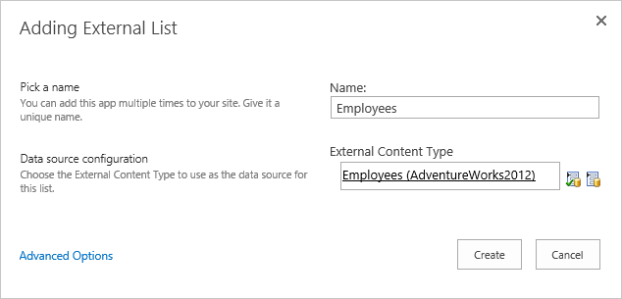
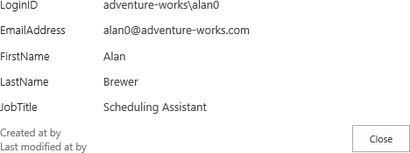
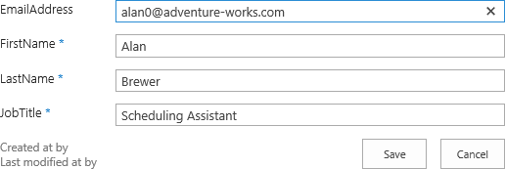
External List
Create an external list to view the data in an External Content Type.
Notes:
An external list is good to use to work with data that is stored outside SharePoint Online such as data stored in SQL Server. An External List provides the ability to read and edit data from within SharePoint similar to native lists. The data source for an external list is called an External content type. Unlike a native SharePoint list, an external list uses Business Connectivity Services to access data directly from an external system (such as Microsoft SQL Server, SAP, Siebel). The external content type can be connected to a database, Web service, or line-of-business system.

Slide 13
Native versus External Lists
SharePoint lists are either native or external
Native lists
Has all its features and data built into SharePoint
External Lists
Also has features built into SharePoint however the data is stored in a data source outside of SharePoint
SQL Database is a common data source used for an external list
From SharePoint Designer, you can create the External List and Data Source
Notes:
There are many differences between a native and external list. A native list has all its features and data built into SharePoint. There are a variety of default lists, such as Announcements, Calendars, and Tasks, custom lists you can start from scratch, and the widest variety of features available. An external list also has its features built into SharePoint but the data is stored in a data source outside of SharePoint such as a SQL database. Someone, such as a business analyst, must first create the external list using an External Content Type. Once created, an external list has many of the same features as a native list, but there are some differences that you should know about.
Such as external lists do not support some basic operations such as configuring per-location views, setting item-level permissions, using Quick Edit to modify items. The column operations are also different with an external list. Adding columns, validation, unique columns, and enforcing list relationships all have to be defined in the external data source and external content type. Also, managed metadata columns are not supported with external lists. External lists cannot be saved as a template and versioning is also not supported.

Slide 14
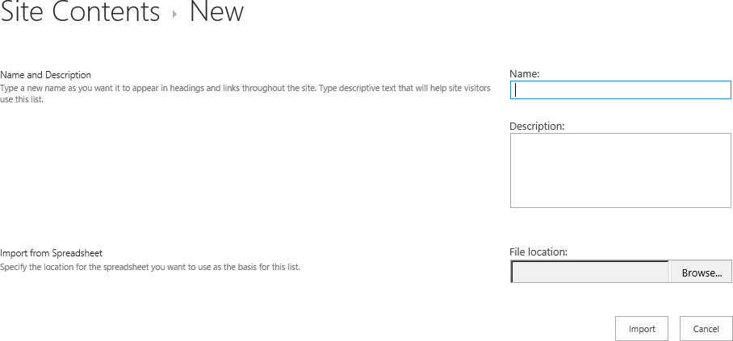
Import Spreadsheet
Create a list which duplicates the columns and data of an existing spreadsheet.
Importing a spreadsheet requires Microsoft Excel or another compatible program
Notes:
SharePoint provides the ability to create a list by importing a spreadsheet file, if your data is already in a spreadsheet format. When you create a list from a spreadsheet, the headings become columns in the list, and the rest of the data is imported as list items. After you import data into a list, you can customize its settings and continue to add data to it, as you would any list on a SharePoint site. As part of the import process, SharePoint will try and format the list to closely resemble the source Excel sheet. It is important to keep in mind that any customizations in Excel, such as calculations, formatting, or macros, will not carry over into the new SharePoint list.
To create a list based on a spreadsheet, you must use a spreadsheet program that is compatible with SharePoint Online, Microsoft Internet Explorer, and Microsoft Windows. For example, you can import a list from Microsoft Office Excel 2013 that you created to store and manage contracts with vendors. Typically, the columns are set up on the SharePoint site based on the type of data they contain. After you import a list, you should inspect the columns and data to make sure everything was imported as expected. For example, you may want to specify a column contains currency rather than a number. To view or change the list settings, open the list and then click List Settings from the LIBRARY tab.

Slide 15
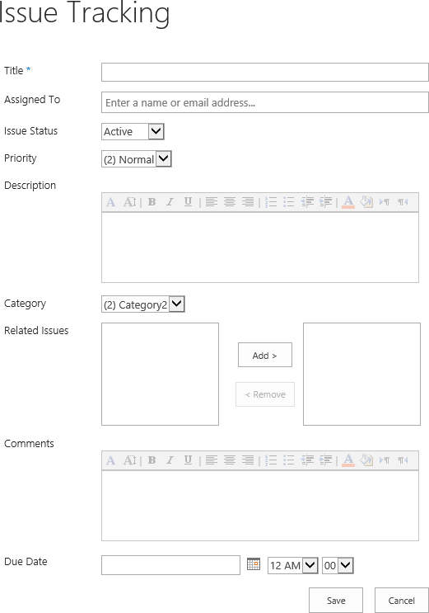
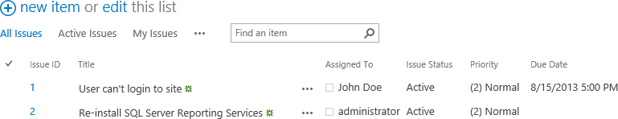
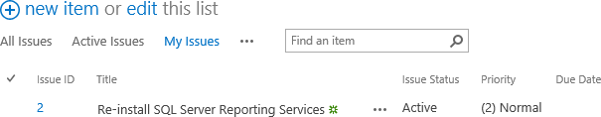
Issue Tracking
List of issues or problems associated with a project or item
Assign, prioritize and track issue status
Notes:
An issue-tracking list can be used to store information about specific issues, such as support issues to track the progress. You can assign issues, categorize them, and relate issues to each other. For example, you can create an issue-tracking list to manage customer service problems and solutions. You can also comment on issues each time you edit them, creating a history of comments without altering the original description of the issue. For example, a customer service representative can record each step taken to resolve a problem and the results. You can also use an Issue Tracking list with a Three-state workflow to help your organization manage issue or project tracking.

Slide 16
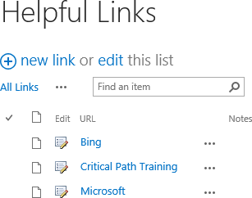
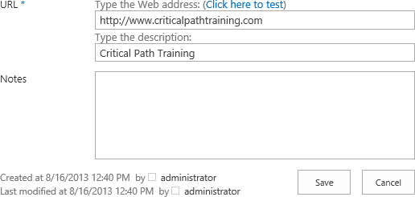
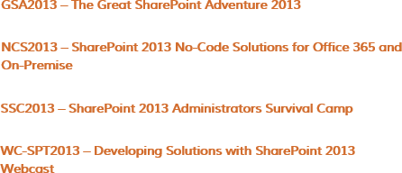
Links
A list of web pages or other resources
Notes:
A links list can be used as a central location for links to the Internet, your company's intranet, or other resources. For example, you might create a list of links to your customers' Web sites or a list of links to your organization’s other web-based applications or Web sites. The pre-defined fields for a links list are URL and Notes however it is common to add a Sort column to allow for customize sorting instead of just sorting by Title or Created.

Slide 17
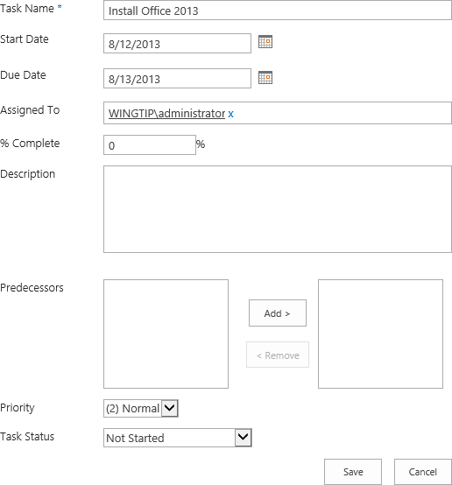
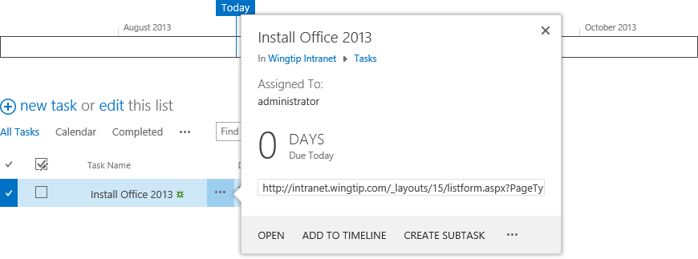
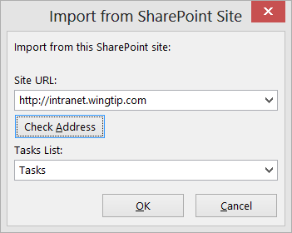
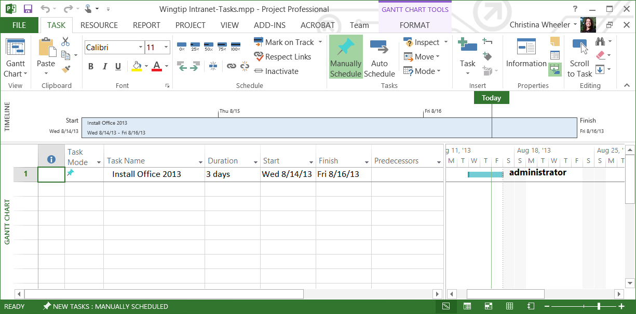
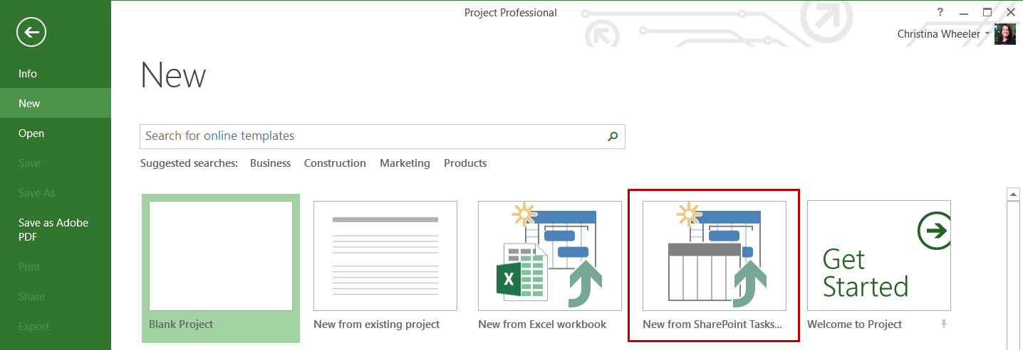
Tasks
A place for team or personal tasks
Sync with Outlook or Project 2013
Notes:
A task list is used to store task information with a Gantt view and progress bars. You can track the status and percentage complete as the task moves toward completion. If you are using an e-mail or task management program that is compatible with SharePoint Online, you can view and update your project tasks from your SharePoint site in your other program. For example, you can create a project task list on your SharePoint site to identify and assign the work to create a training manual, and then you can track your organization's progress from Project 2013.
You can connect tasks lists with Project 2013 using the browser or from within Project. In the browser, on the List tab, click Open With Project in the Connect & Export group. Task items stored in the task list will be directly imported into the project plan. This feature saves the Project author tedious data entry work because values, such as start dates, task progress, and due dates, are carried over into the plan.

Slide 18
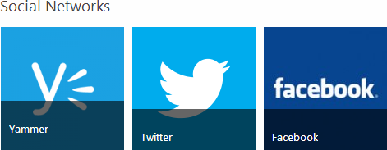
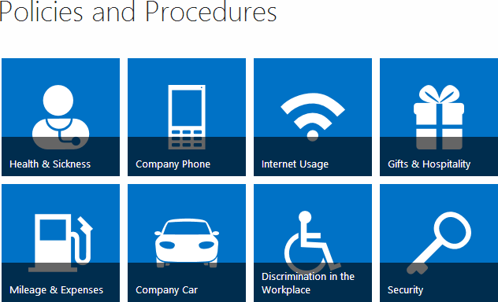
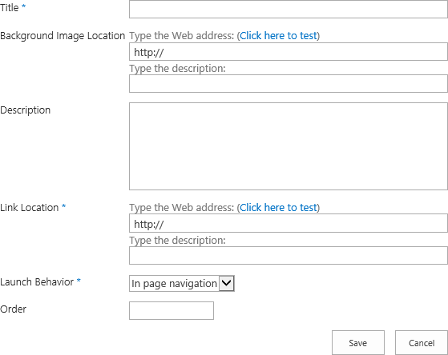
Promoted Links
Use to display a set of link actions in a tile based visual layout
Notes:
One of the cool, new list templates in SharePoint Online is called Promoted Links. Promoted Links provides the ability display a set of link actions in a tile based visual layout. The links animate when the user hovers over the tile with their mouse. When creating a new promoted link you provide the following required and optional fields:
Title – The title to display for the tile such as Twitter or Facebook.
Background Image Location – The location of image you want to use for the background of the tile.
Description – Optional field which provides additional information on the tile.
Link Location – The location of the URL the tile should be linked to.
Launch Behavior – Two options are In Page navigation, Dialog, or New tab.
Order – The display order of where you want the promoted link tile to show up in the list of tiles.

Slide 19
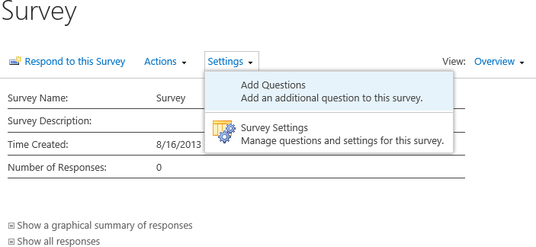
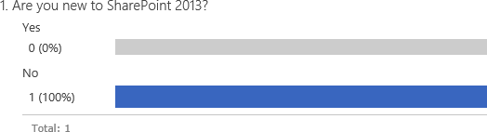
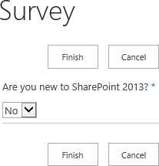
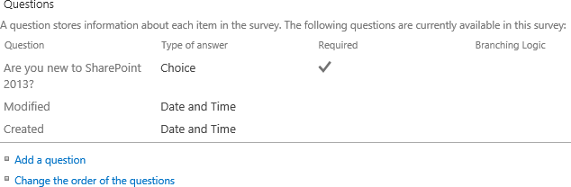
Survey
Surveys allow you to quickly create questions in a list
View graphical summaries of the responses
Notes:
A survey is a special kind of list that enables the owner to create questions, multiple people to respond to the questions, and the results to be summarized. You can use surveys to ask people what they think about issues, how to improve your processes, and many other topics. You can collect the results by using several different types of questions, such as multiple choice, fill-in fields, and even ratings.
Add branching logic to a survey
You can add branching logic to a survey so the survey changes according to the responses to specific questions. In a survey that branches, questions appear only if they apply to someone's situation. If the questions don't apply, the person can answer a different set of questions or skip that set of questions. When you add branching logic to a survey, you can ensure that only the relevant questions are displayed to the appropriate respondents.
By default, every question in a survey appears in numerical order, but you can enable questions to be skipped if they don't apply, or make multiple sets of questions appear, based on the response to a branching question.
For example, you may want to direct questions about home renovations and repairs only to people who already own homes. You can ask people if they own a home, and if the answer is Yes, the questions about painting, flooring, and so on appear. If the answer is No, the survey can skip to the next set of questions.

Slide 20
Lists and Library Templates

Slide 21
Agenda
Intro to SharePoint Lists
List Templates
Creating SharePoint Lists
Customizing List Settings
Adding Columns and Validation Rules

Slide 22
Creating SharePoint Lists
You can create lists easily by navigating to:
Site Contents > Add an app
Create a list from a list template
Use one of the pre-defined list templates
Each templates provides a pre-defined set of fields that can be modified after creation
Create a custom list
Use this template to create a blank list
Modify by adding custom columns and validation rules
Notes:
When creating SharePoint Lists you can use the default SharePoint list templates or you can start with a Custom List. Which list template you choose depends on the requirements of your list. One thing to note is you can always use a list template with pre-defined columns and then remove any pre-defined columns you do not want.
When adding columns it is recommended to create site columns and add them to the list instead of adding the columns at the list level (if the columns are not unique to the list). Adding columns at the site level provides reusable columns that make it easier to maintain.
When creating lists it is recommended to create the List Name with no spaces nor special characters and then change the display name after the list is created. For example, if on creation of a list you name the list “Helpful Links” the space would be replaced with a %20. The URL would be http://intranet.wingtip.com/Lists/Helpful%20Links. However, if on creation of a list you set the name to “HelpfulLinks” then the URL would be a clean URL with no spaces: http://intranet.wingtip.com/Lists/HelpfulLinks. After creating the list you can then go and change the Display Name and the URL would remain the same. The same also applies to creating list columns.

Slide 23
Creating Custom Lists

Slide 24
Agenda
Intro to SharePoint Lists
List Templates
Creating SharePoint Lists
Customizing List Settings
Adding Columns and Validation Rules

Slide 25
Customizing List Settings
Update various list settings such as:
List Name, Description, Navigation
Versioning Settings (enable/disable version history)
Advanced Settings (enable/disable management of content types, attachments)
Audience Targeting Settings and Ratings
Permissions
Workflows
Add/remove Columns
Create/modify Views
Save as Template
Notes:
Lists can be customized in various ways. The name of the list, description and navigation setting can be updated. If you want the list to have a version history you can set the versioning settings for a list. The advanced settings include the ability to allow management of content types, disable/enable attachments, set the read, create, and edit access, as well as disabling the list to show up in the search results. If you want your content to be targeted based on an audience you can enable/disable audience targeting. You can also set the permissions on a list as well as define workflows.
It is common to add/remove columns and create/modify views of a list. For example, you may want to have different views on a list for different groups. Instead of creating custom lists for each group, you can create different views and then link the different groups to the specified view.
Another great feature with customizing lists is the ability to save a list as a template. When you create a list you select a template to use for the creation of the list. Then you customize the list and may want to save the customized list as a new list template so it can be available to use a base template.

Slide 26
Customizing List Settings

Slide 27
Agenda
Intro to SharePoint Lists
List Templates
Creating SharePoint Lists
Customizing List Settings
Adding Columns and Validation Rules

Slide 28
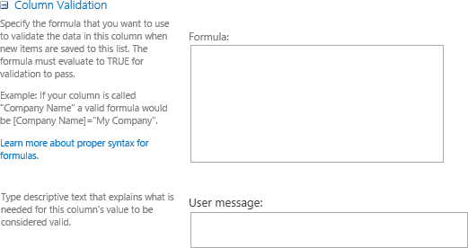
Column Level Validation Rules
Columns can contain validation rules
Use to define additional constraints/limits for your data
Create formulas for validation
Notes:
Another great feature that was introduced in SharePoint 2010 is validation settings for columns. Validation is a formula or statement that must evaluate to TRUE before the data can be saved. The two types of validation that can be set on a list are list validation or column validation. Lists validation compares two or more columns to evaluate to TRUE where as column validation compares only the data in the single column. A very common column validation used is evaluating a phone number column.
The Column Validation settings on list has two sections: Formula and User message. The Formula section is the test your comparison of the columns must pass for the item to be valid. The User Message section is what the user receives if the test fails.

Slide 29
Column Validation

Slide 30
Summary
Intro to SharePoint Lists
List Templates
Creating SharePoint Lists
Customizing List Settings
Adding Columns and Validation Rules

