Slide 1
User Management and Permissions
Notes:
A complete understanding of user management and permission configuration is essential for a site administrator securing content in SharePoint Online. This module teaches students about the authorization and security features available in SharePoint Online which are used to configure secure access to sites, lists and document libraries. You will learn how to create SharePoint security groups and how to manage site membership. You will also learn the proper way to configure permissions in a hierarchy of securable objects which includes sites, lists, document libraries, items and documents. After completing this module, a student will understand how to manage users and configure the permissions required for secured access in a SharePoint Online site collection.

Slide 2
Agenda
Site Security Overview
Permission Levels
SharePoint Groups
Configuring Fine-grained Permissions
Security Best Practices

Slide 3
SharePoint Security Overview
External Users
Users defined outside your organization
SharePoint Groups
Group defined within scope of a site collection
Permission Levels
A named set of permissions (e.g. Contribute, Edit)
Permission Assignments
Top site set permissions set default for site collection
Permissions can be configured at more granular level

Slide 4
O365 External User Types
O365 provides:
Tenancy-scoped user and identity management
Two different O365 external user types:
Authenticated User
Signing in is required before they can view content (Microsoft account or Office 365 user account)
Anonymous Guest
Can access content from a shared link without signing in

Slide 5

Authenticated Users
What you can share:
A complete site
Lists and Libraries
Documents
Who can share:
Site owners and others with full control permissions can share site
All members as contributors can share lists, libraries and documents
What kind of sharing is allowed:
Exactly the same you have with your internal users

Slide 6

Anonymous Guests
What you can share:
Only Documents
Who can share:
All site users can share a document and generate a view or edit link for external sharing
What kind of sharing is allowed:
View only link
Edit link

Slide 7
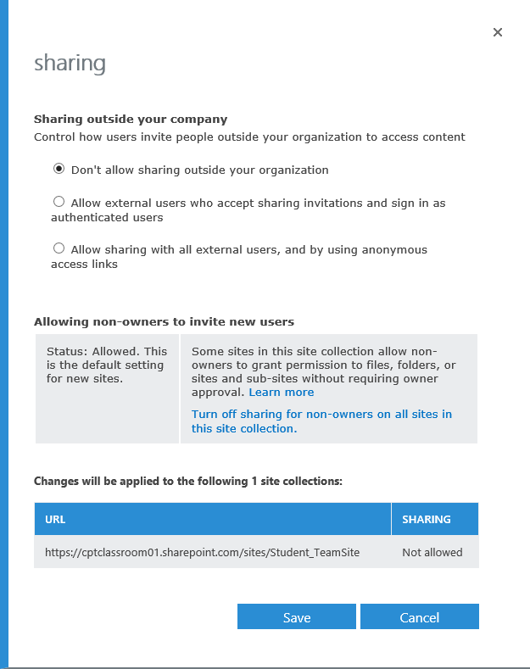
External Sharing
External Users
Disabled by default
Can be enabled on each site collection
Setting available to O365 admin at the tenant level
Notes:
External Sharing can be enabled by the O365 tenant admin.
The 3 sharing options are:
Don't allow sharing outside your organization
Allow external users who accept sharing invitations and sign in as authenticated users (All external users must sign in to access your site collection. So you'll be able to track their activities. They will be considerate as users.)
Allow both external users who accept sharing invitations and anonymous guest links (With the link generated, user can access to the content without signing in. It's easier to share content and to access to it, but much riskier for your organization for lack of tracking possibilities.)

Slide 8
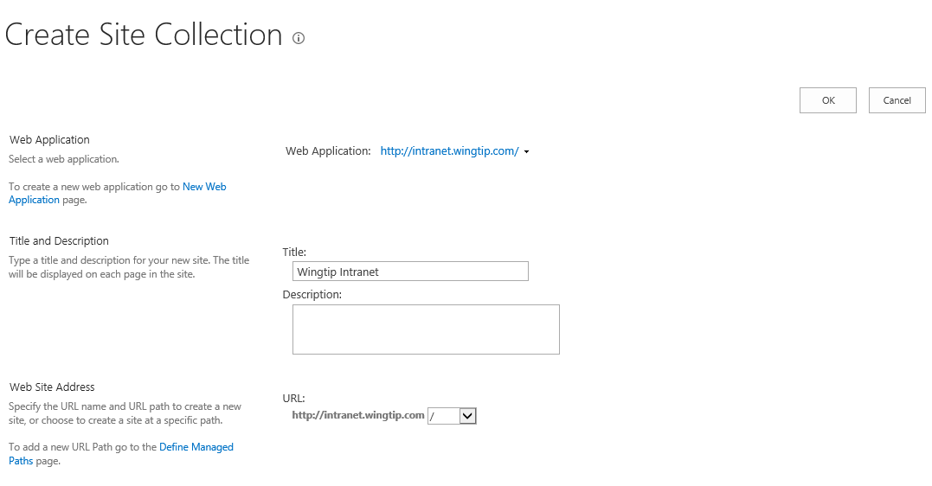
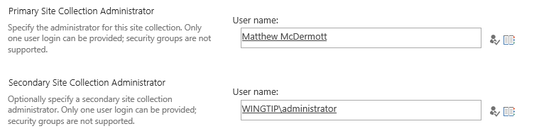
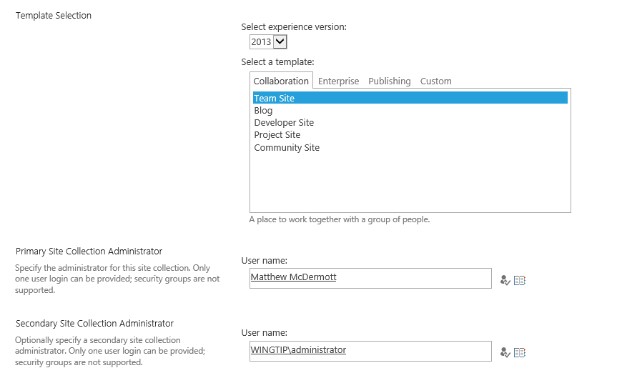
Site Collection Administrator
Granted full administrative permissions
Acts as super user within site collection

Slide 9
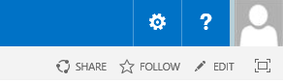
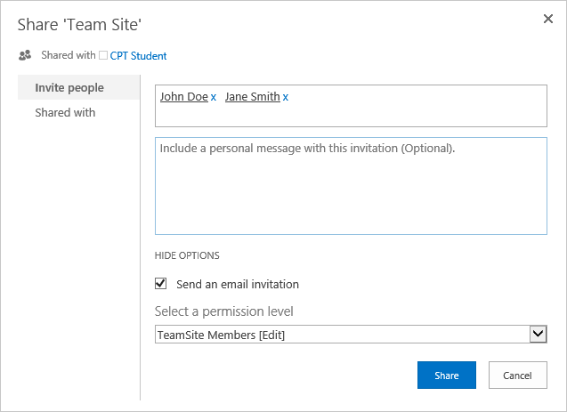

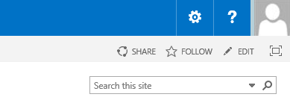

Sharing a Site
1
Click the Share link
2
Type users you want to add in text box
3
Configure user access to site
using Permission Level or Group
4
Confirm the site is shared
Notes:
You can invite new users using the share button located in the top right corner of the site.
You just have to write the email address directly inside the pop-up window. Click on the “suggested” email address (which is clearly the same you just typed) so it would appear underlined.

Slide 10
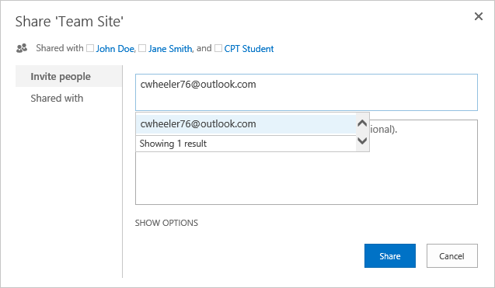
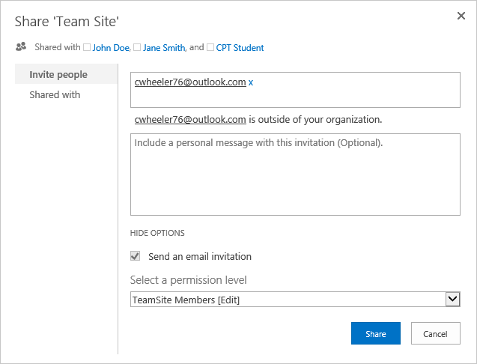
Sharing Site with External Users
2
Type email address in text box then click on the suggested email address
3
Configure user access to site
using Permission Level or Group
Notes:
When you click on "Show options", you’ll get the option to change the group you want to add the external user to. By default, the external users are attributed to group members and have [Edit] rights. This is where you have to be careful, be sure of the group permissions before adding an external user to a group.

Slide 11
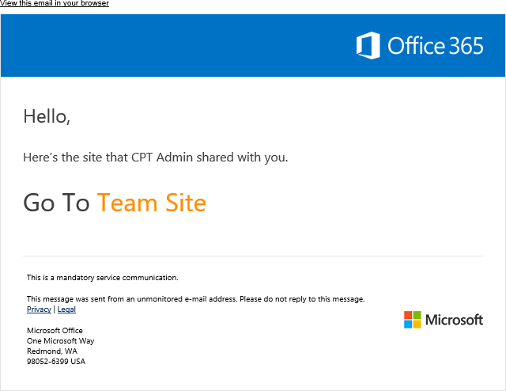
Sharing Site with External Users
Once you share with an external user:
Email invitation is sent to user
Invitation is valid for 7 days only
If invitation expires, you’ll have to send another invite

Slide 12
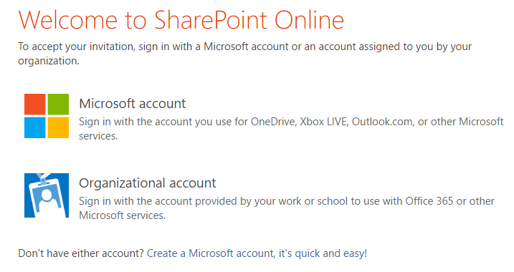
Sharing Site with External Users
If external user does not have a Microsoft account they can create one

Slide 13
Sharing a Site with Other Users

Slide 14
Agenda
Site Security Overview
Permission Levels
SharePoint Groups
Configuring Fine-grained Permissions
Security Best Practices

Slide 15
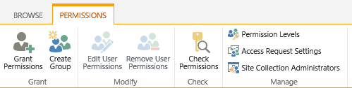
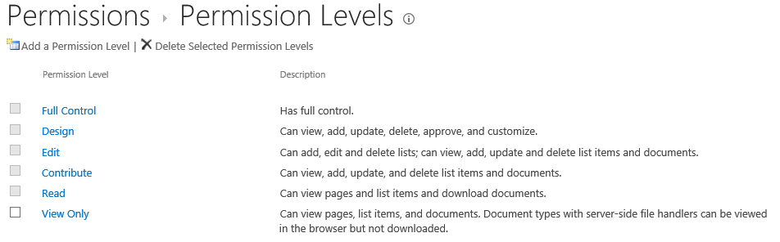
Understanding Permission Levels
Permission level is a named set of permissions
Makes it easier to configure permissions
Named using a verb which implies role (e.g. Contribute)
Several permission levels included automatically
You can create custom permission levels when needed
Permission levels included out-of-the-box with a new Team site

Slide 16
Permission Levels
Standard Permission Levels (created automatically)
View-only (used for Excel Services)
Read
Edit
Contribute
Design
Full Control
Special Permission Level
Limited Access (discuss later)

Slide 17
Permission Levels
SharePoint supports three types of permissions
Site Permissions
Open
View Pages
Browse User Information
Use Remote Interfaces
Use Client Integration Features
Use Self-Service Site Creation
Browse Directories
Edit Personal User Information
Add and Customize Pages
Apply Themes and Borders
Apply Style Sheets
Create Subsites
Create Groups
Enumerate Permissions
Manage Permissions
View Web Analytics Data
Manage Alerts
Manage Web Site
List Permissions
View Items
View Versions
Create Alerts
View Application Pages
Open Items
Add Items
Edit Items
Delete Items
Delete Versions
Approve Items
Manage Lists
Override List Behaviors
Personal Permissions
Manage Personal Views
Add/Remove Personal Web Parts
Update Personal Web Parts

Slide 18
Site Permissions (default settings)
Site Permissions | View-only | Read | Contribute | Edit | Design | Full Control
Open | x | x | x | x | x | x
View Pages | x | x | x | x | x | x
Browse User Information | x | x | x | x | x | x
Use Remote Interfaces | x | x | x | x | x | x
Use Client Integration Features | x | x | x | x | x | x
Use Self-Service Site Creation | x | x | x | x | x | x
Browse Directories |  |  | x | x | x | x
Edit Personal User Information |  |  | x | x | x | x
Add and Customize Pages |  |  |  |  | x | x
Apply Themes and Borders |  |  |  |  | x | x
Apply Style Sheets |  |  |  |  | x | x
Create Subsites |  |  |  |  |  | x
Create Groups |  |  |  |  |  | x
Enumerate Permissions |  |  |  |  |  | x
Manage Permissions |  |  |  |  |  | x
View Web Analytics Data |  |  |  |  |  | x
Manage Alerts |  |  |  |  |  | x
Manage Web Site |  |  |  |  |  | x

Slide 19
List Permissions and Personal Permissions
List Permissions | View-only | Read | Contribute | Edit | Design | Full Control
View Items | x | x | x | x | x | x
View Versions | x | x | x | x | x | x
Create Alerts | x | x | x | x | x | x
View Application Pages | x | x | x | x | x | x
Open Items |  | x | x | x | x | x
Add Items |  |  | x | x | x | x
Edit Items |  |  | x | x | x | x
Delete Items |  |  | x | x | x | x
Delete Versions |  |  | x | x | x | x
Approve Items |  |  |  | x | x | x
Manage Lists |  |  |  | x | x | x
Override List Behaviors |  |  |  |  | x | x
Personal Permissions | View-only | Read | Contribute | Edit | Design | Full Control
Manage Personal Views |  |  | x | x | x | x
Add/Remove Personal Web Parts |  |  | x | x | x | x
Update Personal Web Parts |  |  | x | x | x | x

Slide 20
The "Limited Access" Permission Level
Limited Access used with fine-grained permissions
Enables user to browse site page to access item
Required when user is granted access to an item but has no permissions to parent list
Limited Access permission level includes minimum set of permissions required for user to access item
You do not assign Limited Access permissions directly
SharePoint automatically assigns permission
Occurs when granular permissions assigned at item level or document level

Slide 21
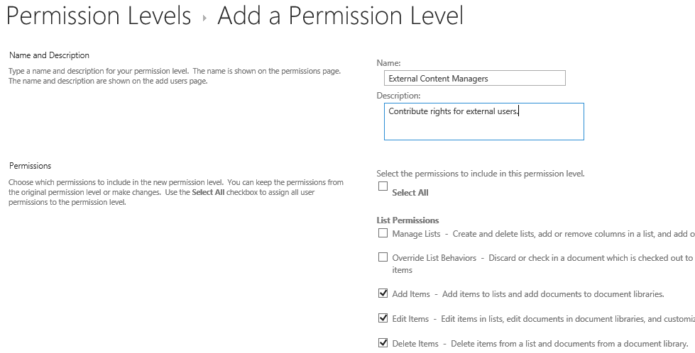
Creating Custom Permission Level
Create custom permission level when needed
Name permission level using verb (e.g. Manage)
Select the appropriate set of permissions

Slide 22
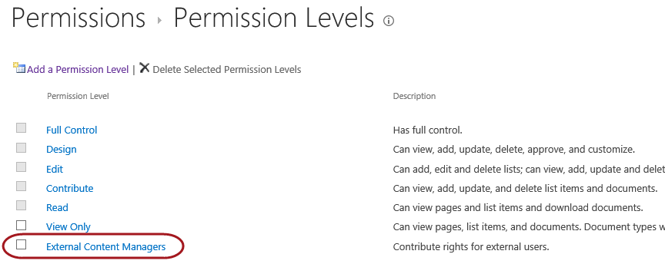
Custom Permission Level
Once the permission level has been created…
Use it to assign permissions

Slide 23
Creating a Custom Permission Level

Slide 24
Agenda
Site Security Overview
Permission Levels
SharePoint Groups
Configuring Fine-grained Permissions
Security Best Practices

Slide 25
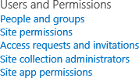
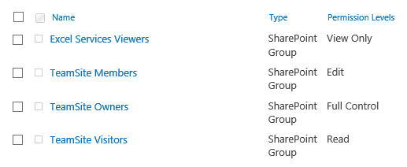
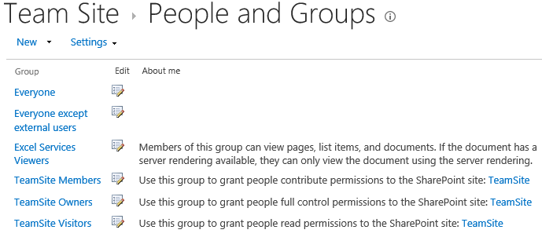
SharePoint Groups
What is a SharePoint Group?
Collection of users who have same set of permissions/permission level
Simplifies task of assigning and managing site access
Use groups to assign same permission level to many people at once
Site Permissions
People and Groups

Slide 26
Benefits of Using SharePoint Groups
Assigning permission levels to SharePoint groups instead of individuals helps to:
Streamline site maintenance for site owners
Ensure people performing similar tasks have same level of access
Ensure people have only the necessary access they need to the site and site content

Slide 27
Default SharePoint Groups
Most frequently used SharePoint groups
Default groups SharePoint creates automatically when a site is created
For example:
A Team Site template automatically includes these pre-defined groups:
Visitors, assigned Read permission level
Members, assigned Edit permission level
Owners, assigned Full Control permission level

Slide 28
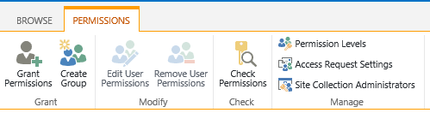
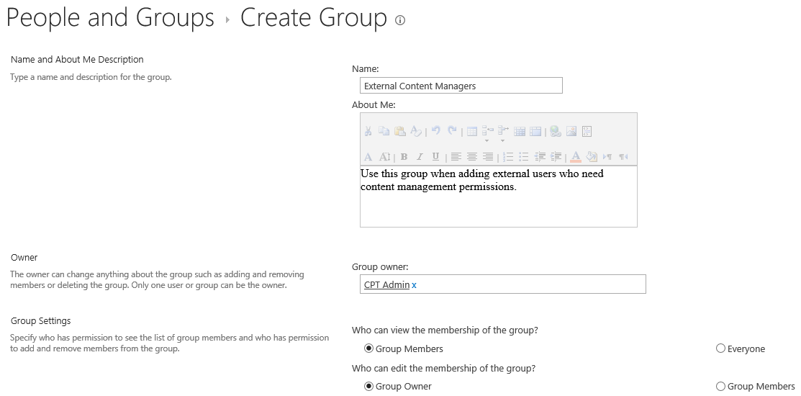
Creating a SharePoint Group (Part 1)

Slide 29
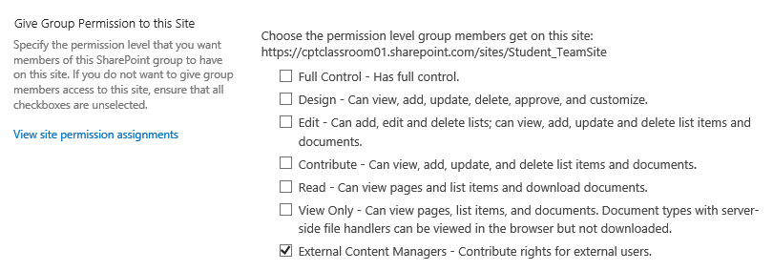
Creating a SharePoint Group (Part 2)

Slide 30
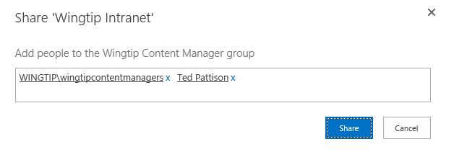
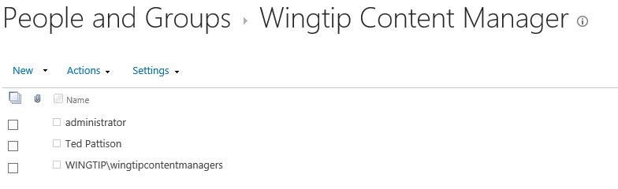
Adding Members to Custom Group
Once you have created a custom group…
Configure permissions on site and other objects
Add external users and external groups

Slide 31
Managing Permissions using SharePoint Groups

Slide 32
Agenda
Site Security Overview
Permission Levels
SharePoint Groups
Configuring Fine-grained Permissions
Security Best Practices

Slide 33
Securable Objects
Securable object:
"What" is having its accessed controlled
Site collection contains securable objects:
Sites (Top-level site & subsites)
Lists or Document Library
Folder, Document, Item

Slide 34
Securable Objects Permissions List
Securable objects support adding a permissions list:
Top-level site always has own permission list
Top-level site permissions list scoped at site collection level
Other securable objects can have unique permissions list
Securable objects without unique permissions inherits permissions

Slide 35
Top-level Site Permissions
Top-level site permissions are required
Unique permissions for Child objects is optional
Child objects without unique permissions inherit from parent
Site
Top-level Site
Perm
List
List
Document Library
Child Site (Subsite)
Item 1
Folder
Item 2
Doc02.pptx
List
Item 1
Item 2

Slide 36
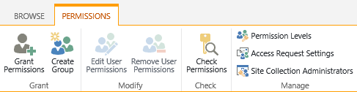
Creating Unique Permissions
When you create unique permissions…
It affects the object and all its children
Site
Top-level Site
Perm
List
List
Document Library
Perm
List
Child Site
(Subsite)
Perm
List
Item 1
Folder
Item 2
Doc02.pptx
List
Item 1
Item 2

Slide 37
Permission Inheritance
By default:
Sites/lists/libraries inherit permissions settings directly above site hierarchy
Site inherits permissions from root site of site collection
Subsite inherits permissions from parent site
List inherits permissions from site that contains the list
List item inherits permissions from list to which it belongs
If default configuration is NOT changed:
Permissions are inherited throughout the entire site collection

Slide 38
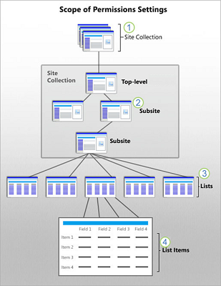
Permission Inheritance

Slide 39
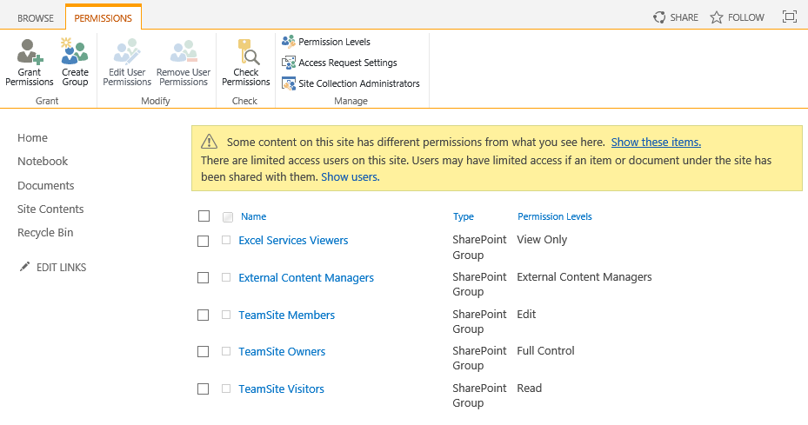
Detecting Unique Permissions

Slide 40
Breaking Inheritance
When you break inheritance for a list:
List still has same permission settings that it did before
To make the list permissions unique
You must assign new permissions explicitly
If you change permissions for parent site:
Those changes are not applied to the list with unique permissions
If you change permissions of the list:
All items in the list inherit the changes (unless an item has unique permissions)

Slide 41
Breaking Inheritance
After you stop inheriting permissions:
The status bar for list changes to “This list has unique permissions”
Ribbon buttons change to include “Delete unique permissions”, “Grant permissions”, “Edit User Permissions”, & “Remove User Permissions”
You can reverse this setting and resume inheriting permissions from parent at any time
IMPORTANT: If you choose to resume permissions inheritance, you lose any unique permission settings on the content

Slide 42
Configuring Fine-grained Permissions

Slide 43
Agenda
Site Security Overview
Permission Levels
SharePoint Groups
Configuring Fine-grained Permissions
Security Best Practices

Slide 44
Security Best Practices
Things you want to avoid…
Configuring unique permissions for too many objects
Configuring permissions in terms of external users and groups
Best Practices in Site Security Configuration
Create custom permission levels when necessary
Create a SharePoint Group for each level of access required
Configure permission as often as possible with SharePoint Groups
Break permission inheritance as infrequently as possible

Slide 45
Summary
Site Security Overview
Permission Levels
SharePoint Groups
Configuring Fine-grained Permissions
Security Best Practices

