Slide 1
Overview of Site Administration
Notes:
In this module, you will learn about the responsibilities and the required skills for a site administrator in the SharePoint Online environment. You will learn about the logical architecture of SharePoint Online sites and the anatomy of a SharePoint site collection. The module teaches students how to work with the Site Settings page to configure various site collection properties and site properties. Students will also gain an understanding of the features and site templates available in SharePoint Online as well as the basic differences between team sites and publishing sites.

Slide 2
Agenda
Overview of Administrators & Site Collections
Site Templates available in SharePoint Online
Configuring Site Properties
Standard Features and Enterprise Features
Understanding Team Site versus Publishing Site

Slide 3
Types of Site Collection Administrators
SharePoint Online has three administrative roles:
  Global Administrator
    Admin of O365 portal and SharePoint Online Administration Center
    Manages service licenses, users & groups, domains, and subscribed services
  SharePoint Online Administrator
    Administrator of SharePoint Online Administration Center
    Create/manage site collections, designate site collection admins, determine SharePoint Online tenant settings, configure BCS and Secure Store, InfoPath Forms Services, Records Management, Search, and User Profiles
  Site Collection Administrator
    Has administrator permissions to manage a site collection
    A site collection can have several administrators, but only one primary administrator
Notes:
When creating a site collection in SharePoint Online for all Office 365 plans other than Office 365 Small Business, a Global Administrator or SharePoint Online Administrator designates a primary site collection administrator. It’s a good safeguard to designate one or more site collection administrators as backups, just as it’s a good practice to have a secondary Global Administrator available inside Office 365. See these articles for more on administrators and permissions.

Slide 4
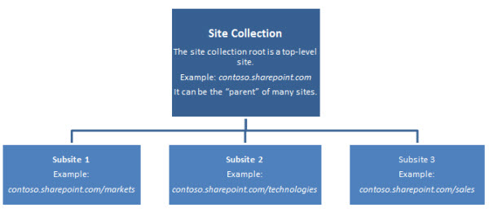
Overview of Site Collections
A SharePoint Online Site Collection is:
  Top-level (or root) site that contains subsites
Subsites
  Share administration settings, navigation, and permissions (if inherited)

Slide 5
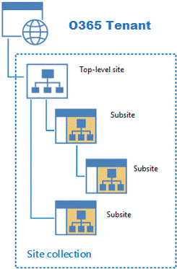
Anatomy of a SharePoint Site Collection
O365 Tenant (SharePoint Online)
  Can contain one or more site collections
  depending on license
Site Collection
  Hierarchical set of sites that can be
  managed together
  Structure made up of one top-level
  site and sites below
  Sites in site collection have common
  features such as: shared permissions,
  content types, common navigation
Notes:
The amount of site collections allowed in SharePoint Online depends on your organizations O365 licensing. A site collection is made up of one top-level site and all sites below. A site collection is a hierarchical set of sites that can be managed together that share common features such as shared permissions, template galleries, content types, Web Parts, and often a common navigation scheme.
Since site collections and sites exist in a parent-child relationship, there are aspects of control and functionality which can be configured at the site collection level and used at the site level.
Site collection’s galleries and libraries (such as the Master Page Gallery) provides means for creating a unified, branded user experience across all sites in a site collection.
Security policies and features can be managed for an entire site collection to help provide site administrators a unified mechanism and scope for administration.
Shared site columns, content types, Web Parts, and other authoring site collection features provide a consistent authoring environment for site content authors.
A site collection’s unified navigation, branding, and search tools provide a unified experience for site users.

Slide 6
Administration & Site Collections

Slide 7
Agenda
Overview of Administrators & Site Collections
Site Templates available in SharePoint Online
Configuring Site Properties
Standard Features and Enterprise Features
Understanding Team Site versus Publishing Site

Slide 8
Site Templates
Site Templates
  Pre-built definitions designed around a particular business need
  SharePoint Online comes with easy-to-use templates
  Every site’s structure and functionality based on a site template
  The kind of site you create depends on how you want to use it
IMPORTANT: The selection of site templates available by default depends on features set up by your administrator, whether you work with sites or site collections, and what O365 plan you have.

Slide 9
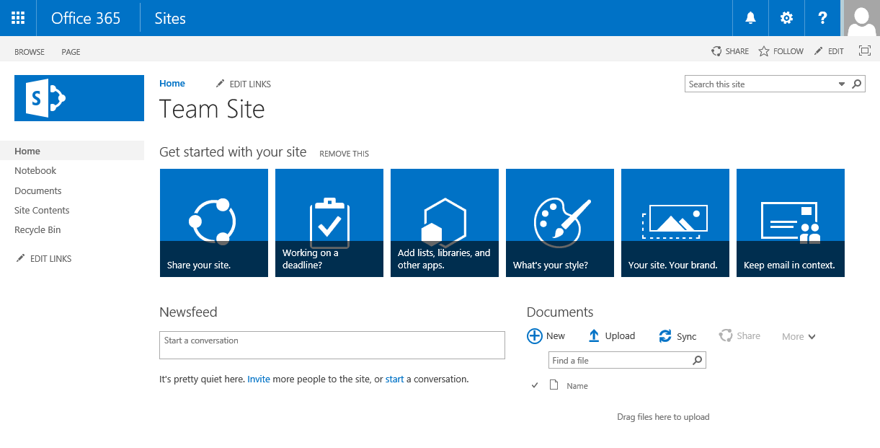
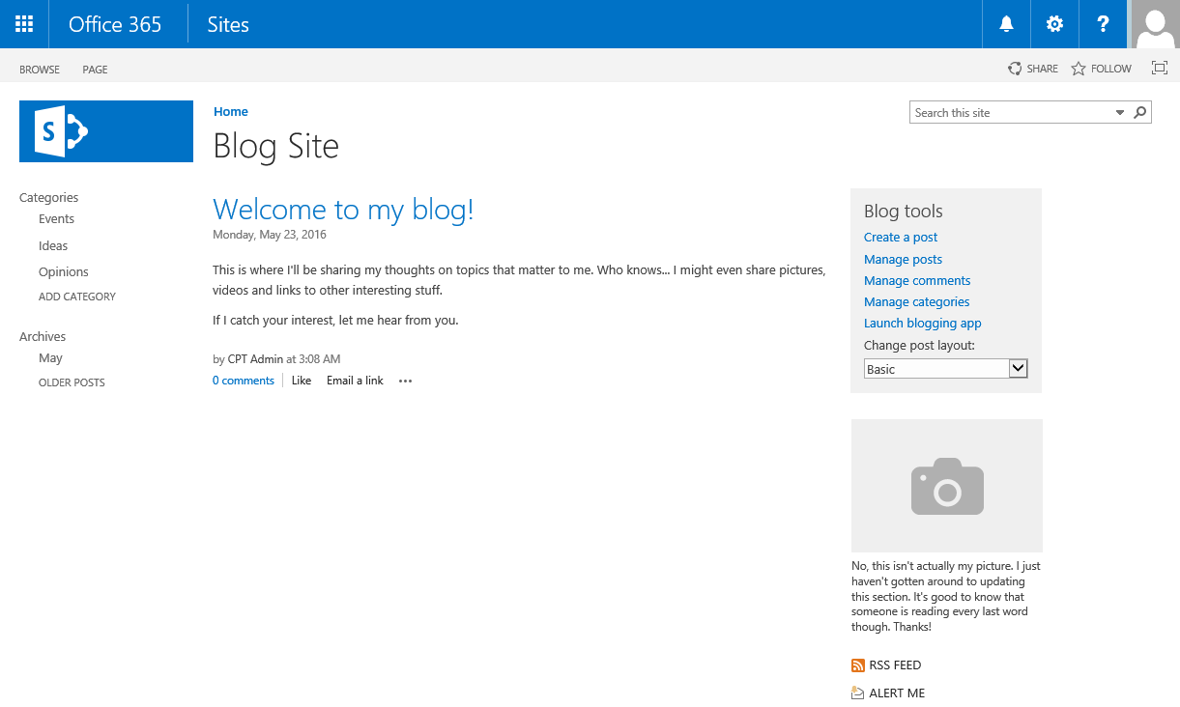
Collaboration Site Templates
Team Site
  Basic site used for
  working with teams
Blog Site
  Full feature blog site - includes libraries such as list for blog posts, library for photos, categories
Notes:
A site template in SharePoint is what you use to create new SharePoint sites. Each site is based off of a site template. SharePoint Online provides various out-of-the-box site templates that can be used for creating new sites.
Team Site
The Team Site template is the most common site template used to enable teams to collaborate, share documents, and stay in sync.
Blog Site
Use the Blog site to quickly announce company announcements, or post ideas, observations, and expertise within your team or organization. The site contains Posts, Comments, and Links. Blog tools help you approve or reject draft posts, and edit or delete old posts. You can even receive alerts when the blog is updated. To help users locate content that interests them, you can assign posts you create to one or more categories. Blog sites allow you to comment on posts, which is a great way to keep your readers engaged.

Slide 10
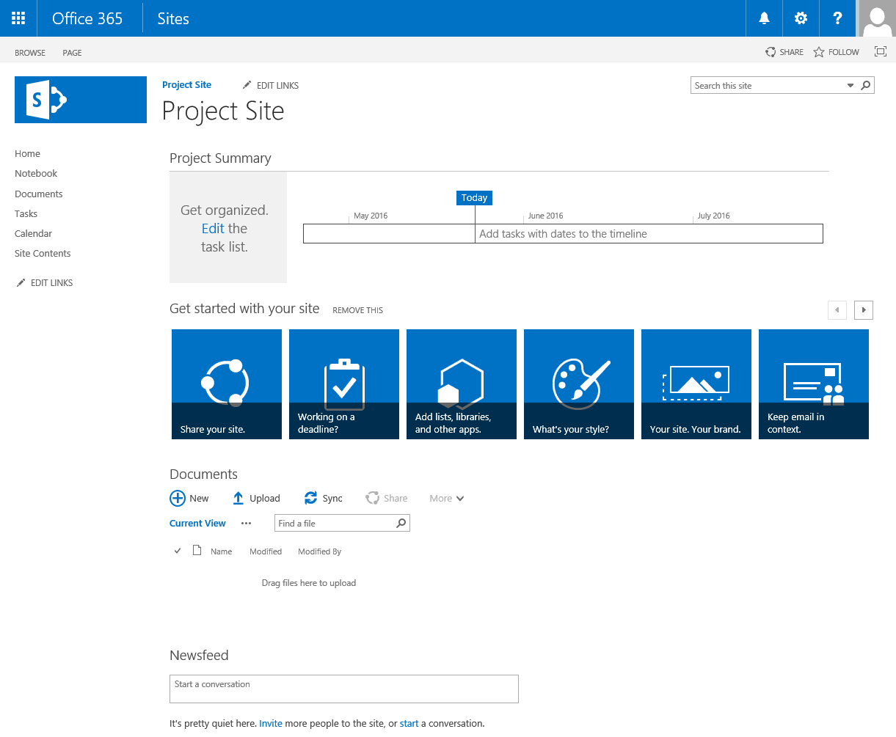
Collaboration Site Templates
Developer Site
  Used by developers for Apps development
  Developers can build, test, publish their custom Apps
Project Site
  Site for managing projects
  Capture and assign tasks,
  manage project related
  documents, track project
  team events
Notes:
Project Site
The Project site template provides an easy way to manage projects. The site has similar collaborative features as the Team site, and includes a Projects Summary web part that is connected to the default Task list. Items added to the Task list are automatically displayed in the Project Summary.
Other advantages to using the Project site:
Visual timeline of the project’s tasks.
Project task schedule.
Library for storing relevant project documents.
Notebook for quickly capturing and organizing information about the project.
Shared calendar for team events.
Ability to connect to Project Professional, Project Server 2013, or Project Online.

Slide 11
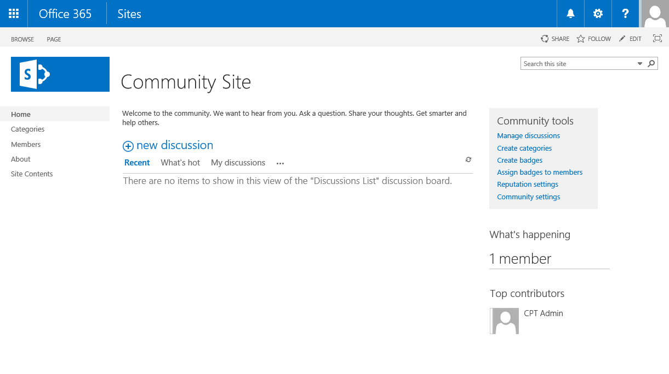
Collaboration Site Templates
Community Site
  An enhanced discussion forum type site
  Offers several benefits over email, instant messaging, or other communication methods:
    Availability of all site content to all members of the community
    Full retention of discussion history in compliance with corporate guidelines
    Built-in search so
    members can search
    all community posts
    Categorization of content to
    improve discoverability and
    simplify maintenance
Notes:
Community Site
A Community Site is an online community and virtual place where users can discuss and share ideas. This site template promotes open communication by fostering discussions among users. Active participation is encouraged through a reward system and community sites can be built as subsites beneath a team site.

Slide 12
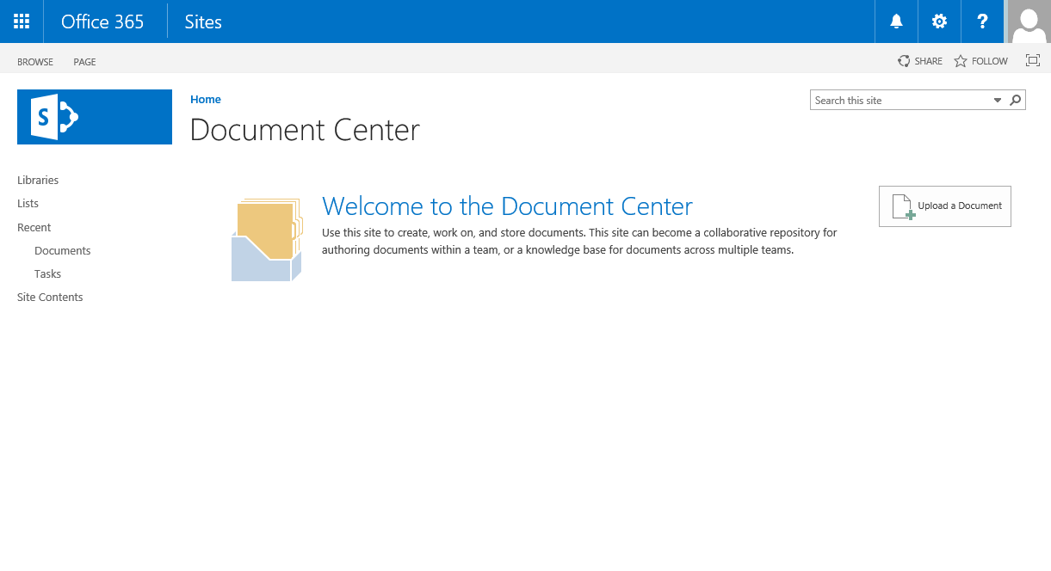
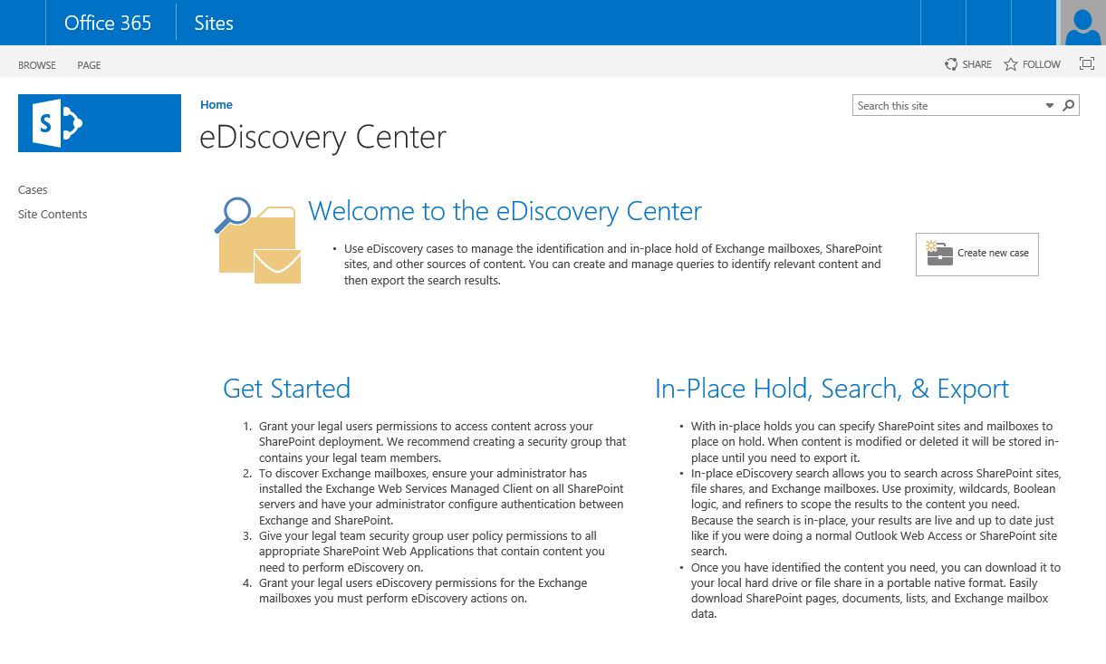
Enterprise Site Templates
Document Center
  Used to centrally
  manage documents
eDiscovery Center
  Provide litigators the ability to discover
  content in electronic format
Notes:
Enterprise site templates are based on the Enterprise features of SharePoint Online.
Document Center
Used to centrally manage documents in your enterprise. The library in the document center site is a large-scaled library useful as an enterprise knowledge base or historical archive. This site template includes features that help users easily navigate, search, and manage lots of documents in a deep hierarchy by using a set of specialized Web Parts.
eDiscovery Center
The eDiscovery Center site template is used to create sites used to provide records managers and litigators the ability to discover content in electronic format.

Slide 13
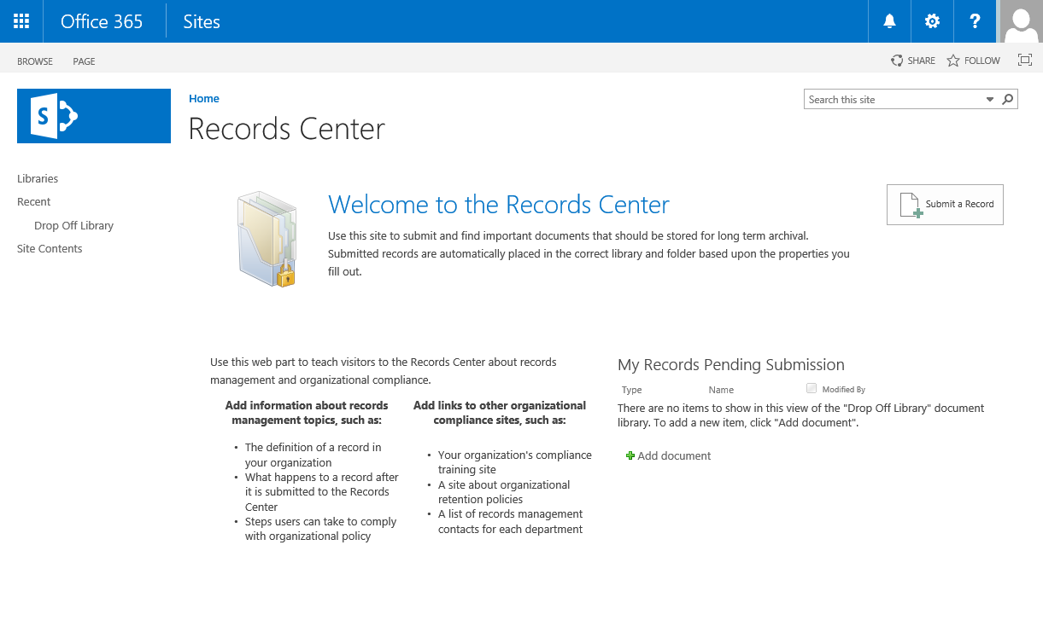
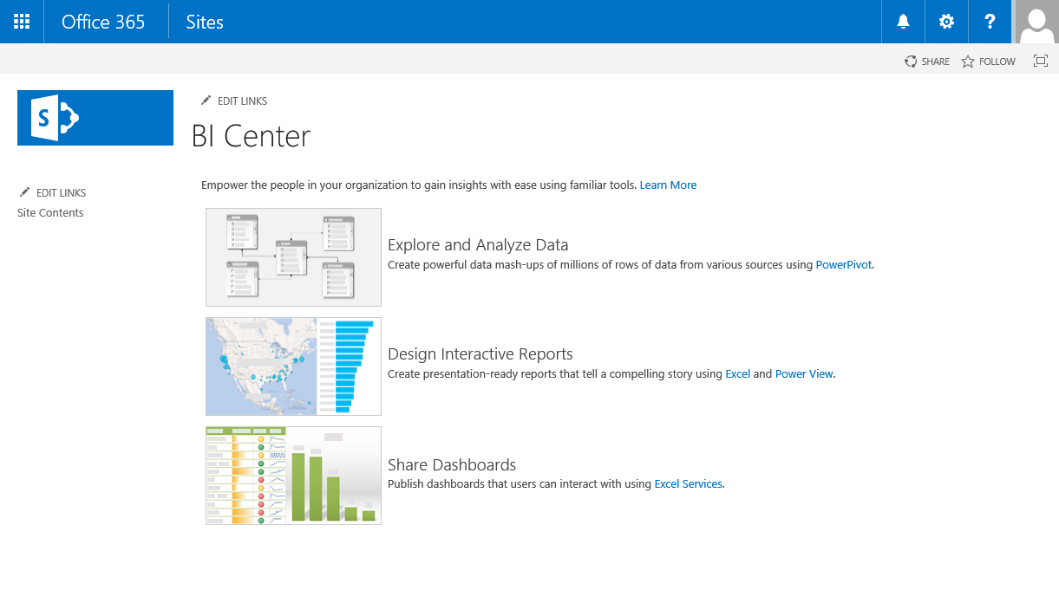
Enterprise Site Templates
Records Center
  Use to organize, store, and
  manage records such as
  legal or financial documents
Business Intelligence (BI) Center
  Use to implement Business
  Intelligence solutions
    Store, manage, share, and
    view business reports,
    scorecards, and dashboards
Notes:
Records Center
A Records Center site template is used to create a site used for providing an alternative way to the traditional processing of copying or moving records to another location and then applying security and retention policies. You can manage records “in place” which means you can leave the document in it’s current location, declare it as a record, and the apply the appropriate security, retention, and disposition properties.
Business Intelligence Center
The Business Intelligence Center site is a pre-built site template used to help working with BI elements. This includes scorecards, dashboards, data connections, status lists, status indicators, and so on. You can use the built-in tools of the site or customize the site.

Slide 14
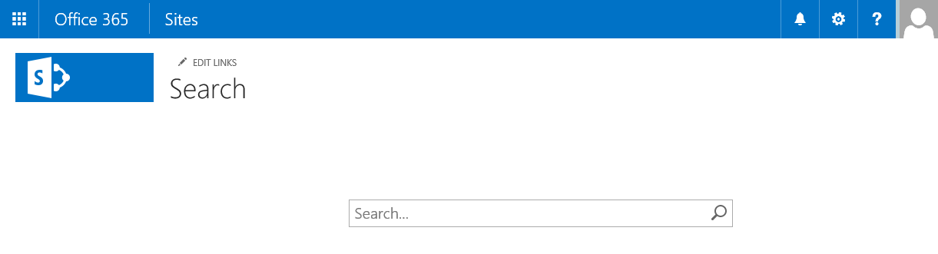
Enterprise Site Templates
Enterprise Search Center
  Provides a more advanced
  search center site
  Includes General search,
  People search, Conversation search, and Video search
Basic Search Center
  Provides a general search center site
Community Portal
  Used to discover community sites
Visio Process Repository
  Used to share and view Visio process diagrams
Notes:
Enterprise Search Center
This site template is used to deliver an enterprise-wide search experience. This includes a welcome page with a search box that connects users to four different search results page experiences. These four search options include one for general search, one for people search, one for conversation search, and another for video searches.
Basic Search Center
The Basic Search Center site is used for delivering a basic search experience. This basic site lacks the multiple results pages of the Enterprise Search Center.
Community Portal
This site is used to discover new Community Sites (otherwise known as communities) across the enterprise.
Visio Process Repository
The Visio Repository site is used to allow sharing and viewing of Visio process diagrams published n SharePoint Online.

Slide 15
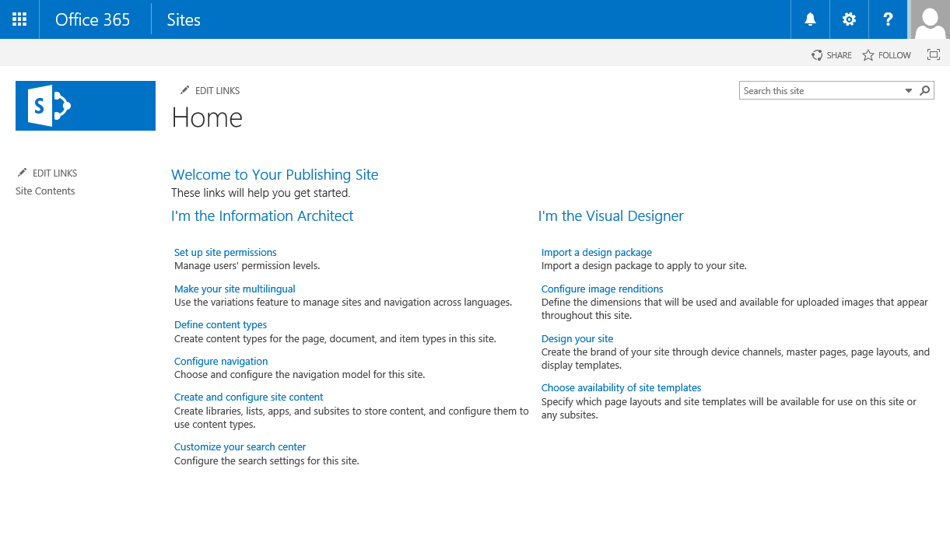
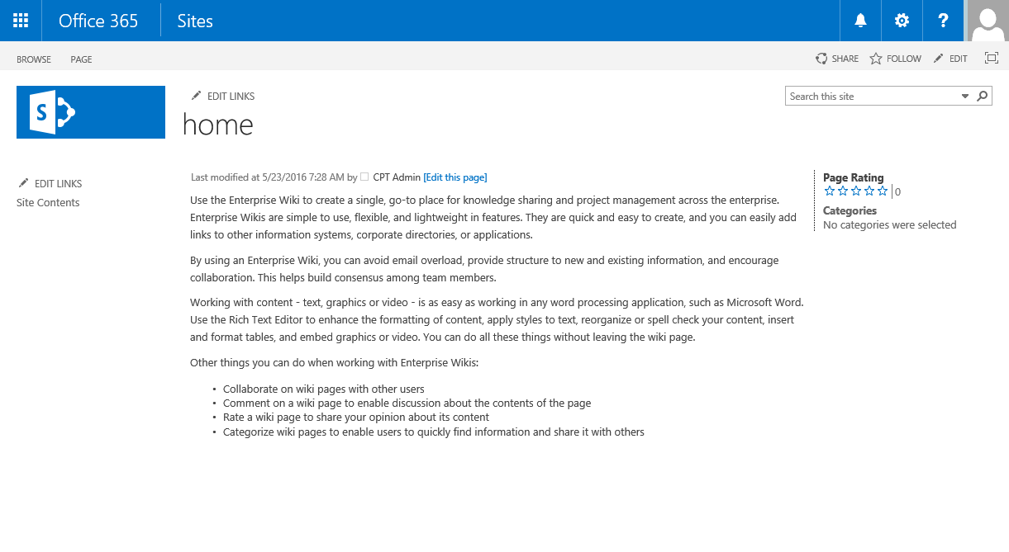
Publishing Site Templates
Publishing Portal
  Used for publishing content
  using the WCM features
Enterprise Wiki
  Used for publishing knowledge you want to share across the enterprise
  Technology based
  on Wiki pages
Notes:
Publishing Portal
A Publishing Portal is a starter hierarchy typically for Internet-facing sites or for large intranet portals. These type of sites can be customized easily with distinctive branding and the sites typically have more readers than contributors used to publish web pages with approval workflows.
Enterprise Wiki
An Enterprise Wiki site is used for publishing knowledge captured that you want to share across the enterprise. These sites use Wiki technology.

Slide 16
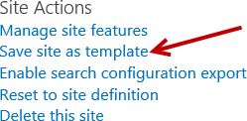
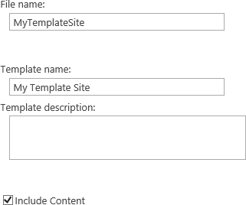
Save Site as Site Template
Turning a customized site into site template
  Is extremely useful and powerful
Saving a site as template saves
overall framework of site
  Lists, libraries, views, forms,
  and workflows
  Ability to include contents of the
  site in template
Save site as a site template
  To quickly recreate the design, structure, or content of a site
NOTE: Publishing sites cannot be saved as template
Notes:
Turning a customized site into a site template is extremely useful and powerful. When saving a site as a template, the overall framework of the site is saved. This includes lists, libraries, views, forms, and workflows. You can also include the contents of the site in the template if necessary. For example, your customized site may include a Document Library that has some base template Word doc files in the library that you want to include in your site template. When you save the site as a template, you have the ability to select the option to Include Content. By default, this option is not selected on the Save as Template page.
There is a limitation on saving site templates. You cannot save a SharePoint publishing site collection or site as a template. This also means if you create a site using a non-publishing site template but then activate the SharePoint Server Publishing Infrastructure feature, the Save site as template link is removed from the Site Actions section of the Site Settings page.

Slide 17
Site Templates

Slide 18
Agenda
Overview of Administrators & Site Collections
Site Templates available in SharePoint Online
Configuring Site Properties
Standard Features and Enterprise Features
Understanding Team Site versus Publishing Site

Slide 19
Site Settings Page
Users and Permissions
  Links to manage users and permissions of the site
Look and Feel
  Administer how the site appears and behaves such as color, title, and landing page
  Links available depends on whether Publishing is activated on the site
Web Designer Galleries
  Manage building blocks used to create sites and pages such as site columns and site content types
Notes:
The Site Settings page contains links to pages where you can administer different aspects of a site. The links are divided into different sections and the sections and links are security trimmed based on the logged in user’s permissions. A person with site collection administer rights has access to all the sections in the site settings page.
Users and Permissions
Provides links to pages for administering users and permissions of the site. This includes administering peoples and groups, site permissions, site app permissions, and managing the site collection administrators.
Look and Feel
Provides links to pages that affect how the site appears and behaves such as color, title, and the landing page. The links available in this group depends on whether Publishing is activated on the site.
Web Designer Galleries
Provides links to pages where you can manage the building blocks used to create sites and pages. This includes managing site columns, site content types, Web Parts, list templates, master pages, themes, sandboxed solutions, and composed looks.

Slide 20
Site Settings Page
Site Actions
  Shortcuts to commands commonly used such as manage site features and save site as template
Site Administration
  Modify administrative settings for a site such as workflow settings and term store management
Site Collection Administration
  Modify administrative settings for site collection such as the site hierarchy and managing site collection features
Search
  Manage search settings such as result sources and query rules
Notes:
Site Actions
Provides links to commands commonly used by administrators, contributors, designers, and hierarchy managers. Link commands include manage site features, save site as template, enable search configuration export, reset to site definition, and delete this site.
Site Administration
Includes links to pages for administering the site’s regional settings, site libraries and lists, user alerts, RSS, sites and workspaces, workflow settings, site closure and deletion, popularity trends, and the term store management.
Site Collection Administrators
Provides links to pages for administering the site collection. This includes links such as to the recycle bin, site collection features, site hierarchy, various policy settings, SharePoint Designer Settings, and links to updates search settings at the site collection level.

Slide 21
Site Settings

Slide 22
Agenda
Overview of Administrators & Site Collections
Site Templates available in SharePoint Online
Configuring Site Properties
Standard Features and Enterprise Features
Understanding Team Site versus Publishing Site

Slide 23
Standard Features
Sites
Communities
User Profiles
Search
  People & expertise search
  Visual previews
  Visual best bests
Enterprise Content Management (ECM)
Notes:
The standard features in SharePoint Online include sites, communities, User Profiles, Basic Search, and Enterprise Content Management (ECM).

Slide 24
Enterprise Features
Search
  Standard search features plus entity extraction
  Video search
  Item recommendations
Business Solutions
  InfoPath Forms Services
  Access Services
Business Intelligence
  Power View
  Performance Point Services
  Excel Services
  Visio Services
Notes:
The enterprise features in SharePoint Online provide more functionality intended for organizations that require more advanced search features, InfoPath and Access Services business solutions, and Business Intelligence capabilities. The enterprise features are available in the SharePoint Server 2013 Enterprise edition and the E3 plan in O365.

Slide 25
SharePoint Features

Slide 26
Agenda
Overview of Administrators & Site Collections
Site Templates available in SharePoint Online
Configuring Site Properties
Standard Features and Enterprise Features
Understanding Team Site versus Publishing Site

Slide 27
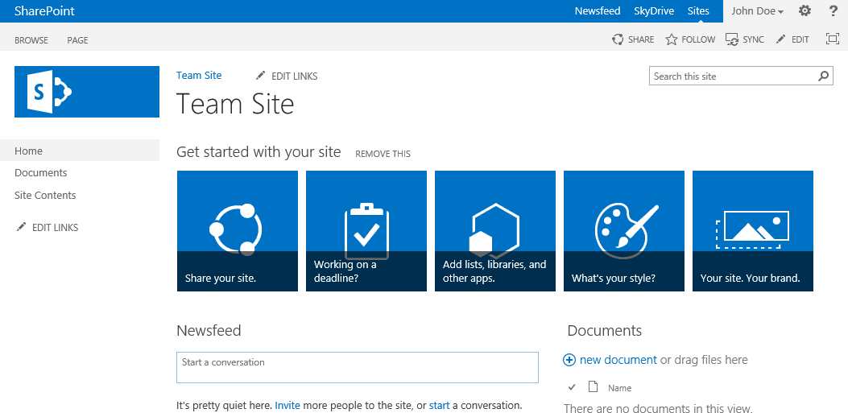
Team Site
Simple and most common site template
  Used by teams to collaborate, organize, create, and share information and documents
Includes:
  Document library for
  sharing files
  Newsfeed for social
  interaction
  Getting Started tiles
    Includes tiles for different actions to help accomplish basic tasks customize your site
Notes:
A Team Site is the most commonly used site by teams to organize, create, and share information and documents. Team site’s include a document library for sharing files, a newsfeed for social interaction and Getting Started tiles. The Getting Started tiles include different actions to help accomplish tasks to customize your site. This Web Part can easily be removed by clicking on the REMOVE THIS link.

Slide 28
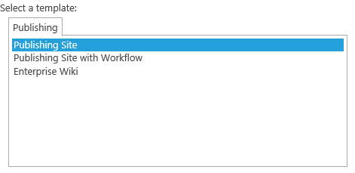
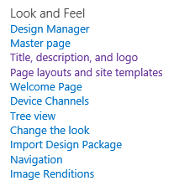
Publishing Site
Widely used for Internet facing sites
Uses Publishing Site templates
  Meant for Web Content
  Management (WCM) sites
  Locks down certain page
  layouts and site templates
Publishing features automatically activated
  Provides more look & feel
  functionality than a team site
  Enables Design Manager
Notes:
Publishing Sites differ from Team Sites in such that publishing sites have the publishing features activated. The publishing features are the Web Content Management (WCM) in SharePoint Online.
Publishing Site
A publishing site is a blank site used for expanding your web site and provide the ability to quickly publish web page content. These sites provide a full authoring experience where content authors (contributors) can work on draft versions of pages and publish them to make them visible to readers. A publishing site includes document and image libraries for storing web publishing assets. Publishing sites provide more look and feel functionality than a team site and enables the Design Manager. More about the Design Manager and Publishing sites will be covered in the Publishing module.

Slide 29
Team Sites and Publishing Sites

Slide 30
Summary
Overview of Administrators & Site Collections
Site Templates available in SharePoint Online
Configuring Site Properties
Standard Features and Enterprise Features
Understanding Team Site versus Publishing Site

