Slide 1
Social Features in O365
Notes:
O365 and SharePoint Online provides social networking features and personal sites so that users have a place for social collaboration. The module shows students how to get around within their personal site in a SharePoint 203 environment. In this module, you will learn how to work with the basic social features in SharePoint Online that includes working with your user profile, blogs, newsfeeds, and OneDrive for Business.

Slide 2
Agenda
Intro to Social
Delve and Profile Page
Personal Blog
Using Newsfeeds
Working with OneDrive for Business

Slide 3



Into to Social
SharePoint Online provides the ability to connect enterprises through social features
Get Connected
Engage in conversations to stay informed and make better decisions
Share Knowledge
Use community knowledge to gain insight and find answers
Work Together
Make it easier to work as a team and manage your projects
Notes:
Social media features in SharePoint Online have come a long way from previous versions SharePoint. In SharePoint Online, the social media features are more powerful and more intuitive which provide a nice interface for getting connected, sharing knowledge, and working together. Users can engage in conversations to stay informed to help make better business decisions.
Get Connected
Social isn’t just about a features, it’s about the ability for users to stay up-to-date with information they care about, helping people get to know each other, and sharing information that’s important. SharePoint Online provides new features that allow you to get better connected by engaging in conversations to stay informed which can help you make better business decisions.
Share Knowledge
Organizations have large amounts of information spread across repositories and in people’s heads and by using SharePoint organizations can make it easier to share knowledge. From questions and answers in communities, to finding information spread throughout silos in the organization, to determining who can help with a particular problem. Users can use community knowledge to gain insight and find answers.
Work Together
Ultimately few things are as important to organizations than the ability to work as a team and jointly accomplish goals and ‘work together’. The new version of Office has done so much to make it as natural as possible for people to work together. Working together is crucial to ‘getting work done’ which is the primary goal for social in SharePoint.

Slide 4
Agenda
Intro to Social
Delve and Profile Page
SharePoint Blogs
Using Newsfeeds
Working with OneDrive for Business

Slide 5


What is Office Delve?
Cloud-based Service in O365
Discover & Find Information
Surfaces personalized pertinent information across O365 (OneDrive for Business, SharePoint, Exchange, Yammer, and more…)
Suggested Content Feed
Powered by Office Graph
Shows your documents & documents your colleagues are working on (only what you have access to)
Organized by most relevant, not by timeline
Notes:
Delve uses the result of the Office Graph analysis to show you documents that are most likely to be relevant to you right now. For example, the Office Graph will notice if several of the people you regularly work with, view a specific document. That document is most likely also interesting to you, so Delve shows it on your Home page.
The information on each content card helps you understand why a document shows up for you. For example, several of your colleagues viewed the document recently or someone you work with modified it.
NOTE: You'll only see documents you have access to. You can see your private documents and other documents that you have access to. Other people can see their documents and documents that they have access to.

Slide 6
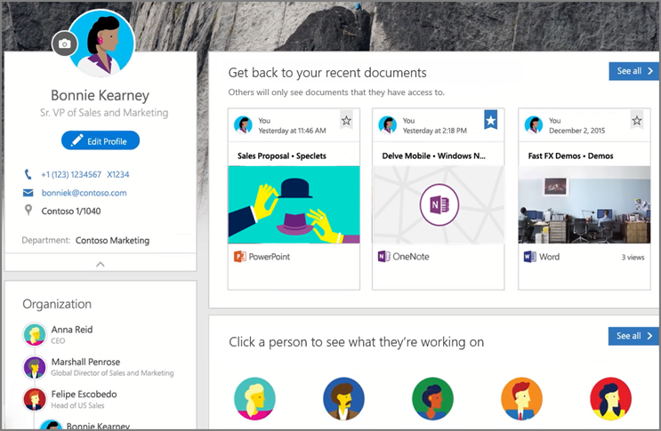
Delve Profile Page
Accessed through your personalized profile page
Displays recent accessed documents, colleague profiles, & suggested content feed

Slide 7
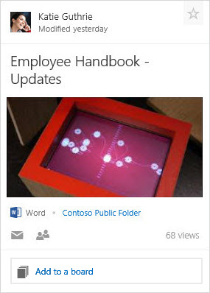
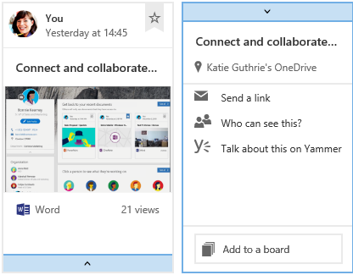
Content Cards in Delve
Documents show up as content cards in views
You may see two versions of the content cards:
On the new compact card, click the bar at the bottom to see all actions
Notes:
In Delve, documents show up as content cards in views. The information on the content card can help you understand why the document would be interesting or relevant to you.
The most obvious way to use a content card is to click or tap it to open the document it represents, but there are also other ways to use the card and the information on it. You may see two versions of the content cards as shown in this slide.
The top part of the card is the activity area. Here you can see for example who modified the document. At the bottom of the card you can see the total views for the document.
Click the star in the upper right corner to add the document to your Favorites. Only you can see what documents you've added to your favorites.
NOTE: Not all document types can be added to favorites yet. If you don't see the star on a card, you can't add that document type to favorites.
The title on the content card is key to finding or discovering documents in Delve. The picture on the card is extracted from the content of the document, and will often give you a hint about what the document is about and make it easier to find back to the document later. If a document has several pictures, Delve tries to show the best one based on things such as resolution and size.

Slide 8
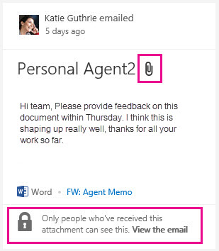
Content Card with Attachments
What's different for attachments?
Some cards in Home view may have paper clip icon next to the title (and text saying when somebody emailed it to you)
These are documents shared with you as attachments in emails
Title on card is file name of document
When you click attachment it opens in Outlook Web App
With document and email conversation side by side
You can edit a copy of document and reply to email

Slide 9
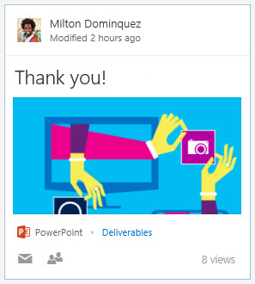
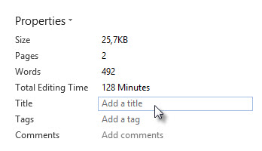
What decides the title on Content Cards?
Delve picks title from document based on set of rules
Word
Delve decides which title to use based on styles used in document:
Text using Title style
Text using Heading 1 style
Test using large font (Even if Title style or Heading 1 exists, text in larger font than what’s used in styles can be picked up as title)
If there’s no likely title found in document, Title property is used (Title property is same as the SharePoint title)

Slide 10
Title on Content Card
PowerPoint
Delve chooses title based on styles in slide layouts
If you use a default template with a Title layout slide, the following could apply:
Title from Title layout slide
Title from first slide
Text using large font (Even if Title from Title layout or first slide Title exists, text in larger font than what’s used in styles can be picked up as title)
If there’s no likely title found in document, Title property is used (Title property is usually prefilled “PowerPoint presentation” unless Title property is changed when uploading to SharePoint)
If you haven't set Title property, the file name is used

Slide 11
Title on Content Card
Excel
Delve will use Title property you have specified for the workbook as the title
If you haven’t set Title property, the file name is used
For attachments
The title on content card is file name of document

Slide 12
Supported Content Types in Delve
Documents
Documents stored in OneDrive for Business or SharePoint in Office 365
Email attachments
Office documents (Word, PowerPoint, Excel) and PDFs that have recently been shared with you in emails
Videos
Videos uploaded in O365 Video portal
Links to webpages from Yammer groups
If someone posts a public link in a public group on Yammer, the webpage can show up as a content card in Delve

Slide 13
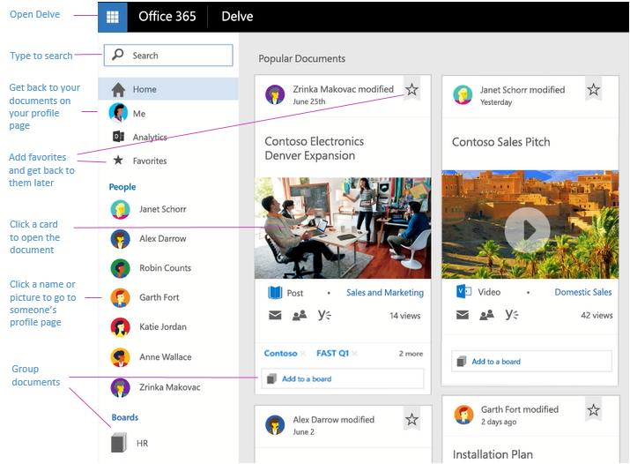
Delve
Notes:
Delve helps you discover the information that's likely to be most interesting to you across Office 365. Find information about people and help others find you.
Delve shows you documents no matter where they're stored in OneDrive for Business or SharePoint in Office 365. You don't have to remember the title of a document or where it's stored.
Delve never changes any permissions, so you'll only see documents you already have access to. Other people will not see your private documents.
Click someone’s name or picture anywhere in Delve to see documents they’re working on or to learn more about them.
When you find a document you’re interested in, add it as a favorite or to a board to easily get back to it later.
Search for people, documents, or boards.

Slide 14
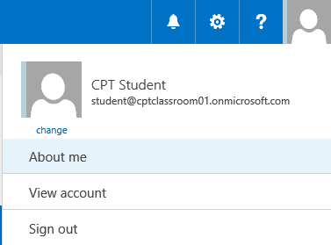
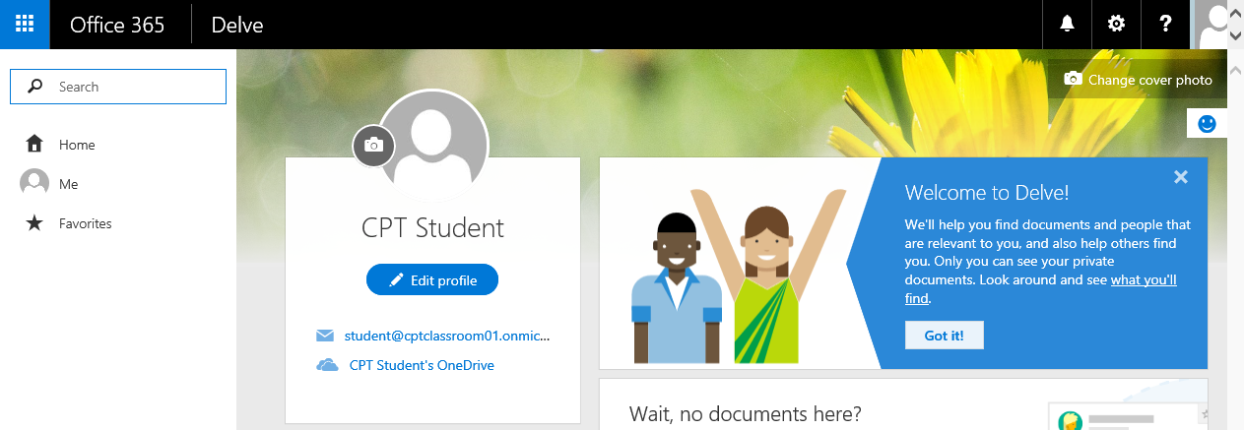
Your Profile
View/Edit Profile
Click on About me
Notes:
NOTE: You may not be able to change all information in your profile. Some information, such as your name or title, may be collected from other systems that your IT or human resources department control. If you want to update those details, contact them or your admin.

Slide 15
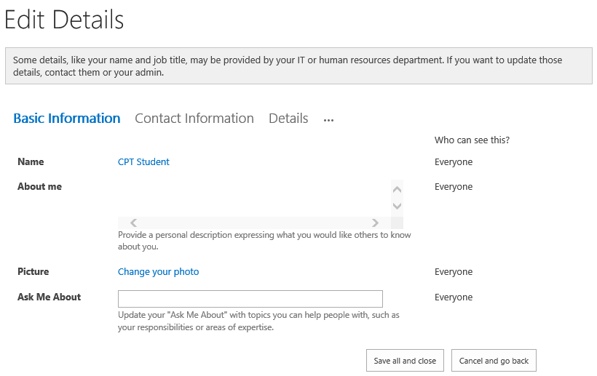
Edit Profile

Slide 16
Navigating around Delve

Slide 17
Agenda
Intro to Social
Delve and Profile Page
Personal Blog
Using Newsfeeds
Working with OneDrive for Business

Slide 18
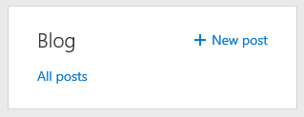
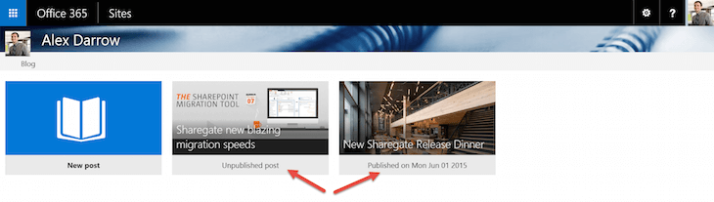
Personal Blog
Blog Feature
Integrated into Delve
O365 Authoring Canvas
Personal blogs use new O365 authoring canvas
Provides consistent content creation & editing experience across parts of O365

Slide 19
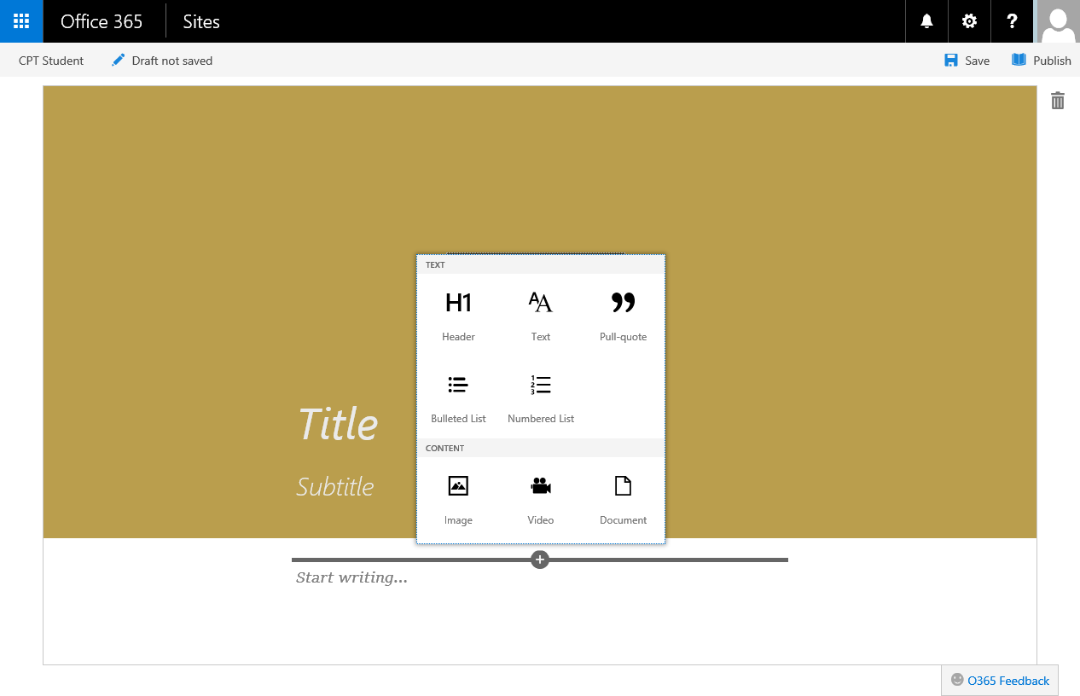
Personal Blog

Slide 20
Personal Blog

Slide 21
Agenda
Intro to Social
Delve and Profile Page
Personal Blog
Using Newsfeeds
Working with OneDrive for Business

Slide 22
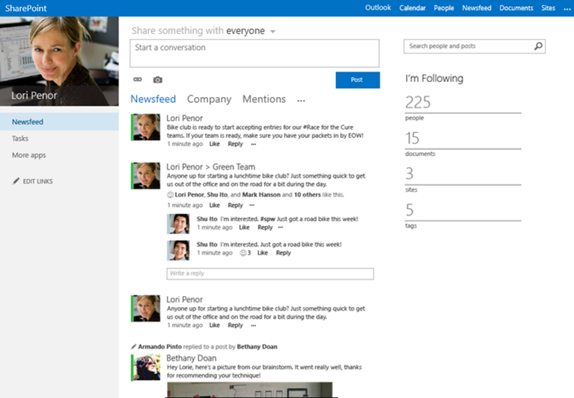
Using Newsfeeds
Newsfeeds (aka microblogging)
Similar to Facebook feeds
Conversations
Start new conversations
Reply to existing conversations
“Follow” link
People – follow people to get updates about people you are following
Documents – follow documents to get updates on document changes.
Tags – follow a tag to see all newsfeed posts that contain a tag you’re following.
Notes:
Newsfeeds in SharePoint Online are conversations amount colleagues and activities are shown in a feed, similar to Facebook, in SharePoint. Users can follow using the “Following” view of a newsfeed and the “Everyone” view allows a newsfeed to become an organization-wide newsfeed.
New Conversations and Replying to Conversation Posts - Conversations you see in the Following view are started only by people you are currently following. Anyone who sees a conversation thread, whether they are following or not, can post a reply to a conversation post. This means you may see replies in threads created by people you are not following. This provides a way to allow you to start following someone from the conversation thread by clicking on a “Follow” link.
Activity Updates of People you’re Following - You will see updates about people you’re following if their user profiles are setup to share information. For example, when following a person you can see updates when the user starts following a document, site, tag, or other people. You will also updates about events such as birthdays and anniversary dates.
Updates about Documents you’re Following - When a document you’re following is modified, you will see an update in the newsfeed even if you are not following the person who updated the document.
Posts Containing a Tag you’re Following – You will see all newsfeed posts that contain a tag you’re following.

Slide 23
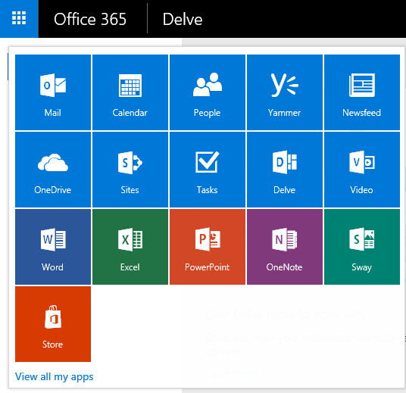
Accessing Newsfeed
Newsfeed Tile
Located in the App Launcher

Slide 24
Newsfeeds

Slide 25
Agenda
Intro to Social
Delve and Profile Page
Personal Blog
Using Newsfeeds
Working with OneDrive for Business

Slide 26
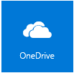
Working with OneDrive for Business
Helps manage work documents and related files
Storage space
O365: each user gets 1TB of space in the cloud
On-premise: organization’s administrators determine storage space limit
All files stored in OneDrive for Business are private unless sharing is configured
OneDrive (short for OneDrive for Business) shortcut is a tile in the App Launcher
Notes:
OneDrive for Businessis a new feature available in SharePoint Online and O365 that provides a place to store and share business-related files. OneDrive for Business synchronizes files to a local computer.
Storage Space
Storage space varies depending on if your organization is using O365 or SharePoint on-premise. In O365, each user gets 25GB of space in the cloud for OneDrive for Business. In SharePoint on-premise, the organization’s administrators determine how much space is available for each user.
Privacy and Sharing
All files stored in OneDrive for Business are private initially and are only viewable by you unless you decide to share the information. Sharing can be easily configured on files and folders in your OneDrive for Business library.
To use your OneDrive for Business library, select the OneDrive link located in the top header of the SharePoint or O365 page.

Slide 27
OneDrive versus OneDrive for Business
OneDrive
Free online personal storage intended for personal use
Use to save documents, photos, other files in the cloud
Share them with friends and collaborate on content
OneDrive for Business
Intended for business purposes
Managed by organization
Let’s you share and collaborate work documents with co-workers
Site collection administrators in organization control what can be done in the library
Notes:
You may be familiar with OneDrive which is another storage service Microsoft offers to store documents and other content in the cloud. The OneDrive service is different from OneDrive for Business.
OneDrive
OneDrive is a free online personal storage intended for personal use that you get from either a Microsoft account or Outlook.com. Use OneDrive to save documents, photos, and other files to the cloud. You can share your files and folders with friends and also collaborate on the content. This service is free and you decide how you want to use it. This service is not integrated with SharePoint.
OneDrive for Business
OneDrive for Business is online storage in the cloud intended for business purposes. Your OneDrive for Business is managed by your organization and allows you to share and collaborate on work documents with co-workers. Site collection administrators within your organization determines what you can do in the library.

Slide 28
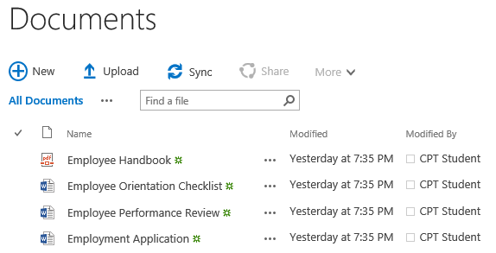
Document Library Sync
Working with documents offline
Sync button introduced in SharePoint Online
Allows you to sync any document library to local drive
Notes:
In the previous version of SharePoint, working with documents offline could be accomplished by using SharePoint Workspace. In SharePoint Online, SharePoint Workspace is no longer needed nor supported due to a new SYNC feature. The SYNC button allows you to sync any document library to your local computer via OneDrive for Business. The SYNC button is located throughout the site above the search box. You can navigate to the site that contains the library you want to sync and then click on the SYNC button to start the wizard for setting up the synchronization.

Slide 29
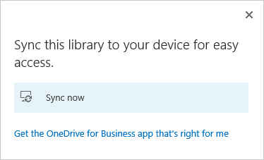
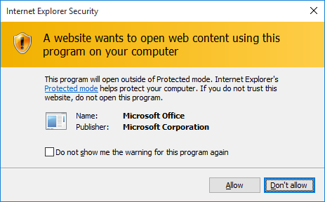
Document Library Sync
Navigate to library you want to sync and then click on Sync button
Once clicked, the Sync now dialog will appear

Slide 30
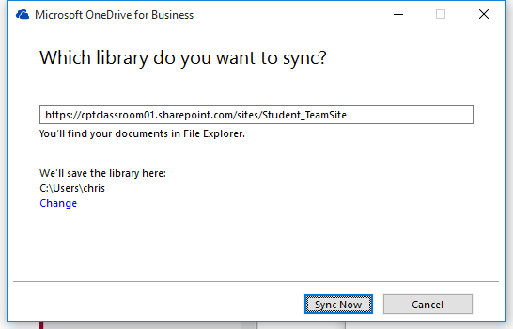
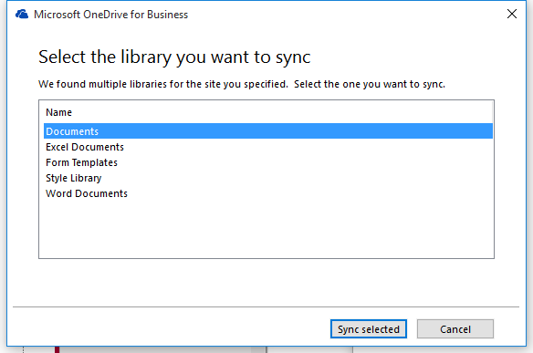
Document Library Sync

Slide 31
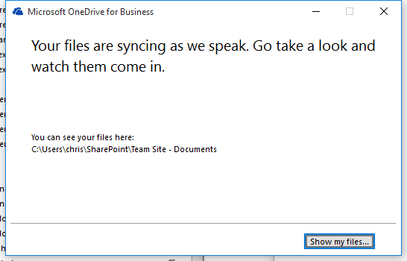
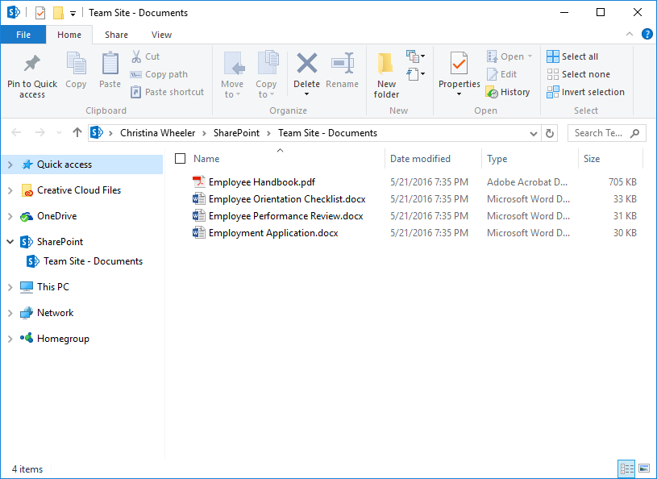

Document Library Sync
Once the Sync setup is complete you can view your files on your local drive
Notes:
Once the sync setup is complete, the dialog will display a button “Show my files…”. When you click on the button, it will open Windows Explorer displaying the files that have been synced locally. You will notice a green checkmark icon on the files which means the files have been synced. If you make changes to any of the files, the icon will change to a sync icon when the changes are being synced and then the icon will change back to a checkmark once the syncing is complete.

Slide 32
OneDrive for Business and Syncing

Slide 33
Summary
Intro to Social
Delve and Profile Page
Personal Blog
Using Newsfeeds
Working with OneDrive for Business

