Slide 1
Workflow in SharePoint Online
Notes:
SharePoint Online provides out-of-the-box support for creating workflows to automate various business processes such as document approval. In this module, students will learn about fundamental concepts in SharePoint workflow such as the role of workflow templates, workflow associations and workflow instances. Students will also learn to start workflow instances on items and documents to begin a business process such as document approval. Students will also learn to monitor and manage the lifetime of workflow instances which often involves waiting on and completing workflow tasks.

Slide 2
Agenda
SharePoint Workflows Overview
Workflow Actions, Conditions, and Shapes
Using Workflow Templates
Starting Workflows and Tasks Actions

Slide 3
SharePoint Workflow
A workflow is a series of tasks and actions to produce an outcome
Scenario – Product Approval
Write
Product
Proposal
Submit
Proposal
For
Approval
Approve
Or
Reject
If approved,
Create New
Product Plan
Notes:
Workflows in SharePoint Online are powered by Windows Workflow Foundation 4 which has substantially been redesigned from previous versions. Workflows conceptually model structured business models and in a business model a workflow is a process. In other words, a workflow is a series of tasks and actions to produce an outcome. In a business scenario, a workflow is a process. Workflows allow you to model and automate business processes in SharePoint.
The diagram in the slide represents a product approval workflow. In the workflow the submitter writes a product proposal then submits the proposal for approval. The proposal will then get sent to the approver where the approver will either approve or reject the proposal. If the proposal is approved a new project plan will be created.

Slide 4
Out-of-the-box Workflows
Approval Workflow
Routes document or item saved to list or library to group of people for approval
Collect Feedback Workflow
Routes document or item saved to list or library to group of people to collect their review feedback
Collect Signatures Workflow
Routes Office document saved to a list or library to group of people to collect digital signatures
Publishing Approval Workflow
Automates routing of content approvers for review and approval of content on publishing sites where publishing of new and updated web pages is tightly controlled

Slide 5
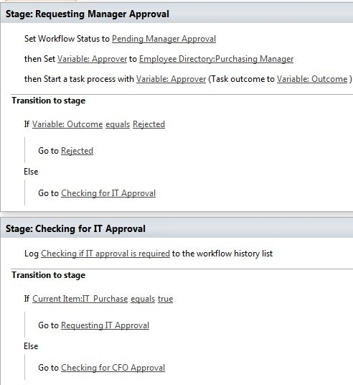
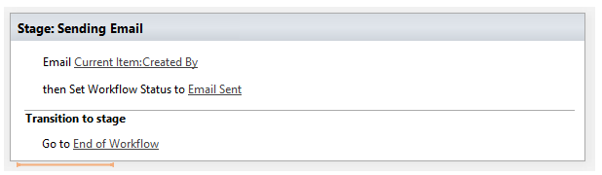
SharePoint Designer Workflows
Provides ability to:
Revise and enhance out-of-the-box workflows or you can start from scratch

Slide 6
Designer Workflow Building Blocks
Stages
Model workflows as containers of logically grouped conditions and actions
Loops
Group conditions and actions you want the workflow to process repeatedly (either a specific number of times or until an exit condition is true)
A loop can also be nested inside another loop
Steps
Group conditions and actions so one set of rules can be evaluated and performed before a second set

Slide 7
Designer Workflow Building Blocks
Events
Start or initiate a workflow
A change to data source (such as new item created or item changed)
Or an event activated by a user (a workflow participant)
Actions
Do something useful such as send an email or send items for approval
Most basic unit of work in a workflow

Slide 8
Designer Workflow Building Blocks
Conditions
Determine when a workflow runs or an activity is performed
For example, check if a field value equals specific value
Variables
Store different types of data in a workflow
Including initiation form parameters and local variables and at later point reference the data using workflow lookups

Slide 9
Designer Workflow Building Blocks
Email Editor
Format email messages sent in workflow by using standard formatting toolbar in workflow email editor
Choose specific users and specify variables in text to customize email message
Forms
Collect information from workflow participants at predefined times in workflow
Gather information from users when they start the workflow
Create association forms to associate workflow with list or content type
Add forms for custom tasks associated with Tasks list

Slide 10
Designer Workflow Building Blocks
Web Services
Integrate data and values from Web Services and data sources (such as OData and SQL Azure) within workflows.
For Example:
You can create a workflow that loads data into a list from the SQL Azure MarketPlace
Or update columns with data calculations based on values external to SharePoint

Slide 11
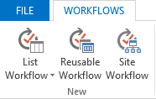
SharePoint Designer Workflow Types
List Workflows
Workflow associated with a single list
Reusable Workflows
Workflow associated to a content type
Reusable for any list or library
Site Workflows
Workflow associated with a site
Notes:
List Workflows
A list workflow is the type of workflow that was first available in SharePoint 2007. A list workflow is associated with the list in which it was created therefore list workflows are not reusable meaning they cannot be made available to other lists or libraries in the site. If you know you will only need the workflows you are designing for a specific list, the list workflow has the advantage of automatically making available the custom fields of the lists.
Reusable Workflow
A reusable workflow is a workflow which may be reused across lists or libraries within a site contained by a site collection. This type of workflow may exist at a subsite or the site collection top-level site. Reusable workflows can only be used at the site in which it was published.
Site Workflow
A site workflow is associated to a site and is not associated to a list, library, or content type. So unlike most workflows, a site workflow is not running on a specific list item. Because of this, many of the actions available for items are not available for site workflows. If you want to create a workflow and don’t need a list, library, or content type for the workflow then a site workflow will probably best meet your needs. For example, you can create a site workflow as a way for users of the site to provide feedback about your site.

Slide 12
SharePoint 2010 vs. 2013 Workflows
SharePoint Online support two workflow platforms
SharePoint 2010 workflows (older format)
SharePoint Online workflows (newer format)
Benefits to using SharePoint 2010 workflows
Migrate existing workflows from SharePoint 2010
Support out-of-box with no additional configuration
Benefits to using SharePoint 2013 workflows
More scalable - especially in SharePoint Online
Improved design experience in SharePoint Designer

Slide 13
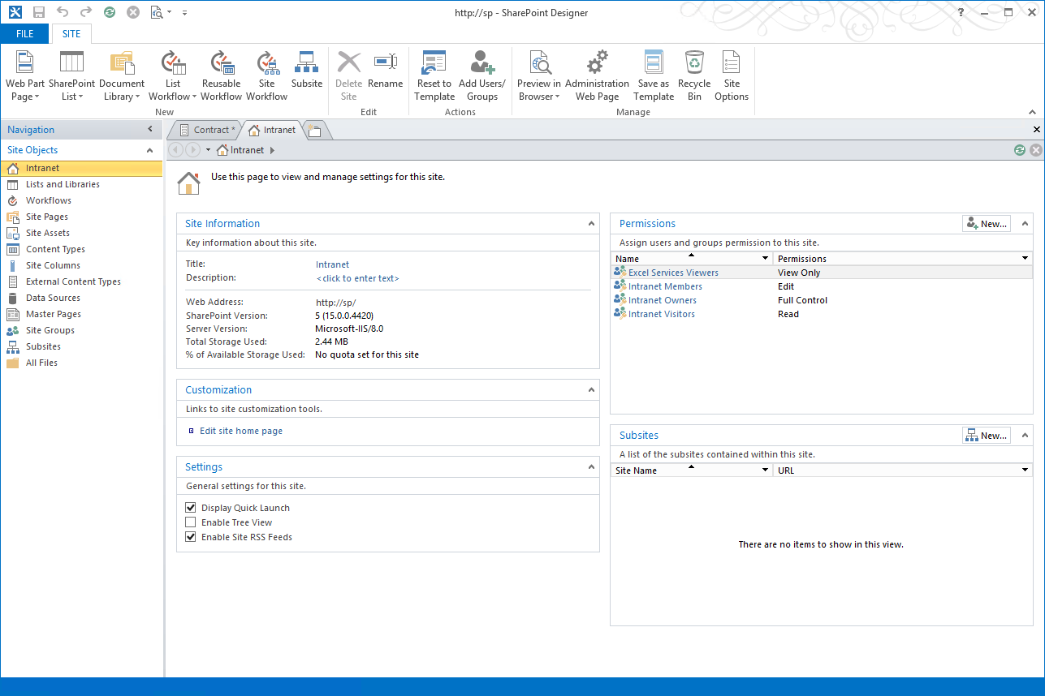
SharePoint Designer 2013
Improved visual designer
Integrated Visio designer into SharePoint Designer
Visio installation required for visual designer
Can switch between visual designer & text-style
Activity properties editable in visual designer
Workflow designer supports Office operations:
cut / copy / paste / undo / redo / select-all
Improved email editor (rich formatting)
Notes:
SharePoint Designer 2013 now provides a visual workflow designer. The previous version, SharePoint Designer 2010, offered integration with Microsoft Visio 2010, so that you could design workflows visually in Visio and then import them into SharePoint Designer. Now, you can visually design your workflows by dragging, dropping, and connecting shapes directly within SharePoint Designer 2013. You can set all the properties of a workflow action in the new visual workflow designer—just select the shape and then click the action tag. Also, if you click Properties on the action tag, the property grids for conditions and actions appear in the visual designer, just as they do in the declarative workflow designer.
Loops: SharePoint Designer 2013 now provides looping. A loop is a container that you can use to group conditions and actions that you want the workflow to process repeatedly.

Slide 14
Agenda
SharePoint Workflows Overview
Workflow Actions, Conditions, and Shapes
Using Workflow Templates
Starting Workflows and Tasks Actions

Slide 15
Core Workflow Actions
Action | Description
Add a Comment | Enables ability to leave informative comments in workflow designer for reference purposes.
Add Time to Date | Adds a specific time in minutes, hours, days, or months to a date (Year not supported), and stores the output value as a variable. The date can be a current data, specific date, or a lookup. The ‘Current Date’ value returns UTC midnight.
Build Dictionary | Builds a Dictionary variable of key/value pairs.
Call HTTP Web Service | Functions as a method call to an HTTP web service and returns data using the JSON format. Basic authentication is supported through the RequestHeader.
Count Items in Dictionary | Returns a count of the number of items in a specified dictionary.
Do Calculation | Performs an arithmetic calculation and stores the output value in a variable.
Get an Item from a Dictionary | Returns a particular item from a dictionary variable.
Log to History List | Writes a message from a list of predefined message items to the workflow history list.
Pause for Duration | Causes a workflow to pause executing for a specified time interval (days, hours, minutes)
Pause Until Date | Causes a workflow to pause executing until a specified date and time.
Send an Email | Automatically sends an email message that contains a predetermined message to a user or group when a specified workflow event occurs.
Set Time Portion of Date/Time Field | Creates a timestamp, and stores the output value in a variable. You can set the time in hours and minutes and add a current date, specific date, or lookup.
Set Workflow Status | Creates a timestamp, and stores the output value in a variable. You can set the time in hours and minutes and add a current date, specific date, or lookup.
Set Workflow Variable | Sets a workflow variable to a value. Also use for workflow to assign data to a variable.
Go to Stage | Specifies the next stage to which flow control should be handed.

Slide 16
Coordination Workflow Actions
Action | Description
Start a List Workflow | Starts a List workflow based on the SharePoint 2010 Workflow platform.
Start a Site Workflow | Starts a Site workflow based on the SharePoint 2010 Workflow platform.
Both workflows have the following issues:
Assignments type field cannot be used as parameter when 2010 workflow has TaskProcess action in it
When multiple calls are made to the same 2010 workflow the result will be multiple data sources in the 2013 workflow lookup functionality
These data sources are all the same
Variable names in 2013 cannot contain special characters such as ‘?’ and ‘#’
If 2010 workflow contains special characters they will be converted to hexadecimal code in the 2013 workflow
Notes:
Coordination actions are used to invoke a workflow based on the SharePoint 2010 Workflow platform.

Slide 17
List Workflow Actions
Action | Description
Check in Item | Checks in an item that is checked out. You can check in items only from a document library. The workflow crashes if you try to check in an item that is not checked out.
Check Out Item | Checks out an item. The workflow verifies if item is checked in before it checks out a document. You can check out items only from a library in your site. The workflow crashes if you try to check out an item that is not checked in.
Copy Document | Copies a document from the current list to a different Document Library list.
Create List Item | Creates a new list item in the list specified. You can supply the fields and values in the new item. You can use this action to create a new item with specific information.
Delete Item | Deletes an item. This action is terminated on the computer running the Workflow Manager workflow engine and throws a System.InvalidOperationException exception. There is no workaround.
Discard Check Out Item | Discards the changes and checks the item back in if an item is checked out and changes have been made to it. The workflow crashes if you try to check in an item that is not checked out.
Set Field in Current Item | Sets a specified field in the current item to a specified value. If you need the workflow to pause until the value of the field has changed, use the Wait for Event in List Item action instead of this action.
Translate Document | Translates a document into a particular language. Requires a preconfigured Machine Translation Service Application.
Update List Item | Updates a list item. You can specify the fields and the new values in those fields.
Wait for Event in List Item | Enhanced version of Office 2010 action. Pauses current instance of workflow to await specified list item event. This action listens for two events: ItemUpdated and ItemAdded.
Wait for Field Change in Current Item | Waits for a field on the current item to equal a particular value.

Slide 18
Project Workflow Actions
Project actions support the integration of Microsoft Project
Used to build Project-based workflows
All Project actions are new in SPD 2013
Action | Description
Create Project from Current Item | Takes the current item and creates a new project in the SharePoint farm PWA site.
Set Project Field | Sets a value for a particular field on Project Server. This action requires the project to be checked in first. If the project is not checked in, the workflow will be terminated and users cannot open that project in Project Web App.
Set Project Stage Status | Sets the status of the Project Stage. An exception occurs when a current project is checked out.
Set status field in idea list | Updates the status on the original list item that is associated to the current project.
Wait for Project Event | Waits for a particular Project Event.

Slide 19
Task Workflow Actions
Task actions provide ability to:
Invoke a workflow based on SharePoint 2010 Workflow platform from within a workflow based on SharePoint Online Workflow platform
Action | Description
Assign a Task | Assigns a workflow task to a user and establishes a due date for completion of the task.
Start a Task Process | Creates tasks on multiple users and enables the tasks to be taken through a customized process.

Slide 20
Utility Workflow Actions
Actions that manipulate strings or find the interval between dates
Action | Description
Extract Substring from End of String | Copies specified number of characters starting from end of a string and stores output in a variable.
Extract Substring from Index of String | Copies substring starting at specified index in string and places value in a variable. The index value in Microsoft SharePoint Designer 2013 is zero-based, values in SharePoint Designer 2010 were indexed starting at 1.
Extract Substring from Start of String | Copies specified number of characters beginning at start of string and stores output in a variable.
Extract Substring of String from Index with Length | Copies out a substring comprising a specified number of characters, starting at a specified index in string and places value in a variable. The index value in Microsoft SharePoint Designer 2013 is zero-based, values in SharePoint Designer 2010 were indexed starting at 1.
Find Interval Between Dates | Calculates the time interval in minutes, hours, or days between two dates and stores the output in a variable.
Trim String | Removes white spaces from the beginning and end of a string.
Find Substring in String | Finds a particular substring inside of a string and returns the index of the substrings’s starting position.
Replace Substring in String | Replaces a particular substring with another substring.
Trim String | Removes white spaces from the beginning and end of a string.

Slide 21
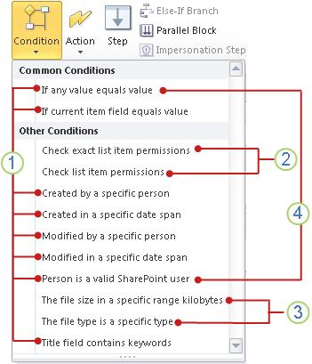
Workflow Conditions
Use workflow conditions when creating SharePoint 2010 workflow in SharePoint Online
Notes:
Everything marked as item 1 are general conditions in SharePoint Designer 2013.
Check exact list item permissions and Check list item permissions is only available inside an impersonation step.
The file size is a specific range kilobytes and The file type is a specific type are available only in a workflow associated with the Document content type, a child of the Document content type, or a library.
If any value equals value and Person is a valid SharePoint user conditions are only available when you create a site workflow.

Slide 22
SharePoint Designer Workflows

Slide 23
Agenda
SharePoint Workflows Overview
Workflow Actions, Conditions, and Shapes
Using Workflow Templates
Starting Workflows on Items and Documents
Responding to Workflow Tasks

Slide 24
Using Workflow Templates
Workflow templates available in Visio 2013/2016
Action Shapes
Includes actions such as Assign a Task, Add a Comment, Create List Item, Do Calculation
Condition Shapes
Compare too values, check user memberships, skip project stage
Terminator Shapes
Start/End, Stage, Step, Stage, Loop n Times, Loop with Condition, Start/Stop Parallel Action (Parallel Block)
Notes:
Visio 2013 includes the new Microsoft SharePoint Online Workflow template and still includes SharePoint 2010 workflows. When creating a workflow in Visio 2013 instead of a blank canvas, every new workflow starts with an empty container know as a “stage”. Each stage contains all of the actions which make up the logical section of the workflow. Simple workflows might only be single stage while complex workflows could have many stages. Within stages, "step" containers allow you to further organize actions. All actions must be within a stage however decision shapes can determine the flow both within and between stages.

Slide 25
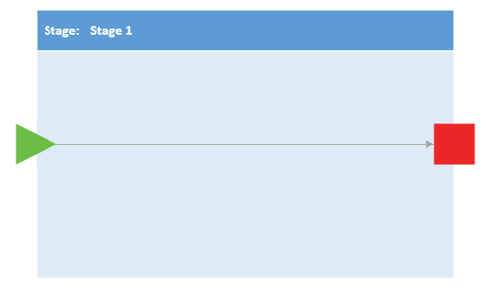
Terminator Shapes - Stage
Container used to contain any number of shapes and actions
SharePoint Workflow template has a Start, Enter and Exit shape
Notes:
A stage is a container used to contain any number of shapes and actions. The SharePoint Workflow template has a Start, Enter, and Exit shape.
Stage Rules
Workflow must have at least one stage. Explicit Start shape required outside stage for entire diagram and explicit Terminate shape outside of stage is NOT required.
Stage containers cannot be nested. You can use other containers within stage to nest (such as a step).
Stop Workflow shapes may exist within stage.
At top level, workflow can contain only stages, conditional shapes, and Start and Terminate terminators. All other shapes must be contained within a stage.

Slide 26
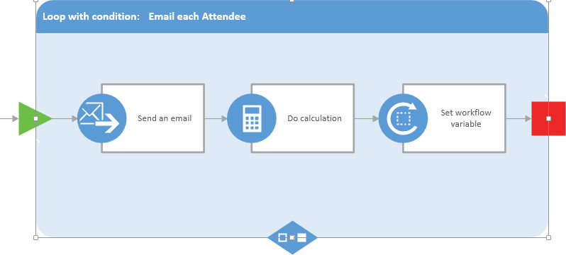
Terminator Shapes - Loop
Series of connected shapes that execute as a single unit within a loop container
Two types supported
Loop n times and loop with condition
Notes:
Loops are a series of connected shapes that will execute as a single unit within a loop container. Like stages, loops are a container shape with an Enter and Exit shape. A loop shape also requires that an Enter and Exit shape be added to the edges of the container to define the paths in and out of the loop. Workflows in SharePoint Server 2013 support two types of loops: loop n times and loop with condition.
Loop Rules
Loops must be within a stage.
Steps may be within a loop.
Loops can only have one entry and one exit point.

Slide 27
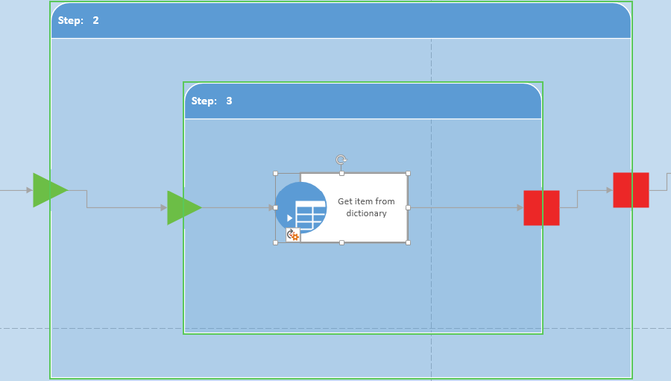
Terminator Shapes - Step
Represent a group of sequential actions to be performed as a single unit
Notes:
A step represents a group of sequential actions to be performed as a single unit.
Step Rules
Steps must be within a stage.
Steps may be within a loop.
Steps can only have one entry and one exit point.
Steps can contain steps.

Slide 28
Workflow Templates

Slide 29
Agenda
SharePoint Workflows Overview
Workflow Actions, Conditions, and Shapes
Using Workflow Templates
Starting Workflows and Tasks Actions

Slide 30
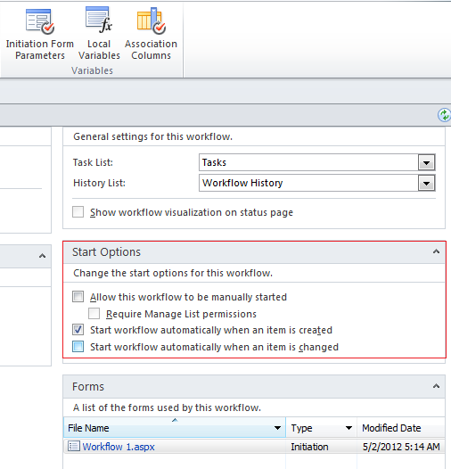
Starting Workflows
Manual Workflows
Can be started on a document or item
Options available depend on how workflow was designed
Permissions required
Edit permission to start workflow
Some workflows may require Manage List permissions
Auto-start Workflows
Can be configured to start automatically when an item is added or edited
Notes:
After a workflow is added to a list, library, or content type and made available for use, you can manually start the workflow on a document or item. The workflow must be configured to allow it to be started manually. To start a workflow, you select the workflow you want from the list of workflows available for the document or item. If necessary, you may also need to fill out a form with the information the workflow requires. Depending on how the workflow was designed and configured, you may have the option to further customize the workflow when you start it on a document or item. This can include customizing such options as participants, due date, and task instructions.
To manually start a workflow you must at least have the Edit Items permission to start a workflow. Some workflows may require you to also have the Manage Lists permission or another specific permission to start a workflow on a document or item.

Slide 31
Workflow Task Actions
Workflow Task
Used to assign work to person or group and then track progress of that work over time
Two workflow actions in SharePoint Designer designed for working with tasks
Assign a task
Used to create task and assign it to a single participant
Start a task process
Used to assign task to multiple participants
Task Actions accessed in Action drop-down menu of SharePoint Designer ribbon

Slide 32
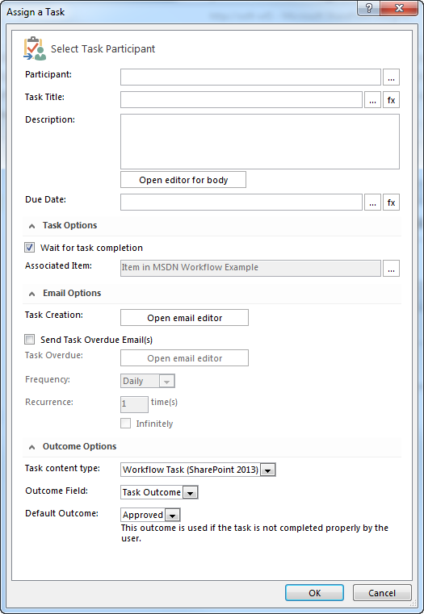
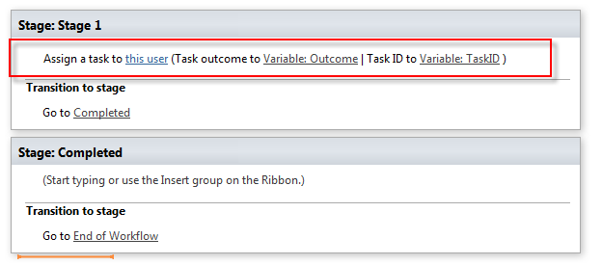
Assign a Task

Slide 33
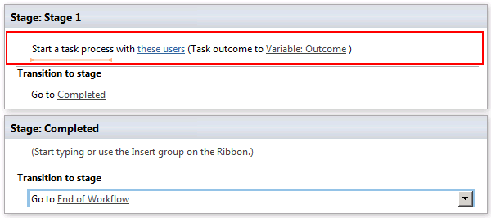
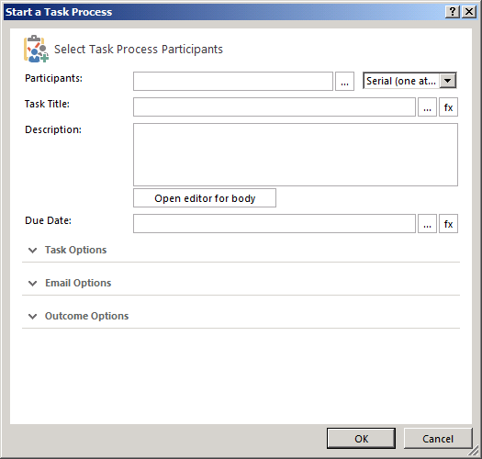
Start a Task

Slide 34
Starting Workflows & Task Actions

Slide 35
Summary
SharePoint Workflows Overview
Workflow Actions, Conditions, and Shapes
Using Workflow Templates
Starting Workflows and Tasks Actions

