Slide 1
Authenticating with Azure AD and OAuth 2.0
Notes:
This module begins with an overview of the Azure Active Directory (AAD) security model which involves user authentication, application authentication and an authorization scheme based on configurable permissions. The module explains the differences between application permissions and delegated permissions as well as how permissions are granted to an application using the Common Consent framework. The module discusses when to use single-tenant applications versus multitenant applications and demonstrates how to configure AAD applications to support common OAuth 2.0 authentication flows using authorization codes, client credentials and implicit flows. The module examines the low-level details of authentication with AAD and then shows how to abstract away these low-level details by authenticating users and acquiring access tokens with the Active Directory Authentication Library for .NET (ADAL-NET) and the OWIN framework.

Slide 2
Agenda
OAuth 2.0 and OpenID Connect
Azure Active Directory
Creating Azure AD applications
Active Directory Authentication Library for .NET
Programming Web Clients

Slide 3
Old-school Enterprise Security
Local AD Domain: WINGTIP.COM
NTLM/Kerberos

Slide 4
Internet Security
FaceBook
Google
Office 365
Power BI

Slide 5
OAuth 2.0
Resource service 1
User agent
End user working in browser
Client
Your Custom Application
Resource service 2
Authentication Flow
Resource service 3
access token
Authorization server
FaceBook, Google,
Twitter, GitHub
Azure Active Directory

Slide 6
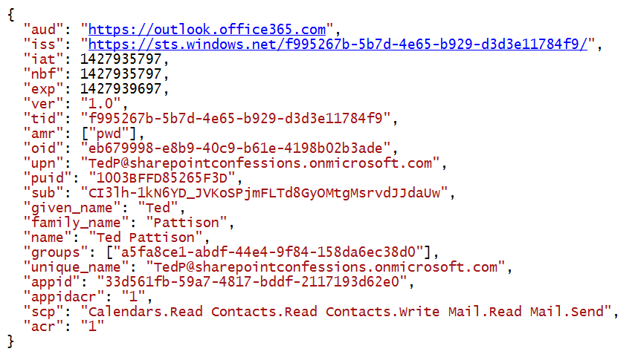
View into an Access Token

Slide 7
OAuth Client Registration
Client must be registered with authorization server
  Authorization server tracks each client with unique Client ID
  Client should be registered with one or more Reply URLs
  Reply URL should be fixed endpoint on Internet
  Reply URL used to transmit security tokens to clients
  Client registration tracks permissions and other attributes

Slide 8
Authentication Flows
User Credentials Flow (public client)
  Used in Native clients to obtain access code
  Requires passing user name and password
Authorization Code Grant Flow (confidential client)
  Client first obtains authorization code then access token
  Server-side application code never sees user’s password
Client Credentials Grant Flow (confidential client)
  Authentication based on SSL certificate with public-private key pair
  Used to obtain access token when using app-only permissions
Implicit Grant Flow (public client)
  Used in SPAs built with JavaScript and AngularJS
  Application obtains access token w/o acquiring authorization code

Slide 9
OAuth 2.0 and Authentication
OAuth 2.0 was designed for authorization
  Creation of access token requires authentication
  Authorization server passes access token to client
  Client passes access token when calling resource services
  Access token serves as app credentials for authorization
Access token not intended for user authentication
  Access token not designed to carry user identity data
  OAuth 2.0 doesn't require validation of access token
  Naïve OAuth 2.0 implementations subject to attack

Slide 10
Open ID Connect
Resource service 1
User agent
End user working in browser
Client (Relying Party)
Your Custom Application
Resource service 2
Authentication Flow
Resource service 3
Id tokens
Open ID Provider
FaceBook, Google,
Twitter, GitHub
Azure Active Directory

Slide 11
Agenda
OAuth 2.0 and OpenID Connect
Azure Active Directory
Creating Azure AD applications
Active Directory Authentication Library for .NET
Programming Web Clients

Slide 12
Azure Active Directory (AAD)
AAD plays role of an OpenID Connect Provider
  Creates access tokens based on OAuth 2.0
  Creates id tokens based on OpenID Connect 1.0
AAD provides authentication & authorization for…
  Office 365, Exchange Online and SharePoint Online
  Power BI REST API
  Custom Web Applications and Web Services

Slide 13
Office 365 and Azure AD
Office 365 environments are based on tenancies
  Tenancy provides scope for creating and managing users
  Tenancy provides a scope for site collections in SharePoint Online
Office 365 is integrated with Azure Active Directory (AAD)
  Each Office 365 tenancy is backed by an AAD directory
  AAD directory can be managed using Office 365 administration
  AAD directory can be managed using Windows Azure Portal
  Azure support registering application within scope of AAD directory
Application using Office 365 APIs must be registered with AAD
  This means you must become familiar with Azure Active Directory

Slide 14
Azure Management Portal
Provides management over one or more directories
  View & configure AAD directory behind Office 365 developers site
  Create, view and configure AAD applications during development

Slide 15
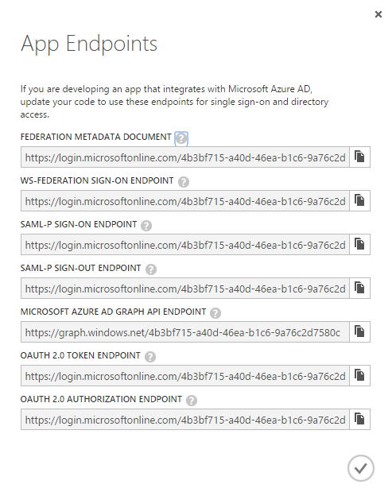
App Endpoints supported by AAD
OpenID Connect Endpoints
  Authorization endpoint
  Token endpoint
Authorization endpoint
  Used to redirect user
  Provides standard Office 365 sign-in
  Optionally, prompts user for consent
Token endpoint
  Used for server-to-server exchanges
  Nothing goes through user browser

Slide 16
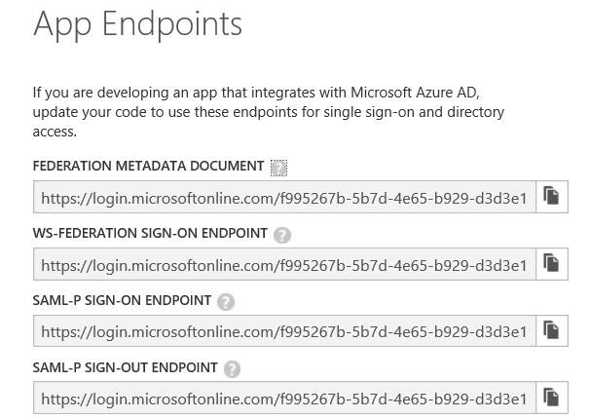
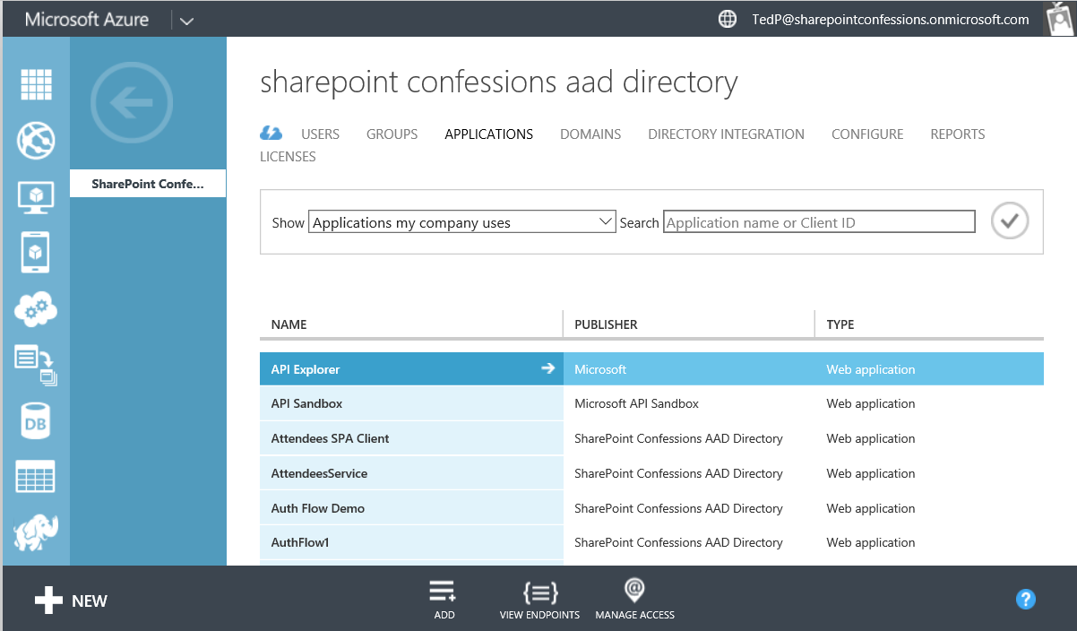
Discovering Your Tenancy ID

Slide 17
Agenda
OAuth 2.0 and OpenID Connect
Azure Active Directory
Creating Azure AD applications
Active Directory Authentication Library for .NET
Programming Web Clients

Slide 18
Azure AD Applications
Azure AD application configured with properties
  Name
  Sign-on URL
  Logo
  Single Tenant vs. Multi-tenant
  Client ID
  Keys (serves as password)
  App ID URI
  Reply URL
  Application Permissions
  Delegated Permissions

Slide 19
Single versus Multi-tenant
Single tenant application
  intended for use within a single organization
  line-of-business applications written by an Office 365 developer
  only needs to be accessed by users in one Office 365 tenancy
  typically registered by a developer in the organization
Multi-tenant application
  intended for use across many organizations
  software-as-a-service (SaaS) applications written by ISVs
  need to be provisioned in each directory where they will be used
  requires user or administrator consent to register them

Slide 20
Application Permissions
Applications can be granted permissions to other applications
  Application permissions are app-only permissions
  Delegated permissions are (app + user) permissions

Slide 21
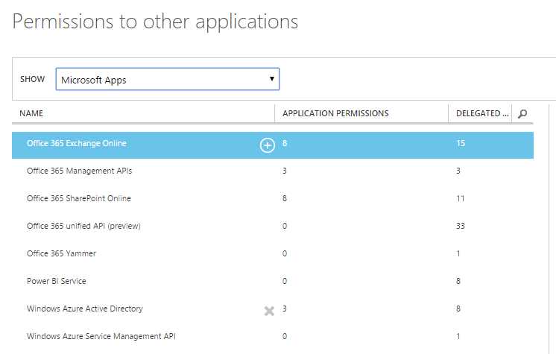
Permissions to Other Applications

Slide 22
Creating an AAD Application

Slide 23
Agenda
OAuth 2.0 and OpenID Connect
Azure Active Directory
Creating Azure AD applications
Active Directory Authentication Library for .NET
Programming Web Clients

Slide 24
ADAL for .NET
Active Directory Authentication Library for .NET
  Used in Native Clients and in Web Clients
  Handles authentication flow behind the scenes
  Provides token cache
ADAL .NET installs as a NuGet Package
  Version 2.x is latest stable version
  Version 3.x is in prerelease

Slide 25
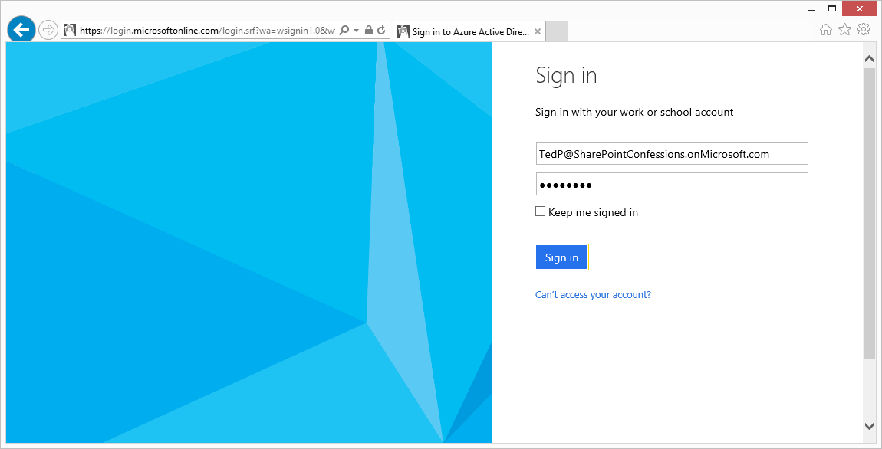
User Sign-in at https://login.microsoftonline.com

Slide 26
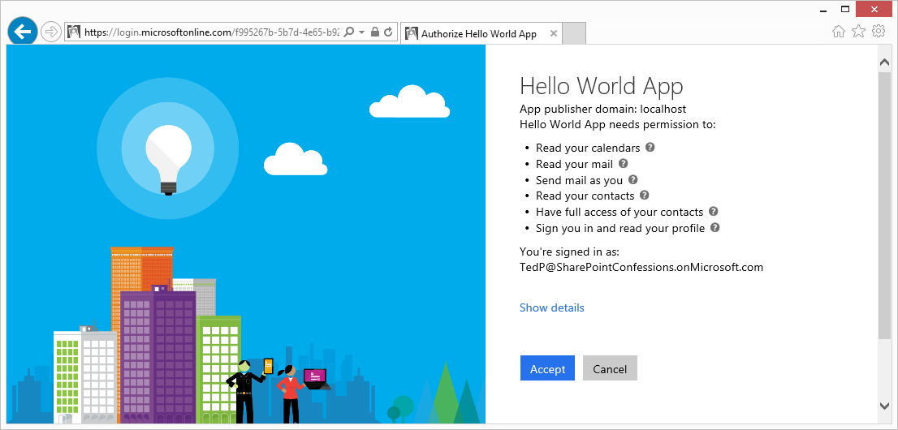
Common Consent Experience (user)

Slide 27
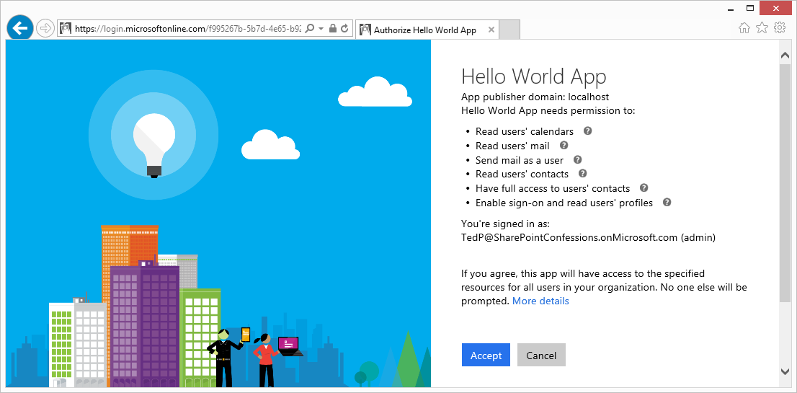
Common Consent Experience (admin)

Slide 28
Using ADAL in a Native Client

Slide 29
Agenda
OAuth 2.0 and OpenID Connect
Azure Active Directory
Creating Azure AD applications
Active Directory Authentication Library for .NET
Programming Web Clients

Slide 30
Authentication Code Flow
Provides Highest Levels of Security
  User credentials never seen by client
  Access token passed to client with Reply URL
  Access token not passed through user agent
Refresh tokens used to get new access tokens
  Access token lifetime is about 1 hour
  Refresh token lifetime is 14 days
  AAD supports multi-resource refresh tokens (MRRTs)

Slide 31
Authorization Code Grant Flow Example
Sign-on URL
  Development: https://localhost:44300/
  Production: https://www.MyDomain.com/
Reply URL
  Development: https://localhost:44300/AcceptDirect
  Production: https://www.MyDomain.com/AcceptDirect
Application ID URI
  String-based identifier for an application – not a retrievable URL
  https://sharepointconfessions.onmicrosoft.com/HelloWorldApp
Client ID
  GUID-based identifier for a specific AAD application
  33d561fb-59a7-4817-bddf-2117193d62e0
Key (aka Client Secret)
  Key that acts as a secret password between Azure AD and application
  ouWdhd2LxDl0Pcu2SKlujEiQ5GmSbKRbBM24nETb5dw=

Slide 32
Authorization Code Grant Flow
Sequence of Requests in Authorization Code Grant Flow
  Application redirects to AAD authorization endpoint
  User prompted to log on at Windows logon page
  User prompted to consent to permissions (first access)
  AAD redirects to application with authorization code
  Application redirects to AAD access token endpoint
Request authorization code
Sign-in via browser pop-up
Return authorization code
Redeem authorization code and acquire access token for Office 365 resource
Return access token and refresh token
Call Office 365 API using the access token
Return Http Response
Authorization Endpoint
Token Endpoint
Client Application
Office 365 API

Slide 33
Using ADAL in a Web Client

Slide 34
Summary of OAuth Client Types
 | Web Client SPA | Hybrid Native Client | Web Application Client | Web Service Client
Client Type | Public | Public or Confidential | Confidential | Confidential
Verifiable Reply URL | Yes | No | Yes | Yes
Authenticates Client | No | It Depends | Yes | Yes
Token from Authorization Endpoint | Yes | Yes | No | No
Access Token from URI Fragment | Yes | No | No | No
Token from Token Endpoint | No | Yes | Yes | Yes
Can use refresh tokens | No | Yes | Yes | Yes
Permissions | Delegated | Delegated + App | Delegated + App | Delegated + App

Slide 35
Summary
OAuth 2.0 and OpenID Connect
Azure Active Directory
Creating Azure AD applications
Active Directory Authentication Library for .NET
Programming Web Clients

