Slide 1
Programming the Client-side Object Model
Notes:
This module introduces students to programming with the Client-side Object Model (CSOM) in SharePoint Online. Emphasis will be placed on using CSOM when writing server-side C# code to implement the remote web of a provider-hosted add-in. Student will learn the various ways in which CSOM can be used to authenticate the user and to authenticate the SharePoint add-in itself. Students will learn CSOM programming techniques for provisioning site columns, content types, lists and document libraries in the host web. Along the way, students will also learn how to optimize CSOM calls across the network and how to utilize CSOM's support for remote exception handling when executing CSOM commands in batches.

Slide 2
Agenda
Understanding CSOM Architecture
Writing Code to Authenticate Users and Add-ins
Optimizing CSOM Code
Remote Exception Handling
Creating Site Columns, Content Types and Lists

Slide 3
Why Client Object Model (CSOM)?
Advantages of CSOM over the REST API
Strongly-typed programming
Format Digest managed automatically
Higher productivity when writing C# or VB
Provides ability to batch requests to web server
CSOM provides functionality beyond REST APIs
CSOM more preferable on server-side
CSOM isn't great fit for JavaScript apps

Slide 4
Supported CSOM Functionality
What can you do with CSOM?
Work within a specific site collection
Read and modify site properties
Create site columns and content types
Create lists, items, views and list types
Register remote event handlers
Create folder and upload and download files
Add web part and web part pages
Create new site collections

Slide 5
CSOM Growth in SharePoint 2013
New APIs introduced with SharePoint Server
User Profiles
Search
Taxonomy
Publishing
Workflow
Business Data Connectivity

Slide 6
CSOM in SharePoint 2013
CSOM Assemblies for SharePoint Foundation
Version 15 intended for SharePoint On-premises
Version 16 intended fro SharePoint Online
CSOM Assemblies for SharePoint Server

Slide 7
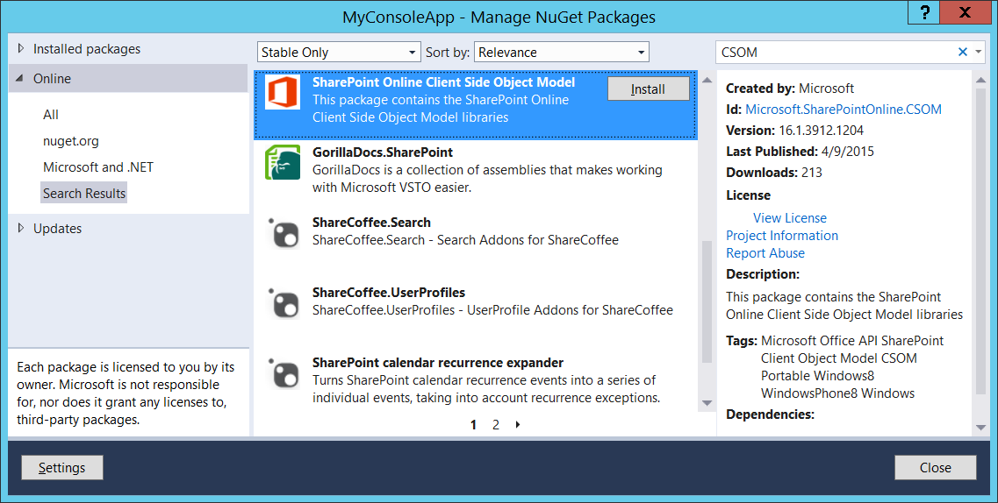
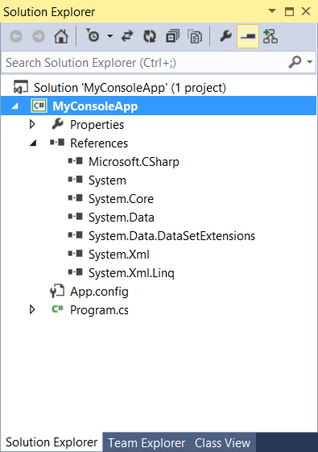
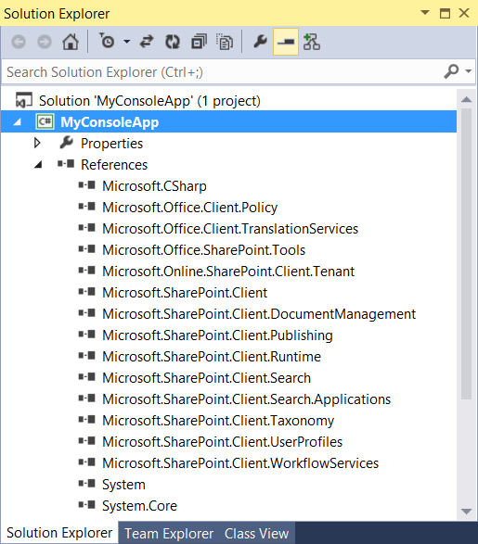
SPO CSOM NuGet Package

Slide 8
CSOM Architecture
CSOM Objects act as client-side proxies
CSOM uses Windows Communication Foundation (WCF)
CSOM Runtime layer handles WCF calls behind scenes
Request body contains XML document of instructions
Response returned in JavaScript Object Nation (JSON)

Slide 9
ClientContext
CSOM coding starts with ClientContext
Provides connection to SharePoint site
Provides access to site and site collection
Provides authentication behavior
Provides ExecuteQuery method to call server

Slide 10
Hello CSOM

Slide 11
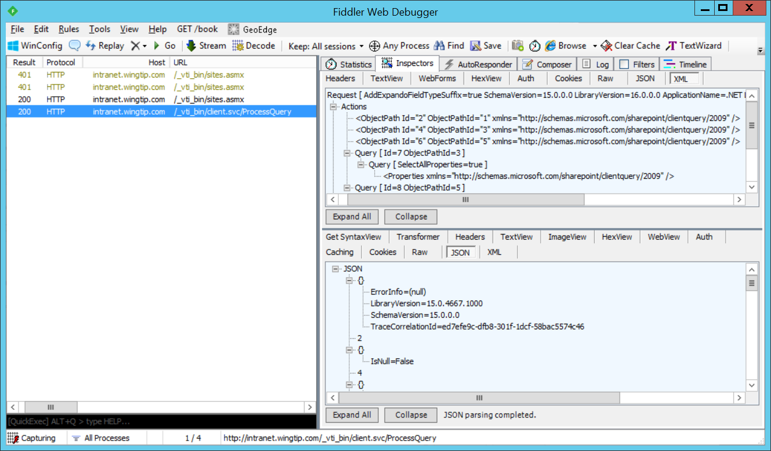
Inspecting CSOM Calls with Fiddler
ExecuteQuery triggers call to SharePoint web server
CSOM calls made behind the scenes using WCF
CSOM calls target /_vti_bin/client.svc/ProcessQuery
Can be helpful to inspect CSOM calls using Fiddler Web Debugger

Slide 12
Agenda
CSOM Fundamentals
User and App Authentication
CSOM Code Optimization
Remote Exception Handling
Creating Content Types and Lists

Slide 13
User Authentication (On-premises)

Slide 14
User Authentication (SPO)

Slide 15
Authentication with TokenHelper
On-premises with S2S
In SharePoint Online with OAuth

Slide 16
Authentication with SharePointContext
SharePointContext simplifies your code
Automatically tracks SharePoint query string variables
Abstracts away issues for OAuth vs S2S
Provides four ways to create ClientContext

Slide 17
ClientContext Usage Pattern
ClientContext is a disposable object
Should be disposed after you are done using it
Common to use within using statement

Slide 18
Agenda
CSOM Fundamentals
User and App Authentication
CSOM Code Optimization
Remote Exception Handling
Creating Content Types and Lists
Managed Metadata and Publishing

Slide 19
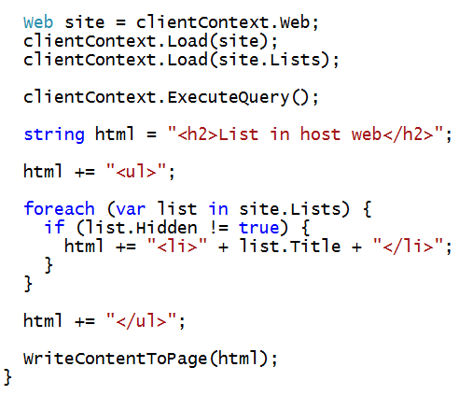
What’s Wrong with This Code?

Slide 20
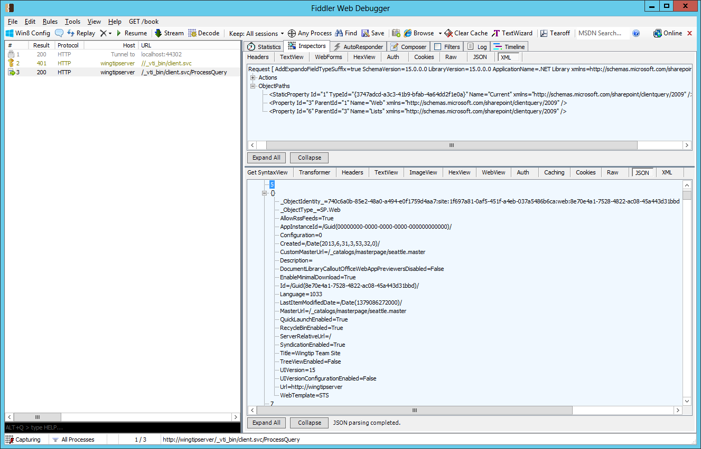

Inspecting CSOM Calls using Fiddler

Slide 21
Coding with Lambda Expressions
C# supports the use of lambda expressions
Syntax Introduced as part of LINQ with .NET 3.5
Can (and should) be used with CSOM
Lambda expression is anonymous function
It defines a parameter list and a function body
Input Parameter(s)
Lambda Operator
Statement Block

Slide 22

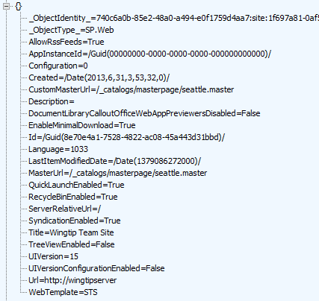

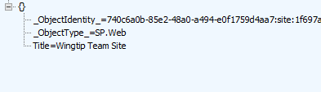
Using Lambda Expressions
Loading an object populates all scalar property values
Can result in inefficient use of network bandwidth
Lambda expressions can be used to optimize
You can indicate which properties you want populated

Slide 23
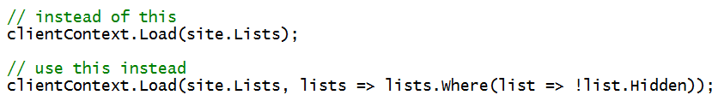
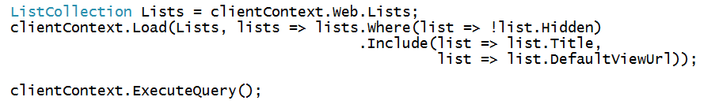
Using Where() and Include()
Where lets you pass filter criteria to server
Include lets you pick fields on item in a collection
Syntax is powerful but tricky to read and write

Slide 24
Check Whether List Exists
How do you determine if a list already exists
CSOM doesn't provide simple approach
Query for the list by it's title or URL
Check to see if match list exists

Slide 25
Retrieving Data using LoadQuery
LoadQuery can be used instead of Load
Allows you to write LINQ query expressions

Slide 26
Retrieving with a CamlQuery

Slide 27
Batching Commands

Slide 28
Agenda
CSOM Fundamentals
User and App Authentication
CSOM Code Optimization
Remote Exception Handling
Creating Content Types and Lists
Managed Metadata and Publishing

Slide 29
Consider the following code…

Slide 30
Remote Exception Handling

Slide 31
General Usage

Slide 32
Agenda
CSOM Fundamentals
User and App Authentication
CSOM Code Optimization
Remote Exception Handling
Creating Content Types and Lists

Slide 33
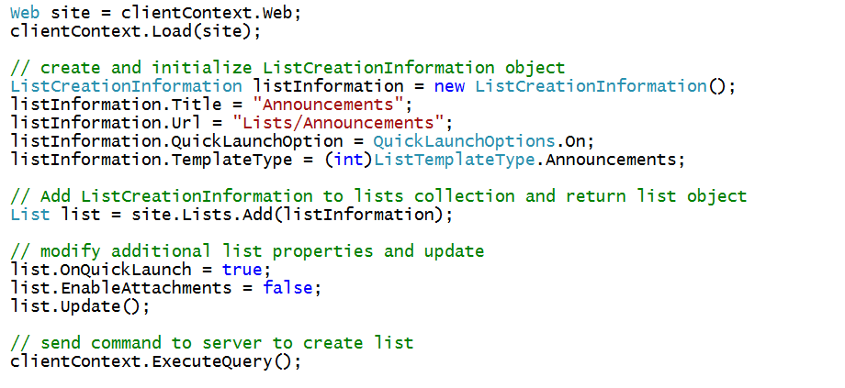
Creating a List

Slide 34
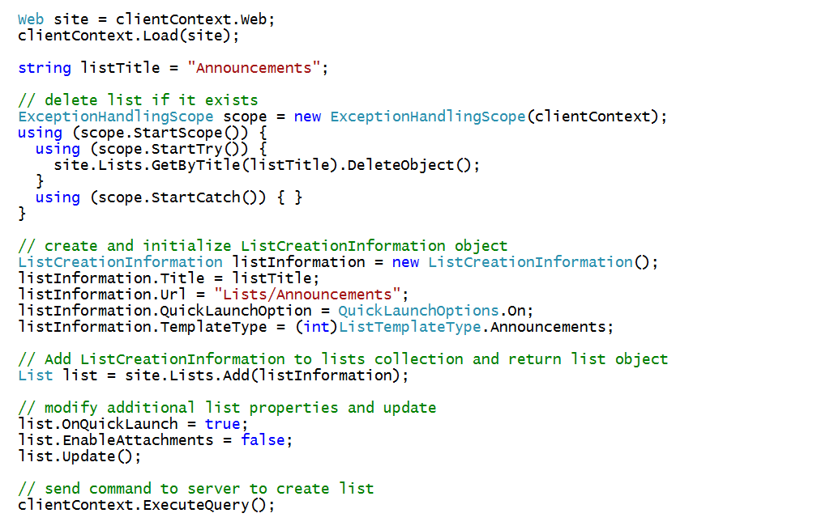
Checking Whether List Already Exists

Slide 35
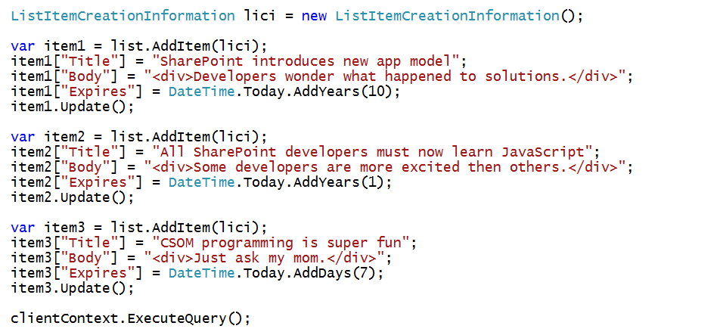
Creating List Items

Slide 36
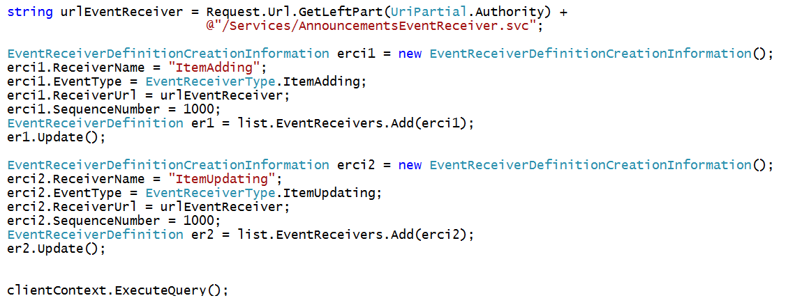
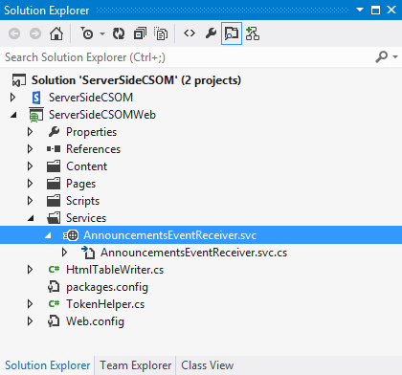
Registering Remote Event Receivers
Remote Event Receivers require registration
Declarative registration only possible in app web
Registration in host web requires CSOM code

Slide 37
Creating Site Columns - Part 1

Slide 38
Creating Site Columns - Part 2

Slide 39
Creating Content Types - Part 1

Slide 40
Creating Content Types - Part 2

Slide 41
Creating List with Content Type

Slide 42
Creating a Document Library

Slide 43
Uploading Files to a Library
Create a utility upload function with common CSOM code
Call function passing file name and byte array

Slide 44
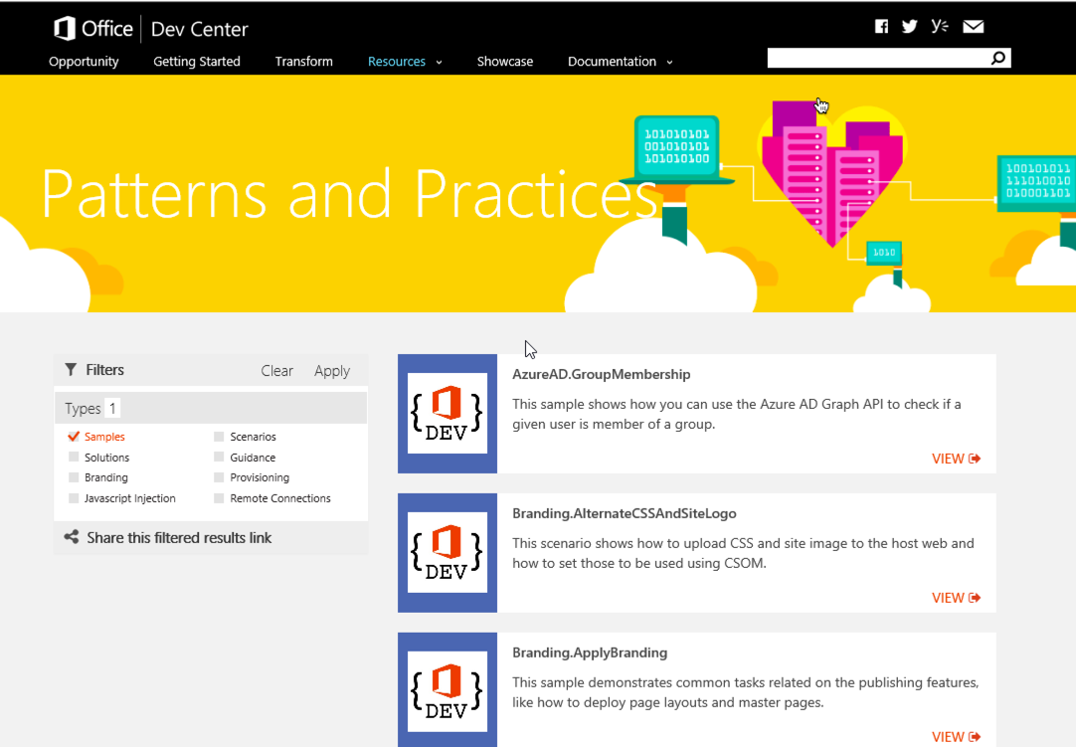
Microsoft Patterns & Practices (PnP)
Providing App Model Patterns for common Full Trust Code scenarios
130+ Visual Studio Projects
Common scenarios
Branding
Site Provisioning
Remote Event Receivers
Large file support
Taxonomy driven navigation
And much more…
http://dev.office.com/patterns-and-practices

Slide 45
Summary
CSOM Fundamentals
User and App Authentication
CSOM Code Optimization
Remote Exception Handling
Creating Content Types and Lists

