Slide 1
Office 365 Developer Roadmap
Notes:
This module provides an introduction to Office 365 as a development platform and discusses the different approaches that can be used to develop custom software solutions for Office 365 and SharePoint Online. The module provides an overview of the Office add-in model and the SharePoint add-in model and then discusses the types of solutions that can be created using them. The module also discusses alternatives approaches for Office 365 development including the use of JavaScript injection in SharePoint Online and developing applications that program against the Office 365 APIs. The module walks through setting up an Office 365 development environment which includes an Office 365 Developer site, an Office 365 tenancy and a directory in Azure Active Directory (AAD). The module also explains how to obtain a Windows Azure subscription which makes it possible to deploy ASP.NET applications to the Azure cloud and to create and configure AAD applications using the Windows Azure Management Portal.

Slide 2
Student Introductions
Basic Info
What’s your name?
Where do you work? (optional)
How long have you been a developer?
List skills with which you already feel comfortable
.NET programming with C# or VB.NET
SharePoint farm solution development
JavaScript, jQuery and Angular
Programming with REST and OData
Developing with ASP.NET MVC and Web API

Slide 3
Agenda
Office 365 Development Platform Overview
The Office Add-in Model
The SharePoint Add-in Model
JavaScript Injection and Remote Provisioning
Development using the Office 365 APIs
Getting Started with Office 365 Development

Slide 4
Office 365 Development Platform
Approaches to Office 365 Development
Developing Office Add-ins
Developing SharePoint Add-ins
Developing Solutions using JavaScript Injection
Developing Applications using the Office 365 APIs
This course examines each of these approaches

Slide 5
Agenda
Office 365 Development Platform Overview
The Office Add-in Model
The SharePoint Add-in Model
JavaScript Injection and Remote Provisioning
Development using the Office 365 APIs
Getting Started with Office 365 Development

Slide 6
What is an Office Add-in?
Web application loaded inside an Office Application
Embedded inline or as task pane within documents or mail item
Works in Office Applications such as Microsoft Outlook
Works in Office Web Applications such as OWA
Works in mobile Office clients
Office application extensions using Web technologies
HTML 5 and CSS used to construct user interface
JavaScript and jQuery used to add executable logic and events
Add-in can provided code to read/write content to/from documents
Add-in can call Web services hosted over Internet or local network
Notes:
An Office Add-in can be seen as a Web page loaded inside an Office Application. In some cases it will appear embedded inline within the document. In other cases it might appear as a task pane or within a message in Outlook. Note that the architecture for Office Add-ins has been designed to work in both Office Applications and Office Web Applications.
Office Add-ins allow Office applications to be extended in such as way so that they can leverage Web technologies such as HTML 5 and CSS for rendering user interface as well as JavaScript and jQuery to add behavior. When you write the JavaScript code for an Office Add-in, you can call REST APIs such as those added to SharePoint 2013 to retrieve and update data from across network.

Slide 7

Anatomy of an Office Add-in
Each Add-in is based on XML-based manifest
Manifest points to a Web page
Manifest defines the type of the Office Add-in
Manifest defines which Office applications it supports
Manifest defines required capabilities
Office Add-in
Office Add-in
Manifest
<XML>
Web
Page
HTML+JS
Notes:
Every App for Office must be distributed with an XML-based manifest which contains information about the app itself. For example, the app manifest contains an address to a Web page on the Internet which is used to load the app. The app manifest also includes information which indicates which Office applications it supports. The app manifest also defines the required capabilities which represent the set of permissions that the app needs in order to run and complete its work.

Slide 8



Designing Office Add-ins - Shapes
Office Add-ins come in different shapes
Task Pane Add-in
Content Add-in
Mail Add-in
Mail Compose Add-in
Word Application
Excel Application
Outlook Application
Outlook Application
Document
Task Pane App
Document
Inbox
Selected Message
Inbox
New Message
Mail Compose
App
Reply | Reply All | Forward
To: xxx@yyy.com
Subject: Top secret stuff
app
Mail App
Content App
Message Body
Message Body
Notes:
When you begin to design an app, you must pick one of the three different shapes. You can create a document-based app as either a Task Pane App or a Content App. Alternatively, you can create a Mail App that targets Outlook and Outlook OWA.

Slide 9
Agenda
Office 365 Development Platform Overview
The Office Add-in Model
The SharePoint Add-in Model
JavaScript Injection and Remote Provisioning
Development using the Office 365 APIs
Getting Started with Office 365 Development

Slide 10
SharePoint Apps Add-ins
SharePoint 2013 introduced new development model
Originally introduced as "SharePoint App Model"
In Q2 of 2015, Microsoft changed the name
"SharePoint Apps" renamed to "SharePoint Add-ins"
"SharePoint App" is same things as "SharePoint Add-in"

Slide 11
SharePoint Add-in Model Overview
Add-in model designed to replace farm solutions
Add-ins supported in Office 365 and on-premises farms
Add-in code never runs in SharePoint host environment
Add-in talks to SharePoint using REST and CSOM
Add-in authenticates and establishes add-in identity
Add-in has permissions independent of user
Add-ins deployed to catalogs using publishing scheme
Published add-ins easier to find, install and upgrade
Notes:
Unlike farm solutions, apps are supported and will work in both on-premises deployments and in Office 365. The business logic within an app does not run within the SharePoint server or host environment, rather it runs external to SharePoint on another server or in the client. There is also a notion of app identities in the sense that apps can be authenticated and assigned permissions, similar to users.

Slide 12
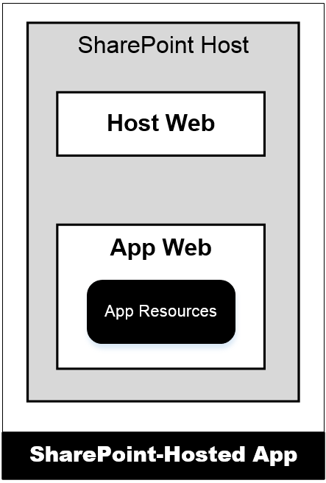
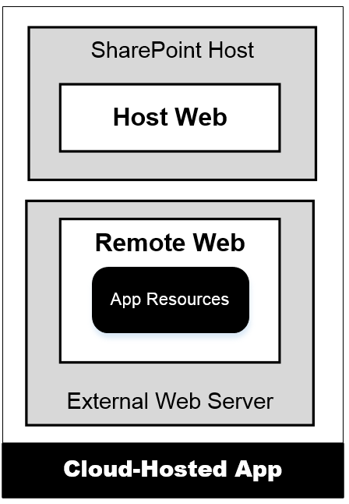
Hosting Options for SharePoint Add-ins
SharePoint-Hosted Add-ins
Add-in resources added to SharePoint host
Stored in child site known as app web
Add-in has only client-side code
Add-in cannot have server-side code
Provider-Hosted Add-ins
Add-in resources deployed on remote server
Remote site known as remote web
Add-in can have client-side code
Add-in can have server-side code
Notes:
There are two different types of apps and a few terms you should be aware of. First, apps are either hosted within SharePoint or they are hosted outside of SharePoint. The first type of app, a SharePoint-Hosted app is the type where all the app’s resources (pages, JavaScript, style sheets and images) are all provisioned to the SharePoint host. The business logic within SharePoint-Hosted apps runs within the client (browser). The hosting model for a Provider-hosted app is quite different in the sense that the bulk of the app logic and maintainable reside outside of SharePoint, for instance as an ASP.NET MVC site on another Windows Server, in Azure, as a PHP site in Amazon Web Services or any number of other options.
The site in which an app is installed form is called the host web. When an app with SharePoint-hosted resources is installed, the SharePoint host will create a subsite known as the app web. For provider-hosted apps, the remote site is known as the remote web.

Slide 13
APIs used by SharePoint Add-ins
SharePoint REST API
Commonly used with client-side JavaScript code
Good fit when developing SharePoint-hosted add-ins
Accessible to any type of client on any platform
Client-side Object Model (CSOM)
Commonly used with server-side C# code
Good fit when developing provider-hosted add-ins
Good fit when creating desktop clients (e.g. Console app)
Used to perform remote provisioning in SPO sites

Slide 14
Agenda
Office 365 Development Platform Overview
The Office Add-in Model
The SharePoint Add-in Model
JavaScript Injection and Remote Provisioning
Development using the Office 365 APIs
Getting Started with Office 365 Development

Slide 15
JavaScript Injection
JavaScript injection based on central concept…
upload custom JavaScript code to SharePoint Online
execute code using identity and permissions of current user
Approaches for using JavaScript injection
Script Editor Web Part
Adding JavaScript code behind SharePoint site pages
Full-blown Visual Studio project development
Why create solution using JavaScript Injection?
Provides more flexibility than SharePoint add-in model
Poses fewer constraints than SharePoint add-in model

Slide 16
Remote Provisioning
Remote provisioning in SPO
Use CSOM to create SPO site elements
Recommended over SharePoint solutions & features
What can you create with Remote Provisioning
New child sites, lists and document libraries
Site columns, content types and remote event receivers
New pages with custom JavaScript logic
User custom actions with custom JavaScript logic

Slide 17
Agenda
Office 365 Development Platform Overview
The Office Add-in Model
The SharePoint Add-in Model
JavaScript Injection and Remote Provisioning
Development using the Office 365 APIs
Getting Started with Office 365 Development

Slide 18
What are the Office 365 APIs?
New web service platform for accessing data in Office 365
Implemented as RESTful services based on ODATA version 4.0
Provides authentication and authorization based on OAuth 2.0
Provides extra authentication support for OpenID Connect
Open standards provide wide range of accessibility
Many choices for developers with respect to platforms, tools, languages and , application types
Windows Azure APIs
Office 365 APIs - initial release in October of 2014
Graph
API
Discovery
API
Exchange
SharePoint
Mail
API
Events
API
Contacts
API
Files
API

Slide 19
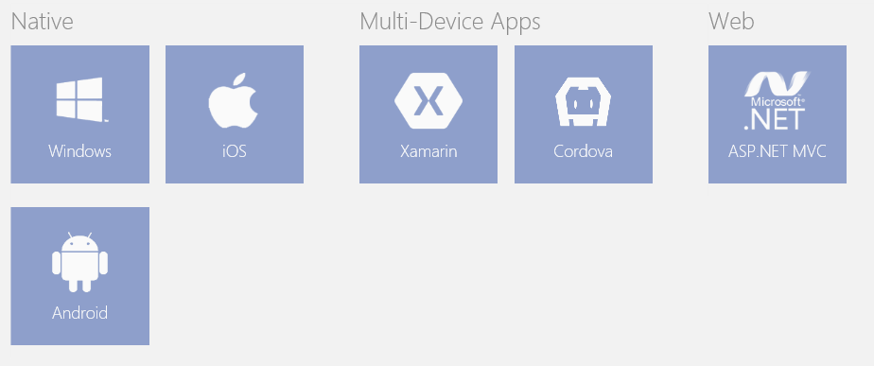
Support for Non-Microsoft Platforms
Office 365 APIs universally accessible via open standards
Any development platform can use REST, ODATA and OAuth2
Office 365 developers can use wide array of tools and languages
No hosting environment dependencies (e.g. Windows or IIS)
SDKs and extra help available for selected platforms
SDKs available for Windows, ASP.NET, iOS and Android
Choose between Visual Studio, XCode, Eclipse or Android Studio

Slide 20
Office 365 and Azure Active Directory
Office 365 environments are based on tenancies
Tenancy provides scope for creating and managing users
Office 365 is integrated with Azure Active Directory (AAD)
Each Office 365 tenancy is backed by an AAD directory
AAD directory can be managed using Office 365 administration
AAD directory can be managed using Windows Azure Portal
Azure support registering application within scope of AAD directory

Slide 21
Agenda
Office 365 Development Platform Overview
The Office Add-in Model
The SharePoint Add-in Model
JavaScript Injection and Remote Provisioning
Development using the Office 365 APIs
Getting Started with Office 365 Development

Slide 22
Getting Started with Office 365 Development
Obtain an Office 365 developer account
Create an Office 365 Developer Site
Obtain a Windows Azure subscription
Develop solutions remotely with Visual Studio
Getting around inside your Office 365 Tenancy
Office 365 administrative tools
SharePoint administrative tools
Azure Management Portal
PowerShell utilities

Slide 23
Office 365 Tenancies in SharePoint Online
Office 365 environment based on tenancies
New tenancy is created for each customer organization
Tenancy provides scope for creating users and groups
Tenancy provides scope for creating SharePoint sites
Tenancy provides scope for SharePoint add-ins
Office 365 Developer should be tenant admin
Provides permissions you need to develop and test

Slide 24
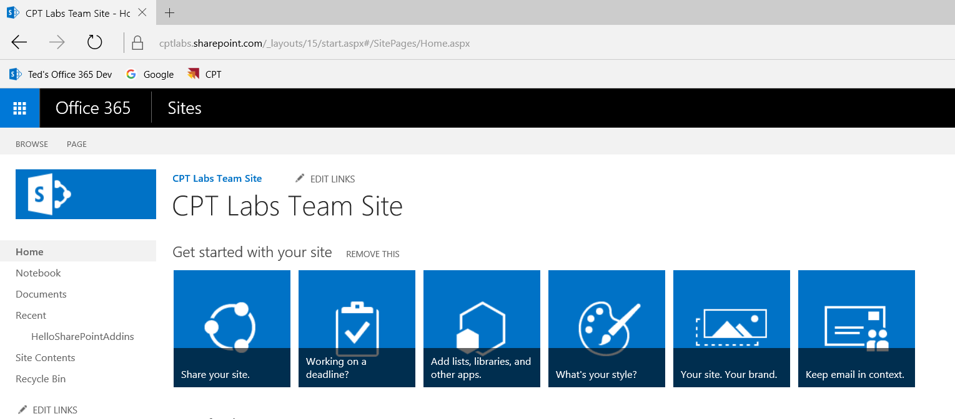
SharePoint Online Team Sites

Slide 25
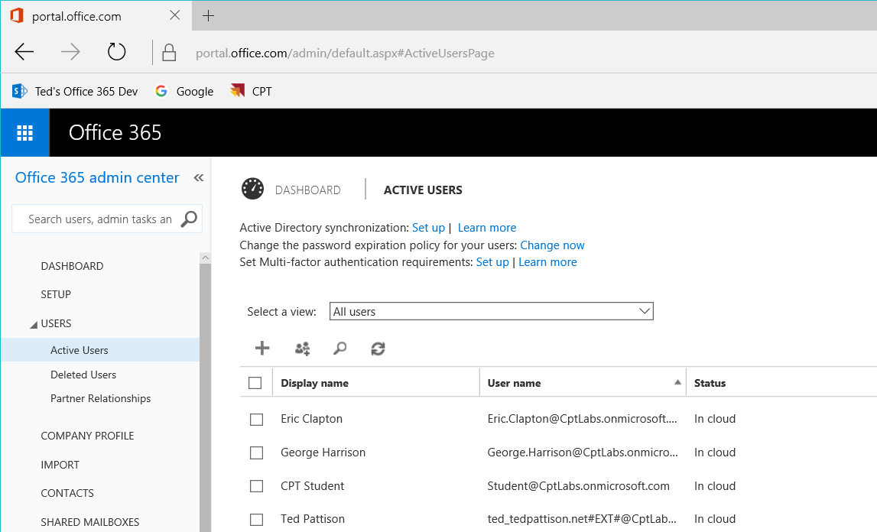
Office 365 admin center

Slide 26
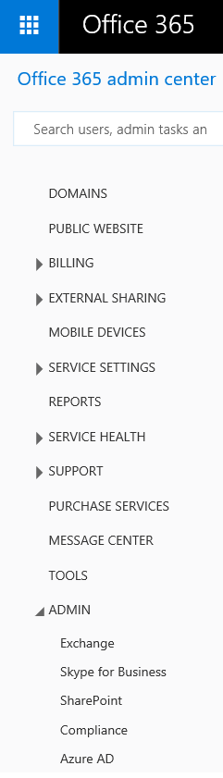
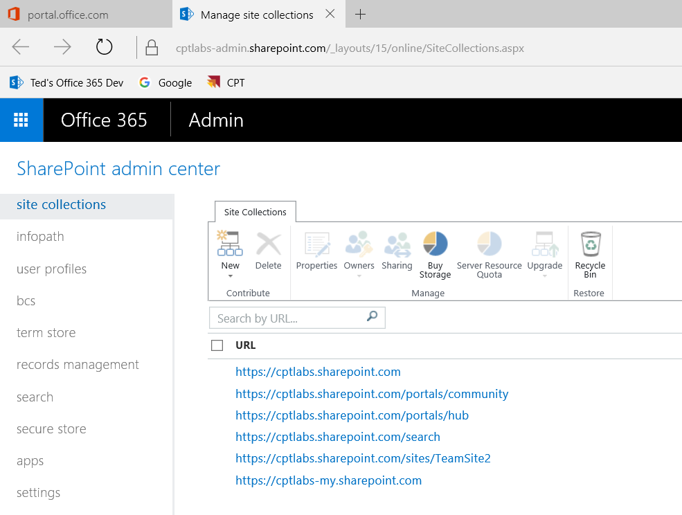
SharePoint admin center

Slide 27
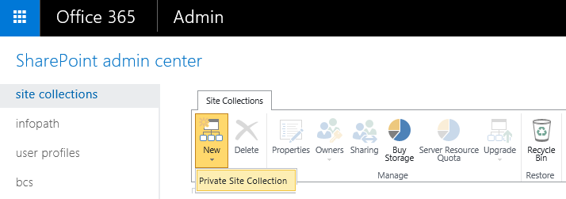
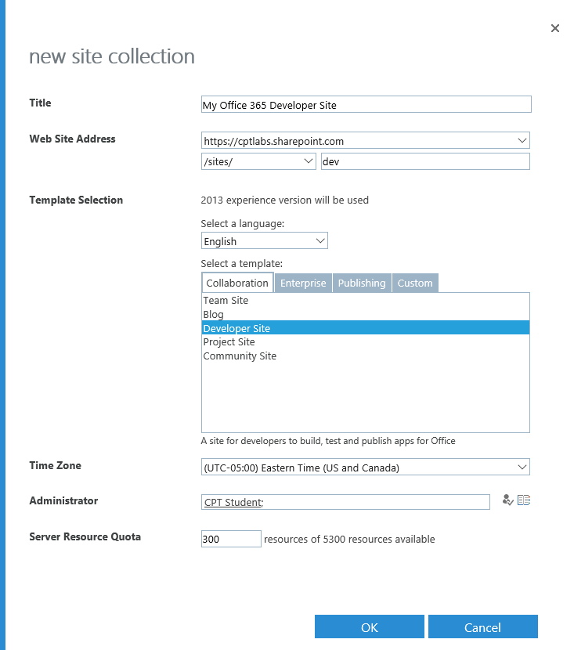
Creating a New Site Collection

Slide 28
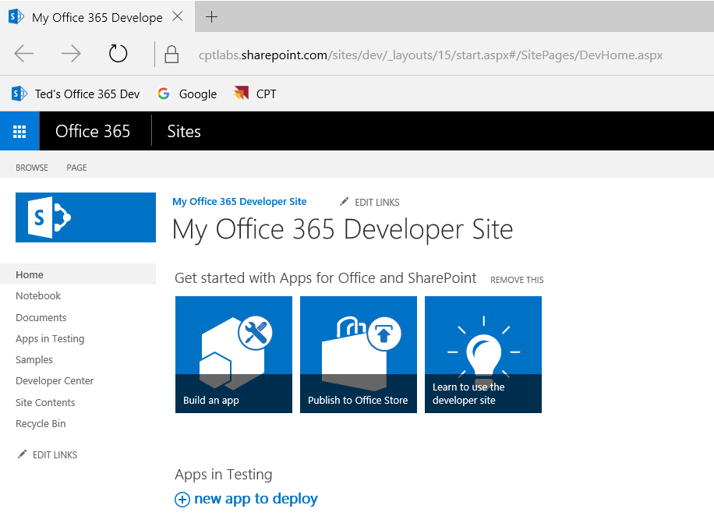
SharePoint Developer Sites

Slide 29
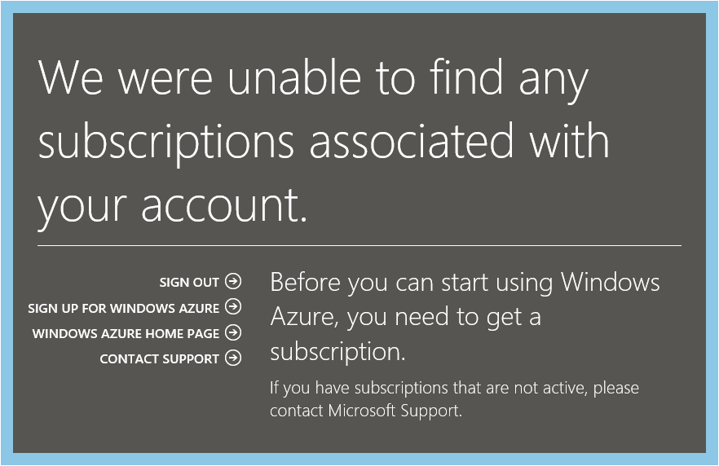
Obtaining an Azure Subscription
Getting an Azure Subscription
Sign up with paid-for account
Get free Azure subscription with a MSDN Subscription
Sign up for free 30-day trial account
Signing up for free trial account
Navigate to Azure Portal using Office 365 credentials
When prompted, sign up for a trial

Slide 30
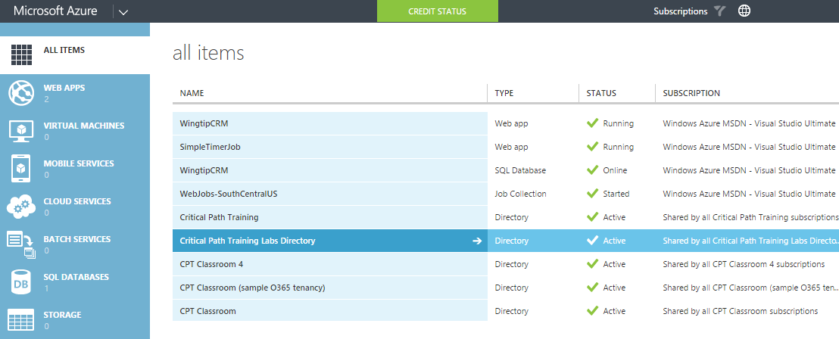
Azure Management Portal
Provides management over one or more directories
View & configure AAD directory behind Office 365 tenancy
Create, view and configure AAD users and groups
Create, view and configure AAD applications

Slide 31
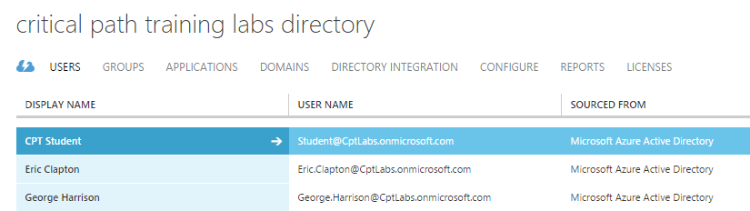
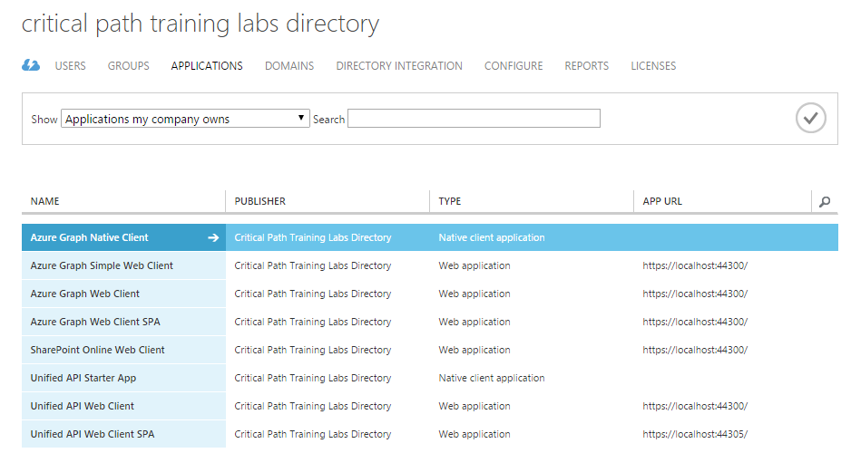
Azure AD Users and Applications

Slide 32
Office 365 Developer Tools
Visual Studio 2015
Fiddler Web Debugger
SharePoint Designer 2013
Various PowerShell Utilities for Office 365

Slide 33
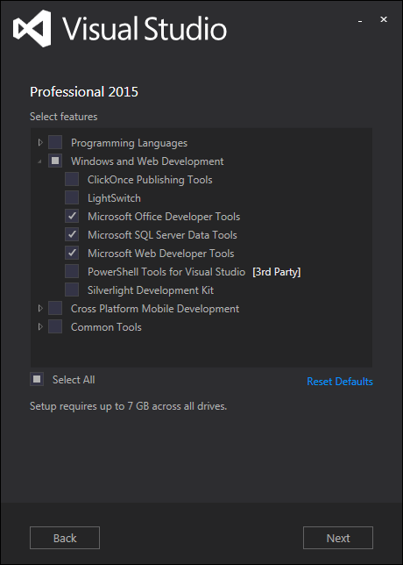
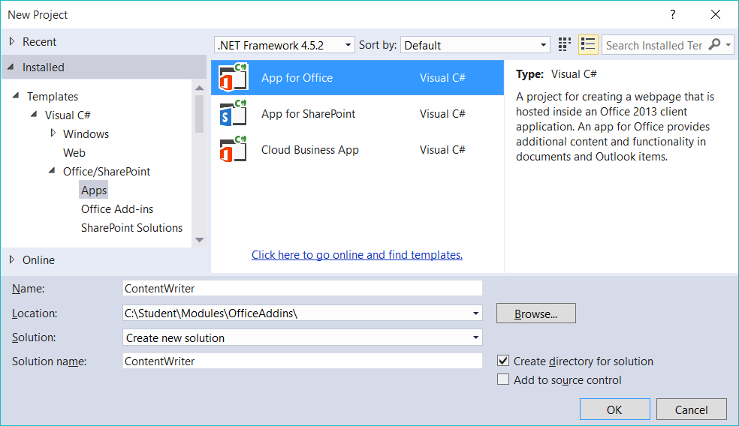
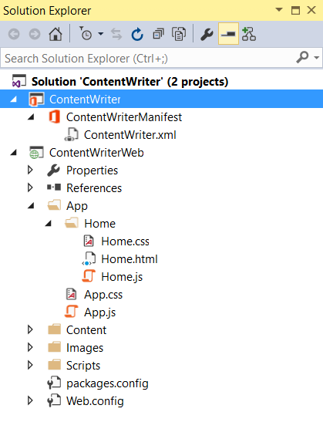
Visual Studio 2015
Latest Version of Visual Studio
Released in summer of 2015
Provides project templates for Office 365 development
Communicates with SharePoint Online, Azure and Azure AAD

Slide 34
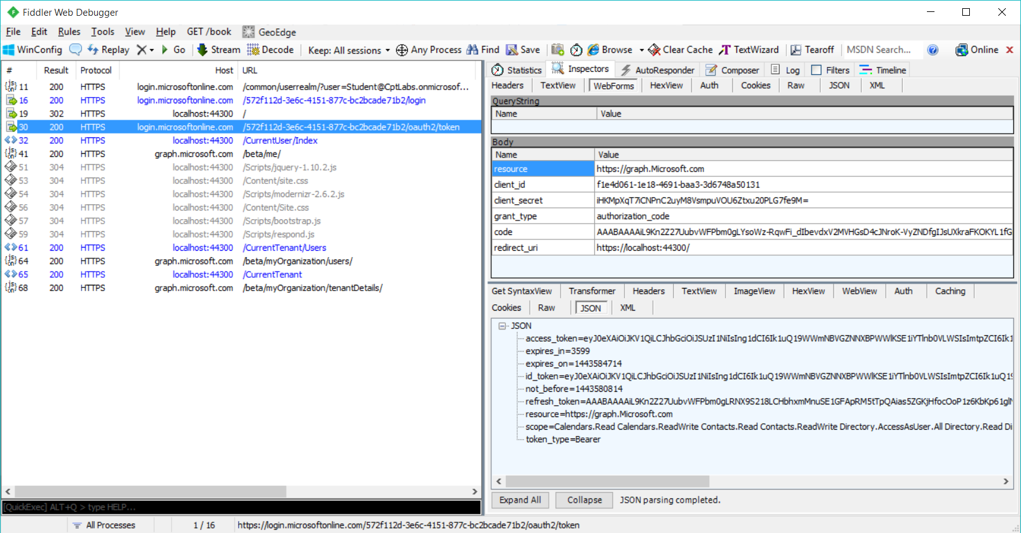
Fiddler Web Debugger
Debugging tool for HTTP-based Development
Allows you to monitor local HTTP requests
Allows you to monitor request and response details
Allows you to compose and send HTTP requests

Slide 35
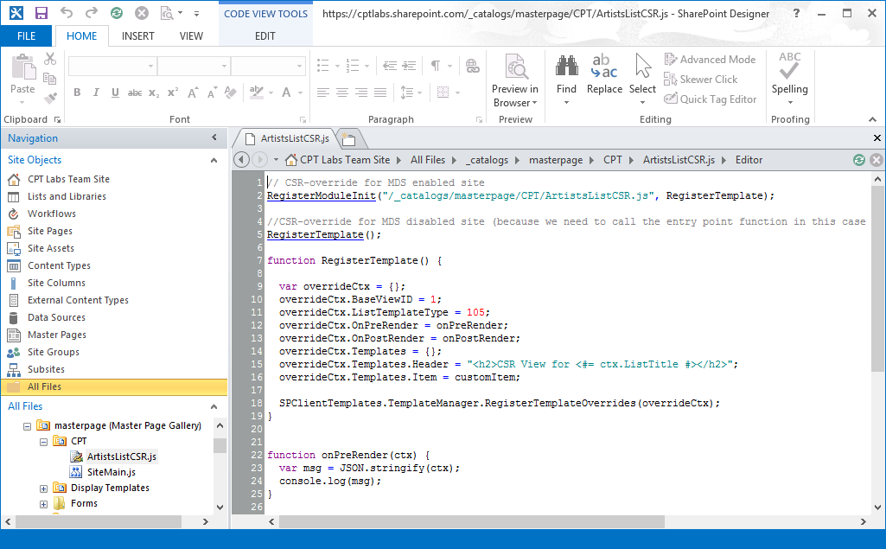
SharePoint Designer 2013
Handy utility for Office 365 development
Allows you to inspect file/folder structure of site
Helps to ensure CSOM provisioning code is working correctly

Slide 36
PowerShell Utilities for Office 365 Development
Microsoft Online Services Sign-In Assistant
Provides other utilities with interactive log-in capabilities
SharePoint Online Management Shell
Allows you to manage users and groups
Allows you to discover and create new SPO sites
Microsoft Azure PowerShell Module
Allows you to create Azure objects (e.g. Web Apps)
Azure Active Directory PowerShell Module
Allow greater control over Azure AD objects

Slide 37
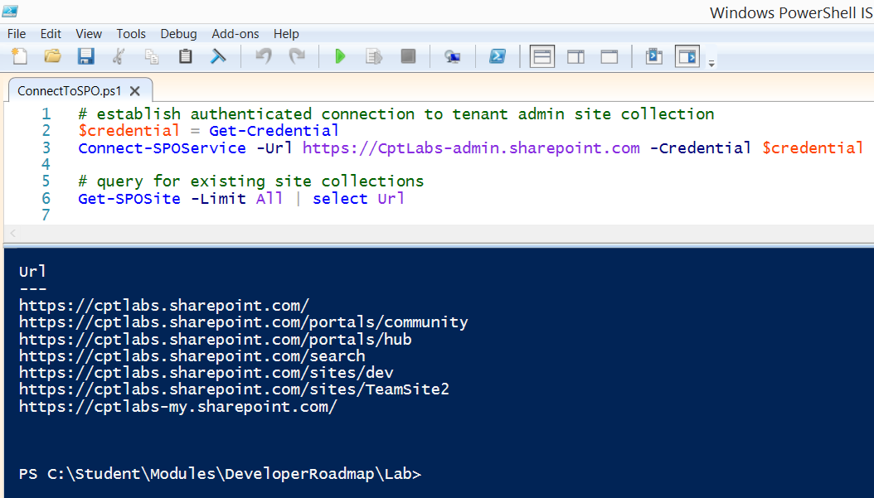
SharePoint Online Management Shell

Slide 38
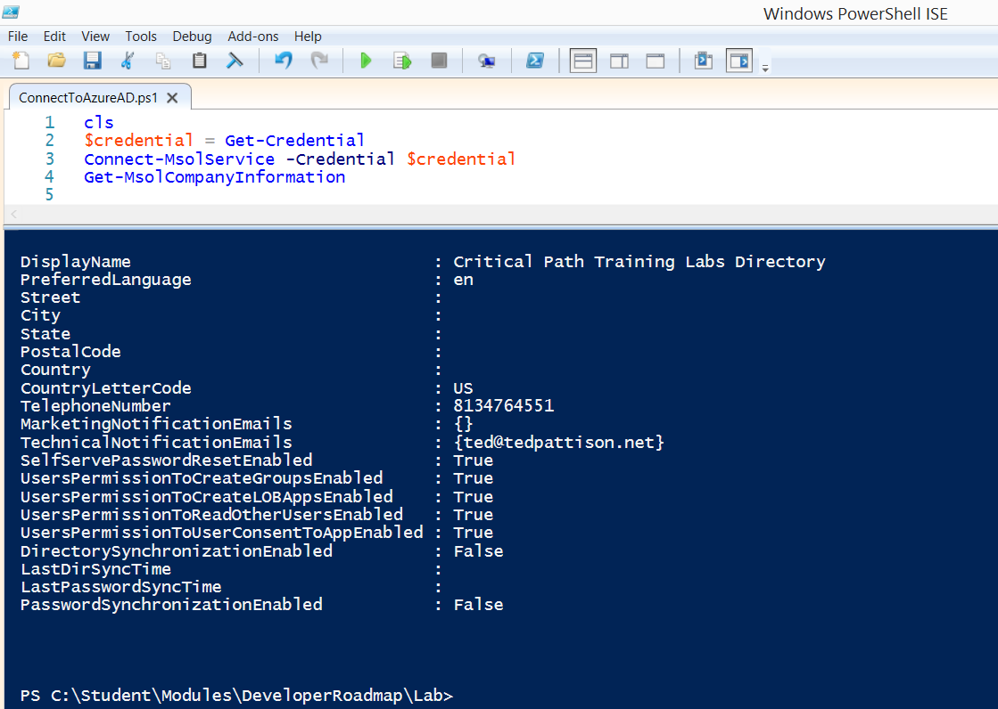
Azure Active Directory PowerShell Module

Slide 39
Schedule of Lectures
Module 01: Office 365 Developer Roadmap
Module 02: Developing Office Add-ins
Module 03: Developing SharePoint-hosted Add-ins
Module 04: Programming with the SharePoint REST API
Module 05: Developing SharePoint Apps using AngularJS
Module 06: Developing Provider-hosted Add-ins
Module 07: Developing Provider-hosted Add-ins with MVC
Module 08: Programming the Client-side Object Model (CSOM)
Module 09: Developing SharePoint Add-ins with Remote Event Receivers
Module 10: Developing Custom Web Services using Web API 2
Module 11: Publishing and Installing Add-ins in the Office 365 Environment
Module 12: JavaScript Injection and Remote Provisioning
Module 13: Authenticating with Azure Active Directory and OAuth 2.0
Module 14: Introduction to the Office 365 APIs
Module 15: Developing MVC Applications with the Office 365 Unified API
Module 16: Developing SPAs with AngularJS and the Office 365 Unified API
YOU ARE HERE

Slide 40
Summary
Office 365 Development Platform Overview
The Office Add-in Model
The SharePoint Add-in Model
JavaScript Injection and Remote Provisioning
Development using the Office 365 APIs
Getting Started with Office 365 Development

