Slide 1
JavaScript Injection and Remote Provisioning
Notes:
The module begins by explaining the central concept of JavaScript injection where scripts containing custom JavaScript code are uploaded to SharePoint Online and executed using the permissions of the current user. Students will learn to get started with JavaScript injection using the Script Editor Web Part. Next, students will learn how to extend a SharePoint site by adding new pages and custom JavaScript code which makes use of the JavaScript Object Model (JSOM) and the SharePoint REST API. The module then explains how to use remote provisioning to effectively deploy a custom solution which uses JavaScript injection. Along the way, the module discusses loading JavaScript library dependencies as well as how to execute custom JavaScript code with user custom actions such as ribbon buttons, ECB menu items and ScriptLinks as well as how to use client-side rendering rendering techniques and JSLink to create customized views for SharePoint lists.

Slide 2
Agenda
Enabling Scripting in Office 365.
Understanding JavaScript Injection
JSOM Programming
Remote Provisioning using CSOM
Designing MDS-enabled Pages
JSLink and Client-side Rendering

Slide 3
Scripting Capabilities in SharePoint Online
SharePoint Online has powerful scripting features
It’s powerful when used by the good guys
It’s powerful when used by the bad guys
SharePoint Online disables scripting by default
The default scripting capabilities disabled for
Personal sites
Self-service created sites
Root site collection of the tenant

Slide 4
Features Affected with Scripting Disabled
When scripting is disabled…
Many links removed from Site Settings page
SharePoint Designer capabilities reduced
You cannot edit master pages or page layouts
You cannot edit theme for current site
Many Web Parts are missing (e.g. Script Editor)
Users cannot upload .aspx files to document libraries
Scripting must be enabled at the site level
Can be done by configuring SPO tenancy policy
Can be done using PowerShell or CSOM

Slide 5
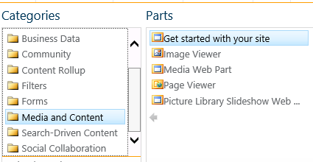
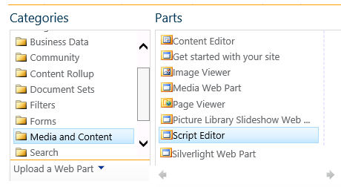
Effects of Scripting Being Disabled
Media and Content Web Parts (scripting disabled)
Media and Content Web Parts (scripting enabled)

Slide 6
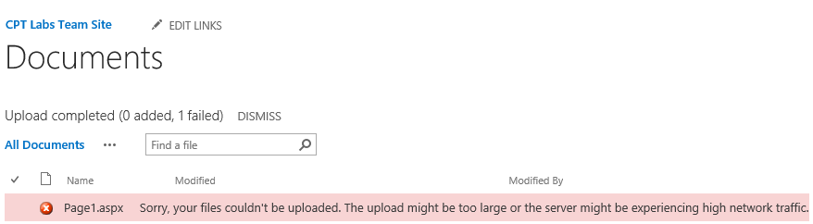
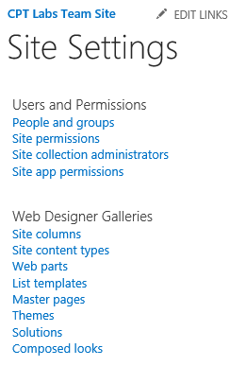
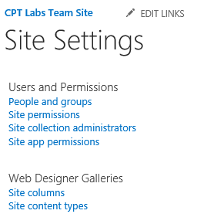
More Effects of Scripting Being Disabled
You cannot upload a .ASPX file to a document library
Many Administrative Links removed from Site Settings page
Scripting Enabled
Scripting Disabled

Slide 7
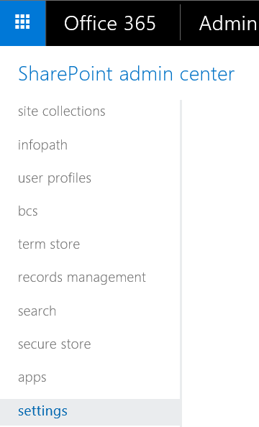
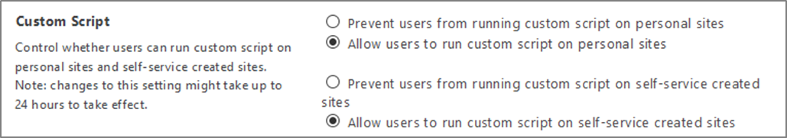
Enabling Scripting in SharePoint Admin Center
Settings configurable in SharePoint admin center
Sets policy for sites created in future
Sets policy for existing sites created within tenancy
Can take up to 24 hours to propagate changes to existing sites

Slide 8
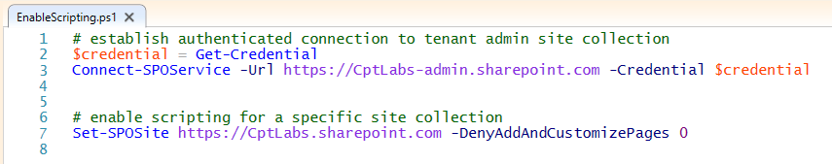
Enabling Scripting using PowerShell
Site scripting setting can be enabled using PowerShell
Use Set-SPOSite cmdlet to update DenyAddAndCustomizePages
Changes take affect immediately
PowerShell syntax
Set-SPOsite <_YOUR_SITE_URL_> -DenyAddAndCustomizePages 0

Slide 9
Agenda
Enabling Scripting in Office 365.
Understanding JavaScript Injection
JSOM Programming
Remote Provisioning using CSOM
Designing MDS-enabled Pages
JSLink and Client-side Rendering

Slide 10
JavaScript Injection
JavaScript injection based on central concept…
upload custom JavaScript code to SharePoint Online
execute code using identity and permissions of current user
Approaches for using JavaScript injection
Script Editor Web Part
Uploading Custom pages and JavaScript files
Use remote provisioning to deploy files to target site
Why create solutions using JavaScript Injection?
Provides more flexibility than SharePoint add-in model
Poses fewer constraints than SharePoint add-in model

Slide 11
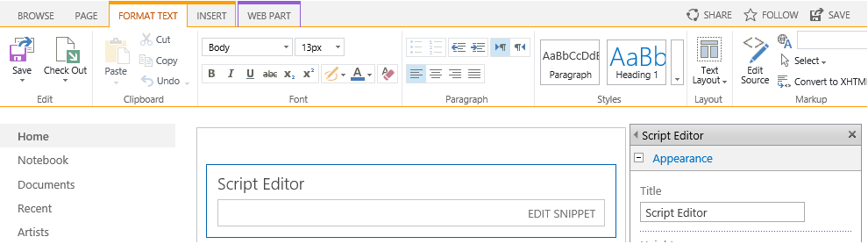
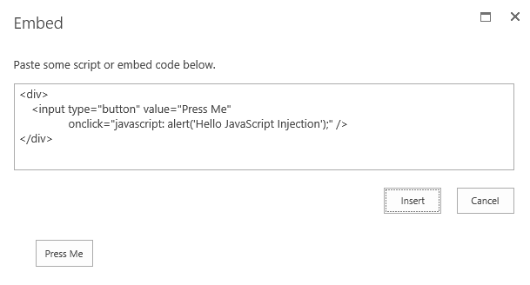
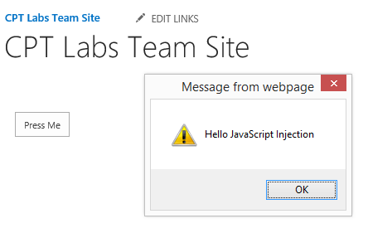
Script Editor Web Part
Allows user to add custom script logic in ad-hoc fashion

Slide 12
Adding Custom Site Logic using the Script Editor Web Part

Slide 13
Creating and Uploading Custom Pages
Uploading Custom Pages
Scripting must be enabled for target SPO site
Page file must be ASPX file (HTML files do not work)
Page can be uploaded to any document library
Page can link to same master page as other site pages
Page can link to custom CSS files and JavaScript files
What about the SharePoint sites running in MDS mode?
Minimal Download Strategy (MDS) affects how pages run
MDS-enabled pages run in MDS mode through start.aspx
MDS mode redirects unsupported pages back to non-MDS URLs

Slide 14
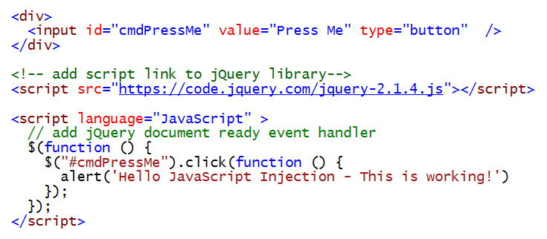
Adding a Script Link for jQuery
SharePoint does not load jQuery library
It must be explicitly for Script Editor Web Part

Slide 15
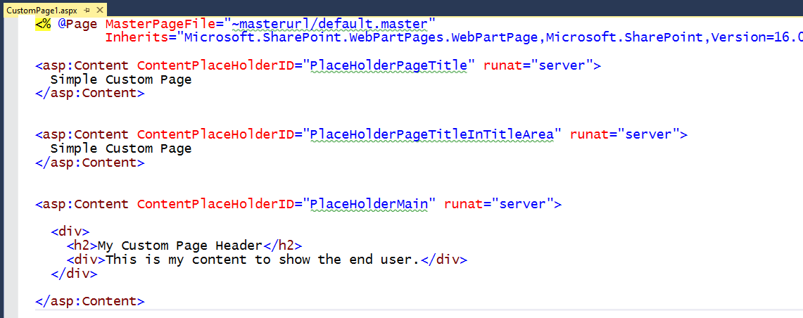
Creating a Simple Site Pages for SPO
Custom pages should link to current site's master page
Set MasterPageFile to dynamic token ~masterurl.default.master
Custom Page should inherit from WebPartPage
Required to work correctly with Minimal Download Strategy feature
Required if you want to add support for Web Parts

Slide 16
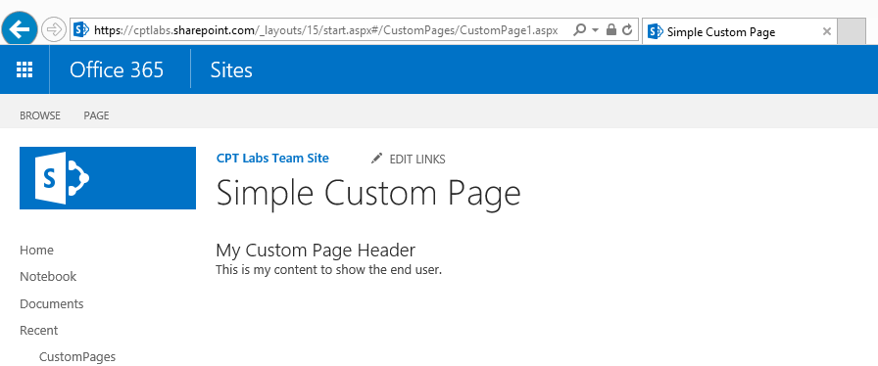
Creating a Simple Site Pages for SPO
Essential SharePoint Master Page Placeholders
PlaceHolderPageTitle
PlaceHolderPageTitleInTitleArea
PlaceHolderMain

Slide 17
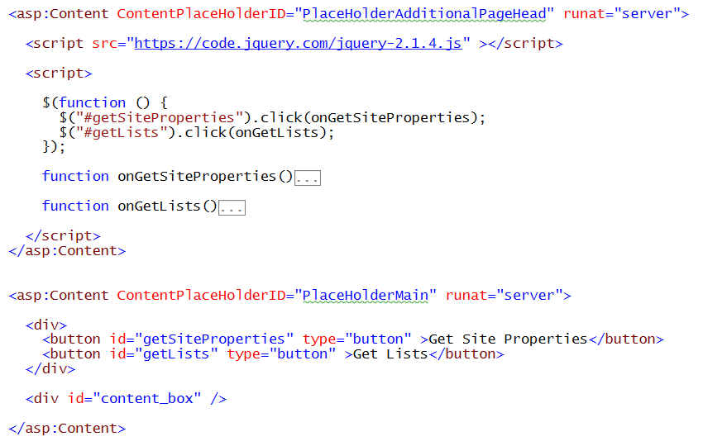
Adding Scripting to a Custom Page
Adding scripts and links using PlaceHolderAdditionalPagehead

Slide 18
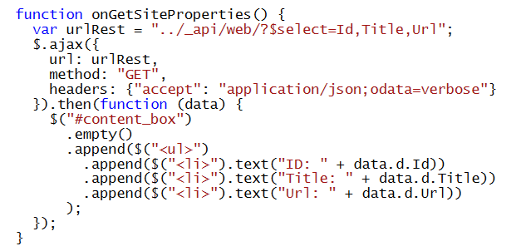
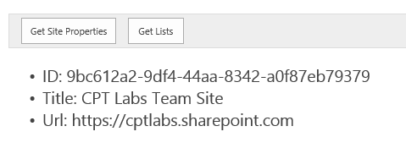
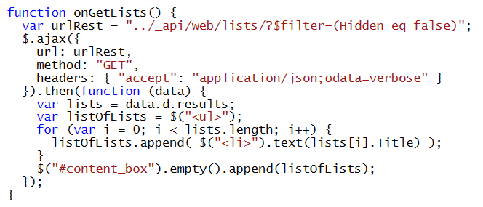
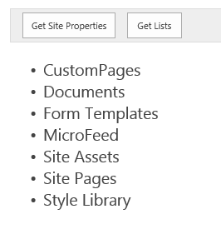
Programming the SharePoint REST API

Slide 19
Agenda
Enabling Scripting in Office 365.
Understanding JavaScript Injection
JSOM Programming
Remote Provisioning using CSOM
Designing MDS-enabled Pages
JSLink and Client-side Rendering

Slide 20
JavaScript Object Model (JSOM)
SharePoint's Client-side JavaScript API
Provides equivalent to CSOM available to .NET code
Provides extra functionality for browser-based apps
Automatic authentication – no ability to impersonate
Requires execution within valid SharePoint context
Core JSOM libraries
MicrosoftAjax.js
SP.Runtime.js
SP.js

Slide 21
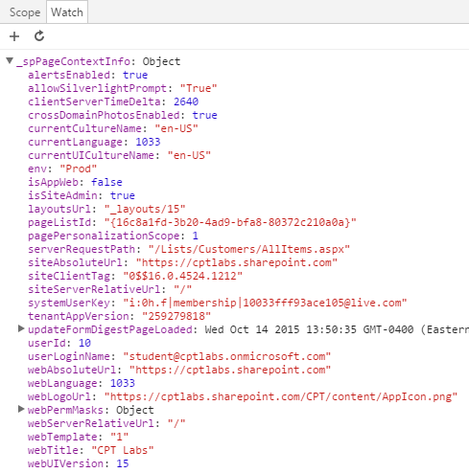
The _spPageContextInfo Variable
_spPageContextInfo
Culture/Locale information
Server-relative URL for site
Absolute URL for Site
Current page relative URL
Pages ListID
Web Title
Web UI Version

Slide 22
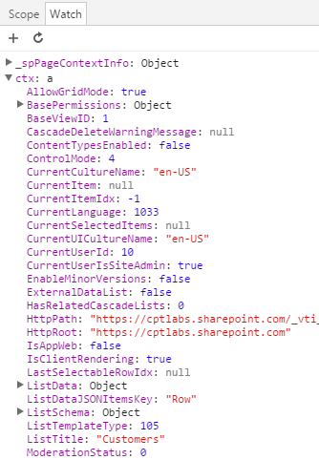
The ctx Variable
ListData on ListViews
ListGuid, ListTitle, ListUrl
Row collection property
Column values
ContentTypeId
FSObjType (0=ListItem, 1=Folder)
displayFormUrl
editFormUrl
newFormUrl
ListSchema
IsDocLib
Field Information
LocaleID
PagePath

Slide 23
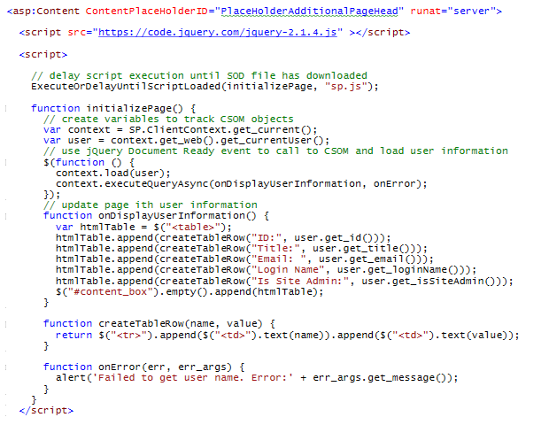
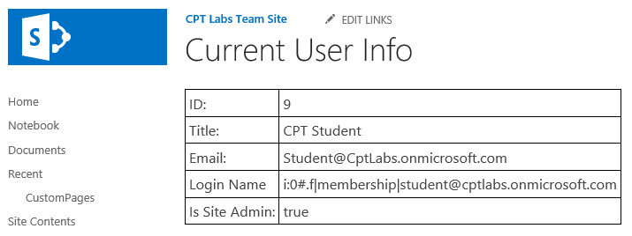
Using SharePoint JavaScript Libraries
Many SharePoint library files use lazy loading
Based on script-on-demand (SOD)
SPO library files downloaded using ExecuteOrDelayUntilScriptLoaded

Slide 24
Agenda
Enabling Scripting in Office 365.
Understanding JavaScript Injection
JSOM Programming
Remote Provisioning using CSOM
Designing MDS-enabled Pages
JSLink and Client-side Rendering

Slide 25
Deploying Custom Pages
Several approaches can be used to deploy custom pages
Upload pages to document library using browser
Upload pages to document library using Windows Explorer
Upload pages to document library using SharePoint Designer
Upload pages to document library using custom installer program
Creating custom installer program benefits
Automates copying files to target SharePoint site
Eliminates copy-by-hand approach that is error-prone and tedious
Provides opportunity for more than just copying files
Provides opportunity to use CSOM for remote provisioning

Slide 26
Remote Provisioning using CSOM
What can you do to a SPO site using CSOM?
Upload custom ASPX pages and JavaScript files
Add navigation nodes on the top navigation bar
Create child sites, lists and document libraries
Create site columns, content types and term sets
Create user custom actions and script links

Slide 27
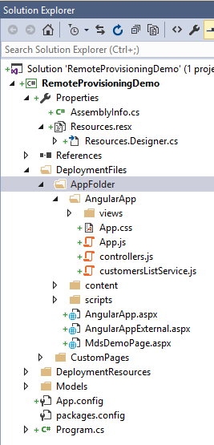
Remote Provisioning Demo Console App
What does this sample app demonstrate?
Connects to an SPO site
Creates private folder at root of site
Uploads custom pages, scripts and style sheets
Sets Alternate CSS URL for the current site
Registers ScriptLinks for jQuery and custom script
Adds custom actions to site Actions menu
Creates and populates sample Customer list
Embeds an Angular app into SharePoint UX
Uses JSLink and custom client-side rendering

Slide 28
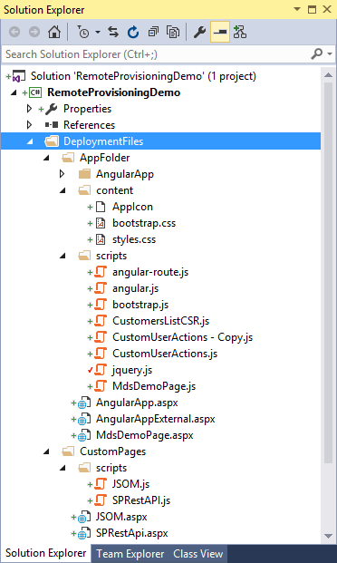
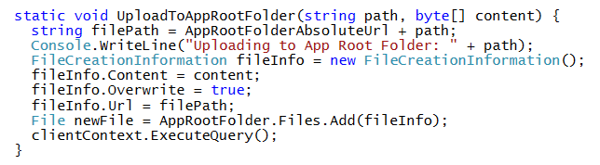
Uploading Pages and Scripts using CSOM
Where can you upload custom pages and scripts?
Master Page Gallery
Style Library
Standard document library
New folder created at site root
Sample CSOM Code for uploading file

Slide 29
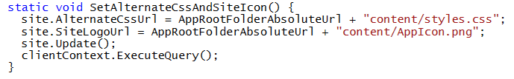
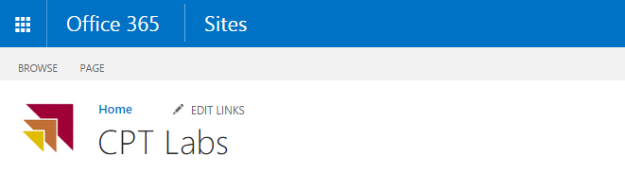
AlternateCssUrl and Site Icon
Adding styling to an SPO Site
AlternateCssUrl links one style sheet to all pages in SPO site
SiteLogoUrl used to substitute custom site icon

Slide 30
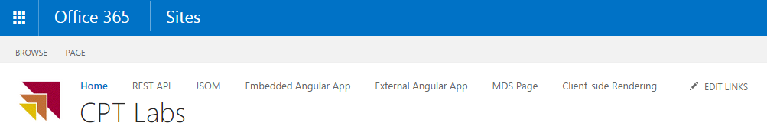
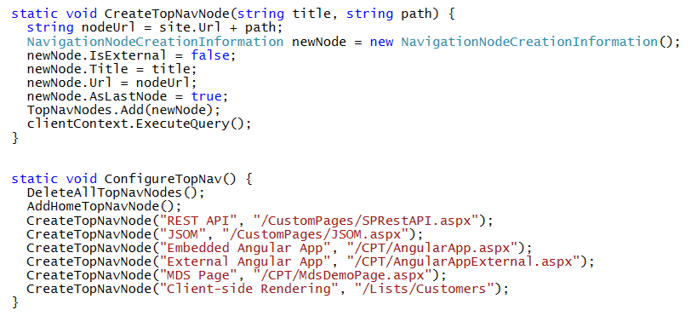
Creating Top Nav Nodes
CSOM allows you to create Top Nav Nodes
Provides easy way to provide navigation to custom pages

Slide 31
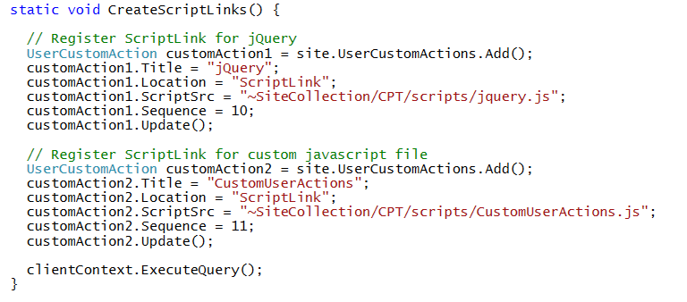
Adding ScriptLinks to Site
ScriptLink added to site as UserCustomAction
Provides easy way to link all pages in site to common script file
Does not require modification to site's master page
Can be used to load common JavaScript libraries (e.g. jQuery)
Can be used to load custom scripts

Slide 32
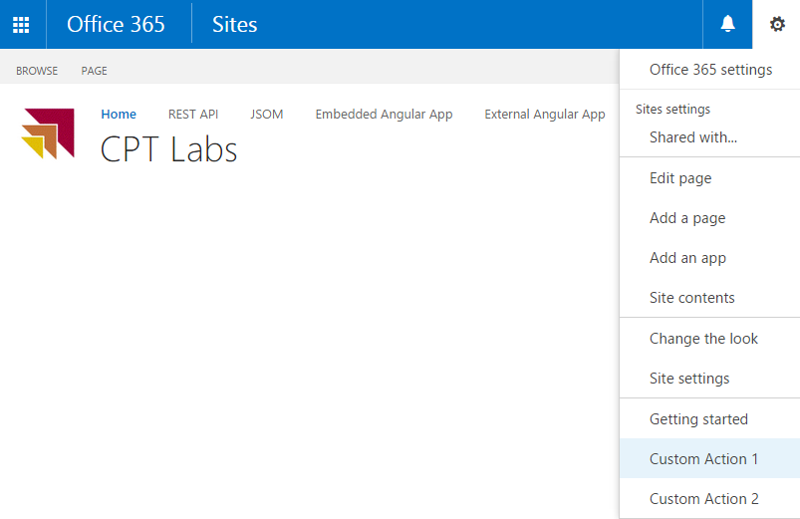
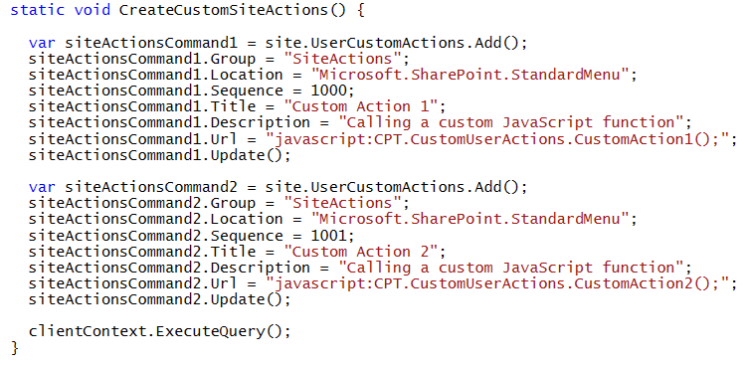
Adding Custom Actions to the SiteActions Menu
Adding menu commands to SiteActions menu

Slide 33
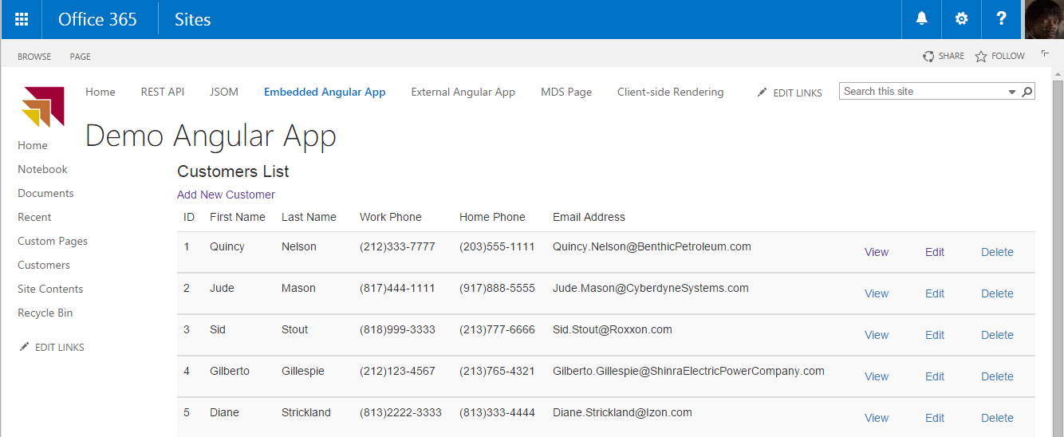
Embedding an Angular App
Angular apps can be injected using remote provisioning
Angular App can be embedded in SharePoint UU
Angular App can be designed external to SharePoint UI

Slide 34
Remote Provisioning Demo Console App

Slide 35
Agenda
Enabling Scripting in Office 365.
Understanding JavaScript Injection
JSOM Programming
Remote Provisioning using CSOM
Designing MDS-enabled Pages
JSLink and Client-side Rendering

Slide 36
Minimal Download Strategy (MDS)
MDS creates SPA architecture for SharePoint site
First page request loads MDS environment
Page transitions involve AJAX request for page deltas
Significantly complicates JavaScript programming
Incorrect code results in double page processing
When do you have to deal with MDS?
MDS enabled by default on Team sites
MDS can be disabled on Team sites
MDS not supported on Publishing Sites

Slide 37
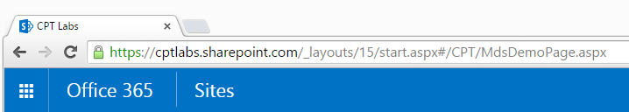
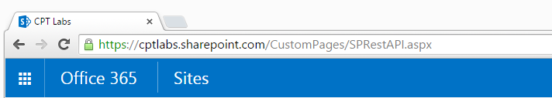
Page URLs in MDS Mode
When a site has MDS feature enabled…
MDS-enabled pages processed using MDS URLs
Pages not supporting MDS redirected to non-MDS URLs

Slide 38
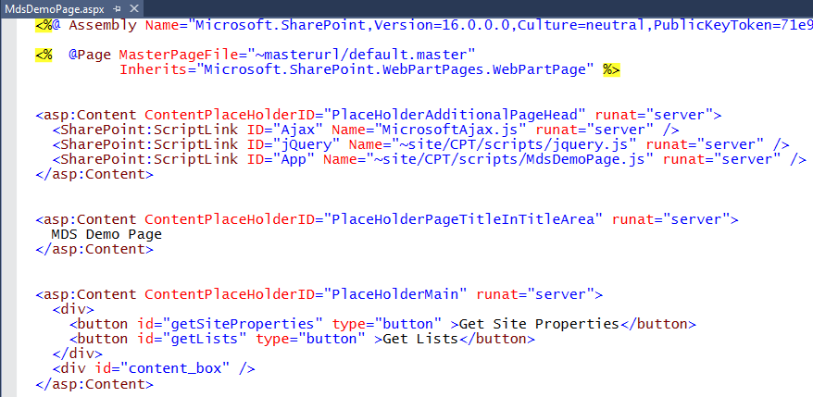
Using the SharePoint:ScriptLink Control
When designing pages for MDS mode
Do not use script tags because they break MDS mode
Use the SharePoint:ScriptLink control instead
Link to JavaScript files uploaded inside to the site

Slide 39
What Happens When in MDS Mode?
On the first page load
Processing occurs just like non-MDS page load – all events fire
On subsequent MDS page transitions
JavaScript files are not reparsed
Inline code does not execute
jQuery document ready event handler does not run
SharePoint load event handler does not run
MDS performs garbage collection to purge global variables

Slide 40
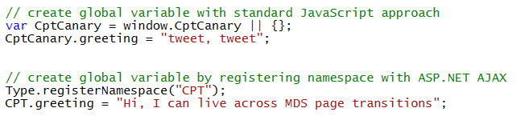
MDS Garbage Collection
MDS performs garbage collection
Global variables are purged during page transitions
MDS garbage collection prevents memory bloat
MDS garbage collection requires your attention
Creating global variables that survive garbage collections
Create global variable by registering it as an ASP.NET namespace

Slide 41
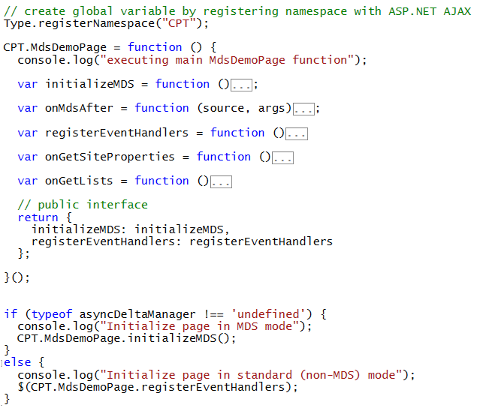
Managing MDS and Non-MDS Page Loads

Slide 42
Understanding MDS Events
MDS events occur during page transitions
Request Initialized
Begin Request
End Request
asyncDeltaManager used to add event handlers
add_initializeRequest
add_beginRequest
add_endRequest

Slide 43
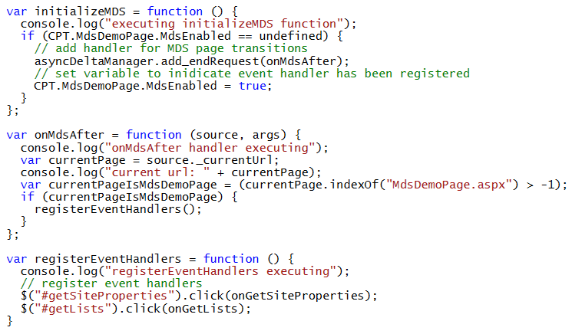
Handling MDS Events on Page Transitions

Slide 44
Agenda
Enabling Scripting in Office 365.
Understanding JavaScript Injection
JSOM Programming
Remote Provisioning using CSOM
Designing MDS-enabled Pages
JSLink and Client-side Rendering

Slide 45
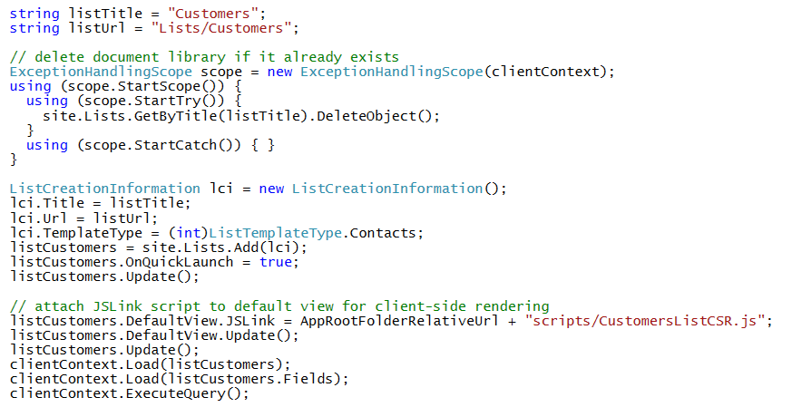
Attaching Custom Scripts using JSLink
JSLink property can attach custom script to
List Views
List Forms (e.g. New / Edit / Display forms)
List View Web Parts and List Form Web Parts
Site Columns and Content Types

Slide 46
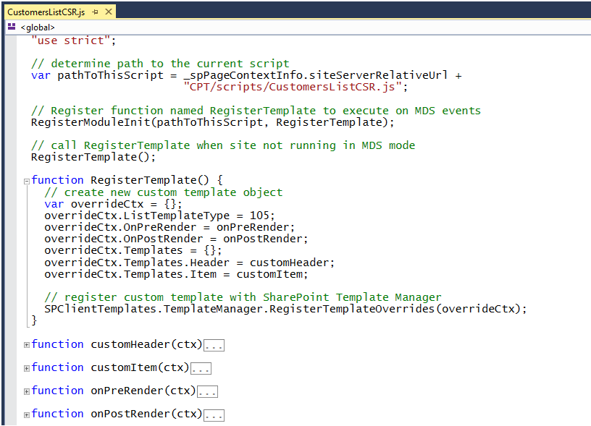
Custom Client-side Rendering (CSR)

Slide 47
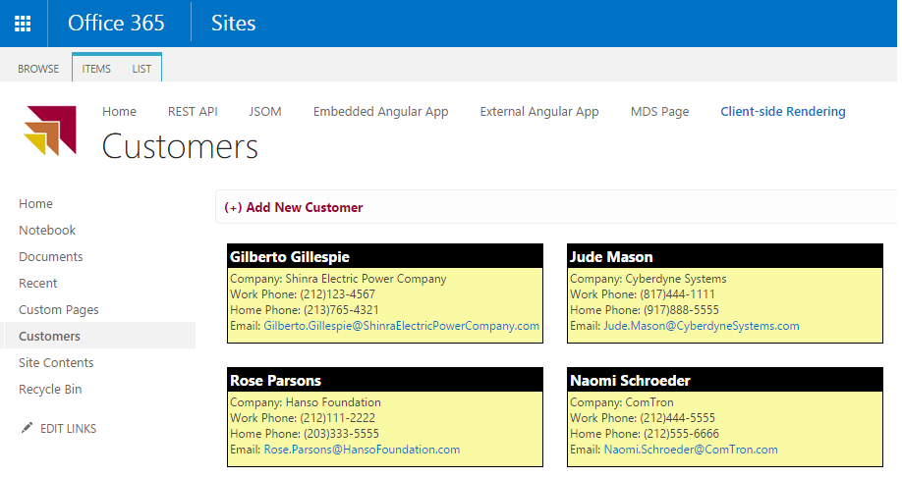
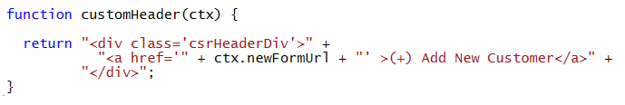
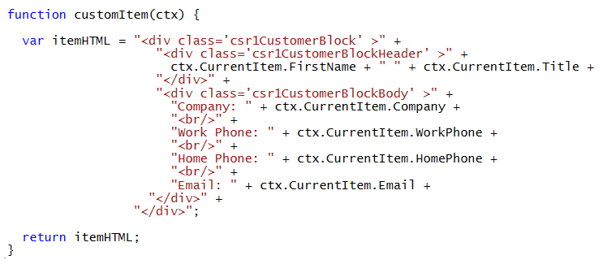
Implementing Custom Rendering Logic

Slide 48
Summary
Enabling Scripting in Office 365.
Understanding JavaScript Injection
JSOM Programming
Remote Provisioning using CSOM
Designing MDS-enabled Pages
JSLink and Client-side Rendering

