Slide 1
Developing Provider-hosted Add-ins with MVC
Notes:
The module discusses how to design and develop a provider-hosted add-in using the MVC framework in ASP.NET. Students will learn how to add controllers and views to an MVC application as well as how to integrate these MVC components into a provider-hosted add-in project in Visual Studio. The module teaches students how to leverage controllers and views in MVC when developing a provider-hosted add-in containing add-in parts and user custom actions. The module also provides students with an introduction to creating custom databases in a cloud-friendly fashion using Entity Framework and the code-first approach to entity modeling. After seeing how Entity Framework can be used to create an entity model and a custom database, students will then be shown how to leverage an entity model in an MVC application by creating a strongly-typed controller class which makes it easier and more error proof to develop MVC views which intermix HTML and C# code.

Slide 2
Agenda
Introduction to MVC
Controllers and Views
Using Strongly-typed Models
MVC in SharePoint App Development

Slide 3
Agenda
Developing Provider-hosted Add-ins using MVC
Developing Add-in Parts using MVC
Developing User Custom Actions using MVC
Creating Databases using Entity Framework
Creating a Strongly-typed MVC Controller Class

Slide 4
Web Forms Versus ASP.NET MVC
ASP.NET provides two different platforms
ASP.NET Web Forms (e.g. ASPX files)
ASP.NET MVC
MVC provides better platform for the web
More flexible routing
Lighter-weight
Richer templating
Better C# integration
Unit testing

Slide 5
History of MVC
MVC is a design pattern as old as the hills
MVC = Model-View-Controller
Very popular pattern for many web platforms
ASP.NET introduced MVC platform in 2007
Provides alternative to ASP.NET Web Forms
Visual Studio 2013 includes MVC4
Visual Studio 2013 includes MVC5

Slide 6
MVC Request Processing
How does MVC handle an incoming HTTP request
Incoming HTTP request routed to specific Controller
Controller (optionally) creates Model (i.e. presentation object)
Controller creates View and delegates rendering responsibilities
If Model exists, it is passed to View
View renders response as HTTP Response
HTTP Request
Controller
Model
HTTP Response
View

Slide 7
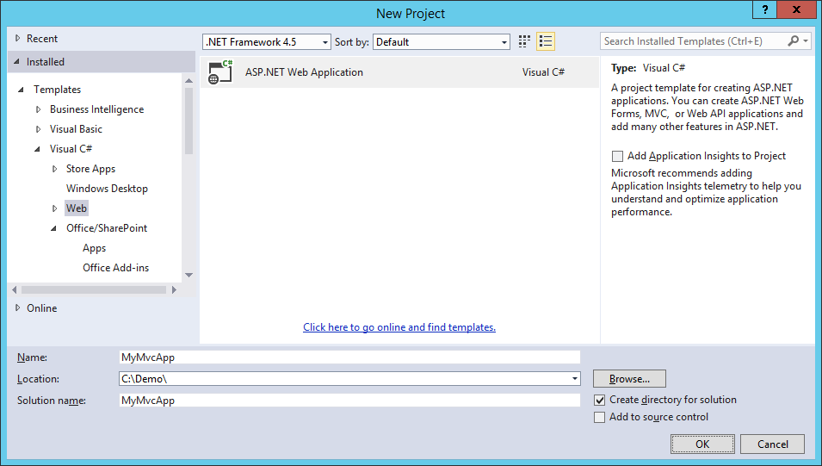
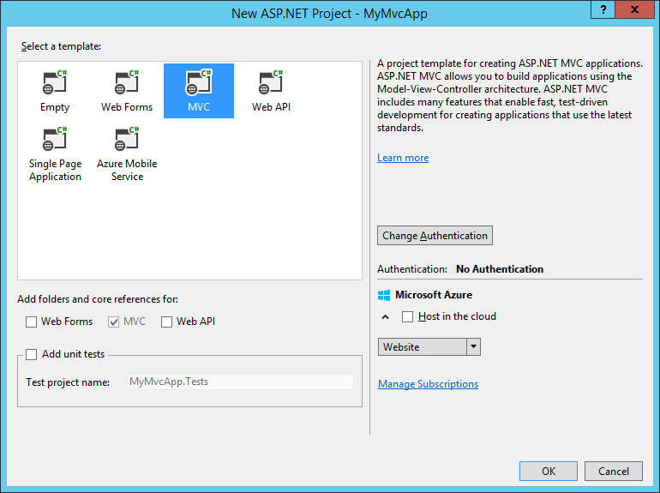
Creating an MVC Project

Slide 8

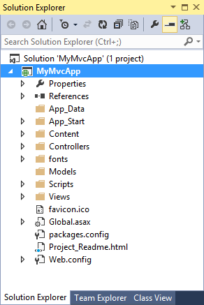


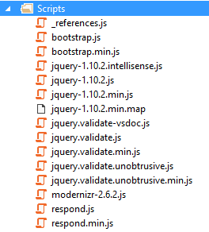
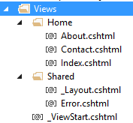
MVC App Project Files

Slide 9
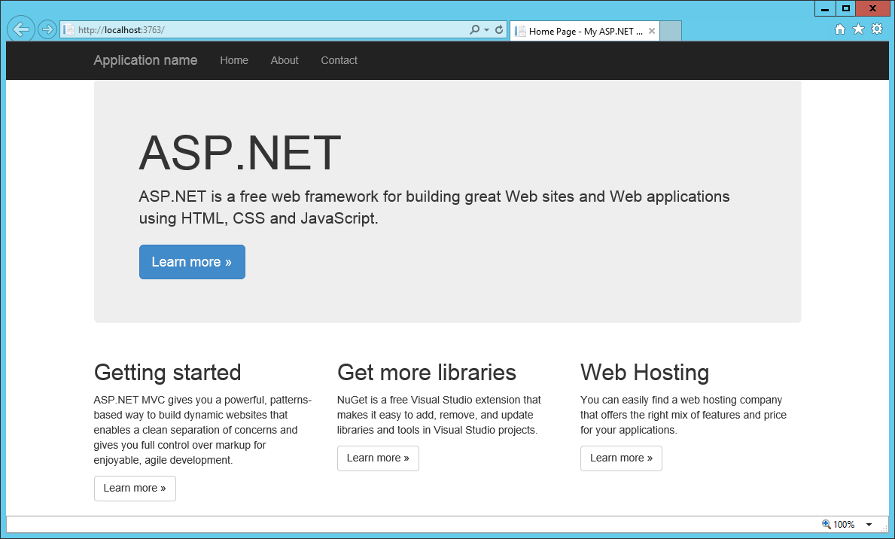
Running an MVC Project

Slide 10
Creating a Simple App with ASP.NET MVC

Slide 11
Agenda
Introduction to MVC
Controllers and Views
Using Strongly-typed Models
MVC in SharePoint App Development

Slide 12
Understanding Controllers
A set of classes that manage…
processing incoming HTTP requests
communication to and from user
overall application flow and application-specific logic
Every controller has one or more Actions
It’s critical to understand the role of Actions in MVC

Slide 13
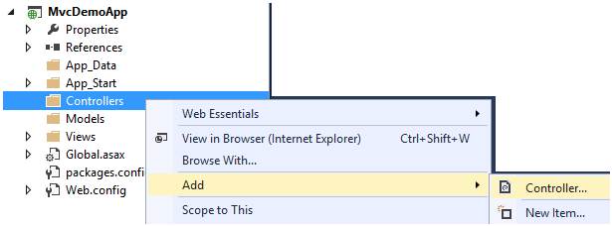
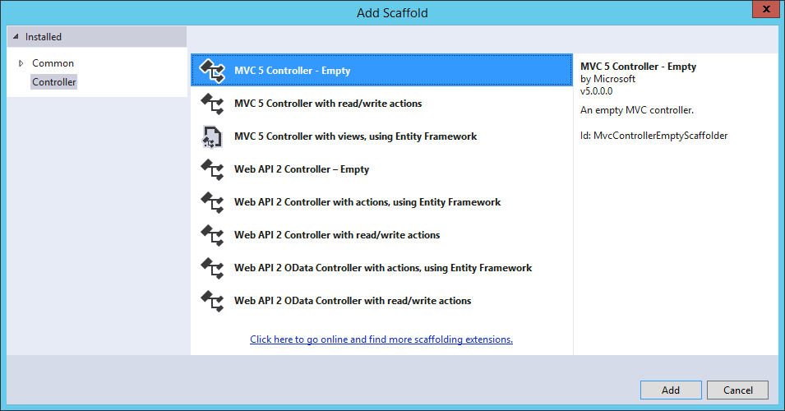
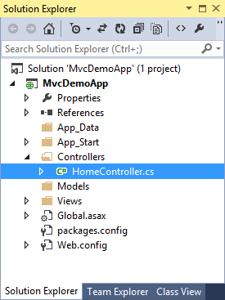
Adding a Controller

Slide 14
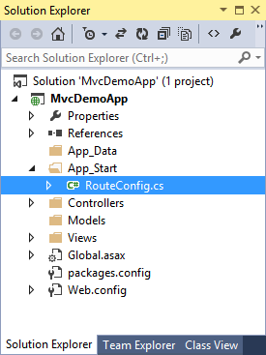
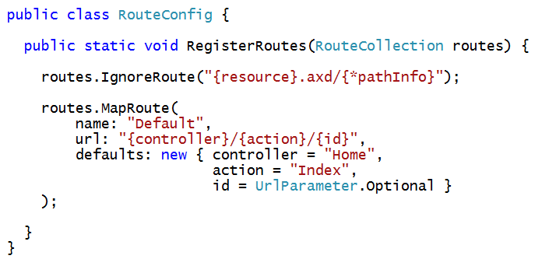
Wiring Up a Controller
When you ad a controller…
Visual Studio updates RouteConfig class
Routing scheme defined using standard format
{controller}/{action}/{id}

Slide 15
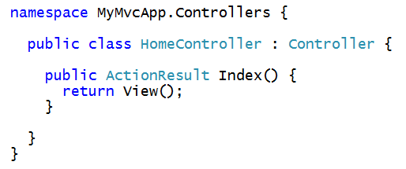
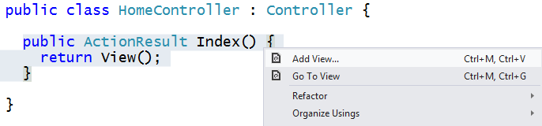
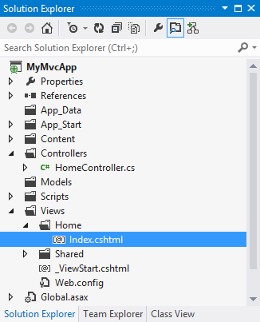
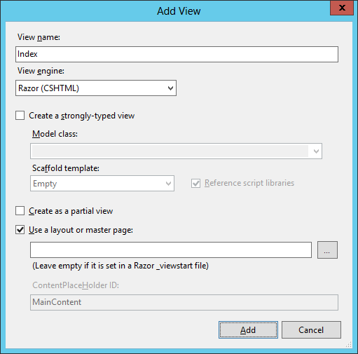
Creating a View from a Controller Action
Controller method often return ActionResult
Right-click on Controller method to generate its view

Slide 16
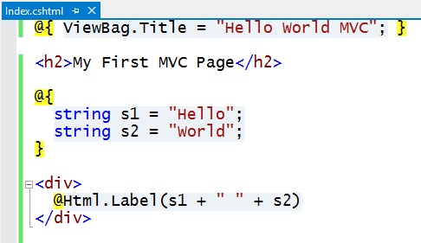
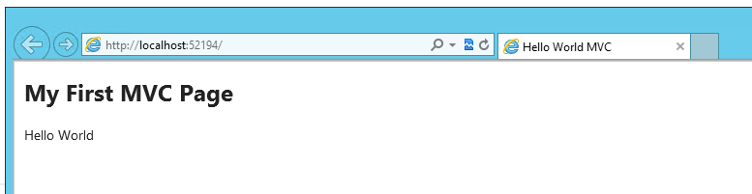
Customizing the View
Views are creating using the Razor engine
Provides a lean and elegant way to create HTML pages
Use data passed from controller
Write in-line C# code
Construct pages using HTML Helpers

Slide 17
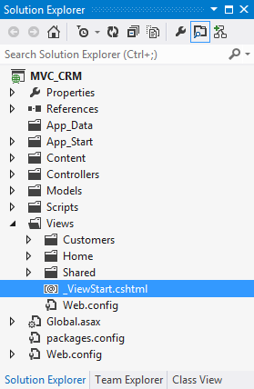
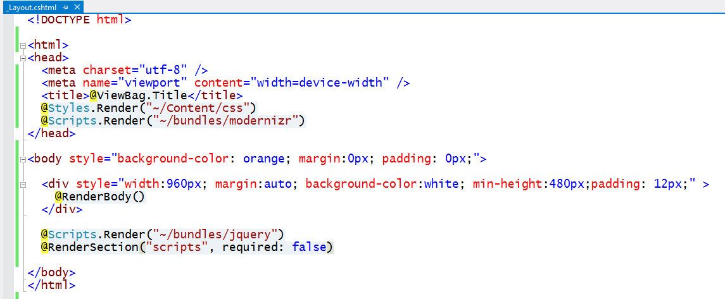
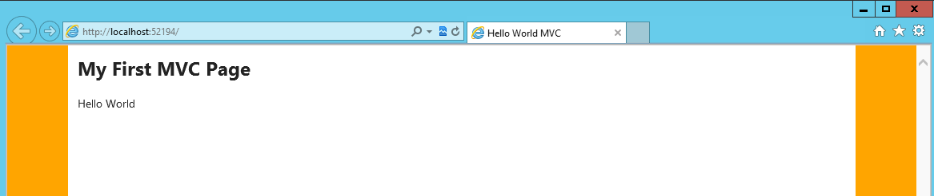
Customizing the Shared View
MVC provides Shared Views
Provides same purpose as master pages in ASP.NET web forms
Default MVC shared view is named _ViewStart.cshtml

Slide 18
Working with Controllers and Views

Slide 19
Agenda
Introduction to MVC
Controllers and Views
Using Strongly-typed Models
MVC in SharePoint App Development

Slide 20
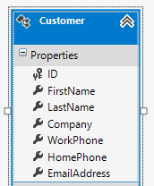
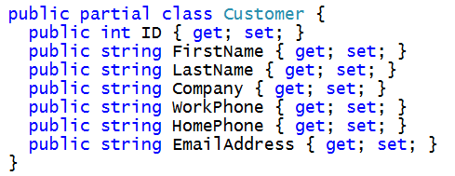
Motivation for Strongly-typed Models
MVC designed based on strongly-typed models
Controller creates model object and passes it to view
Razor view engine supplies IntelliSense for model behind view
HTML helpers make it easy to create views and forms
HTTP Request
Controller
Model
HTTP Response
View

Slide 21
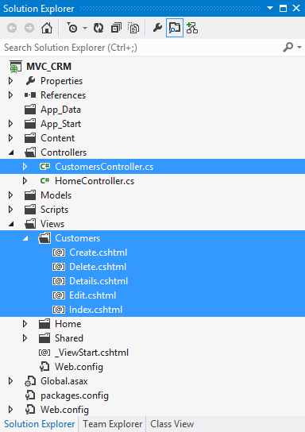
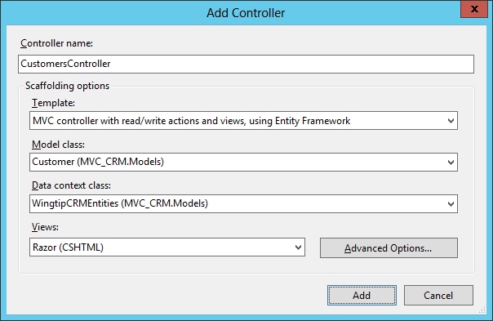
Creating a Strongly-typed Controller Class

Slide 22
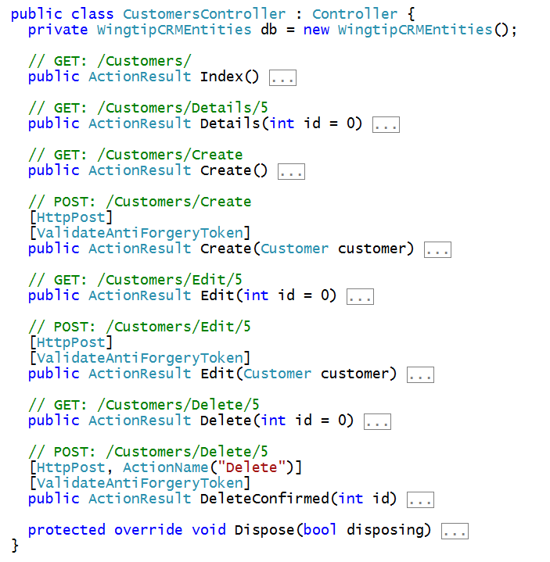
Customers Controller Class

Slide 23
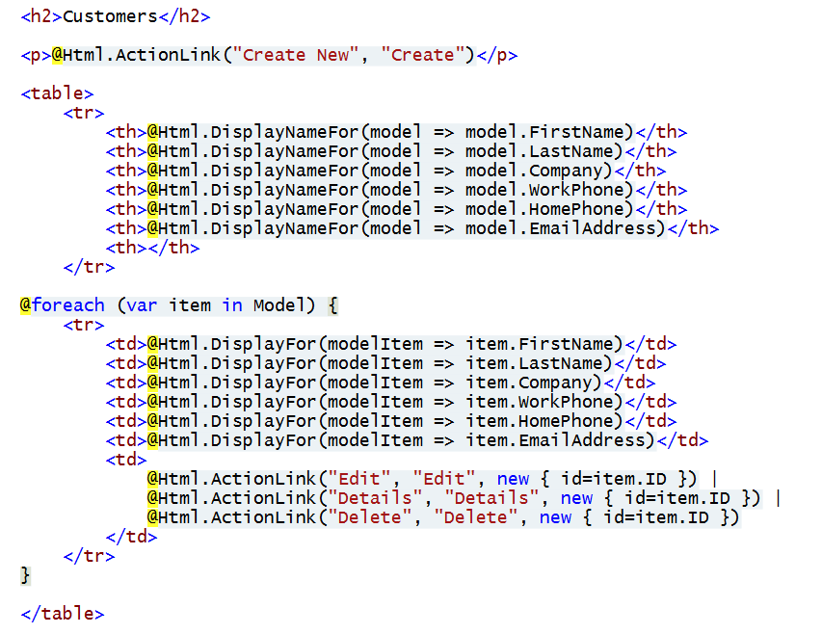
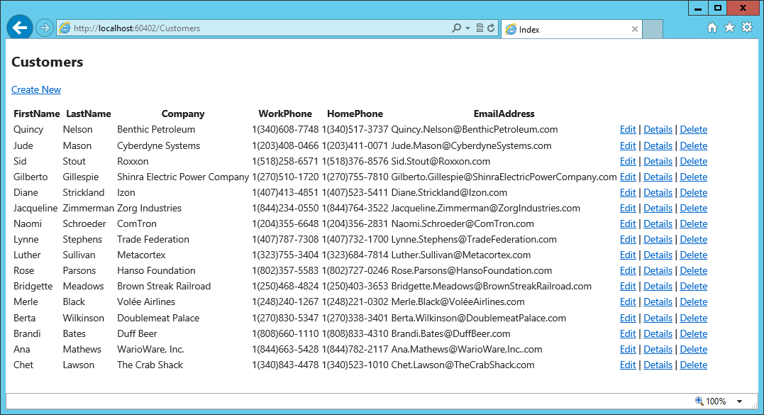
Customers Controller – Index View

Slide 24
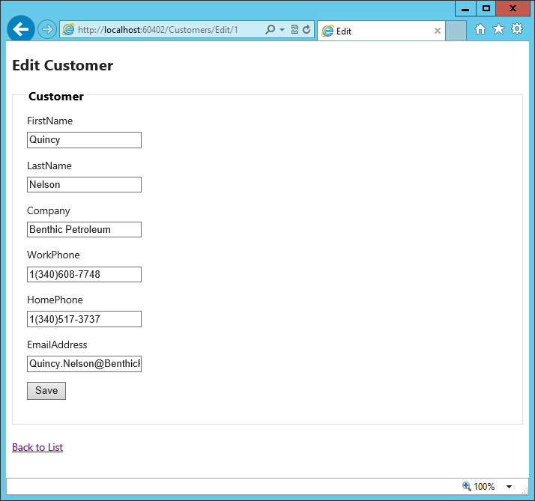
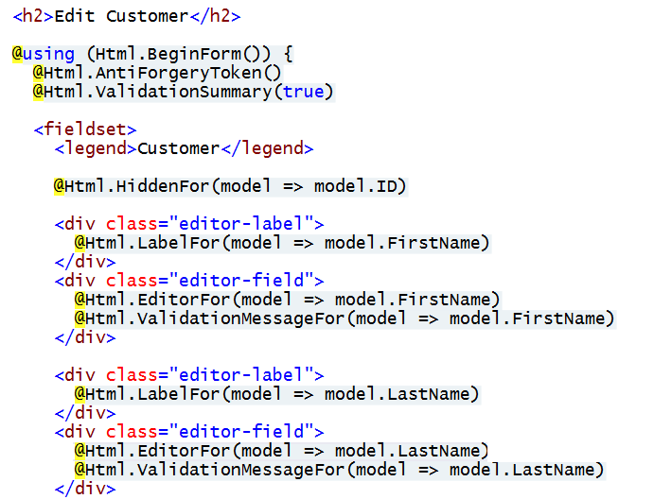
Customers Controller – Edit View

Slide 25
Using a Strongly-typed Model

Slide 26
Agenda
Introduction to MVC
Controllers and Views
Using Strongly-typed Models
MVC in SharePoint App Development

Slide 27
Integrating MVC with SharePoint Apps
Visual Studio 2012 poses two noteworthy limitations
One VS project cannot contain both Web Forms and MVC4
None of the SharePoint App project templates integrate with MVC4
Steps to create SharePoint app using MVC4
Create new VS solution for provider-hosted SharePoint App
Delete with original Web project which is based on Web Forms
Add a new MVC4 project into the same VS solution
Configure the MVC4 project to be the new Web Project
Visual Studio 2013 provides much better experience
VS2013 can mix Web Form items and MVC5 in single VS project
SharePoint app projects integrated with MVC5

Slide 28
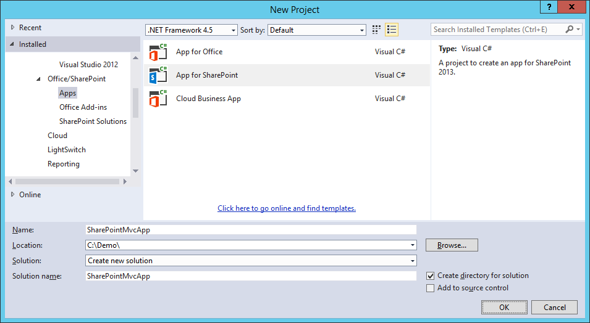
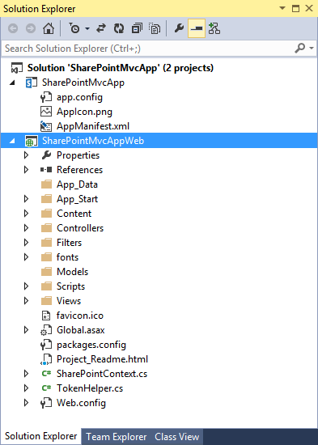
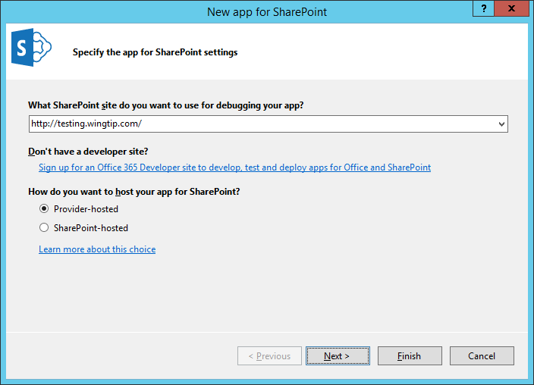
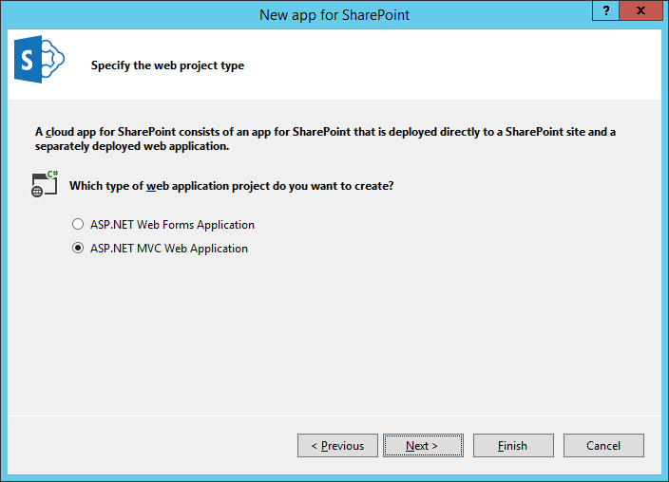
Creating a Provider-hosted App with MVC

Slide 29
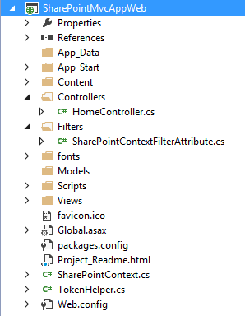
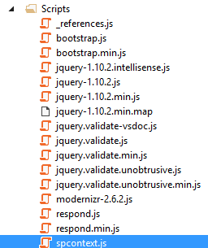
SharePoint-specific Files
TokenHelper.cs and SharePointContext.cs
Same as discussed earlier in course
SharePointContextFilterAttribute.cs
Provides OAuth redirect logic for when context token is missing
Filter has no purpose when using app authentication based on S2S trust
spcontext.js
Client-side JavaScript code to propagate SPHostUrl query string parameter

Slide 30
Creating a Provider-hosted SharePoint App Using MVC5

Slide 31
Summary
Introduction to MVC
Controllers and Views
Using Strongly-typed Models
MVC in SharePoint App Development

