Slide 1
Developing Office Add-ins
Notes:
This module begins by introducing the Office Add-in model and discussing the different types of Office add-ins which can be used in Office 365 development. Students will learn how to leverage the JavaScript API for Office to read and write content to and from the current Office document when developing a Task Pane add-in or a Content Add-in. Students will also learn how to create data bindings to specific content regions in an Office document to enable callback notifications from the host Office application whenever a user updates content. The module also demonstrates how to use coercion types and Office Open XML formats to provide an advanced technique for programmatically adding formatted content into a Word document. The module concludes with a discussion of Mail add-ins and a walkthrough of the steps required to create and debug a Mail add-in project using Visual Studio and an Exchange mailbox in the Office 365 environment.

Slide 2
Agenda
Introduction to the Office Add-in Model
Developing Office Add-ins with Visual Studio
Coercion Types and Open XML Formats
Data Bindings and Events
Creating and Debugging Mail Add-ins

Slide 3
What is an Office Add-in?
Web application loaded inside an Office Application
Embedded inline or as task pane within documents or mail item
Works in Office Applications such as Microsoft Outlook
Works in Office Web Applications such as OWA
Works in mobile Office clients
Office application extensions using Web technologies
HTML 5 and CSS used to construct user interface
JavaScript and jQuery used to add executable logic and events
Add-in can provided code to read/write content to/from documents
Add-in can call Web services hosted over Internet or local network
Notes:
An Office Add-in can be seen as a Web page loaded inside an Office Application. In some cases it will appear embedded inline within the document. In other cases it might appear as a task pane or within a message in Outlook. Note that the architecture for Office Add-ins has been designed to work in both Office Applications and Office Web Applications.
Office Add-ins allow Office applications to be extended in such as way so that they can leverage Web technologies such as HTML 5 and CSS for rendering user interface as well as JavaScript and jQuery to add behavior. When you write the JavaScript code for an Office Add-in, you can call REST APIs such as those added to SharePoint 2013 to retrieve and update data from across network.

Slide 4

Anatomy of an Office Add-in
Each Add-in is based on XML-based manifest
Manifest points to a Web page
Manifest defines the type of the Office Add-in
Manifest defines which Office applications it supports
Manifest defines required capabilities
Office Add-in
Office Add-in
Manifest
<XML>
Web
Page
HTML+JS
Notes:
Every App for Office must be distributed with an XML-based manifest which contains information about the app itself. For example, the app manifest contains an address to a Web page on the Internet which is used to load the app. The app manifest also includes information which indicates which Office applications it supports. The app manifest also defines the required capabilities which represent the set of permissions that the app needs in order to run and complete its work.

Slide 5



Designing Office Add-ins - Shapes
Office Add-ins come in different shapes
Task Pane Add-in
Content Add-in
Mail Add-in
Mail Compose Add-in
Word Application
Excel Application
Outlook Application
Outlook Application
Document
Task Pane App
Document
Inbox
Selected Message
Inbox
New Message
Mail Compose
App
Reply | Reply All | Forward
To: xxx@yyy.com
Subject: Top secret stuff
app
Mail App
Content App
Message Body
Message Body
Notes:
When you begin to design an app, you must pick one of the three different shapes. You can create a document-based app as either a Task Pane App or a Content App. Alternatively, you can create a Mail App that targets Outlook and Outlook OWA.

Slide 6


Shapes for Document-based Add-ins
Task Pane Add-in
Positioned to right of document
Used to assist user working with document
Can search and retrieve content from Internet
Content Add-in
Adds content inline into position in document
Document is always an Excel workbook
Content app can read & write to document
Word Application
Document
Task Pane Add-in
Excel Application
Document
Content Add-in
Notes:
There are two basic styles (i.e. shapes) for creating an Office Add-in.
A task pane add-in is positioned to right of document in a style that is familiar to experience Officers users. A task pane add-in is typically used to assist a user working with a specific document. For example, a task pane add-in can be designed to search and retrieve content from Internet that can be inserted into the document.
A content add-in is designed to add its content inline into a position within current document. Note that content add-in are only supported into Excel so that document is always an Excel workbook. The content add-in must be added to a specific worksheet within a workbook. The content add-in can read and write contents to cells within the same workbook.

Slide 7
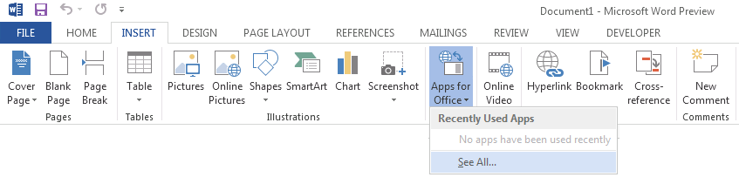
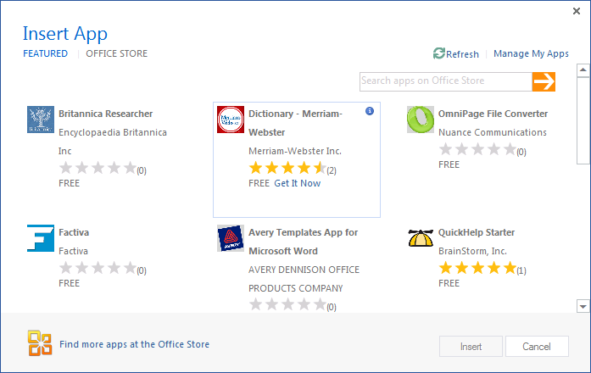
Adding Add-in using Insertion UI
Office Add-in insertion UI located in Ribbon inside Insert Tab
Dialog allows you to add and start Office Add-in
Notes:
Office 2013 applications provide users with the ability to discover add-ins and insert them. In Word and Excel, this support is included in the Ribbon inside the Insert Tab.
When you drop down the Apps menu from the ribbon, you can see recently selected add-ins. If you click "Select All", you will be prompted with a dialog that allows you to look in various app directories. Once you find an add-in you want to use, you can click the Start button to insert the app into the current document and start it up. After this, you can save the current document which will then include the add-in.

Slide 8
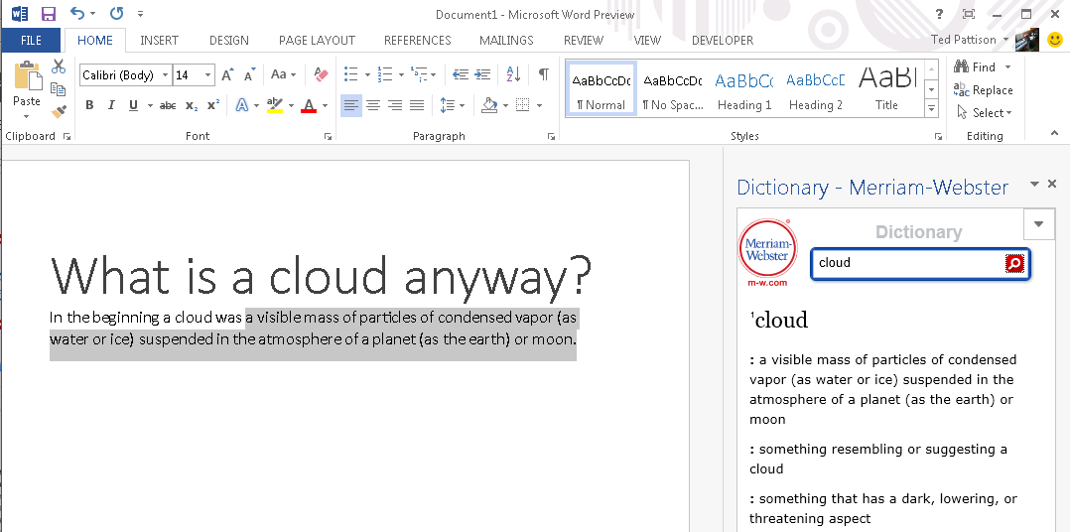
Task Pane Add-in User Experience
Familiar User Experience
Leverages familiar Office UI paradigm
Reference Information
Ideal for providing reference information associated with document.
Notes:
One reason to create a task pane add-in is that it provides Office users with a familiar user experience. For example Microsoft Word and Microsoft Excel have exposed many of its internal features using task panes so task pane add-ins provides a familiar Office UI paradigm.
Task pane add-ins are ideal for providing users with reference information. For example, a task pane add-in can perform Internet searches or lockups and provide reference information that can be inserted back into the current document.
This slide contains a screenshot showing the add-in after it has been inserted in a document. In Microsoft Word 2013. Different add-ins provide different user experiences. This add-in which is available for free on the Office Store allows the user to leverage the Marriam-Webster online dictionary lookup service to look up words and terms right from within Microsoft Word.

Slide 9
Agenda
Introduction to the Office Add-in Model
Developing Office Add-ins with Visual Studio
Coercion Types and Open XML Formats
Data Bindings and Events
Creating and Debugging Mail Add-ins

Slide 10
Visual Studio Experience
Create new App for Office project
Create/design user interface for Web page
Enhance Web page with CSS and JavaScript
Set project properties in manifest
Run!
Notes:
This slide is pretty self-explanatory and demonstrates just how easy it is to create and test your first Office Add-in using Visual Studio. First, you will create a new project using one of the project templates in Visual Studio. Next, you will create the user interface for the app using HTML5 and CSS. After that, you add behavior to the add-in by writing JavaScript. Finally, you will update the XML file which serves as the add-in manifest. After that, you can press the {F5} key to test and debug your add-in.

Slide 11
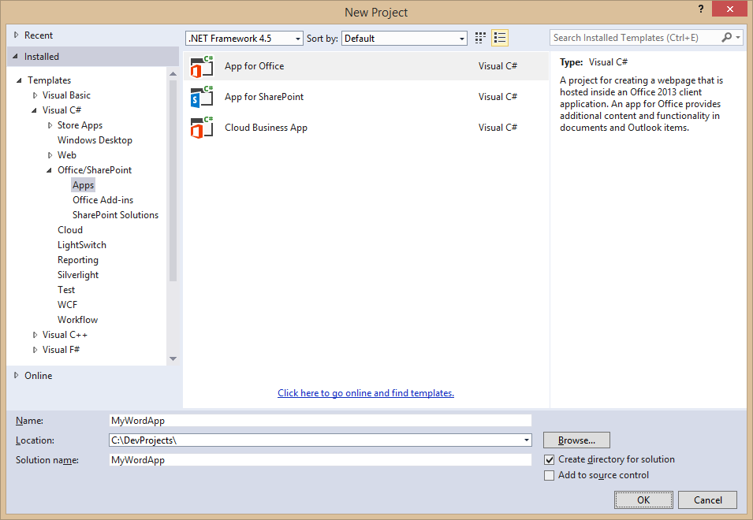
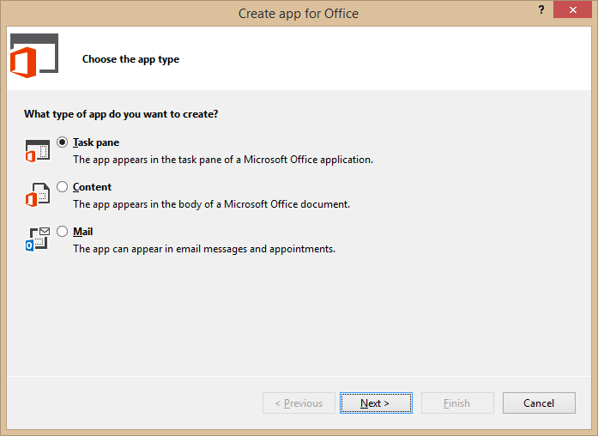
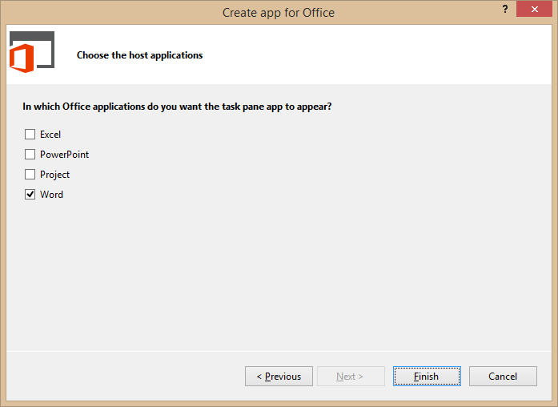
Creating a New Office Add-in
Notes:
Visual Studio has a project template for Apps for Office. These project types gives you a starter project with a web page and manifest.

Slide 12
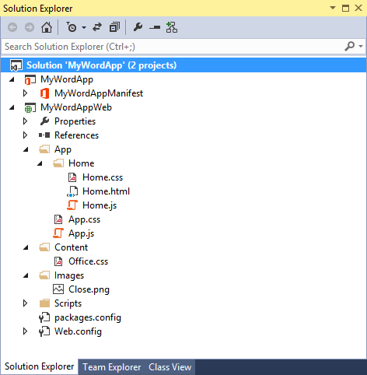
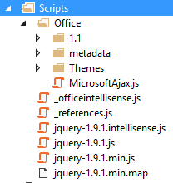
Office Add-in Project Structure
Office Add-in solution has two projects
Top project contains app manifest
Bottom project for remote web
Remote Web Project is ASP.NET Website
Contains HTML, CSS and JavaScript source files
Integration with jQuery library already included
Notes:
The slide shows the initial structure of a task pane add-in created with the Visual Studio.

Slide 13
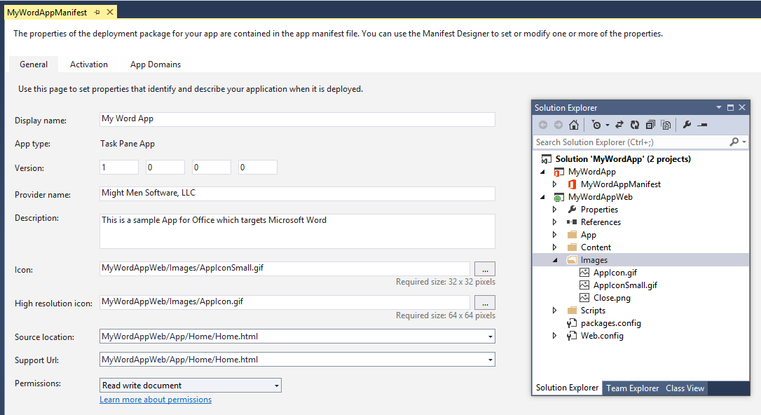
App Manifest Designer
Notes:
This slide shows the Visual Studio designer for an app manifest in a task pane app. It will look different for other types of Office Add-in.

Slide 14
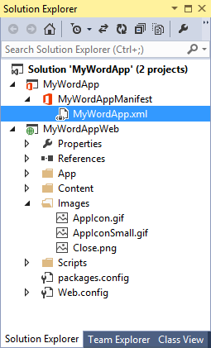
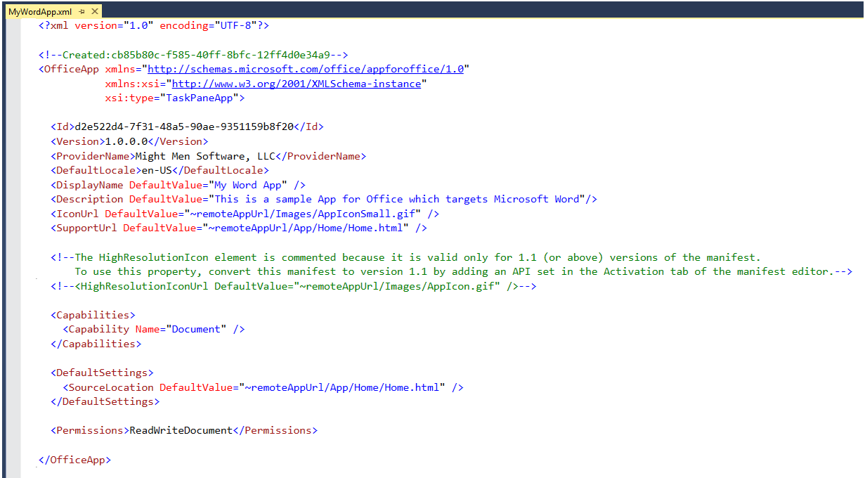
App Manifest - XML View
Notes:
There are times when it is also useful or necessary to examine or update the manifest in XML view. You can enter XML view by clicking the XML file in the Solution Explorer.

Slide 15
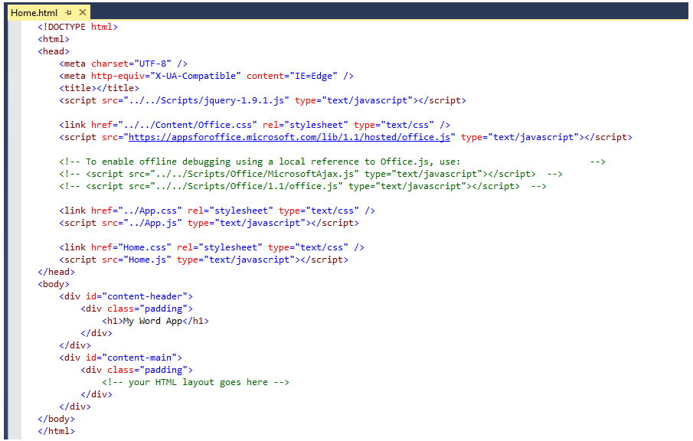
Create the HTML for a Web Page
Notes:
Each add-in has a source location which points to a entry point Web page somewhere on the Internet. Here is an example of a simple Web page that is used to load a task pane add-in. Note that this page must link to any required CSS files and JavaScript that will be adding styles or behavior behind the add-in. Visual Studio automatically adds the links for jQuery and ASP.NET AJAX. Also note that the page adds HTML elements which are often created with ids and/or classes.

Slide 16
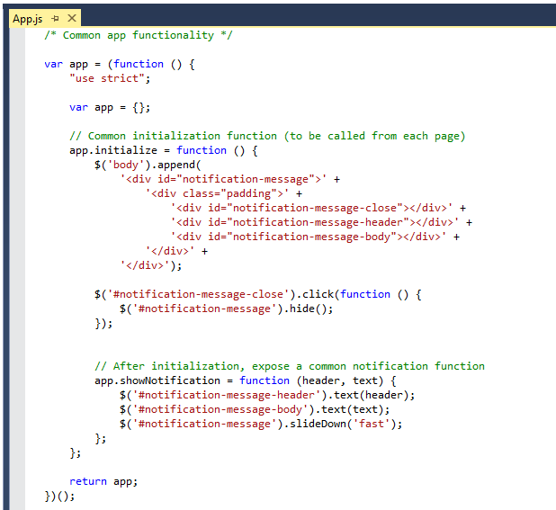
Code Added by Visual Studio
Notes:
JavaScript is the language that is used to add executable code and behavior to an Office Add-in. The JavaScript you write for an add-in will typically take advantage of the various JavaScript APIs supplied for Office.js and other JavaScript library files for specific Office applications such as Word, Excel and Outlook. In addition to the Office JavaScript APIs, the JavaScript code you write for an Office Add-in can also take advantage of the ASP.NET AJAX library as well as jQuery.
The Office JavaScript API provide a top-level named Office which provides an initialize function. By overriding this function as shown in the code above, you can write code that will automatically execute as the end of the initialization process when an add-in is started. A common approach is to register a jQuery document ready event handler inside this function.

Slide 17
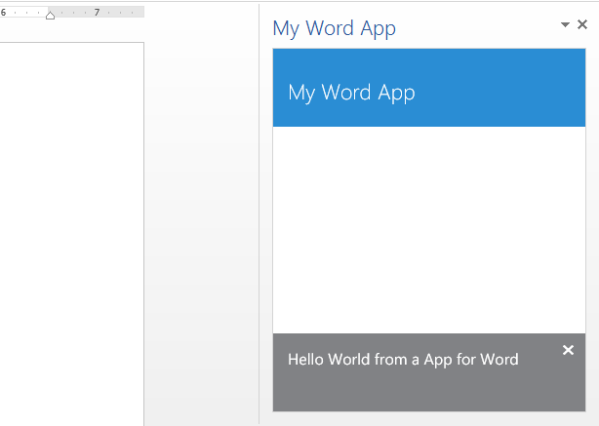
Test/Debug Add-ins using {F5}
When you press the {F5} key…
Visual Studio builds the app package and temporarily registers it
Visual Studio starts Microsoft Word and adds the add-in to new Word document
Notes:
When you press the {F5} with a Visual Studio project for an task pane add-in or a content add-in, Visual Studio automatically adds a registry entry to allow Office applications such as Word and Excel to discover the add-in which makes it possible to add it to a document.

Slide 18

Common API for Document Add-ins
Document Add-ins share common objects
Used to read and write content to and from document
Used to create bindings and event handlers
Common Objects x-Office!
Picture
Charts
Clip Art
Hyperlink
Shapes
Text
Table
Matrix
XML Parts
Word Art
Notes:
Office 2013 provides a common JavaScript API for developing document-based apps. This API provides a common set of objects used to read and write content to and from document. The common API can also be used to create bindings and event handlers. Note that with Office 2013, the common API is only used across Word and Excel but there are plans to expand the common API and have it used by additional Office applications in later versions.

Slide 19
Core API Objects
Office.context
Entry point into Office API
Office.context.document
Common document API
Office.context.settings
Custom properties saved within document
context
document
settings
Read and write selection
Create binding
Register event handlers
Use custom XML files
Read and writer properties
Properties saved to document
Notes:
The Office JavaScript object model provides a top-level object named Office with a context property which provides your entry point into the API. The context property provides three properties which expose the following objects.
Office.context.document provides access to the current document.
Office.context.settings provides access to a custom property bag allowing the developer to save and retrieve custom property settings
Office.context.application provides access to the entry points for app-specific APIs such as the APIs used to program against Microsoft Project and Outlook

Slide 20
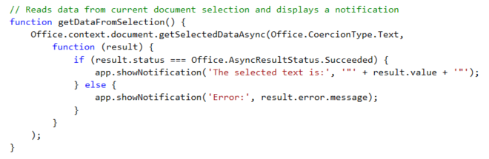
getSelectedDataAsync()
Use this function to read from document select
Notes:
The function getSelectedDataAsync() is used to read content from the selected region of the current Word document.

Slide 21
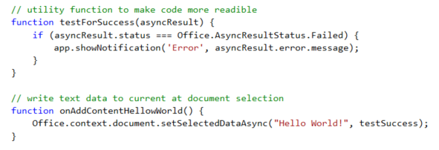
setSelectDataAsync()
Use this function to insert content into document
Notes:
The function setSelectedDataAsync is used to write content into the selected region of the current document. If there is no selected region, the content is added at the location of the cursor.

Slide 22
Navigation and Links
DOs
Provide hyperlinks to open in browser
Design app to fit on one host page
Use iFrame with navigation bar if absolutely necessary
Consider ways to provide messages to users
DON’Ts
Expect hyperlinks to open in app window (blocked).
Send users to trapped pages via poor navigation trails
Use alerts
Notes:
This slides discusses what to use and what to avoid when designing an add-in.
Do provide hyperlinks within an to open Web pages in a new browser window. This makes it easier to design an app that fits cleanly on a single host page. Within the host page you can also use an iFrame to host content and provide a navigation bar if needed to change the contents of the iFrane using JavaScript. Also consider how your add-in will provide informational messages to the user. Typically this is done by adding a HTML element such as a div to the host page and dynamically writing text inside using JavaScript.
Here is a list of design issues to avoid. When creating hyperlinks, do not use <a> tags without a target attribute to open the link in a new window browser. You will find that such links are blocked by the Office UI if they attempt to take the user to a different domain. Also avoid links which navigate the user to pages which do not allow them to return to the start page as there is nothing similar to the back button inside the browser. Also, avoid interaction with the user using the poor man's technique of using the JavaScript alert function which has more restrictions inside an add-in than it does when used inside a browser.

Slide 23
Context Menus and Settings Controls
Full control of what is inside the Office Add-ins
Developer can override the right-click Context Menu
No Control to customize the Add-in container menus
Developer cannot customize Task Pane or Content/Chart object menu
Ability to save settings to “property bag”
Property bag values saved with the add-in within the document
With Mail Office Add-ins property bag values save within Exchange
Notes:
If you want an add-in to provide custom menus to the user, you should understand that you have control only of the users interface inside the add-in but not any UI elements outside. You can override the add-in context menu that appears at the upper right-hand corner of an add-in. However, when creating an add-in you have no control over customizing any other menus within Office add-ins.
Also remember that you have the ability to save custom properties as name values pairs using the settings API. These names value pairs are saved within the current document with task pane add-ins and with content add-ins. With mail add-ins these property values are saved within Exchange along with the host message or appointment.

Slide 24
Agenda
Introduction to the Office Add-in Model
Developing Office Add-ins with Visual Studio
Coercion Types and Open XML Formats
Data Bindings and Events
Creating and Debugging Mail Add-ins

Slide 25
Coercion Types
Content in binding/selection can be converted on read/write
Text
Matrix
Table
HTML
Office Open XML (OOXML)
Office.context.document.getSelectedDataAsync(‘ooxml’, etc…)
Notes:
There are five possible coercion types. In some cases, it should be obvious whether to use Text, Matric or Table. Note that HTML and OOXML are advanced coercion types that are only support in Word 2013 and not in Excel.

Slide 26
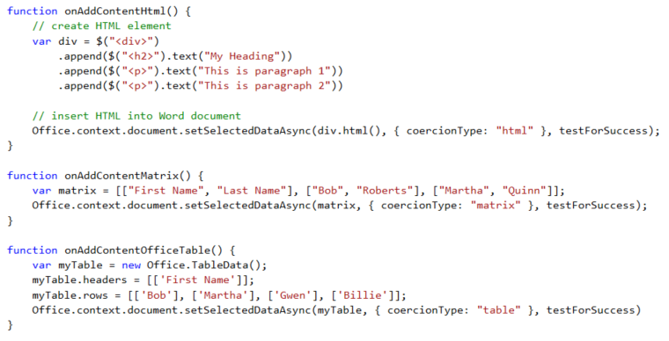
Coercion Types
Remember this only works with Microsoft Word

Slide 27

Setting Selected Data
setSelectedDataAsync (data, {coercionType, asyncContext}, callback)
Use asyncResult parameter in callback function to verify call was successful
Passing data to setSelectedDataAsync
For text shape, pass data as string
For matrix shape, pass data using 2 dimensional JavaScript array
For table shape, pass data using TableData object
Coercion types can be used to convert string to/from HTML and OOXML
Dealing with table size when inserting data
If single cell selected: table of any size can be written
If range selected range, supplied array must match size of table being written
Notes:
You should use the document's setSelectedDataAsync method to write content back to a document. When calling the setSelectedDataAsync function, you will pass a callback function and use the asyncResult parameter in this callback function to verify call was successful
You must determine how to pass data when calling setSelectedDataAsync. For text shape, you can pass data as a string. For matrix shape, you should pass the data using 2 dimensional JavaScript array. For a table shape, you should pass the data using a special TableData object which can be created using the Office JavaScript API. Also note that with Word you can also use two additional coercion types which are HTML and OOXML.
There are a few tricks you should know about when dealing with matrix and table size when inserting data. If the user has selected a single cell selected, a matrix or table of any size can be written. However, if the user has select a range with two or more cells, the matrix or table be written must match the size of target range exactly with respect to the number of rows and columns.

Slide 28
Agenda
Introduction to the Office Add-in Model
Developing Office Add-ins with Visual Studio
Coercion Types and Open XML Formats
Data Bindings and Events
Creating and Debugging Mail Add-ins

Slide 29
What are App Bindings?
Bindings link Office Add-in to specific document section
Can be defined current selection of a named item in a template
Arbitrarily read/write binding data at anytime
Read and write operations do dependent upo current select
Enable Event handling
Bindings support three different data shapes
Text binding for binding to an individual cell in Excel or text in word.
Matrix binding for a two dimension array representing rows and columns
Table binding is like a matrix binding with support for headers
Notes:
Bindings are a valuable concept because they link an app to a specific section within a document. A binding can be created based on the current selection. A binding can also be defined used a named item such as a named range in an Excel workbook or a bookmark in a Word document. A binding adds value by providing a named section that can be read from or written to regardless of what the current selection is. A binding also support events so you can add an event handler that detects when the user has made a change to the content inside a binding.
Bindings support three different data shapes. Text bindings are used for binding to an individual cell in Excel or text in word. Matrix bindings are used for a two dimension array representing rows and columns. Table bindings are used to support Excel tables with named columns and a set of rows that support inserts and deletions by the user.

Slide 30
Bindings in Office Add-in with Excel
Excel supports data binding to content in document
Excel supports binding to named ranges inside Workbook
Bindings created using name of named range which serves as ID
You can read and write bound content regardless of selection
You can register event handlers to fire when user updates content
Notes:
Bindings are import because they make it so you can read and write to specific areas in a Word document without having to worry about what the selected region is

Slide 31
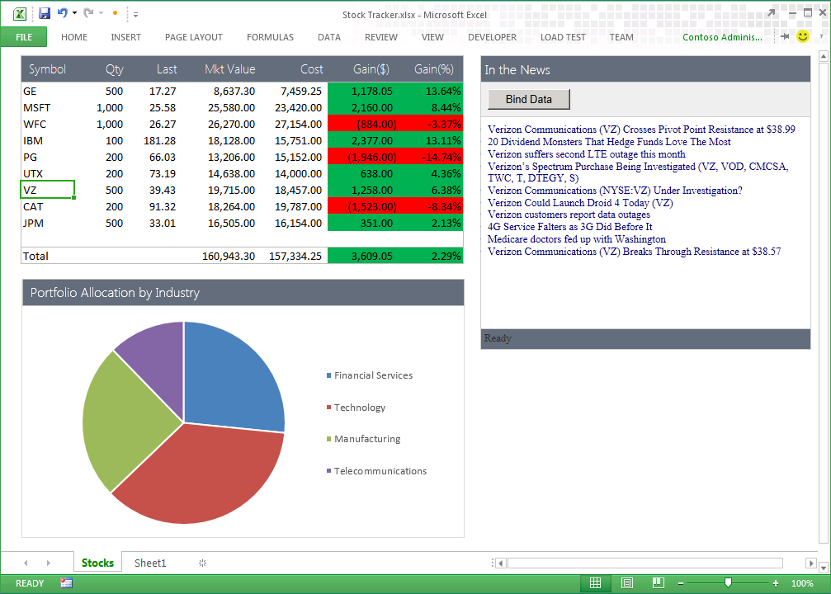
Uses of Office Add-in Bindings
App handles SelectionChanged event associated with the binding to retrieve news associated with stock symbol
Bound range of stock symbols
Notes:
Bindings provide a scope which allows an app to distinguish between selection changes or updates at the document level or just within a specific section of a document. Therefore, bindings can bridge the gap between Office documents and the cloud. Bindings are also key in reading and writing data and detecting changes made by the user.

Slide 32
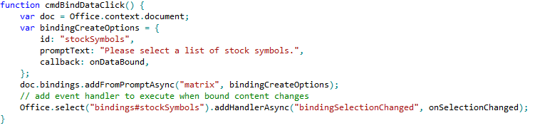
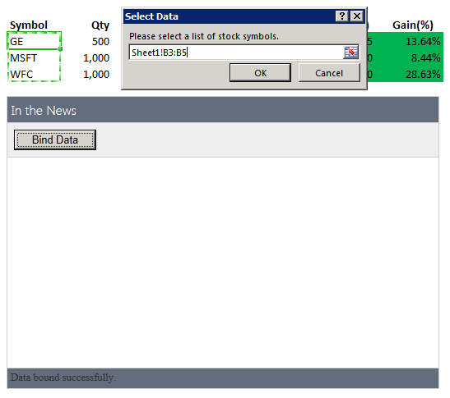
Using Bindings
Adding a binding
Bindings.addFromPromptAsync
Bindings.addFromSelectionAsync
Bindings.addFromNamedItem
Referencing a binding
Bindings.getAllAsync
Bindings.getByIdAsync
Office.Select
Removing a binding
Bindings.releaseByIdAsync
Binding event handler to a binding
Binding.addHandlerAsync(“type”, handler);
A dialog is presented to the user experience when you call addFromPromptAsync.
Notes:
To add a binding, you should use one of the following method
Bindings.addFromPromptAsync
Bindings.addFromSelectionAsync
Bindings.addFromNamedItem
You will also need to reference bindings to read and write content and register event handlers. When you need to reference a binding, you can use one of these method.
Bindings.getAllAsync
Bindings.getByIdAsync
Office.Select
If you ever need to remove a binding, you can use this methods.
Bindings.releaseByIdAsync
To register an event handler on a binding, you can use the following method.
Binding.addHandlerAsync(“type”, handler);

Slide 33
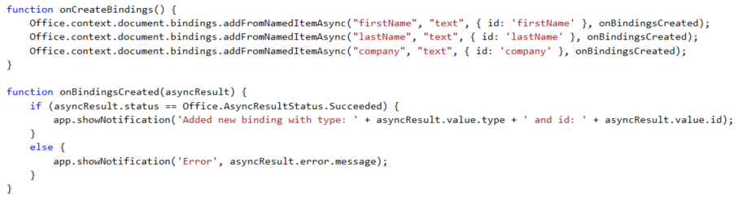

Adding Bindings in JavaScript
Notes:
The top code listing shows how to create bindings in JavaScript code using addFromNamedItemAsync. Note that the first parameter (e.g. "firstName") is used to indicate which content control you want to bind to. The third argument (e.g. { id: 'firstName' } is used to create the binding ID that will be used to retrieve the binding when call the Office.select function.
Note that the call to Office.select gets the binding using a syntax of "bindings#" followed by the ID of a registered binding.

Slide 34
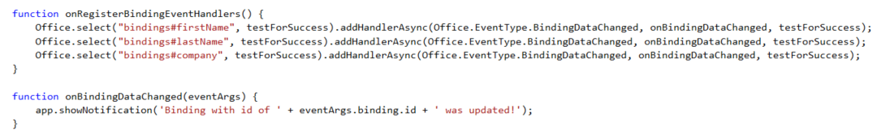
Adding Event Hander Bindings
Event handlers added using addHandlerAsync
Callback function called automatically when user updates binding content
Notes:
This code shows how to register an event handler on a binding using the addHandlerAsync function.
The call also registers a callback function named onBindingDataChanged which is called automatically when user updates the bound content.

Slide 35
Agenda
Introduction to the Office Add-in Model
Developing Office Add-ins with Visual Studio
Coercion Types and Open XML Formats
Data Bindings and Events
Creating and Debugging Mail Add-ins

Slide 36
Mail Add-in Capabilities
Rule-based activation
Add-ins can appear based on regex match
Based on presence of entities (e.g. email, postal address, etc)
Based on presence of attachments
Based on type of item
Extensive JS object model API
Access to core item properties in read and compose
Access to body and attachments
Ability to modify fields and add attachments in compose
Launch native reply and new appointment forms
Ability to set custom properties on items

Slide 37
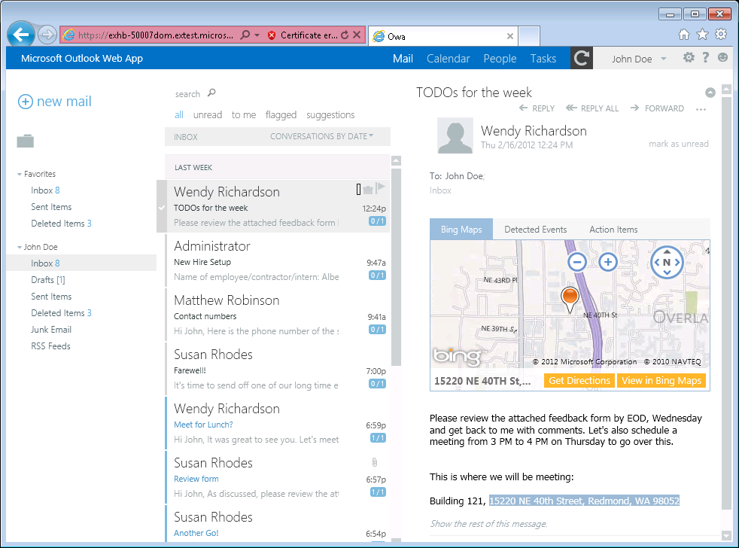
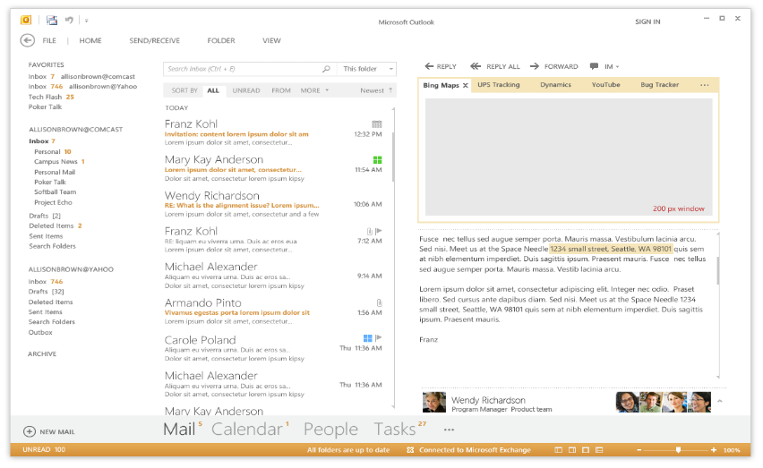
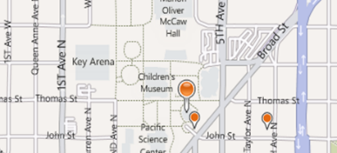
Mail Add-in
Mail Add-in runs in Outlook, OWA and Office mobile clients
Mail Add-ins Require Exchange 2013 or Office 365
Mail Add-in Development based on activation rules
Activation rules run whenever user selects item
Activated mail add-ins are added into Outlook UI
Notes:
A key concept of mail apps is that they are written once and can run anywhere Outlook runs including the rich client, the browser and mobile devices. The development model for mail apps based on activation rules. The idea is that activation rules for all installed mail apps run whenever user selects item. All mail apps whose activation rules result in activation are then available to use within the context of that selected item. Furthermore, the experience of app activation and starting a mail app is consistent across Outlook and OWA. When a mail app is started by the user, the mail app is designed to provide the user with contextual information for the selected e-mail message, meeting request, or appointment.
The infrastructure for mail apps has been designed to be secure. With Outlook, mail apps are run in an isolated, sandboxed process. In the browser, mail apps are isolated within their own iFrame. As you will see later in this model, mails apps run with a three-tier permission model which affords a great deal of power in a secure manner.

Slide 38
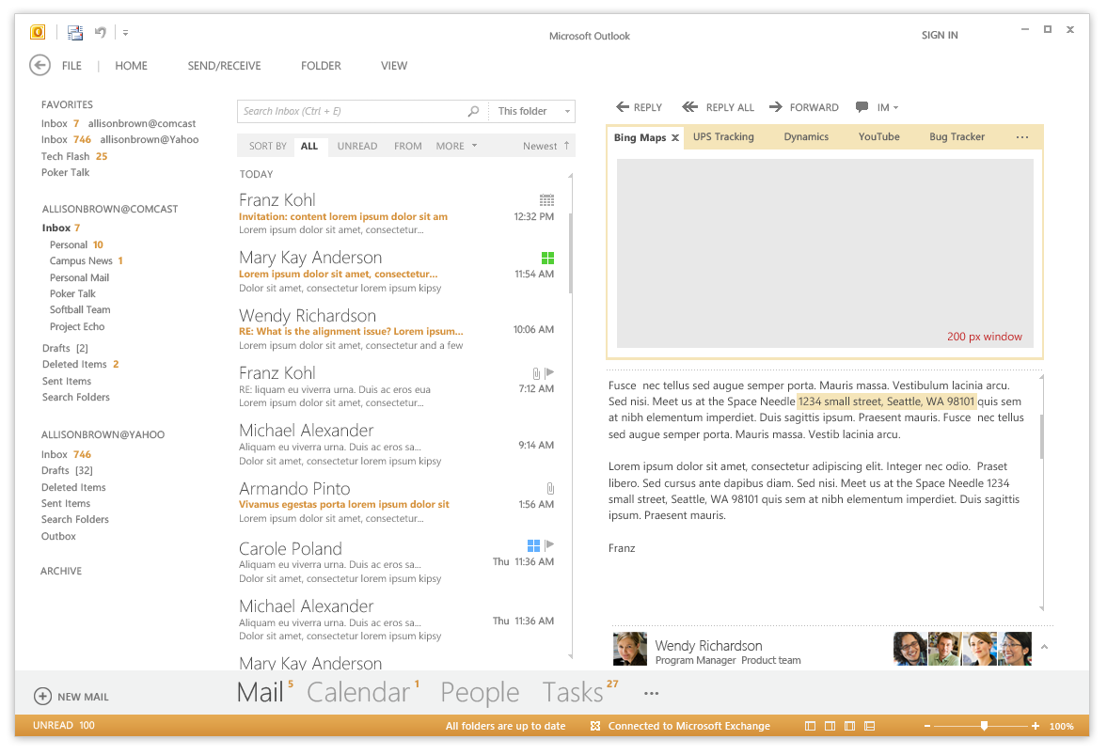
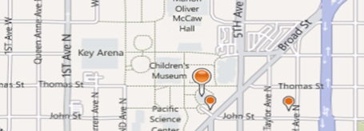
Mail Add-ins – Up Close and Personal
Add-in Name
Mail Add-in Body
Context trigger
Notes:
This slide shows some key aspects of how mail apps integrate into the Outlook and OWA user interface.
When a mail app has activated for a specific Outlook item, its App Name appears in a special App Bar just above the body of the host mail item. A user can start up a mail app by clicking on the App Name in the App Bar. This action results in the mail app loading which will display the Mail App Body. Many activation rules for mail apps are based on finding specific types of content in the host item. For example, the Bing Maps mail app looks for content inside the body that is interested as an address. Such content is considered a Context Trigger and is highlight in the body of the mail item showing the user what specific data the mail app is using to do its work.

Slide 39

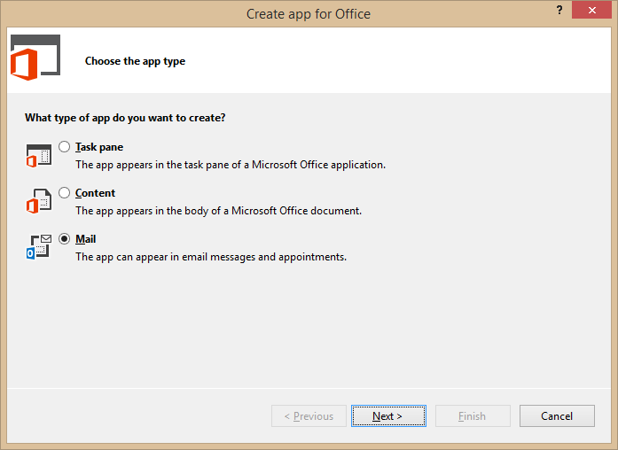
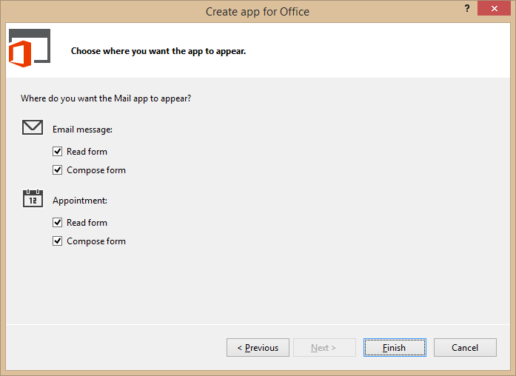
Developing Mail Add-ins
Use the Visual Studio project template for Mail Add-ins
Notes:
To create mail app, you can use Visual Studio and a new project template dedicated to creating mail apps.

Slide 40
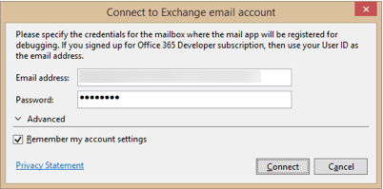
Steps for Testing and Debugging
Specify height from 32 to 350 pixels
Define activation rules
Create UI and style with CSS
Write JavaScript to add behavior and business logic
Debug using Exchange Server and a valid Exchange account
Press {F5} and Visual Studio prompts for server and user mailbox credentials
Notes:
This slide details the high-level steps of creating a mail app. Within the app manifest, you should specify a height for the mail app between 32 pixels to 350 pixels. Note that you cannot specify the width as the mail app will take up all the available width in the host application. Next, you define one or more activation rules. Next, you create the user interface for the mail app using HTML5 and CSS. After that, you write JavaScript to add the required behavior and business logic. When you are finally ready to test your work, you can press the {F5} key to begin the debugging process.
In order to test and debug a mail app, you must have a installed version of Exchange 2013 and a valid Exchange account with a mailbox. When you press the {F5} key for the first time Visual Studio 2012 prompts you with the dialog shown above to track the server running Exchange 2013 as well as the login credentials for the user mailbox used for testing.

Slide 41
Rule-based Activation
Mail Add-ins activate based on rules
Rules are defined in the manifest
Rules are applied to the selected item in the Explorer or Inspector
If conditions are met, Add-in will be activated and available for use
About rules
Multiple rules can be combined for complex activation needs
Apply logical AND or OR operators
Rules can access known entities such as phone numbers
Rules can be defined using regular expressions
Notes:
Every mail app is created with one or more activation rules. These rules are defined in the app manifest using XML. These activation rules are run for each installed mail app whenever the user select a new mail item that is a mail message, and event or an appointment. If the conditions for an activation rule are met, then the mail app is activated and becomes available to start by the user.
A simple mail app can be based on a single activation rule. However, a mail app can contain multiple rules that can be combined for complex activation needs. When you add more than one activation rule, you must decide whether to AND the rules together or to OR the rules together.
Activation rules can be based on known entities such as address and phone numbers. For more specific scenarios, activation rules can also be defined using custom regular expressions.

Slide 42
Activation Rule Types
ItemIs
A rule that checks the item type (appointment or message)
<Rule xsi:type=“ItemIs” ItemType=“Message”>
ItemHasKnownEntity
A rule to check if the item has a specific type of known entity
<Rule xsi:type=“ItemHasKnownEntity” EntityType=“Address” />
ItemHasRegularExpressionMatch
Defines a rule using a custom regular expression to match the contents of an item
RuleCollection
Defines a rule composed of multiple rules (combined using AND or OR)
Notes:
There are several different types of activation rules.
The ItemIs rule checks to see whether the item type is a message or an appointment.
<Rule xsi:type=“ItemIs” ItemType=“Message”>
The ItemHasKnownEntity rule checks to see if the item has a specific type of known entity
<Rule xsi:type=“ItemHasKnownEntity” EntityType=“Address” />
The ItemHasRegularExpressionMatch rule checks to see if an item has content that matches custom regular expression.
The RuleCollection rule combines two or more inner rules using either the AND operator or the OR operator. When using the AND operator, all inner rules must be met for activation to occur. When using the OR operator, only one inner rule must be met for activation to occur.

Slide 43
Well-known Entity Examples
Outlook is aware of specific types of entities
Items are parsed and scanned for common types of entities
Use ItemHasKnownEntity rules to based activation rules on entities
Within app use API functions getEntities or getEntitiesByType
Entity type | Recognition condition
Address | United States street addresses 1 Microsoft Way, Redmond, WA 07722
EmailAddress | Any SMTP email address
MeetingSuggestion | A reference to an event or meeting Let’s meet next Tuesday for lunch.
Contact | A personal name related to other entities Steve Ballmer, Microsoft, 1 Microsoft Way, Redmond, WA 07722
PhoneNumber | United States telephone numbers (507) 555-1212
TaskSuggestion | Actionable sentences in an email Please install Office 2013 on my computer.
Url | A file name or web address
Notes:
Outlook 2013 is aware of several specific well-known types of entities which are listed in the table on the slide above. When you create an activation rule based on one of these entities, Outlook will parse and scan the current item for the presence of content that matches that type of entity.
To create an activation rule based on a well-known entity with XML inside the app manifest, you use the ItemHasKnownEntity rule
<Rule xsi:type=“ItemHasKnownEntity” EntityType=“Address” />
When you are writing JavaScript code for the mail app, you will need to retrieve the entity value which can be done using the API functions getEntities or getEntitiesByType.

Slide 44

Accessing the Office.js API for Outlook
Outlook Add-in API available through mailbox
Office
context
mailbox
Message
Item can be cast to one of four different types
Message Compose
item
Appointment
Appointment Compose
Notes:
Access to the Outlook JavaScript Object Model (JSOM) is available through the Office.context.mailbox object. From here you can obtain access to information about the selected mail item and user profiles for the current user as well as other users such as the one that sent the message.

Slide 45
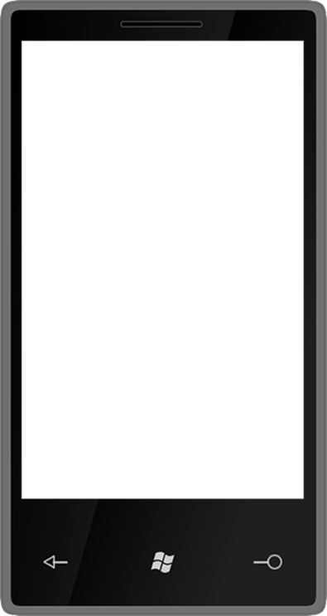

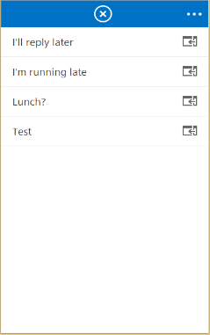
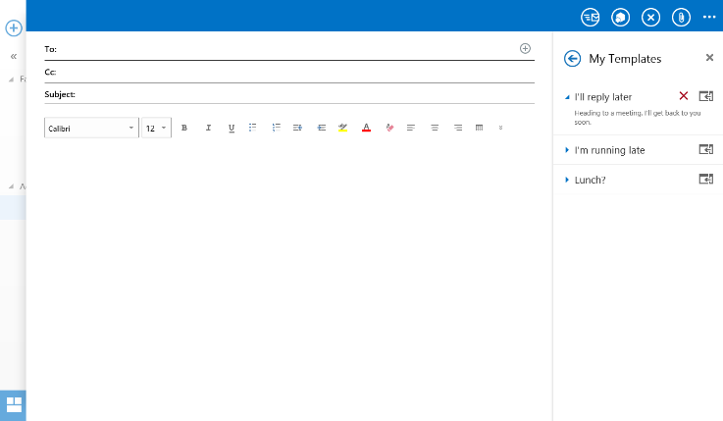
Compose Add-ins Activation
Add-ins can appear in messages and/or appointments
Compose add-ins work across Desktop, Tablet and Mobile

Slide 46
Summary
Introduction to the Office Add-in Model
Developing Office Add-ins with Visual Studio
Coercion Types and Open XML Formats
Data Bindings and Events
Creating and Debugging Mail Add-ins

