Slide 1
Getting Started with Provider-hosted Add-ins
Notes:
The module begins by examining the architecture of a provider-hosted add-in and describing the details of how SharePoint Online launches a provider-hosted add-in by redirecting the user to a start page in the remote web. Students will learn how to decide between Web Forms and the MVC framework when creating a new provider-hosted add-in project as well as when to leverage the SharePoint Chrome Control when designing the user interface experience. The module also discusses how to design and implement a provider-hosted add-in as a single page application (SPA) which deploys client-side JavaScript code to the remote web which is able to program against the host web using the Cross Domain Library. The module also explains how provider-hosted add-ins with server-side code rely on external authentication using the OAuth 2.0 protocol. Students will learn how to write server-side code using the SharePointContext class and the TokenHelper class to acquire and manage access tokens.

Slide 2
Agenda
Architecture of a Provider-hosted Add-in
Web Forms Versus the MVC Framework
Using The SharePoint Chrome Control
Working with the Cross Domain Library
Implementing OAuth 2.0 Security

Slide 3
Provider-Hosted App
Developer responsible for deploying remote web
App deployed to remote web on remote web server
Developer deploys remote web prior to app installation
Developer often required to deploy database as well
Notes:
Provider-Hosted apps create a remote web and reside external to SharePoint. This doesn’t mean they cannot interact with SharePoint artifacts like lists and libraries, it just means that they primarily live outside of SharePoint like other Cloud-Hosted apps. In this scenario, the developer (or provider of the app) is responsible for deploying, installing & configuring all resources that are external to SharePoint.
For instance, if a Provider Hosted app references an ASP.NET MVC application deployed to Windows Azure that leverages Azure services like Service Bus, Access Control Services and SQL Azure, the developer is responsible for standing up and configuring all the non-SharePoint pieces of the application.

Slide 4
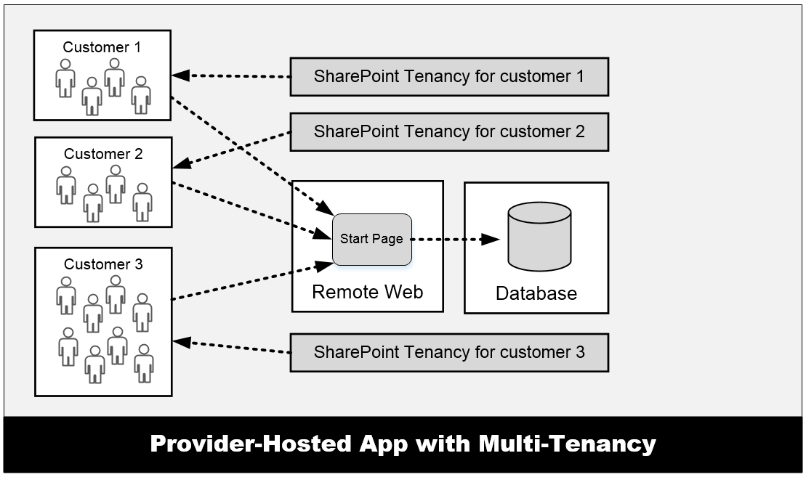
Provider-Hosted App with Multi-tenancy
Many customers access the same remote web
Remote web must be able to scale as needed
App design must isolate data on per-customer basis
Complexity increases time and cost of development
Notes:
One important aspect of provider-hosted apps is that you can have the same app installed multiple times across multiple SharePoint farms and/or SharePoint tenancies. However, all users that access the remote web of the app all connect through the same entry points as shown in the graphic in the slide. This can pose design issues when you are designing and developing a provider-hosted app for a multi-tenant environment and you are storing data for customers in a custom database. The database design often becomes more complex because you are usually required to isolate the data from different customers in separate tables and possibly separate database as well.

Slide 5
Pros and Cons of Provider-hosted Apps
Benefits of provider-hosted over SharePoint-hosted apps
You can write server-side .NET code using C# or VB.NET ([wahoo!])
You can make HTTP calls w/o cross-domain scripting constraints
Your server-side code can access data in a custom database
You can leverage the support for remote event receivers
You can make CSOM/REST API calls using App-only permissions
Provider-hosted apps more strategic for Microsoft moving forward
Negatives when compared to SharePoint-hosted apps
You must deploy and manage the remote web
Requires extra code to acquire and manage security tokens
Multi-tenant aware app design can introduce significant complexity

Slide 6
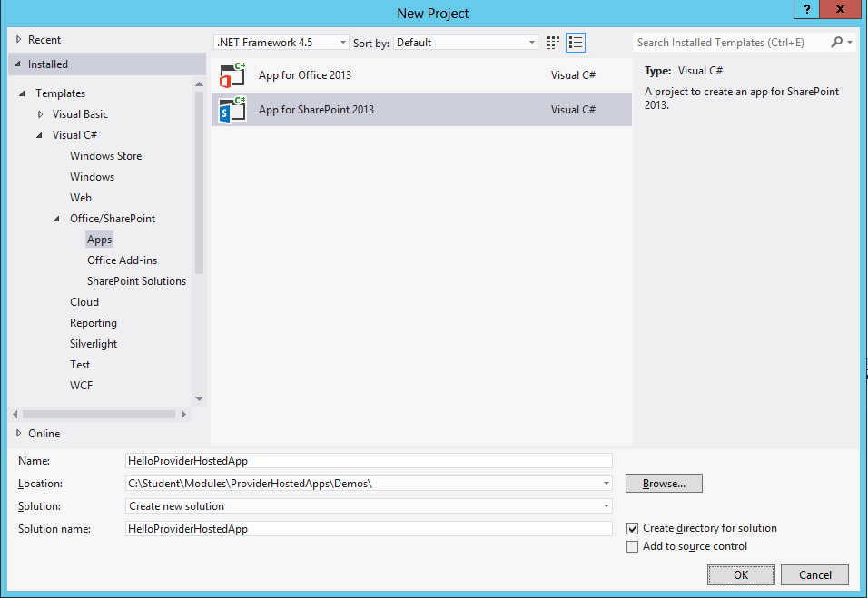
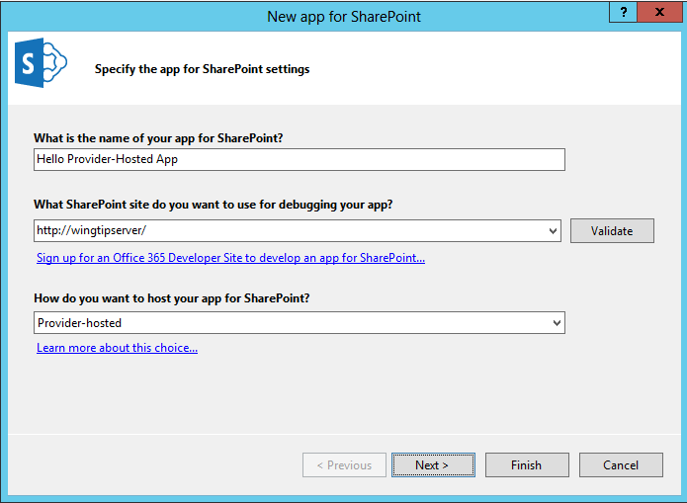
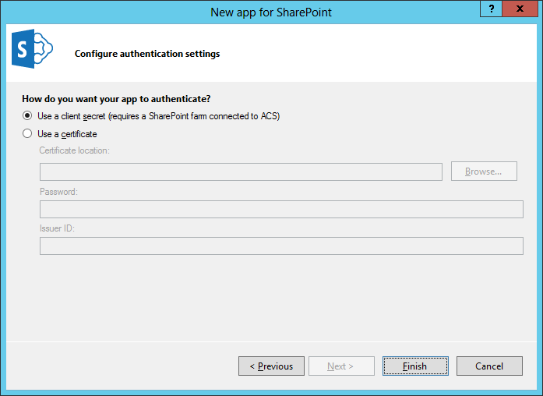
Creating a Provider-hosted App Project

Slide 7
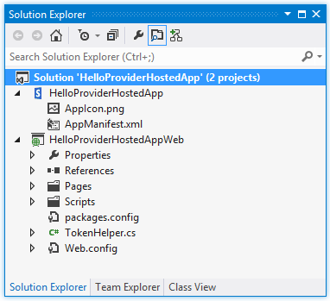
Provider-hosted App Projects
Visual Studio create solution with two projects
SharePoint app project
ASP.NET Website project for remote web this project is known as the “web project”

Slide 8
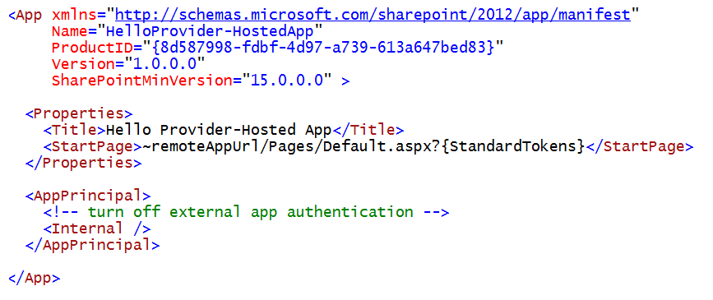
AppManifest.xml
Provider-hosted app adds requirements to App Manifest
StartPage must point to page in remote web
AppPrincipal requires app authentication settings
External app authentication can be disabled using Internal setting

Slide 9
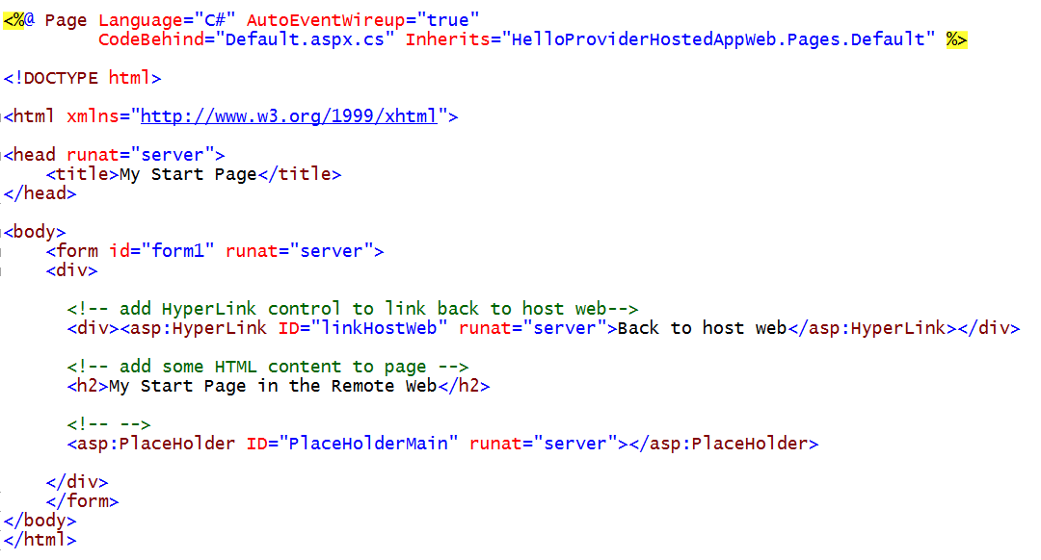
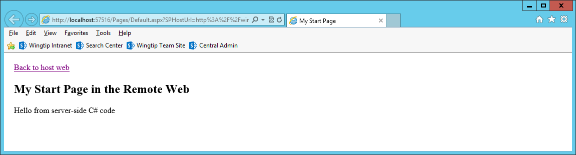
A Sample Start Page

Slide 10
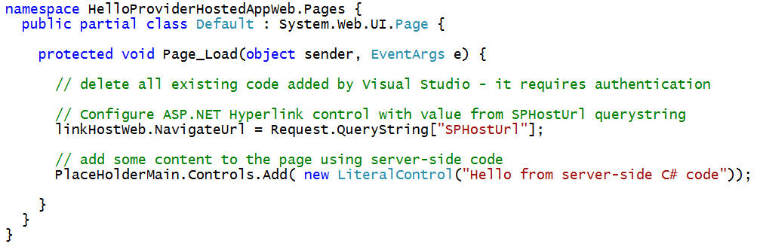
C# Code Behind Sample Start Page

Slide 11
Debugging the Remote Web in IIS Express
Visual Studio debugging involves IIS Express
URL created in localhost domain (e.g. https://localhost:57516)
Port number for Remote Web project selected automatically behind scenes
IIS Express debugging support allows you to debug…
Server-side C# code behind pages in the remote web
Web service calls from browser to remote web
Web service calls from SharePoint to remote web
SharePoint
Worker Process
Browser
Client-side JavaScript
Remote Web running locally in IIS Express
attach
Visual Studio .NET Debugger

Slide 12
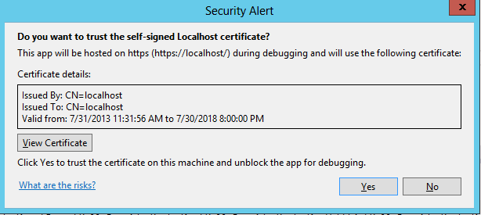
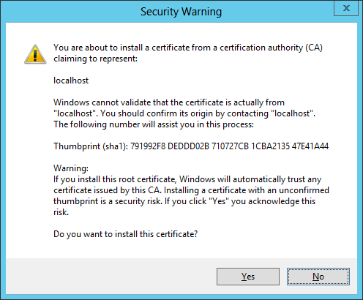
Debugging Code in the Remote Web
Remote Web can optionally use SSL
Pages can be served using HTTPS or HTTP
Use of SSL is usually preferred
IIS Express can configure SSL through https://localhost
Visual Studio registers self-signed certificate on first use

Slide 13
Creating the ‘Hello World’ Provider-Hosted App

Slide 14
Agenda
Architecture of a Provider-hosted Add-in
Web Forms Versus the MVC Framework
Using The SharePoint Chrome Control
Working with the Cross Domain Library
Implementing OAuth 2.0 Security

Slide 15
Web Forms Versus MVC
ASP.NET provides two different platforms
ASP.NET Web Forms (e.g. ASPX files)
ASP.NET MVC
MVC provides better platform for the web
More flexible routing
Lighter-weight
Richer templating
Better C# integration
Unit testing

Slide 16
Agenda
Architecture of a Provider-hosted Add-in
Web Forms Versus the MVC Framework
Using The SharePoint Chrome Control
Working with the Cross Domain Library
Implementing OAuth 2.0 Security

Slide 17
Designing the Remote Web User Interface
Create user interface using single page app pattern
Start page serves as exclusive user entry point into remote web
Start page designed with HTML markup and ASP.NET controls
Start page can be written with server-side C# code
Start page can also include client-side JavaScript code
JavaScript code can call to custom web services in remote web
Create user interface as a multi-page app
Users can navigate from start page to other pages in remote web
ASP.NET master page can create consistent UI across pages
Master page can leverage SharePoint Chrome control
Multi-page app loses major benefits of single-page app pattern
Extra work required to track start page POST data across requests

Slide 18
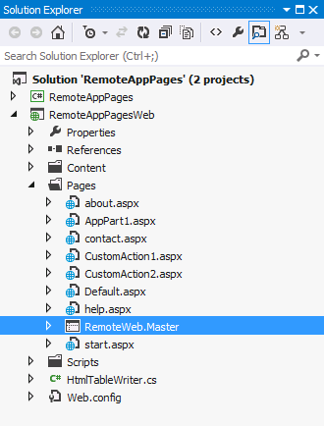
Using Master Pages in the Remote Web
Pages in remote web live outside SharePoint
You have responsibility and freedom to build entire UI
Often makes sense to create remote web master page
<%@Master language="C#" %>
<!DOCTYPE html PUBLIC "-//W3C//DTD XHTML 1.0 Strict//EN" "http://www.w3.org/TR/xhtml1/DTD/xhtml1-strict.dtd">
<html>
<head>
<title>Remote App Pages</title>
<link href="/Contents/app.css" type="text/css" rel="stylesheet" />
<asp:ContentPlaceHolder ID="PlaceholderAdditionalPageHead" runat="server" />
</head>
<body>
<form id="form1" runat="server">
<div id="pageWidth">
<div id="chrome_ctrl_container"></div>
<div id="contentBody">
<asp:ContentPlaceHolder ID="PlaceholderMain" runat="server" />
</div>
</div>
</form>
</body>
</html>
Notes:
MSDN: Apps for SharePoint UX design guidelines
http://msdn.microsoft.com/en-us/library/office/apps/jj220046(v=office.15)

Slide 19
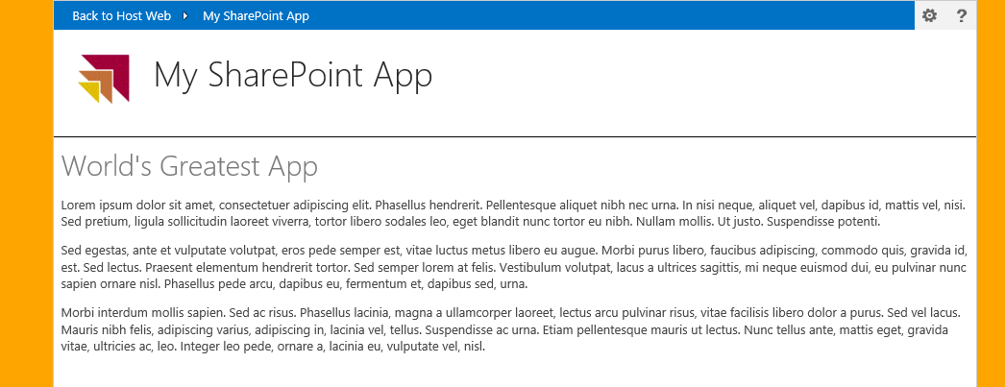
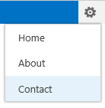
Leveraging the Chrome Control
Optional JavaScript component for use in Remote Web
Used to create top banner of page with SharePoint look and feel
Provides link to host web, configurable navigation and help link
Can pull custom styles used in host web
Notes:
Pages in the remote web of Cloud-Hosted Apps do not have access to the app.master and thus don’t have the same look & feel of their hosted SharePoint sites. To address this Microsoft provides something called the chrome control which is a JavaScript library that writes the HTML that includes the header of the hosting SharePoint site as well as a reference to an ASP.NET HTTP Handler that pulls all the CSS from the parent site so the pages in the remote web can look the same as the host web.

Slide 20
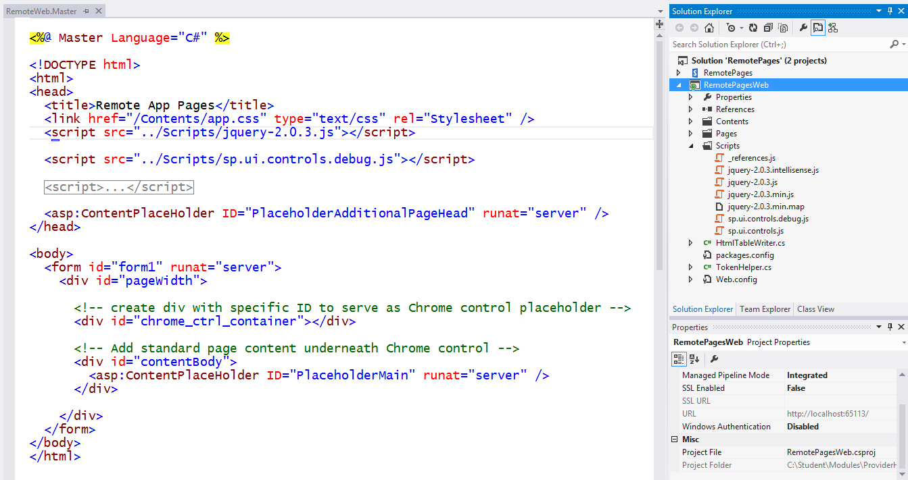
Using the Chrome control

Slide 21
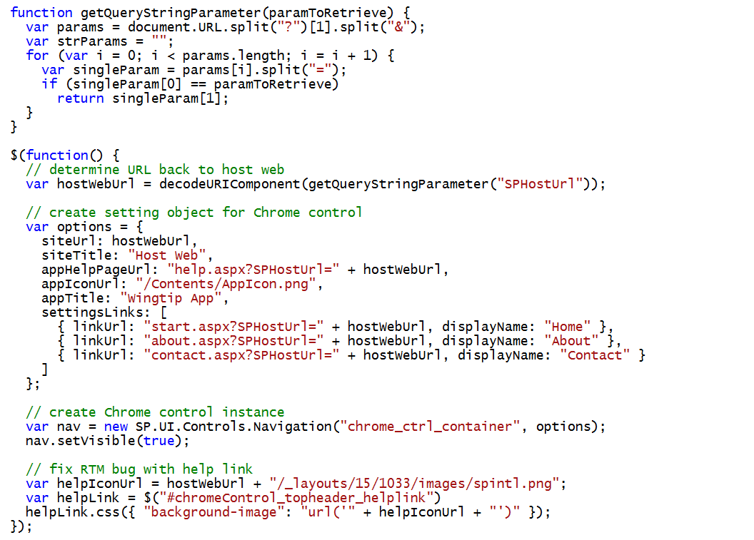
Initializing the Chrome Control

Slide 22
Creating Pages in the Remote Web using the Chrome Control

Slide 23
Agenda
Architecture of a Provider-hosted Add-in
Web Forms Versus the MVC Framework
Using The SharePoint Chrome Control
Working with the Cross Domain Library
Implementing OAuth 2.0 Security

Slide 24
Cross Domain Library
Where is it used?
In client-side JavaScript code in pages of remote web
When do you need it?
To enable CSOM and REST API calls from browser to host web
In scenarios where external app authentication is not possible
How does it work?
You use SharePoint Cross Domain library to execute calls
Calls are routed through app web which use internal app authentication
Cross domain library calls proxy page to deal with cross-domain issues

Slide 25
Exploring the RestCrossDomain App Project

Slide 26
Agenda
Architecture of a Provider-hosted Add-in
Web Forms Versus the MVC Framework
Using The SharePoint Chrome Control
Working with the Cross Domain Library
Implementing OAuth 2.0 Security

Slide 27
Authentication and Authorization
Authentication creates identity for principal
SharePoint 2010 only supports user authentication
SharePoint 2013 adds support to authenticate apps
SharePoint apps are given first class identities
Authorization provides the access control
Used to verify an principal has the proper permission
SharePoint 2010 only supports user permissions
SharePoint 2013 adds support for app permissions
Notes:
The two most basic concepts in computer security are authentication (AuthN) and authorization (AuthZ). Authentication is a process which answers the basic question "who are you". Authorization answers the basic question, "what can you do".
Authentication used to create identity for security principal. SharePoint 2010 supports authenticating users. However, SharePoint 2013 adds support to authentication Apps in addition to users. This means that Apps in SharePoint 2013 are given first class identities.
SharePoint provides an authorization infrastructure which allows privileged users configure access control for other users and apps to access SharePoint sites and the elements inside them such as pages and documents. SharePoint 2013 tracks user permissions using access control list (ACL) entries stored in the content database. SharePoint also tracks permissions for Apps but not in the same way that it does for user permissions.

Slide 28
Internal Authentication
Internal authentication is used if the following are true
Incoming call targets a CSOM or REST API endpoint
Incoming call carries claims token with established user identity
Incoming call targets URL of an exiting app web
Important points about using internal authentication
It just works – no need to program in terms of access tokens
It’s always used with client-side calls from pages in the app web
It can be used from remote web pages using cross domain library
It does not support app-only authentication to elevate privledge

Slide 29
External Authentication
In which scenarios does external authentication occur?
When server-side code in the remote web issues CSOM or REST API calls against the SharePoint host
Incoming calls free to target host web and other sites in tenancy
How does it work?
App code must written to create and manage access tokens
Access token carries app identity
Access token can (and usually does) carry user identity as well
App must transmit access token when calling to SharePoint

Slide 30
SharePoint 2013 Authentication Flow
Notes:
When SharePoint 2013 begins to authenticate an incoming request, it first looks to see if the incoming request contains a SAML token with a user identity. If the SharePoint 2013 authentication pipeline finds a SAML token, it can then assume that the incoming request was initiated by a user and not an app. Once it finds a SAML token, SharePoint 2013 then inspects the target URL of the incoming request to see whether it references a standard SharePoint site or a child site associated with a specific app (i.e. an AppWeb). If the incoming request targets a standard site, SharePoint 2013 conducts its authentication and authorization identically to how things worked in SharePoint 2010. If the incoming request targets an AppWeb, SharePoint 2013 initializes the call context with both a user identity and an app identity.
When an incoming request does not contain a SAML token, SharePoint 2013 knows that a user did not initiate the request. In this scenario, the SharePoint 2013 authentication pipeline inspects the incoming request to see if it contains a security token identifying a provider-hosted app. The security token for an app can be created using OAuth when Office 365 and ACS is involved. If the security token for an app was created in a server-to-server (S2S) configuration, it will be similar to but slightly different from a valid OAuth token. Once SharePoint 2013 finds a security token identifying an app, it sets up call context with the app identity and optionally the user identity as well.

Slide 31
OAuth Protocol Flow in SharePoint 2013
1
SharePoint authenticates user using claims
Content Server
SharePoint 2013
Web Server
2
SharePoint requests context token for user
2
3
ACS returns context token
1
4
SharePoint pass context token to User
User
desktop computer
laptop computer
mobile device
tablet or iPad
4
3
Authentication Server
Trusted ACS server that authenticates applications and creates OAuth tokens
5
User POSTS to app passing context token
6
Client app is able to pull refresh token out
of context token. Client app then passes
refresh token to ACS to request OAuth token
8
9
7
ACS returns OAuth token to client app
5
Client App
Web Server running remote app code
6
8
Client App makes CSOM/REST calls to SharePoint site passing OAuth token
10
7
9
SharePoint returns site content to app
10
Client App returns HTML to user device

Slide 32
Security Tokens used in OAuth
Context Token
Contextual information passed to app
Refresh Token
Used by client app to acquire an access token
Access Token
Token passed to SharePoint to app when using external authentication
Authorization Code
Used to register an app with on the fly permissions

Slide 33
Developing Apps that use OAuth
What's an OAuth access token?
Access token created using format in OAuth2 specification
Access token contains app identity (client ID)
Access token contains issuer identity (issuer ID)
Access token can optionally include user identity
Notes:
There are several responsibilities for the developer when creating an S2S app. First, you must deploy the Web project that contains the implementation of the client app itself. Next, the client app must be configured to perform its own user authentication. This can be done using any supported style of authentication including Windows Integrated Authentication, Basic Authentication, FBA, etc. Finally, the client app must create its own security tokens and sign them with the private key associated with the SSL certificate.
Create security tokens to send to SharePoint server
Note that the security token created by a client app in the S2S trust scenario is like OAuth token but it differs from the OAuth specification in a few different ways. The security token created by a client app in an S2S trust must contain information about app identity. The security token created by a client app in an S2S trust usually contains information about the identity of the current user but this is not a requirement. Once the security token it created with the required information inside, it then must be signed with the private key before it is sent to the SharePoint server. This private key signing is what allows the SharePoint server to perform the authentication on calls originating from the client app.

Slide 34
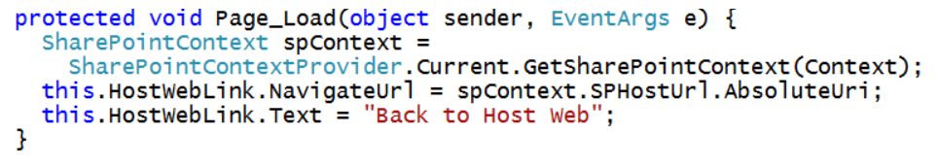
Programming with Access Tokens
Visual Studio adds two utility helpful classes
TokenHelper (it's been around since VS 2012)
SharePointContext (this is new with Visual Studio 2013)

Slide 35
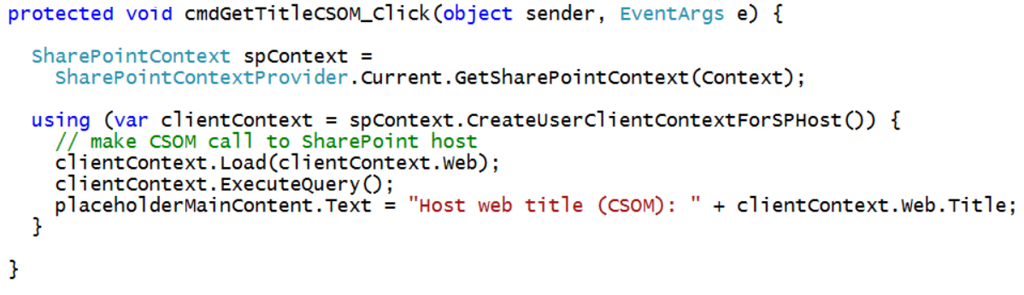
CSOM Calls using S2S Authentication
TokenHelper class has methods specific to S2S
SharePointContext has methods that are not S2S-specific

Slide 36
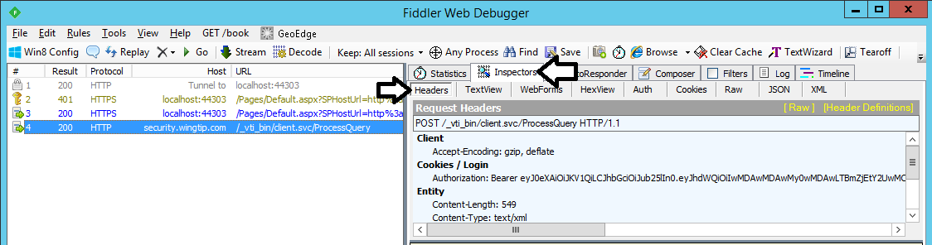
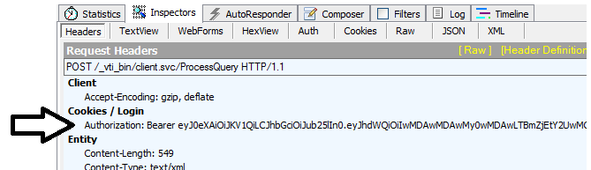
Examining CSOM Calls using Fiddler

Slide 37
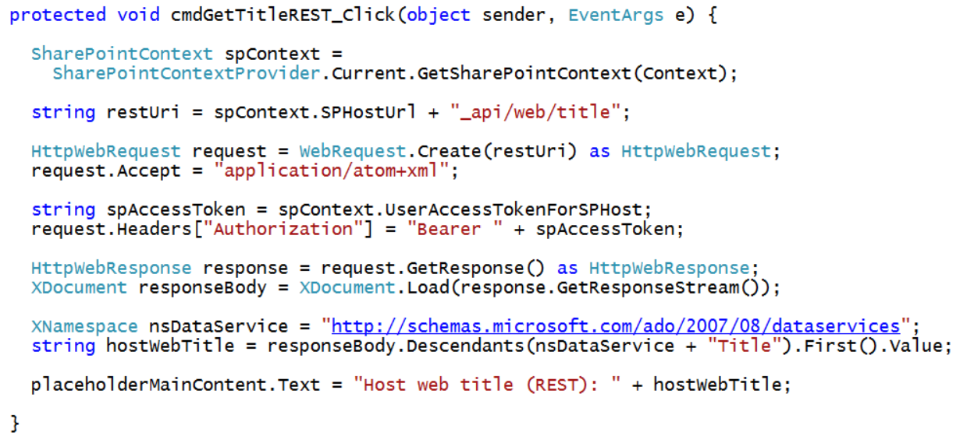
REST Calls using OAuth Authentication
Authorization header must be added explicitly

Slide 38
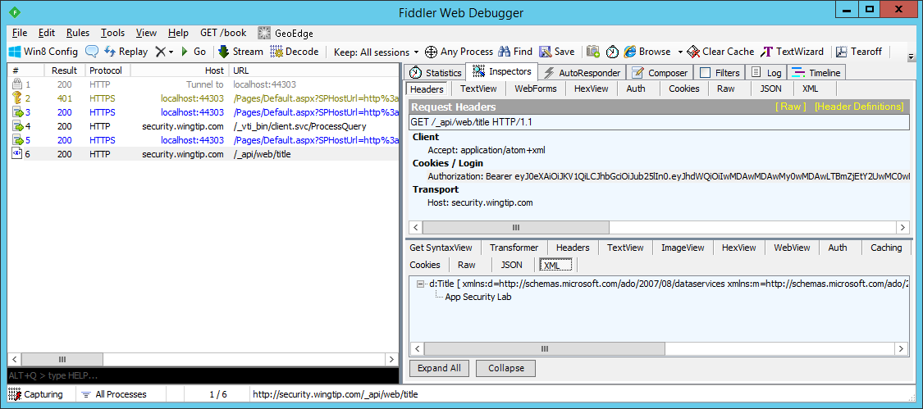
Examining REST Calls using Fiddler

Slide 39
Summary
Architecture of a Provider-hosted Add-in
Web Forms Versus the MVC Framework
Using The SharePoint Chrome Control
Working with the Cross Domain Library
Implementing OAuth 2.0 Security

