Slide 1
Extending Add-ins with Remote Event Receivers
Notes:
This module discusses when and how to use remote event receivers in the design of a provider-hosted add-in. The module discusses the architectural differences between "before events" which are modeled as two-way events and "after events" which are modeled as one-way events. Students will learn how to configure and implement an App-Installed event handler which can be used to provision lists, document libraries and other types of assets in the host web during the installation of a provider-hosted add-in. Students will learn how to configure debugging support for remote event receivers in the SharePoint Online environment by registering an Azure service bus endpoint and integrating that service bus endpoint with a Visual Studio project. The module also demonstrates a CSOM programming technique which can be used to register a remote event receiver dynamically so it's possible to wire up remote event handlers to lists and document libraries in the host web.

Slide 2
Agenda
Review of SharePoint Classic Event Model
Remote Event Receiver Architecture
Configuring Debugging Support
Handling App Lifecycle Events
Registering Event Receivers in the Host Web

Slide 3
Event Handling Support in SharePoint 2013
Classic server-side events for SharePoint solutions
Supported as early as SharePoint 2003
Based on ‘before’ events and ‘after’ events
Event handlers implemented using event receiver class in C#
Event handler assembly loads into SharePoint worker process
New remote event infrastructure introduced for app model
Event handler code runs in remote web not in SharePoint host
SharePoint calls web service in remote web to trigger event
Set of supported remote events is subset of server-side events
Remote “before” events implemented as two-way events
Remote after events implemented as one-way events

Slide 4
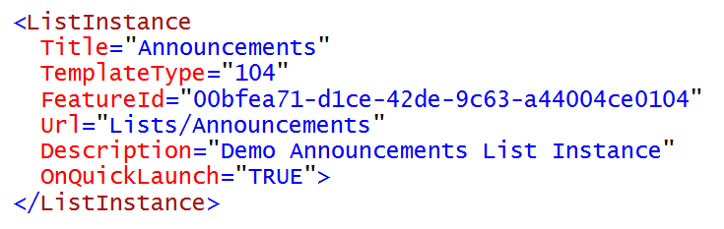
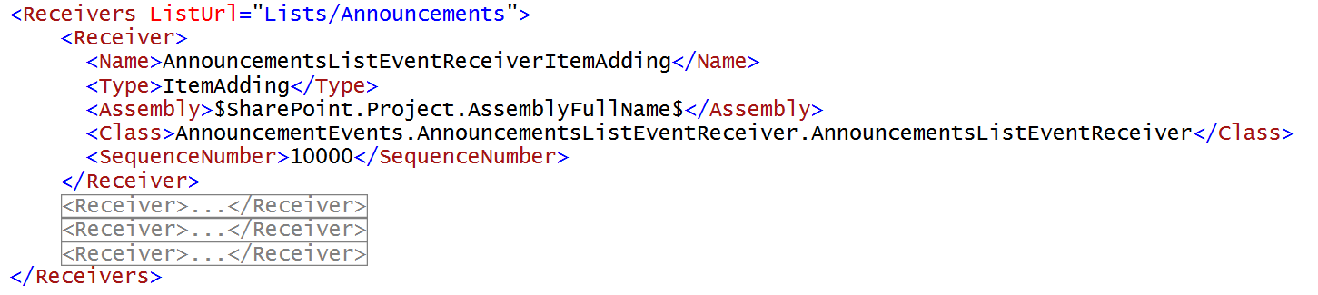
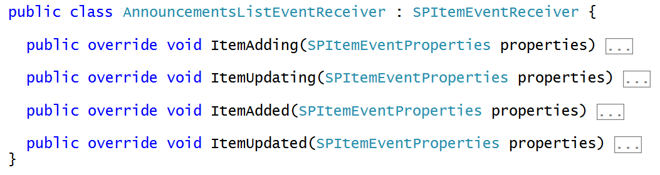
Review of Classic Server-side Events
You must have a target object which supports events
You must register for event handlers by referencing event receiver class
Event receiver class deployed by farm solution in .NET assembly DLL

Slide 5
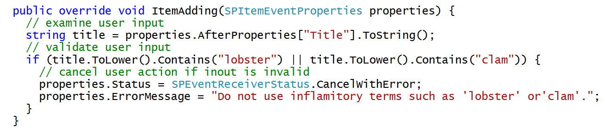
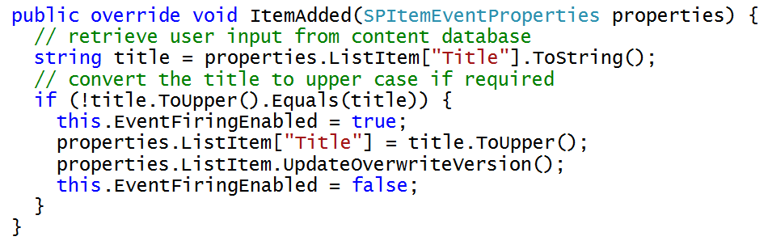
Programming Classic Server-side Events

Slide 6
Agenda
Review of SharePoint Classic Event Model
Remote Event Receiver Architecture
Configuring Debugging Support
Handling App Lifecycle Events
Registering Event Receivers in the Host Web

Slide 7
Why Use Remote Event Receivers?
Respond to user actions and modifications to content
Add validation logic for columns on list items
Cleanup and format content as it is entered by users
Calculate and store aggregated values
Initialize host web with new lists during app installation

Slide 8
Supported Remote Events
Site
Create
Move
Delete
Create
Delete
List / Library Schema
Create
List Item
Create
Update
Delete
Move
CheckIn
Attachment Added
File Moved
SharePoint App
Install
Uninstall
Update
Delete
UnCheckIn
CheckOut
Attachment Removed
File Converted
List / Library
Update
Notes:
The goal is to make the remote event receivers equivalent to the standard event receivers in SharePoint.
In cases where latency is high, remote synchronous events could cause significant delays in the operations that the event is responding to. Synchronous events are available today, though, and they’re important, especially for complex data validation rules.

Slide 9
Remote “Before” Events
Remote before events modeled as two-way events
Execution flow goes to remote web and then back to SharePoint
Client is blocked while event processing occurs in remote web
Sample execution flow for two-way event
Client attempts action which triggers an event (e.g. update item)
SharePoint host calls to web service in remote web
SharePoint host blocks until call returns from remote web the key point is that two-way events block the SharePoint host and delay response back to user
SharePoint host commits action and returns to Client
Two Way Event (aka before event)
Client
1
SharePoint Host
Remote Web
2
3
4

Slide 10
Remote “After” Events
Remote after events modeled as one-way events
Execution flow goes to remote web but does not return
Unlike before events, after events do not block client response
Sample execution flow for one-way event
Client attempts action which triggers an event (e.g. update item)
SharePoint host commits action and returns to Client
SharePoint host executes one-way WCF call on remote web the key point is that one-way events do not block the SharePoint host nor delay response back to user
One Way Event (aka after event)
Client
1
SharePoint Host
Remote Web
2
3

Slide 11
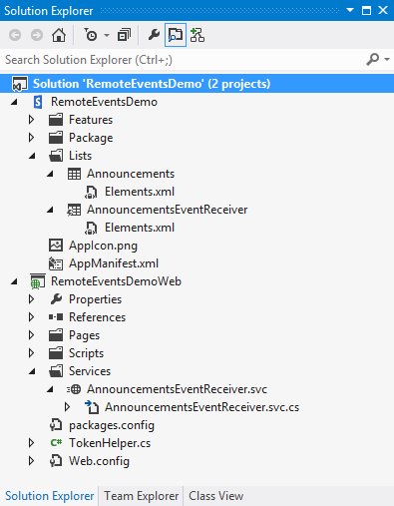
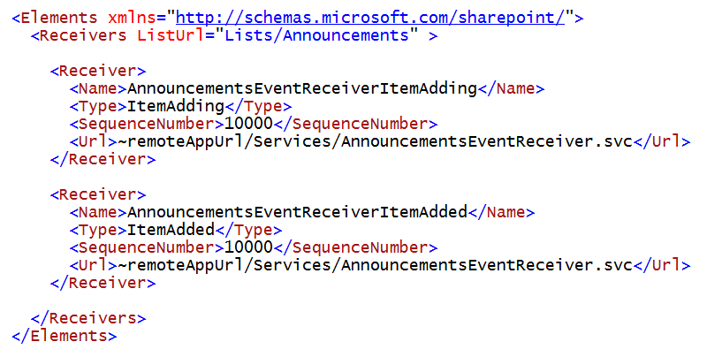
Registering Remote Events Receivers
Event receivers must be registered with SharePoint host
Registration can be declaratively for events occurring in app web
Registration for events occurring in host web requires code

Slide 12
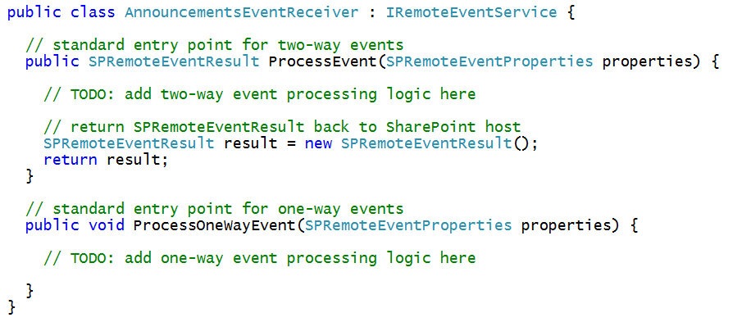
The Remote Event Receiver Entry Point
Remote event receiver implemented with .svc file
Event receiver code written as C# code code-behind .svc file
Event receiver is class that implements IRemoteEventService
ProcessEvent method executes when two-way event is triggered
ProcessOneWayEvent method executes when one-way event is triggered

Slide 13
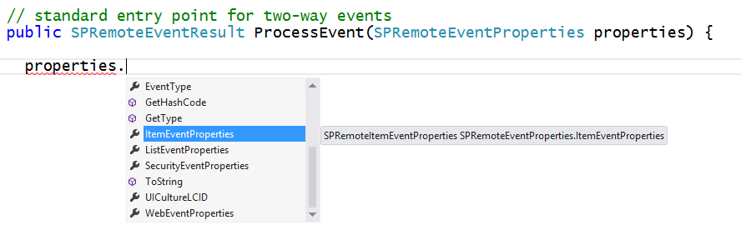
SPRemoteEventProperties
SPRemoteEventProperties parameter passed to event handlers
Provides you with contextual information about the current event
Allows you to read and update user input during before event
Makes it possible to perform validation in before events

Slide 14
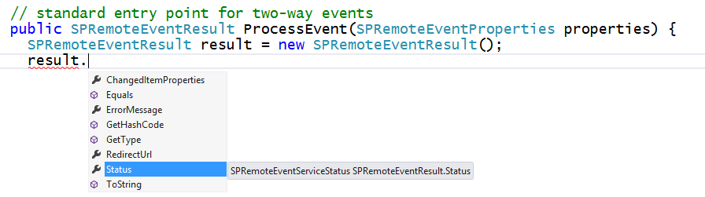
SPRemoteEventResult
Two-way event handlers return SPRemoteEventResult object
SPRemoteEventResult object makes it possible to cancel action

Slide 15
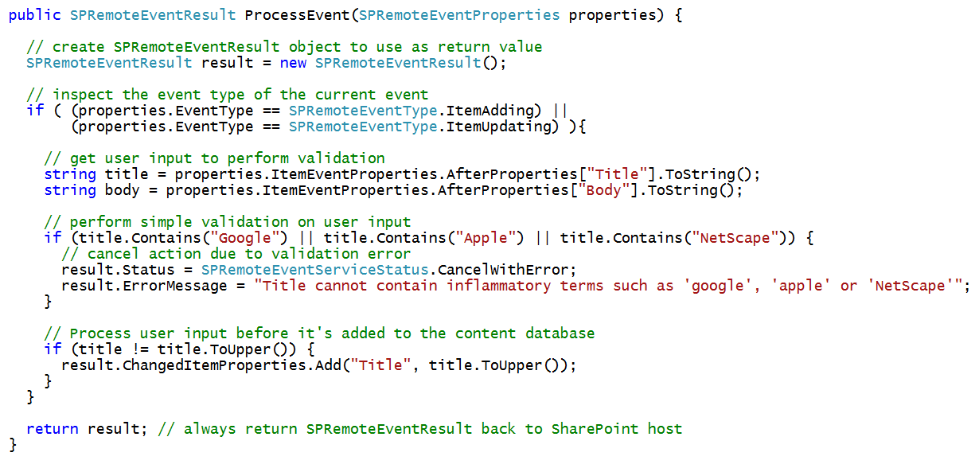
Example Before Event with a List Item

Slide 16
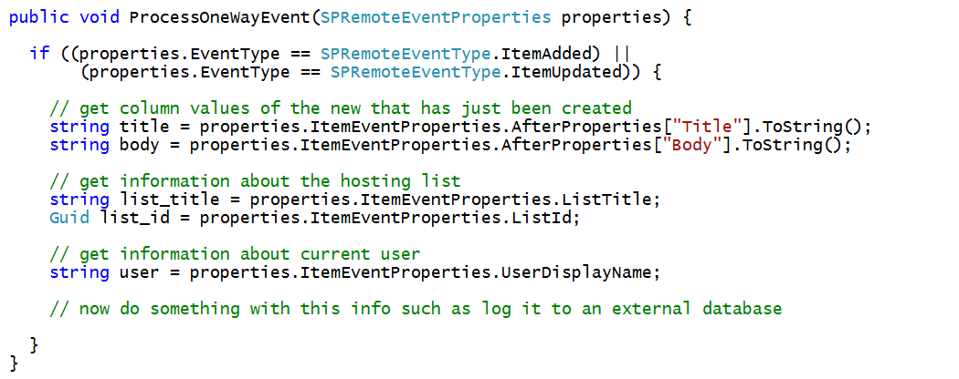
Example After Event with a List Item

Slide 17
Agenda
Review of SharePoint Classic Event Model
Remote Event Receiver Architecture
Configuring Debugging Support
Handling App Lifecycle Events
Registering Event Receivers in the Host Web

Slide 18
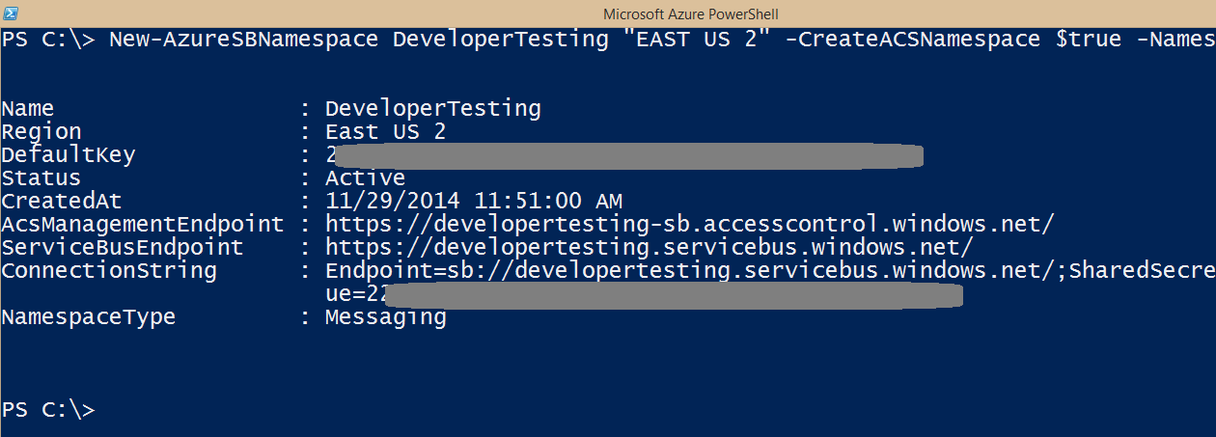
Debugging Event in Office 365
Addresses with http://localhost do not work!
You must use Azure Service Bus Namespace

Slide 19
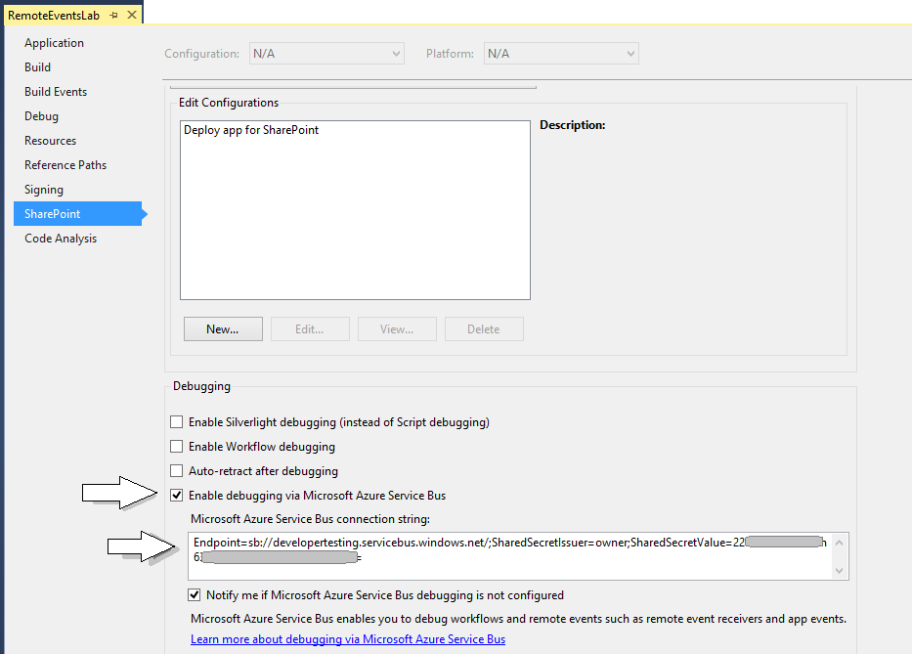
Visual Studio Debugging Support

Slide 20
Agenda
Review of SharePoint Classic Event Model
Remote Event Receiver Architecture
Configuring Debugging Support
Handling App Lifecycle Events
Registering Event Receivers in the Host Web

Slide 21
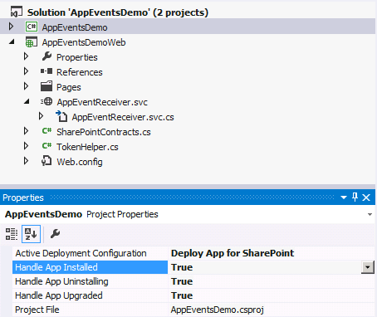
App Lifecycle Events
SharePoint app models support app events
App events for installation, upgrade and uninstall
Added to app project using property sheet
Implemented as a remote event receiver
Notes:
The installation, upgrade and uninstallation of an app raises events that developers can trap. These are surfaced as remote event receivers where the app calls out to a well known endpoint where the developer can do something upon these events.

Slide 22
App Lifecycle Event Registration
Declaratively register remote event receivers
Definitions found in AppManifest.xml
<Properties>
<Title>App Lifecycle Event</Title>
<StartPage>~appWebUrl/Pages/Default.aspx?{StandardTokens}</StartPage>
<InstalledEventEndpoint>~remoteAppUrl/AppEventReceiver.svc</InstalledEventEndpoint>
<UninstallingEventEndpoint>~remoteAppUrl/AppEventReceiver.svc</UninstallingEventEndpoint>
<UpgradedEventEndpoint>~remoteAppUrl/AppEventReceiver.svc</UpgradedEventEndpoint>
</Properties>
Notes:
Remote Event Receivers can also be set up for Installed, Uninstalling, and Upgrading events in the App lifecycle.
To handle a SharePoint app event, set its event value to True in Visual Studio. The default value for the events is False. When you set the value of an app event to True, Visual Studio creates an app event receiver. To disable an app event receiver, set its value to False

Slide 23
Exploring the RemoteEventsDemo App Project

Slide 24
Agenda
Review of SharePoint Classic Event Model
Remote Event Receiver Architecture
Handling App Lifecycle Events
Configuring Debugging Support
Registering Event Receivers in the Host Web

Slide 25
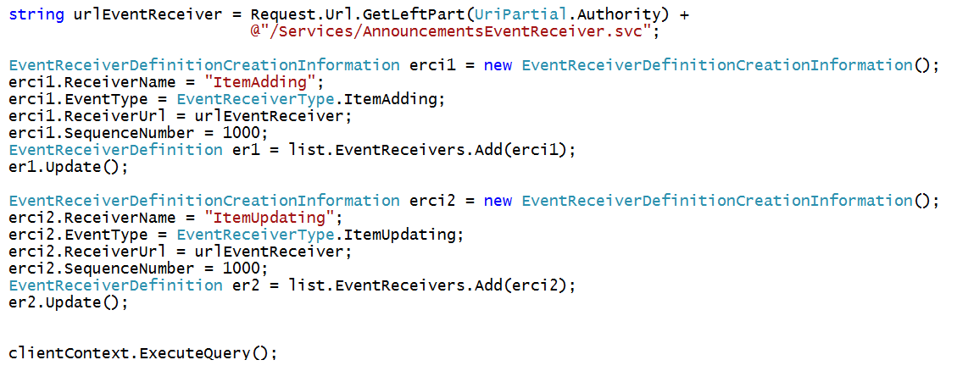
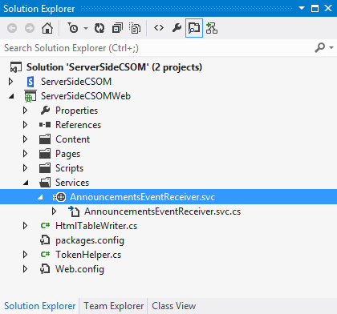
Registering Remote Event Receivers
Remote Event Receivers require registration
Declarative registration only possible in app web
Registration in host web requires CSOM code

Slide 26
Summary
Review of SharePoint Classic Event Model
Remote Event Receiver Architecture
Handling App Lifecycle Events
Configuring Debugging Support
Registering Event Receivers in the Host Web

