Slide 1
Developing SharePoint-hosted Add-ins
Notes:
This module begins by examining the architecture of a SharePoint-hosted add-in and discussing the role of the add-in web (formerly known as the app web). Students will learn why SharePoint Online creates a new add-in web within its own isolated DNS domain each time a SharePoint-hosted add-in is installed. Students will learn about the default permission set granted to a SharePoint add-in as well as how to elevate to higher levels of permissions by including permissions requests in the add-in manifest. The module also examines user interface design issues with SharePoint-hosted add-ins such as whether to create pages using ASPX files versus using HTML files and whether to design a SharePoint-hosted add-in project as a multipage application or a single page application (SPA). The module also demonstrates how to extend the user interface of the host web with a SharePoint-hosted add-in by creating custom add-in parts (formerly app parts) and user custom actions.

Slide 2
Agenda
SharePoint Add-in Model
SharePoint-hosted Add-in Architecture
User Interface Design Techniques
Developing Add-in Parts
Adding User Custom Actions

Slide 3
Pain Points with SharePoint Solutions
Custom code runs inside SharePoint environment
This poses risks and compromises scalability
Custom solutions are SharePoint version dependent
Server-side code has must be rewritten for next version
SharePoint solutions hard code version specific paths to resources
Makes it hard to migrate to new versions of SharePoint
Permissions model based entirely on user identity
You cannot configure permissions for the solution itself
Impersonation solves the too-little-permissions problem
Impersonation causes too-many-permissions problem
SharePoint solutions are hard to manage
They lack effective support and easily understood semantics for distribution, installation and upgrade
Notes:
The first problem with SharePoint solutions is that much of the code you write runs inside the SharePoint environment. For example, managed code deployed in a farm solution runs inside the main SharePoint worker process (w3wp.exe). Managed code deployed using a sandboxed solution runs inside the SharePoint sandbox worker process (SPUCWorkerProcess.exe). However, The SharePoint app model mandates that code from an app cannot run inside any process that is launched or managed by SharePoint.
There are a few simple reasons why Microsoft wants to get rid of custom code that runs inside the SharePoint environment. The first reason has to do with increasing the stability of SharePoint farms. The one is pretty obvious. Getting rid of any type of custom code running inside the SharePoint environment results in lower risk, fewer problems and greater stability for the hosting farm.
The second reason has to do with a company’s ability to upgrade to newer versions of SharePoint. The underlying problem is that SharePoint solutions which contain code that programs against the SharePoint server-side object model have been notorious at creating migration problems when a company is upgrading from one version of SharePoint to the next. More to the point, Microsoft has witnessed many of their biggest SharePoint customers postponing the upgrade of their production farm for months and sometimes years until they have had time to update and test all their SharePoint solutions on the new version of SharePoint. Since this problem negatively affects SharePoint sales revenue, you can bet it was pretty high on the fix-it priority list when Microsoft began to design SharePoint 2013.
Security causes problems with impersonation. The problem is that solution code is always recognized as a specific user and that compromises your options.

Slide 4
What's in a Name?
SharePoint 2013 introduced new development model
Originally introduced as "SharePoint App Model"
In Q2 of 2015, Microsoft changed the name
"SharePoint Apps" renamed to "SharePoint Add-ins"
Name change provides a potential source of confusion
"SharePoint App" and "SharePoint add-in" are the same thing
Visual Studio still calls them "SharePoint Apps"
SharePoint UI still calls them "SharePoint Apps"

Slide 5
SharePoint Add-in Model Overview
SharePoint app model based on these assumptions:
Add-ins supported in SPO and in on-premises farms
Add-in code never runs in SharePoint host environment
Add-in talks to SharePoint using Web services
Add-in is authenticated and has established identity
Add-in has permissions independent of current user
Add-in deployed to catalogs using a publishing scheme
Published add-ins easier to find, install and upgrade
Notes:
Unlike farm solutions, apps are supported and will work in both on-premises deployments and in Office 365. The business logic within an app does not run within the SharePoint server or host environment, rather it runs external to SharePoint on another server or in the client. There is also a notion of app identities in the sense that apps can be authenticated and assigned permissions, similar to users.

Slide 6
SharePoint Tenancies
A tenancy is a set of site collections
Configured and administrated as a unit
Created with administrative site collection
A scope for provisioning new site collection
Central concept to site management in Office 365
A requirement for installing SharePoint apps
What about tenancies in on-premises farms?
Most farms do not have explicitly created tenancies
To add support for SharePoint apps, on-premises farm can be configured with a farm-wide default tenancy
Notes:
For the benefit of Office 365 and SharePoint Online SharePoint 2010 introduced the notion of a multi-tenant deployment in the sense that multiple customers (tenants) use the same SharePoint farm and the same hardware. Each customer (i.e. tenant) is assigned a tenancy and all the site collections for that customer are created inside the customer’s tenancy.
With SharePoint 2010, you never needed to worry about tenancies in an on-premises farm with the exception of the very rare scenario where a hosting company wanted to provide SharePoint sites for multiple customers. However, things are different in SharePoint 2013. That’s because the new SharePoint app model requires a tenancy before you can install and run apps in an on-premises farm. However, it’s not that complicated to set up because you never have to explicitly create and manage tenancies. You simply create a special service application (as discussed on the next slide) which will create a single default farm-wide tenant that services the entire farm and configures the support you need to install and run apps.

Slide 7
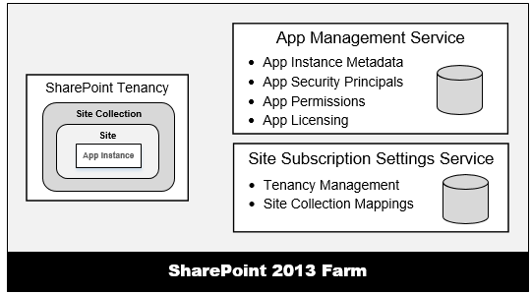
Service Application Support for Add-ins
App support requires two service applications
App Management Service
Site Subscription Management Service
These services must be created in on-premises farms to support add-ins
Notes:
The App Management Service is what manages the installation of apps. Any time an app is installed, SharePoint calls to the App Management Service which updates its database with metadata for the app to track various aspects of the app such as the app’s start page URL and security information for app authentication.
The Site Subscription Management Service is used by the SharePoint host environment to track tenancies. In the Office 365 environment, each customer is assigned its own tenancy. However, in on-premises farms the vast majority of SharePoint customers do not manage their site collections using tenancies. However, an on-premises farm still requires the Site Subscription Manage Service to be created. You can create an instance of the Site Subscription Manage Service in an on-premises farm using the following PowerShell script. Simply creating the service will create a single farm-wide default tenancy which meets the requirements for installing and running SharePoint apps. Note that there is a PowerShell script available in the Demo folder for this module under the name of CreateSubscriptionSettingsService.ps1 if you want to open it up and see how the service is actually created.

Slide 8
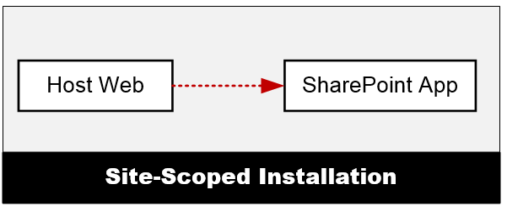
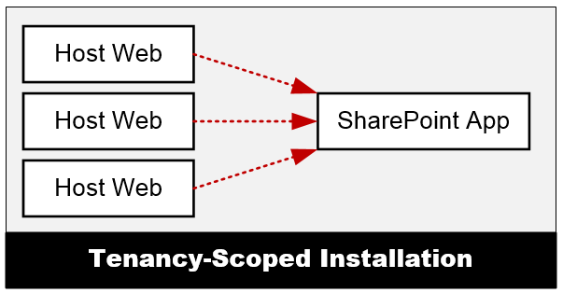
Add-in Installation Scopes
Site-scoped Installation
Add-in installed in SharePoint site which becomes host web
Add-in can be installed multiple times across site collections
Each installed instance of an add-in gets its own app web
Tenancy-scoped Installation
Provides centralized approach to app deployment & management
Requires app to first be installed in an app catalog site
Once installed, the app is then configured for use multiple sites
Tenancy install scoped to web application in on-premises farms
Notes:
There are two scoping options for installing apps which include site-scope installation and tenancy-scoped installation.
When a app is installed at site scope, the app is installed within the context of a single SharePoint site (SPWeb) which can be either a top-level site or a child site. After installation, the app is available to all users of that site. If the same app is installed in other sites, each installed instance of the app is isolated from the others. In other words, an installed instance of an app does not share resources with other installed instances of the same app. Note that when you debug an app project in the Visual Studio debugger, the app is always installed at site scope.
When an app is installed at tenancy scope, the tenant administrator can then configure the app to make the app available to many sites and site collections at once. The key point is that you don’t have to install it once per site to make it available across many sites and site collections. The details of installing and configuring apps at tenancy scope will be configured in a later module of this course named Publishing, Installing and Versioning Apps.

Slide 9
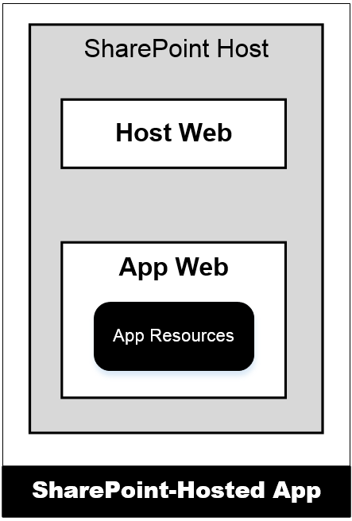
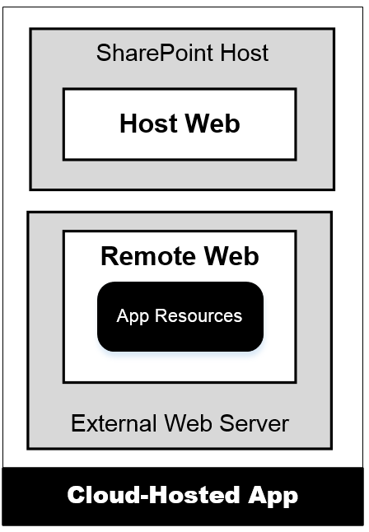
Hosting Options for SharePoint Add-ins
SharePoint-Hosted Add-ins
App resources added to SharePoint host
Stored in child site known as app web
Add-in can have only client-side code
Add-in cannot have server-side code
Provider-Hosted Add-ins
Add-in pages deployed to remote server
Remote site known as remote web
Add-in can have client-side code
Add-in can have server-side .NET code
Notes:
There are two different types of apps and a few terms you should be aware of. First, apps are either hosted within SharePoint or they are hosted outside of SharePoint. The first type of app, a SharePoint-Hosted app is the type where all the app’s resources (pages, JavaScript, style sheets and images) are all provisioned to the SharePoint host. The business logic within SharePoint-Hosted apps runs within the client (browser). The hosting model for a Provider-hosted app is quite different in the sense that the bulk of the app logic and maintainable reside outside of SharePoint, for instance as an ASP.NET MVC site on another Windows Server, in Azure, as a PHP site in Amazon Web Services or any number of other options.
The site in which an app is installed form is called the host web. When an app with SharePoint-hosted resources is installed, the SharePoint host will create a subsite known as the app web. For provider-hosted apps, the remote site is known as the remote web.

Slide 10
Autohosted App Support Discontinued
SharePoint App Model had a third hosting option
Autohosted apps designed as hybrid of provider-hosted
Support to "magically" deploy/configure remote web
Office 365 communicates with Azure behind the scenes
Autohosted app support discontinued at Q3 2014
You will still see "autohosted app" in docs & tools
Don't design apps based on autohosted app model
What does this mean?
More developers will need to learn the skills for working directly with Windows Azure when deploying remote web for a provider-hosted app

Slide 11
Add-in Start Page
Every SharePoint add-in requires a start page
Start page provides entry point into add-in
SharePoint adds app launcher to Site Contents in host web
SharePoint-Hosted add-in start page hosted by SharePoint
Provider-Hosted add-in start page hosted in remote web
Notes:
As you will learn in a later module, there are a few different ways an app can be surfaced in SharePoint. At minimum, every app must contain a start page. This start page is where the user is taken when they click on the app from the Site Contents page. This page contains an app launcher that redirects the user to the start page of the app which may reside in an app web (if SharePoint-Hosted) or a remote web (if Provider-Hosted).

Slide 12
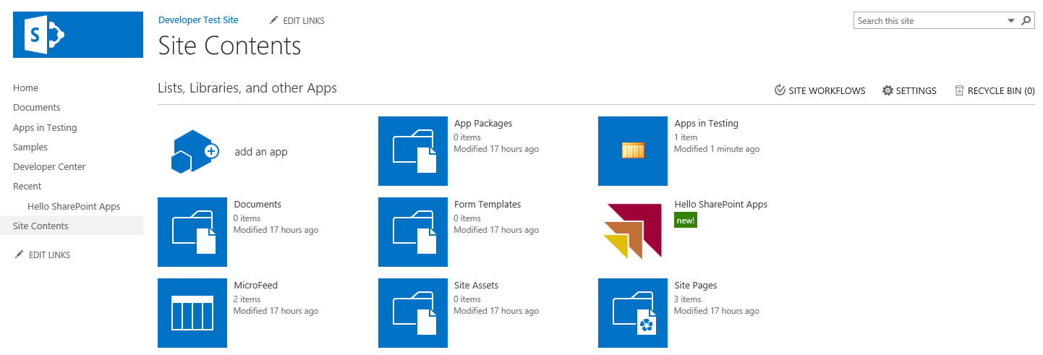
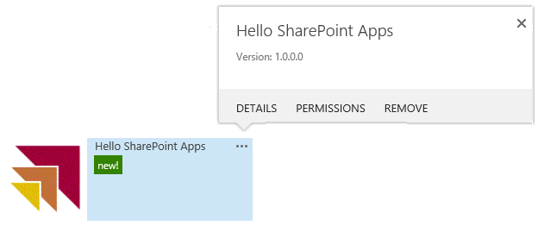
User Experience with SharePoint Add-ins
Users launch add-ins from tile on Site Contents
SharePoint add-ins grouped together with lists and libraries
Clicking on add-in tile redirects user to app's start page
Add-in tile provides fly-out menus for details and uninstall

Slide 13
Working with Add-ins from the Business User Perspective

Slide 14
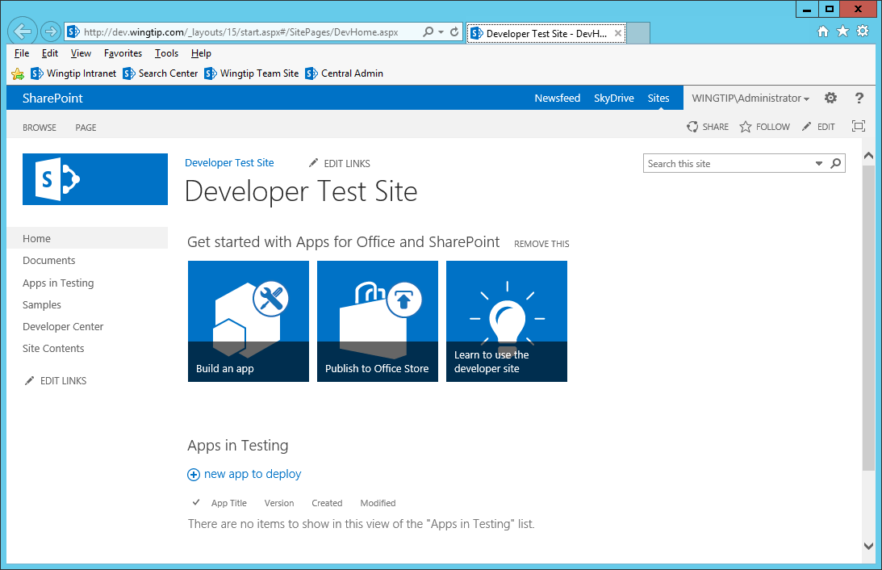
Developer Sites
Allows for remote add-in installation by Visual Studio
Required for testing add-ins in SharePoint Online environment
Notes:
SharePoint introduces a new site template which can be used to create Developer Sites. The main thing to know about Developer sites is that they are the only type of SharePoint sites that allow for the remote development of SharePoint apps. In other words, you do not need to create and configure a local SharePoint farm running on your development computer which is also running Visual Studio.
A Developer site can be created in a SharePoint farm running in a private network or up in the cloud in Office 365. When you begin a debugging session for your SharePoint app in Visual Studio, Visual Studio is able to reach across the network and install the SharePoint app in the Developer site that you have configure as the Visual Studio projects Site URL property. However, Visual Studio is not able to install an app from across the network if you have configure the Site URL to point to another type of SharePoint sites such as Team sites and Publishing sites.
When you are doing SharePoint app development in the Office 365 environment, you must use a developer site or things will not work. However, developer sites are not essential when you have a local version of SharePoint running on the same computer on which you are running Visual Studio. When you have a local SharePoint farm, Visual Studio does not require Developer sites and you might prefer to work with a team site or a Publishing site for your testing and debugging as these types of test sites might provide a better simulation for real-world testing.

Slide 15
Creating a Developer Site

Slide 16
Agenda
SharePoint Add-in Model
SharePoint-hosted Add-in Architecture
User Interface Design Techniques
Developing Add-in Parts
Adding User Custom Actions

Slide 17
SharePoint-hosted Add-in Architecture
SharePoint-hosted app fundamentals
SharePoint host creates app web during installation
App start page and resources are added into app web
All app logic must be written in client-side JavaScript
App authentication happens behind the scenes
SharePoint Tenancy
Site Collection
Site (Host Web)
App Web
Start Page

Slide 18
App Web
App web is created during app installation
App web created as child to site where app is installed
SharePoint-Hosted apps must create app web
App must add start page and related resources
App can add other SharePoint elements (e.g. lists)
Provider-hosted apps can create app web
Provider-hosted apps will not create app web by default
Provider-hosted app can create app web if needed
Notes:
As previously covered, an app web is where the app is installed. This is only created when an app package contains a WSP. Therefore provider-hosted apps don’t necessarily create an app web unless they contain something that gets provisioned in SharePoint and is deployed with a WSP.

Slide 19
App Web Hosting Domain
App web pages served out of isolated domain
Isolates JavaScript code on app web pages
Allows SharePoint to authenticate callbacks from app
URL to app web made up of 4 parts
Tenancy name: wingtiptenant
APPUID: ee060af276f95a
App web hosting domain: apps.wingtip.com
App name: MyFirstApp
https://wingtiptenant-ee060af276f95a.apps.wingtip.com/MyFirstApp
Notes:
When app webs are created, they are given their own top-level domain name. The reason for this is to block cross-site-scripting attacks. The parts of this URL are specified on this slide.

Slide 20
Start Page URL
Dynamic tokens used in start page URL
SharePoint-Hosted apps use ~appWebUrl token
~appWebUrl/Pages/Default.aspx
All apps should use {StandardTokens} token
~appWebUrl/Pages/Default.aspx?{StandardTokens}
Notes:
There are two types of tokens that can be used in projects: those found at the start of a URL and those that can be used within a URL. The ones that can be used at the start of a URL start with a ~ character while those used within a URL are wrapped in curly brackets {}.
A complete token list follows and additional details can be found here:
http://msdn.microsoft.com/en-us/library/jj163816(v=office.15)

Slide 21
{StandardTokens}
Start Page URL contains {StandardTokens}
Dynamic placeholder for querystring parameters
Parameter | Purpose
SPHostUrl | URL back to host web
SPAppWebUrl | URL to app web
SPLanguage | Language in use (e.g. en-US)
SPClientTag | Client cache control number for the current website.
SPProductNumber | Version of SharePoint (e.g. 15.0.4433.1011)
Notes:
The SPHostUrl parameter passes the URL to the host web and it very commonly used because the start page of every SharePoint app requires a link back to the host web.
The SPAppWebUrl parameter passes the URL to the app web. This can be used in scenarios when you need the base URL to the app web so you can parse that together with web service entries points. Note that with provided-hosted apps and Autohosted apps, there might not be an app web created upon app installation. If the app does not have an associated app web, the SharePoint host environment will omit this query stringparameters.
The SPLanguage parameter passes a string which indicates the current language and locale in use. For example, a parameter of en-US indicates that the host site use English localized for the United States.
The SPClientTag parameter contains the client cache control number for the host web and indicates how long the SharePoint host will cache resoures.
The SPProductNumber parameter passes the current version of SharePoint which is running the host web. The version number will be in a form of 15.0.4433.1011 and can be used to figure out which updates have been applied to the local farm. Note that the version numbers will be different and larger when the host web is in the Office 365 environment.

Slide 22
Agenda
SharePoint Add-in Model
SharePoint-hosted Add-in Architecture
User Interface Design Techniques
Developing Add-in Parts
Adding User Custom Actions

Slide 23
SharePoint Add-in User Interface Design
Start page (required)
Represents user entry point into add-in
Can be implemented with .aspx file or .htm file
Add-in Parts
External page (e.g. from app web) surfaced in host web
Displayed on host web pages using iFrame
User Custom Actions
URL-based command surfaced in host web
Used to create ECB commands and ribbon controls
Notes:
A host web Feature, just a standard SharePoint Feature, is something that is deployed to the host web by an app. The only things that can be included in a host web Feature are the start page, app parts and custom UI actions.

Slide 24
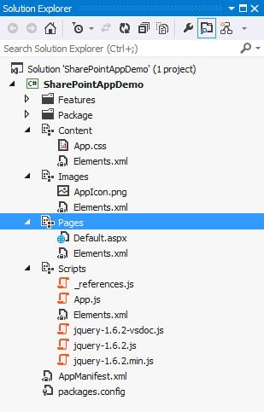
Modules in a SharePoint-Hosted Add-in
Visual Studio adds Modules to each new project
Content
Images
Pages
Scripts
Notes:
Visual Studio adds a few SharePoint modules to a project when creating a SharePoint-Hosted App. These are used to provision style sheets, scripts, pages and images used by the application.

Slide 25
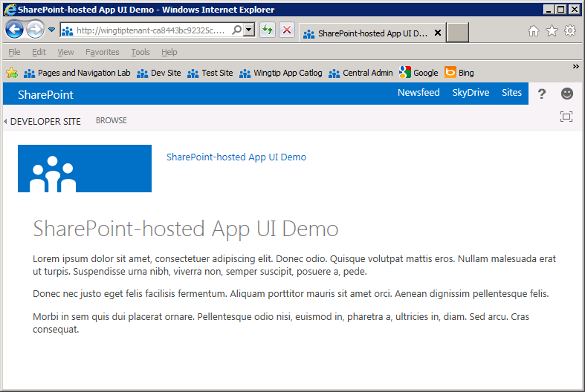
App.master
App web uses app.master by default
Gives app SharePoint look and feel
Provides app with required link back to host web
Does not have Site Actions menu or top link bar
Notes:
SharePoint-Hosted apps, by default, use a specific master page (app.master) that SharePoint provides. One thing you’ll notice is that many things from a typical SharePoint page are missing such as the Quick Launch, the top navigation bar, the site actions menu, etc.

Slide 26
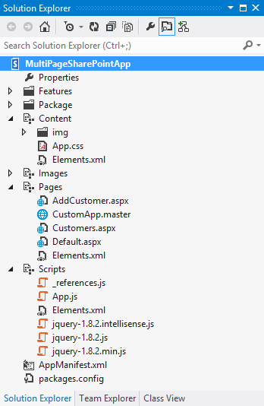
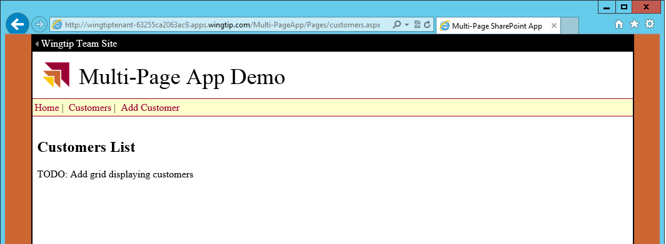
Multi-page Add-in with Custom Master Pages
Multiple pages can use same master page
Link to host web can be added to master page
Navigation can be added to master page
Issue: query string parameters only sent to start page
Notes:
Developers are free to create custom master pages used by the pages within a SharePoint-Hosted app. Things work the same way they work in traditional ASP.NET sites in the sense that the developer is responsible for wiring things up manually.

Slide 27
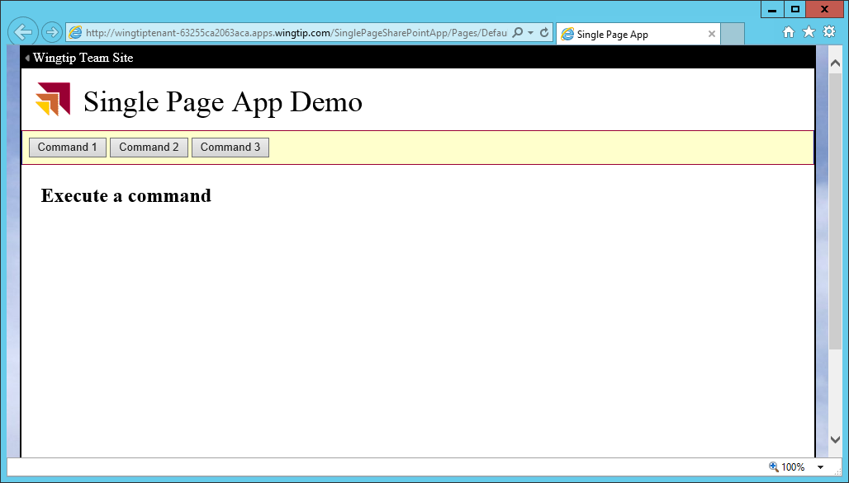
Single Page App (SPA) Model
Web applications often designed as SPAs
Design leads to better and more fluid user experience
Request data posted to start page is always there
JavaScript variables do not unload/reload
App makes AJAX calls and uses client-side JavaScript
Web Server
Page
AJAX
Web Service Entry Points

Slide 28
Creating a Single Page App

Slide 29
Agenda
SharePoint Add-in Model
SharePoint-hosted Add-in Architecture
User Interface Design Techniques
Developing Add-in Parts
Adding User Custom Actions

Slide 30
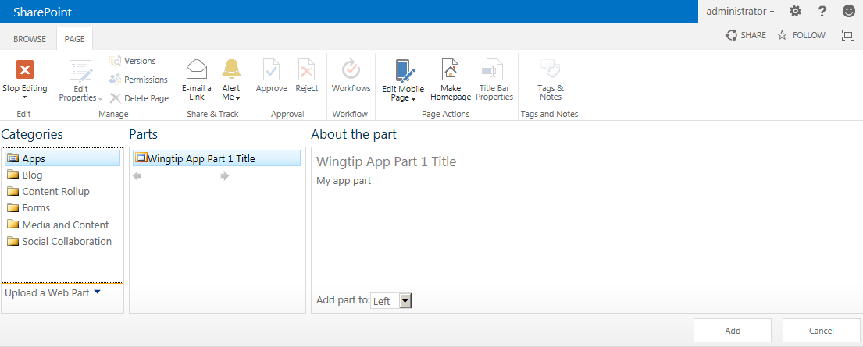
Creating Add-in Parts Using Client Web Parts
Add-in parts implemented using client Web Part
Add-in parts added to host web pages
<?xml version="1.0" encoding="utf-8"?>
<Elements xmlns="http://schemas.microsoft.com/sharepoint/">
<ClientWebPart Name="AppPart1"
Title="Wingtip App Part Title"
Description="My app part"
DefaultWidth="600"
DefaultHeight="360">
<Content Type="html" Src="~remoteAppUrl/Pages/AppPart.aspx?{StandardTokens}" />
</ClientWebPart>
</Elements>
Notes:
SharePoint 2013 introduces a new artifact to supplement the server-side nature of the Web Part and Visual Web Part. The Client Web Part is meant to provide Web Part like functionality but without the server-side code and thus, to make apps more useful. Effectively what happens is the Client Web Part renders an HTML IFrame that loads another page but looks and acts like a regular Web Part. This other page can come from a page hosted in the app web or in the remote web.

Slide 31
Developing Add-in Parts

Slide 32
Agenda
SharePoint Add-in Model
SharePoint-hosted Add-in Architecture
User Interface Design Techniques
Developing Add-in Parts
Adding User Custom Actions

Slide 33
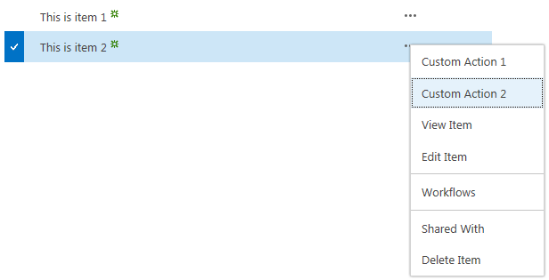
Creating User Custom Actions
User custom actions used to extend host web UI
Used to create ECB menu items and ribbon buttons
Cannot use JavaScript or other types of custom actions
Supports several important dynamic tokens
<?xml version="1.0" encoding="utf-8"?>
<Elements xmlns="http://schemas.microsoft.com/sharepoint/">
<CustomAction Id="CustomAction1"
RegistrationType="List"
RegistrationId="100"
Location="EditControlBlock"
Sequence="10"
Title="Custom Action">
<UrlAction Url="~remoteAppUrl/Pages/CustomAction.aspx?Source={Source}
&amp;ListURLDir={ListUrlDir}&amp;ListID={ListId}
&amp;ItemURL={ItemUrl}&amp;ItemID={ItemId}
&amp;{StandardTokens}"/>
</CustomAction>
</Elements>
Notes:
Like previous versions of SharePoint, SharePoint 2013 includes Custom Actions which allows developers to add navigation elements to various places in SharePoint. New in SharePoint 2013 is the ability to make these custom actions launch a dialog and not just redirect to another page.

Slide 34
URL Tokens for User Custom Actions
Certain tokens must be used with certain actions
Token use changes between ECB actions and Ribbon actions
Token | Purpose
{AppWebUrl} | URL of the app web in an app for SharePoint
{HostLogoUrl} | Logo for the host web of an app for SharePoint
{HostTitle} | Title of the host web of an app for SharePoint
{HostUrl} | URL of the host web of an app for SharePoint
{ItemId} | Integer-based ID of item in a list or library (ECB menu actions only)
{SelectedItemId} | Array of item IDs in a list or library (Ribbon menu actions only)
{ItemUrl} | URL of target item being acted upon (ECB menu actions only)
{SelectedItemUrl} | URL array of target items being acted upon (Ribbon menu actions only)
{Language} | current language/culture of the host web of an app for SharePoint
{ListId} | ID of the current list (a GUID).
{RecurrenceId} | Recurrence index of a recurring event
{Site} | URL of the current website
{SiteCollection} | URL of the parent site of the current website
{SiteUrl} | URL of the current website
Notes:
Tokens that can be used within the URL you create for your apps:
{AppWebUrl}: URL of the app web in an app for SharePoint.
{HostLogoUrl}: logo for the host web of an app for SharePoint.
{HostTitle}: title of the host web of an app for SharePoint.
{HostUrl}: URL of the host web of an app for SharePoint.
{ItemId}: integer-based ID of item (ECB menu actions).
{SelectedItemId}: array of item IDs in list (Ribbon menu actions).
{ItemUrl}: URL of target item (ECB menu actions).
{SelectedItemUrl}: URL array of target items (Ribbon menu actions).
{Language}: current language/culture of host web.
{ListId}: ID of the current list (a GUID).
{RecurrenceId}: recurrence index of a recurring event.
{Site}: URL of the current website.
{SiteCollection}: URL of the parent site of the current website.
{SiteUrl}: URL of the current website

Slide 35
Adding User Custom Actions

Slide 36
Summary
SharePoint Add-in Model
SharePoint-hosted Add-in Architecture
User Interface Design Techniques
Developing Add-in Parts
Adding User Custom Actions

