Slide 1
Programming the SharePoint REST API
Notes:
This module begins with a quick primer on the fundamentals of REST and the OData protocol. Next, the module examines the architecture and the functionality of the SharePoint REST API provided by SharePoint Online. Students will learn how to formulate REST URIs which target SharePoint objects such as sites, lists and list items and how to execute asynchronous REST API calls using the jQuery library. The module steps through how to use the SharePoint REST API to implement the full range of CRUD behavior in a SharePoint-hosted add-in by creating, reading, updating and deleting items in a SharePoint list. The module demonstrates how to implement paging with SharePoint list items using skip tokens returned by the SharePoint REST API. Students will also learn advanced OData programming techniques in SharePoint Online for dealing with the request digest and using verbose metadata and eTags to implement optimistic concurrency when performing updates.

Slide 2
Agenda
Understanding REST and ODATA
The SharePoint REST API
Programming the SharePoint REST API
Paging SharePoint List Items
Modifying SharePoint List Items

Slide 3
Are You Getting Enough REST?
In the beginning there was SOAP
XML-based protocol for executing web service operations
SOAP = Simple Object Access Protocol
SOAP makes simple things more complicated than they could be
Acronym status of SOAP revoked in 2003
REST is simpler and much easier to use
REST = REpresentational State Transfer
Simple approach based on HTTP request/response pairs
HTTP requests target specific resources using unique URIs
Resources move back and forth using representations
Representations of resources defined using Internet Media Types
Notes:
Over the last few years REST-based Web services have become increasing popular through the IT industry and particularly within Microsoft. REST-based Web services are much easier to use than SOAP-based Web service and therefore lower the barrier of entry to different types of potential clients. REST-based Web services are also much easier to call from JavaScript code especially when using the jQuery library.

Slide 4
RESTful Web Services
RESTful Web Service
implemented using the principles of REST
REST URI = [base URI] + [resource path] + [query options]
Calls based on standard HTTP verbs (GET, POST, PUT, DELETE)
Passes data to and from client using representations
Can be designed to implement custom APIs and/or standard APIs
Data passed across network using representations
Representations model resources – but they’re different
Based on common formats: HTML, XML, ATOM and JSON
Based on specific Internet media types

Slide 5
Internet Media Types
Internet media type defines format of representation
Commonly referred to as Content Types previous known as MIME types
Examples of common Internet media types
text/html
text/xml
application/xml
application/atom+xml
application/json
HTTP headers used to indicate Internet Media Type
ACCEPT request header indicates what client wants in response
Content-Type header indicates type of request/response body

Slide 6
OData Primer
What is OData?
A standardized REST API interface for common CRUD operations
Defined by Open Data Protocol specification
OData services becoming more popular on Internet (e.g. NetFlix)
SharePoint 2010 introduced a REST API for dealing with list items
SharePoint 2013 introduces new and expanded REST API
for an excellent resource go to
http://www.odata.org
Notes:
OData is quickly becoming the industry’s new data access API. It’s popularity is based on the fact that it is the first mainstream data access API for HTTP-based Clients. OData serves to standardize performing CRUD (Create, Read, Update, Delete) operations from across the network using HTTP verbs such as GET, PUT and POST.
OData services are becoming more popular on the Internet. Examples of OData services include NetFlix, Dallas, and the Azure Data Mart. Client application such as Excel 2010 and Excel 2013 are examples of client application that can consume data from any OData-based data source.

Slide 7
OData URIs
URI has three significant parts
Service root URI
Resource path
Query string options
Notes:
To understand how to use OData as a developer, you must understand how OData URIs are constructed. Each URI has three significant parts, The first part of the URI is the Service root URI which points to a site on the Internet and a path to an entry point such as a .svc file. The next part of the URI is the Resource path which identifies a specific object such as a site, a collection (e.g list) or an entry (e.g. item). The final part of the URI are the optional query string parameters that allow you to request special processing instructions such as filtering and sorting.

Slide 8
Returning OData Results as ATOM vs. JSON
ATOM-PUB (XML)
Good when you want to read and write using XML
Set ACCEPT header to application/atom+xml
JavaScript Object Notation (JSON)
Smaller payload than XML for same data
Set ACCEPT header to application/json;odata=verbose
Notes:
When you run REST-based queries against SharePoint 2013 sites, you have the option of having the data returned as either XML in the ATOM format or JSON (JavaScript Object Notation). The default behavior is to return XML but you can change this default behavior to return JSON by including the ACCEPT header with a value of "application/json". If you include the ACCEPT header with an explicit value of "application/atom+xml", this has the same result as the default behavior in that the results are returned as ATOM-based XML.
Both XML & JSON can be consumed client-side and server-side:
Both can be serialized & deserialized into strongly typed objects in managed code
ATOM-PUB: using standard XML serialization objects & techniques
JSON: using the JavaScriptSerializer object
In client-side code, XML is a bit more cumbersome to work with
ATOM-PUB: manual parsing of XML
JSON: community libraries, such as datajs (covered later), make it easier to consume

Slide 9
OData Query Option Parameters
$select
http://services.odata.org/OData/OData.svc/Products?$select=Price,Name
$filter
http://services.odata.org/OData/OData.svc/Products?$filter=startswith(CompanyName, 'Alfr')
$orderby
http://services.odata.org/OData/OData.svc/Products?$orderby=Rating
$top
http://services.odata.org/OData/OData.svc/Products?$top=5
$skip
http://services.odata.org/OData/OData.svc/Products?$skip=5
http://services.odata.org/OData/OData.svc/Products?$skip=5&$top=5
$expand
http://services.odata.org/OData/OData.svc/Categories?$expand=Products

Slide 10
Using the $filter Parameter

Slide 11
$filter Parameter String Functions

Slide 12
Other $filter Parameter Functions

Slide 13
Agenda
Understanding REST and ODATA
The SharePoint REST API
Programming the SharePoint REST API
Paging SharePoint List Items
Modifying SharePoint List Items

Slide 14
Remote Communications with SharePoint
In SharePoint 2003 and SharePoint 2007
SOAP-based web services (e.g. Lists.asmx)
In SharePoint 2010
Client-side Object Model (CSOM)
REST API for list items accessible through ListData.svc
In SharePoint 2013
Expanded CSOM Support
New SharePoint REST API replaces ListData.svc
Notes:
The SharePoint client-side object model (CSOM) debuted in SharePoint 2010 where it was made available as a WFC entry point named client.svc. However, SharePoint 2010 did not support developers accessing client.svc directly. Instead, the developer uses client-side proxy objects exposed by either a .NET assembly or a JavaScript library.

Slide 15
What About ListData.svc?
ListData.svc added REST support for reading & writing to SharePoint lists in SharePoint 2010
Still present in SharePoint 2013, but primarily only for backwards capability
Existing code won’t break
New development recommendation: use new SharePoint 2013 REST/OData API
Notes:
In SharePoint 2010, the product provided OData support through the Web server entry point ListData.svc. The ListData.svc Web service is available in SharePoint 2013. However, you should understand that it is mainly provided for backwards compatibility for older clients that are migrating to SharePoint 2013. When creating new projects for SharePoint 2013 and later, you should not be using ListData.svc. Instead, you should be using the newer remote APIs with OData support that are discussed later in this module.

Slide 16
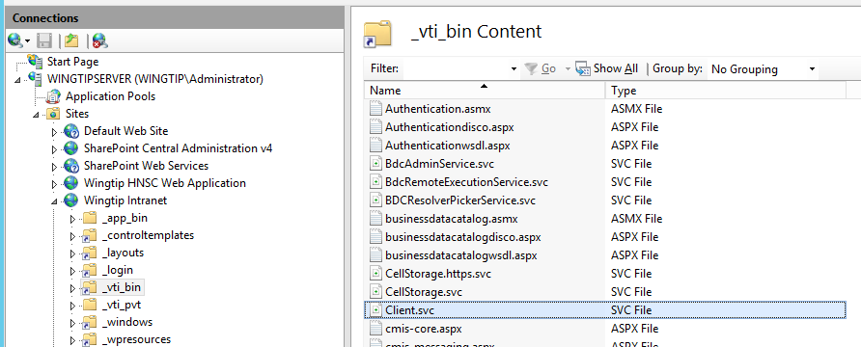
SharePoint REST API Architecture
REST API entry point is client.svc
In SharePoint 2010, client.svc only used by CSOM
In SharePoint 2013, client.svc used by CSOM and REST API
REST API Client
client.svc
CSOM Client

Slide 17
SharePoint REST URLs and the _api Alias
SharePoint REST API provides _api alias
The _api alias maps to _vti_bin/client.svc
Alias used to make SharePoint REST API URLs cleaner
Alias serves to decouple URLs from underlying architecture
This URL works but it is not recommended
http://intranet.wingtip.com/_vti_bin/client.svc/web
SharePoint REST API URLs should be created with _api
http://intranet.wingtip.com/_api/web
Notes:
In SharePoint 2013 the Service root URI contains the URI to the target SharePoint site and then the relative path to the client.svc entry point inside the _vti_bin virtual directory. After that you add the resource path to specify an object such as a site or list. Here's an example of a resource path for the current site.
http://wingtipserver/_vti_bin/client.svc/web
SharePoint 2013 allows REST URLs can go through the _api folder which cleans up the look of the URLs that need to be built and removes client.svc file name from URL. The URL below is equivalent to the one above and should be preferred.
http://wingtipserver/_api/web

Slide 18
Anatomy of a SharePoint REST URL
SharePoint REST made up of three parts
Base URI
http://intranet.wingtip.com/_api
Target SharePoint Object
web
Query String Parameter options
?$select=Id,Title,MasterUrl
Notes:
The collection of lists for the current site: /_api/web/lists
Get a specific list by its title: /_api/web/lists/getByTitle('Announcements')
Get all the Web templates within the current site which is based on US English: /_api/web/getAvailableWebTemplates(lcid=1033)
Refer to the following article on MSDN, specifically figure 9, to see how SharePoint constructs REST URLs:
http://msdn.microsoft.com/en-us/library/office/apps/fp142385(v=office.15).aspx
A fantastic resource for the detailed documentation for all REST APIs can be found in the protocol documents:
Web Versions:
http://msdn.microsoft.com/en-us/library/cc339475(v=office.12).aspx
ZIP of all protocol docs as PDFs:
http://download.microsoft.com/download/8/5/8/858F2155-D48D-4C68-9205-29460FD7698F/SharePointProtocols.zip

Slide 19
Mapping SharePoint Objects to URLs
SharePoint Object | Object mapping
Site Collection | site
Site | web
Lists collection | web/lists
List by ID | web/lists(guid'402cd788-9c5c-4931-92d6-09f18efb368c')
List by Title | web/lists/getByTitle('Customers')
List property | web/lists/getByTitle('Customers')/Title
List items collection | web/lists/getByTitle('Customers')/items
List item | web/lists/getByTitle('Customers')/items(1)
List item property | web/lists/getByTitle('Customers')/items(1)/FirstName

Slide 20
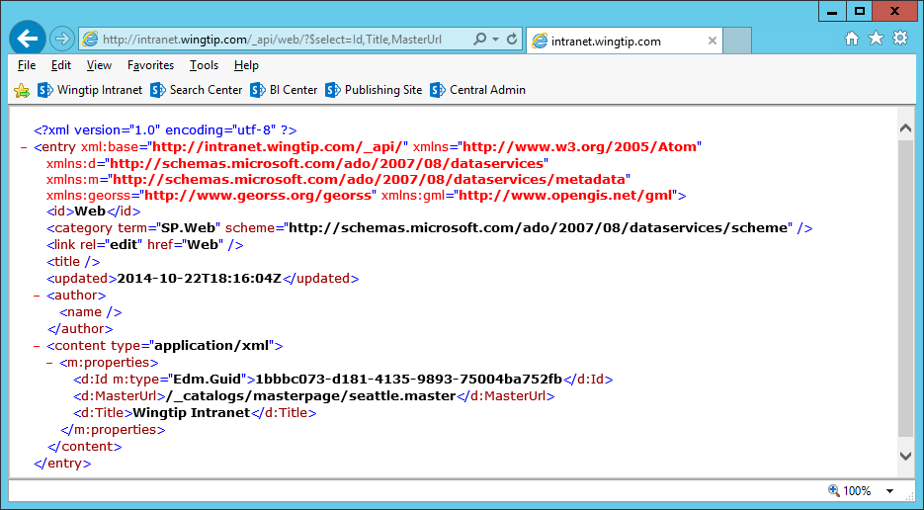
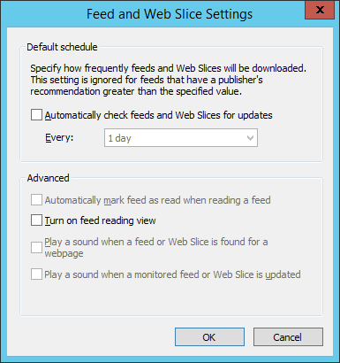
Testing REST Calls Through the Browser
It can be helpful to disable the Internet Explorer option feed reading view
Notes:
One of the best parts of REST is that it simplifies calling Web service operations. All you need is a browser that can authenticate against a SharePoint 2013 site and you can simply run queries by typing the REST-based URIs for HTTP GET operations. This becomes a fast and easy way for you to learn how to put together URIs that query, filter and sort content from SharePoint sites.

Slide 21
OData Support in SharePoint 2013
SharePoint Online supports ODATA version 4.0
OData v4.0 support added in December of 2014
SharePoint 2013 On-premises supports ODATA v3.0
SharePoint 2013 SP1 supports for ODATA v3.0
PowerShell script must be run to enable all ODATA formats

Slide 22
ODATA Formats and the Accept Header
Verbose (aka Full Metadata)
accept: application/json; odata=verbose
Minimal Metadata
accept: application/json; odata=minimalmetadata
accept: application/json
No Metadata
accept: application/json; odata=nometadata

Slide 23
Agenda
Understanding REST and ODATA
Creating REST URIs for SharePoint Objects
Programming the SharePoint REST API
Paging SharePoint List Items
Modifying SharePoint List Items

Slide 24
Service Root URI of the App Web
Creating the App Web’s Service Root URI
Use URL relative to Pages folder
Use URL created from SPAppWebUrl query string parameter
Use URL created from _spPageContextInfo.webAbsoluteUrl

Slide 25
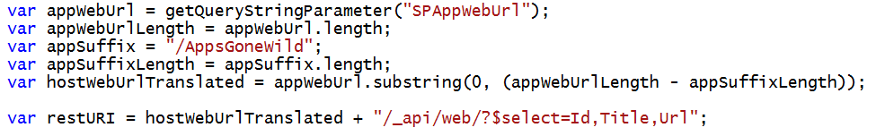
Finding the Service Root of the Host Web
Will it ever work?
Will it work when host web is not at top of domain
Will it work when app installed at tenancy scope
No
No
No
Yes
No
No
Yes
Yes
No
Yes
Yes
No
Yes
Yes
Yes

Slide 26
Reliable URIs for SharePoint REST Calls
For the app web
For the host web

Slide 27
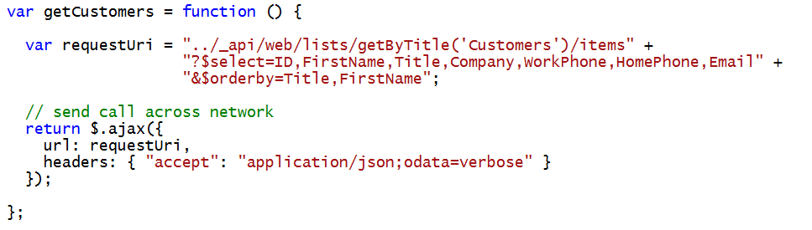
Querying a List in the App Web

Slide 28
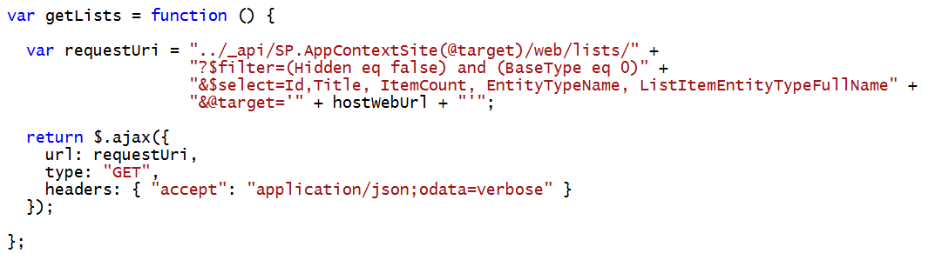
Querying for Lists within the Host Web

Slide 29
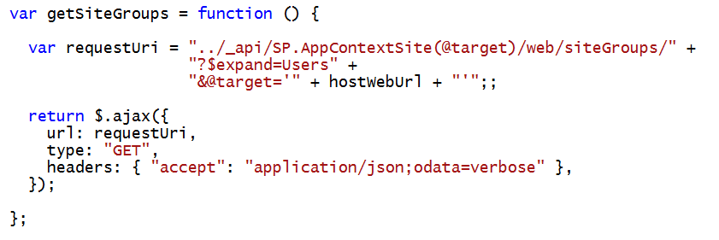
Using the $expand Query Option
$expand used to create more efficient code
Deferred content held back by default
$expand used to retrieve results with deferred content
Effectively reduces round trips

Slide 30
HostWebExplorer App
Ted Pattison

Slide 31
Agenda
Understanding REST and ODATA
Creating REST URIs for SharePoint Objects
Programming the SharePoint REST API
Paging SharePoint List Items
Modifying SharePoint List Items

Slide 32
Paging with SharePoint Lists
SharePoint does not support $skip for list items
You cannot create typical OData paging scheme with a SharePoint list
What do you do instead?
Create a custom paging scheme using $filter
Create a paging scheme using $skiptoken

Slide 33
Paging with SharePoint List Items

Slide 34
Agenda
Understanding REST and ODATA
The SharePoint REST API
Creating REST URIs for SharePoint Objects
Programming the SharePoint REST API
Paging SharePoint List Items
Modifying SharePoint List Items

Slide 35
Updating SharePoint Objects
All write operations must pass valid request digest value
You must include type metadata for inserts & updates
Sometimes you must pass ETags for updates & deletes

Slide 36
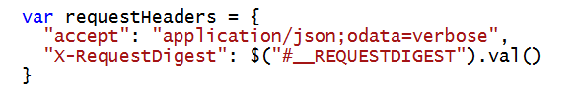
Understanding the Request Digest
All SharePoint write operations require Request Digest
Provides security mechanism to protect again replay attacks
Request digest known to SharePoint old timers as “Form Digest”
SharePoint adds request digest element with ID __REQUESTDIGEST
Request digest value passed using X-RequestDigest header

Slide 37
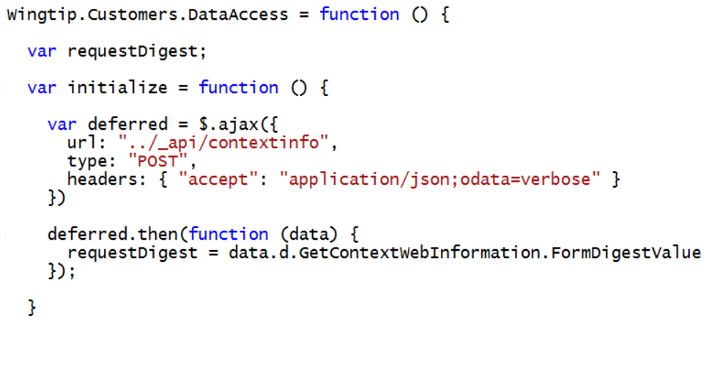
Caching the Request Digest
Request digest queried using /_api/contextinfo

Slide 38
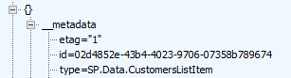
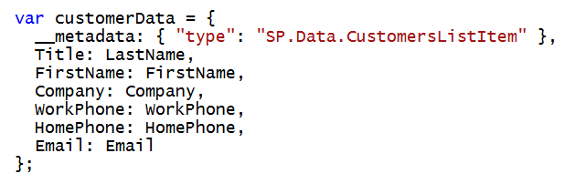
Working with List Item Type Metadata
Each SharePoint list has a unique type for its list items
type value must be passed with all inserts and updates
type discoverable using ListItemEntityTypeFullName property

Slide 39
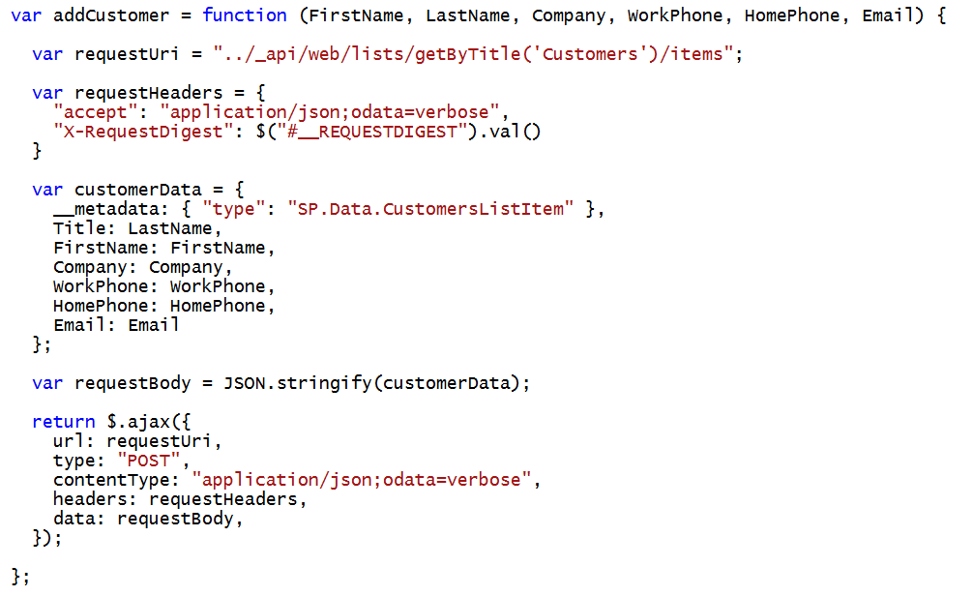
Adding a SharePoint List Item

Slide 40
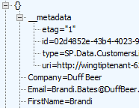

ETags and Optimistic Concurrency
OData v2 requires items to carry ETags
ETag is integer value in that it identities version of item
ETag is automatically incremented with each update
ETag use to support for optimistic concurrency control
ETag works to eliminate the “lost update” scenario
ETag must be tracked in order to post updates in most scenarios

Slide 41
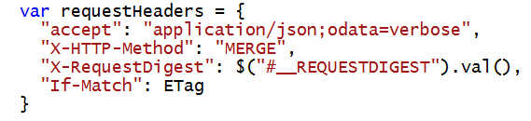
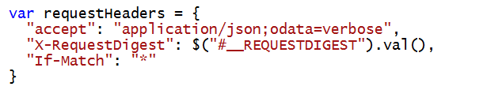
ETags and the If-Match Header
Update and Delete operations require If-Match Header
Allows you to pass ETag value during an update
Update fails if ETag value changed due to update by other user
You can pass wildcard (*) value inside If-Match Header
Done to disable optimistic concurrency control
This is commonly done with delete operations

Slide 42
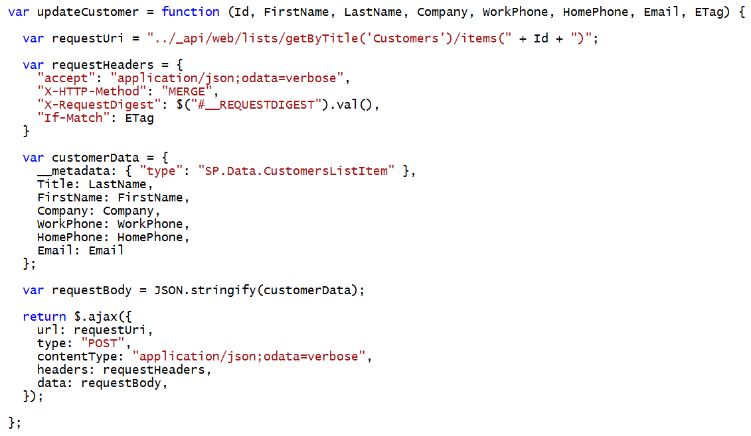
Updating a SharePoint List Item

Slide 43
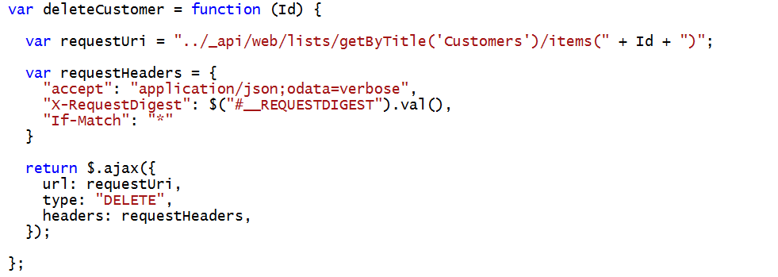
Deleting a SharePoint List Item

Slide 44
Exploring the SharePointCRM App

Slide 45
Summary
The SharePoint REST API
Creating REST URIs for SharePoint Objects
Programming the SharePoint REST API
Paging SharePoint List Items
Modifying SharePoint List Items

