Slide 1
Developing with MVC and the Office 365 Unified API
Notes:
This modules provides a step-by-step look at designing and implementing a MVC web application which leverages the Office 365 Unified API to access data and content from Azure Active Directory, Exchange and SharePoint Online. Students will learn how to use the Connected Services Wizard in Visual Studio to register an MVC web application with AAD and to configure the associated Visual Studio project with AAD application properties and NuGet packages. The module provides an in-depth walkthrough of the steps involved with implementing authentication and authorization in an MVC web application by inserting OWIN middleware components into the request processing pipeline to implement cookie-based authentication and to add support for managing OpenID Connect security tokens. This module concludes with a discussion of best practices in managing access tokens using the token caching support of the Active Directory Authentication Library for .NET (ADAL-NET) combined together with the Entity Framework.

Slide 2
Agenda
Implementing Security with the OWIN Framework
Token Caching using ADAL
Creating an Account Controller Class
Caching and Refreshing Access Tokens

Slide 3
OWIN and Katana
OWIN = Open Web Interface for .NET
Standard interface web servers and web applications
Serves to decouple web server and application
Encourages of simple modules for .NET web development
Allows fasters evolution of specific web modules
Katana is Microsoft's OWIN implementation
Provides lots of support for implementing security

Slide 4


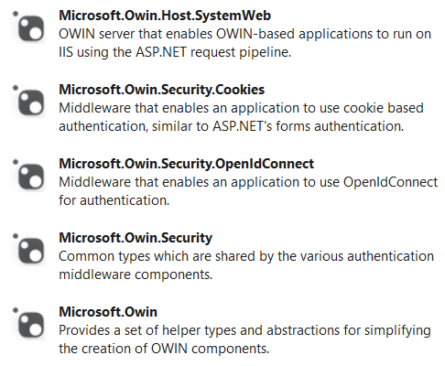


NuGet Packages used in Demo

Slide 5
OWIN Security Middleware
OWIN ties OpenIDConnect to ASP.NET Security
Automatically redirects user to authorization endpoint
Handles callback from authorization server to Reply URL
Establishes User identity in AP.NET security model
Makes user claims available to your code
Let's you use [Authorize] attribute on your controllers

Slide 6
Token Caching with ADAL
ADAL for .NET provides token caching
Helps to save round trips & increase performance
Helps to reduce user interaction with AAD
How is ADAL used?
Creates static cache for native clients
ADAL 1.x did not support web clients
ADAL 2.x adds support for web clients
Web client support requires custom cache

Slide 7
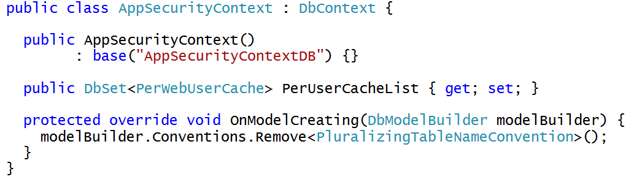
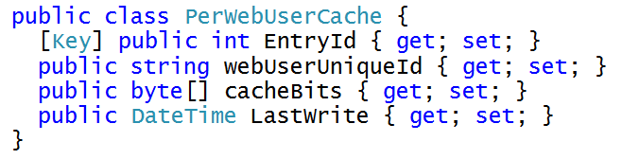
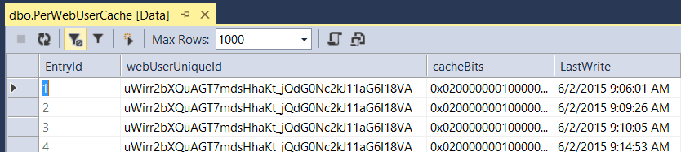
Caching Security Tokens using Entity Framework
Security tokens can (and should) be cached across requests
Best practices lead to caching security tokens in database instead of Session object
Entity Framework provides means to automatically create database to track per user data
AppSecurityContextDB database created automatically
by Entity Framework

Slide 8
Using OWIN Middleware Components to Implement OpenID Connect

Slide 9
Your Learning Curve
Skills required for Office 365 API development
Working with Azure AD Applications
Understanding OAuth Authentication Flows
Working with the Connected Services Wizard
Developing MVC5 apps with controllers and views
Working with the OWIN framework and Katana
Working with the Active Directory Authentication Library
Working with the Discovery Service
Working with the Entity Framework (Version 6)

Slide 10
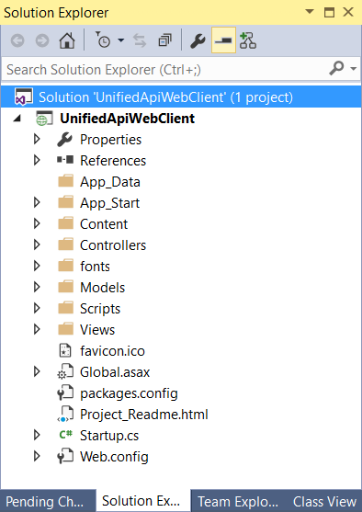
MVC Application Code Walkthrough
Sample MVC5 Application
Provides user with Office 365 sign-on experience
Acquires and manages access tokens for Office Graph API
Accesses Office Graph API through .NET client Library
Development techniques employed
Uses OWIN middleware to authenticate user and manage tokens
Uses AccountController class to control sign-on experience
Uses ADAL to authenticate user and retrieve access tokens
Caches access tokens using ADAL and Entity Framework database

Slide 11
NuGet Packages used in Demo

Slide 12
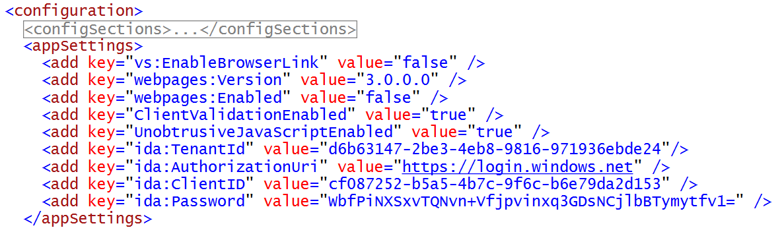
web.config
web.config tracks essential information
ida:AuthorizationUri - Redirection URL to begin sign-in process
ida:TenantID - ID of the hosting tenancy in Azure AD
ida:ClientID - ID of registered application in Azure AD
ida:Password - Base64 encoded string used as client password

Slide 13
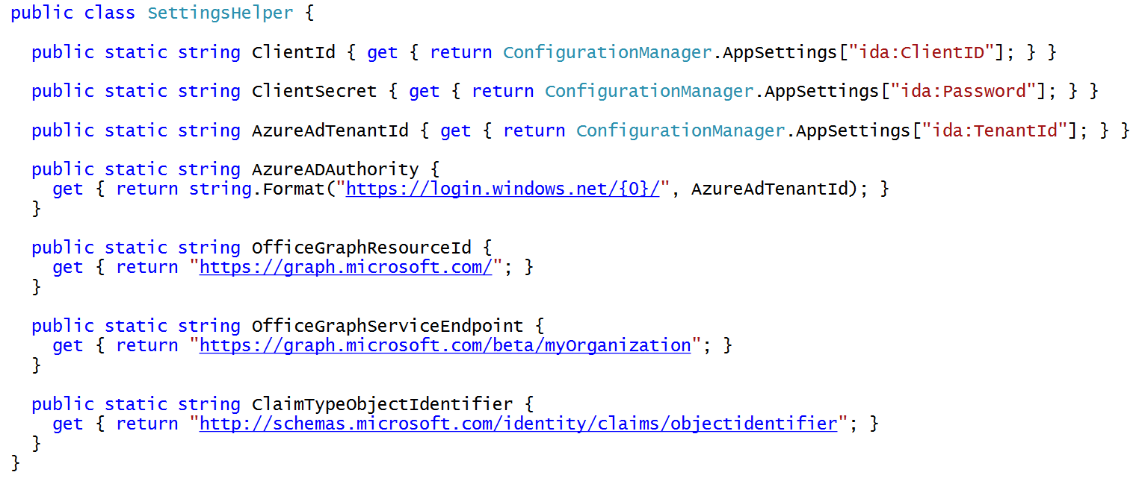
The SettingsHelper class

Slide 14
Caching Security Tokens using Entity Framework
Security tokens can (and should) be cached across requests
Best practices lead to caching security tokens in database instead of Session object
Entity Framework provides means to automatically create database to track per user data
AppSecurityContextDB database created automatically
by Entity Framework

Slide 15
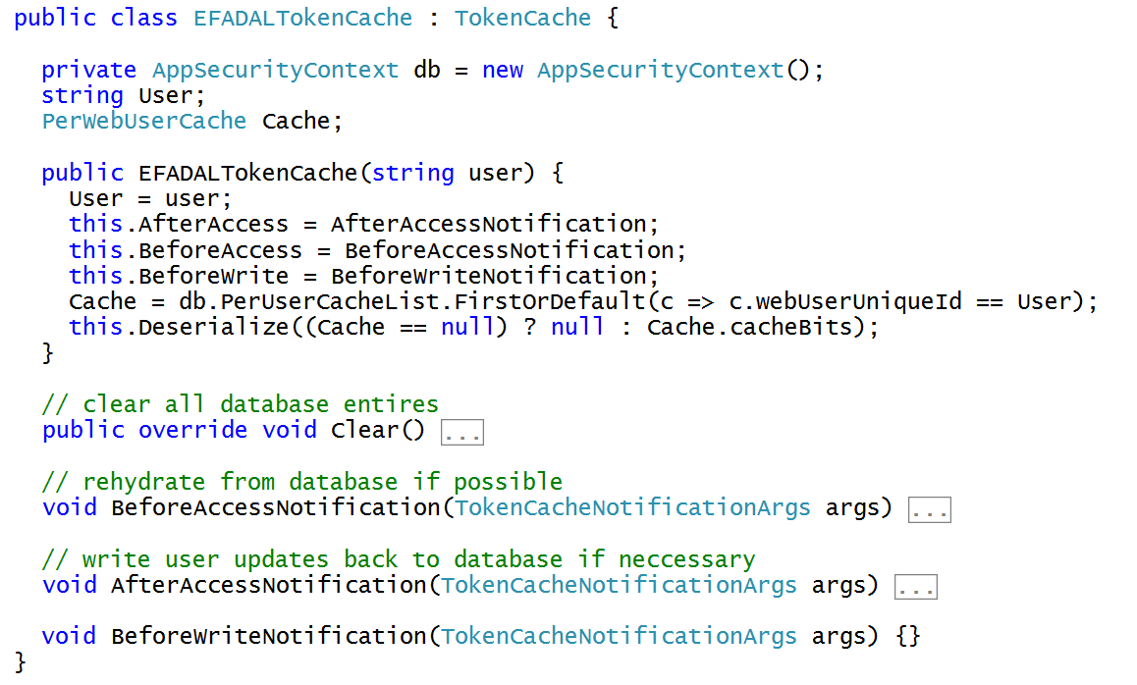
Implementing a Custom TokenCache
ADAL allows you to plug-in a custom token cache
You must create a class that inherits from TokenCache base class defined by ADAL

Slide 16
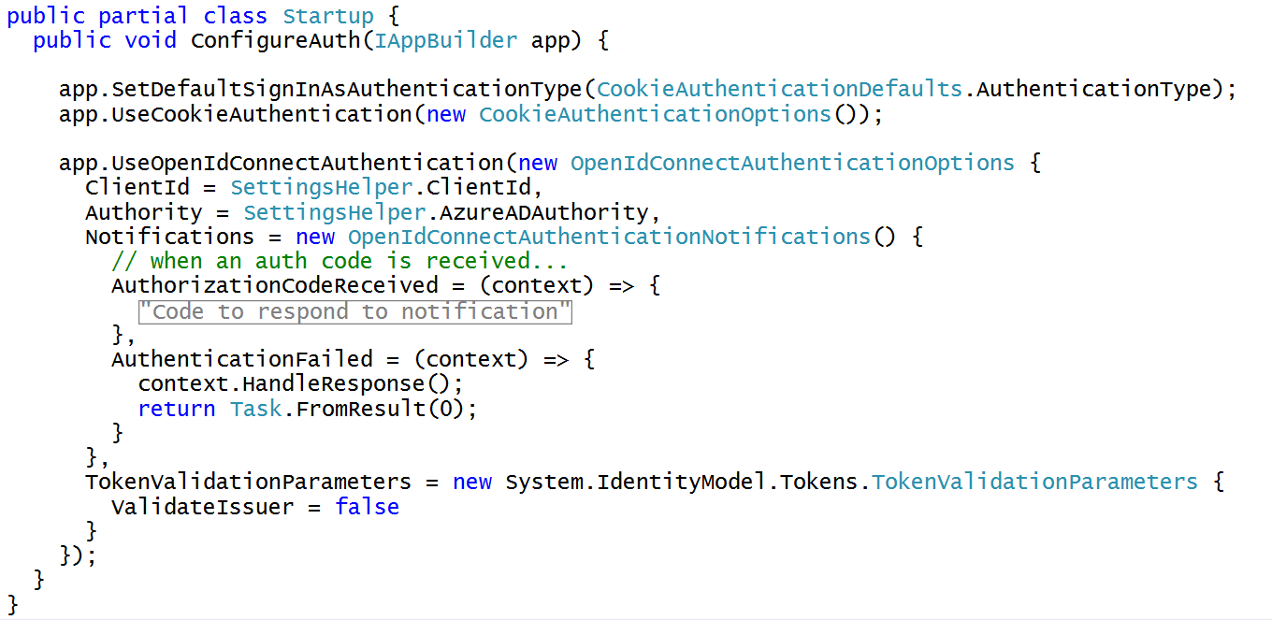
Initializing Security with OWIN Startup Class

Slide 17
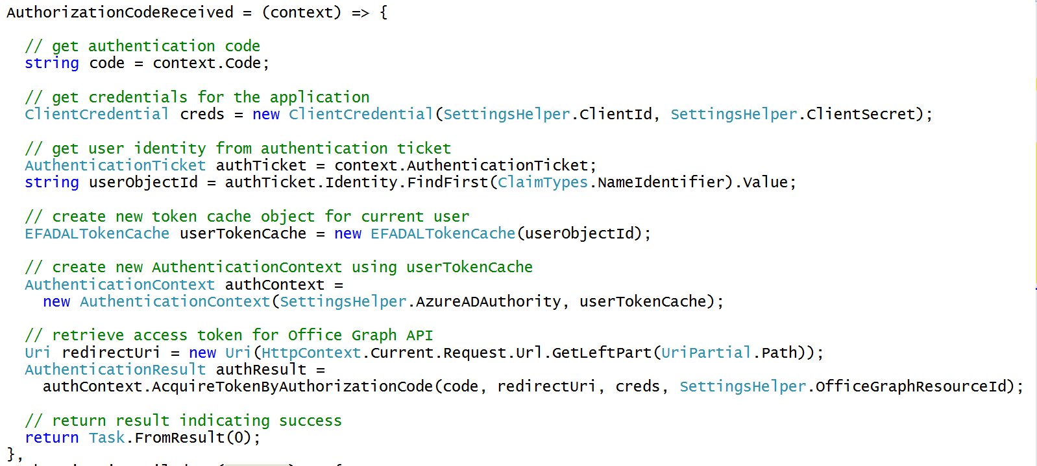
Responding to AuthorizationCodeReceived

Slide 18
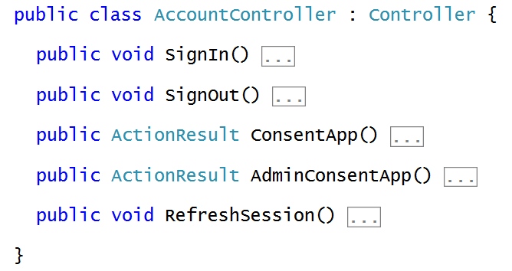
Adding an AccountController Class
AccountController class used to control sign-on behavior
Implement SignIn, SignOut, ConsentApp, AdminConsentApp & RefreshSession

Slide 19
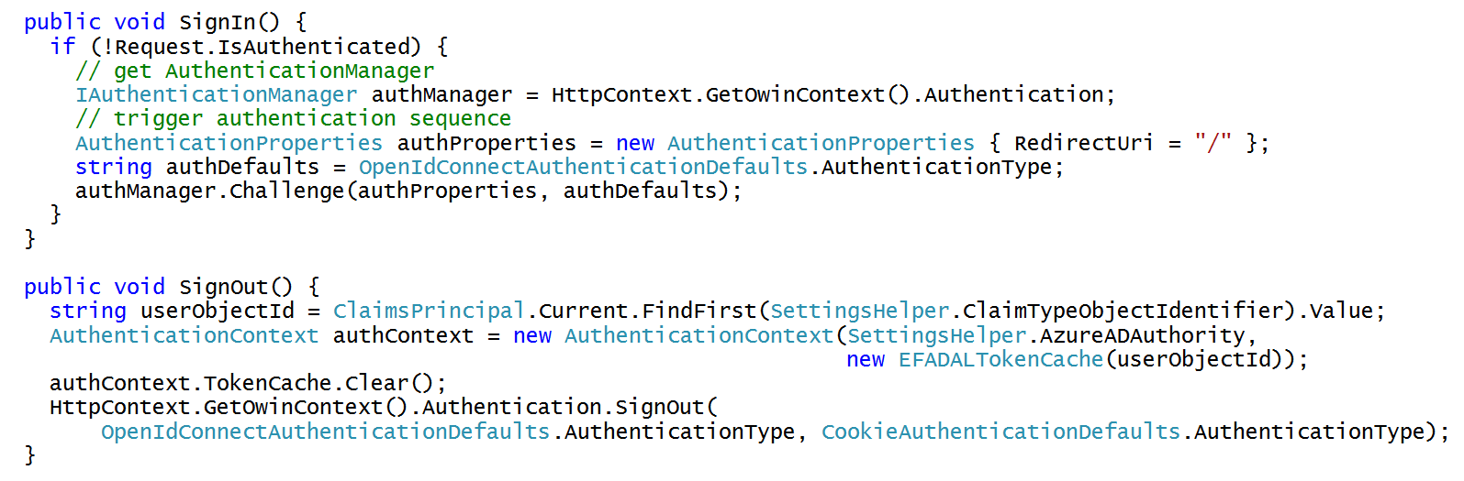
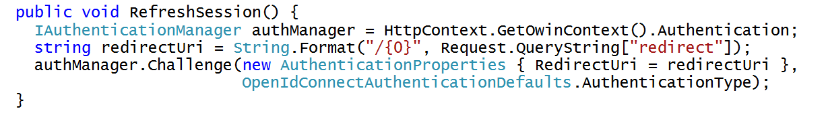
AccountController Implementation

Slide 20
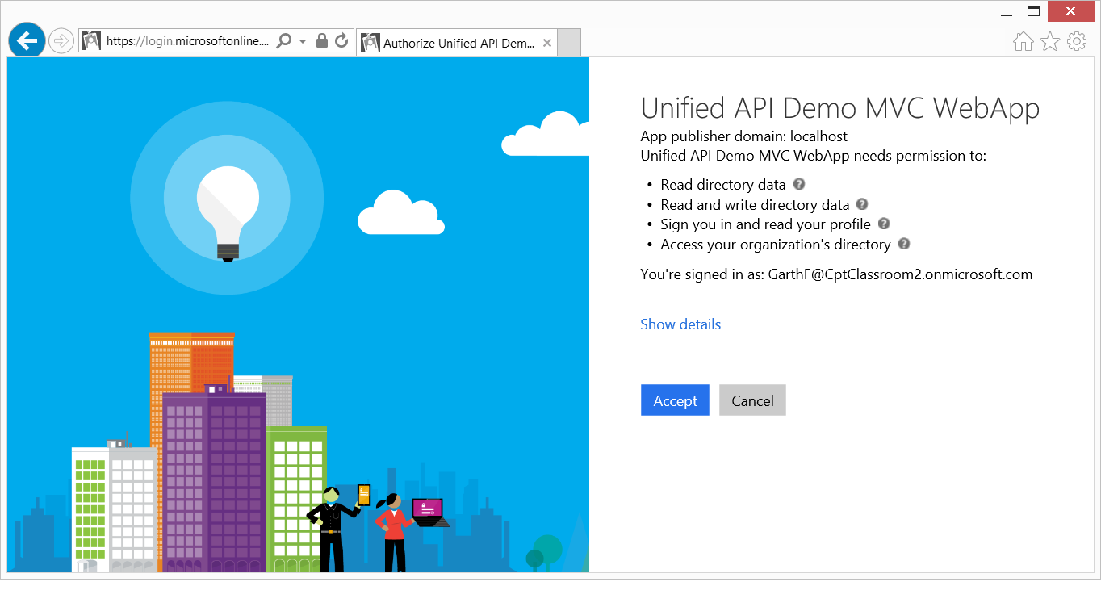
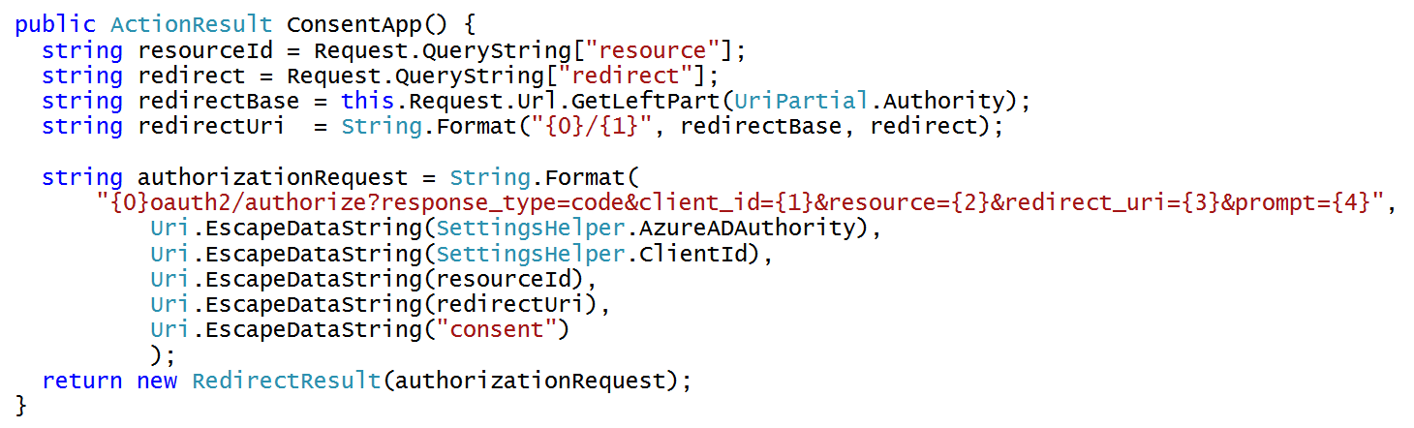
Controlling the User Consent Experience

Slide 21
Summary
Implementing Security with the OWIN Framework
Token Caching using ADAL
Creating an Account Controller Class
Caching and Refreshing Access Tokens

