Slide 1
Developing SPAs with AngularJS and the Office 365 Unified API
Notes:
This module discusses how to develop single page applications (SPAs) that authenticate users with Azure Active Directory (AAD) and access the Office 365 environment using the Office 365 Unified API. Students will learn how to write client-side JavaScript code which leverages the Active Directory Authentication Library for JavaScript (ADAL-JS) together with the AngularJS framework to authenticate users and to acquire and cache access tokens with minimal effort. The module explains how to configure an Azure AD application to support the implicit flow grant which is a requirement when using ADAL-JS. Along the way, students will learn how to extend an AngularJS application using a custom service which accesses the Office 365 Unified API as well as how to integrate this custom service into an AngularJS application design along with controllers and views.

Slide 2
Agenda
Understanding the Implicit Grant Flow
Developing with the ADAL-JS Library
Initializing ADAL-JS with Service Endpoints
Making Secure Calls to Custom Web Services
ADAL-JS Development Techniques

Slide 3
Understanding the Implicit Grant Flow
Implicit Grant Flow
Used when client cannot keep secrets (public client)
Used with SPAs built using JavaScript and AngularJS
Less secure than Authentication Code Grant
How does it work?
Client authorizes user with AD authorization endpoint
AD returns access token directly to SPA in browser
Authentication flow does not involve authorization code

Slide 4
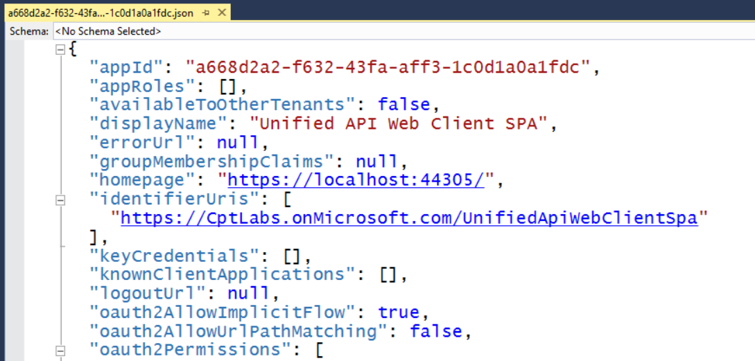
Configuring Implicit Flow in Azure AD
Requires configuring AD application in Azure AD
Download manifest from Azure AD
Update oauth2AllowImplicitFlow setting equal to true
Upload manifest to Azure AD to save changes

Slide 5
Agenda
Understanding the Implicit Grant Flow
Developing with the ADAL-JS Library
Initializing ADAL-JS with Service Endpoints
Making Secure Calls to Custom Web Services
ADAL-JS Development Techniques

Slide 6
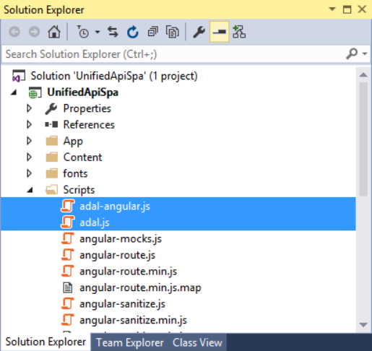
Downloading the ADAL-JS Library
Developing with ADAL-JS involves to two library files
adal.js – core ADAL-JS library
adal-angular.js –integration of ADAL-JS with AngularJS
Library files downloadable from GitHub Repository
https://github.com/AzureAD/azure-activedirectory-library-for-js

Slide 7
Agenda
Understanding the Implicit Grant Flow
Developing with the ADAL-JS Library
Initializing ADAL-JS with Service Endpoints
Making Secure Calls to Custom Web Services
ADAL-JS Development Techniques

Slide 8
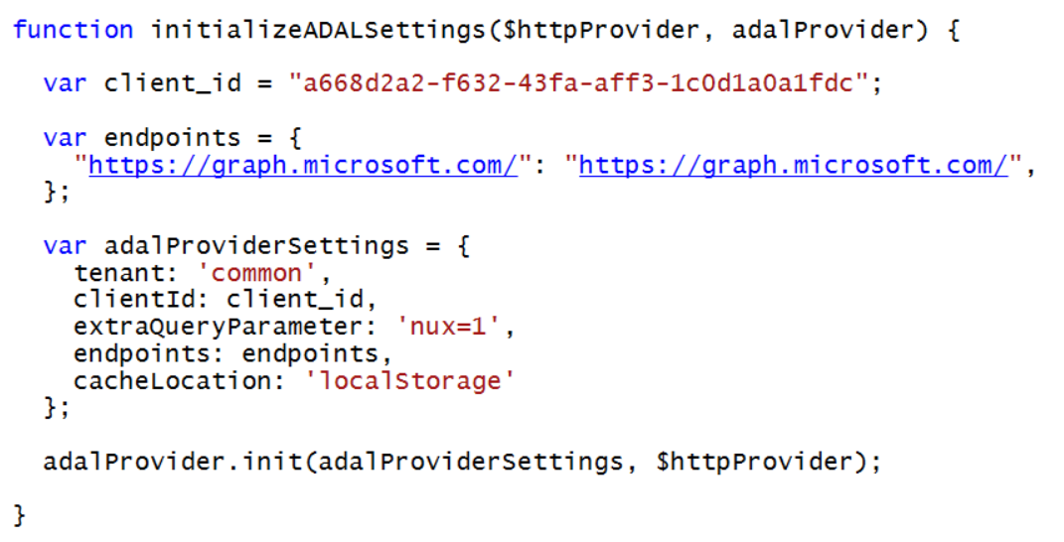
Initializing ADAL-JS Settings

Slide 9
Using ADAL-JS to Develop SPAs that Implements OpenId Connect

Slide 10
Agenda
Understanding the Implicit Grant Flow
Developing with the ADAL-JS Library
Initializing ADAL-JS with Service Endpoints
Making Secure Calls to Custom Web Services
ADAL-JS Development Techniques

Slide 11
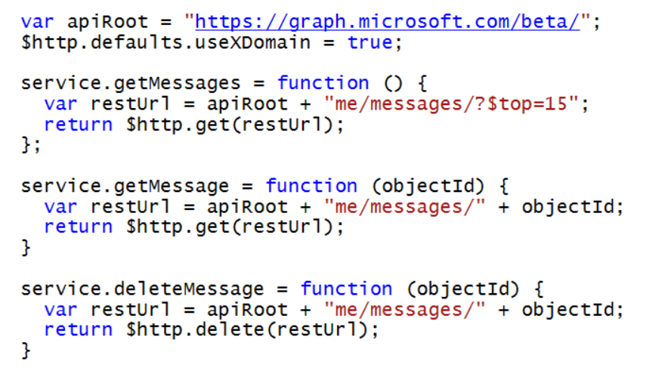
Making Secure Calls to Custom Web Services
adal-angular.js adds interceptors to $http service
adal detects when calls are made to secure endpoints
adal acquires & caches access tokens behind scenes
adal attaches access token to Authorization header

Slide 12
Agenda
Understanding the Implicit Grant Flow
Developing with the ADAL-JS Library
Initializing ADAL-JS with Service Endpoints
Making Secure Calls to Custom Web Services
ADAL-JS Development Techniques

Slide 13
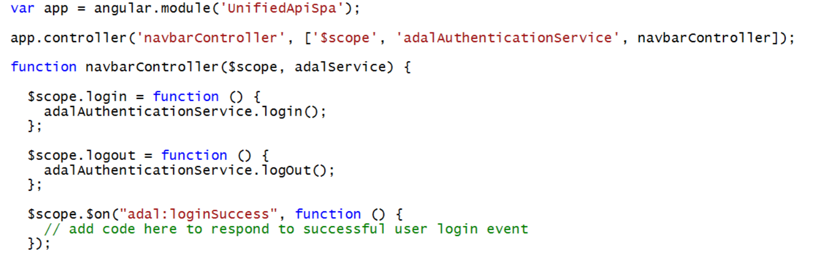
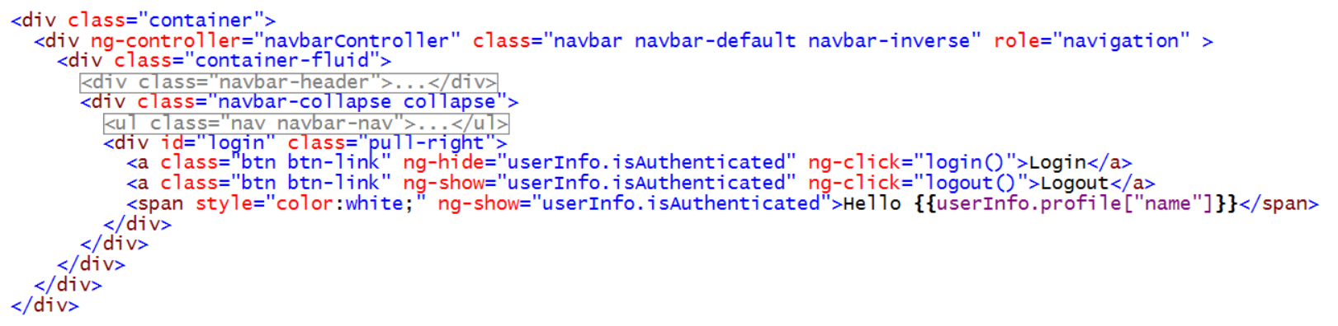
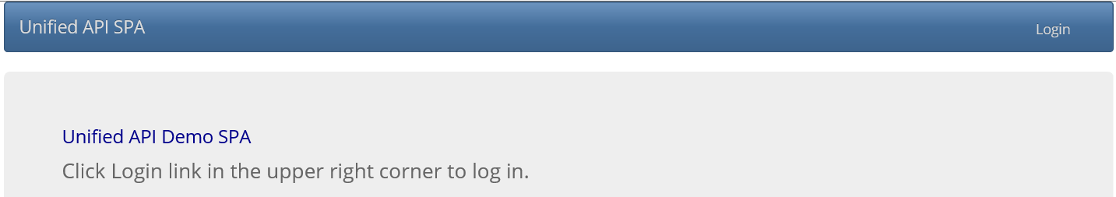
Implementing the User Sign-In Experience

Slide 14
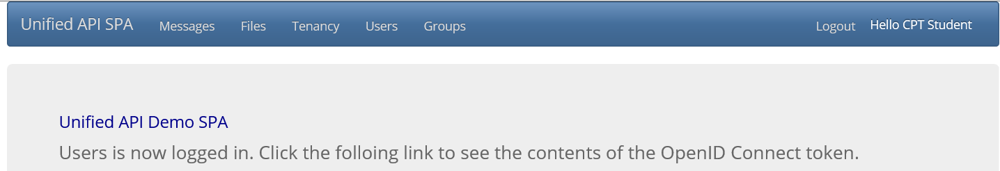
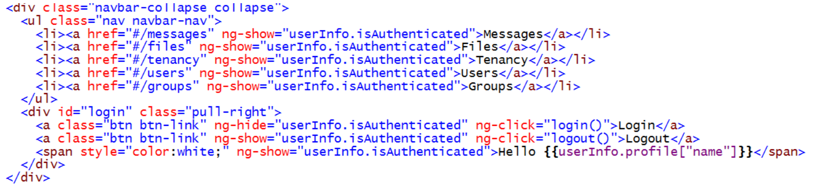
Hiding and Showing Links
Before user has authenticated with adal
After user has authenticated

Slide 15
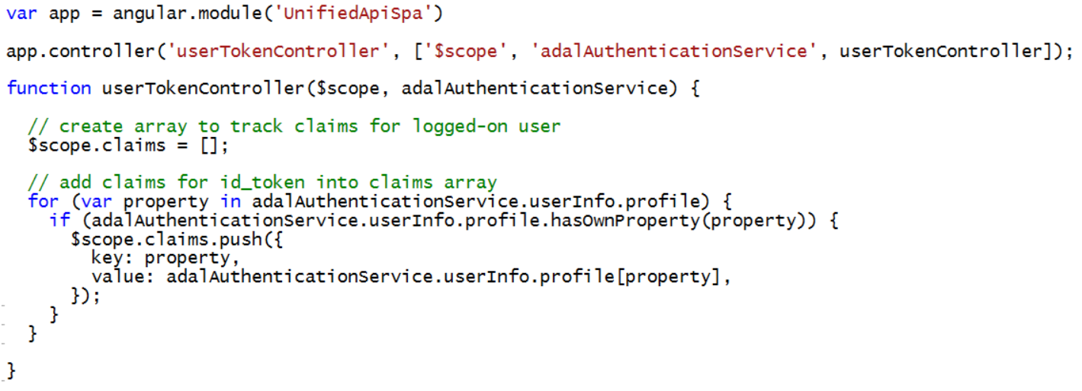
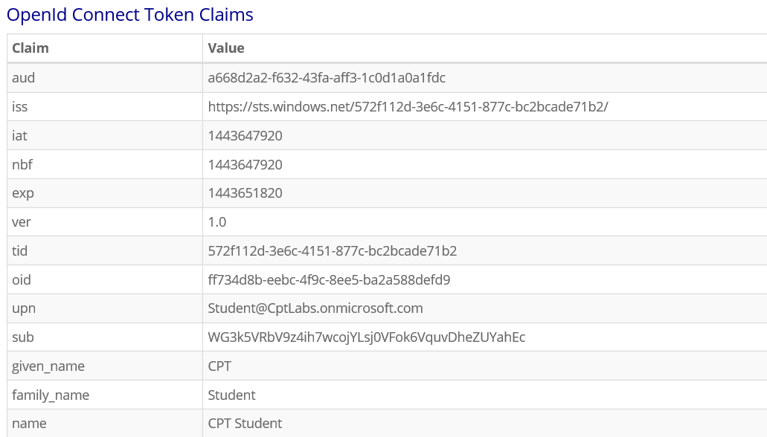
Inspecting Authenticated User Claims

Slide 16
Summary
Understanding the Implicit Grant Flow
Developing with the ADAL-JS Library
Initializing ADAL-JS with Service Endpoints
Making Secure Calls to Custom Web Services
ADAL-JS Development Techniques

