Slide 1
Developing Custom Web Services using Web API 2
Notes:
This module teaches students how to create, test and debug custom web services using Web API 2. Students will learn how to implement a RESTful web service using an API controller as well as how to call this RESTful service from JavaScript code running in the browser. Students will learn how to use attribute routing to create a web service with a custom routing schemes. After discussing API controllers, the module then moves on to cover ODATA controllers and how they can be used to implement the ODATA protocol and to add support for ODATA query options such as filtering, sorting and inline count. Student will learn how to leverage the Visual Studio scaffolding support to quickly create a strongly-typed ODATA controller from an entity model created using Entity Framework. The module concludes with an examination of Cross-Origin Resource Sharing (CORS) and a demonstration of how to add CORS support to web services created with Web API 2 to allow cross-domain calls from client-side JavaScript code running in a browser.

Slide 2
Agenda
Understanding API Controllers and Call Routing
Creating RESTful Web Services
Custom Routing Schemes and Attribute Routing
Developing OData Controller
Cross-Origin Resource Sharing (CORS)

Slide 3
Introducing WebAPI
Framework and tooling for building RESTful services
Part of ASP.NET MVC
Uses Controller and Routing paradigm
Tooling, wizards, scaffolding
Simplified creation of REST and OData services
Simplified use of Entity Framework to wrap database operations
Can be a stand-alone service or part of an app
When added to an app, you perform additional manual modifications to Global.asax

Slide 4
Controllers
Controllers inherit from ApiController
By default methods are mapped to HTTP verbs
public class ValuesController : ApiController
public IEnumerable<string> Get() {}
public string Get(int id) {}
public void Post([FromBody]string value){}
public void Put(int id, [FromBody]string value){}
public void Delete(int id){}

Slide 5
Routing
Routes are controlled through maps
Router makes decisions if information is missing
Similar to MVC
By default methods are mapped to HTTP verbs
config.Routes.MapHttpRoute(
name: "DefaultApi",
routeTemplate: "api/{controller}/{id}",
defaults: new { id = RouteParameter.Optional }
);

Slide 6
Responding
Content Negotiation is automatic
accept: "application/json"
accept: "application/xml"
Return IQueryable to support query syntax
Return HttpResponseMessage for headers and status
public IQueryable<string> Get()
{
var d = new List<string>() {"a", "b" };
return d.AsQueryable();
}
public HttpResponseMessage Get(int id)
{
return Request.CreateResponse<string>(HttpStatusCode.OK, data[id - 1]);
}

Slide 7
Agenda
Introducing WebAPI
Calling API Controllers from MVC Apps
Creating a RESTful Service
Creating an OData Service
Using Cross-Origin Resource Sharing

Slide 8
Scenarios to Consider
Additional API Controllers NOT Required
You don’t require JavaScript access to the data
App has direct EF access to database anyway
Additional API Controllers MAY be Required
You require JavaScript access to the data
Data source cannot be accessed directly using EF
Want to support clients outside of the App

Slide 9
Adding an API Controller
Create a new Provider-Hosted App
Based on ASP.NET MVC Web Application template
Add a new Web API 2 Controller
Use any template
Modify the Global.asax file
Additional using statements
Additional configuration commands

Slide 10
Calling an API Controller
Add a new MVC5 Controller
Use existing Index method
Or add a new method to an existing controller
Add a View for the Method
Call from Managed Code
HttpWebRequest
Call from JavaScript
jQuery ajax

Slide 11
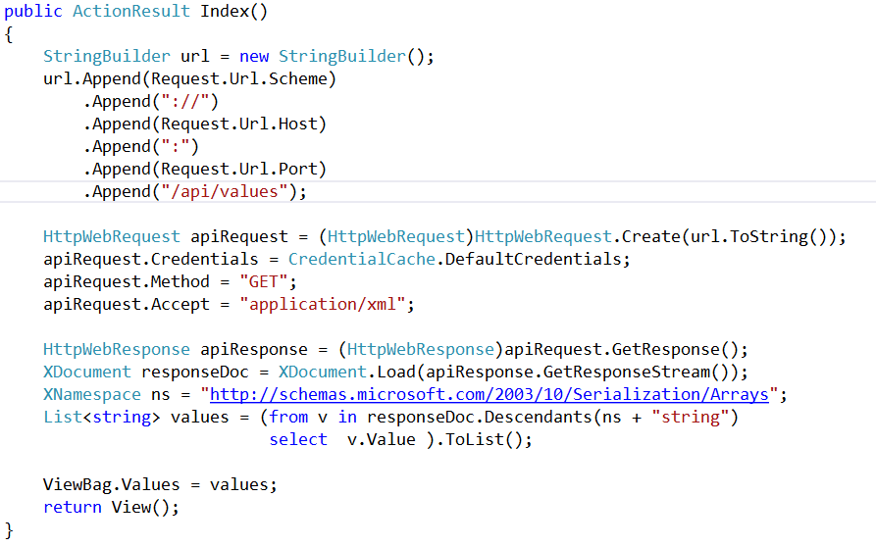
Calling with Managed Code

Slide 12
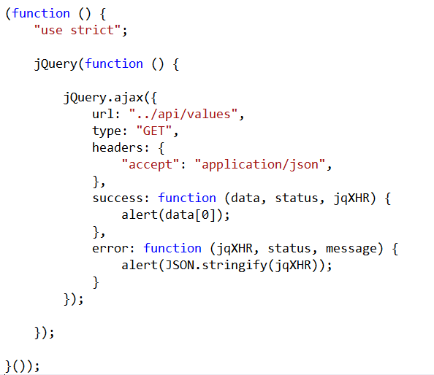
Calling with JavaScript

Slide 13
Calling API Controllers from MVC Apps

Slide 14
Agenda
Introducing WebAPI
Calling API Controllers from MVC Apps
Creating a RESTful Service
Creating an OData Service
Using Cross-Origin Resource Sharing

Slide 15
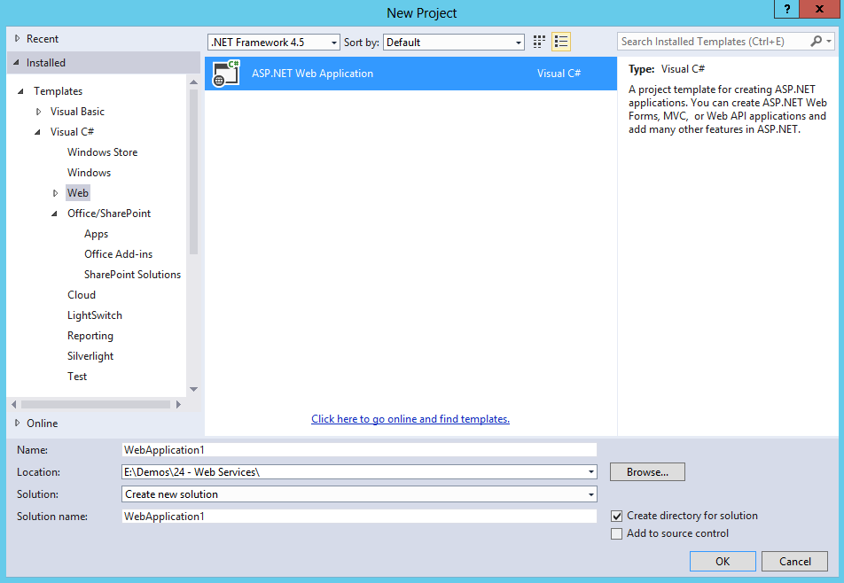
Creating a Stand-Alone RESTful Service

Slide 16
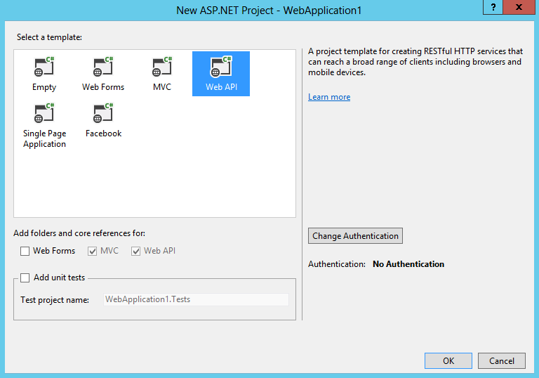
Creating a Stand-Alone RESTful Service

Slide 17
Creating and Testing a RESTful Service

Slide 18
Agenda
Introducing WebAPI
Calling API Controllers from MVC Apps
Creating a RESTful Service
Creating an OData Service
Using Cross-Origin Resource Sharing

Slide 19
OData Query Options
$select
$filter
$orderby
$top
$skip
$expand

Slide 20
Controllers
Controllers inherit from ODataController
Methods are mapped to HTTP verbs just like ApiController
Content Negotiation is automatic
IQueryable generated by default
public class ContactsController : ODataController

Slide 21
Routing
Routes are controlled through maps
Router makes decisions if information is missing
By default methods are mapped to HTTP verbs
ODataConventionModelBuilder builder = new ODataConventionModelBuilder();
builder.EntitySet<Contact>("Contacts");
builder.EntitySet<Company>("Companies");
config.Routes.MapODataRoute("odata", "odata", builder.GetEdmModel());

Slide 22
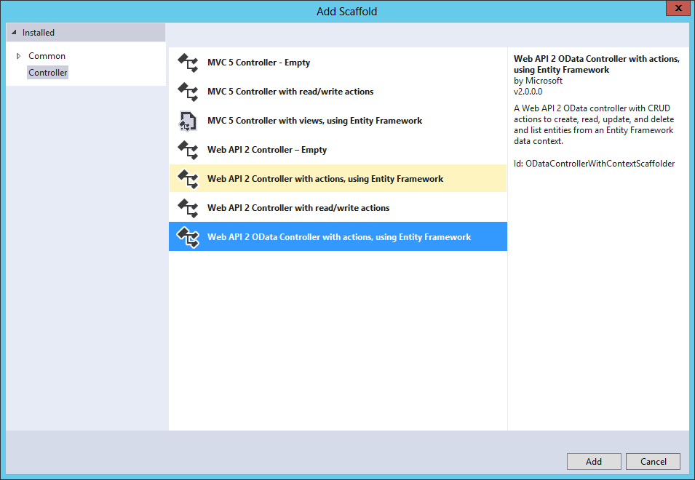
Adding an OData Controller

Slide 23
Creating and Testing an OData Service

Slide 24
Agenda
Introducing WebAPI
Calling API Controllers from MVC Apps
Creating a RESTful Service
Creating an OData Service
Using Cross-Origin Resource Sharing

Slide 25
Cross-Origin Resource Sharing
Allows JavaScript to make a call across domains
Superior to JSONP, which only supports GET
Supported in current versions of all major browsers
Browser and resource exchange headers
Origin header from browser contains origin requesting
Access-Control-Allow-Origin header returned from resource if call is allowed
Enabling in WebAPI2
Install Microsoft ASP.NET WebAPI2 CORS NuGet Package
Enable CORS in WebApiConfig
Use [EnableCors] attribute in controllers

Slide 26




Security Considerations
Secure Sockets Layer – always!
Always validate calling domain
Allowing all domains can open network to attack
Service not validating domains
Script gains access
Page with malicious script

Slide 27
Cross-Origin Resource Sharing

Slide 28
Summary
Introducing WebAPI
Calling API Controllers from MVC Apps
Creating a RESTful Service
Creating an OData Service
Using Cross-Origin Resource Sharing

Slide 29
Status Codes
200: OK
201: Created – returned after POST
204: No Content (i.e. successful DELETE)
400: Bad Request (validation error, missing parameters)
401: Unauthorized
403: Forbidden
404: Not Found

