Slide 1
Working with Lists and Content Types
Notes:
This module focuses on site customization of list and columns that can be accomplished in SharePoint Online using the browser or SharePoint Designer 2013. You will learn how to use the new SharePoint Online user interface to configure important site settings and to create essential site elements such as pages, lists, document libraries and child sites. You will also learn how to customize lists by creating and managing custom site columns and content types. The module concludes with an in-depth look at building no-code solutions which involve creating custom site columns and content types.

Slide 2
Agenda
Working with Lists
Creating Site Columns
Designing Content Types
Using Content Types in Lists

Slide 3
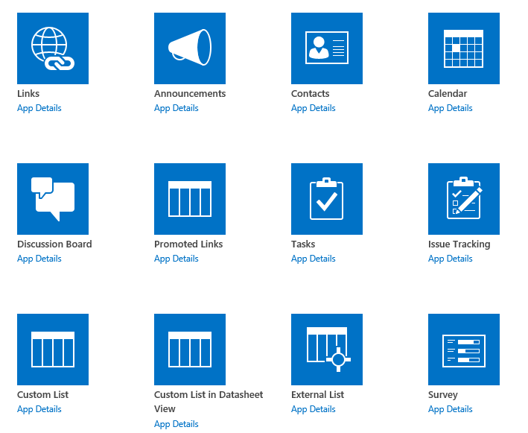
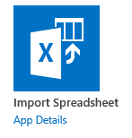
Out-of-the-box List Templates
Notes:
Aside from the new look and new name (“Apps”) , SharePoint lists and libraries are still the main storage location for all your content in SharePoint. Many of the lists and libraries have gotten a “face lift” with updates to the UI.

Slide 4
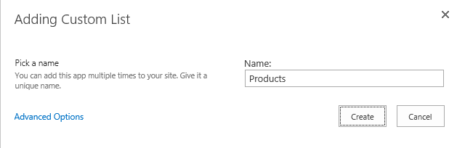

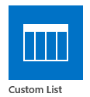
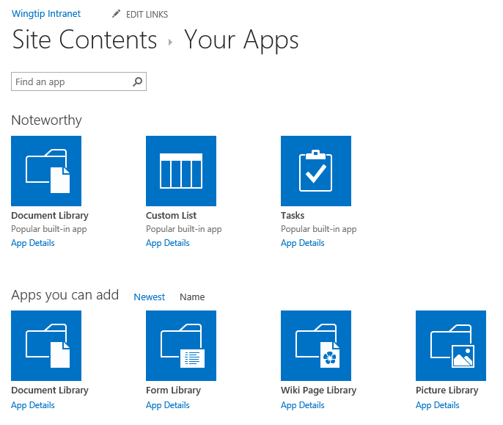
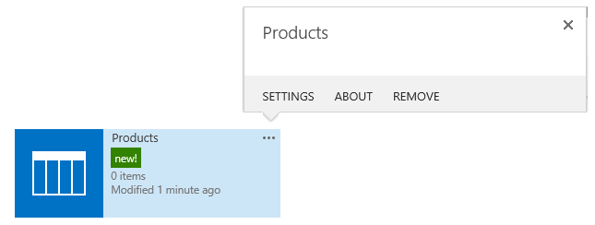
Creating a New List
Click add an app
Click on tile of desired list type
Provide "Name" for new list name used to create list title and list URL
Locate tile for list on Site Contents page
Use ellipse (…) menu for setting
3
1
2
4
5
Notes:
Creating a new list is very similar to the process in SharePoint 2010 except you choose “Add an App”. Then complete the necessary information to complete the creation process. Once the new list is created the Site Contents page reflects the new list and highlights it with a “new” icon. List settings are accessed through the ellipsis (“…”) menu.

Slide 5
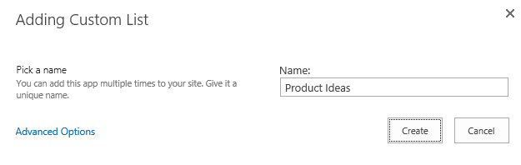
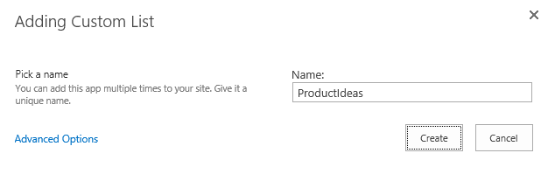
List URL versus List Title
Name you provide used to create URL and Title
Spaces in name replaced in URL using %20
Avoid spaces during list creation to make URLs more readable
When using spaces
When avoiding spaces
List Title property can be modified with spaces after creation
List URL: http://intranet.wingtip.com/Lists/Product%20Ideas
List URL: http://intranet.wingtip.com/Lists/ProductIdeas
Notes:
In general in SharePoint it is considered a best practice to create your lists and libraries with no spaces in the initial name. This can later be changed through the list settings. By omitting the spaces you prevent SharePoint from replacing the spaces with “%20” in the list URL. This leads to cleaner URLs for your lists and libraries.

Slide 6
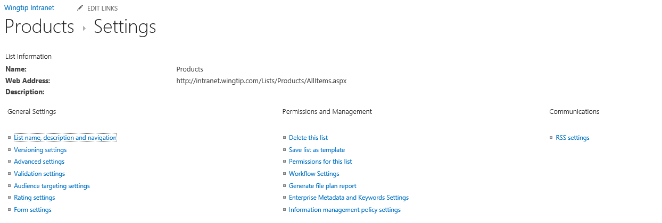
List Settings
Used to configure many aspects of lists
Notes:
The List Settings page is used to configure all of the options on the list like permissions, content types, and versioning.

Slide 7
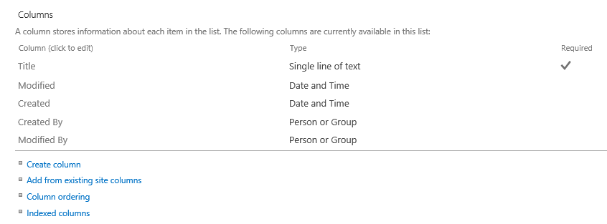
List Columns
Used to add, remove and edit columns
Notes:
There is a big difference between “List Columns” and “Site Columns” when it comes to list design. In this graphic the columns are added to the list and are only available on this list. As a result, if you need to reuse the column settings on another list, you will have to duplicate the effort.

Slide 8
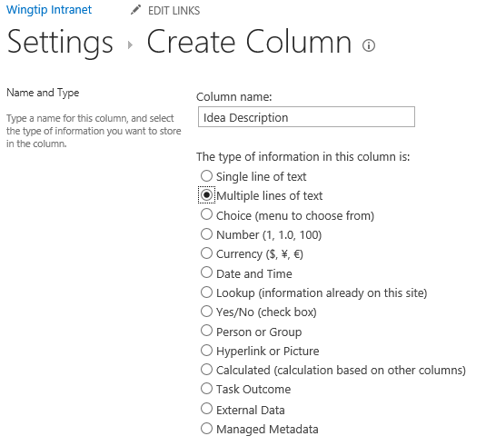
Adding Custom List Columns
List columns must be created using field types.
Notes:
Adding custom columns to a list is done through the list settings. You have a choice of data types when you add columns to the list. It is important to consider how the data will be used when you select a data type for your columns.

Slide 9
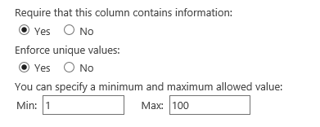
Column Validation Constraints
Columns can have field type-specific constraints
Require a value
Require a unique value required
Min, Max, etc
Configuring a column to be unique
Column can be configured to be unique per list
Good for e-mail, social security number, etc.
Unique columns must be indexed
Caveat: Uniqueness determined by SQL collation
Notes:
In SharePoint Online, you can indicate that a column must contain unique values within the list. This means that no duplicate values can occur in the list for that column. Once the unique column constraint has been configured on an existing column in an existing list, the save item action will fail if a duplicate value is already present for that column in another item.
A column can only be defined as unique when the column is indexed. However, when you configure a column to be unique, SharePoint will prompt you informing you that it will configuring the column indexing for you.

Slide 10
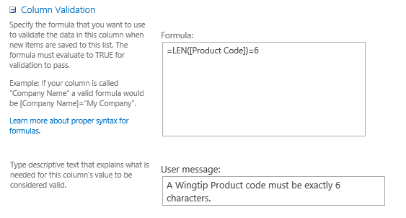
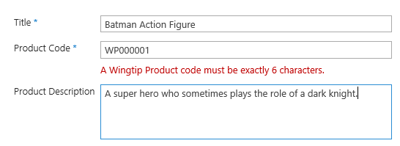
Column-level Validation Settings
Columns can define validation formulas
Allows for domain-specific validation
Example: Product Code must be exactly 6 characters
User experience when a formula returns false
Notes:
You can create column level validation for your lists to ensure that data is properly entered by your users. Column level validation is performed by creating a formula that must evaluate to “true”. If it doe not you can display a validation error message.

Slide 11
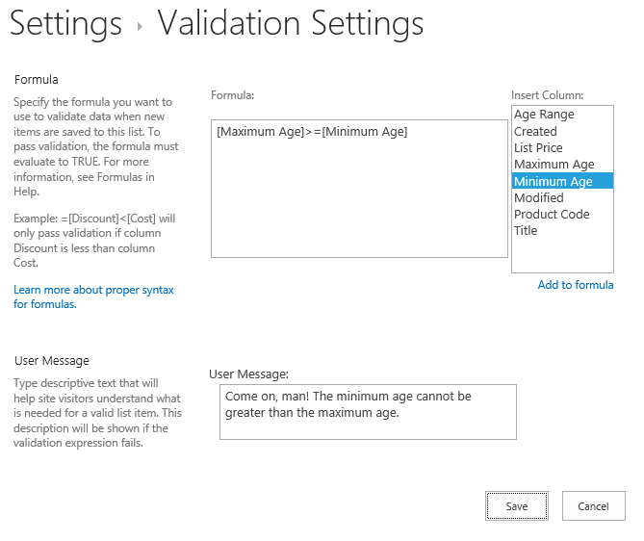
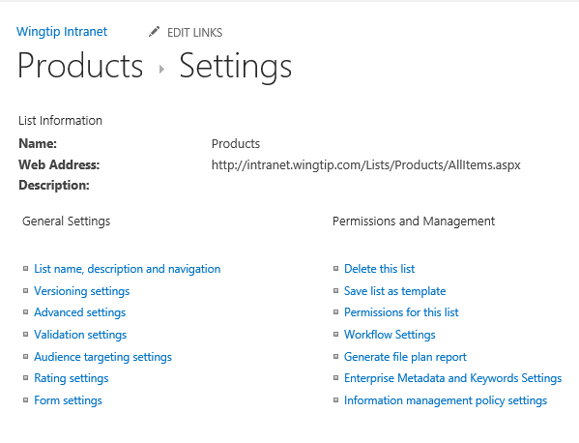
List-level Validation Settings
SharePoint supports list-scoped validation rules
Evaluation rules can look at multiple columns
Notes:
You can also achieve column validation when you create a new column or modify an existing column.
Notice the new section Column Validation where you can enter a formula against which the data entered in that column will be validated. The formula must evaluate to true before the list item can be saved.

Slide 12
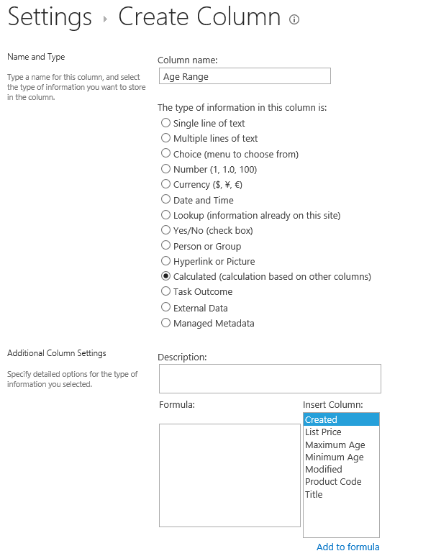
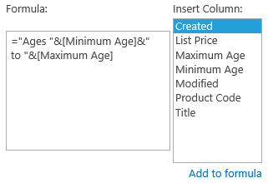
Calculated Columns
SharePoint 2013 supports calculated columns
Based on the evaluation of custom formulas
Formula can reference other columns in list
Formulas can use built-in function much like Microsoft Excel
Notes:
Calculated columns do not receive user input. They generate a value based on the values of other columns. For example you could calculate an extended price based on a column price multiplied by a quantity.

Slide 13
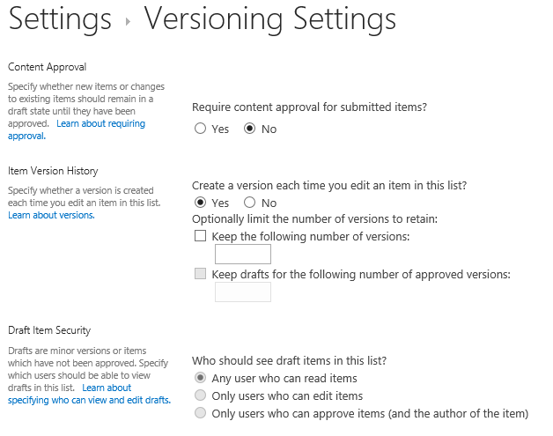
List Item Versioning
List support versioning
Can track and restore overwritten versions of an item
Notes:
List and libraries support versioning of items. This may be used in conjunction with check in/ check out, but is not necessary. The goal of versioning is to maintain a history of changes to an item. The versions are stored as complete copies of the previous item, not just the delta. For this reason, versioning can impact site quota limits if left unchecked.

Slide 14
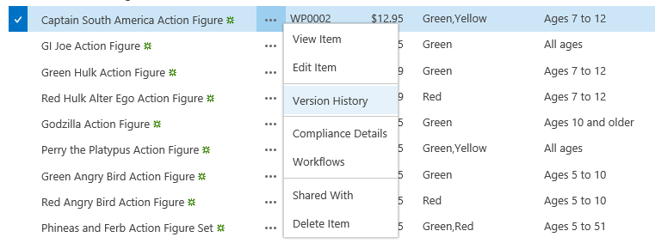
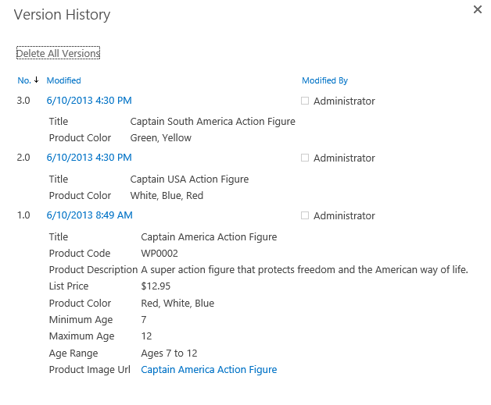
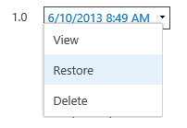
List Item Version History
User can view previous versions of a list item
Can serve as a poor man's audit log
User can restore pervious on top of current version
Restoring version always creates new version number
Notes:
There is a feature that enables users to see previous versions of items and compare them to see what changed. You can also restore the previous version which create a new version number and copies the previous version information.

Slide 15
Creating and customizing the Product Ideas list

Slide 16
Agenda
Working with Lists
Creating Site Columns
Designing Content Types
Using Content Types in Lists

Slide 17
Site Columns
Reusable column templates that define…
The underlying field type for column value
The default value
Rendering characteristics
Each site has its own Site Column Gallery
Site columns available in current site and sites below
Site columns in top site available to site collection
Notes:
A site column represents the definition for a reusable column templates. Each site column defines an underlying field type for column value, a default value and the rendering characteristics for that field type. For example, a site column based on the underlying field type of Currency can define the formatting in terms of US Dollars.
Each site has its own Site Column Gallery. This is true of both top level sites as well as child sites. A site column in the site column gallery is available for use in the current site and in child sites below in the site hierarchy. A site column in the site column gallery of the top-level site is available for use throughout the entire site collection.

Slide 18
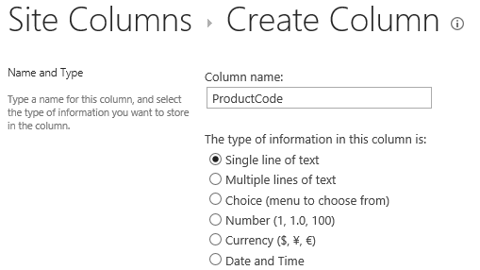
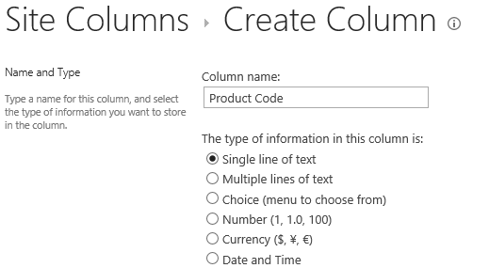
Display Name versus Internal Name
Each site column really has two names
Site column has display name and internal name
Both names created when the site column is created
Best to omit spaces from name during creation adding a space results in an internal name with a funky _x0020_
Display name can be updated with space after creation
Create site columns names like this…
Not like this…
Notes:
Like list names, columns have two names. The internal name is created when the field is created and cannot be changed, the Display Name is initially the same but can be changed later. Any spaces in the initial name are converted to “_x0020_”. To avoid tis do not use space in the column names when creating them. Change the name after you have created the column, adding spaces for clarity, later.

Slide 19
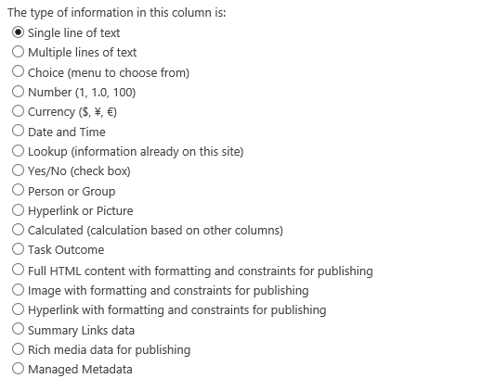
Column Types (aka Field Types)
List of available columns has extra choices
More field types available for site column than for list column
Notes:
Many of the data types for Site Columns are the same as for List Columns, with some exceptions. For example you cannot create an External Data Column as a site column.

Slide 20
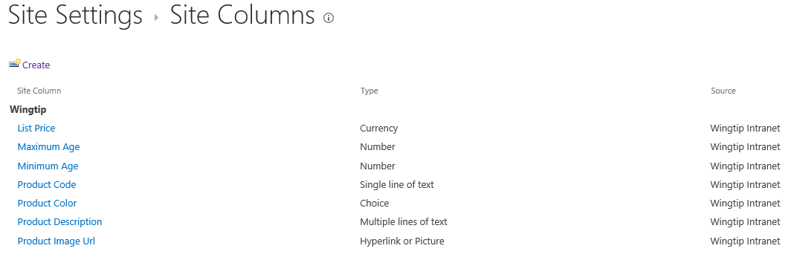
Site Columns to Track Wingtip Products
Notes:
In your lab you will create Site Columns for your Products Content Type. There are many good reasons to use Site Columns rather than list columns, the most important being reusability. As site columns are defined at the site level they can be reused on many lists and libraries.

Slide 21
Creating Custom Site Columns

Slide 22
Agenda
Working with Lists
Creating Site Columns
Designing Content Types
Using Content Types in Lists

Slide 23
Content Types
Reusable item/document templates that define…
A parent content type
A collection of site columns
Each site has its own Content Type Gallery
Content types available in current site and sites below
Content types in top site available to site collection
Notes:
A content type is a reusable template of site columns used for an item or document. Since we are concentrating on publishing sites in this course, we are interested in content types that are used behind the Pages document library.
Each content type lives in a large hierarchy of content types and therefore must be defined with a parent content type. The content type inherits a set of site columns from its parent content type and can add more of its own.
Just like site columns, content types are tracked in a content type gallery. Each site within a site collection has its own Content Type Gallery. Content types in a content type gallery are available in the current site as well as in child sites below in the sire hierarchy. Content types that have been added to the content type gallery of the top-level site are available for use throughout the current site collection.

Slide 24
Content Type Hierarchy
Content types designed in hierarchy
All content types inherit (aka derive) from Item
Child content type inherits site columns from parent
Child content type can add new site columns
Child content type can remove site columns inherited from parent
SharePoint content type hierarchy
Item
Announcement
Contact
Task
Document
Form
Picture
Notes:
Content Types are hierarchical and must descend from a “parent”. The top most parent is the List Item. All content types come from this common parent and add additional fields as metadata to describe the content they contain.

Slide 25
Creating Custom Content Types
Creating a custom content type
Select a content type name
Select a parent content type to inherit from
Add whatever site columns are required
Configure content type settings
SharePoint-supplied content types
Item
Document
Custom content types
Product
Product Images
Notes:
In our fictitious company, the Product content type is a list item, so we will have it descend from Item. The product images are files so we will have the image descend from Document. It is important to consider what the parent content type is in order for you to minimize the amount of work you have to do on the solution that you are building.

Slide 26
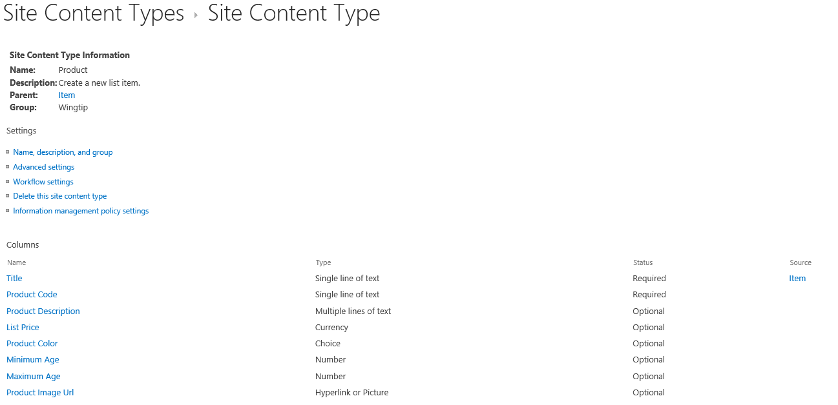
Example: The Product Content Type
Notes:
This screen shot shows the completed Product Content type. Notice the column on the far right, it shows the inheritance of the column. In this case only the Title column was inherited from the Item content type.

Slide 27
Creating the Product Content Type

Slide 28
Agenda
Working with Lists
Creating Site Columns
Designing Content Types
Using Content Types in Lists

Slide 29
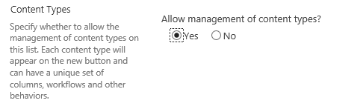
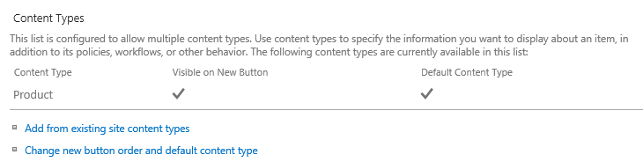
Lists and Content Types
List contains a collection of content types
Every list must contain at least one content type
Content types hidden on the List Settings page by default
Advanced Settings page for list provides option to show them
Content Types section allows for adding/removing content types
Notes:
Most lists and libraries that you have worked with in SharePoint contain a single Content Type association. When building advanced solutions in SharePoint you have to consider that you can override this behavior and add your own content type association (or many associations). This is where you, as a SharePoint expert, must make decisions about how the information in your solution will be stored.

Slide 30
Configuring the Products list to use the Product content type

Slide 31
Summary
Working with Lists
Creating Site Columns
Designing Content Types
Using Content Types in Lists

