Slide 1
Getting Started with SharePoint Online
Notes:
This module explains the features and improvements that have been introduced to Office 365 and SharePoint Online. You will learn about the difference between using SharePoint 2013 in an Office 365 environment versus using SharePoint 2013 in an on-premises environment. The module also explains why building business solutions with a no-code approach works equally well across both environments. The module concludes with an exploration of the new SharePoint Online team site and demonstrates new ways in which to change a site's appearance.

Slide 2
Agenda
Office 365 Overview
SharePoint Online versus SharePoint On-premises
Strategies for Building No Code Solutions
Working with Team Sites in SharePoint Online
Working with Composed Looks

Slide 3
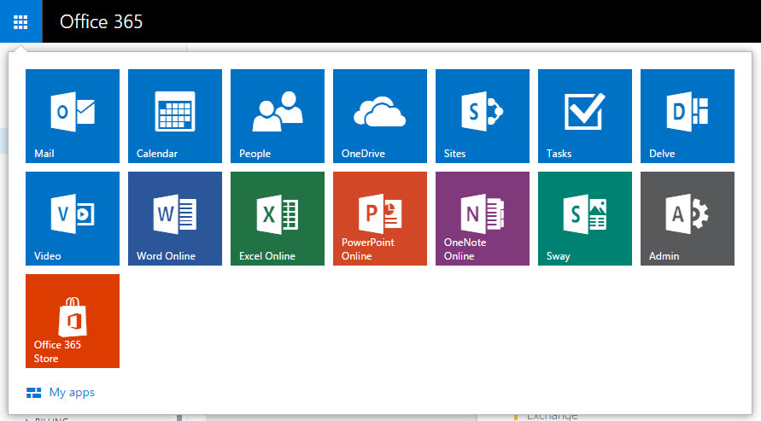
What is Office 365?
A suite of Applications and Services for business
Hosted and Administered by Microsoft
Managed by your company

Slide 4
What is SharePoint Online?
Site Collections
User Profiles
Search + Delve
Business Connectivity Services
Term Store
Apps

Slide 5
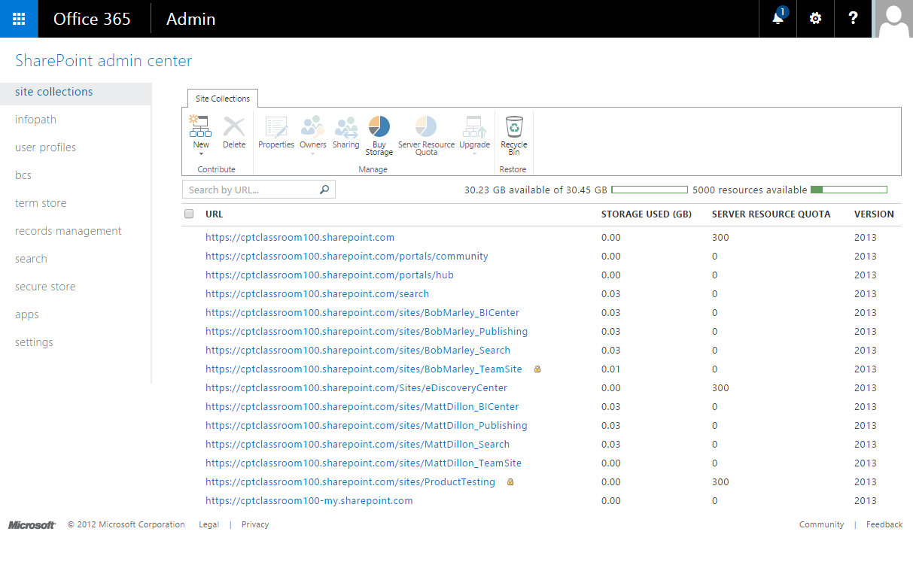
Tenant Administration
Notes:
This is the layout of the SharePoint admin center. The home page displays an overview of the different management tasks and service applications availale in your tenant. On this page you get a visual status of the many site collections and thier current storage levels and lock status.

Slide 6
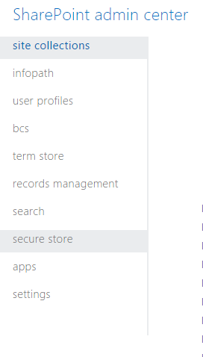
Tenant Services
Site Collections
InfoPath
User Profiles
BCS
Term Store
Records Management
Search
Secure Store
Apps
Notes:
The various service applications available to your tenant depend on the licensing level purchased by your company. In this class we will be exploring many of these services.

Slide 7
Site Collections
Site Collections contain Sites and Content
Site Collections can contain hundreds of sub sites
Site Collections are a permissions boundary
Tenant Administrator creates Site Collections
SharePoint Web Application Hosted and Managed by Microsoft
site collection company.sharepoint.com
site collection company.sharepoint.com/sites/sales
site collection company.sharepoint.com/sites/finance
top-level site
(root)
top-level site
(root)
top-level site
(root)
child site
/WestDivision
child site
/EastDivision
child site
/FY2012
child site
/FY2013
child site
/Reports
child site
/Dashboards

Slide 8
Creating a new site collection using Tenant Administration

Slide 9
Agenda
SharePoint Online Overview
Office 365 versus SharePoint On-premises
Strategies for Building No Code Solutions
Working with Team Sites in SharePoint Online
Working with Composed Looks

Slide 10
Office 365 and SharePoint Online
SharePoint 2013/2016 was designed for Office 365
Architectural changes made to improve hosting support
SharePoint Online now runs SharePoint 2013/2016
Microsoft is investing heavily in the cloud
Office 365
Exchange
Skype for Business
SharePoint Online
Etc.
Notes:
SharePoint 2013 marked the first version of the product in which Microsoft shifted its focus to support hosting SharePoint in the cloud. Much of this has to do with Microsoft’s recent investments in Office 365 and SharePoint Online. A significant percentage of the investment that Microsoft has made to make SharePoint 2013 and 2016 better than SharePoint 2010 resolves around making things work in cloud-based hosting scenarios.
With the SharePoint 2013 environment hosted within Office 365, Microsoft assumes the role of SharePoint administrator. One important factor to note is that companies don't require hardware or as much SharePoint expertise to leverage SharePoint in their business.

Slide 11
SharePoint Online versus On-premises
Using SharePoint Server 2013 On-Premises
SharePoint farm must be created/configured
Runs within the context of local Active Directory domain
Services configured at web application scope
Using SharePoint Online in Office 365
New tenancy is provisioned for each new customer
Tenancy defines a scope for creating user accounts
Active Directory accounts can be imported
Notes:
There are two primary ways in which a company can use SharePoint 2013. A company can install SharePoint 2013 on server computers which it controls. This type of SharePoint 2013 installation is known as an on-premises farm. Alternately, a company can establish an account in Office 365 which makes it possible to create and utilize SharePoint sites which make use of SharePoint services. Furthermore, there is nothing that prevents a company from using both approaches at the same time which involves one or more on-premises farms used in conjunction with a SharePoint presence in Office 365.
With an on-premises farm deployment, a company must acquire its own hardware and purchase licenses from Microsoft. The company must also maintain expertise within its IT staff to install SharePoint 2013 on servers running on premises. This is largely the focus of this training class.
When establishing a company account in Office 365, a company must purchase an Office 365 plan for hosting SharePoint sites which typically involves monthly per-user charges but eliminates the need to purchase SharePoint 2013 licenses. Microsoft provides the hardware and manages the SharePoint farm behind the scenes. A company will administrate its account at a higher level which is known as “tenancy level”. Therefore, the company will have one or more users who will play the role of tenancy administrator.

Slide 12
A SharePoint Online Tenancy
Tenancy provides top-level administrative scope
Customer has no visibility to farm or web application
Special site collection created for tenant administration
SharePoint Online Tenancy
site collection company-admin.sharepoint.com
site collection company.sharepoint.com
site collection wingtip.sharepoint.com/sites/sales
top-level site
(root)
top-level site
(root)
top-level site
(root)
child site
/Reports
child site
/Operations
child site
/WestDivision
child site
/EastDivision
Notes:
In the Office 365 environment, customers are never permitted to perform administrative work at the farm level or the web application level. Instead, Office 365 customers using SharePoint Online create and manage site collections with the scope of a tenancy.
SharePoint Online provides each customers with a Tenant Admin site collection that is accessible to users who have been granted Tenant Admin permissions. If you have been granted the required permissions, you can use the Tenant Admin site collection to create and manage site collections with your tenancy and to configure the tenancy's service applications.

Slide 13
Agenda
SharePoint Online Overview
Office 365 versus SharePoint On-premises
Strategies for Building No Code Solutions
Working with Team Sites in SharePoint Online
Working with Composed Looks

Slide 14
Building "No Code" Solutions
What do you need to get started?
An out-of-the-box SharePoint environment
A browser (IE10, FireFox, Chrome, Safari, etc.)
SharePoint Designer 2013
Modest coding skills with HTML, CSS and JavaScript
What will be avoided?
Use of Visual Studio is explicitly prohibited
No custom development of SharePoint solutions
No custom development of SharePoint apps
Notes:
When building No-Code solutions you will be using all of the tools available to you that do not require you to deploy code. For example, the browser, SharePoint Designer, InfoPath. You will also run a few scripts and use editors like Notepad to create visuals in SharePoint with HTML and CSS.

Slide 15
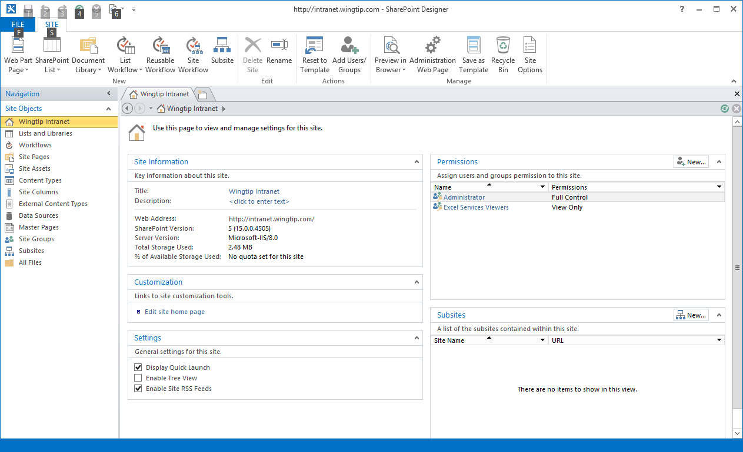
SharePoint Designer 2013
A Valuable SharePoint Utility Tool
Inspect and update site properties
Create and manage lists and document libraries
Many other things as well (e.g. create custom workflows)
Notes:
SharePoint Designer 2013 is the go to tool for Site management and workflow creation. If you are a visual designer, you may use SharePoint Designer, but you don’t have to. New features of SharePoint enable you to use any text editor you like for creating Master Pages and Page Layouts.

Slide 16
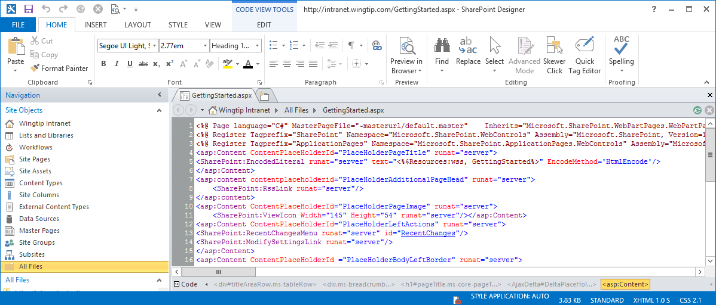
What’s New in SharePoint Designer 2013?
The Good News
Significantly improved support for creating workflows
The Bad News
No more Design View for editing HTML in web pages
Site pages must be edited in Code View
Notes:
SharePoint Designer 2013 is now used mainly for building workflows in SharePoint Online. You don’t need it for visual design, but if you decide to use it you should know in advance that it no longer has any preview capability. It only has code view. Use a browser for previews.

Slide 17
Customizing a SharePoint Online Site using SharePoint Designer 2013

Slide 18
Agenda
SharePoint Online Overview
Office 365 versus SharePoint On-premises
Strategies for Building No Code Solutions
Working with Team Sites in SharePoint Online
Working with Composed Looks

Slide 19
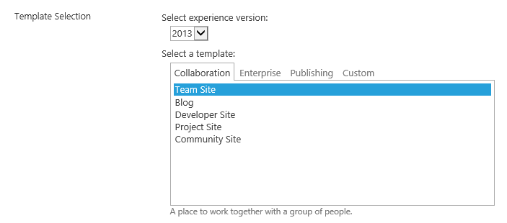
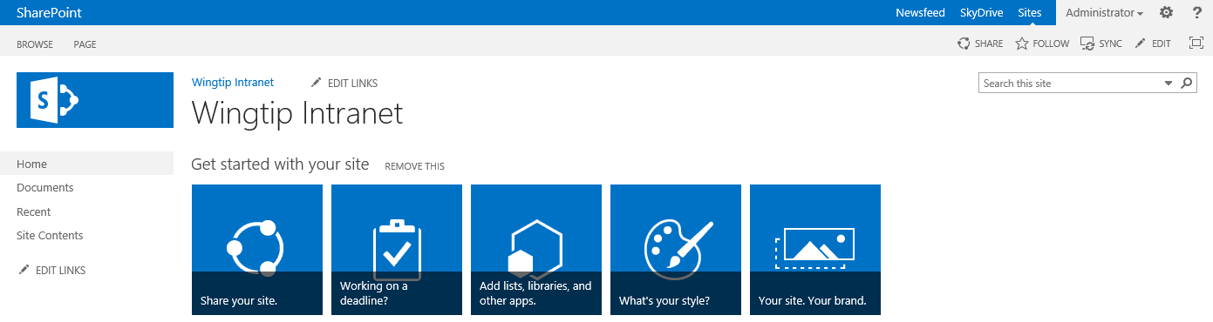
SharePoint Online Team Sites
Team sites provide support for collaboration
Same functionality as in earlier versions
SharePoint Online introduces new UI experiences
Notes:
SharePoint Online is the fifth major version of the SharePoint technology stack. Each version has enhanced the product and made significant changes to account for changes in the IT industry. However, a few things have remained consistent across versions. One example of this is the site template for creating Team Sites which has been available since the very first version of SharePoint technologies released in 2001. Team sites are the most commonly-created type of site in all versions of SharePoint.
The new team site in SharePoint Online looks quite a bit different from SharePoint 2010. The master page has changed. The Site Actions menu has been moved from the left to the right. Much of the user interface has been redesigned around the new app model.

Slide 20
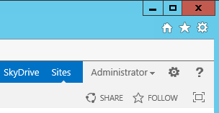
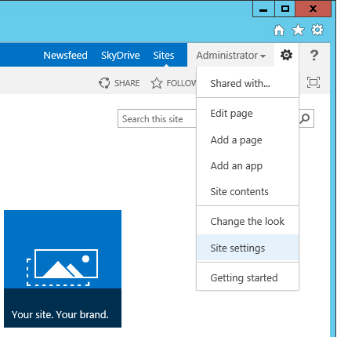
Site Actions Menu
Site Actions menu displayed in top right corner
Provides commands for actions and navigation
Internet Explorer Settings menu
SharePoint Site Actions menu
Configure permissions to this site
Edit the current page (applies to web part pages or wiki pages)
Add a new wiki page to the SitePages wiki page library
(Create new list or document library) OR (Install a new SharePoint app)
Navigate to Site Contents page
Navigate to the Change the Look page
Navigate to the Site Settings page
Navigate to the Getting Started page
Notes:
The Site Actions menu by default is now a Gear icon. It supports most of the necessary functions for managing your site and getting you to the site settings page.

Slide 21
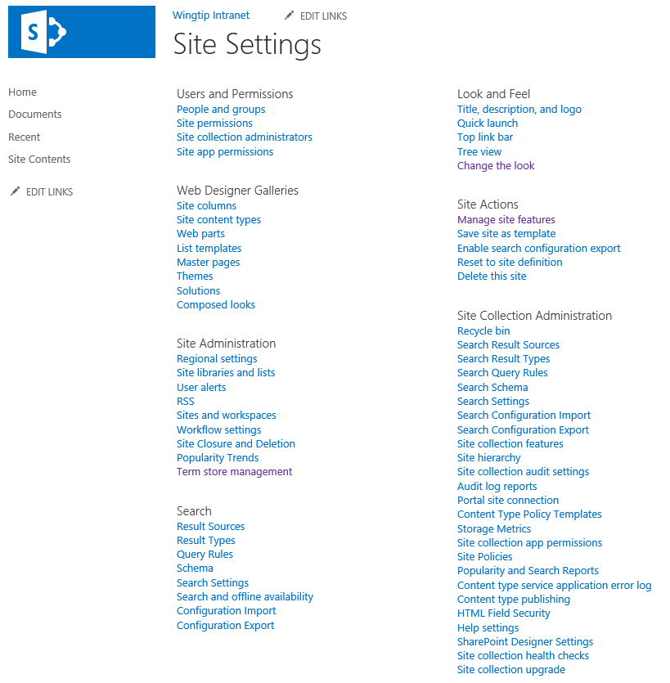
Site Settings
Notes:
Certain users are given the role as “site administrator”. Quite often this means that the user has been assigned the permissions of a site collection administrator. In some scenarios, the IT staff within a company may elect to use a more elaborate security configuration where business users are never configured as site collection administrators, but instead they are assigned less-powerful administrative permissions on one or more sites within a site collection. In either case, these users will be responsible for certain administrative duties at the site level.
Each site contains a site settings page ([site_url]_layouts/settings.aspx) which provides links to administrative pages which make it possible to perform common administrative tasks at the site level. The site settings page of the top-level site also contains links to pages which are used to perform administrative tasks on the site collection as a whole.

Slide 22
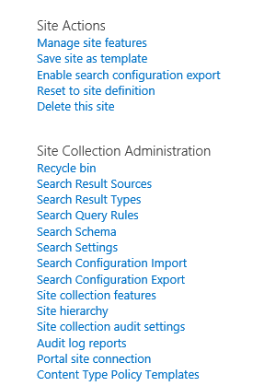
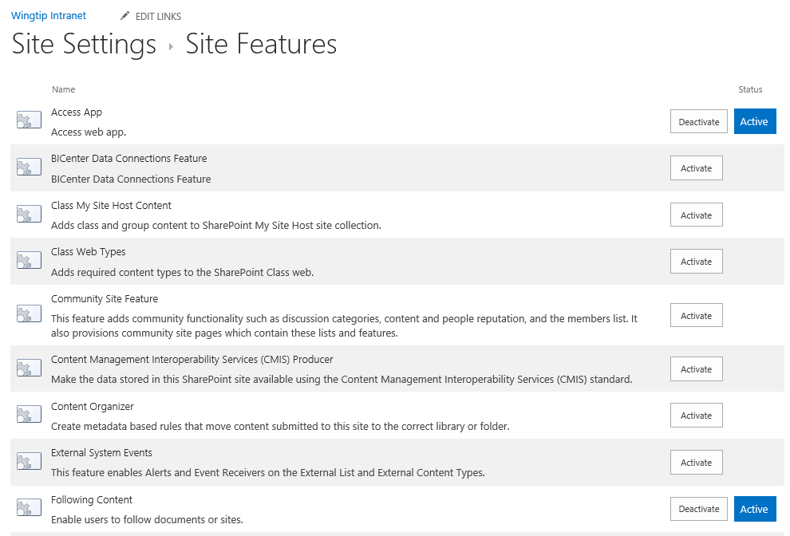
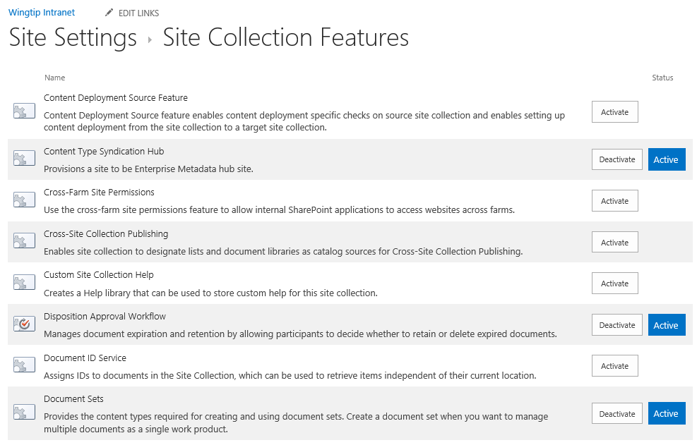
Managing Features
Site collection administrator can activate features
Some features activate at site (aka web) level
Other features activate at site collection level
Notes:
SharePoint adds functionality to sites through “Features”. If a desired behavior is not present you can Activate the associated feature and add that feature to your site. Features are scoped to the Site or Site Collection and may also have dependencies that must also be activated.

Slide 23
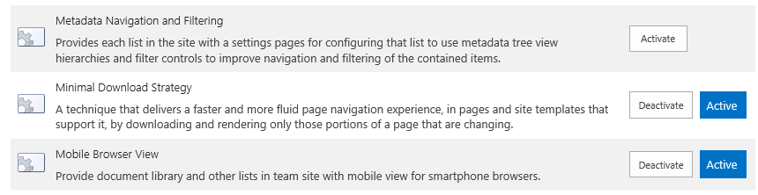
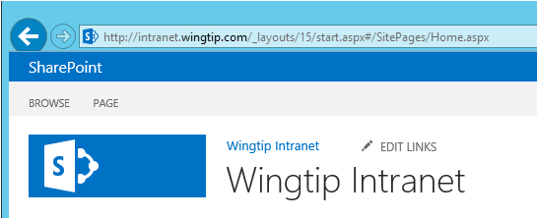
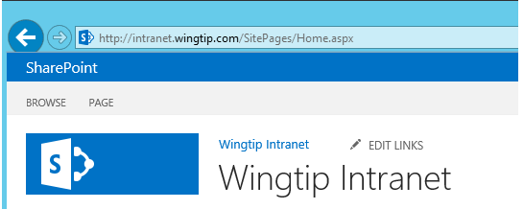
Minimal Download Strategy (MDS) Feature
MDS features used to smooth page transitions
Implemented with site-scoped feature that's
MDS features is activated in Team Site by default
Feature can be deactivated if change to URLs is undesirable
URL structure to site page with MDS feature activated
URL structure to site page with MDS feature deactivated
Notes:
The new feature Minimal Download Strategy uses an optimization that only sends the part of the page that has changed from view to view. This optimization does cause the URLs to get “funny looking” if you deactivate the MDS feature it will result in longer page load times and more predictable URLs.

Slide 24
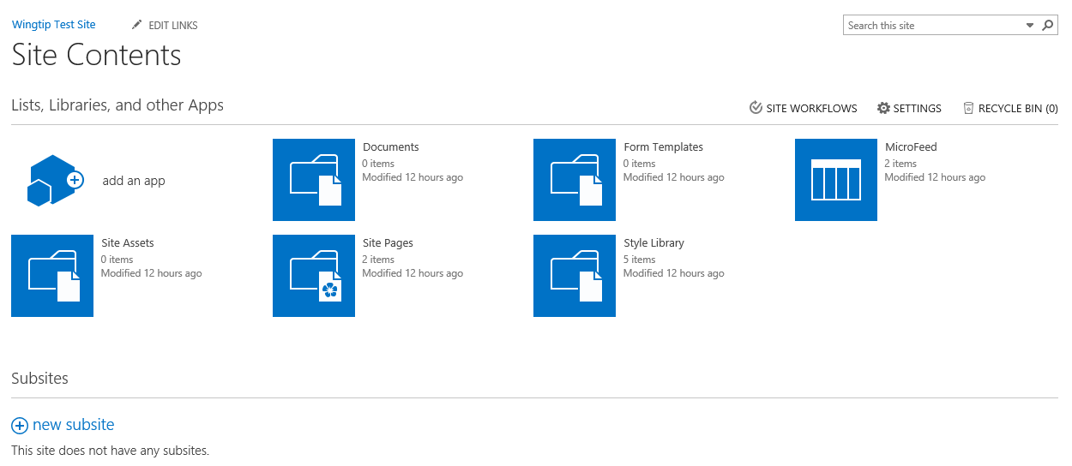
Site Contents
Site Contents page shows…
Lists in current site
Document libraries in current site
Apps available in current site
Add an app icon
Notes:
The Site Contents page shows the Apps (aka, lists and libraries) for the current site and a list of sub sites. From this page you can navigate to lists or directly to their settings and permissions pages.

Slide 25
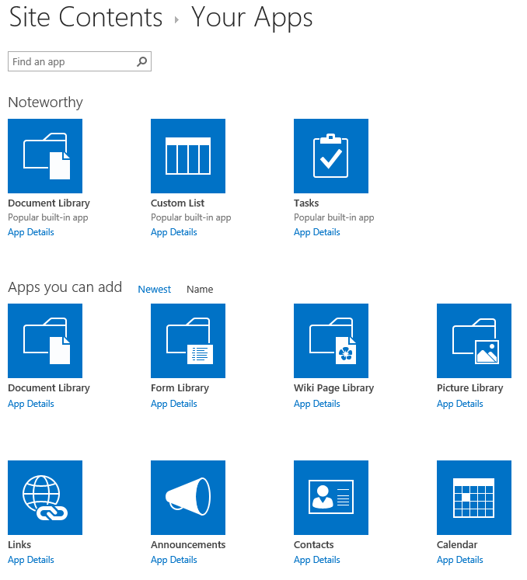
Your Apps
Steps to create a new list
Go to the Your Apps page
Click on desired list type
Provide title for new list
Configure list as required
Begin using list
Notes:
Creating a list or library (App) involves the following steps:
Navigate to the Site Contents page, this displays “Your Apps”.
Choose the list or library (or App).
Provide a name and other optional information,
Configure additional settings after the App is created.
Use the list.

Slide 26
Agenda
SharePoint Online Overview
Office 365 versus SharePoint On-premises
Strategies for Building No Code Solutions
Working with Team Sites in SharePoint Online
Working with Composed Looks

Slide 27
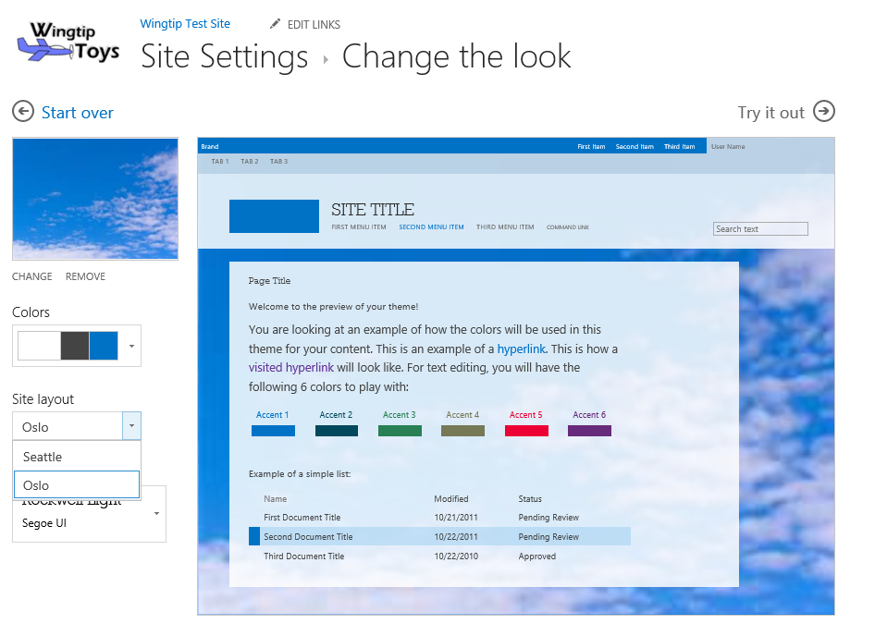
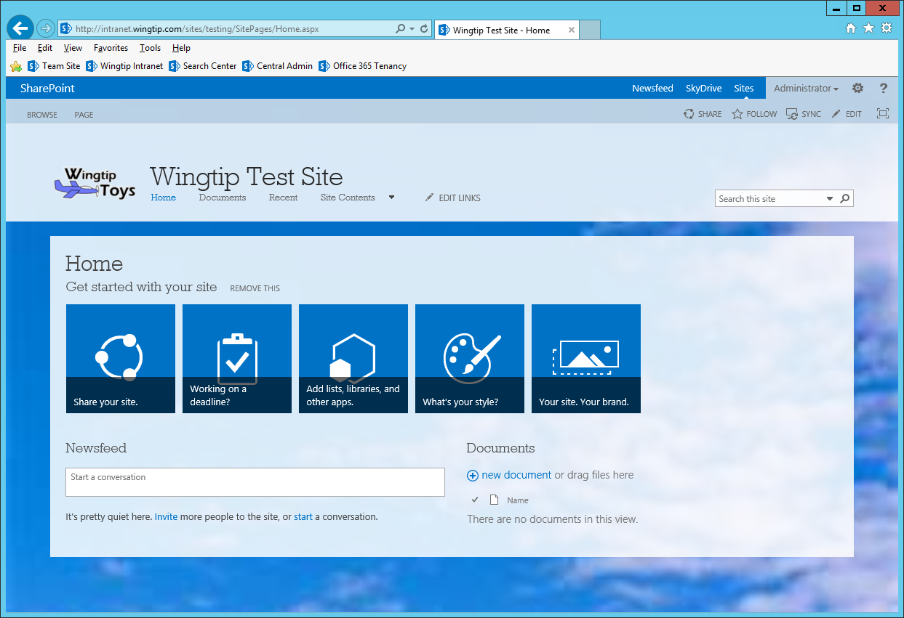
Changing the Look of a Site
Notes:
SharePoint Online introduces a new way to theme sites called Composed looks. These consist of a color pallet and fonts you can use to change the way a site looks.

Slide 28
Customizing the Look and Feel of a Team Site in SharePoint Online

Slide 29
Summary
SharePoint Online Overview
Office 365 versus SharePoint On-premises
Strategies for Building No Code Solutions
Working with Team Sites in SharePoint Online
Working with Composed Looks

