Slide 1
The SharePoint Online Search Service​
Notes:
Previous versions of SharePoint included various search implementations between SharePoint search and FAST search. In SharePoint Online Microsoft merged their search implementations into a single, unified search architecture with a powerful and robust search API that is accessible both in server-side and client-side solutions. In this module students will learn about the search architecture as well as how to leverage it in custom solutions.

Slide 2
Agenda
Search Administration
Managed Properties
Query Execution using KQL
Understanding Result Sources
Creating Display Templates and Result Types
Creating Custom Query Rules

Slide 3
Configuring the SharePoint Search Service
Tenant Administration (SSA)
Result Sources
Query Rules
Managed Properties
Site Collection and Site
Result Sources
Result Types
Query Rules
Reassign Managed Properties
Notes:
Search can be configured at the Tenant level for all major areas of Search Configuration. A subset of configuration items are available now in the Site Collection and the Site.

Slide 4
Search Administration
Notes:
Search Administration
Contrast with Site Administration

Slide 5
Agenda
Search Administration
Managed Properties
Query Execution using KQL
Understanding Result Sources
Creating Display Templates and Result Types
Creating Custom Query Rules

Slide 6
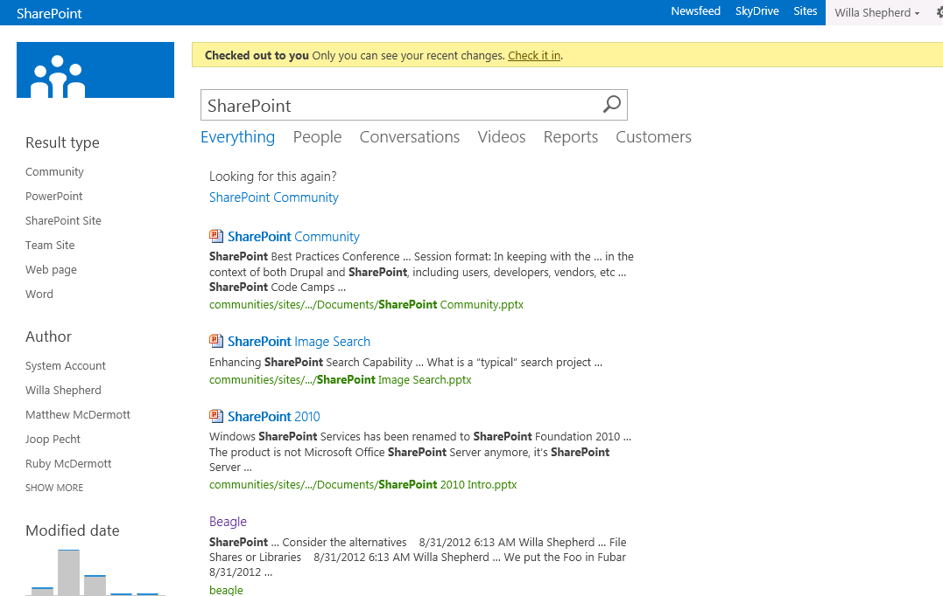
How do Queries get processed?
Index
Result
Types
Display
Templates
?
Query
Rules
Notes:
When an end user executes a query the query is processed and Query Rules are applied. The results are evaluated against Result Type Rules and matched to Display Templates. The final combination of Results are presented in the Search Results.

Slide 7
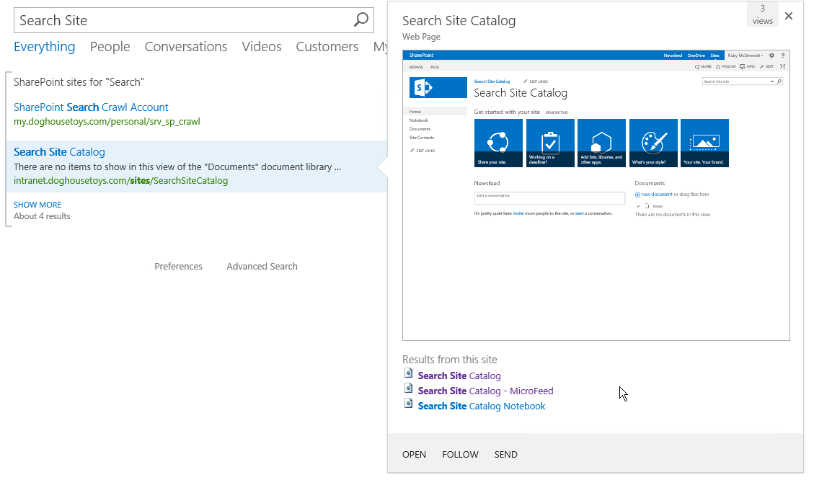
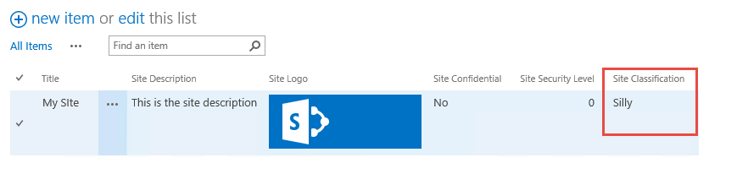
Why Managed Properties?
SiteConfidential:0
Classification: Silly

Slide 8
Automatic Managed Properties
Site column type | Site column name | Crawled property name | Managed property name
Single line of text | ProductName | ows_q_TEXT_ProductName | ProductNameOWSTEXT
Multiple lines of text | ProductDesc | ows_r_MTXT_ProductDesc | ProductDescOWSMTXT
Choice | ProductColor | ows_q_CHCS_ProductColor | ProductColorOWSCHCS
Choice (allow multiple) | ProductColor | ows_q_CHCM_ProductColor | ProductColorOWSCHCM
Number | ProductCost | ows_q_NMBR_ProductCost | ProductCostOWSNMBR

Slide 9
Managed Properties and Problem Solving
Create a List of Customers
Create a Text Field for
Customer ID
CustomerID -> ows_CustomerID
CustID -> ows_CustID
Customer ID -> ows_Customer_x0020_ID

Slide 10
Managed Properties
Not only for Administrators anymore
Tenant
Site Collection
Site
Managed Property Controls
Type & Multivalue
Query, Search, Retrieve, Refine, Sort, Safe
Notes:
Managed Properties used to be only available at the Farm level. Now in SharePoint Online site and site collection administrators can manage some settings for search. They can create and assign Managed Properties for creating search solutions for their sites.

Slide 11
Managed Properties
Notes:
Create and Map Managed Properties
Discuss Managed Property Attributes

Slide 12
Agenda
Search Administration
Managed Properties
Query Execution using KQL
Understanding Result Sources
Creating Display Templates and Result Types
Creating Custom Query Rules

Slide 13
Query Language Options
Keyword Query Language (KQL)
Default query language
FAST Query Language (FQL)
Available, though disabled by default
Notes:
SharePoint uses Keyword Query Language for requesting search results. You can also use the predecessor, FAST Query Language if you need to.
More info: http://msdn.microsoft.com/en-us/library/jj163973.aspx

Slide 14
KQL
Free text
SharePoint
Wildcard
Share*
Property
Author:McD*, ContentType:Image
NEAR, ONEAR
SharePoint NEAR Social
Notes:
Keyword Query Language is pretty easy to understand. At it’s core is just a word or phrase that you are looking for, but it can be so much more. You can request a value of a specific property, like author, or content type. You can also use special operators like NEAR and ONEAR to find words in relation to one another.

Slide 15
Search Queries
Notes:
Free text Queries
Managed Property Queries
People Queries (Phonetic Name Search)
MacDermot
Theodore
Kenneth

Slide 16
Agenda
Search Administration
Managed Properties
Query Execution using KQL
Understanding Result Sources
Creating Display Templates and Result Types
Creating Custom Query Rules

Slide 17
Search Result Sources
Think “Scopes”
…then forget everything you know about scopes
Consider them…
…a way to help the user find content
…a way to improve the users query
…a way to discover popular content
…or just call them new and improved scopes!
Notes:
Search Result Sources are “slices” or sub sections of the Index. They are based on rules. One you have crawled content and you decide you need to run a query against a specific kind of content you can create a result source to make that process easier.

Slide 18
Create a Result Source
Notes:
Free text Queries
Managed Property Queries
People Queries (Phonetic Name Search)
MacDermot
Theodore
Kenneth

Slide 19
Result Types
Result Types are Applied with Rules
Result Types Act on Search Results
Result Types are tied to a Display Template
Notes:
Result Types run when results are returned from a Query. The result Type rules run to determine what Display Template should be applied to the results.

Slide 20
Agenda
Search Administration
Managed Properties
Query Execution using KQL
Understanding Result Sources
Creating Display Templates and Result Types
Creating Custom Query Rules

Slide 21
Display Templates
HTML Template for
Search Result
Refiner
Content By Search
Controls
Containers
Etc…
Upload HTML and SharePoint Converts it to *.JS
Use any editor
NotePad++, Dreamweaver…
even SharePoint Designer!
Notes:
Display Templates determine how a specific result should look. Out of the box you get a bunch of templates, and you can easily create more for your specific needs. They consist of a HTML file with specific markup that SharePoint understands. You don’t need SharePoint Designer for this either.

Slide 22
Display Templates and Result Types
Notes:
Create a Display Template for the new Managed Properties
Create a Result Type
Discuss Refiners too.

Slide 23
Agenda
Search Administration
Managed Properties
Query Execution using KQL
Understanding Result Sources
Creating Display Templates and Result Types
Creating Custom Query Rules

Slide 24
Query Rules
Intercept and change a users query
Promote Special Content
Best Bets
Detect the User
Act on user “intent”
Perform another query
Create banner ads
Change the rank of results
So much more…
Notes:
Query Rules allow you to promote content (we used to call these Best Bets), but they do so much more thanks to the powerful rules we can run on the query submitted by the user. For example, you can detect who the user is or what department they are in and use that in your rule to promote content.

Slide 25
Query Rules
Notes:
Query Rules for:
Banner
Experts
My Documents

Slide 26
Summary
Search Administration
Managed Properties
Query Execution using KQL
Understanding Result Sources
Creating Display Templates and Result Types
Creating Custom Query Rules

