Slide 1
Publishing Sites in SharePoint 2013
Notes:
This module introduces the Web Content Management (WCM) architecture of SharePoint 2013 and explains how all the WCM features are made available through the use of publishing sites. You will learn how to create and add pages to a publishing site that uses the new metadata-driven navigation scheme. You will also learn the fundamentals of managing content in a publishing site in terms of content pages, topic pages and page layouts. You will learn how to take advantage of new publishing features in SharePoint 2013 such as using Design Manager to import a new look and feel as well as working with channels, renditions, cross-site publishing and the Content by Search web part.

Slide 2
Agenda
Publishing Sites in SharePoint 2013
Understanding Metadata-driven Navigation
Creating a Custom Brand with Designer Manager
Cross-site Publishing using a Product Catalog

Slide 3
Overview of WCM in SharePoint
SharePoint WCM based on Publishing sites
Site collection requires publishing site as top-level site
Created using site template named Publishing Portal
Publishing sites used for public Internet Websites
Infrastructure for collecting and publishing content
Includes built-in content approval process
Includes built-in support for branding
Notes:
The functionality for Web Content Management (WCM) in SharePoint 2013 based on Publishing sites. Using this functionality involves creating a new site collection and using the Publishing Portal site template to create the top-level site.
The functionality and appearance of a publishing site was created to support publically facing sites on the Internet. Publishing sites provide an infrastructure for collecting and publishing content, including a built-in content approval process and built-in support for branding.

Slide 4
Publishing Site Hierarchy in SharePoint 2010
A structured hierarchy of sites and pages
\ (root site)
\Pages
\default.aspx
\contact.aspx
\about.aspx
\Locations (child site)
\Pages
\default.aspx
\tampa.aspx
\jacksonville.aspx
http://www.wingtiptoys.com/Pages/default.aspx
Top-site home page
http://www.wingtiptoys.com/Pages/contact.aspx
Top-site secondary page
\Products (child site)
requests
\Pages
\default.aspx
\trainst.aspx
\planes.aspx
http://www.wingtiptoys.com/Locations/Pages/Tampa.aspx
Locations site secondary page
http://www.wingtiptoys.com/Products/Pages/defaulkt.aspx
Products site home page
\Trains (child site)
http://www.wingtiptoys.com/Products/Trains/Pages/train1.aspx
Products child site secondary page
\Pages
\default.aspx
\train1.aspx
\train2.aspx
\Planes (child site)
\Pages
\default.aspx
\plane1.aspx
\plane2.aspx
Notes:
When you design the hierarchy of sites and pages, you are also committing to the structure which determines the URL for each page. The slide above shows a hierarchy of sites where different types of products have been factored out into their own child sites such as Trains and Planes. This adds the product category into the URL of each product page and provides a better way to take advantage of the out-of-the-box support for navigation.

Slide 5
Adding Sites
You construct site hierarchy by adding child sites
Each site gets a landing page (/Pages/default.aspx)
Secondary publishing pages added to site as needed
Child publishing sites added to each site as needed
Publishing pages can be structured into folders
Allows you to scale to 1000s of pages per site
Some OOB functionality only available to pages at root
Notes:
When it is time to design the content for a new publishing site collection, you construct the site hierarchy by adding child sites. Each site that is added gets a landing page inside the Pages document library named default.aspx. By default, this landing page is configured as the home page for the new child site. Once you have created a new site, you then add extra publishing pages as needed.
Starting with SharePoint 2010, publishing sites support adding new publishing pages to folders created inside the Pages document library. By using folders efficiently, you can scale a single publishing site to contain hundreds or even thousands of pages. However, it should be noted that some of the stock functionality such a having SharePoint 2013 automatically provide navigational menus to publishing pages is only available to publishing pages at the root of the Pages document library.

Slide 6
Adding Publishing Pages to a Publishing Site

Slide 7
Page Layouts
Page layouts are publishing page templates
They extend template layout of an existing master page
They define constrains for content to be added & edited
They define layout for editing mode and display mode
v4.master
Products.aspx
Product Name
Product Description
Product Picture
Product Discounts
Notes:
Page layouts serve as a second layering of templates for publishing pages. That's because they extend template layout of an existing master page.
A page layout is based on a content type that defines the constrains for any content which is added and edited by content authors. The page layout itself defines a user interface with a layout for editing mode and for display mode.

Slide 8
Page Layouts and Content Types
Each page layout is based on a content type
Content type defines collection of site columns
Page layout has field control bound to each site column
Page layout may optionally include Web Part zone(s)
ProductLayout.aspx
Field control 1
Field control 2
Field control 3
Product Page content type
Field Control 4
Site Columns (aka Fields collection)
Site Column 1
Site Column 2
Site Column 3
Site Column 4
Web Part zone
Notes:
Each page layout is based on an associated content type. Whenever you create or upload a page layout, you must assign a content type to it at that point.
A content type defines the schema for form data using a collection of site columns. At a high level, the architecture for a page layout has field control that is bound to each site column in the underlying content type.
In addition to field controls, a page layout may optionally include Web Part zones. This provides flexibility as a content author has much more freedom to add all kinds of Web Parts and to customize them as desired.

Slide 9
Content Type Can Have Many Page Layouts
Multiple page layouts can use same content type
Provides alternative ways to layout the same content
Product Page content type
Site Columns (aka Fields collection)
Site Column 1
Site Column 2
Site Column 3
Site Column 4
ProductLayout1.aspx
ProductLayout2.aspx
ProductLayout3.aspx
Field control 1
Field control 1
Field control 1
Field control 2
Field control 3
Field control 3
Field control 2
Field control 2
Field Control 4
Field Control 4
Field control 3
Field Control 4
Notes:
Note that more than one page layouts can be associated with a single content type. This possibility makes it possible to show the same content in different ways.
For example, a content author can create a publishing page based on one page layout and then switch to another. As long as both page layouts are based on the same content type or the same set of columns, the displays the exact same information, just in different ways.

Slide 10
Where do Pages Layouts Live?
Page Layouts deployed to Master Page Gallery
Page layout can be used in current site
Page layout can be used in all descendant sites
Page layout in top site usable throughout site collection
Notes:
Page Layouts must be deployed to the Master Page Gallery. Once a page layout has been deployed to the Master Page Gallery of a specific site, it can be used in current site as well as in all descendant sites. A page layout that has been deployed in the top level site can be used in all sites throughout the current site collection.

Slide 11
Associated Content Types
Publishing page content types inherit from Page
Welcome Page and Article Page provides out of box
Custom content types should inherit from Page as well
Item
Document
System Page
Page
Welcome Page
Article Page
Landing Page
Custom Content Types
Product Page
Notes:
The content types associated with page layouts must inherit either directly or indirectly from a special content type named Page. As discussed earlier this lecture, the Page content type includes the following standard site columns which are automatically inherited by all Page-derived content types.
Article Date
Contact
Contact E-Mail Address
Contact Name
Contact Picture
Scheduling End Date
Scheduling Start Date
Target Audiences
There are content types provided out-of-the-box such as Welcome Page and Article Page that demonstrate inheriting from the Page content type. Any custom content types you create for a page layout should inherit from the Page content type as well.

Slide 12
Steps to Create a New Page Layout
Create site columns
Create content type
Add created site columns to content type
In the Master Page Gallery
Create new Page Layout file
Check-out file and edit in SharePoint Designer
Populate the file with content fields
Check-in and approve
Use the new page layout file
Notes:
Once you have created the required Page-derived content type, you can then create the page layout itself using SharePoint Designer. SharePoint Designer provides a very friendly environment for creating a page layout because you can drag and drop the site columns from the associated content type to easily create bound field controls.
Here are the steps you will go through in the lab
Create the extra site columns required for tracking content
Create the Page-derived content type
Add any required site columns to the Page-derived content type
Create a new page layout file in the master page gallery of target site
Check-out file and edit in SharePoint Designer
Populate the page layout with field controls associated with specific site columns
Check in the page layout and approve it
Configure publishing pages to use the new page layout

Slide 13
Creating Page Layouts and Associated Content Types

Slide 14
Agenda
Publishing Sites in SharePoint 2013
Understanding Metadata-driven Navigation
Creating a Custom Brand with Designer Manager
Cross-site Publishing using a Product Catalog

Slide 15
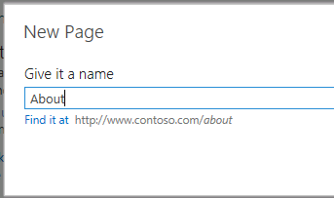
Site Navigation & Topic Pages
Navigation based on taxonomy
Enables clean URLs
Enables multilingual URLs
Allows for easy reorganization of content by modifying the term set
Automatic generation of term-driven page
“Home page” for a term » contains search results for a term
Template can be customized by designers & developers
Notes:
The new navigation structure in SharePoint 2013 will use taxonomy to generate the URLs and paths to content. Even when creating new content, SharePoint will automatically add a new term to the taxonomy that maps to this new page.
When navigating to a term that points to a rollup page, SharePoint will automatically generate a Page Layout (.ASPX) that will be used to display the contents. Developers and designers are free to update this template to use specific display templates used within the content by a search web part.

Slide 16
Configuring Managed Navigation

Slide 17
Agenda
Publishing Sites in SharePoint 2013
Understanding Metadata-driven Navigation
Creating a Custom Brand with Designer Manager
Cross-site Publishing using a Product Catalog

Slide 18
Implementing Custom Branding
Empowering Web Designers
Completely revamped CSS classes
Minimizing ramp up time
Develop SharePoint 2013 sites in any Web design tool
Expression Web, Adobe Dreamweaver, Notepad, etc…
New “Design Manager” tool makes it easier to implement custom branded sites
Notes:
Branding WCM sites is now much easier in SharePoint 2013 with the Design Manager. SharePoint allows developers and designers to copy non-SharePoint specific design assets and upload them to SharePoint. Then, with a behind-the-scenes automatic creation of SharePoint specific assets (*.MASTER & *.ASPX), designers can work with the HTML files in any tool they are comfortable with, getting a real design-time preview of the pages they are working within.

Slide 19
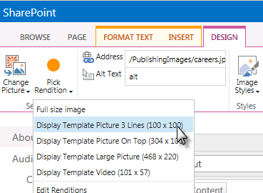
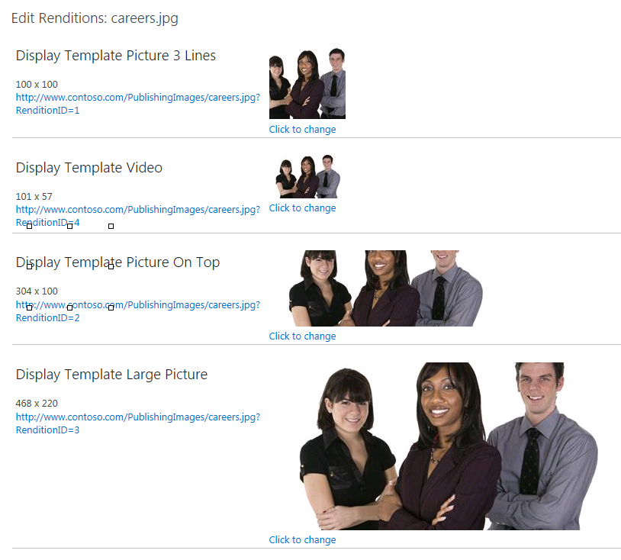
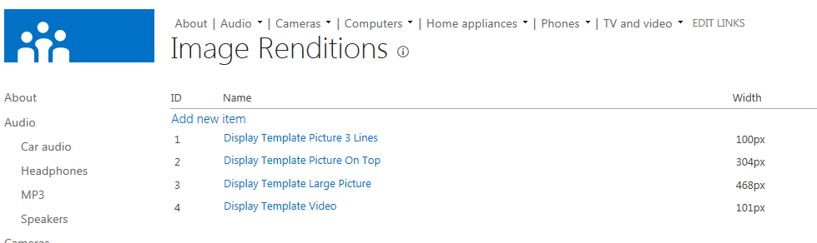
Image Renditions
Image transformation on demand
Thumbnails are actual thumbnails
Consistency sized images
Cropping for targetting areas of pictures
Notes:
Many times the same image needs to be used across a site in standard formats. What SharePoint now offers is something called Image Renditions. Site owners can create multiple renditions of an image and when content owners want to use an image on a page, they select the image and then the rendition they want. SharePoint then, when first requested, generates the image according to the rendition and saves it to the WFE disk for future requests.

Slide 20
Working with Design Manager

Slide 21
Agenda
Publishing Sites in SharePoint 2013
Understanding Metadata-driven Navigation
Creating a Custom Brand with Designer Manager
Cross-site Publishing using a Product Catalog

Slide 22


SharePoint 2013 Content Model
Shared Metadata
Topic / Catalog Page
Catalog Item Page
Authored Content
Indexed Content
Federated Content
Item Catalog
Item Catalog
Reusable Content
External Content
Notes:
The new content model for SharePoint 2013 sites is centered on two main components: the search index and shared metadata. The metadata, facilitated by Managed Metadata taxonomies, drives the navigation and ability to find content both in the index as well as traditionally authored content. The search index consists of content coming from content catalogs and other sources configured using the search management tools. SharePoint automatically generates rollup pages for each term in the taxonomy which lead to detail pages. Each of these pages is a template which can be customized by developers.

Slide 23
Content by Search Web Part
Similar to Content by Query Web Part
Exposes results as JSON on page
Customize search results rending
Easier to customize than CBQ styles
Client-side solution using returned results as JSON
Server side via custom Display Templates
Content is only editable at the source, not in different presentations (presentation = search results)
Notes:
Previous version of SharePoint WCM sites included a powerful web part used for content aggregation and rollup: Content by Query Web Part (CBQ). New in SharePoint 2013 is the Content by Search Web Part (CBS).
The CBS, when placed on a page, allows developers and designers to pull content directly from the search index. The query can be designed to pull content based on values on the page or within the URL, such as terms in a term site. The results are then written to the page in JSON format and a display template is used to render the content in HTML.
When search engines hit the page, SharePoint detects this is not a regular user and instead renders the HTML server side so the engine does not parse through the JSON, rather it parses the standard HTML page. There is also a property on the CBS Web Part that allows developers to force server-side rendering if they choose, as in the case for accessibility reasons.

Slide 24
Summary
Publishing Sites in SharePoint 2013
Understanding Metadata-driven Navigation
Creating a Custom Brand with Designer Manager
Cross-site Publishing using a Product Catalog

