Slide 1
Working with User Profiles and MySites
Notes:
This module introduces the social networking features in SharePoint 2013 and explains how these features are built on top of the User Profile Service. You will learn how to extend user profiles by adding custom properties. You will also see how custom properties can be used to configure the audience targeting feature to personalize page views. The module also takes an in-depth look at the new structure of the MySite in SharePoint 2013 and explains how to use new social networking features for sharing documents as well as following the activities of people, sites, documents and conversations.

Slide 2
Agenda
Understanding the User Profile Service
Working with MySites
Sharing Documents and Content
Following People, Sites and Documents
Using the User Profile Service in Solutions

Slide 3
The User Profile Service
User Profile Data
User Profile Synchronization
Active Directory
Third Party Stores for augmentation via BCS
Audiences
Based on User Attributes
Based on User Profile Properties
Supports MySite Data
Social Tags
Followers and Following
Social Feeds
Notes:
The User Profile Service is a collection of user based features that gather user information from Active Directory and store it in a SharePoint Profile Database. The data is used throughout SharePoint. Users can optionally add additional data to their profile. This data in the profile is used by Search and Audiences. The User Profile also stores lists of Follows and Followers.

Slide 4
Working with MySites
My Site Host (http://my)
Profile
Newsfeed Social Views
Personal Site (http://my/personal/kens)
Personal Content and Apps
Manage Following
Task Management
MySite links are everywhere
About Me
People search results
Anywhere you see a person’s presence
Notes:
When working with My Sites there are two parts to be aware of, the My Site Host and the Personal Site. The Personal Site is created for the users and is “owned” by the user. Their personal content, lists and libraries are stored there. Hidden lists also track Social Data and Tasks. The My Site Host is read only and presents the Profile Page. The profile page is what other people see initially when they visit other user’s My Site.

Slide 5
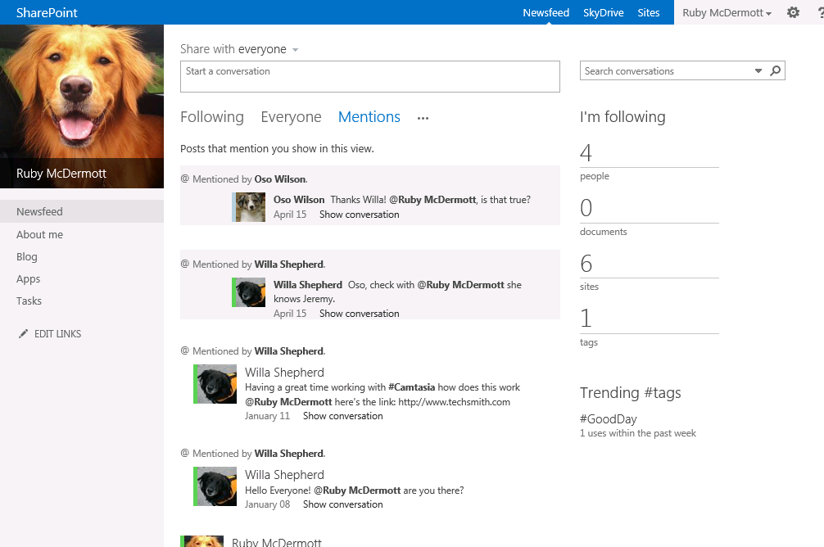
The Newsfeed
Notes:
This is a view of the Newsfeed on the My Site Host. On this page users can view threaded conversations for the whole company or just the people they follow. They also have links to the content (Sites, Documents, People and Tags) that they follow. If they are @Mentioned in a conversation that will show up here as well.

Slide 6
A tour of the new MySite

Slide 7
Task Management
Consolidate Tasks
SharePoint Tasks
Exchange Tasks (requires Exchange 2013)
Project Server 2013
Notes:
The Task page shows a consolidated view of tasks from SharePoint, Exchange 2013 and Project Server sites. The idea is to create a single dashboard for all tasks the user is responsible for. They can interact with the tasks and the updates will be pushed back to the source system.

Slide 8
Task Management

Slide 9
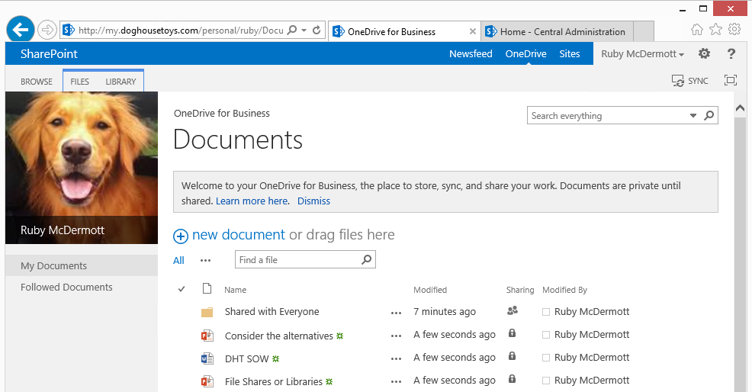
Sharing Documents and Content
OneDrive for Business
Content on Users Personal Site
Synchronized to local My Documents folder
NOT related to onedrive.com
Notes:
OneDrive for Business is a synchronization agent that keeps the files in SharePoint in sync with a folder on the users computer. The synchronization runs in the background so no matter if the file is added through the web or to the local folder the files are kept synchronized.

Slide 10
OneDrive for Business

Slide 11
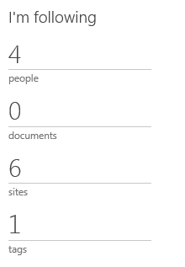
Following People, Sites and Documents
Following Content new in SharePoint 2013
Sites
Documents
People
Tags
Updates in your Newsfeed
Followed Sites
Followed Documents
Followed Tags
People I’m Following/My Followers
Notes:
SharePoint allows you to keep track of changes and be notified through your newsfeed when items you follow are updated. You can follow People (this used to be called Colleagues), Documents, Sites and Tags. The My Site has links t the items you follow making it very easy to find the content that you are interested in.

Slide 12
Following Content
On Sites
Documents
Profile
Tag Profile
In Search Results
Sites
People
Documents
Notes:
Each item has a link associated with it to help you manage your following. For example on Sites there is a link to follow the site, but the search results page also includes links to follow right in the search result.

Slide 13

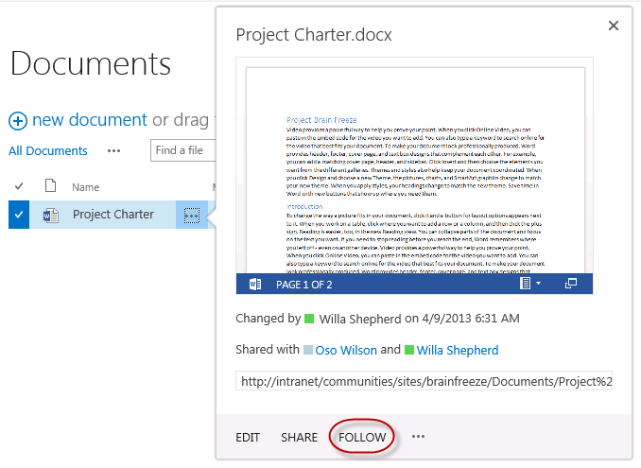
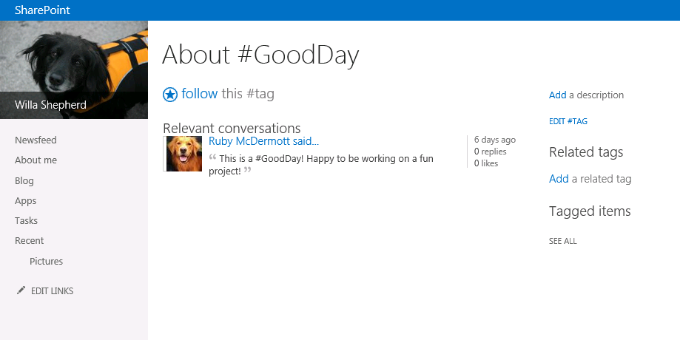
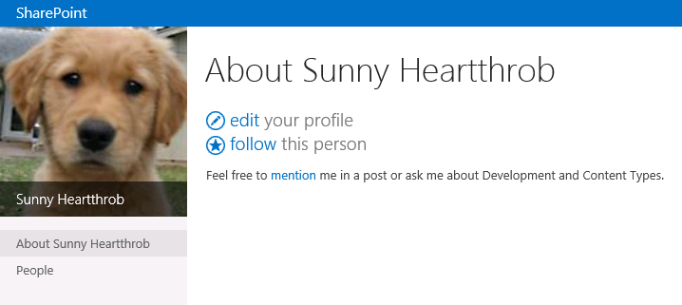
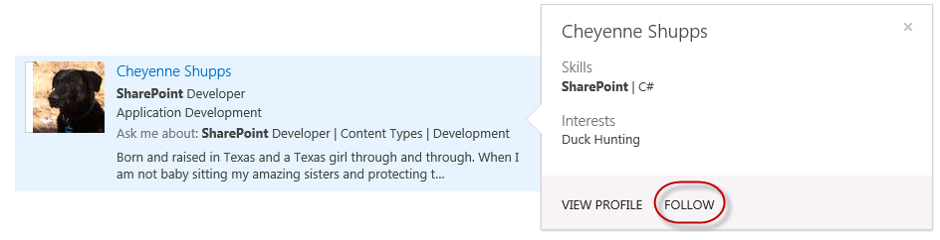
Following Content
On Sites
On Documents and in Search
Profile
People Search
Tag Profile

Slide 14
Following Content

Slide 15
Using the User Profile Service in Solutions
The User Profile can be used in Solutions
Several APIs available
Server Side – C#
CSOM – C#
JSOM – JavaScript
REST – You get to chose!
New Workflow Dictionary Entity
Notes:
When interacting with the User Profile there are several approaches you can take, unfortunately most involve some kind of code. When working in Workflow there is a new Dictionary Entity Activity that makes interacting with User Profiles possible, though not very easy or intuitive.

Slide 16
REST Services
REST is a Protocol
REST Serves data from SharePoint 2013
User Profile
Social
REST Uses URLs
http://<site>/_api/social.feed/my/Feed/Post
http://<site>/_api/social.feed/post/Reply
http://<siteUri>/_api/SP.UserProfiles.PeopleManager
http://<siteUri>/_api/SP.UserProfiles.PeopleManager/GetUserProfilePropertyFor(accountName=@v,propertyName='PreferredName')?@v='domain\user'
Notes:
The User Profile Service introduces a new REST endpoint for solution development. The request for resources takes the form of a URL and can be passed in JavaScript or as part of a request from Workflow.

Slide 17
What you can do…
Get Profiles and Properties
Get Feeds and Replies*
Update the Current Users Picture
Create posts for the Current User
* (some assembly required)
Notes:
With the SharePoint User Profile REST services you can get User Profile Properties and Feeds. You can also update the Users Photo and Create Posts.

Slide 18
What you cannot do…
Find out if an account exists
Create a User Profile
Change a User Profile*
Delete a User Profile
Create posts for another user
Notes:
You cannot create new user profiles or make any changes to the user profile data (aside from the photo). You cannot delete User Profiles or create posts on behalf of another user (no impersonation).

Slide 19
User Profile Service API

Slide 20
Summary
Understanding the User Profile Service
Working with MySites
Sharing Documents and Content
Following People, Sites and Documents
Using the User Profile Service in Solutions

