Slide 1
Introduction to the Power BI Platform
Notes:
This module introduces the basic terminology and Business Intelligence features supported by Office 365 and the Power BI platform. Students will learn about the enhanced BI features offered by the Power BI service and the self-service BI tools including Power BI Desktop, Power Query, PowerPivot and Data Analysis Expressions (DAX) Language. The module also discusses Microsoft’s strategic vision for BI which includes support for traditional BI as well as new support for the self-service BI model where power users are able to complete BI projects involving data analysis and reporting in a more timely fashion. The module concludes by demonstrating how to get a BI project up and running by creating a Power BI group, a dataset, a report and a dashboard.

Slide 2
Agenda
Introduction to Power BI
Creating a Power BI Test Environment
Importing Datasets
Creating Reports and Dashboards

Slide 3
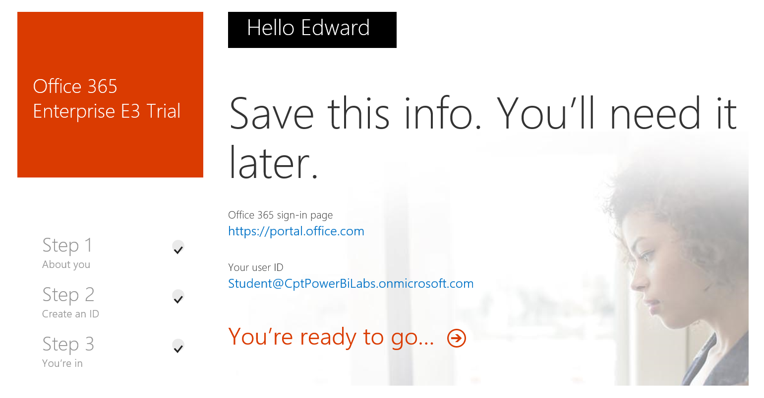

Slide 4
BI Stakeholders
BI Consumer
BI Consumers
General Business Users
Business Decision Makers
BI Producers
Business Analysts
Data Scientists
BI Administrator
Administrators of SQL Server and SharePoint
BI Developers
Technical folks using SQL Server Data Tools
BI Producer
BI Administrator
BI Developer
Notes:
There are several roles that people can play within a BI project within an organization.
BI Consumers are general business users and business decision makers. These are usually the least technical people of the four groups. However, they are often the people who will be making decision and taking actions based on what BI reports and visualizations are telling them.
BI Producers are more technical that BI consumers and often play the role of a business analyst or data scientist. A BI producer is often working for BI consumers to get them the BI insights that are needed. BI Producers need to be experts with self-service BI tools such as Excel 2103, PowerPivot, Power Query and Power View.
BI Administrators work directly with backend software products and services such as SQL Server and SharePoint Server 2013. Their role is to make sure the correct BI functionality as been configured in SharePoint Server 2013 and in SQL Server.
BI Developers are very technical people that work with the SQL Server Data Tools in Visual Studio. They often work with SQL Server in creating and managing OLTP databases and SQL Server Integration Services importing data from external sources into data warehouses. BI developers also often work directly with SQL Server Analysis Services creating multidimensional database with cubes and/or tabular databases.

Slide 5
Traditional BI
Work done in long term projects by BI developers
Requires lengthy requirement gathering phase
Data extracted from different locations
Data is cleaned up and designed in model
BI developers build multidimensional cubes and KPIs
Unexpected blocking problems are common
Users must often wait a year or more to see any results
Notes:
Over the past decade, a traditional BI project has involved a consistent set of factors. First, the work cannot accomplished by standard business users but instead it requires specialized technical professionals known as BI developers. Secondly, projects are never completed quickly. They take months and quite often years to complete. This is frustrating for project owners and other stakeholders who want to see the results of BI project in days or weeks. Furthermore, a significant percentage of BI projects have failed over the last decade providing absolutely nothing in return for all the time and money invested.

Slide 6
Self-service BI (SSBI)
Traditional BI projects typically involve the following…
Integrate data from multiple sources
Perform data transformation and complex calculations
Analyze large data sets with rapid query response
Create insightful reports and visualizations
Self-service BI projects add more dimensions…
BI producers create reports to share with BI consumers
BI consumers quickly analyze data in an agile manne
Notes:
Self-service BI (SSBI) represents a growing trend within the software industry. There are specialty software products and services from software companies such as Tableau, QlikView, TIBCO Spotfire. Many larger venders such as Microsoft, IBM, SAP and Oracle have also begun adding serf-service BI features into their platforms.
The main idea is that self-service BI provides an environment that enable business users to become more self-reliant and less dependent on the IT organization. These facilities easier access to source data for reporting and analysis, easier and improved support for data analysis features as well as simpler, customizable, and collaborative end-user interfaces.

Slide 7
What is Power BI?
Power BI is…
Collection of online services and features
Environment created to promote self-service BI
Based on data discovery, analysis and visualization
Power BI Service Url: https://app.powerbi.com/
An online service which displays workspace
Workspace is where you create dashboards, share reports, and directly connect to

Slide 8
Project Lifecycle in Power BI
Discover and Extract Data
Build Datasets
Create Reports
Consolidate to Dashboards
Share Dashboards

Slide 9
Power BI for Office 365 the first and version that never was
First version
Cloud service for publishing dashboards and reports

Slide 10
Power BI Workspaces
Context in Power BI provided by Workspaces
Personal workspace
Shared Workspaces
What can you do with Personal

Slide 11
Power BI Service
online Software as a Service (SaaS) offering
displays dashboards that are interactive
, and can be created and updated from many different data sources
Central Power BI Concepts

Slide 12
Central Power BI Concepts
Workspace
Provides user context (personal workspaces & group workspaces)
Dashboard
Dashboard is a collection of one or more tiles
Tiles often based on visualization from a report
Tiles provides navigation to report with visualization
Reports
Report is a collection of one or more pages
Page is a collection of one or more visualizations
Datasets
Dataset is a data model with one or more tables

Slide 13
Agenda
Introduction to Power BI
Creating a Power BI Test Environment
Importing Datasets
Creating Reports and Dashboards

Slide 14
Agenda
Introduction to Power BI
Creating a Power BI Test Environment
Importing Datasets
Creating Reports and Dashboards

Slide 15
Agenda
Introduction to Power BI
Creating a Power BI Test Environment
Importing Datasets
Creating Reports and Dashboards

Slide 16
Summary
Introduction to Power BI
Creating a Power BI Test Environment
Importing Datasets
Creating Reports and Dashboards

Slide 17
Types of Dashboards
Personal Dashboards
Shared Dashboards
Shared with other users in same organization
Sharing gives read-only access to dashboard and reports
Other users interact with db and reports in presentation view
Dashboard sharing involves accepting invitation
Dashboard owner can see who has accepted invitation

Slide 18
Power BI Tools
The Browser
Power BI Desktop
dedicated report authoring tool
PowerQuery features for Extract-Transform-Load operations
transform data, create powerful reports and visualizations, and easily publish to the Power BI service. Power BI extends to all your mobile devices, too.
Microsoft Excel 2016
Excel 2010 and Excel 2013 offer some Power BI features

Slide 20
What is Business Intelligence?
BI focuses on business health and performance
Gather insights into health of business processes
Take corrective actions in a timely fashion
BI projects typically involve the following…
Integrate data from multiple sources
Perform data transformation and complex calculations
Analyze large data sets with rapid query response
Create insightful reports and visualizations
Notes:
"Business Intelligence" is a widely used term that can different things to different people. However, BI generally refers to the practice of monitoring business health and performance. BI who perform BI roles in an organization have the job of gathering insights into health of business processes and helping the organization take corrective actions in a timely fashion.
Many BI projects share a common set of chores. There include importing and integrate data from multiple sources and performing data transformation and complex calculations on that data. Once the data has been imported and transformed, there is then the need to analyze large data sets with rapid query response and to create insightful reports and visualizations for business executives and managers.

Slide 21
Agenda
Essential BI Concepts and Terminology
Microsoft Software Involved in BI Solutions
Understanding BI Data Sources
Introduction to the Excel Data Model

Slide 22
BI Features in SQL Server
SQL Server Database Engine
Used to create OLTP systems
Used to create data warehouses for OLAP systems
SQL Server Integration Services (SSIS)
Used to ELT support (Extract, Load, Transform)\
SQL Server Analysis Services (SSAS)
Used to build multidimensional cubes
Used to build tabular models (new with SQL Server 2012)
SQL Server Reporting Services (SSRS)
Used to write/deploy reports for viewing and printing
Notes:
The SQL Server family of products and services make up a big part of Microsoft's BI strategy.
First, there is the SQL Server Database Engine which is most often used to create OLTP systems. However, the SQL Server Database Engine can also be used to create a data warehouse to provide the foundation for a large-scale BI project.
SQL Server Integration Services (SSIS) provides BI developers with ELT support with sophisticated tools for extracting data for external systems and loading it into a data warehouse while transforming the data into whatever form is required.
SQL Server Analysis Services (SSAS) is a central component for creating OLAP systems and BI systems. When SSAS was first introduced, it allow a developer to design BI systems using multidimensional cubes. Recently, Microsoft enhanced SSAS to supporting building tabular databases and data models which are compatible with Excel 2013.
SQL Server Reporting Services (SSRS) is a reporting component that can be used either with or without its integration to SharePoint 2013. It is used to design and deploy interactive reports for viewing online as well as printing physical reports.

Slide 23
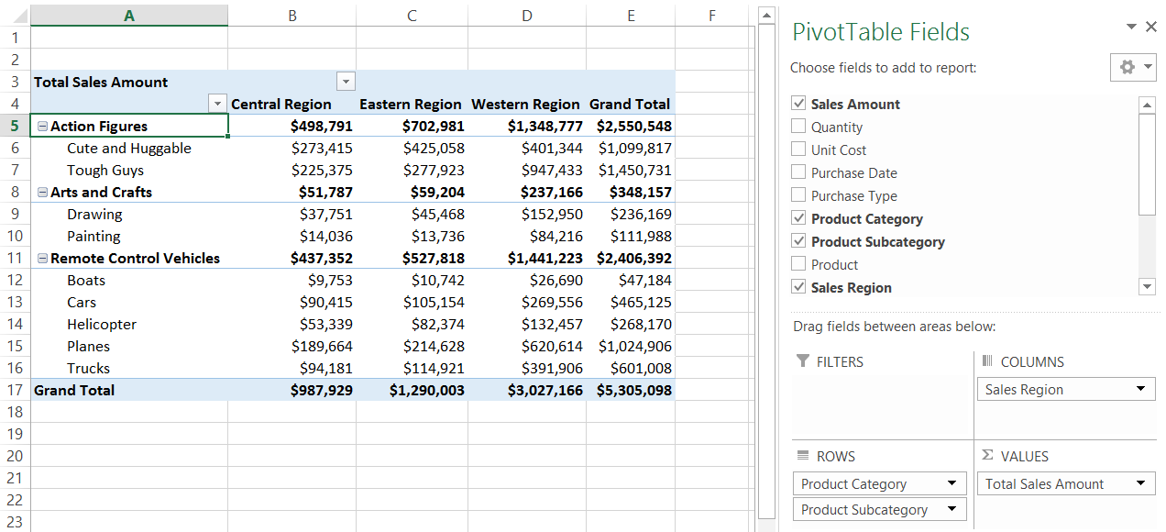
BI Features in Excel before Excel 2013
Excel has traditionally been a BI-centric product
Support for tables, PivotTables and PivotCharts
Powerful language and formulas for cell calculations
Support for connections to databases and OLAP cubes
Notes:
Microsoft Excel has been heavily used for the last two decades as a tool for analyzing business data. Traditionally, Excel has supported data analysis using tables, PivotTables and PivotCharts. Excel also provides a powerful language and formulas for cell calculations. The data analysis support in Excel has also been enhanced by its ability to establish data connections to databases and OLAP cubes.

Slide 24
Creating PivotTables and PivotCharts in Excel 2013

Slide 25
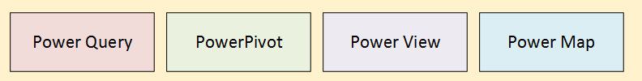
New BI Features in Excel 2013
New BI features added to Excel 2013
Every Excel workbook now supports Data Model
Excel 2013 provides 4 add-ins for self-service BI
Excel Workbook
worksheet
Data Model
worksheet
worksheet
Notes:
While early versions of Excel provide valuable BI support, the new BI features added to Excel 2013 add a significant number of new features that are really changing the way that Excel is being used as a BI tool. First, every Excel workbook now supports a Data Model which acts as an OLAP database embedded inside the Excel .xlsx file format. Also, Microsoft has created several important add-ins for working with the Data Model including PowerPivot, Power View and Power Query.

Slide 26
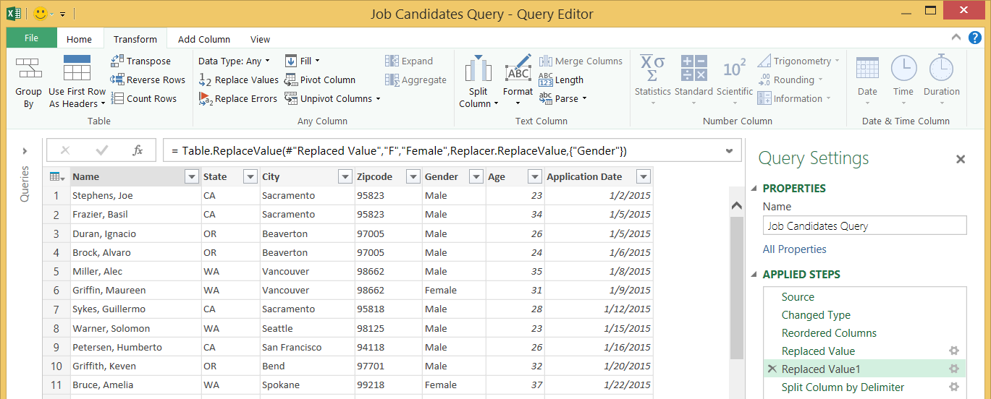
The Power Query Add-in for Excel 2013
Used to perform ETL operations on data
ETL = Extract, Transform and Load
Queries can be saved inside Excel workbook
Saved query can be run on demand to refresh data
Notes:
Power Query is a SSBI tool for discovering data and extracting it from a wide variety of data sources on a local network or from across the Internet. A key point is that you use Power Query to import data from external source into a worksheet or into the data model of an Excel workbook. Importing data is typically the first step in a BI project because importing data is how you create tables inside the data model.
Power Query supports extracting data directly from common file types such as Excel workbooks, Access databases and CSV files as well as database systems such as SQL Server, Oracle and DB2. It also offers capabilities to extract data from HTML tables in web pages and from public datasets that have been published on the Internet. Power Query provides a valuable productivity layer when it comes to importing data from SharePoint lists. Behind the scenes, Power Query figures out how to extract SharePoint lists by creating OData queries that are executed against the SharePoint REST API.
When extracting data from external data sources, Power Query provides the ability to perform transformation operations to shape the data as it is being loaded into Excel. For example, you can split a column with delimited values into multiple columns. You can combine multiple columns into a single column using string parsing or mathematical operations. You can perform table operations such as merging columns and appending rows from multiple data sources. You can also perform powerful transform operations such as transposing, pivoting and un-pivoting the rows and columns in a source table.
When you work with Power Query, you work with a Query Editor to extract the data and to shape it as you import into Excel. A query in Power Query represents a set of steps (i.e. extract and transform operations) that are applied on data that has been extracted from an external data source. A query is saved inside the Excel workbook and can be executed to import data and then to refresh that data on demand. The screenshot shows an example of working with the Query Editor and demonstrates how this tools allows you to see the data are you are shaping before you import it into the data model.

Slide 27
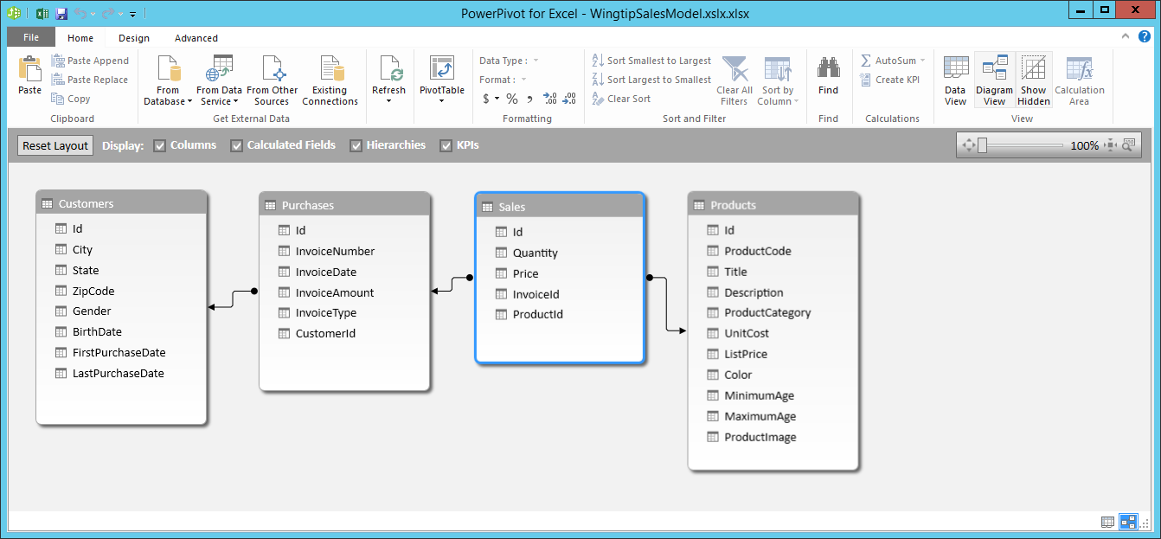
The PowerPivot Add-in for Excel 2013
Adds support for designing data model
Importing data from external sources to create tables
Defining relationships between tables
Creating calculated columns, calculated fields and KPIs
Provides data modeling capabilities to business users
Notes:
The main purpose of using the PowerPivot add-in in Excel 2013 is to create and enhance the data model within a specific Excel workbook. First, PowerPivot makes it possible to import data from a large variety of external sources such as Excel workbooks, Access databases, CSV files and SharePoint lists. Once you have imported data and created tables in the data model, PowerPivot allows you to define relationships between tables and to create BI calculations such calculated columns, calculated fields and Key Performance Indicators (KPIs).
PowerPivot is an add-in that is automatically installed along with Excel 2013. While this add-in is part of Excel 2013, it is not activated by default. Therefore, you must activate it before you can use it.

Slide 28
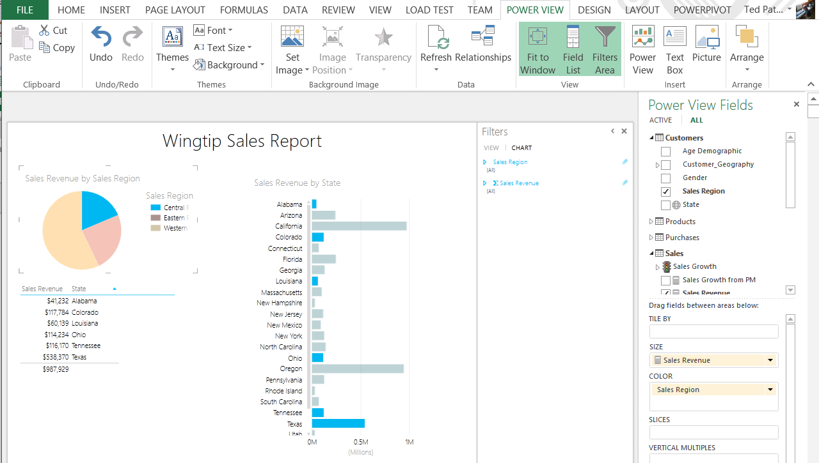
The Power View Add-in in Excel 2013
New visualization tool added to Excel 2013
Power View reports added into Excel workbook like a worksheet
Power View reports built on top of Excel data model
Similar to (but different from) Power View support in SharePoint
Notes:
The Power View add-in for Excel 2013 is a tool that allows business users to create reports and BI visualizations on top of a tabular data model. When you create a new Power View report in Excel 2013, the report is added to the Excel workbook and appears on the bottom tab along with the worksheets. The Power View report designer provides a Fields list in the task pane on the right which is very similar to working with the fields list when working with an Excel PivotTable. You design a Power View report by adding tables and other BI visualizations to a canvas as shown in the screenshot in the slide above.
A potential point of confusion exists because Microsoft has released two different versions of Power View. The one we are discussing here is the Power View add-in that loads into Excel 2013 on the desktop which saves its reports inside an Excel workbook file. The other version of Power View is supported on the server side by SharePoint Server 2010 and SharePoint Server 2013. When using the Power View with SharePoint Server, the business user designing a report uses a browser-based version of Power View to connect to a tabular database. Also, reports created using Power View for SharePoint are saved as standalone files in a SharePoint document library with a file extension of .RDLX. While the two different versions of Power View provide a similar user experience for designing reports, there are some obvious differences because one is a browser-based tool and the other is not.
Power View is an add-in that is automatically installed along with Excel 2013. While this add-in is part of Excel 2013, it is not activated by default. Therefore, you must activate it before you can use it.

Slide 29
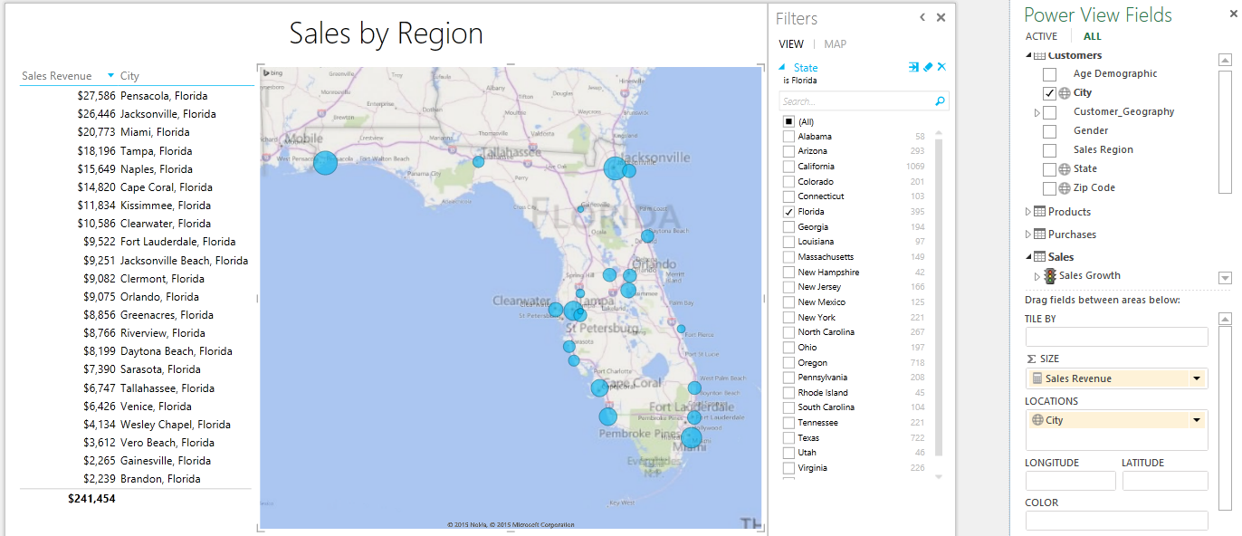
The Power Map Add-in in Excel 2013
Produces visualizations of data across geographic region
Power Map used to create Power View reports
Power Map relies on Bing mapping service in cloud
Power Map translates dimensional data into longitude and latitude
Power Map layers data visualizations on top of a map
Notes:
Power View is complimented by another Excel add-in which known as Power Map. Power Map provides the ability to visualize data spread out across geographic locations when creating a Power View report. For example, imagine you have dimensional customer data such as country, state or zip code that can be translated to a specific point in longitude and latitude. Power Map interacts with the Bing location service behind the scenes to translate dimensional data to geographical coordinates. This allows Power Map to produce reports which visualize how BI data is spread out across a geographic distribution.
It's important to remember that the current version of Power View and Power Map have a dependency on Microsoft Silverlight. That means business users working on a BI project must install Silverlight on their computers before they can begin to design BI reports in Excel 2013 using Power View or Power Map. Moreover, the requirement to install Silverlight also applies to any business user who is just viewing Power View reports using Excel 2013. This also applies to a business user that is viewing a Power View report rendered through the browser by Excel Services in SharePoint Server 2013 in an on-premises environment. Later in this whitepaper, you will hear more about Microsoft's ongoing effort to remove these dependencies from their BI reporting layer.
Power Map is an add-in that is automatically installed along with Excel 2013. While this add-in is part of Excel 2013, it is not activated by default. Therefore, you must activate it before you can use it.

Slide 30
BI Features in SharePoint 2013
BI features and services covered in this course
Excel Services
PowerPivot for SharePoint
Power View Support in SharePoint
PerformancePoint Services
SQL Server Reporting Services (SSRS) Integration
Visio Services
Notes:
SharePoint 2013 provides many BI-centric features and services. Here is a quick overview.
Excel Services allows you to publish Excel workbooks in a SharePoint document libraries which can then be accessed using a common browser.
PowerPivot for SharePoint allows you to publish and interact with an Excel worksheet that contains a data model.
Power View in SharePoint allows you to use a browser to create Power View reports which as stored as RDLX files in SharePoint document library.
PerformancePoint Services is a BI visualization tool to that allows you to create dashboard pages in a SharePoint Business Intelligence Center site.
SQL Server Reporting Services integration allows you to create reports using SSRS tools such as Report Builder which are saved to SharePoint document libraries as RDL files.
Visio Services allows you to create Visio diagrams that can be accessed using the browser. Visio provides a somewhat-limited ability to connect a Visio diagram to external data to provides enhanced visual graphics to a BI dashboard page.

Slide 31
Scopes of BI
Self-service BI (little to no involvement of IT)
Working with PowerPivot for Excel
Working with Power View for Excel
Team BI (IT required to configure Team BI services)
Working with Excel Services
Working with PowerPivot for SharePoint 2013
Working with PowerPivot for SharePoint 2013
Enterprise BI (work done by BI developers)
Working with SQL Server Reporting Services
Building tabular data models with SSAS
Building cubes and KPIs with SSAS

Slide 32
Agenda
Essential BI Concepts and Terminology
Microsoft Software Involved in BI Solutions
Understanding BI Data Sources
Introduction to the Excel Data Model

Slide 33
Where’s the Data?
Data can live in a variety of sources
OLTP Databases
OLAP Databases
LOB Systems
Web services
Spreadmarts
Notes:
As this slide shows, the data you want to analyze can live in many different places and can exist in many different formats. We will explore each of these types of data source in more detail over the next few slides.

Slide 34
OLTP Systems
Online Transaction Processing (OLTP) System
Used for real-time data access and transaction-based data entry
Optimized for faster transactions (e.g. inserts, updates & deletes)
Tables normalized to reduce/eliminate redundancies
OLTP systems do not prioritize keeping historical data
Problems with OLTP System for Business Intelligence
Not built for running complex queries
Fewer indexes and informational queries require more joins
Joins often required when querying data
Reporting can be confusing for business users
Notes:
Online Transaction Processing (OLTP) databases are used for databases that have high transaction rates. The data model of tables in this type of database is optimized to speed up transactions for operation such as inserting, updating and deleting records. Tables in an OLTP database are usually normalized to reduce or eliminate any redundancies.
Another noteworthy issue is that OLTP systems are often not designed to track historical data. For example, imagine a customer living in California makes a number of purchases over a 5 year period and then the customer moves to Florida. If you run a query to determine sales revenue by state, you will likely find that all the historic purchases for the customer are attributed to the new state Florida and not the state where the purchases were made which is California.
In a nutshell, there are several common issues that you deal with when try to build BI projects on top of an OLTP database. First, they are not designed for complex queries so you will have to join more tables together and performance might be poor since it will not have indexes to optimize these queries. Also, the table schema is often more complicated and not intuitive for the average business user.

Slide 35
OLAP Systems
Online Analytical Processing (OLAP) System
Used for analysis and data drilldown on online or historical data
Data in OLAP system is read-only database.
Optimized for performance and details in querying the data.
Relaxes database normalization rules.
Relatively more indexes and fewer joins.
OLAP Systems often built using a Data Warehouse
Data must be gathered from multiple sources
Often this data must be cleaned up, formatted or transformed
Data model is de-normalized resulting in fewer tables
Fewer tables results in fewer joins
Tables are categorized as fact tables and dimension tables
Notes:
OLAP systems are inherently different than OLTP system because they are not designed to support data entry. Instead, OLAP systems are based on the idea of bulk-loading pre-existing data for the sole purpose of data analysis. This means that OLAP systems data drilldown on online or historical data in an environment where the data has been optimized for read-only performance and low-level detail in querying the data.
OLAP Systems in larger projects are often built using a Data Warehouse. However, a simple OLAP system can be created using nothing more than Excel 2013. However, the data must be typically be gathered from multiple sources and this data often requires some type of clean up, formatting or transformation. The data model can be de-normalized resulting in fewer tables and a data model which is much easier to business users to understand.

Slide 36
What is a Spreadmart?
An analysis system running on desktop database
Spreadsheets
Access databases
Created and maintained by an individual or group
What is the work involved with a spreadmart?
Extracting, transforming, and formatting data
Defining metrics for data
Submitting queries
Formatting and publishing reports to others
Notes:
The term "spreadmart" is a general term which usually means that a business user has used desktop tools to build an ad hoc OLAP system. Common tools for building spreadmarts include Microsoft Access and/or Microsoft Excel. However, a key point is that the spreadmart has been created and maintained with little or no assistance from the IT department.
since a spreadmart is an OLAP system, creating one requires the same steps as creating a more sophisticated OLAP system. The creator of a spread mart must often locate and gain access to data that must be extracted, formatted and/or transformed. The spreadmart creator must also define metrics for data being analyzed to create a process for submitting queries and publishing reports to others business users.

Slide 37
Deciding What To Measure
You Must Determine Measurable Objectives
Financial (revenue, expenses, profit margin, etc.)
Business processes efficiency
Customer Satisfaction Levels
Notes:
When you begin to create any type of BI system for monitoring the health and reporting on business processes, it is important to take a step back in the initial design phase and decide what your system is going to measure. This provides an opportunity to define what type of business analysis the results of the BI should provide. For example, one BI system might just need to track sales revenue in order to calculate commission for sales people. Another system with different requirements might need to analyze expenses and profit in addition to sales revenue. Determining high-level goals and capabilities is an important thing to do before getting into the nuts and bolts of beginning to extract and transform data.

Slide 38
Defining Grain Statements
Grain statements should be defined in initial design phase
Grain statements helps determine requirements for BI queries
Grain statements can be created & understood by business users
Example grain statements for BI project at Wingtip Toys
What was the total sales revenue over the last 4 years?
What was the sales revenue by year, quarter and month?
What was the sales revenue by region, state, city and zip code?
What was the sales revenue by category, subcategory and product?
What was the growth in sales revenue from month to month in 2013?
What was profit margin for each product by year, quarter and month?
Have their been any products with significantly decreasing profit margin?
Notes:
A popular technique for establishing the requirements for a BI system is to define a set of grain statements. What's valuable about grain statements is that they can easily be created by business users with little or no technical experience.
It's a good idea to create a set of grain statements when you begin a BI project. From a set of grain statements you can determine what data needs to be imported as well as what queries and reports need to be generated as well.

Slide 39
Agenda
Essential BI Concepts and Terminology
Microsoft Software Involved in BI Solutions
Understanding BI Data Sources
Introduction to the Excel Data Model

Slide 40
Introducing The Excel Data Model
Excel 2013 introduces the data model
Data model stored as OLAP database inside Excel workbook file
Data model is separate from tables created in worksheets
Data model contains tables and table relationships
Tables in data model loaded into memory for query execution
Tables stored in highly-compressed, column-based format
This type of OLAP database known as a "Tabular" database
Excel Workbook
worksheet
Database
worksheet
worksheet
Notes:
A very significant enhancement to the BI support for Excel 2013 is the introduction of the data model. This changes everything about the Excel BI story because you no longer have to rely on tables stored in worksheets.
The data model is a separate OLAP database that is separate from anything stored in a worksheet such as a classic Excel table. The data model contains two primary things: tables and table relationships. Data which has been imported into tables inside the data model is stored in a highly-compressed, column-based format which is often referred to as the "tabular format" or a "'tabular database". A key factor of this tabular data model is that it can accommodate data sets that have tens of millions (10,000,000) of rows.
All the data contained within the data model is stored in the Excel workbook file and is loaded into memory the first time the data model is used. It is important to note that query execution only works with data which has been loaded into memory. Therefore, the query engine never needs to read anything from persistent storage such as a hard drive which would slow performance.
Microsoft implementation of the tabular data model in Excel is based on a query execution engine known as the xVelocity engine. You might also hear some people refer to the tabular database engine as "Vertipaq". That's because Vertipaq is the name of the company that Microsoft acquired to obtain the code base which implements the tabular database model.

Slide 41
PowerPivot Versions
Using PowerPivot Add-in with Excel 2010
PowerPivot add-in is separate download
Add-in must be downloaded, installed and activated
Excel 2010 supports Data Model only if add-in is active
Using PowerPivot Add-in with Excel 2013
PowerPivot add-in included out-of-box with Excel 2013
Add-in is already installed, but it still must be activated
Excel 2013 supports Data Model with or without add-in
Notes:
A previous version of PowerPivot is available as an add-in with Excel 2010. However, it is not included with the product as it is with Excel 2013. Therefore, the Excel 2010 version of PowerPivot must be separately downloaded and installed. Note that Excel 2010 does not natively support the data model so Excel 2010 users cannot open workbooks created using PowerPivot unless they have the add-in installed.
Management of the PowerPivot Add-in is much easier with Excel 2013. That's because the PowerPivot add-in in installed by default but it is not activated. If you are a BI producer, you can activate the PowerPivot add-in and begin to create Excel workbooks with data models. Any user with Excel 2013 will be able to open a workbook with a data model whether the PowerPivot add-in is activated or not. In general, BI producers will activate the PowerPivot add-in and BI consumers and less technical business users will not.

Slide 42
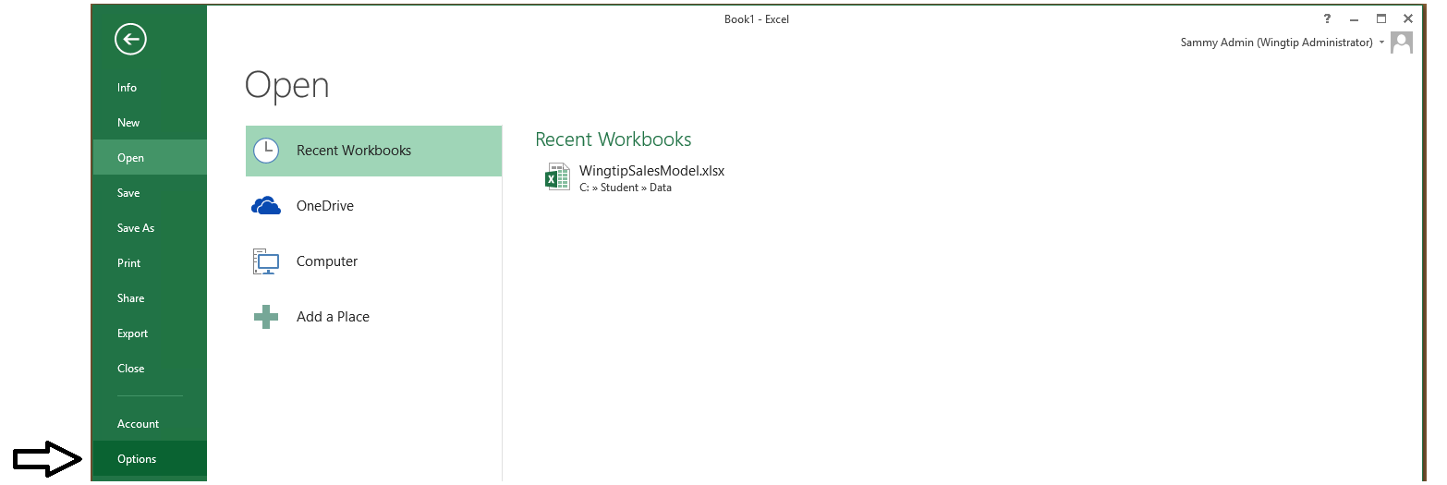
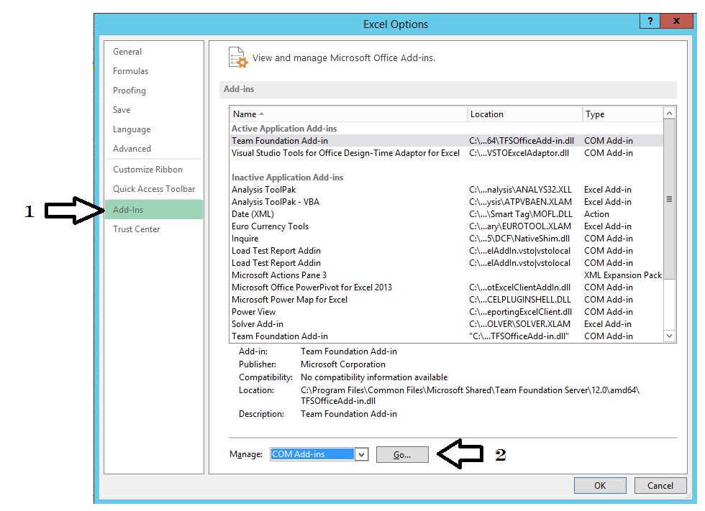
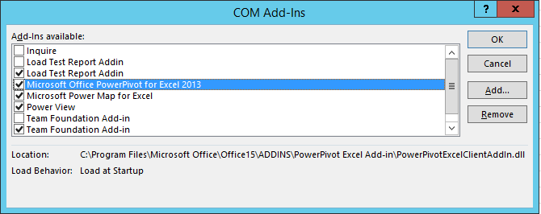
Enabling the Excel PowerPivot Add-In
1
2
4
3
Notes:
The sequence on this slide shows the steps involved in activating the PowerPivot add-in when using Excel 2013.

Slide 43
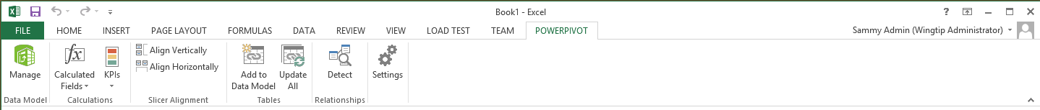
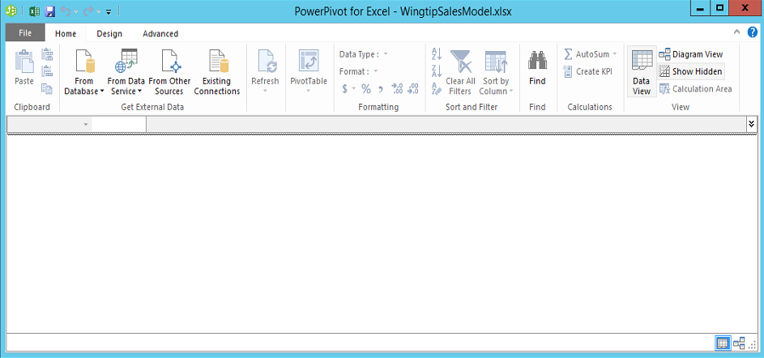
Working with the PowerPivot Add-In
PowerPivot Add-In adds a tab to Excel ribbon
Click Manage button display PowerPivot window
You must switch back and forth between Excel application window
Notes:
Most of the task for creating and enhancing the data model are created using the PowerPivot Add-In. These tasks include importing tables and defining table relationships. It's also used to design the data model which involves renaming and hiding tables and columns as well as creating calculated columns, calculated fields and key performance indicators (KPIs).
When you begin to use the PowerPivot add-in in Excel 2013, you must get used to navigating back forth between two different windows. One window is the familiar Excel application window which displays the workbook which contains the data model. The second window is the PowerPivot window which provides an environment to import, view and customize the tables inside the data model. Note that the Excel application window and the PowerPivot window are two different views into a single Excel workbook file.

Slide 44
Enabling the PowerPivot Add-in with Excel 2013

Slide 45
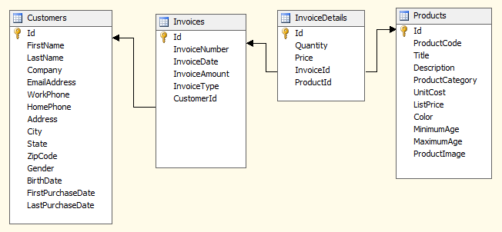
The Wingtip Sales Database Schema
Which tables will be used to build measures?
Which tables will be used as dimensions?
Notes:
The demos and lab exercise of this course are based on a fictitious company named Wingtip Toys, Inc. The source data will be imported from an OLTP-style database named Wingtip Sales. The screenshot in the slide above shows the tables, columns and table relationships in the Wingtip Sales database that will represent the starting point for the lab work you have ahead.

Slide 46
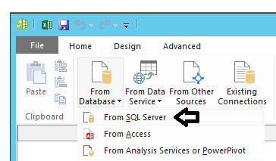
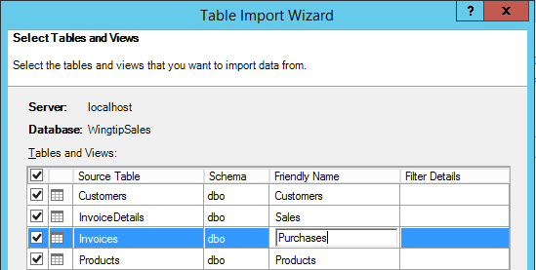
Importing Tables
Tables can be imported from a variety of sources
SQL Server databases or Microsoft Access databases
Data in Excel workbook
Tables can be renamed during the import process
Notes:
The PowerPivot add-in makes it relatively simple to import external data from a wide variety of sources into the data model of the currently-opened Excel workbook. Note that tables can be renamed during the import process. You can also filter out unneeded rows and columns as part of the import process.

Slide 47
Importing Data in the Data Model

Slide 48
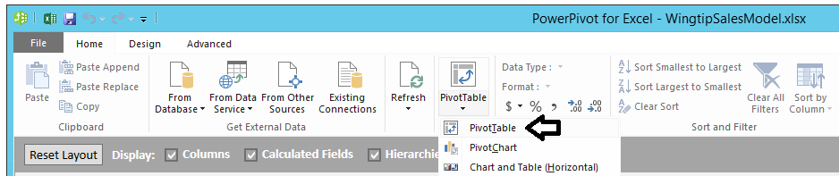
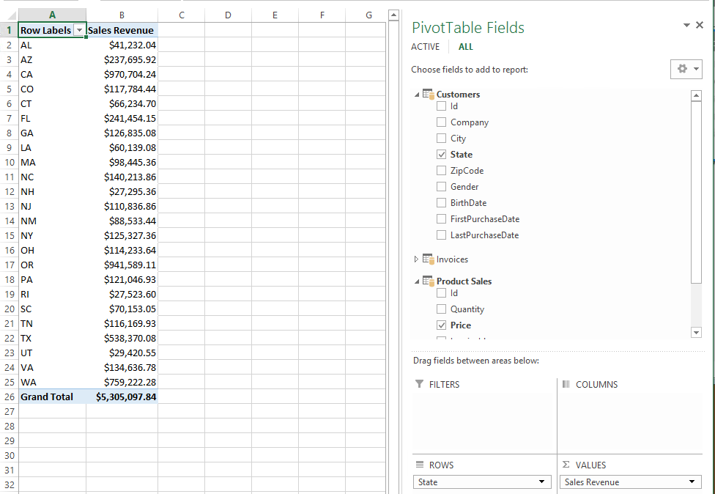
Creating a Pivot Table from the Data Model
From PowerPivot window, select PivotTable command
Create PivotTable in Excel application window
Notes:
Once you have imported one or more tables into the data model of an Excel workbook, you can use the data model to create PivotTables and PivotCharts. Note that PivotTable and PivotCharts get created not inside the data model but inside of worksheets in the Excel application window. However, the PivotTables and PivotCharts are generating their results by running queries against the data model.

Slide 49
Creating a PivotTable from an Excel Data Model

Slide 50
Summary
Essential BI Concepts and Terminology
Microsoft Software Involved in BI Solutions
Understanding BI Data Sources
Introduction to the Excel Data Model

