Slide 1
Modeling Data for Analytics using PowerPivot
Notes:
This module introduces students to the PowerPivot features and data modeling tools available when working with Power BI Desktop. Students will learn about the various ways that Power BI Desktop can be used to model data for richer analytics and reporting. The module discusses how to get up and running with the DAX programming language as well as how to extend tables in a dataset with Calculated Columns and Measures.

Slide 2
Agenda
Understanding PowerPivot and DAX
Creating Calculated Columns
Creating Measures
Creating Dimensional Hierarchies

Slide 3
Creating the Data Model with PowerPivot
Steps to creating the data model (aka BISM)
Create tables by importing data from external sources
Create relationships between tables
Rename tables and columns if desired
Create calculated columns
Create calculated fields
Create Dimensional Hierarchies
Create time table(s) for time intelligence support
Create key performance indicators (KPIs)

Slide 4
Working with DAX
DAX is the language used to create data model
DAX stands for "Data Analysis Expression Language"
DAX expressions are similar to Excel formulas
They always start with an equal sign (=)
DAX provides many built-in functions similar to Excel
DAX Expressions are unlike Excel formulas…
DAX expressions cannot reference cells (e.g. A1 or C4)
Instead DAX expressions reference columns and tables
=SUM('Sales'[Sales Amount])

Slide 5
Calculated Columns vs Calculated Fields
Calculated Columns
Evaluated based on context of a single row
Evaluated when data is loaded into memory
Calculated Fields (also known as Measures)
Evaluated based on filter context of a single table
Commonly used for aggregations (e.g. SUM, AVG, etc.)
Evaluated after data loads into memory at query time
Column1 = <DAX expression>
Field1 := <DAX expression>

Slide 6
Types of DAX Functions
Date and Time Functions
Information Functions
Logical Functions
Mathematical and Trigonometric Functions
Statistical Functions
Filter Functions
Text Functions
Time Intelligence Functions

Slide 7
Agenda
DAX Fundamentals
Creating Calculated Columns
Creating Calculated Fields
Creating Dimensional Hierarchies

Slide 8
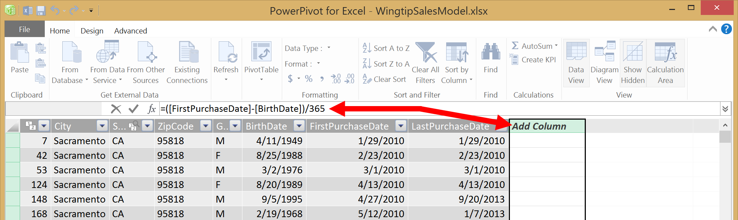
Creating Calculated Columns
Edited in formula bar of PowerPivot table view
Start with an equals (=) sign
Enter a valid DAX expression
Clicking on column adds it into expression
DAX formula builder can be very helpful

Slide 9
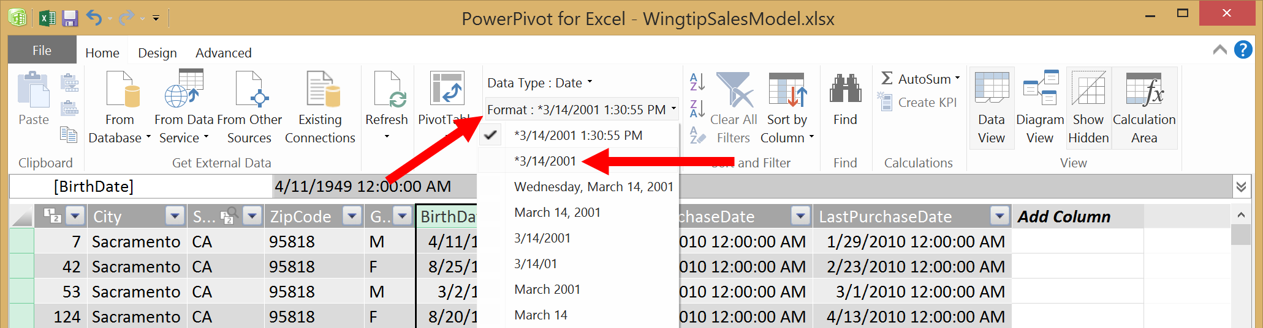
Formatting Columns
Each column has formatting properties
Formatting will be used by reports and visualizations built on top of data model

Slide 10
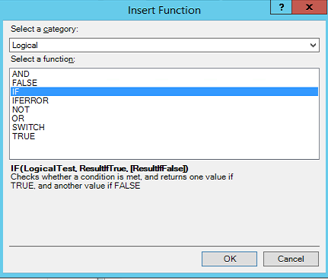
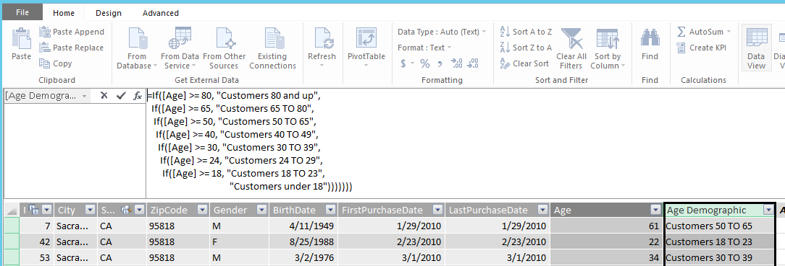
Using Logical Functions in DAX
Used to create conditional evaluations

Slide 11
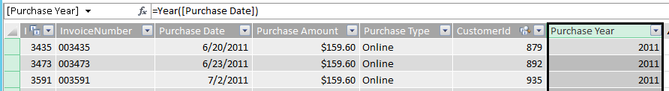
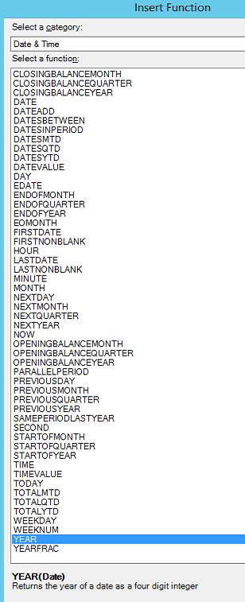
Time Functions
Calculate Year or Month from Date
DAX contains many time and date functions

Slide 12
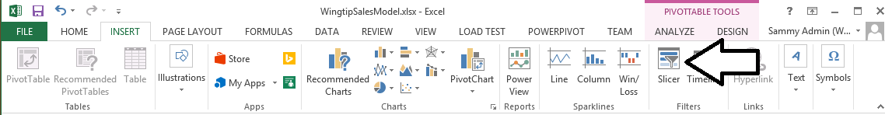
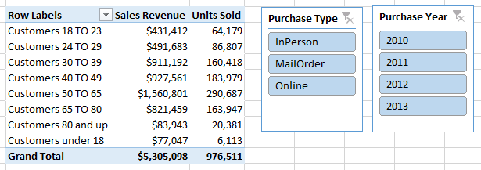
Adding Slicers for Calculated Columns
Slicers can be created using calculated columns
Provides intuitive and easy-to-use interface

Slide 13
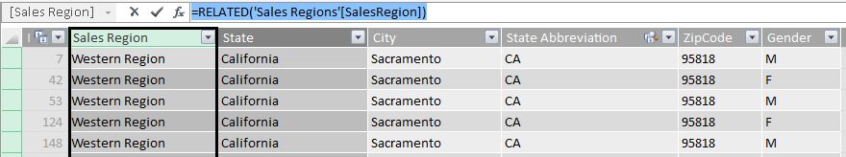
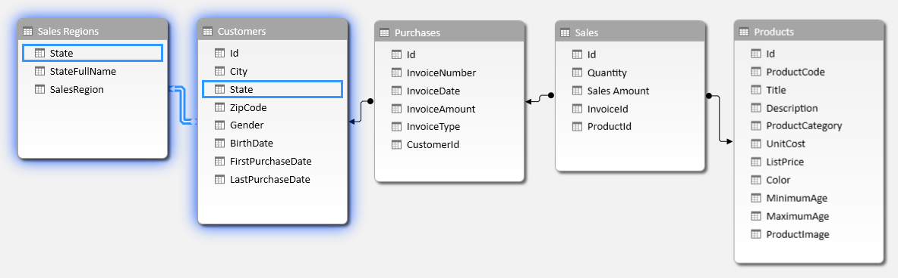
The RELATED Function
RELATED function performs cross-table lookup
Effectively replaces older VLOOKUP function
Used in many-side table to look up value from one-side

Slide 14
Creating Calculated Columns

Slide 15
Agenda
DAX Fundamentals
Creating Calculated Columns
Creating Calculated Fields
Creating Dimensional Hierarchies

Slide 16
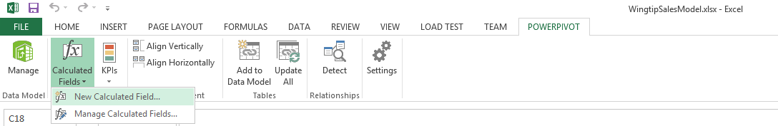
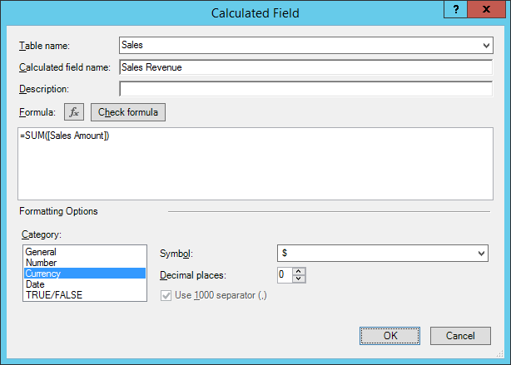
Creating Calculated Fields
Use built-in commands for Calculated Fields
In Excel application window not of PowerPivot window
Excel provides dialog for editing calculated fields

Slide 17
Creating Calculated Fields

Slide 18
Agenda
DAX Fundamentals
Creating Calculated Columns
Creating Calculated Fields
Creating Dimensional Hierarchies

Slide 19
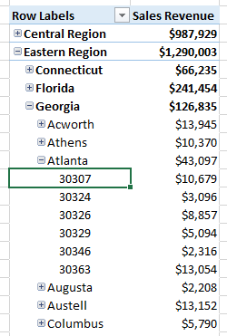
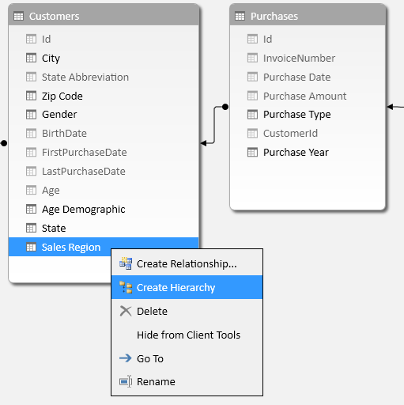
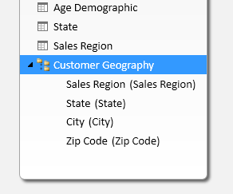
Dimensional Hierarchies
Dimensional hierarchies used to provide drilldown
Hierarchy created using a set of columns
Columns must all exist within a single table

Slide 20
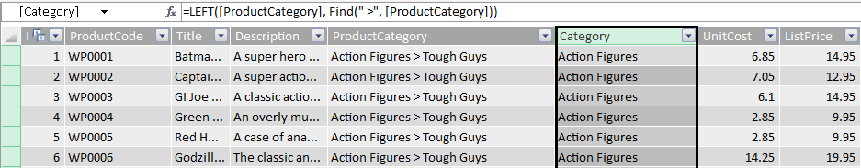
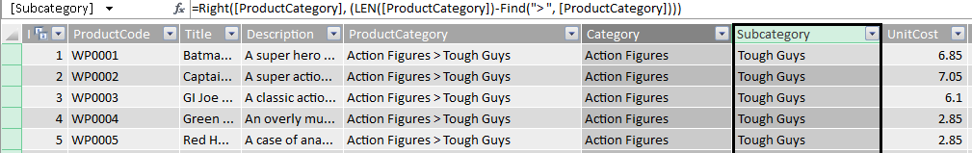
Using Text Functions in DAX
Calculated columns must be created for hierarchy
Extracting Category value from Product Category column
Extracting Subcategory value from Product Category column

Slide 21
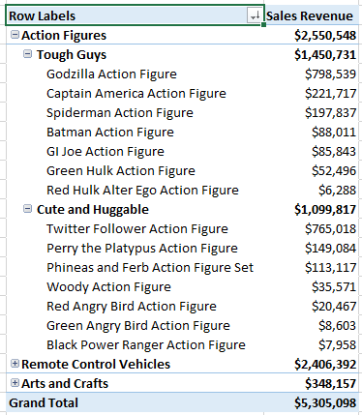
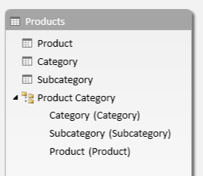
Product Categories
Product Categories Hierarchy has three levels
Category
Subcategory
Product

Slide 22
Creating a Dimensional Hierarchy

Slide 23
Summary
DAX Fundamentals
Creating Calculated Columns
Creating Calculated Fields
Creating Dimensional Hierarchies

