Slide 1
Extending Datasets to Support Time Intelligence
Notes:
This module will begin by introducing concepts and terms used when modeling a dataset using time dimensions. Students will learn why and how to create a specialized date tables to track time dimensions as well as how to design a time-dimensional hierarchy which allows users to drill down into more specific regions of time while analyzing data. The second half of the module focuses on the support in the DAX language for creating calculated columns and measures within a dataset which provide rich analytic capabilities to calculate year-to-date totals and rolling averages and to provide drill down capabilities to the level of month, week or day.

Slide 2
Agenda
Understanding Evaluation Contexts
Creating a Time Dimension Table
Understanding DAX Time Intelligence Support
Working with DAX Time Intelligence Functions

Slide 3
Evaluation Contexts
DAX expressions evaluated using two context
Filter context
Row context
Row Context
The set of active rows in a calculation
Filter Context
The current row in a table iteration

Slide 4
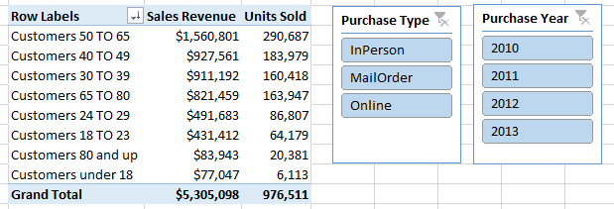
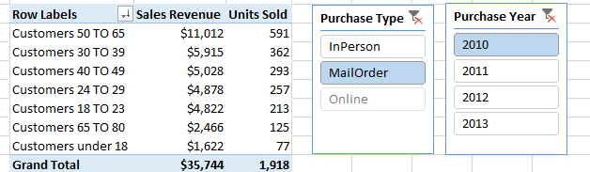
Filter Context in a Single Table
Filter context can apply to entire table
Filter context affected by slicers and other filters

Slide 5
Understanding Row Context
There are 2 cases that create active row context
Evaluation of a calculated column
Evaluation of a DAX function that iterates over a table
=([FirstPurchaseDate]-[BirthDate])/365
=LEFT([ProductCategory], Find(" >", [ProductCategory]))
=SUMX(RELATEDTABLE(Sales), Sales[Sales Amount])
=SUMX(Sales, Sales[Quantity] * RELATED(Products[Unit Cost]))

Slide 6
DAX Functions With Tables Parameter
The following DAX functions create row context
AVERAGEX
COUNTAX
COUNTX
MAXX
MINX
SUMX

Slide 7
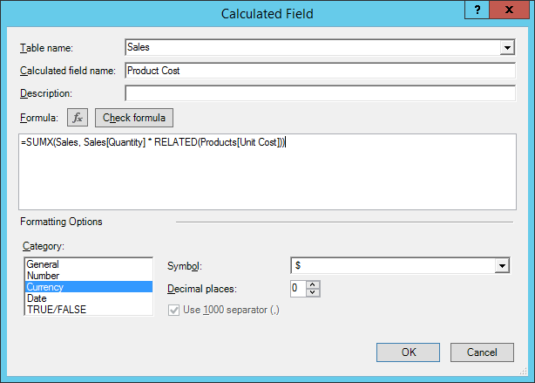
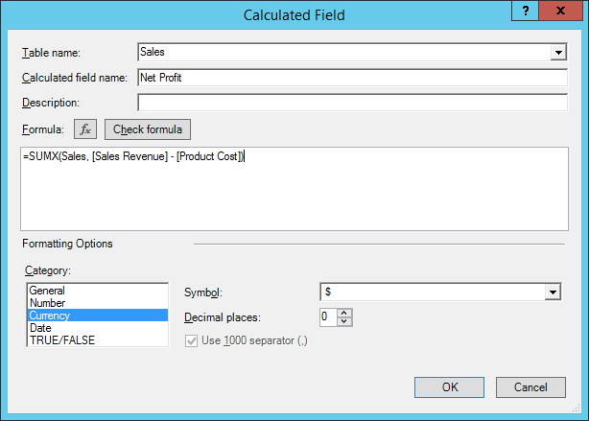
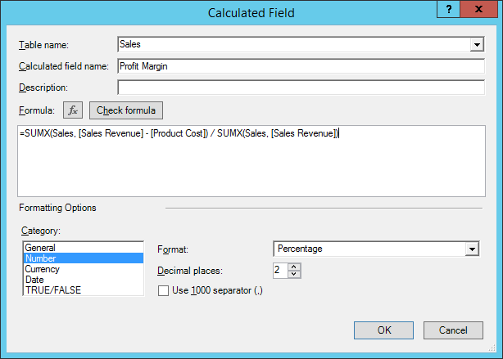
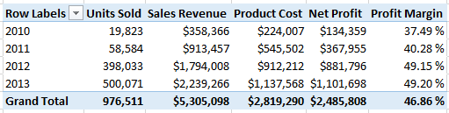
Using SUMX in a Calculated Field

Slide 8
DAX Functions that Return a Table
ALL
ALLEXCEPT
CALCULATETABLE
DISTINCT
FILTER
RELATEDTABLE
VALUES

Slide 9
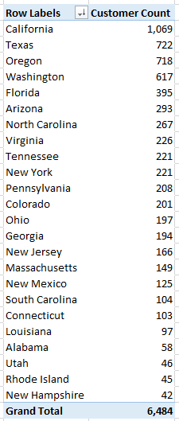
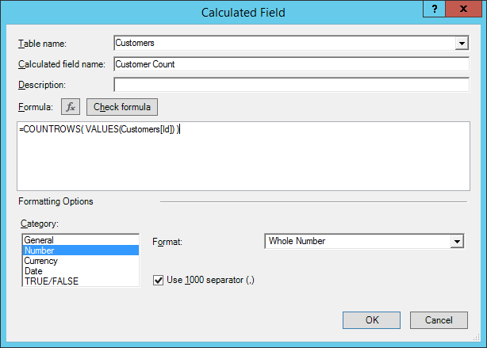
Using the VALUES Function
VALUES function…
Executes within current filter context
returns a table with one column
All rows in table are distinct

Slide 10
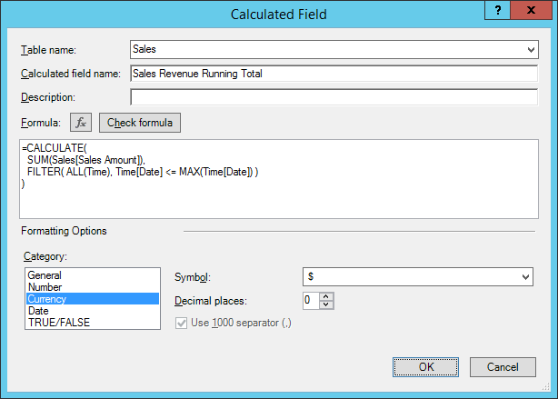
Using the CALCULATE Function
CALCULATE provides greatest amount of control
CALCULATE( Expression, Condition1, [Condition2] )

Slide 11
Agenda
Understanding Evaluation Contexts
Creating a Time Dimension Table
Creating a Calendar Drilldown Hierarchy
Working with Time Intelligence Functions
Creating KPIs

Slide 12
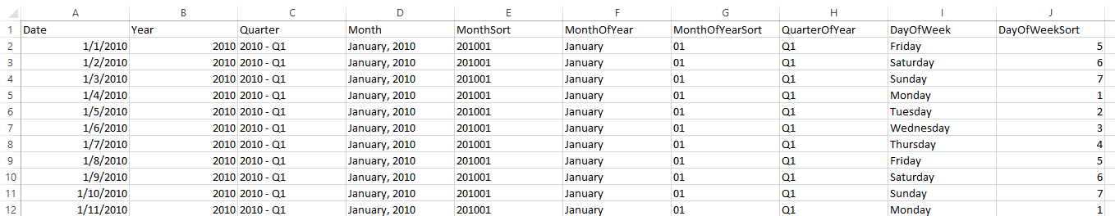
Creating a Time Dimension Table in Excel
Excel can be used to create Time table
Excel Formulas used to create this Tie table
Column | Value or Formula in Cell
Date | 1/1/2010
Year | =YEAR(A2)
Quarter | =YEAR(A2) & " - " & CHOOSE(MONTH(A2), "Q1", "Q1", "Q1", "Q2", "Q2", "Q2", "Q3", "Q3", "Q3", "Q4", "Q4", "Q4")
Month | =TEXT(A2, "MMMM, YYYY")
MonthSort | =TEXT(A2, "YYYYMM")
MonthOfYear | =TEXT(A2,"MMMM")
MonthOfYearSort | =RIGHT("0" & MONTH(A2),2)
QuarterOfYear | =CHOOSE(MONTH(A2), "Q1", "Q1", "Q1", "Q2", "Q2", "Q2", "Q3", "Q3", "Q3", "Q4", "Q4", "Q4")
DayOfWeek | =TEXT(A2,"dddd")
DayOfWeekSort | =WEEKDAY(A2, 2)

Slide 13
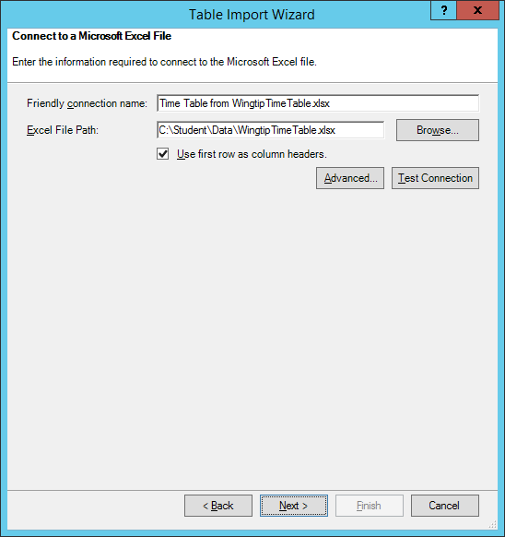
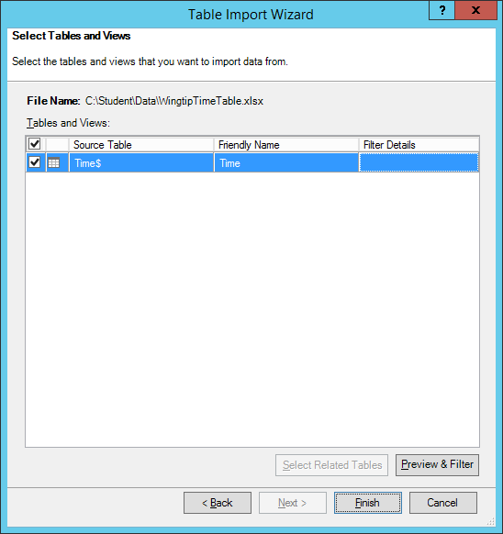
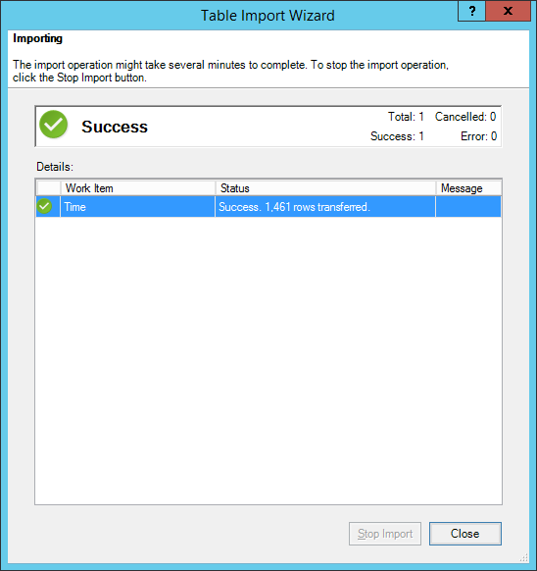
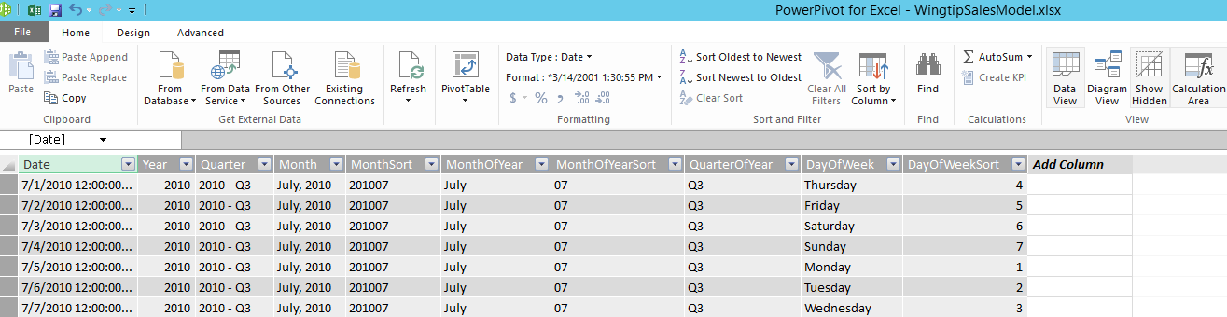
Importing the Time Table into Data Model
1
2
3
4

Slide 14
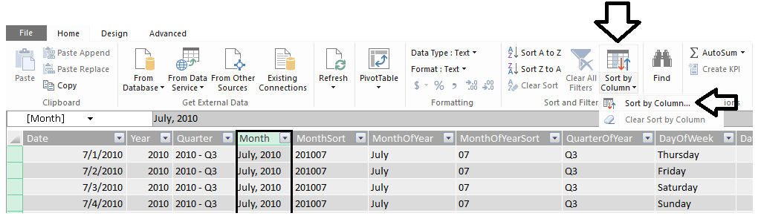
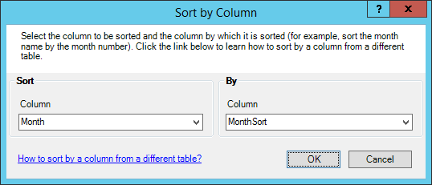
Configuring Sort Columns
Some columns do not sort in desired fashion by default
For example, April will sort before January, February and March
Column must be configured with sort column for desired sorting
2
1
3
4

Slide 15
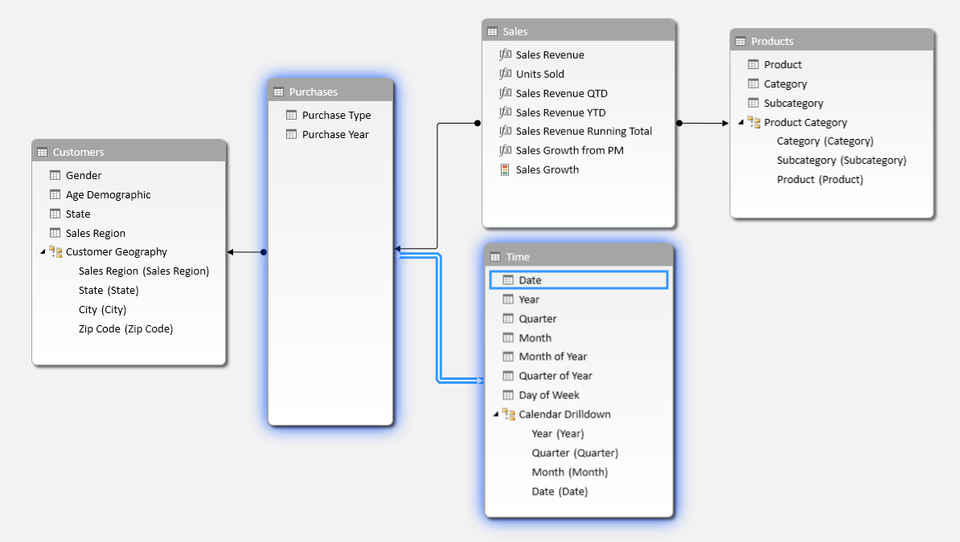
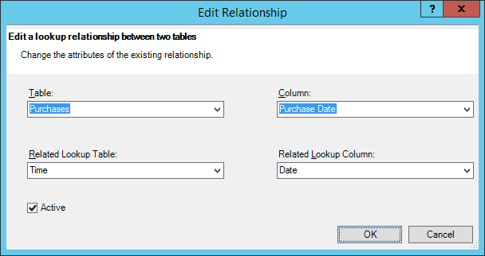
Creating a Relationship to the Time Table
You must integrate time table into data model
Done by creating relationship to Purchase Date column in Purchases table

Slide 16
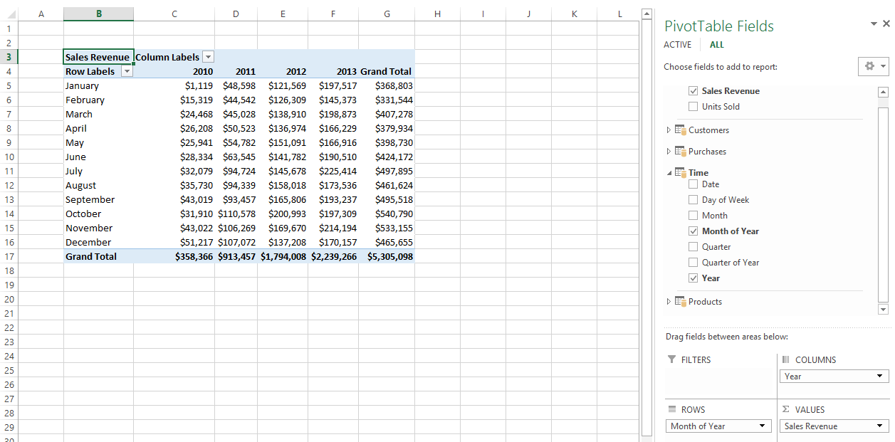
Sample PivotTable #1
Sales Revenue by Month and Year

Slide 17
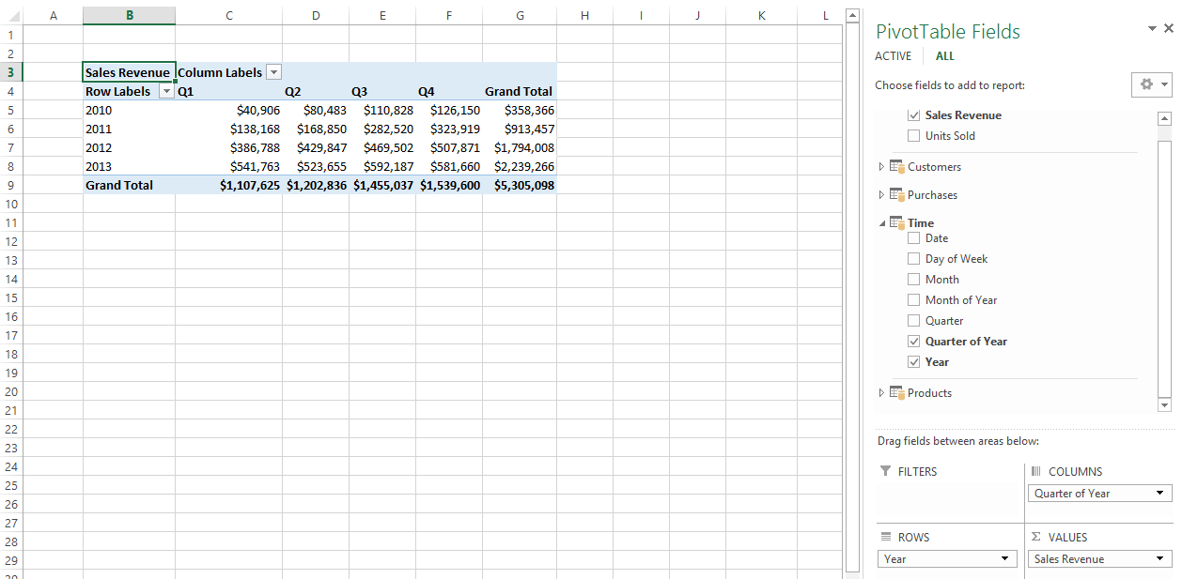
Sample PivotTable #2
Sales Revenue by Year and Quarter

Slide 18
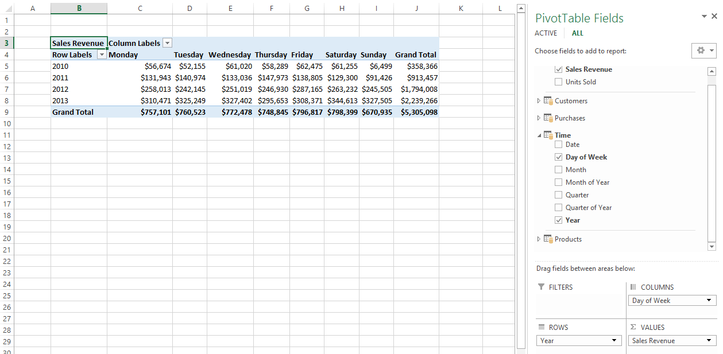
Sample PivotTable #3
Sales Revenue by Year and Day of Week

Slide 19
Agenda
Understanding Evaluation Contexts
Creating a Time Dimension Table
Creating a Calendar Drilldown Hierarchy
Working with Time Intelligence Functions
Creating KPIs

Slide 20
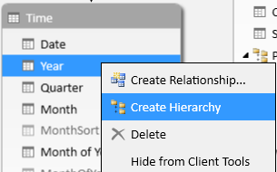
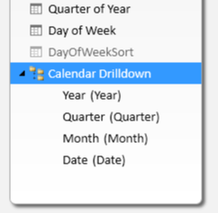
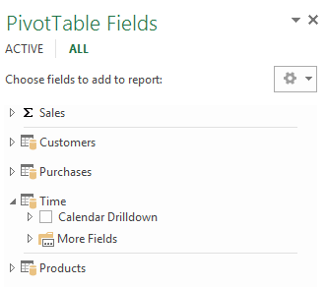
Creating a Calendar Drilldown Hierarchy
Hierarchy created in Time table provides drilldown capabilities
Create new hierarchy on Year column named Calendar Drilldown
Add Quarter, Month and Date columns
See Calendar Drilldown hierarchy appear in PivotTables view
1
2
3

Slide 21
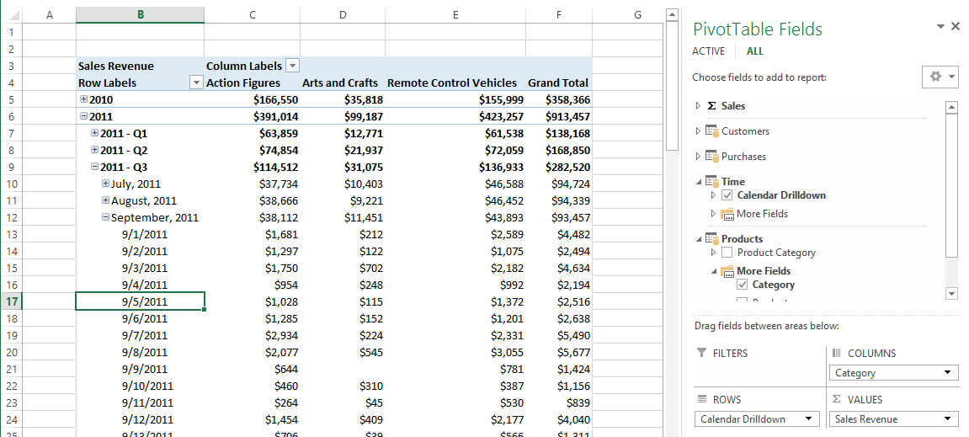
Drilldown in Time on Sales Revenue

Slide 22
Agenda
Understanding Evaluation Contexts
Creating a Time Dimension Table
Creating a Calendar Drilldown Hierarchy
Working with Time Intelligence Functions
Creating KPIs

Slide 23
Functions That Return a Single Date
FIRSTDATE / LASTDATE
FIRSTNONBLANK / LASTNONBLANK
STARTOFMONTH / ENDOFMONTH
STARTOFQUARTER / ENDOFQUARTER
STARTOFYEAR / ENDOFYEAR

Slide 24
To Date Functions
Convenience To Date functions
TOTALMTD
TOTALQTD
TOTALYTD
Convenience To Date functions really do this
CALCULATE (Expression, DATESMTD(Date) [, SetFilter ] )
TOTALMTD (Expression, Date [, SetFilter ] )

Slide 25
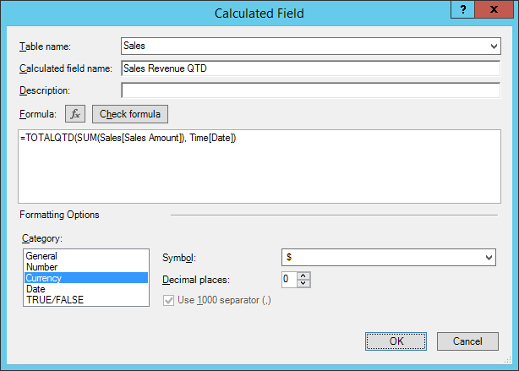
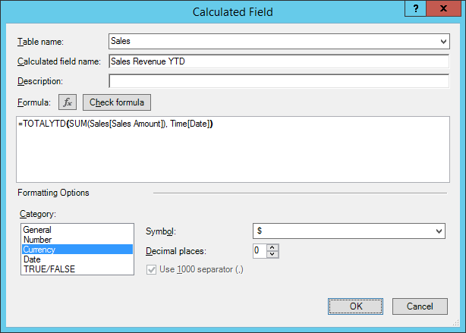
Calculated Fields for QTD and YTD Sales

Slide 26
Using the CALCULATE Function
Calculate a running total of sales revenue across years

Slide 27
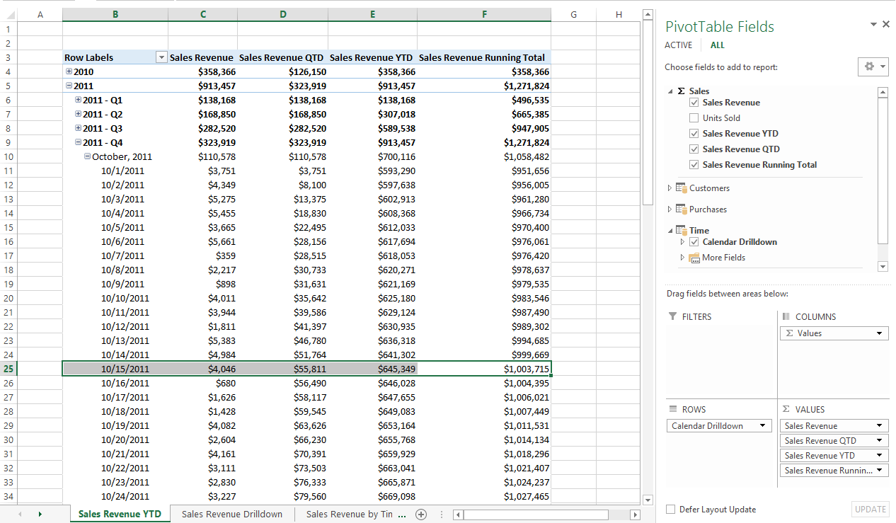
PivotTable with To Date Totals

Slide 28
Balance Functions
DAX Functions return value at specific point in time
OPENINGBALANCEMONTH
OPENINGBALANCEQUARTER
OPENINGBALANCEYEAR
CLOSINGBALANCEMONTH
CLOSINGBALANCEQUARTER
CLOSINGBALANCEYEAR

Slide 29
Function That Return a Table of Dates
PREVIOUSDAY / NEXTDAY
PREVIOUSMONTH / NEXTMONTH
PREVIOUSQUARTER / NEXTQUARTER
PREVIOUSYEAR / NEXTYEAR
DATESMTD / DATESQTD / DATESYTD
SAMEPERIODLASTYEAR
DATEADD
DATESBETWEEN
DATESINPERIOD
PARALLELPERIOD

Slide 30
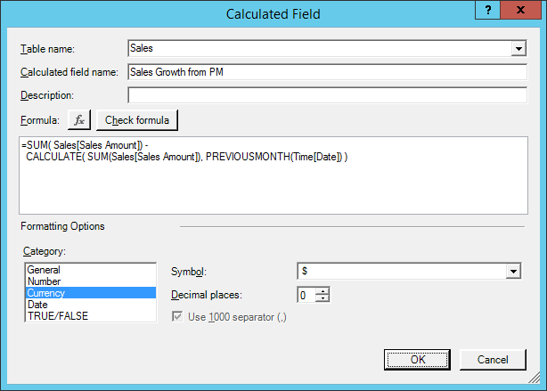
Sales Growth from Previous Month

Slide 31
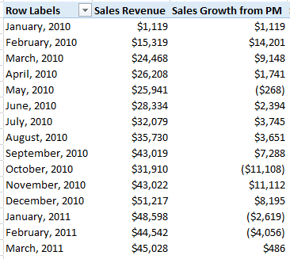
Analyzing Month to Month Sales Growth

Slide 32
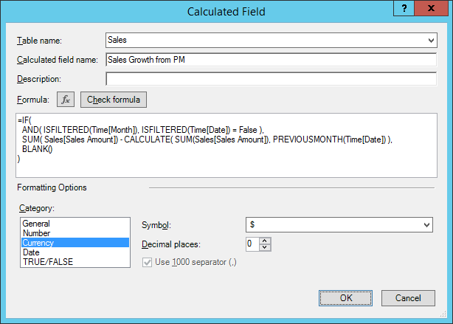
Configuring for a Specific Type of Filter

Slide 33
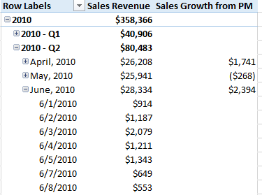

The Often Desired Effect of Filtering
Removes values for unwanted hierarchy levels

Slide 34
Agenda
Understanding Evaluation Contexts
Creating a Time Dimension Table
Creating a Calendar Drilldown Hierarchy
Working with Time Intelligence Functions
Creating KPIs

Slide 35
Creating KPIs
Steps to creating a KPI
Create a calculated field
Convert the calculated field into a KPI

Slide 36
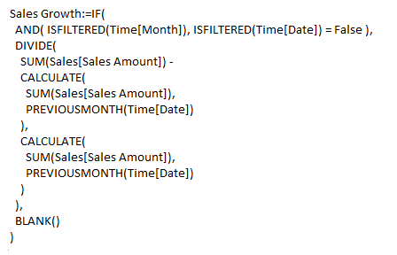
The Sales Growth Calculated Field

Slide 37
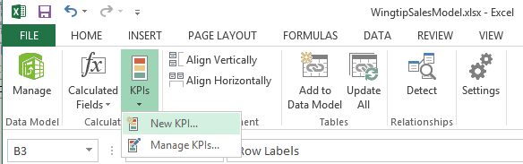
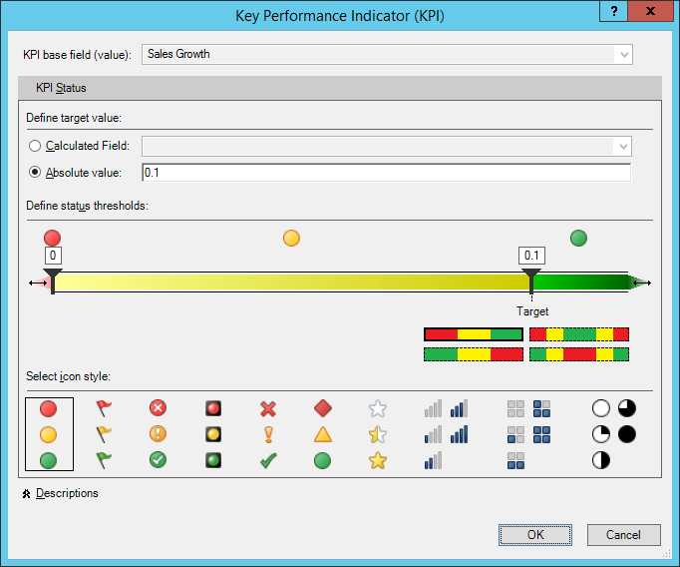
Creating the KPI

Slide 38
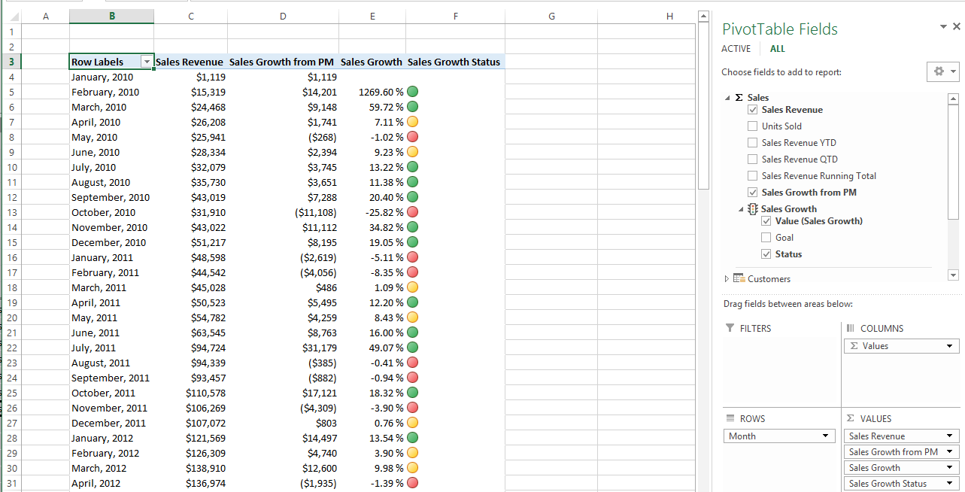
Using the KPI in a PivotTable

Slide 39
Summary
Understanding Evaluation Contexts
Creating a Time Dimension Table
Creating a Calendar Drilldown Hierarchy
Working with Time Intelligence Functions
Creating KPIs

