Slide 1
Developing Features for WSS
Creating SharePoint Components with Visual Studio

Slide 2
Agenda
SharePoint Customization versus Development
The WSS system directories
What Are Features?
Developing a Custom Feature
Adding Event Handlers to a Feature

Slide 3
Customization Versus Development
Site Customizations
Changes to one particular site
Done using the browser or the SharePoint Designer
Changes recorded in content database
Easy to do but hard to reuse
WSS Development
Creation of reusable templates/components
Templates/components installed on Web server
Development based on Visual Studio projects
Project source files checked into source code control
Projects can be moved through staging to production

Slide 4
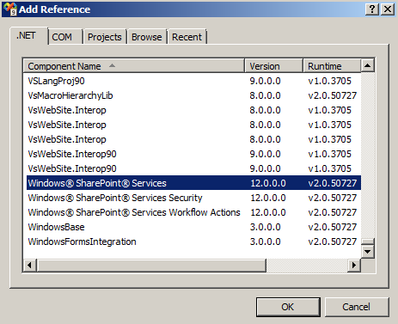
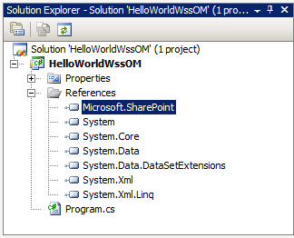
Hello World: The WSS Object Model
Create a simple Console Application
Add a reference to Microsoft.SharePoint.dll
Write the code to access a site and see it's lists

Slide 5
Watch Out: Inconsistent Terminology
New Term | Old Term | WSS Object Model
Site Collection | Site | SPSite
Site | Web | SPWeb

Slide 6
The 'Hello World' Code
using System;
using Microsoft.SharePoint;
namespace Hello_WSS_OM {
class Program {
static void Main(string[] args) {
string sitePath = "http://litwareinc.com";
// enter object model through site collection.
SPSite siteCollection = new SPSite(sitePath);
// obtain reference to top-level site.
SPWeb site = siteCollection.RootWeb;
// enumerate through lists of site
foreach (SPList list in site.Lists) {
Console.WriteLine(list.Title);
}
// clean up by calling Dispose.
site.Dispose();
siteCollection.Dispose();
}
}
}

Slide 7
What is a Feature?
A building block for creating SharePoint solutions
A unit of design, implementation and deployment
Features can contain elements
e.g. menu items, links, list types and list instances
Many other element types possible
Features can contain event handlers
You can add any code which used WSS object model

Slide 8
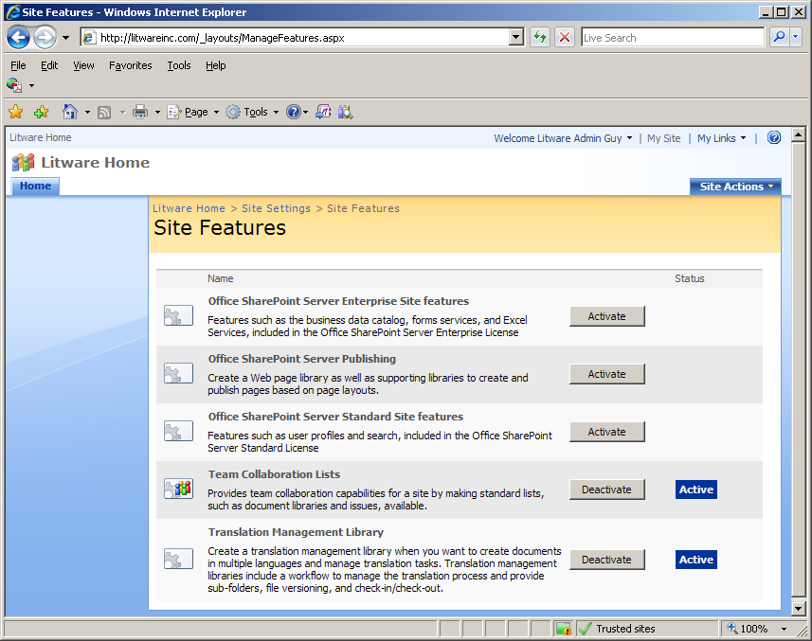
User’s View of Features
Features support concept of activation/deactivation
This is the site-level feature management page in a WSS farm where MOSS has been installed.
Much of the functionality of MOSS is enabled and disable by activating and deactivating features that have been developed by the MOSS team.

Slide 9
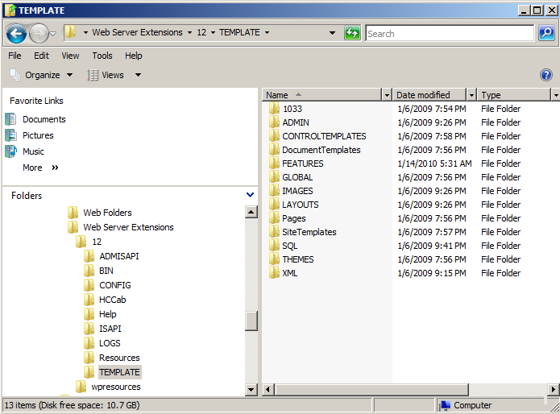
The WSS System Directories
Developers must learn WSS system directories
\12\TEMPLATE
\12\TEMPLATE\FEATURES ← This is the one we care about in this lecture
\12\TEMPLATE\IMAGES
\12\TEMPLATE\LAYOUTS

Slide 10
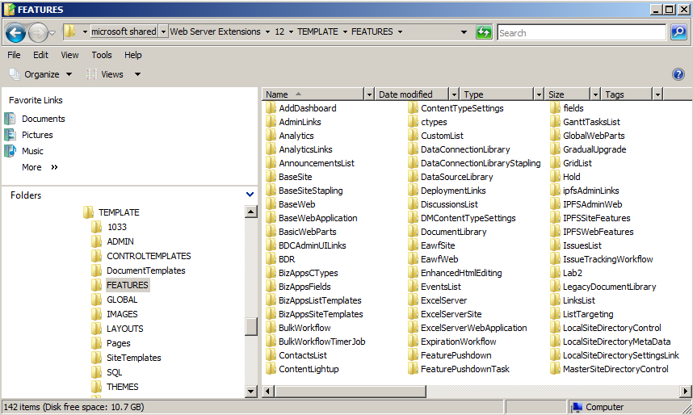
The Features Directory
Functionality in WSS based on Features
Features are installed at farm level
Feature activation makes functionality available
WSS supports for different feature activation scopes
(1) Site (2) Site Collection (3) Web Application (4) Farm
Your custom features will each need a directory created here

Slide 11
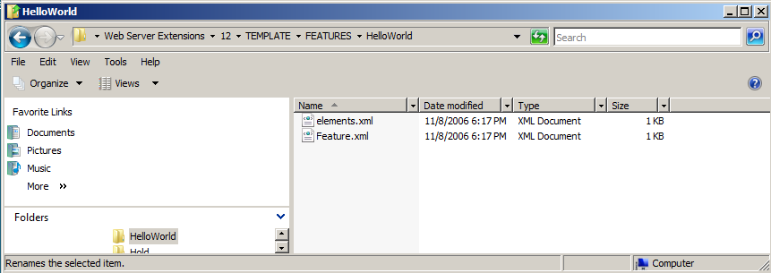
Developer’s View of a Feature
Each feature requires its own directory
Directory must contain feature.xml file
Directory often contains other files definition elements

Slide 12
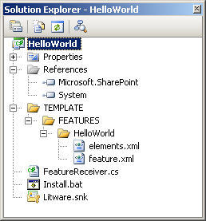
Creating the 'Hello World' Feature
Create a new Visual Studio Class Library project
Create XML files which define feature
Add a FeatureActivated event handler

Slide 13
The feature.xml file
Feature.xml file serves as feature manifest
Features defined in declarative fashion using CAML
CAML = Collaborative Application Markup Language
<Feature
Id="B2CB42E2-4F0A-4380-AABA-1EF9CD526F20"
Title="A Sample Feature: Hello World"
Description=“Hi mom, class is fun. I am doing great"
Scope="Web"
Hidden="FALSE"
ImageUrl="TPG\WhitePithHelmet.gif"
xmlns="http://schemas.microsoft.com/sharepoint/">
<ElementManifests>
<ElementManifest Location="elements.xml" />
</ElementManifests>
</Feature>

Slide 14
Elements.xml
Feature includes elements defined using CAML
This element defines a Site Actions menu item
There are many other types of elements
<Elements xmlns="http://schemas.microsoft.com/sharepoint/">
<CustomAction
Id="SiteActionsToolbar"
GroupId="SiteActions"
Location="Microsoft.SharePoint.StandardMenu"
Sequence="100"
Title="Hello World"
Description="A custom menu item added using a feature"
ImageUrl="_layouts/images/crtsite.gif" >
<UrlAction Url="http://msdn.microsoft.com"/>
</CustomAction>
</Elements>

Slide 15
Install.bat
Visual Studio supports post-build events
Can be used to run batch file to deploy components
Used on development machines
Should not be used on staging/production machines
@SET TEMPLATEDIR="c:\program files\common files\microsoft shared\web server extensions\12\Template"
@SET STSADM="c:\program files\common files\microsoft shared\web server extensions\12\bin\stsadm"
@SET GACUTIL="c:\Program Files\Microsoft SDKs\Windows\v6.0A\bin\gacutil.exe"
Echo Installing HelloWorld.dll in GAC
%GACUTIL% -if bin\debug\HelloWorld.dll
Echo Copying files to TEMPLATE directory
xcopy /e /y TEMPLATE\* %TEMPLATEDIR%
Echo Installing feature
%STSADM% -o installfeature -filename HelloWorld\feature.xml -force
Echo Restart all IIS worker processes
IISRESET
Echo Restart just the IIS worker process for a particular Application Pool
REM cscript c:\windows\system32\iisapp.vbs /a "SharePointDefaultAppPool" /r
Notes:
GACUTIL is nowlocated in the :\Program Files\Microsoft SDKs\Windows\v6.0A\Bin\ directory instead of in the Visual Studio sub directories

Slide 16
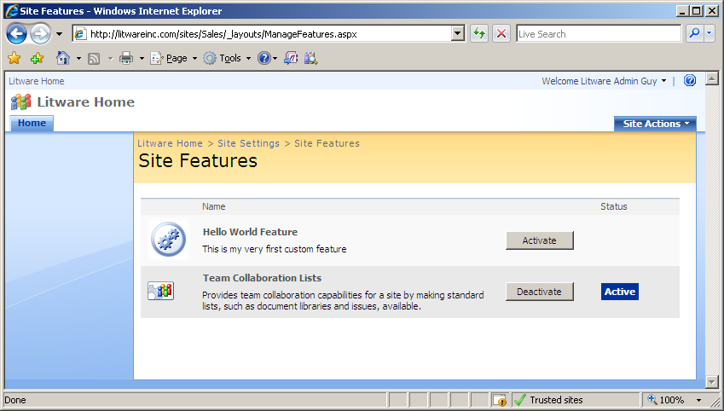
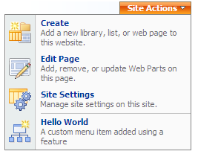
Feature Activation
Steps to testing Feature
Copy Feature files to FEATURES directory
Install feature with WSS
Activate Feature within a specific site

Slide 17
Feature event handlers
FeatureReceiver class provides 4 event handlers
using System;
using Microsoft.SharePoint;
namespace HelloWorld {
public class FeatureReceiver : SPFeatureReceiver {
// no functionality required for install/uninstall events
public override void FeatureInstalled(SPFeatureReceiverProperties properties) { }
public override void FeatureUninstalling(SPFeatureReceiverProperties properties) { }
public override void FeatureActivated(SPFeatureReceiverProperties properties) {
SPWeb site = (SPWeb)properties.Feature.Parent;
// track original site Title using SPWeb property bag
site.Properties["OriginalTitle"] = site.Title;
site.Properties.Update();
// update site title
site.Title = "Hello World";
site.Update();
}
public override void FeatureDeactivating(SPFeatureReceiverProperties properties) {
// reset site Title back to its original value
SPWeb site = (SPWeb)properties.Feature.Parent;
site.Title = site.Properties["OriginalTitle"];
site.Update();
}
}
}

Slide 18
The feature.xml file revisited
Feature.xml file serves as feature manifest
<Feature
Id="B2CB42E2-4F0A-4380-AABA-1EF9CD526F20"
Title="A Sample Feature: Hello World"
Description=“Hi mom, class is fun. I am doing great"
Scope="Web"
Hidden="FALSE"
ImageUrl="TPG\WhitePithHelmet.gif"
ReceiverAssembly="HelloWorld, [full 4-part assembly name]"
ReceiverClass="HelloWorld.FeatureReceiver"
xmlns="http://schemas.microsoft.com/sharepoint/">
<ElementManifests>
<ElementManifest Location="elements.xml" />
</ElementManifests>
</Feature>

Slide 19
Agenda
SharePoint Customization versus Development
The WSS system directories
What Are Features?
Developing a Custom Feature
Adding Event Handlers to a Feature

