Slide 1
SharePoint Architecture
Taking a Look Under the Hood

Slide 2
Agenda
WSS Integration with ASP.NET 2.0
IIS Web sites and Web Applications
The farm and the configuration database
Web Application and Content Database
content databases
The web.config file
Site pages versus application pages
Creating custom application pages
Deployment using Solution Packages

Slide 3
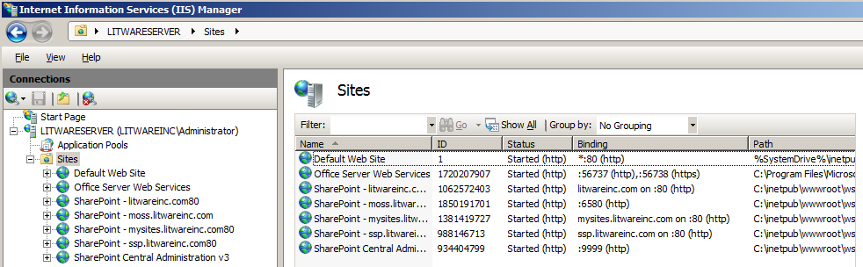
IIS Web Sites
WSS depends on IIS Web sites for…
HTTP listener mechanism
Process management through Application Pools
Security and user authentication

Slide 4
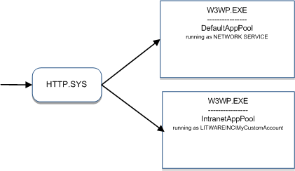
IIS Application Pools
IIS dispatches requests to Application Pools
Each Application Pool configured to run in own process
IIS lets you configure Application Pool identity
App Pool identity can be local or domain account

Slide 5
The ASP.NET Framework
ASP.NET is a productivity framework on top of IIS
Integrated with IIS via ISAPI extension (aspnet_isapi.dll)
Provides abstractions such as page, request, response
Integrates with Visual Studio and managed code

Slide 6
The web.config file
Provides configuration for ASP.NET runtime
<configuration>
<system.web>
<customErrors mode="On" />
<httpRuntime maxRequestLength="51200" />
<authentication mode="Windows" />
<identity impersonate="true" />
<authorization>
<allow users="*" />
</authorization>
</system.web>
</configuration>

Slide 7
ASP.NET Pages
ASP.NET development typically based on pages
Pages are deployed as .ASPX files to Web server
.ASPX files parsed and compiled on first request
Compiled page class inherits from System.Web.UI.Page
<%@ Page Language="C#" %>
<script runat="server">
protected override void OnLoad(EventArgs e) {
lblDisplay.Text = "Hello, ASP.NET";
}
</script>
<html>
<body>
<form id="frmMain" runat="server">
<asp:Label runat="server" ID="lblDisplay" />
</form>
</body>
</html>

Slide 8
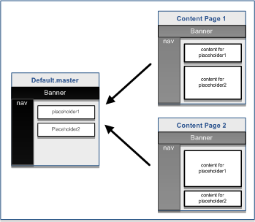
Master Pages in ASP.NET
ASP.NET 2.0 introduces Master Pages
Defines common layouts used across content pages

Slide 9
Linking Content Page to Master Page
<!-- default.master -->
<%@ Master %>
<html><body>
<form id="frmMain" runat="server">
<table width="100%">
<tr><td> <h1>Litware Inc.</h1><hr /></td></tr>
<tr>
<td> <!-- Display Main Body of Page -->
<asp:contentplaceholder id="PlaceHolderMain" runat="server" />
</td>
</tr>
</table>
</form>
</body></html>
<!-- content page linking to default.master -->
<%@ Page Language="C#" MasterPageFile="~/default.master" Title="Page 1" %>
<asp:Content ID="Main" ContentPlaceHolderID="PlaceHolderMain">
Unique page content goes here
</asp:Content>

Slide 10
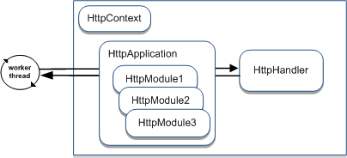
The HTTP Pipeline of ASP.NET
ASP.NET processing based on HTTP pipeline
HttpApplication and HttpModule act as interceptors
HttpHandler acts as endpoint for request
All object types can be replaced with custom code
HttpContext object available anywhere in pipeline

Slide 11
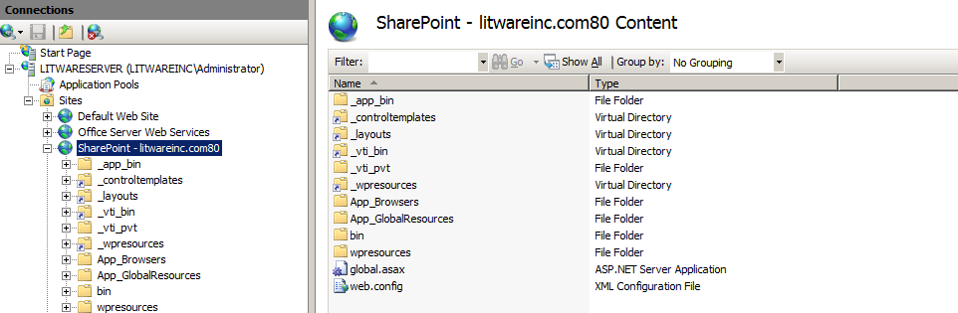
The WSS-extended Web Application
Web Applications extend IIS and ASP.NET
IIS wildcard application map sends all requests to ASP.NET
ASP.NET extended using common objects inside HTTP pipeline
Web Application configured with WSS system virtual directories
_layouts
_controltemplates
_vti_bin
_wpresources

Slide 12
The WSS-extended web.config file
WSS replaces HttpApplication object
WSS configures pipeline with its own HttpHandler and HttpModule
<!-- global.asax file at root of WSS Web Application -->
<@Application Inherits=”Microsoft.SharePoint.ApplicationRuntime.SPHttpApplication” >
<!-- web.config file at root of WSS Web Application -->
<configuration>
<system.web>
<httpHandlers>
<remove verb="GET,HEAD,POST" path="*" />
<add verb="GET,HEAD,POST" path="*"
type="Microsoft.SharePoint.ApplicationRuntime.SPHttpHandler,..." />
</httpHandlers>
<httpModules>
<clear />
<add name="SPRequest"
type="Microsoft.SharePoint.ApplicationRuntime.SPRequestModule,..." />
<!-- other standard ASP.NET httpModules added back in -->
</httpModules>
</system.web>
</configuration>

Slide 13
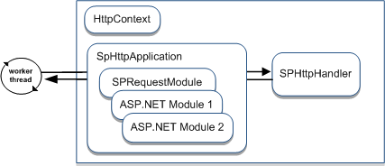
WSS Web Applications
WSS extends HTTP pipeline with custom objects
Configuration added to every WSS Web Application
Modifications made to web.config file and IIS metabase
Different and superior architecture than WSS 2.0
WSS 2.0 architecture based on problematic ISAPI filter

Slide 14
WSS Extensions to the web.config file
<configuration>
<configSections>
<sectionGroup name="SharePoint">
<section name="SafeControls" type="..." />
<section name="RuntimeFilter" type="..." />
<section name="WebPartLimits" type="..." />
<section name="WebPartCache" type="..." />
<section name="WebPartWorkItem" type="..." />
<section name="WebPartControls" type="..." />
<section name="SafeMode" type="..." />
<section name="MergedActions" type="..." />
<section name="PeoplePickerWildcards" type="..." />
</sectionGroup>
</configSections>
<SharePoint>
<SafeMode />
<WebPartLimits />
<WebPartCache />
<WebPartControls />
<SafeControls />
<PeoplePickerWildcards />
</SharePoint>
</configuration>

Slide 15
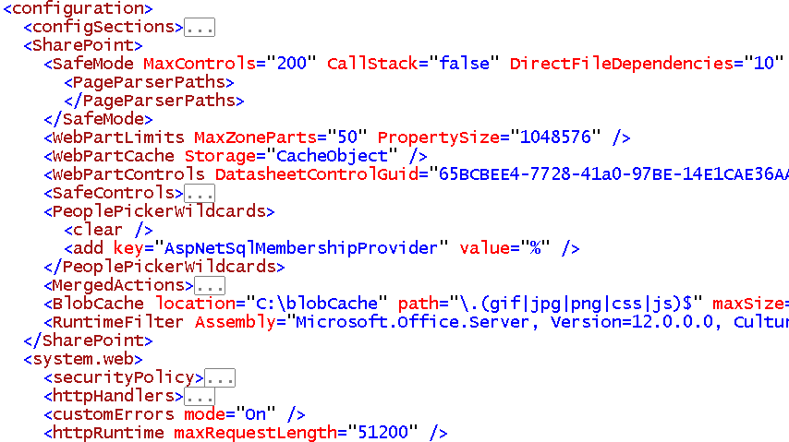
Important Debugging Settings
set to true
set to Off

Slide 16
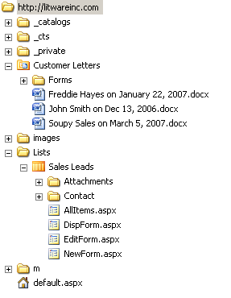
The Virtual File System of a Site
Site is a virtual file system
made up of folders and files
Pages are files
Documents are files
Stored in content database
How can you look at it?
SharePoint Designer
Windows Explorer (WebDav)

Slide 17
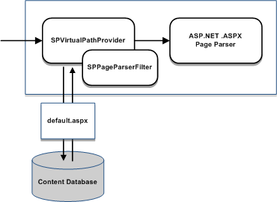
Processing Pages within a Site
WSS stores.aspx files in content database
Retrieved using SPVirtualPathProvider object
Page based on page templates on Web server
Non-customized pages can be ghosted
Customized pages cannot be ghosted

Slide 18
The _layouts Virtual Directory
Files in _layouts directory accessible to all sites
_layouts provides access to common resources
_layouts contains files for images, CSS and JavaScript
_layouts contains Application Pages
All these URLS resolve to the same page
http://Litwareinc.com/_layouts/settings.aspx
http://Litwareinc.com/sites/Vendors/_layouts/settings.aspx
http://Litwareinc.com:1001/sites/Accounting/_layouts/settings.aspx

Slide 19
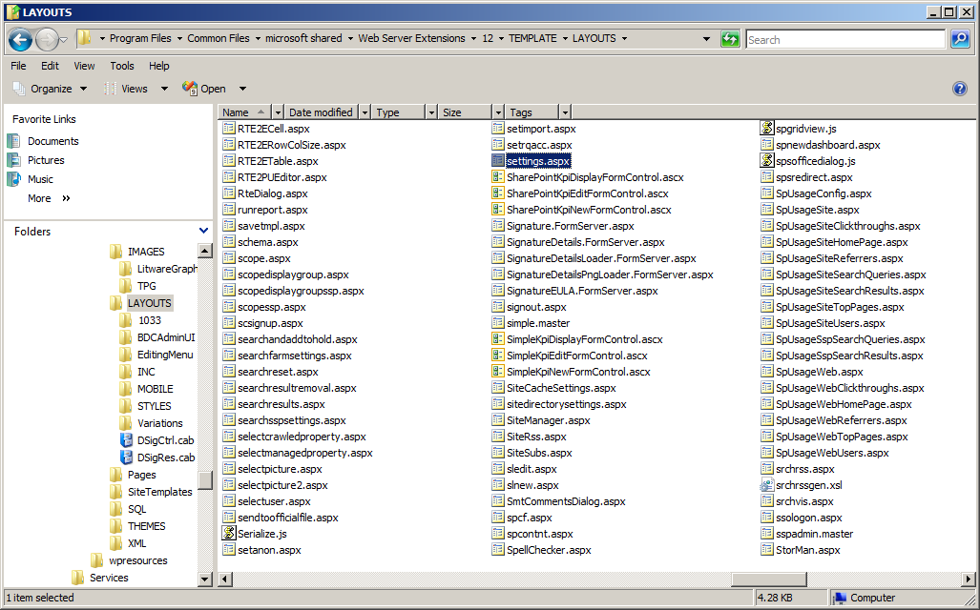
Application Pages
Standard Application Pages are part of WSS

Slide 20
Site Pages Versus Application Pages
Site Pages exist within virtual file system of site
They may or may not be ghosted
They support customization via Web Parts
They support customization via SharePoint Designer
Customized pages impact performance and security
Application Pages are deployed once per farm
They do not support customization or Web Parts
They are parsed/compiled as classic ASP.NET pages
They run faster than Site Pages
They always support code behind

Slide 21
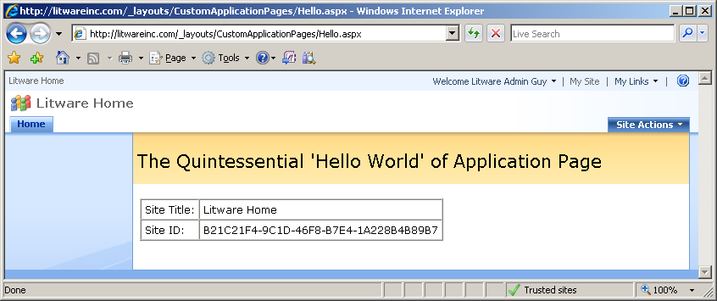
Creating Custom Application Pages
Steps to creating a custom Application Page
Inherit from LayoutsPageBase
Link to application.master
Add server-side controls and code
Deploy to LAYOUTS directory

Slide 22
'Hello World' Custom Application Page
<%@ Assembly Name="Microsoft.SharePoint, [full 4-part name]"%>
<%@ Page Language="C#" MasterPageFile="~/_layouts/application.master"
Inherits="Microsoft.SharePoint.WebControls.LayoutsPageBase" %>
<%@ Import Namespace="Microsoft.SharePoint" %>
<script runat="server">
protected override void OnLoad(EventArgs e) {
// SPWeb site = SPContext.Current.Web;
SPWeb site = this.Web; // base class provides access to WSS objects
lblSiteTitle.Text = site.Title;
lblSiteID.Text = site.ID.ToString().ToUpper();
}
</script>
<asp:Content ID="Main" contentplaceholderid="PlaceHolderMain" runat="server">
Site Title: <asp:Label ID="lblSiteTitle" runat="server"/><br />
Site ID: <asp:Label ID="lblSiteID" runat="server" />
</asp:Content>
<asp:Content ID="PageTitleInTitleArea" runat="server"
contentplaceholderid="PlaceHolderPageTitleInTitleArea" >
The Quintessential 'Hello World' of Application Page
</asp:Content>

Slide 23
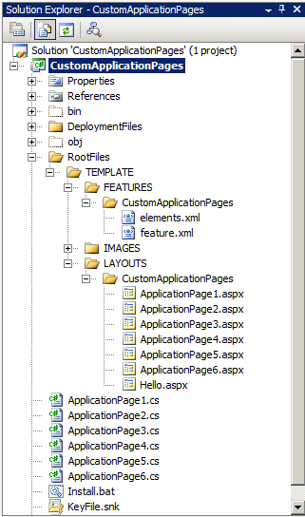
Demo: CustomApplicationPages

Slide 24
Adding a Feature for Navigation
Feature can be used with custom applications
Custom actions provide navigation menu items
<?xml version="1.0" encoding="utf-8" ?>
<Elements xmlns="http://schemas.microsoft.com/sharepoint/">
<!-- Add Menu Command to Site Actions Dropdown -->
<CustomAction Id="HelloApplicationPage"
GroupId="SiteActions"
Location="Microsoft.SharePoint.StandardMenu"
Sequence="2000"
Title="Hello World Application Page"
Description="Getting up and going with inline code">
<UrlAction Url="~site/_layouts/CustomApplicationPages/Hello.aspx"/>
</CustomAction>
</Elements>

Slide 25
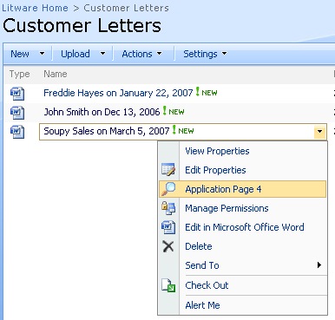
Adding an ECB Menu Item
Custom ECB menu items can be added to lists
Redirect to application page
Registration Types
List
Content Type
File Extension
<CustomAction
Id="CustomApplicationPage4"
RegistrationType="List"
RegistrationId="101"
ImageUrl="/_layouts/images/GORTL.GIF"
Location="EditControlBlock"
Sequence="240"
Title="Application Page 4" >
<UrlAction Url="~site/_layouts/CustomApplicationPages/
ApplicationPage4.aspx?ItemId={ItemId}&amp;ListId={ListId}"/>
</CustomAction>

Slide 26
Deployment using Solution Packages
Evolution of Web Part Packages from WSS 2.0
Solution Package is a CAB file with .wsp extension
Solution Package contains a manifest
Solution Package contains files required on Web server
What can be deployed via a Solution Package
Feature definitions
Application Pages
Assembly DLLs
And much more…

Slide 27
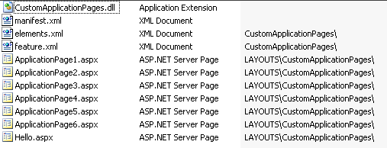
Deployment using Solution Packages
WSS Deployment done with Solution Packages
Solution Package is CAB file with .wsp extension
Created using DDF file and MAKECAB.EXE
Deployed using STSADM.EXE or WSS Central Admin
CustomApplicationPages.wsp

Slide 28
Solution Package Manifest
Solution Manifest read by WSS installer
<Solution SolutionId="9EFFE92B-781D-4c99-BBCC-432D248B899D"
xmlns="http://schemas.microsoft.com/sharepoint/">
<FeatureManifests>
<FeatureManifest Location="CustomApplicationPages\feature.xml" />
</FeatureManifests>
<TemplateFiles>
<TemplateFile Location="LAYOUTS\CustomApplicationPages\Hello.aspx"/>
<TemplateFile Location="LAYOUTS\CustomApplicationPages\ApplicationPage1.aspx"/>
<TemplateFile Location="LAYOUTS\CustomApplicationPages\ApplicationPage2.aspx"/>
<TemplateFile Location="LAYOUTS\CustomApplicationPages\ApplicationPage3.aspx"/>
<TemplateFile Location="LAYOUTS\CustomApplicationPages\ApplicationPage4.aspx"/>
<TemplateFile Location="LAYOUTS\CustomApplicationPages\ApplicationPage5.aspx"/>
<TemplateFile Location="LAYOUTS\CustomApplicationPages\ApplicationPage6.aspx"/>
</TemplateFiles>
<Assemblies>
<Assembly Location="CustomApplicationPages.dll"
DeploymentTarget="GlobalAssemblyCache" />
</Assemblies>
</Solution>

Slide 29
Solution Package: install vs. deploy
Solution Package Installation
WSP file copied into configuration database
Done using addsolution operation of STSADM.EXE
Solution Package Deployment
WSP files copied to each FE Web Server and deployed
Done using deploysolution operation of STSADM.EXE
REM – a batch file named DeploySolutionPackage.cmd from CustomApplicationPage project
Echo Generating Solution Package CustomApplicationPages.wsp
if EXIST CustomApplicationPages.wsp del CustomApplicationPages.wsp
cd ..
makecab /f Solution\cab.ddf
cd package
Echo Installing CustomApplicationPages.wsp in WSS Solution Package Store
%STSADM% -o addsolution -filename CustomApplicationPages.wsp
%STSADM% -o execadmsvcjobs
Echo Deploying Solution Package CustomApplicationPages.wsp
%STSADM% -o deploysolution -name CustomApplicationPages.wsp -immediate -allowGacDeployment
%STSADM% -o execadmsvcjobs

Slide 30
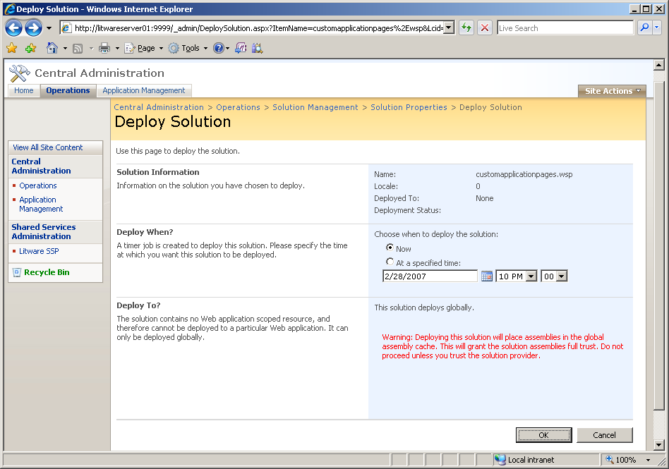
Deploying Solution Packages

Slide 31
Summary
WSS Integration with ASP.NET 2.0
IIS Web sites and Web Applications
The farm and the configuration database
Web Application and Content Database
content databases
The web.config file
Site pages versus application pages
Creating custom application pages
Deployment using Solution Packages

