Slide 1
Page Design and Provisioning
Adding Customizable Pages

Slide 2
Agenda
Page parsing and Safe Mode restrictions
Creating custom page templates
Provisioning page instances
Designing Web Part Pages

Slide 3
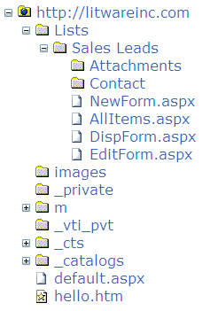
Site Page Fundamentals
Site Pages are part of site
Represented with SPFile objects
Structured in SPFolder objects

Slide 4
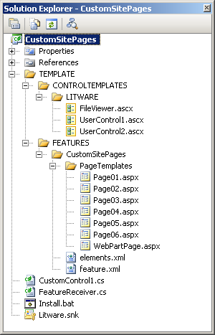
Demo: CustomSitePages
Important Concepts
Page template vs. page instance
Page customization
SafeMode processing

Slide 5
'Hello World' Page Template
Page Template can be added to feature
MasterPageFile points to ~masterurl/default.master
progid adds support for SharePoint Designer
<%@ Page MasterPageFile="~masterurl/default.master"
meta:progid="SharePoint.WebPartPage.Document" %>
<asp:Content runat="server" ContentPlaceHolderID="PlaceHolderMain">
<h3>Hello World</h3>
A simple page template used to create site pages
</asp:Content>

Slide 6
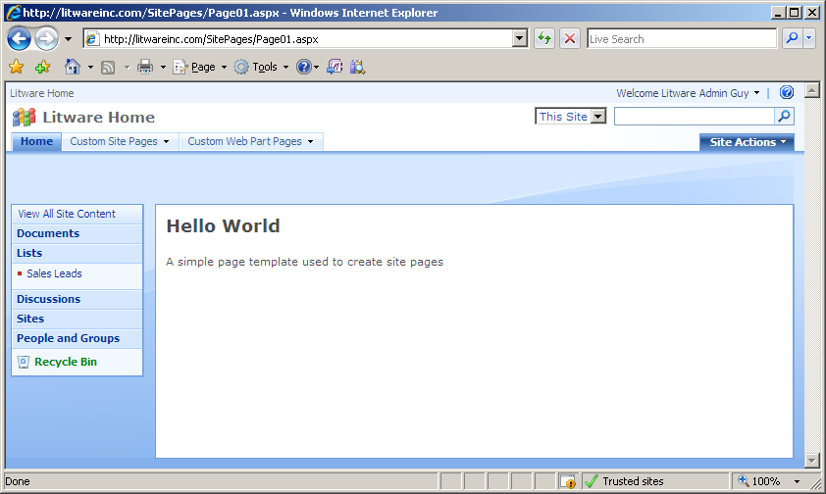
Provisioning a Page Instance
Module element used to provision page instance
File element per page instance
Supports page ghosting
<Elements xmlns="http://schemas.microsoft.com/sharepoint/">
<Module Path="PageTemplates" Url="SitePages" >
<File Url="Page01.aspx" Type="Ghostable" />
</Module>
</Elements>

Slide 7
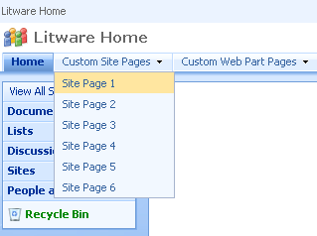
Adding Navigation Support for Pages
Navigation nodes can be added
Can be added during feature activation
Can be added to top-link bar
Can be added to QuickLaunch
Nodes created as SPNavigationNode
public class FeatureReceiver : SPFeatureReceiver {
public override void FeatureActivated(SPFeatureReceiverProperties properties) {
// get a hold off current site in context of feature activation
SPWeb site = (SPWeb)properties.Feature.Parent;
SPNavigationNodeCollection topNav = site.Navigation.TopNavigationBar;
// create dropdown menu for custom site pages
SPNavigationNode DropDownMenu1 =
new SPNavigationNode("Custom Site Pages", "", false);
topNav[0].Children.AddAsLast(DropDownMenu1);
DropDownMenu1.Children.AddAsLast(
new SPNavigationNode("Site Page 1", "SitePages/Page01.aspx"));
}
}

Slide 8
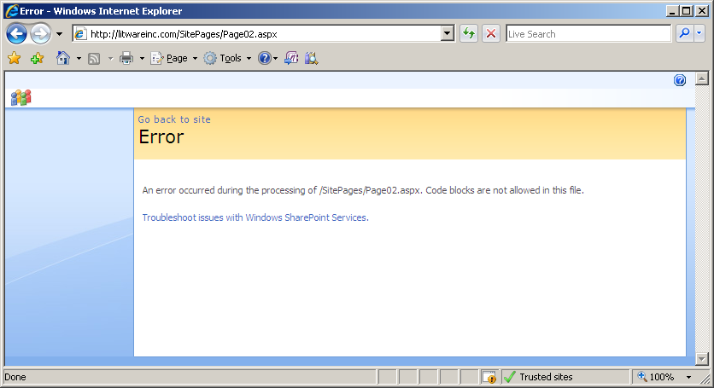
Safe Mode Processing
Customized site pages run in SafeMode
They do not support inline code
They only support controls registered as SafeControls

Slide 9
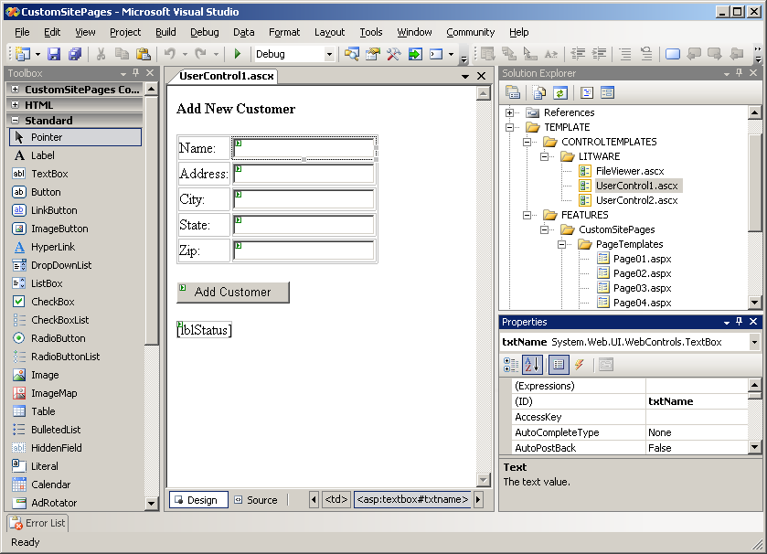
Designing Pages with Controls
Two kinds of ASP.NET controls
Custom controls
User controls

Slide 10
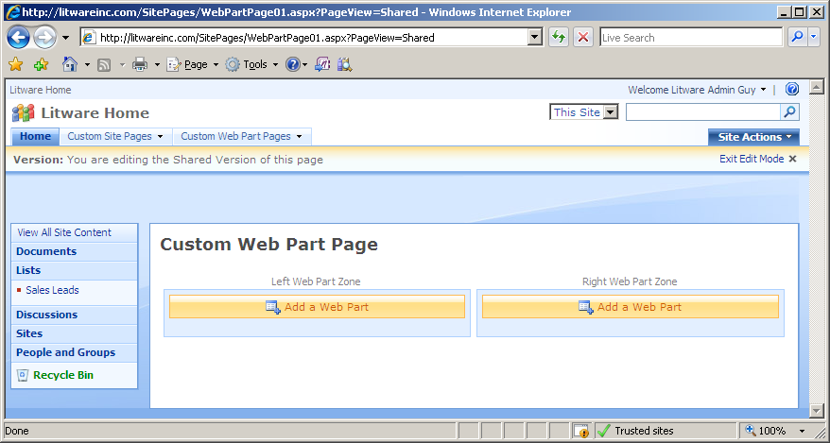
Designing Web Part Pages
Creating a Web Part Page template
Inherit from WebPartPage
Add one or more Web Part Zones

Slide 11
Templates for Web Part Pages
<%@ Page Language="C#" MasterPageFile="~masterurl/default.master"
Inherits="Microsoft.SharePoint.WebPartPages.WebPartPage,[asm name]"
meta:progid="SharePoint.WebPartPage.Document" %>
<%@ Register Tagprefix="WebPartPages"
Namespace="Microsoft.SharePoint.WebPartPages"
Assembly="Microsoft.SharePoint, [asm name]" %>
<asp:Content ID="main" runat="server" ContentPlaceHolderID="PlaceHolderMain" >
<h3>Custom Web Part Page</h3>
<table width="100%">
<tr>
<td valign="top" style="width:50%">
<WebPartPages:WebPartZone ID="Left" runat="server"
FrameType="TitleBarOnly"
Title="Left Web Part Zone" />
</td>
<td valign="top" style="width:50%">
<WebPartPages:WebPartZone ID="Right" runat="server"
FrameType="TitleBarOnly"
Title="Right Web Part Zone" />
</td>
</tr>
</table>
</asp:Content>

Slide 12
Adding Web Parts into Zones
Web Parts can be pre-populated into zones
Can be done declaratively through CAML
Can be done programmatically through WSS OM
<File Url="WebPartPage.aspx" Name="WebPartPage03.aspx" Type="Ghostable" >
<!-- Add a Web Part to right zone -->
<AllUsersWebPart WebPartZoneID="Right" WebPartOrder="0">
<![CDATA[
<WebPart xmlns="http://schemas.microsoft.com/WebPart/v2"
xmlns:iwp="http://schemas.microsoft.com/WebPart/v2/Image">
<Assembly>Microsoft.SharePoint, [asm name]</Assembly>
<TypeName>Microsoft.SharePoint.WebPartPages.ImageWebPart</TypeName>
<FrameType>None</FrameType>
<Title>Watch My Gears Run</Title>
<iwp:ImageLink>/_layouts/images/GEARS_AN.GIF</iwp:ImageLink>
</WebPart>
]]>
</AllUsersWebPart>
</File>

Slide 13
Summary
Page parsing and Safe Mode restrictions
Creating custom page templates
Designing Web Part Pages
Master Pages
Branding a site collection with a custom feature
Understanding and extending core.css

