Slide 1
Master Pages and Site Branding
Working with Master Pages and CSS

Slide 2
Agenda
Master Pages
Branding a site collection with a custom feature
Understanding and extending core.css

Slide 3
Master Pages in WSS
Application pages use application.master
Farm-wide master page
Cannot be customized on a per-site basis
Site Pages use default.master by default
default.master is a page template
default.master instance is created in Master Page Gallery
default.master can be customized on a per-site basis
default.master can be replaced with a different template

Slide 4
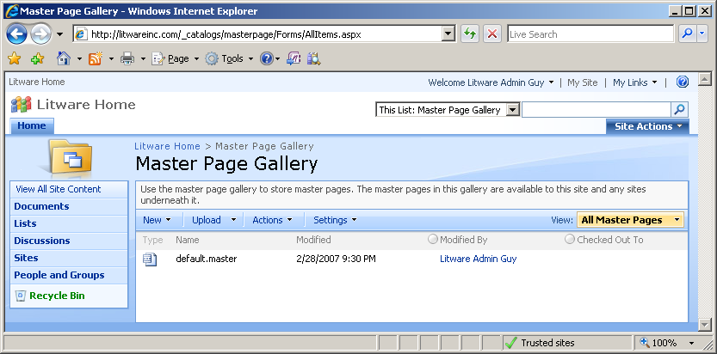
The Master Page Gallery
Each site has a Master Page Gallery
Instance of default.master automatically provisioned
default.master can be customized on a per-site basis

Slide 5
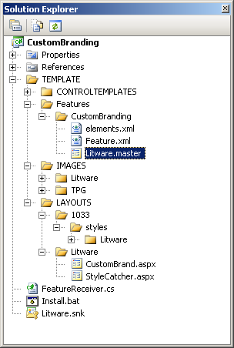
Demo: CustomBranding
Important Concepts
Custom Master Page Templates
Custom CSS File
Custom Site Logo

Slide 6
Custom Master Page Templates
Creating a Master Page Template
Use default.master as a starting point
Make changes to suit your tastes
Master Page templates are like site page templates
Support ghosting and unghosting
Provisioned using a File element within a Module
<Elements xmlns="http://schemas.microsoft.com/sharepoint/">
<Module Name="MasterPages" List="116" Url="_catalogs/masterpage">
<File Url="Litware.master" Type="GhostableInLibrary" />
</Module>
</Elements>

Slide 7
Master Page Elements
<%@Master language="C#"%>
<%@ Register Tagprefix="SharePoint"
Namespace="Microsoft.SharePoint.WebControls"
Assembly="Microsoft.SharePoint, …" %>
<HTML id="HTML1" runat="server">
<HEAD id="HEAD1" runat="server">
<!-- SharePoint Utility Controls -->
<SharePoint:CssLink ID="CssLink1" runat="server"/>
<SharePoint:Theme ID="Theme1" runat="server"/>
<!-- Named Placeholders -->
<Title ID=onetidTitle>
<asp:ContentPlaceHolder id=PlaceHolderPageTitle runat="server"/>
</Title>
<asp:ContentPlaceHolder id="PlaceHolderAdditionalPageHead" runat="server"/>
<!-- Named Delegate Control -->
<SharePoint:DelegateControl
ID="DelegateControl1" runat="server"
ControlId="AdditionalPageHead" AllowMultipleControls="true"/>
</HEAD>

Slide 8
Updating the MasterUrl Property
Update MasterUrl to redirect site pages
Child site can reference the Master Page in a top-level site
public partial class _Default : System.Web.UI.Page {
protected void cmdApplyCustomBrand_Click(object sender, EventArgs e) {
SPWeb site = SPContext.Current.Site.RootWeb
string MasterUrlPath = site.ServerRelativeUrl;
if (!MasterUrlPath.EndsWith(@"/"))
MasterUrlPath += @"/";
MasterUrlPath += @"_catalogs/masterpage/Litware.master";
ApplyCustomBrand(MasterUrlPath, site);
}
protected void ApplyCustomBrand(string MasterUrlPath, SPWeb site) {
site.MasterUrl = MasterUrlPath;
site.Update();
// use recusion to update all child sites in site collection
foreach (SPWeb child in site.Webs) {
ApplyCustomBrand(MasterUrlPath, child);
}
}

Slide 9
Understanding core.css
All styles in WSS initially defined by core.css
Located in \TEMPLATE\LAYOUTS\1033\STYLES
Contains over 4000 lines of CSS class definitions
Classes used throughout standard WSS UI elements
Extending core.css
Applying WSS styles (meant for end users)
Applying custom CSS files (meant for developers)

Slide 10
Applying Custom Branding
protected void cmdApplyCustomBrand_Click(object sender, EventArgs e) {
SPWeb site = SPContext.Current.Web;
string MasterUrlPath = site.ServerRelativeUrl;
if (!MasterUrlPath.EndsWith(@"/"))
MasterUrlPath += @"/";
MasterUrlPath += @"_catalogs/masterpage/Litware.master";
ApplyCustomBrand(MasterUrlPath, site);
Response.Redirect(Request.RawUrl);
}
protected void ApplyCustomBrand(string MasterUrlPath, SPWeb site) {
site.ApplyTheme("");
site.MasterUrl = MasterUrlPath;
site.AlternateCssUrl = "/_layouts/1033/STYLES/Litware/LitwareBrand.css";
site.SiteLogoUrl = "/_layouts/images/Litware/LitwareFullLogo.png";
site.Update();
foreach (SPWeb child in site.Webs) {
ApplyCustomBrand(MasterUrlPath, child);
}
}

Slide 11
Top Navigation Areas
ms-globalbreadcrumb
ms-globalleft
ms-globalright
ms-globallinks
ms-sitetitle
ms-globalTitleArea
ms-siteaction
ms-siteactionsmenu
ms-topNavContainer
ms-banner
ms-topnav + ms-topNavSelected
ms-bannerframe
ms-bannerContainer
ms-topnav

Slide 12
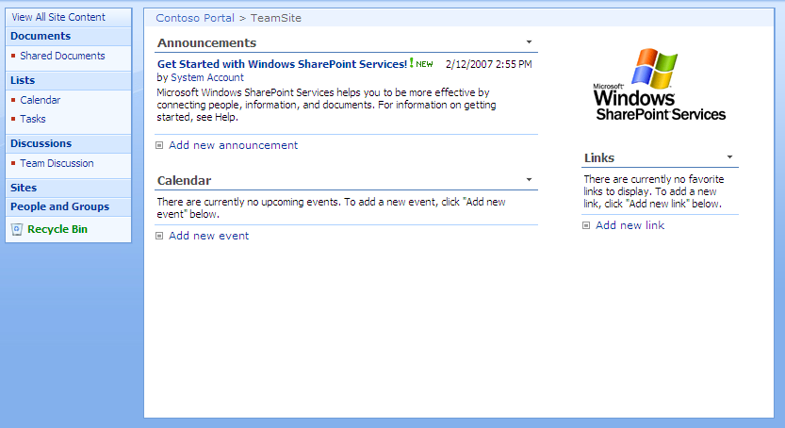
Body Structure
ms-titlearealeft
ms-pagetitleareaframe
ms-titlearearight
ms-titleareaframe
ms-pagetitle
ms-titleareaframe
ms-leftareacell
ms-navframe
ms-pagemargin
ms-pagebottommargin
ms-pagebottommarginright
ms-pagemargin
ms-pagebottommarginleft
ms-bodyareapagemargin
ms-rightareacell

Slide 13
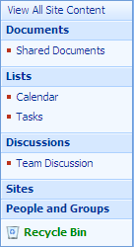
Quick Launch
ms-quicklaunchouter
ms-quickLaunch
ms-standardheader
ms-navSubMenu1
ms-quicklaunchheader
ms-navheader
ms-navSubMenu2
ms-navitem
ms-recyclebin

Slide 14
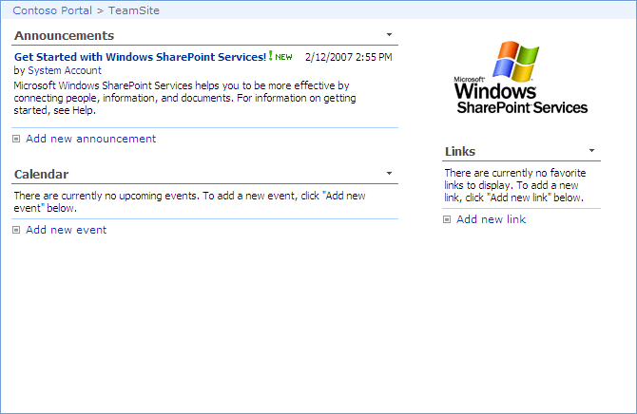
Page Body
ms-bodyareacell
ms-propertysheet
ms-pagebreadcrumb
ms-bodyareaframe
ms-sitemapdirectional

Slide 15
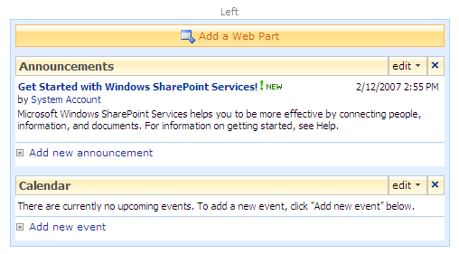
Web Parts
used in edit mode only
ms-SPZone
ms-SPZoneLabel
ms-HoverCellInActive
ms-SPButton ms-WPAddButton
ms-WPEditText
ms-WPHeader
ms-standardheader ms-WPTitle
ms-HoverCellInActive
ms-summarycustombody
ms-addnew
list view web part only
ms-vb

Slide 16
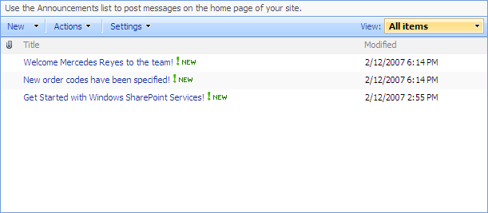
List Views
ms-listdescription
ms-menutoolbar
ms-viewselectorhover
ms-toolbar
ms-listheaderlabel
ms-vh-icon
ms-splitbuttonhover
ms-separator
ms-vh2
ms-unselectedtitle
ms-vb
ms-alternating
ms-vb-title
ms-unselectedtitle
ms-vb
ms-vb2

Slide 17
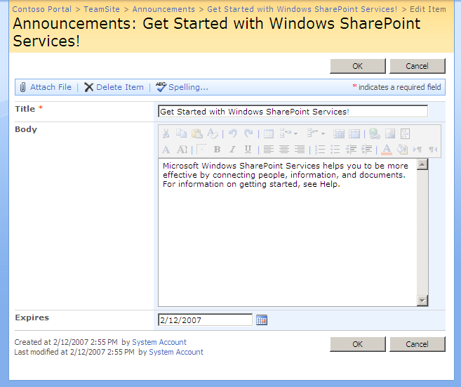
Forms
ms-areaseparatorleft
ms-areaseparatorright
ms-areaseparator
ms-titlearea
ms-pagetitle
ms-sitemapdirectional
ms-formtoolbar
ms-toolbar
ms-ButtonHeightWidth
ms-formtable
ms-formlabel
ms-formbody
ms-formtoolbar
ms-toolbar
ms-descriptiontext

Slide 18
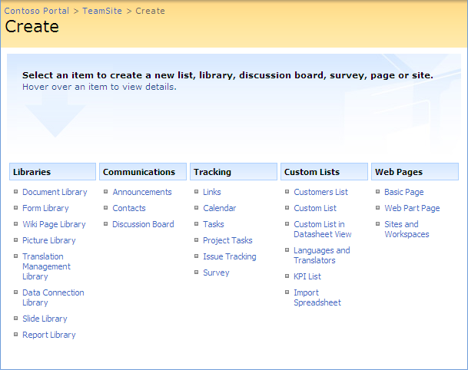
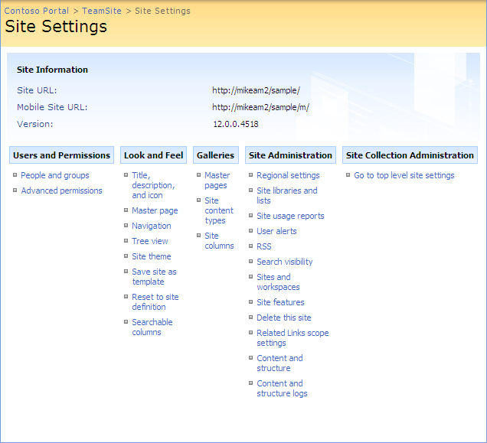
Application Pages (Landing Pages)
ms-settingsframe
ms-createpageinformation
ms-informationtablestatic
ms-pageinformation
ms-linksectionheader
ms-standardheader
ms-propertysheet
ms-descriptiontext

Slide 19
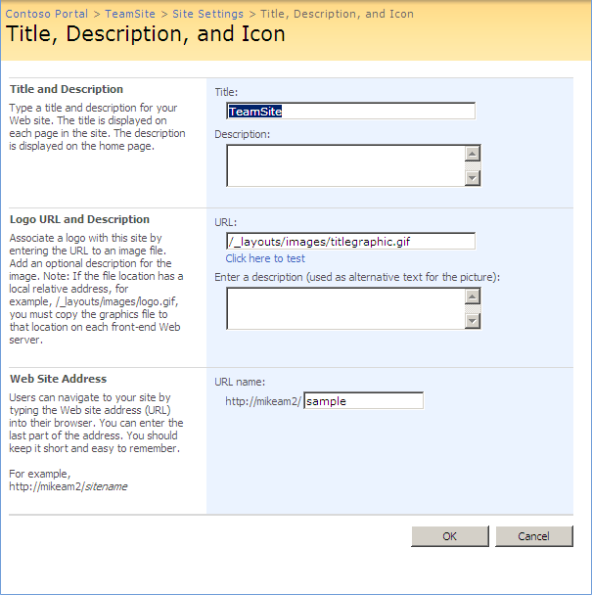
Application Pages (Form Pages)
ms-formareaframe
ms-propertysheet
ms-descriptiontext
ms-sectionheader
ms-standardheader
ms-descriptiontext ms-inputformdescription
ms-authoringcntrols ms-inputformcontrols

Slide 20
Summary
Master Pages
Branding a site collection with a custom feature
Understanding and extending core.css

