Slide 1
Developing Web Parts
Creating User Interface Components that
Support Customization and Personalization

Slide 2
Agenda
Developing ASP.NET Web Parts for WSS 3.0
Persistent Web Part properties
Importing Web Parts into the Web Part Gallery
Creating a feature to for deploying Web Parts
Advanced Web Part Techniques

Slide 3
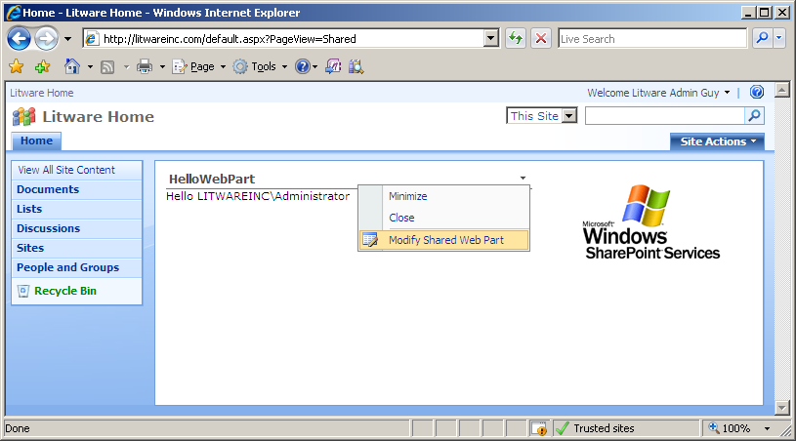
Web Parts
Web Parts are used to build portal-style applications
Content is modular, consistent and easy to navigate
Configurable chrome: border and title bar
Web Parts support for customization/personalization

Slide 4
Web Part History
Windows SharePoint Services 2.0 (WSS V2)
Designed with its own Web Part infrastructure
WSS serializes/stores/retrieves personalization data
ASP.NET 2.0
Designed with a newer universal Web Part infrastructure
Serializes/stores/retrieves personalization data
More flexible and more extensible than WSS
ASP.NET 2.0 does not support WSS v2 Web Parts
Windows SharePoint Services 2007 (WSS V3)
Supports WSS V2 style Web Parts
Supports ASP.NET 2.0 style Web Parts (preferred)

Slide 5
ASP.NET Web Part Page Structure
Web Part Page in ASP.NET 2.0
One instance of the WebPartManager class
One or more Web Part Zones
Optionally an Editor Zone and/or a Catalog Zone
WebPartManager
WebPartZone (Left)
WebPartZone (Right)
Editor Zone
Web Part 1
Web Part 3
Editor Part 1
Web Part 4
Editor Part 2
Web Part 2
Web Part 5
Catalog Zone
Catalog Part 1
Catalog Part 2

Slide 6
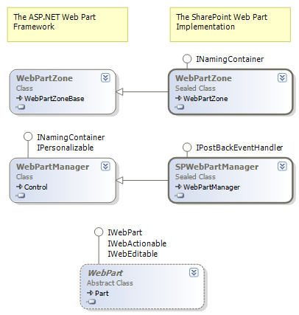
SharePoint's Web Part Implementation

Slide 7
WSS Web Part Page Structure
Web Part Pages in WSS
Inherits from the WSS WebPartPage base class
Contains one SPWebPartManager control
Contains one or more WSS WebPartZone controls
SPWebPartManager
WebPartZone (Left)
WebPartZone (Right)
Editor Zone
Web Part 1
Web Part 3
Editor Part 1
Web Part 2
Web Part 4
Editor Part 2
Web Part 5
Catalog Zone
Catalog Part 1
Catalog Part 2

Slide 8
Overview of Developing Web Parts
Create a new class library DLL project
Create class that inherits from ASP.NET Web Part class
Override methods as required (e.g. RenderContents)
Deploy Web Part DLL
Compile DLL into \bin directory
Configure DLL in web.config file SafeControl list
Import Web Part into a WSS site collection
Add Web Part class to Web Part Gallery
Add Web Part to zone on a Web Part Page

Slide 9
ASP.NET 2.0 Web Parts
Web Parts derive from the WebPart base class
All Web Parts inherit common functionally
using System;
using System.Web.UI;
using System.Web.UI.WebControls.WebParts;
namespace LitwareWebParts {
public class HelloWorld : WebPart {
protected override void RenderContents(HtmlTextWriter writer) {
writer.Write("Hello, world");
}
}
}

Slide 10
Persistent Web Part Properties
Web Parts support persistent properties
Customization data is seen by all users
Personalization data is seen only by one user
namespace LitwareWebParts {
public class HelloWorld : WebPart {
protected string _ZipCode;
[ Personalizable(), WebBrowsable(true),
WebDisplayName("Zip Code"),
WebDescription("used to track user zip code") ]
public string ZipCode {
get{ return _ZipCode; }
set{ value = _ZipCode; }
}
//...
}
}

Slide 11
Web Part As A Safe Control
Web Parts usually run on Web Part Pages
Web Parts must be registered as Safe in web.config file
You must add entry to web.config before testing
<!– web.config in Web Application root directory -->
<configuration>
<SharePoint>
<SafeControls>
<SafeControl Assembly="AcmeWebParts"
Namespace="AcmeWebParts"
TypeName="*"
Safe="True" />
</SafeControls>
</SharePoint>
</configuration>

Slide 12
Web Part Security Caveats
Web Parts in \bin subject to security restrictions
Security restrictions from Code Access Security (CAS)
You might want to turn off security during development
You can choose between three built-in levels
WSS_Minimum (default for WSS V3)
WSS_Medium
Full
<!-- web.config -->
<configuration>
<system.web>
<!-- default setting for WSS and MOSS -->
<trust level=“WSS_Minimal" originUrl="" />
</system.web>
</configuration>

Slide 13
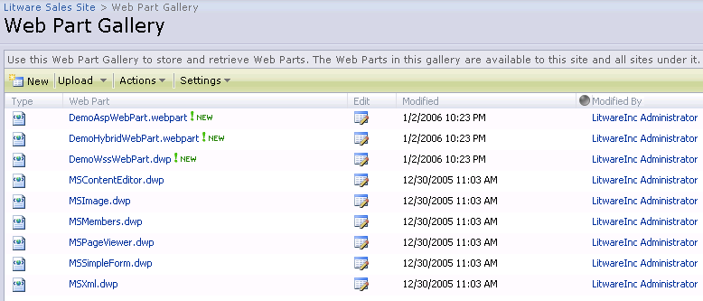
The Web Part Gallery (WPG)
The WPG is scoped at Site Collection level
Contains list of Web Parts available to place on pages
Contains .webpart files and .dwp files

Slide 14
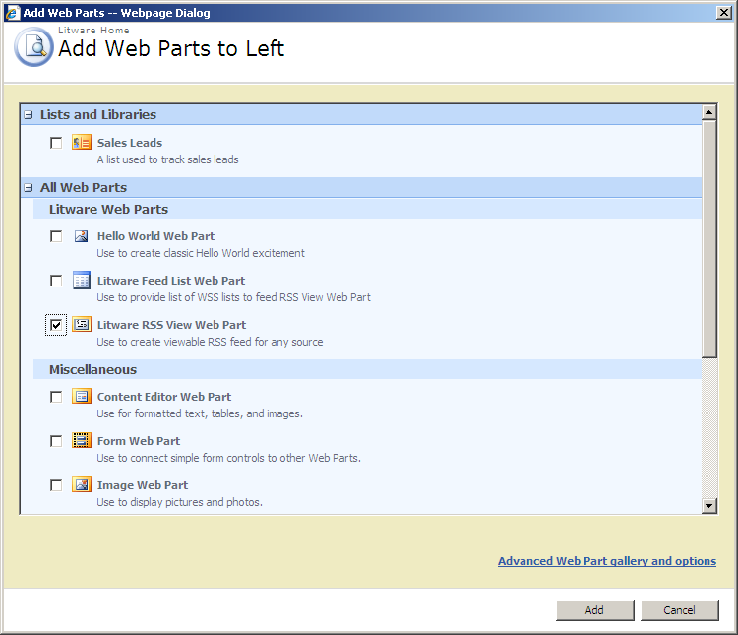
Adding Web Parts from the Gallery
WSS provides standard dialog for adding parts

Slide 15
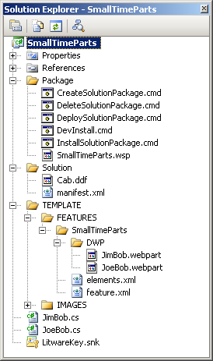
Demo: SmallTimeParts
Important Concepts
.webpart files
Web Part Deployment Feature
Web Part Solution Package
Custom CAS Settings

Slide 16
Provisioning .webpart files
.webpart file needs to be included with WP deployment feature
Modules is then used to provision .webpart file into Web part Gallery
<webParts>
<webPart xmlns="http://schemas.microsoft.com/WebPart/v3">
<metaData>
<type name="SmallTimeParts.JimBob, SmallTimeParts, [full 4-part assembly name]" />
<importErrorMessage>Cannot import this Web Part.</importErrorMessage>
</metaData>
<data>
<properties>
<!-- standard Web Part properties -->
<property name="ChromeType" type="chrometype">Default</property>
<property name="Title" type="string">Jim Bob's Web Part</property>
<property name="Description" type="string">Some valuable description goes here</property>
</properties>
</data>
</webPart>
</webParts>
<!-- this module goes in the feature used to deploy your Web Parts -->
<Module Name="SmallTimeParts“ List="113“ Url="_catalogs/wp“ Path="dwp“ RootWebOnly="true">
<File Url="JimBob.webpart" Type="GhostableInLibrary" >
<Property Name="Group" Value="A Set of Smalltime Web Parts" />
</File>
</Module>

Slide 17
Solution Manifest for WP Deployment
<Solution
SolutionId="DEADBEEF-BADD-BADD-BADD-BADBADBADBAD"
xmlns="http://schemas.microsoft.com/sharepoint/">
<FeatureManifests>
<FeatureManifest Location="SmallTimeParts\feature.xml" />
</FeatureManifests>
<TemplateFiles>
<TemplateFile Location="IMAGES\TPG\compass.gif"/>
<TemplateFile Location="IMAGES\TPG\SmallCompass.gif"/>
<TemplateFile Location="IMAGES\TPG\SmallBinoculars.gif"/>
</TemplateFiles>
<Assemblies>
<Assembly DeploymentTarget="WebApplication" Location="SmallTimeParts.dll">
<SafeControls>
<SafeControl Assembly="SmallTimeParts, [full 4-part assembly name]"
Namespace="SmallTimeParts" TypeName="*" Safe="True"/>
</SafeControls>
</Assembly>
</Assemblies>
<CodeAccessSecurity>
<!-- use when custom CAS policy is needed for deployment in \bin -->
</CodeAccessSecurity>
</Solution>

Slide 18
Solution Manifest for WP Deployment
<Solution SolutionId="DEADBEEF-BADD-BADD-BADD-BADBADBADBAD“
xmlns="http://schemas.microsoft.com/sharepoint/">
<!-- other solution elements omitted for clairty -->
<CodeAccessSecurity>
<PolicyItem>
<!-- create permission set for this policy -->
<PermissionSet class="NamedPermissionSet" version="1"
Description="Permission set for SmallTimeParts assembly">
<!-- add generic .NET CAS security permission -->
<IPermission class="SecurityPermission" version="1“
Flags="Execution, UnmanagedCode, ControlThread" />
<!-- add ASP.NET hosting permission -->
<IPermission class="AspNetHostingPermission” version="1" Level="High" />
<!-- add SharePoint permission -->
<IPermission class="Microsoft.SharePoint.Security.SharePointPermission, [asm name]"
version="1" ObjectModel="true" Impersonate="true" UnsafeSaveOnGet="true" />
</PermissionSet>
<!-- add assembly to be associated with this policy -->
<Assemblies>
<Assembly Name="SmallTimeParts" />
</Assemblies>
</PolicyItem>
</CodeAccessSecurity>
</Solution>

Slide 19
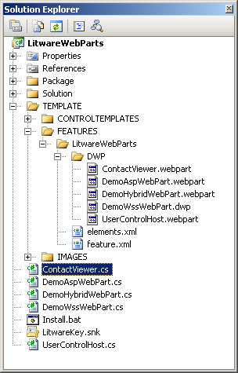
Demo: LitwareWebParts
Important Concepts
Editor Parts
Web Part Verbs
Web Part Connections
Asynchronous Processing

Slide 20
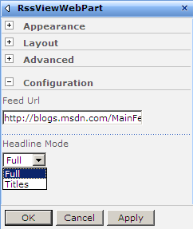
Standard Editor Parts
WSS provides standard editor parts

Slide 21
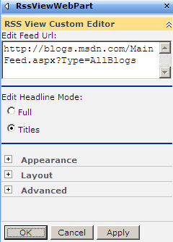
A Custom Editor Part
Custom Editor Parts provide more control
Control over rendering
Control over validation

Slide 22
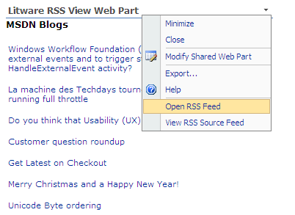
Web Part Verbs
Used to add menu items to Web Parts
Supports client-side handlers through JavaScript
Supports server-side handlers through managed code

Slide 23
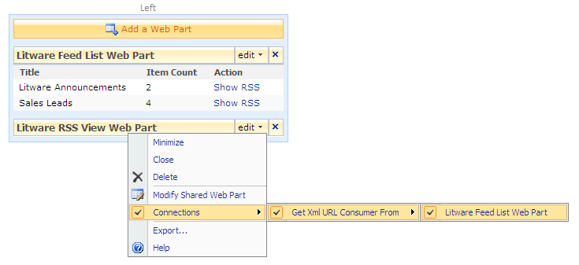
Web Part Connections
ASP.NET provides Web Part Connection model
Provider Web Part supplies data
Consumer Web Parts retrieve data
WSS provides UI elements to establish connections

Slide 24
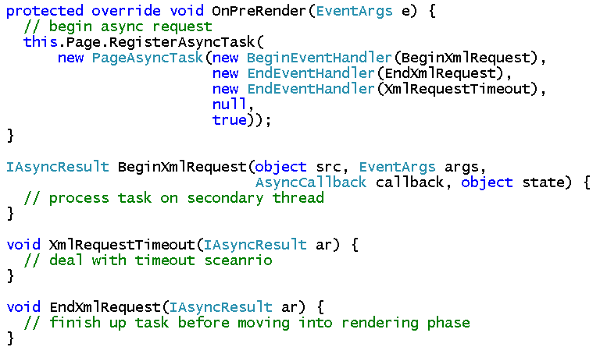
Async Processing with Web Parts
Critical for Web Parts that call across network
Async tasks initiated from OnPreRender event

Slide 25
Summary
Developing ASP.NET Web Parts for WSS 3.0
Persistent Web Part properties
Importing Web Parts into the Web Part Gallery
Creating a feature to for deploying Web Parts
Advanced Web Part Techniques

