Slide 1
Silverlight
Lighting Up SharePoint with Silverlight

Slide 2
Agenda
What is Silverlight?
SharePoint Configuration
Silverlight 3 and SharePoint
Get Started
Deployment
Data Transfer between Silverlight and SharePoint
Data binding

Slide 3

What is Silverlight?
Rich User Presentation (XAML + Code-Behind)
Silverlight 1.0 is 100% JavaScript-driven
Silverlight 2 uses managed code (small .NET Framework footprint)
Silverlight 3 supports .NET RIA Services
Applications are packaged as ZIP files (.XAP extension)
Notes:
New features Silverlight 3: http://timheuer.com/blog/archive/2009/03/18/silverlight-3-whats-new-a-guide.aspx

Slide 4
Getting Started with Silverlight
Silverlight 3 Runtime
Silverlight 3 SDK
Visual Studio 2008
Microsoft Silverlight Tools Visual Studio 2008
Silverlight 3 Application Project Template
Silverlight 3 Class Library Project Template
Silverlight 3 Navigation Application Template
XAML IntelliSense
Limited Design Experience
Expression Blend 3
Rich Design Experience
Sync options with project in Visual Studio 2008

Slide 5
Silverlight and SharePoint
Sample scenarios
Complex and dynamic interaction with data in dashboard pages (charting, reporting, ...)
Visualize multimedia data stored in SharePoint
Rich navigation controls
Interactive field types, Web parts and pages
Off-load more work to the clients

Slide 6
SharePoint Server Configuration
WSS 3.0 Service Pack 1 adds support for .NET Framework 3.5
.NET Framework 3.5 needed for Silverlight 3
.NET Framework 2.0 is fine for Silverlight 1.0
MIME type registration of the .XAP file extension for IIS Web application
Format: application/x-silverlight-app
Automatically included as of IIS 7

Slide 7
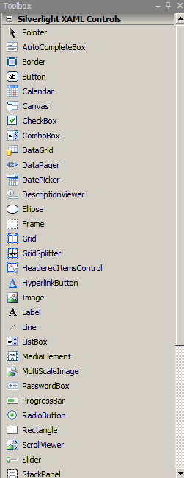
XAML Essentials
App.xaml
Entry Point of the Silverlight application
Can contain Application Resources
such as styles
MainPage.xaml
UserControl
Canvas vs Grid
TextBlock
StoryBoard
MyControl.xaml
Re-usable control

Slide 8
XAML Code Behind
App.xaml.cs
Application_Startup is place where incoming parameters are processed and MainPage object is created
MainPage.xaml.cs
Handle events
Dynamically create XAML elements
Connect to browser DOM
Connect to external data (e.g. Web Services)
MyControl.xaml.cs
Code-behind for control

Slide 9
Where to deploy the XAP?
Scope = Site
Document Library in Site
Scope = IIS Web Application
ClientBin folder in IIS Web App folder
Scope = Server
Layouts folder
ControlTemplates folder
Scope = Web Part
Embedded Resource

Slide 10
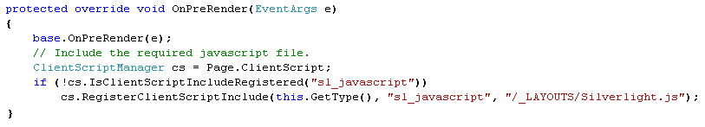
Hosting Silverlight in Web Part - 1
Silverlight.js
Comes with the Silverlight 3 SDK
Location:
C:\Program Files\Microsoft SDKs\Silverlight\v3.0\Tools
Must be deployed in the 12 Hive
Must be loaded in OnPreRender event
Heavy Silverlight usage in SharePoint:
Deploy as ControlTemplate to AdditionalPageHead delegate control

Slide 11
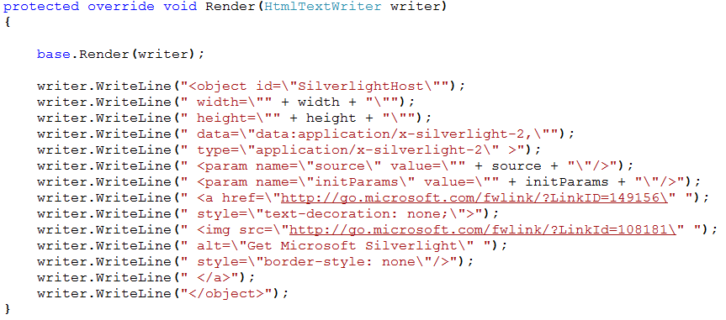
Hosting Silverlight in Web Part - 2
Add Silverlight obect in Render method

Slide 12
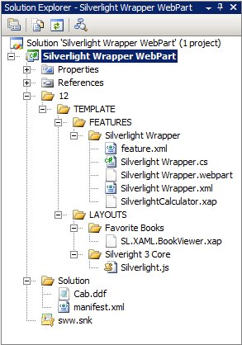
Demo: Silverlight Enabled Web Part
Important Concepts
Developing a Silverlight
enabled Web Part
Packaging the Web Part
Deploying the Web Part

Slide 13
Communication with Silverlight
Silverlight.InitParameters
Small amount of initialization data
Pass as comma delimited string
Key1=value1,key2=value2,…
Process as IDictionary in Application_StartUp
Hidden INPUT Field (two-way)
Pass client ID with InitParameters
Cross-Browser compatible
XML Data Island
Pass ID with InitParameters
Works only in IE but useful for XML data

Slide 14
Consuming Web Services
OOB SharePoint Web Services
Use System.Net.HttpWebRequest (Asynchronously)
Custom SharePoint Web Services
Enable for AJAX Scripting
Deploy in ISAPI (run in context of SharePoint)
AJAX Client Side Web Service Proxies are possible
Custom SharePoint WCF Services
Does not run in context of SharePoint
Service proxy in Silverlight application

Slide 15
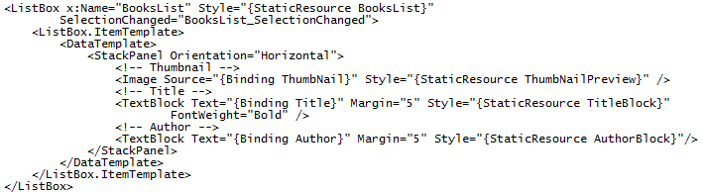
Data Binding in XAML
Grid and StackPanel elements
Define {Binding} in XAML

Slide 16
Data Binding in Code Behind
Data is represented by class
Objects of class are collected in ObservableCollection<class>
Controls expose ItemsSource property for binding
Book Class
Title
Author
Publisher
Description
ObservableCollection <Book> instance
XAML Element
External Data

Slide 17
Updating data
In XAML:
Set BindingMode property
OneWay
OneTime
TwoWay
In Book class:
Implement INotifyPropertyChanged
Raise NotifyPropertyChanged

Slide 18
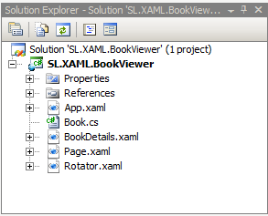
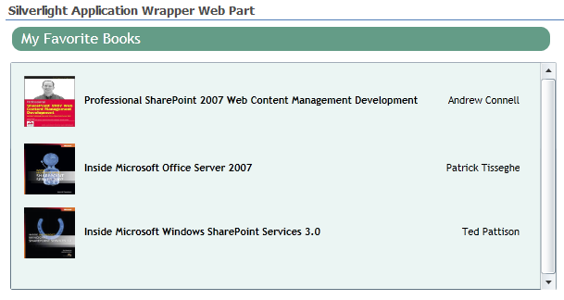
Demo: Data binding to SharePoint
Important Concepts
InitParams
HttpWebRequest
ItemsSource
DataContext

Slide 19
Downloading Media
WebClient object
Streams
Asynchronous
OpenReadCompleted
Pass Incoming Stream to
Pictures go into an Image Element
Videos go into a MediaElement

Slide 20
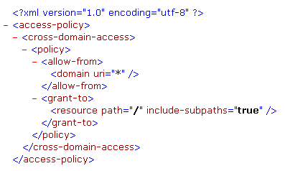
Data Across Domains
By default not allowed
If required, add client access policy to the root of the site via SharePoint Designer or Feature

Slide 21
Summary
Why do we need Silverlight
Silverlight Integrating with SharePoint
Where to deploy the Silverlight application
Communication between Silverlight and SharePoint
Data binding
Downloading Media

