Slide 1
Lists and Content Types
Designing and Implementing
Types for Content Storage

Slide 2
Agenda
Content storage enhancements in WSS 3.0
Querying data in lists
WSS storage fundamentals
Site columns
Custom field types
Content types
Provisioning lists and document libraries
Event handling with receiver classes

Slide 3
Motivation: Content Storage in WSS
All storage in WSS is based on the concept of lists
Everything is modeled in terms of rows and columns
The Document Library is really just a hybrid list
WSS adds value on top of the generic list concept
Transparent content storage in SQL Server
Automatic generation of the user interface

Slide 4
Platform Storage Enhancements in WSS3
Parity between lists and document libraries
Folders are supported for lists as well as document libraries
Versioning is supported for list items as well as documents
Events are supported on lists as well as in document libraries
List and Document Library Enhancements
New productivity-oriented built-in field types
Wide list support allowing 100s of columns (e.g. surveys)
Custom column indexing to improve performance
Cross web queries, list views and lookup fields
Enhanced versioning with major and minor versions
Lists and document libraries automatically support RSS feeds

Slide 5
Accessing List Data
Updating list data
Enumerating through list items
SPListItem newItem = list.Items.Add();
newItem["Title"] = "Litware Goes Public!";
newItem["Body"] = " We all live in exciting times.";
newItem["Expires"] = DateTime.Now + TimeSpan.FromDays(2);
newItem.Update();
foreach (SPListItem item in list.Items) {
foreach (SPField field in list.Fields) {
if (field.Hidden != true && !field.ReadOnlyField)
Console.WriteLine("{0} = {1}", field.Title, item[field.Id]);
}
}

Slide 6
SPQuery
SPQuery supports CAML-based queries
Faster access than enumerating through all list items
Limited to a single list per query
SPQuery query = new SPQuery();
query.ViewFields = @"<FieldRef Name='Title'/><FieldRef Name='Expires'/>";
query.Query =
@"<Where>
<Lt>
<FieldRef Name='Expires' />
<Value Type='DateTime'>
<Today />
</Value>
</Lt>
</Where>";
SPList list = site.Lists["Litware News"];
SPListItemCollection items = list.GetItems(query);
foreach (SPListItem expiredItem in items) {
Console.WriteLine(expiredItem["Title"]);
}

Slide 7
SPSiteDataQuery
SPSiteDataQuery can extend across lists/sites
Introduced in WSS 3.0
Scope can be Site, SiteCollection or Recursive
SPSiteDataQuery query = new SPSiteDataQuery();
query.Lists = @"<Lists ServerTemplate='104' />";
query.ViewFields = @"<FieldRef Name='Title'/><FieldRef Name='Created'/>";
query.Webs = "<Webs Scope='SiteCollection' />";
string queryText =
@"<Where>
<Eq>
<FieldRef Name='Created' />
<Value Type=""DateTime"">
<Today />
</Value>
</Eq>
</Where>";
query.Query = queryText;
DataTable table = site.GetSiteData(query);
foreach (DataRow row in table.Rows) {
Console.WriteLine(row["Title"].ToString()); }

Slide 8
Issues with Managing Content
Problems with managing content in large companies
There are many document types identified in an organization, but there is no clear way to enforce standards
There's a need to create different types of documents and store them all in one central location
Content management applications should make a list of actions available to users depending on the type of content or document
WSS provides new features to solve these problems
Site Columns
Content Types

Slide 9
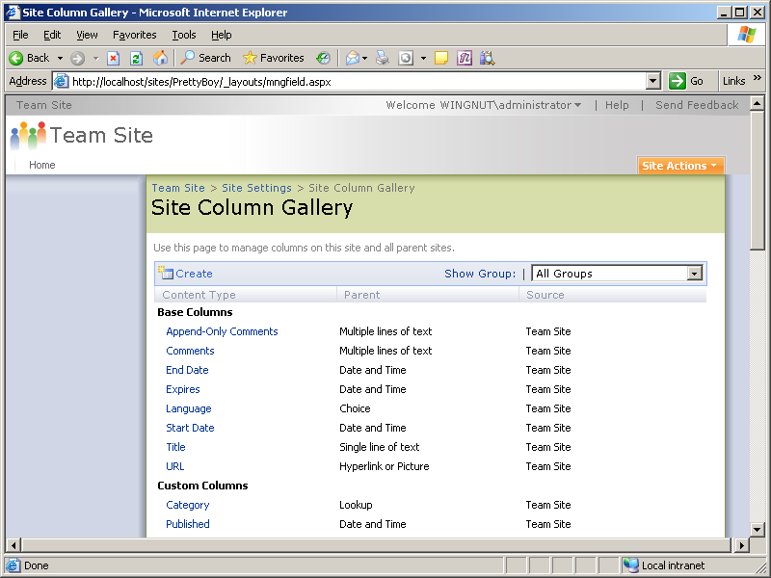
Site Columns
Site columns are reusable column definitions
Site columns can be reused across multiple lists
Site columns are scoped to site in the Site Column Gallery
Site columns are visible within the site collection to all child sites

Slide 10
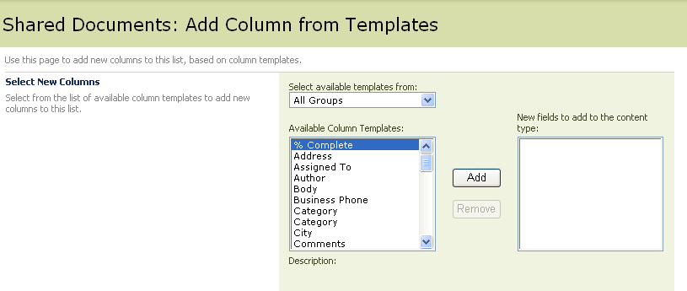
Using a Site Column in a List
Site Columns can be used in List Definitions
A Site column represents a reusable, named column definition
Site columns are used in lists, document libraries or content types
Updates to a site column can optionally be pushed out to lists, document libraries and content types where it has been used

Slide 11
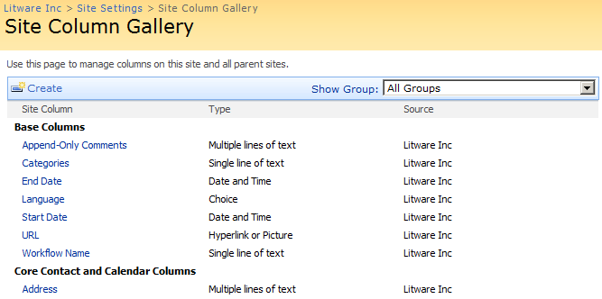
Demo: Creating Site Columns

Slide 12
Introduction to Content Types
Foundation for content management in WSS v3
Reusable definition for list schema
Defines constraints and requirements for an item type
Created by users and developers
Reused and extended by users

Slide 13
Examples for Content Types
Proposals for software projects
Requires author
Requires data for scheduling and budgeting
Requires reviews by technical and finance departments
Customer presentation
Requires author
Requires reviews by legal and art departments
Customer report for consulting work
Requires consultant name
Requires hourly billing information

Slide 14
Content Types
A content type definition can include…
Columns to represent metadata or properties
A document template on which to base documents of this type
Custom forms for New, Edit, and Display use with content type
Event handlers
Workflows

Slide 15
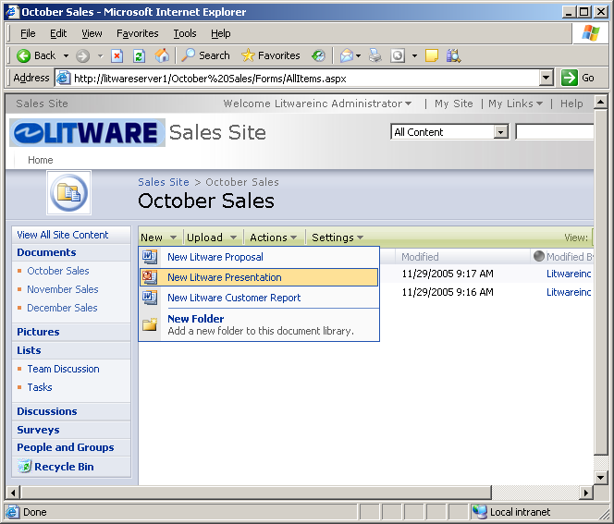
Supporting Multiple Content Types
Lists can support multiple content types
Makes it possible to support heterogeneous content
The “New button” becomes a dropdown list
Input and display forms change depending on content type

Slide 16
Inheriting Content Types
Allows base definition reuse across multiple types
Core properties can be defined in base content types
The Base content type is inherited by more specific content types
Base Document
Litware Document
Litware Proposal
Litware Presentation

Slide 17
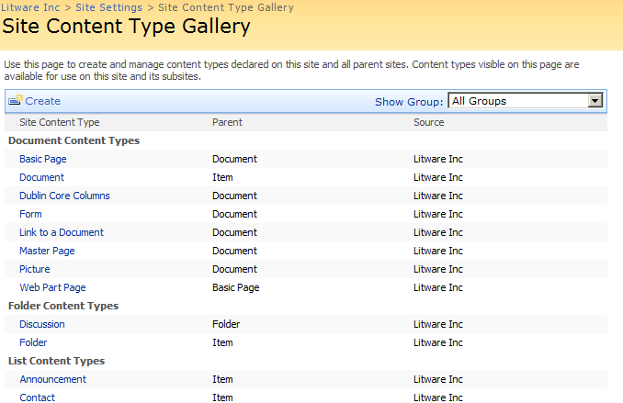
Demo: Creating Content Types

Slide 18
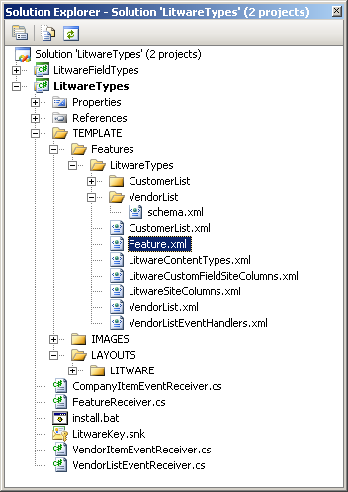
Demo: LitwareTypes
Important Concepts
Defining WSS types in features using CAML
Defining site columns
Custom field types
Defining content types
Defining list schemas
Creating event handlers

Slide 19
WSS 3.0 Events
Events architecture has significantly improved
Events are supported for lists, document libraries and content types
Events are supported for changes to list schema as well as items
Events are supported at site collection and site level
Events are supported for incoming email messages
Support for synchronous events and asynchronous events
Synchronous events occur before the fact and are cancel-able
How do you get events to work
Create a custom class inheriting a WSS receiver class e.g. SPItemEventReceiver or SPWebEventReciever
Compile class into assembly DLL and install in GAC
Add event configuration by installing and activating a feature

Slide 20
Item-level Events
Define the receiver class by inheriting from SPItemEventReceiver
namespace Litware {
public class TimesheetEventReceiver : Microsoft.SharePoint.SPItemEventReceiver {
public override void ItemUpdating(SPItemEventProperties properties) {
SPWeb web = properties.OpenWeb();
SPListItem timesheet = web.Lists[properties.ListId].GetItemById(properties.ListItemId);
// check to make sure date is not day in future
if (Convert.ToDateTime(timesheet["Submitted On"]).CompareTo(DateTime.Today) > 0) {
properties.ErrorMessage = "You cannot enter future timesheets";
properties.Cancel = true;
return;
}
}
}
}
Register receiver class through either OM code or feature element
SPList list = web.Lists["Timesheets"];
list.EventReceivers.Add(SPEventReceiverType.ItemAdding,
"LitwareAssembly, [asm name]",
"Litware.TimesheetEventReceiver");

Slide 21
Summary
Content storage enhancements in WSS 3.0
Querying data in lists
WSS storage fundamentals
Site columns
Custom field types
Content types
Provisioning lists and document libraries
Event handling with receiver classes

