Slide 1
Site Definitions
The Origin of Life for a WSS Site

Slide 2
Agenda
What is a site definition?
Built-in site definitions with WSS and MOSS
The Global Site Definition
Creating a site definition

Slide 3
What is a Site Definition?
Top-level component for site provisioning
Used to create site templates
Aggregates smaller, more modular definitions
Every site is provisioned from a site definition
The association remains in place for lifetime of site
Each site definition has one or more configurations
Each configuration can serve as creatable site template

Slide 4
What files make up a Site Definition?
ONET.XML
Acts as manifest for site definition
WEBTEMP.XML
Language-specific file used to activate site definition
Page template files
Used to provision home page and secondary pages

Slide 5
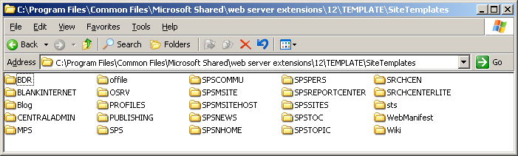
Standard SharePoint Site Definitions
Out-of-box with WSS
STS, MPS, CENTRALADMIN, Blog, Wiki
All others in picture provided by MOSS

Slide 6
Create A Site From A Site Definition
Create a new site from Team Site template
Using default configuration for STS site definition
Create a new site from Blank Site template
Using explicit configuration from STS site definition
STSADM.EXE -o createsite -url http://litwareinc.com
-ownerlogin LITWAREINC\Administrator
-owneremail administrator@Litwareinc.com
-sitetemplate STS
STSADM.EXE -o createsite -url http://litwareinc.com
-ownerlogin LITWAREINC\Administrator
-owneremail administrator@Litwareinc.com
-sitetemplate STS#1

Slide 7
The Global Site Definition
Contains global provisioning instructions
What's inside affects provisioning for every site in farm
Eliminates redundant CAML required in WSS v2
Global Site Definition defines and provisions
Master Page Gallery and default.master (all sites)
Web Part Gallery (top-level sites only)
List Template Gallery (top-level sites only)
Site Template Gallery (top-level sites only)
User Information Profile list (top-level sites only)

Slide 8
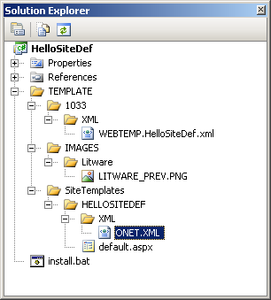
Developing Site Definitions
Sample Visual Studio project: HelloSiteDef
Just build the project and test it out

Slide 9
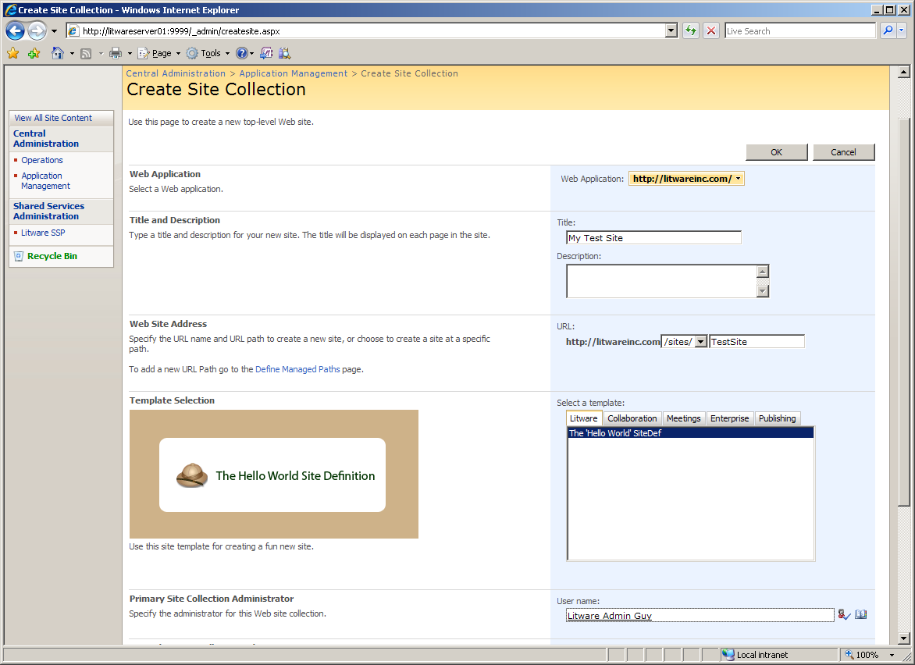
Testing HelloSiteDef

Slide 10
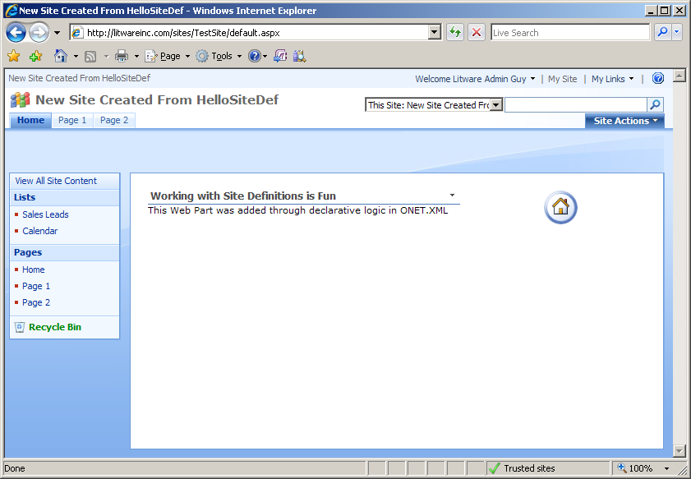
A Freshly Created Test Site

Slide 11
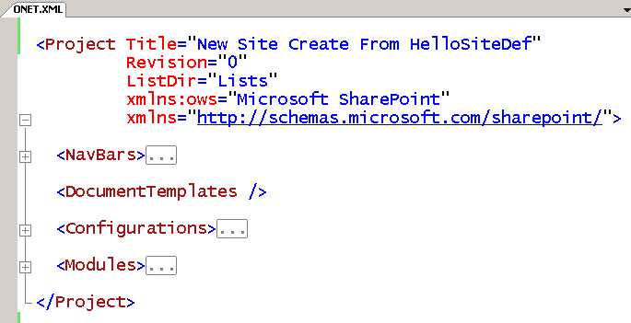
ONET.XML
Provides top-level provisioning instructions

Slide 12
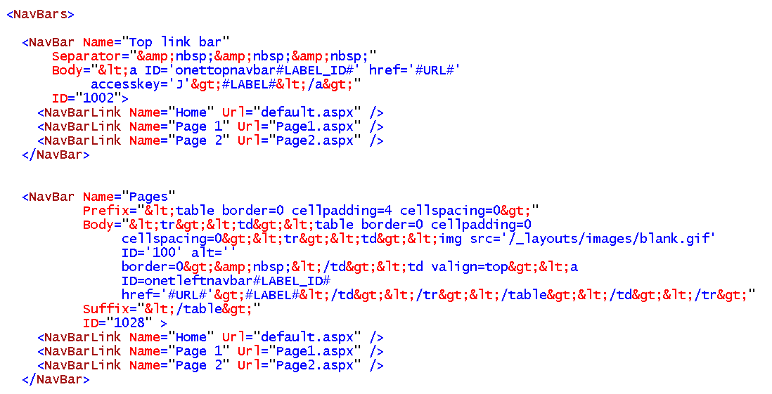
Navbars

Slide 13
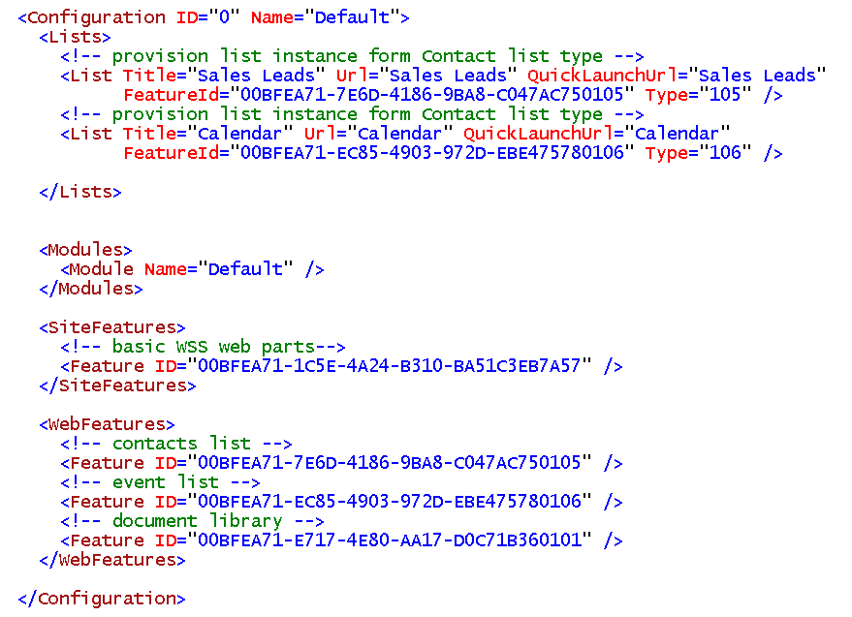
Configurations

Slide 14
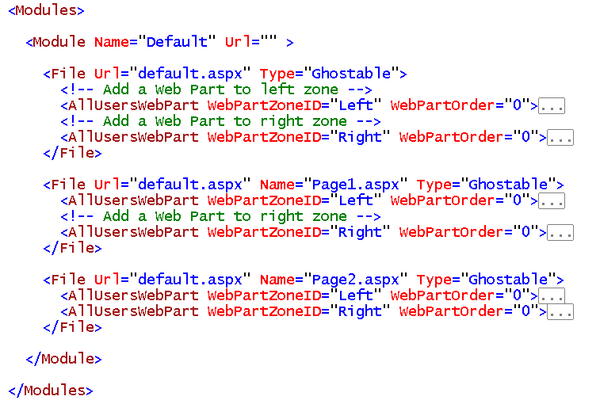
Modules

Slide 15
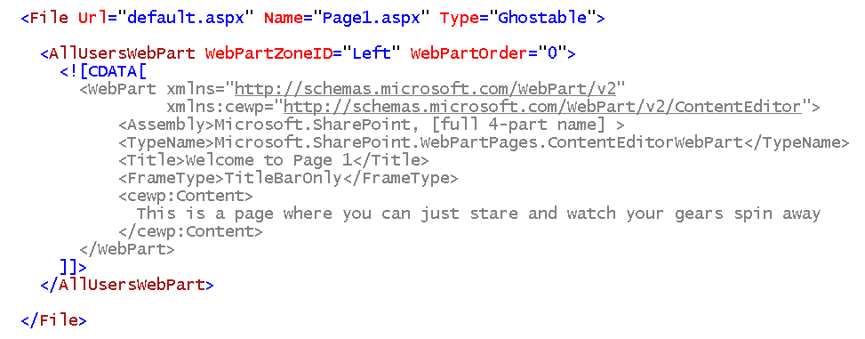
File and AllUsersWebPart

Slide 16
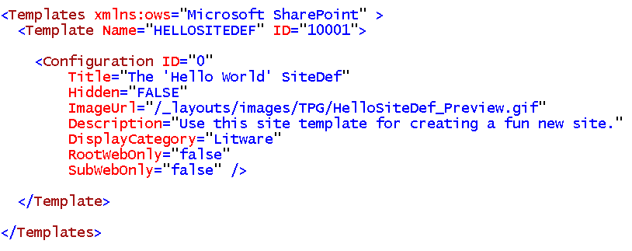
WEBTEMP*.XML

Slide 17
Summary
What is a site definition?
Built-in site definitions with WSS and MOSS
The Global Site Definition
Creating a site definition

