Slide 1
Forms Services and InfoPath 2007
Designing browser-based forms to
capture schema-validated XML data

Slide 2
Agenda
Background in InfoPath 2003
The InfoPath Forms Designer
Integration with WSS forms libraries
Forms Services Architecture
Designing server-side forms with InfoPath 2007
Visual Studio Tools for Applications(VSTA)

Slide 3
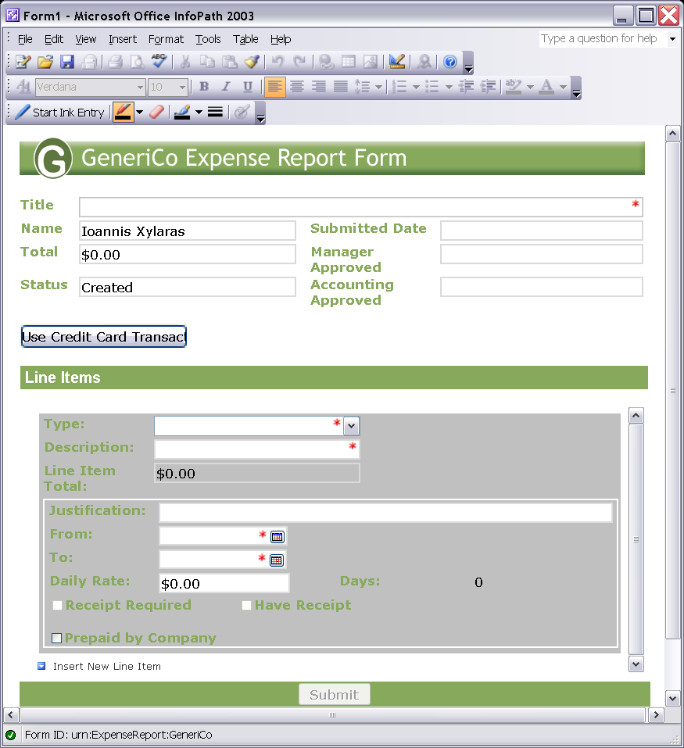
The Role of InfoPath in Office 2003
InfoPath was introduced with Office 2003
Platform for next generation of electronic forms
InfoPath Forms
Captures XML data
Based on XML Schema
Requires little/no code

Slide 4
Challenges with InfoPath 2003
Companies like InfoPath 2003, but…
They want better support for offline scenarios
They want to greater reach (browser-based clients)
They want a better code-behind model
InfoPath 2007 introduces several improvements
Improved offline support through wizard
Forms Services extended InfoPath forms to browser
IT People Responsible for the Deployment
Code-behind using Visual Studio Tools Applications

Slide 5
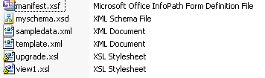
Inside an InfoPath Form
InfoPath for is a CAB file with .XSN extension
Contains manifest with form metadata (XSF)
Contains an XML Schema (XSD)
Contains XSL transforms to for view rendering
Contains XML files with data
LitwareBugReport.xsn

Slide 6



Security – Trust Levels
Restricted
Deployed via email, no auto-updates
No data connections, no managed code
Not applicable for browser forms
Domain
Deployed to SharePoint library, browser forms
Connect to own server only, no code for browser forms
Use trusted Data Connection Library for cross-domain
Full Trust
Installed, Digitally Signed, or .NET Code Group
Must be admin-deployed for browser forms
Connect to any server, managed code in browser forms
Notes:
Instructor Notes
Depending on your deployment option, different trust levels will be active
Deployed via email → very limited permissions
Deployed in a web server (e.g. SharePoint library) → depending on your IE security settings
Deployed via installer → possibility to get full trust

Slide 7
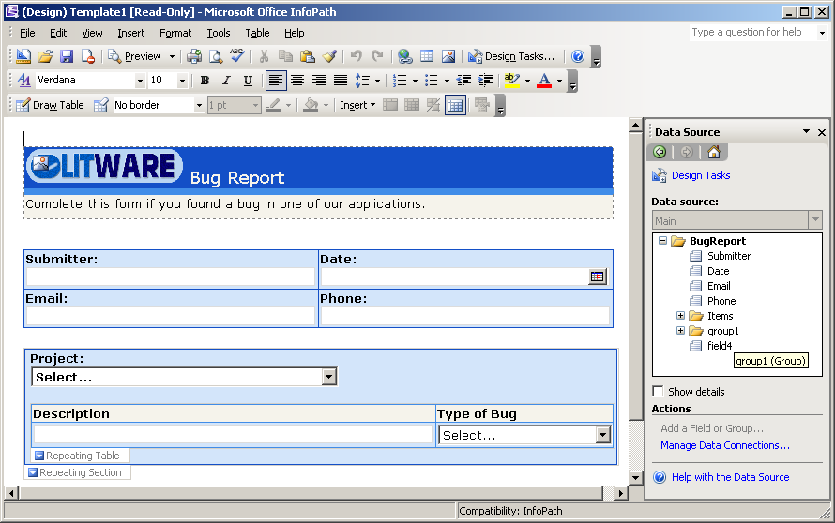
Demo: The InfoPath Forms Designer

Slide 8
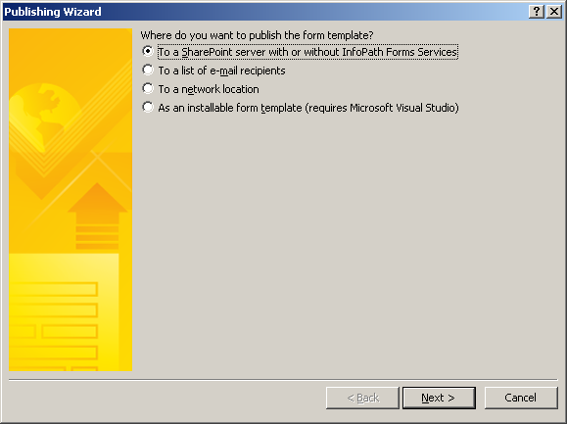
InfoPath Integration with WSS
Forms Libraries
A document library with a .XSN document template
Introduced with InfoPath 2003 and WSS 2.0
Create by users through InfoPath Publishing command

Slide 9

Template Importing
InfoPath
XYZ
InfoPath
XYZ
Your
Your
XSN Folder
XSN Folder
Document
Document
Importer
Importer
Designer
(XSF, etc)
Designer
(XSF, etc)
Built-in support for Word, Excel documents
Extensible framework
Options and progress only
IFormTemplateConverter
Use in combination with the Design Checker

Slide 10
Data Importing
No OOB solutions for this
Extensible framework
Any custom UI
IInfoPathDataImporter

Slide 11
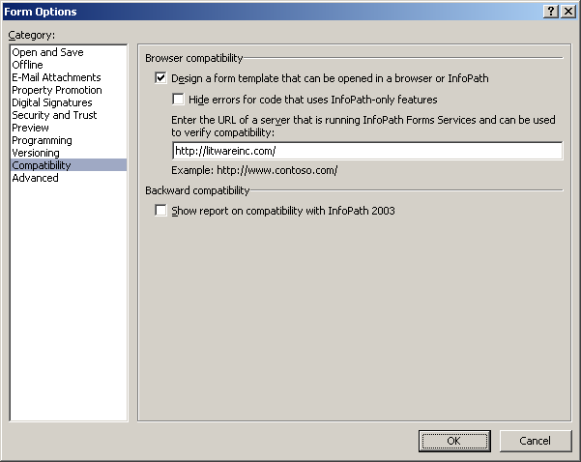
Browser-based Forms
Forms Services provides HTML rendering
Forms must be designed using InfoPath 2007
Forms must be designed to be browser compatible

Slide 12
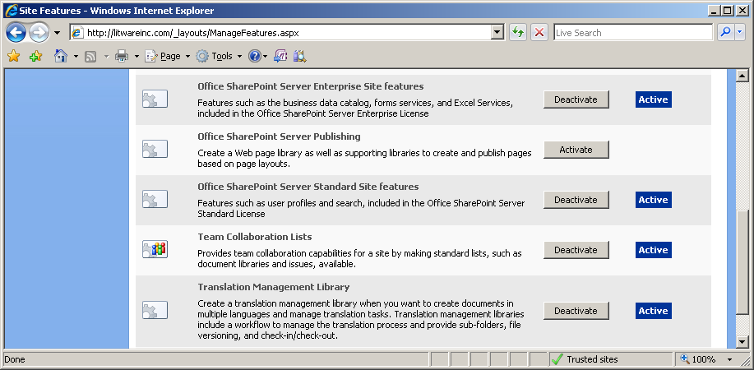
Sites and Browser-based Publishing
Activate MOSS Standard and Enterprise features
Should be done for target site and site collection
Turn this on

Slide 13
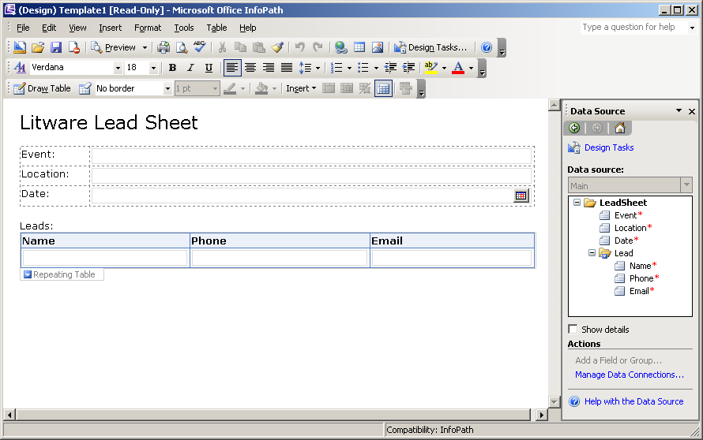
Designing a Browser-based Form

Slide 14
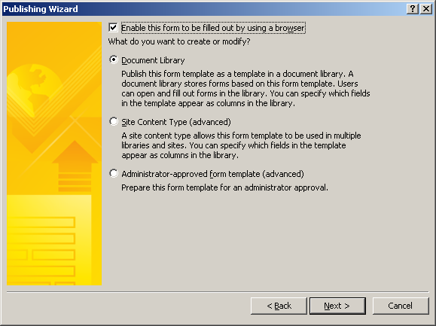
Publishing a Browser-based Form
Saved up to WSS Forms Library
MOSS uses document template .xsn file for rendering

Slide 15
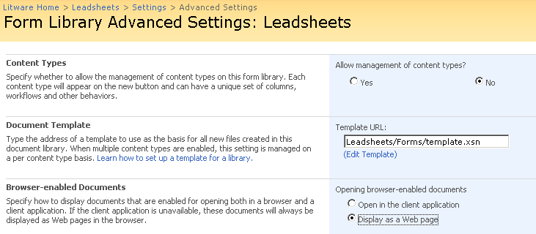
Forms Library Settings
Important Forms Library settings
template.xsn is the editable InfoPath form template
Open browser-enabled documents
The default is to open with InfoPath rich client if possible

Slide 16
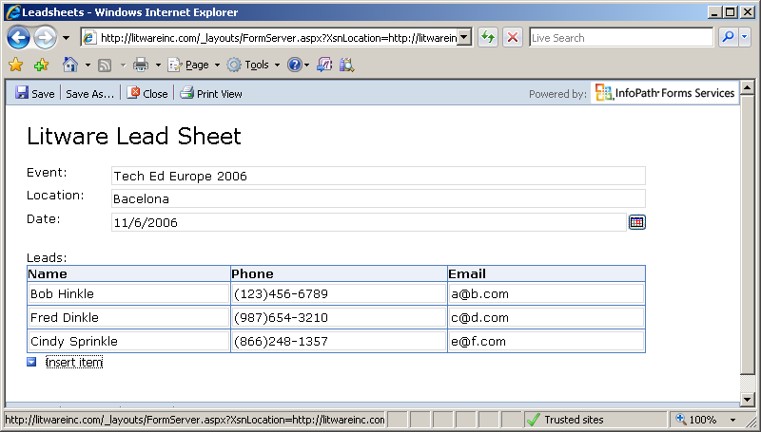
Browser-based Rendering
Browser-based rendering for wide reach
Based on DHTML and JavaScript
Tested with IE, FireFox, Netscape & hand-held devices

Slide 17
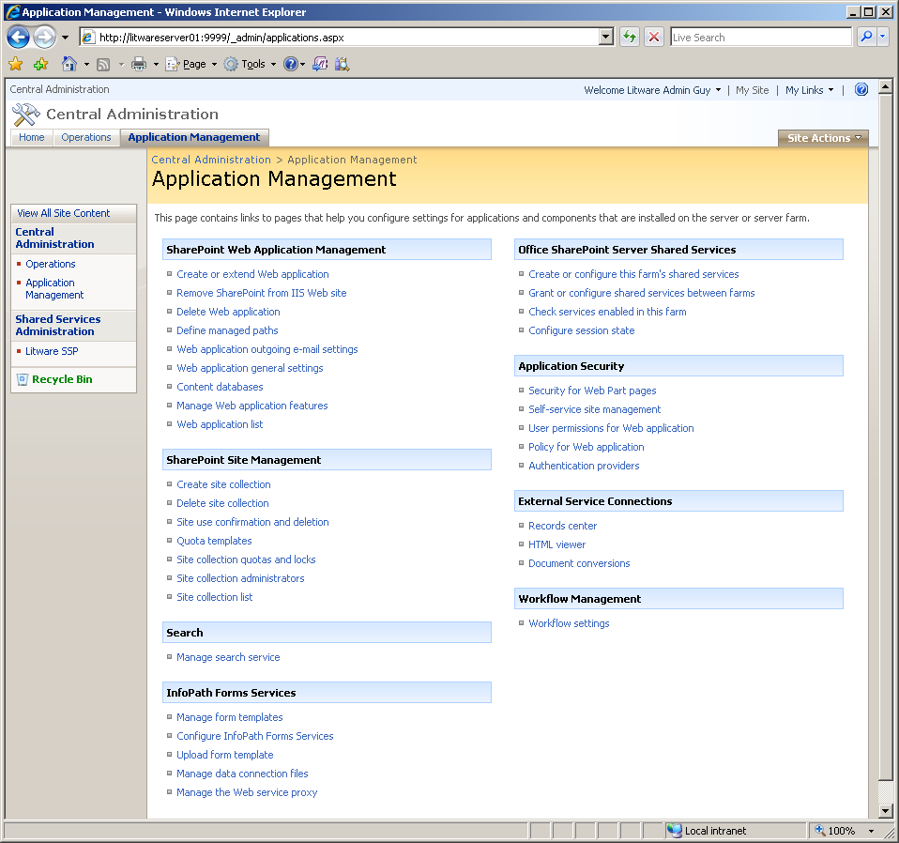
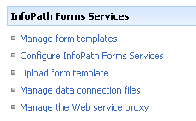
Forms Services Administration
Part of WSS Central Administration
Used to upload/manage forms and data connections

Slide 18
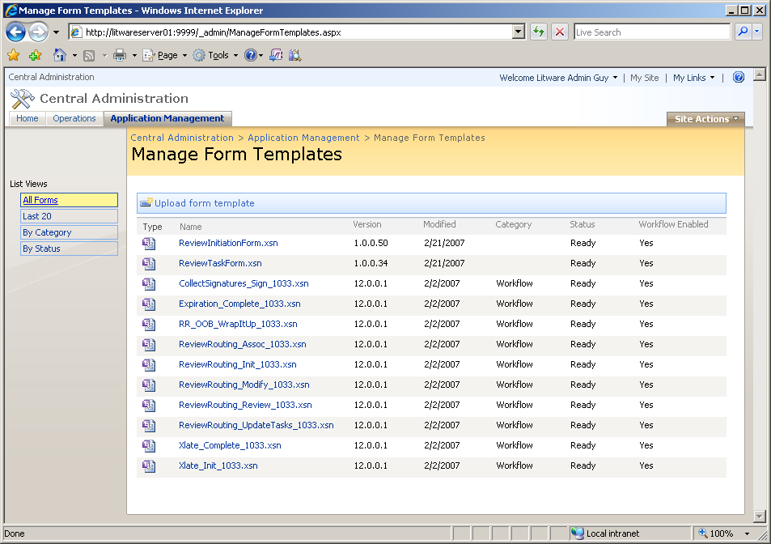
Administrator Uploaded Form Templates
Some forms must be uploaded by administrator
Forms with code and/or forms with data connections
Benefit: deployed at farm scope not at site scope

Slide 19
Supporting the .NET Developer
Visual Studio Tools for Applications (VSTA)
Provided with InfoPath 2007 out-of-box
Lowers the bar for forms with managed code
Compatible with Visual Studio Tools for Office
Visual Studio Tools for Office (VSTO)
Embedded designer for professional developers
One IDE for all your projects: Workflow, etc.
Integrated toolbox, project wizard, etc.

Slide 20
Summary
Background in InfoPath 2003
The InfoPath Forms Designer
Integration with WSS forms libraries
Forms Services Architecture
Designing server-side forms with InfoPath 2007
Visual Studio Tools for Applications(VSTA)

