Slide 1
SharePoint Workflows
Using the Windows Workflow Foundation to
Attach Business Logic to Items and Documents

Slide 2
Agenda
Windows Workflow Foundation (WF) Primer
Creating WF programs in Visual Studio
Creating workflow templates for WSS
Workflow associations and workflow instances
Creating and waiting on WSS tasks
Integrating workflow input forms

Slide 3
Reactive Programs
Automating a business process
Often requires program with episodic behavior
Program waits around and then reacts to some event
How would you automate document approval?
In a Windows Forms application…
In an ASP.NET Application

Slide 4
Windows Workflow Foundation (WF)
What is the Windows Workflow Foundation?
Development platform for building reactive programs
Set of development tools integrated with Visual Studio
Runtime components that ship with.NET FX 3.0
Windows Workflow Foundation concepts
WF program
Workflow instance
Activities

Slide 5
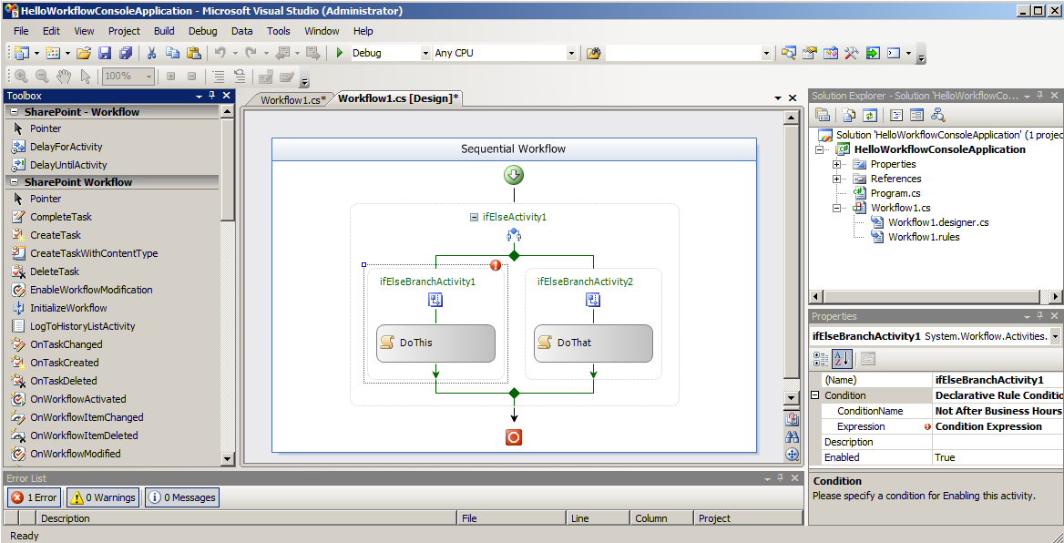
Visual Studio Workflow Designer

Slide 6
Activities
An activity is…
atomic set instructions used complete a unit of work
reusable component used to compose WF programs
Activities are like a controls in forms development
You drag and drop them onto a design surface
You modify their properties through property sheet
You generate event handlers and write code inside
Activities are different than controls
Activities are resumable

Slide 7
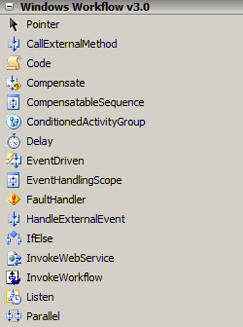
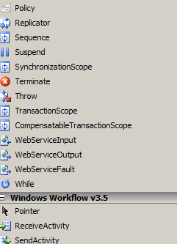
WF Base Activity Library
Standard WF activities provide basic building blocks

Slide 8
Composite Activities
Composite Activities can contain children
Composite activity controls execution of children
Composite activity can encapsulate control-of-flow
Examples: IfElse, While, Sequence, Parallel, Replicator
WF program is itself a composite activity
WF program models a tree of activities

Slide 9
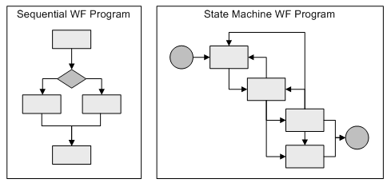
WF Program Types
WF provides two main styles of WF programs
Sequential WF program modeled as flow chart
State machine WF program models using states

Slide 10
The WF Runtime
using System;
using System.Workflow.Runtime;
using System.Workflow.Runtime.Hosting;
namespace HelloWorkflowConsoleApplication {
class Program {
static void Main() {
// start WF runtime
using(WorkflowRuntime workflowRuntime = new WorkflowRuntime()) {
AutoResetEvent waitHandle = new AutoResetEvent(false);
workflowRuntime.WorkflowCompleted +=
delegate(object sender, WorkflowCompletedEventArgs e) {
waitHandle.Set();
};
workflowRuntime.WorkflowTerminated +=
delegate(object sender, WorkflowTerminatedEventArgs e) {
Console.WriteLine(e.Exception.Message);
waitHandle.Set();
};
// create and start workflow instance
WorkflowInstance instance = workflowRuntime.CreateWorkflow(
typeof(WorkflowConsoleApplication1.Workflow1));
instance.Start();
waitHandle.WaitOne();
}
}
}
}

Slide 11
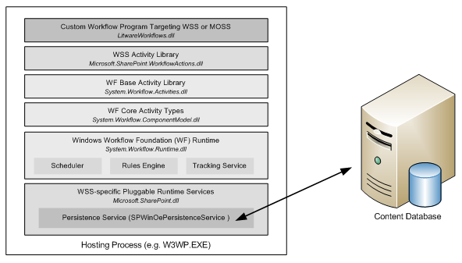
WF Runtime Services
Custom services can be written and plugged in
WSS provides its own persistence service

Slide 12
SharePoint Workflow Concepts
Design goals for WF integration with WSS
Use WF to attach logic to items and documents
Add a human dimension on top of WF
Maintain self-service capabilities common in WSS
Create strong developer story for custom WF programs
Provide valuable WF programs out-of-box with MOSS
The human dimension
Any SharePoint workflow can assign tasks to users
Users can see the status of any workflow instance

Slide 13
SharePoint Workflow Actors
Workflow Template
WF Program and optionally workflow input forms
A feature to install it inside WSS farm
Workflow Association
Binding of workflow template to list or content type
A named instance containing parameterized data
Workflow Instance
A running instance of a WF program attached to an item

Slide 14
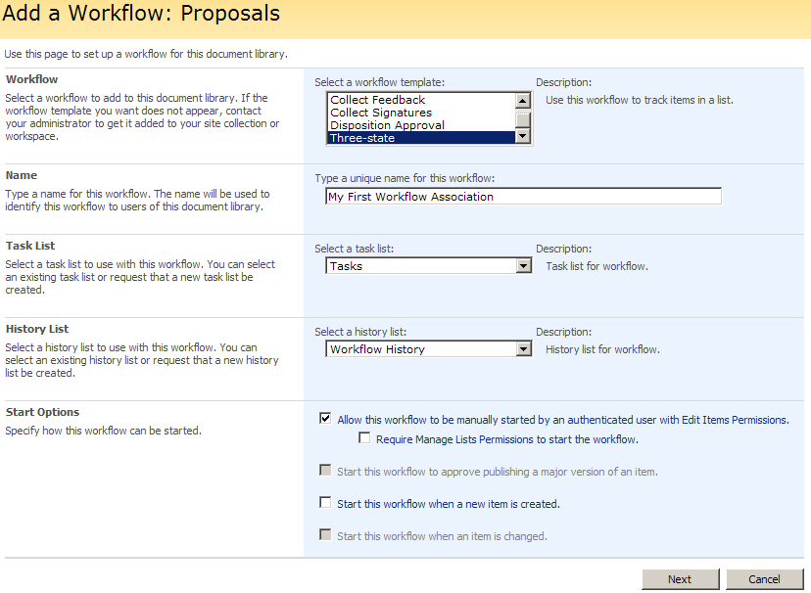
Creating a Workflow Association

Slide 15
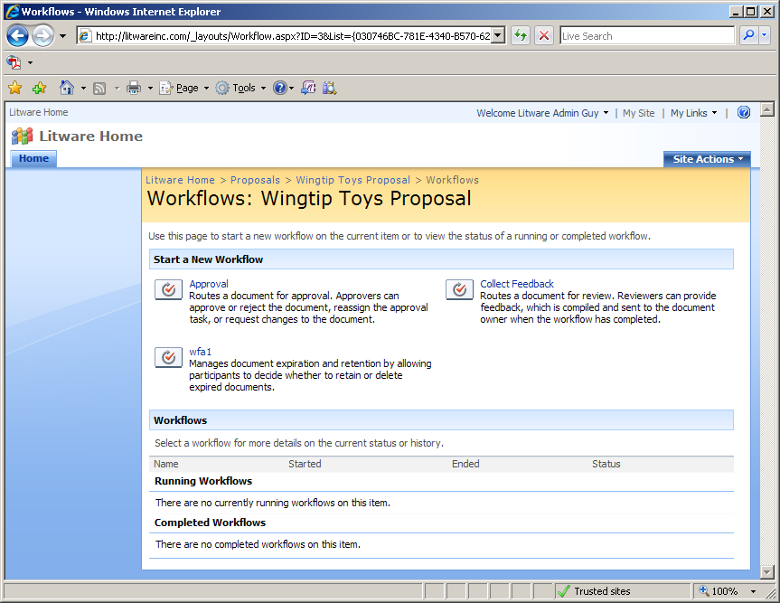
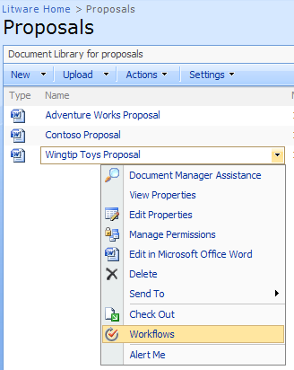
Starting a Workflow Instance
Users can manually start workflows

Slide 16
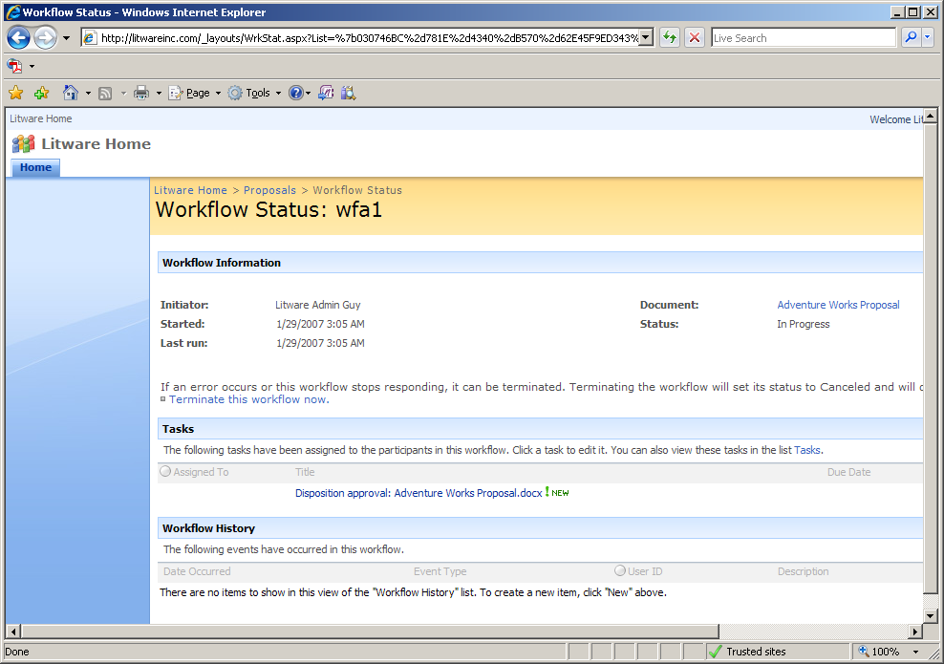
The Workflow Status Page
Any user can see the status of a workflow instance

Slide 17
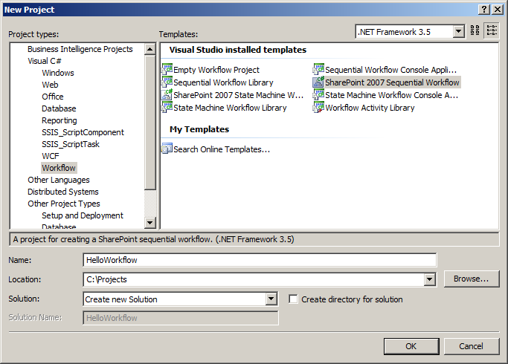
Creating a Workflow Template Project
Creating a SharePoint Workflow Project in Visual Studio 2008

Slide 18
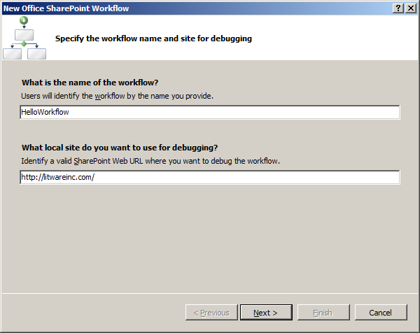
Complete the Wizard
Step 1 – Specify SharePoint URL
Enter the name of the workflow
Specify the URL to SharePoint site

Slide 19
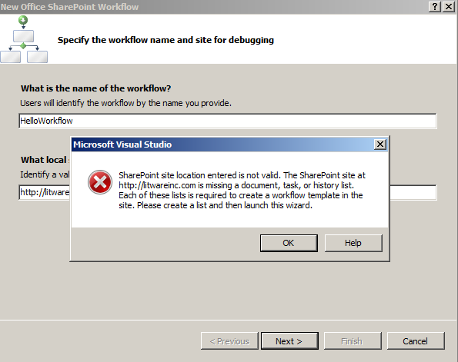
Complete the Wizard
Following lists need to be available:
Document Library
Tasks list
History list

Slide 20
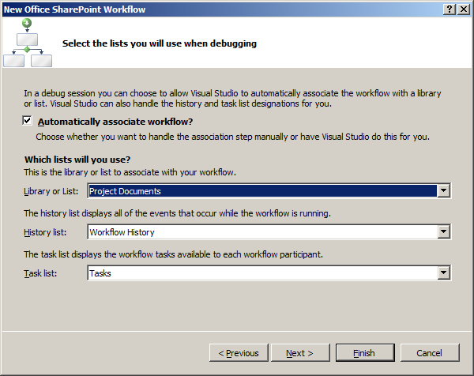
Complete the Wizard
Step 2 – select the necessary lists
List or document library to associate workflow
History list
Tasks list

Slide 21
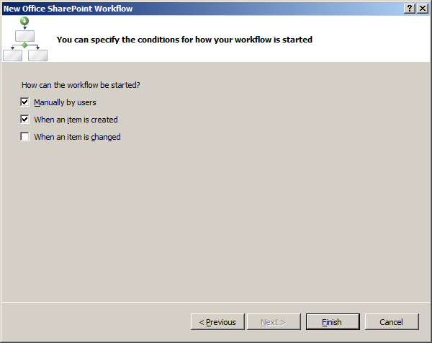
Complete the Wizard
Step 3 – decision on how to start the workflow

Slide 22
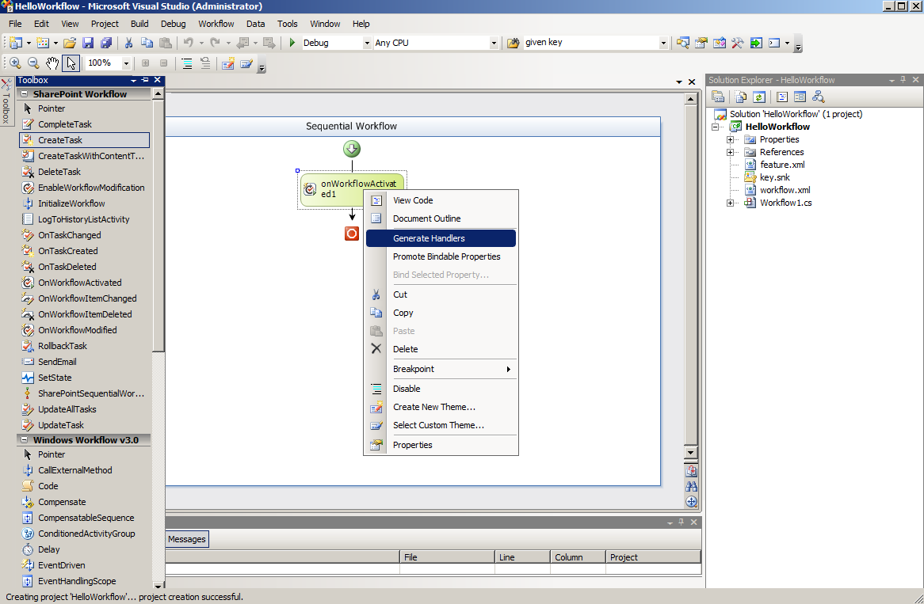
Developing the WF Program
Getting around inside the Workflow Designer
Learn to move between Designer View and Code View
Get to Know the Activities in the SharePoint Activity Library

Slide 23
Working in Code View
Here is what you get as a starting point
using Microsoft.SharePoint.Workflow;
namespace HelloWorkflow {
public partial class Workflow1 : SharePointSequentialWorkflowActivity {
// code to call wizard-generate code
public Workflow1() {
InitializeComponent();
}
// default fields added by project template
public Guid workflowId = default(System.Guid);
public SPWorkflowActivationProperties workflowProperties =
new SPWorkflowActivationProperties();
// TODO: add fields here
// TODO: add event handlers here
}
}

Slide 24
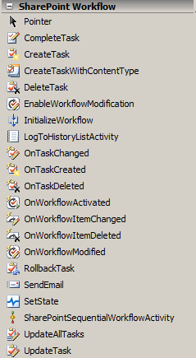
SharePoint Activity Library
WSS-specific activities used to create SharePoint WF Programs

Slide 25
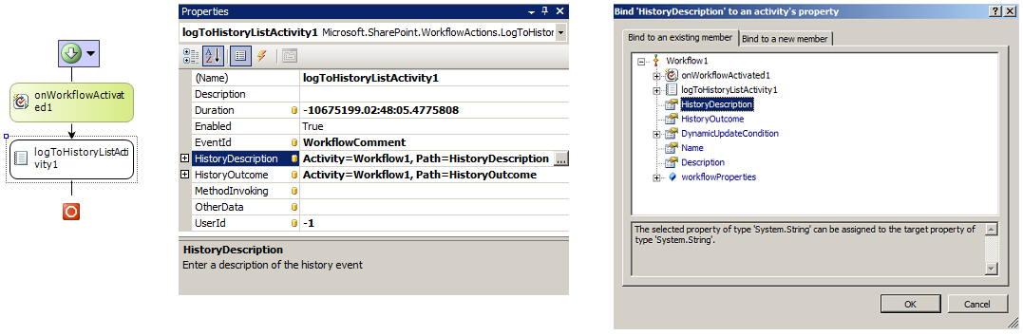
Data Bound Properties
WF supports data binding of properties
Allows for declarative flow of data between activities
Used extensively for creating SharePoint WF programs
public partial class Workflow1 : SharePointSequentialWorkflowActivity {
// other members removed for clarity
public String HistoryDescription;
public String HistoryOutcome;
}

Slide 26
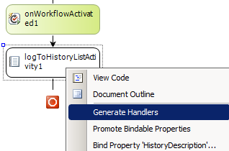
Generating Event Handlers
Right-click on activity and choose Generate Handlers
Generate event handlers to add code
Event handlers can program against WF objects
public class Workflow1 : SharePointSequentialWorkflowActivity {
public SPWorkflowActivationProperties workflowProperties =
new SPWorkflowActivationProperties();
public String HistoryDescription;
public String HistoryOutcome;
private void logActivated_MethodInvoking(object sender, EventArgs e) {
// Generate message using information of current item
SPListItem item = workflowProperties.Item;
// determine whether workflow is running on a standard item or a document
if (item.File == null) {
HistoryDescription = "Workflow started on item " + item.Title;
}
else {
HistoryDescription = "Workflow started on document " + item.File.Name;
}
HistoryOutcome = "Workflow activation complete";
}
}

Slide 27
Workflow Template Deployment
Workflow Templates are deployed via Features
Feature must be scoped to site collection (Scope=Site)
Feature may contain multiple workflow templates
<Feature
Id="0CEED7AE-D327-41ad-BC33-B3F3F8A4DAD2"
Title="Hello World Workflow Template Feature"
Description="This feature installs our Hello World Workflow Template"
Version="12.0.0.0"
Scope="Site"
xmlns="http://schemas.microsoft.com/sharepoint/">
<ElementManifests>
<ElementManifest Location="workflow.xml" />
</ElementManifests>
</Feature>

Slide 28
Workflow Template Definition
Workflow Element defines Workflow Template
Must point to one specific WF program
WF program must be compiled into an assembly DLL
Assembly DLL must be installed in GAC
<Elements xmlns="http://schemas.microsoft.com/sharepoint/">
<Workflow
Id="1EE1C818-DB7A-4a55-B21B-959D413C6A9C"
Name="Hello World Workflow Template"
Description="This WF template provides classic Hello World functionality"
CodeBesideClass="HelloWorkflow.Workflow1"
CodeBesideAssembly="HelloWorkflow, [four-part assembly name]" >
<Categories/><!-- no categories needed -->
<MetaData /><!-- no metadata needed -->
</Workflow>
</Elements>

Slide 29
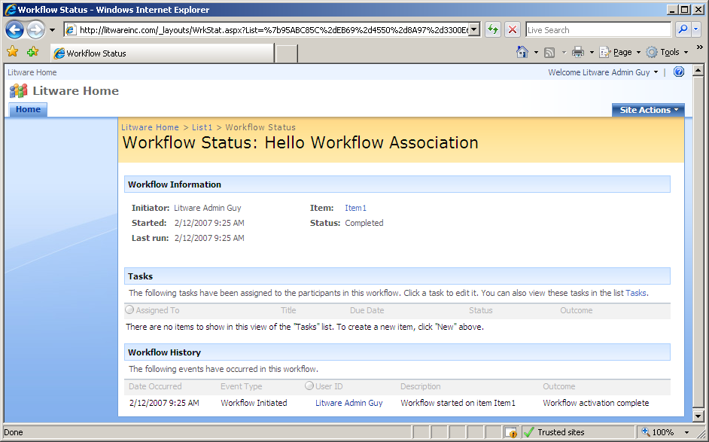
Testing 'Hello World' Workflow Template

Slide 30
Creating and Waiting on Tasks
SharePoint Workflows revolve around tasks
Represents significant value-add WSS brings to WF
Based on standard WSS tasks visible/editable by users
Users update tasks through browser or Office programs
Your code automatically wakes up and executes
WSS Tasks are generated with subscriptions
WSS encapsulates the listener mechanism
WSS registers event handlers behind the scenes
You just add event activities and write event handlers

Slide 31
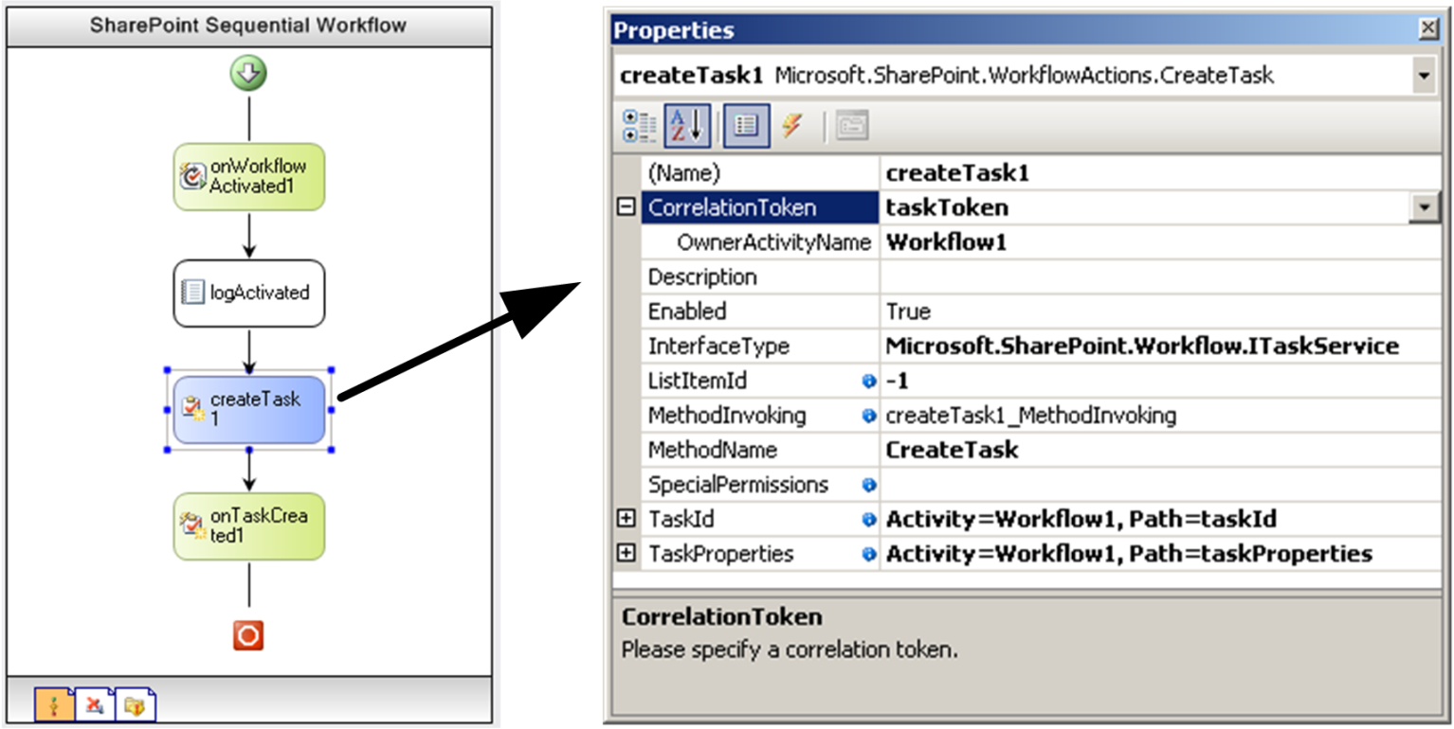
Task GUIDs and Correlation Tokens
WSS sets up subscriptions for tasks
Based on registering event handlers
WSS needs way to identify certain task across activities
Each tasks is assigned a GUID and a correlation token

Slide 32
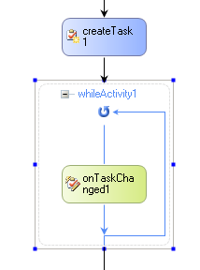
Action Activities vs. Event Activities
Action activities perform work
Their event handlers fire before work is done
Event activities run code in response to an event
Their event handlers run after the event has occurred
Action Activities
are blue
Event Activities
are blue

Slide 33
Initializing a New Task
Add event handler behind CreateTask activity
This event handlers fires before task creation
Gives you a chance to initialize task properties
// these fields are data-bound to properties of task activities
public Guid taskId = default(System.Guid);
public SPWorkflowTaskProperties taskProperties =
new SPWorkflowTaskProperties();
private void createTask1_MethodInvoking(object sender, EventArgs e) {
// generate new GUID used to initialize task correlation token
taskId = Guid.NewGuid();
// assign initial properties prior to task creation
taskProperties.Title = "Task for " + workflowProperties.Item.Title;
taskProperties.Description = "Please review and approve this item.";
taskProperties.AssignedTo = @"LITWAREINC\BrianC";
taskProperties.PercentComplete = 0;
taskProperties.StartDate = DateTime.Today;
taskProperties.DueDate = DateTime.Today.AddDays(2);
}

Slide 34
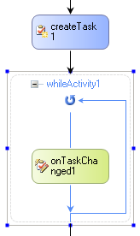
Waiting on a Task
Event activity creates subscription
OnTaskChanged puts activity to sleep
Event handler fires upon modifcation
While activity used to control flow
While activity loops until task complete

Slide 35
Creating Workflow Forms with ASP.NET
Workflow input forms can be created in ASP.NET
Benefits to creating workflow forms with ASP.NET
Can run from WSS-only farms
Drawback to creating forms with ASP.NET
More coding involved

Slide 36
ASP.NET Workflow Form Integration
<Elements xmlns="http://schemas.microsoft.com/sharepoint/">
<Workflow
Name="LitwareWorkflowsInfoPath"
Description="Simple workflow with InfoPath forms."
Id="48500BEB-D1BE-4ec4-8D21-5DEF76BEEDA8"
CodeBesideClass="LitwareWorkflowsInfoPath.Workflow1"
CodeBesideAssembly="LitwareWorkflowsInfoPath, [full assembly name]"
TaskListContentTypeId="0x01080100C9C9515DE4E24001905074F980F93160"
AssociationUrl="_layouts/Litware/LitwareApprovalAssoc.aspx"
InstantiationUrl="_layouts/Litware/LitwareApprovalInit.aspx"
ModificationUrl="_layouts/Litware/LitwareApprovaMod.aspx">
<MetaData>
<StatusPageUrl>layouts/WrkStat.aspx</StatusPageUrl>
</MetaData>
<Categories/>
</Workflow>
</Elements>
standard MOSS
task content type
custom application pages

Slide 37
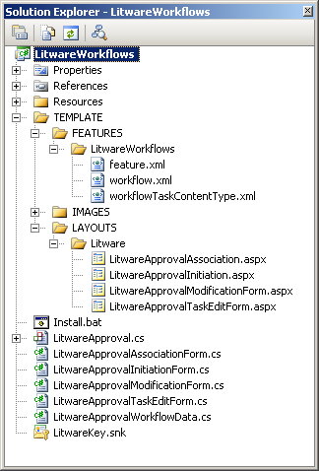
Integrating Workflow Input Forms
Workflow Input Form Types
Association Form
Initiation Forms
Modification Forms
Task Edit Form
Sample Project
LitwareWorkflows

Slide 38
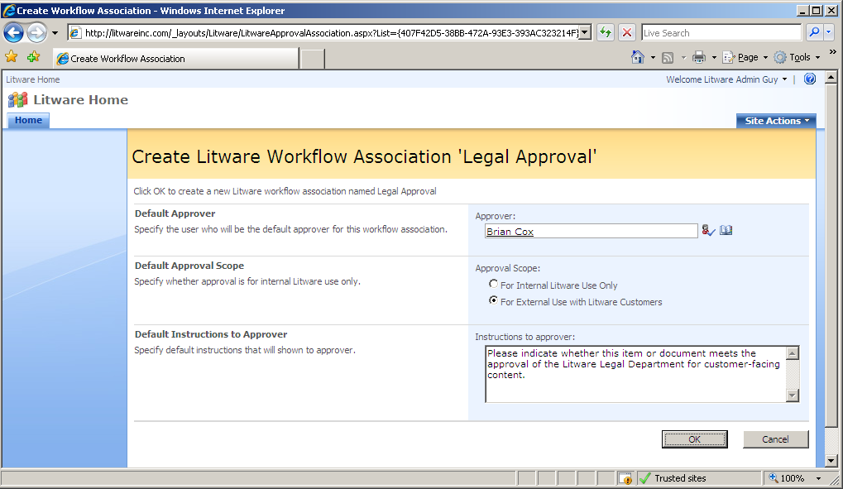
The Association Form

Slide 39
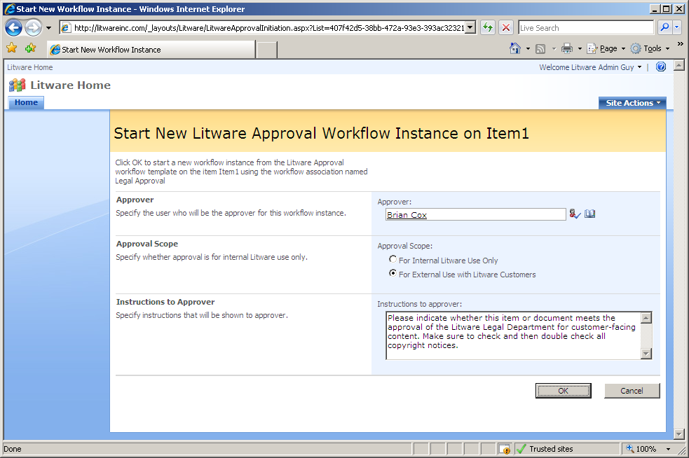
The Initiation Form

Slide 40
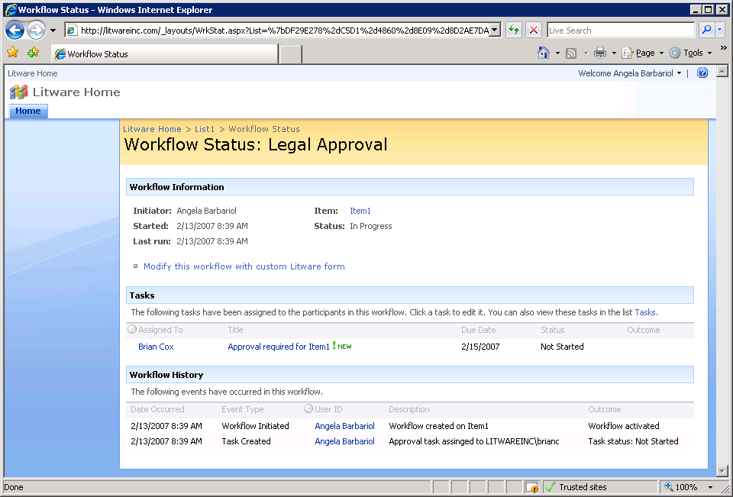
Invoking the Modification Form
There is one link per modification

Slide 41
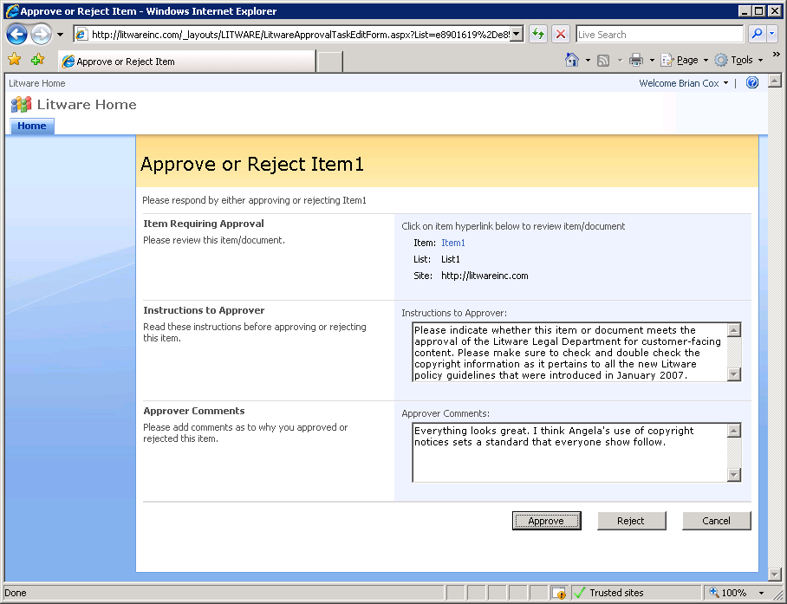
The Task Edit Form

Slide 42
Creating Workflow Forms with InfoPath
Workflow input forms can be created in InfoPath
Benefits to creating workflow forms with InfoPath
Significantly better forms designer experience
Significantly less coding
Forms can be opened directly with Office client apps
Drawback to creating forms with InfoPath
Workflow template will only run in MOSS farms
Workflow template will not run in WSS-only farms

Slide 43
InfoPath Workflow Form Intergation
<Elements xmlns="http://schemas.microsoft.com/sharepoint/">
<Workflow
Name="LitwareWorkflowsInfoPath"
Description="Simple workflow with InfoPath forms."
Id="48500BEB-D1BE-4ec4-8D21-5DEF76BEEDA8"
CodeBesideClass="LitwareWorkflowsInfoPath.Workflow1"
CodeBesideAssembly="LitwareWorkflowsInfoPath, [full assembly name]"
TaskListContentTypeId="0x01080100C9C9515DE4E24001905074F980F93160"
AssociationUrl="_layouts/CstWrkflIP.aspx"
InstantiationUrl="_layouts/IniWrkflIP.aspx"
ModificationUrl="_layouts/ModWrkflIP.aspx">
<MetaData>
<Instantiation_FormURN>[INFOPATH FORM ID]</Instantiation_FormURN>
<Association_FormURN>[INFOPATH FORM ID]</Association_FormURN>
<Task0_FormURN>[INFOPATH FORM ID]</Task0_FormURN>
</MetaData>
<Categories/>
</Workflow>
</Elements>
standard MOSS
task content type
standard MOSS application pages
urn:schemas-microsoft-com:office:infopath:ReviewInitiationForm2:-myXSD-2005-11-22T23-49-53

Slide 44
Integrating Workflow Input Forms
Workflow Input Form Types
Association Form
Initiation Forms
Modification Forms
Task Edit Form
Sample Project
LitwareWorkflows

Slide 45
Summary
Windows Workflow Foundation (WF) Primer
Creating WF programs in Visual Studio
Creating workflow templates for WSS
Workflow associations and workflow instances
Creating and waiting on WSS tasks
Integrating workflow input forms

