Slide 1
Creating MOSS Collaboration Portals
Understanding and leveraging
Shared Service Providers in MOSS

Slide 2
Agenda
Collaboration Portals
Shared Service Provider (SSP) Architecture
Creating corporate portal sites
User Profiles
Audience Targeting
MySites
Extending Search

Slide 3
SharePoint Portal Server 2003 (SPS)
SharePoint Portal Server 2003 Features
Areas and listings
User profiles and audience targeting
Search
My Sites
Shared Services
Single sign on
Notes:
Instructor Notes
Start the lecture by asking which students have experience with SPS 2003. Ask any students that have used SPS 2003 which features were particularly valuable to their company.
Step through the SPS 2003 feature set in the top set of bullets and take 2-3 sentences to describe the purpose of each feature for students that do not have SPS 2003 experience.
Finally, walk through the second set of bullet points and discuss customer complaints about SPS. Emphasize the problems with CMS integration. Ask students if any them have experience with CMS or the integration layer between SPS 2003 and CMS named SPARK.

Slide 4
Problems with SPS 2003
Problems with SharePoint Portal Server 2003
A strange semi-undocumented layer on top of WSS V2
Limited to one SPS portal site per IIS Web application
Portal user interface hard to customize and extend
Shared Services architecture hard to deploy and administrate
Limited and clunky integration with Content Management Server
Notes:
Instructor Notes
Start the lecture by asking which students have experience with SPS 2003. Ask any students that have used SPS 2003 which features were particularly valuable to their company.
Step through the SPS 2003 feature set in the top set of bullets and take 2-3 sentences to describe the purpose of each feature for students that do not have SPS 2003 experience.
Finally, walk through the second set of bullet points and discuss customer complaints about SPS. Emphasize the problems with CMS integration. Ask students if any them have experience with CMS or the integration layer between SPS 2003 and CMS named SPARK.

Slide 5
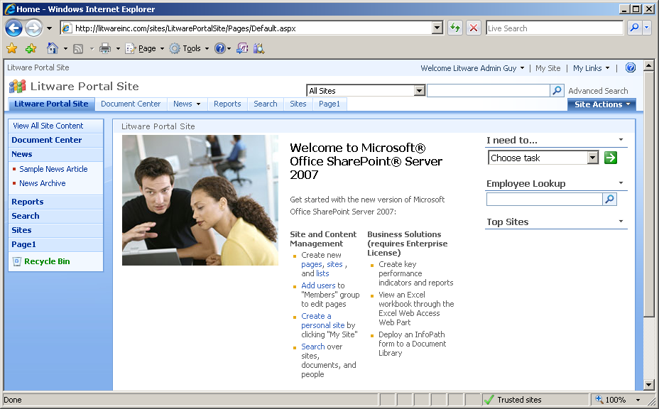
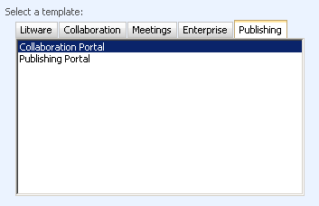
Collaboration Portal Site Template
Used to create SPS-like Portal sites
Supplies same basic features as SPS
Except that Areas and Listing have been eliminated

Slide 6
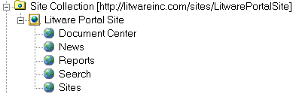
Collaboration Portal Architecture
A collaboration portal is a hierarchy of WSS sites
Created as a WSS site collection
Created using standard Site Definitions and Features
Architectural improvements over SPS portals
Not limited to one portal per IIS Web site
Portals extended using standard WSS V3 development
Notes:
Instructor Notes
The portal architecture of MOSS is very different than SPS 2003 because portals are now created using standard WSS site templates. That means you create a new portal as a new site collection using the WSS Central Administration application.
There are several site templates used to create portals in MOSS
Corporate Portal
Blank Portal
Publishing Site
Portal for Internet presence
Note that the site templates for portals define child sites. That means you will be creating a new site collection with several sites each time you create a new portal. And because a portal is simply seen as another WSS site collection, you can create 100s or 1000s of portals per Web application.

Slide 7
Sharing Resources and Services
Need to share resources/services across sites
Content crawling and index creation
Querying for search results
Allocating and managing storage for My Sites
SPS used 1st generation shared services model
One portal site is selected as "Master" portal
Other portals use shared services of master portal
MOSS takes a different and better approach
Enter the Shared Service Provider (SSP)
Notes:
Instructor Notes
Shared Service Providers (SSPs) are an important architectural piece of MOSS so you should take some time to motivate them properly. Start by motivating that there are important tasks in the portal (e.g. building indexes for search and provisioning MySites) that should not be done two or more times when unnecessary. It makes sense to have a central entity that can do this work a single time across multiple portal sites.
Quickly explain that SPS 2003 used an approach where one portal was deemed as the master to do the work to be shared across portals. Other portals were configured as slaves so that they could use the indexes and MySite provisioning of the master. However, this architecture was not flexible and it was very fragile when it cam to backup and restore. The new architecture is much better because an SSP is defined and configured independently of any portal site.

Slide 8
SSP Architecture
Shared Service Provider (SSP)
Configured independently of any portal or site
SSP resources/services accessible to all types of sites
Each Web Application maps to exactly one SSP
MOSS Farm
Web Application 1
Public Web Sites
Web Application 2
Intranet Sites for Employees
Web Application 3
Extranet Site for Vendors
Portal 1
Site 1
Portal 1
Portal 1
Site 1
Site 1
Site 2
Dashboard 1
Site 2
Shared Service Provider A
Search, Excel Services
Shared Service Provider B
Search, User Profiles, BDC
Notes:
Instructor Notes
Earlier the physical machine topologies in WSS and OSS and the similarities between them were discussed. Now move on to the conceptual model and the relation between the physical topology and the conceptual model.
In SPS 2003, customers could have shared services across the enterprise. However setting this and administering this was greatly difficult. Going forward in MOSS high value and resource intensive services have been grouped to a Shared Service provider. Shared services are “Always on”. These shared services are consumed by various Web applications associated with the SSP.
As indexing is a resource intensive operation and it's important to avoid redundant indexing.
Search is also a shared service provided at the SSP level. All Web applications consuming the search shared service from a SSP use the same index. A single indexer crawls all content associated with a SSP
The advantage to this model is that the resource intensive operations like crawling are centrally managed where as scopes and best bets which contribute to the experience of the consuming portals search can still be administered at the consuming site level.

Slide 9
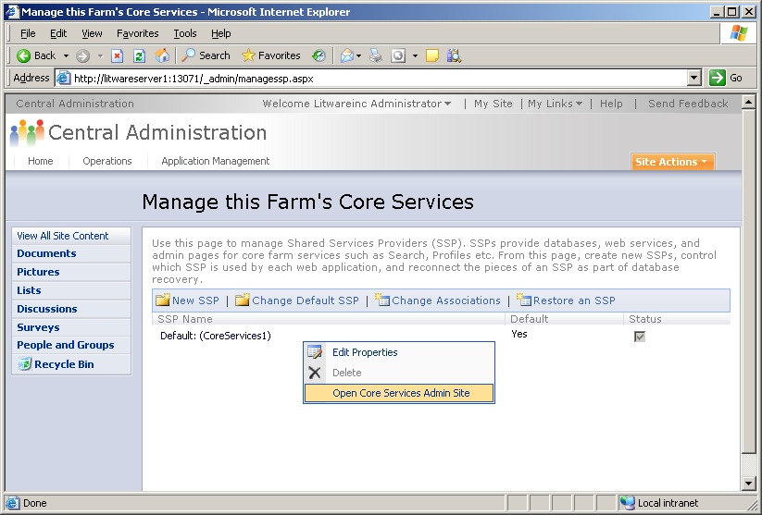
Creating An SSP
Central Administration -> Application Management -> Create of Configure this Farm's Core Services
Notes:
Instructor Notes
Before being able to use portal features in an MOSS farm, someone must create and configure the default SSP. The screenshot on the slide above shows the page on the WSS Central Administration application that is used to create and configure an SSP.
Note that it is possible to create more than one SSP. That means different portals and team sites can be configured to use different content sources in their searches or different MySite provisioning. However, each Web application (and all the sites on it) must be assigned to the same SSP. For two sites to use different SSPs, they must be created on different Web applications.

Slide 10
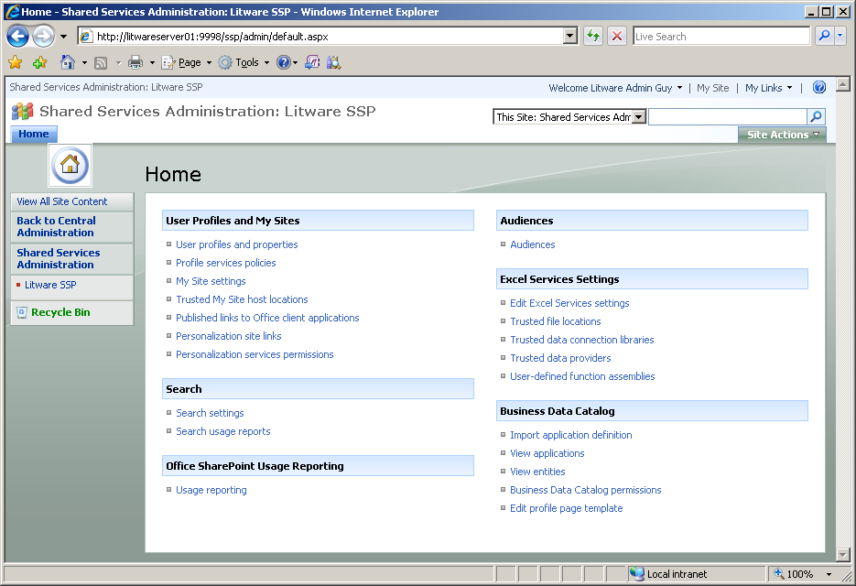
SSP Administration
Functionality of SSP Broken out into Sections
MOSS
Enterprise
Edition Only
Notes:
Instructor Notes
This is the main configuration page for an SSP. You can use this slide to explain which new MOSS services are configured through SSPs. In SPS 2003, the Shared Services infrastructure involved user profiles indexing, search and my sites. The new SSP architecture has all the same things and has been expanded with Excel Services and the Business Data Catalog as well.

Slide 11



So what is a Portal, Really?
A Site Collection that…
has the correct features activated
is consuming services from an underlying SSP
might or might not have been created from a portal site template
SharePoint Server
Web Application(s)
Portal Template
SSP Admin
Central Admin
Portal Template

Slide 12
User Profiles
User profiles track user information for social networking
Information used to describe users to each other
Information users to target information to interested parties
MOSS maintains user profiles in SQL Server
Profile data can be imported from Active Directory or LDAP
Profile data can be extended with custom properties
Profiles can be extended with BDC data source
What MOSS features rely on user profiles?
My Site infrastructure
Audience targeting
People Search
Notes:
Instructor Notes
User Profiles are a feature carried over from SPS 2003. User profiles represent data in a MOSS-specific database which contains information about site users. This information allows user to describe themselves to other users and it also allows users to discover things about each other. User profiles can also be used by developers to target content to interested parties.
Office Server maintains user profiles in SQL Server. User profile data can be imported from various identity stores such as Active Directory or LDAP repositories. User profile data can be extended by adding custom properties for application-specific purposes.
There are two built-in MOSS features that rely on user profiles: Audience targeting and the My Site infrastructure. User profiles can also be exploited may other ways through custom code.

Slide 13
People and Personalization
Custom components can access…
Privacy policies
Audience targeting
User profile store: reading/writing:
Users
Profiles
Memberships
Colleagues
Audiences

Slide 14
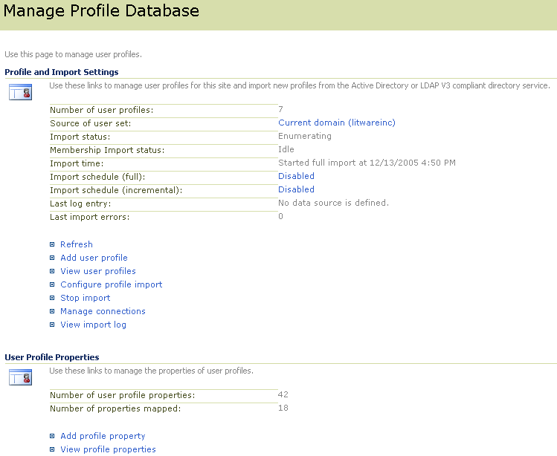
Configuring User Profiles
Administrative control for adding, viewing, managing and importing profiles
You can see and modify user profile properties
You can add application-specific properties
Notes:
Instructor Notes
You can get to this page shown above to manage the profile database and the import process through a link on the home page of the SSP. If you are using Active Directory, you can configure MOSS to import profiles for every uses within the current Active Directory domain or the entire forrest.
The page above also allows you to inspect, modify and re-import the profiles of you users.
The bottom of the page provides the facilities for adding custom properties to user profiles. This provides an very elegant way to track application-specific preferences and characteristics on a user-by-user basis. These custom properties can be assigned and inspected through custom code. They can also be used in conjunction with the audience targeting feature described on the next slide. Finally, you should point out that custom property values can be assigned by users themselves through their own personal My Sites.

Slide 15
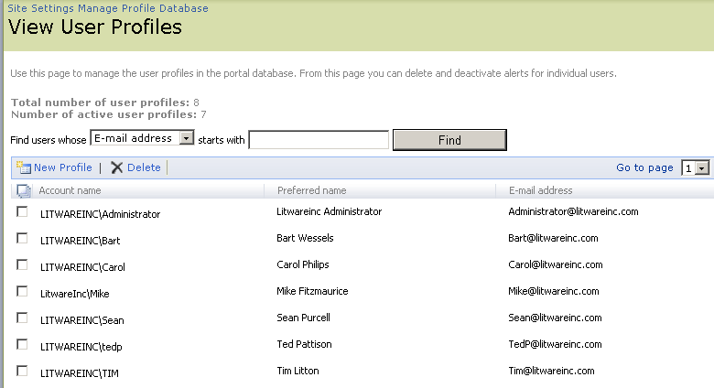
Viewing User Profiles
User profiles can be added and deleted
Notes:
Instructor Notes
User profiles can be imported from an Active Directory domain. That is probably how you will demo it in class. If you drill down on one of the user profiles, you will be able to see all the property values that have been directly imported from Active Directory.

Slide 16
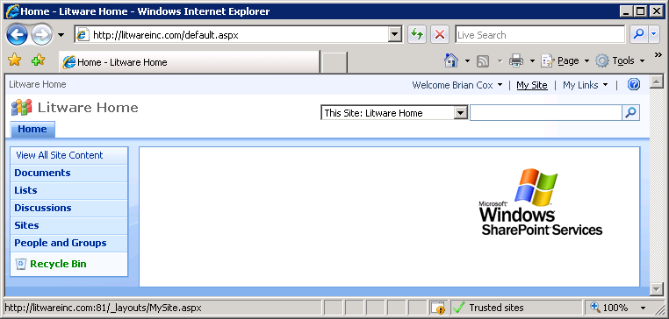
Creating a new My Site
Each My Sites is a site collection that…
is provided on demand upon first access
maps to a specific user profile
enables users to edit some aspects of their profile
Provides a private aspect and a publicly-facing aspect

Slide 17
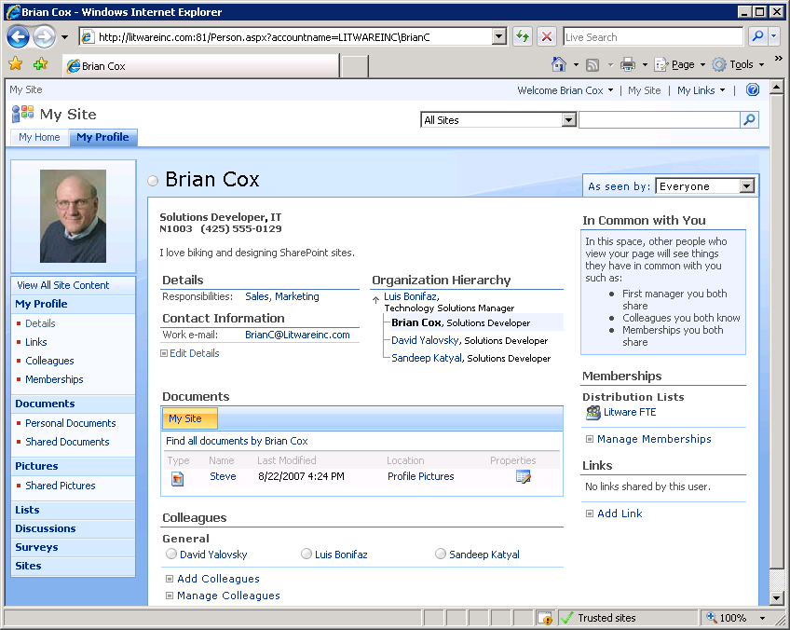
Updating A User Profile

Slide 18
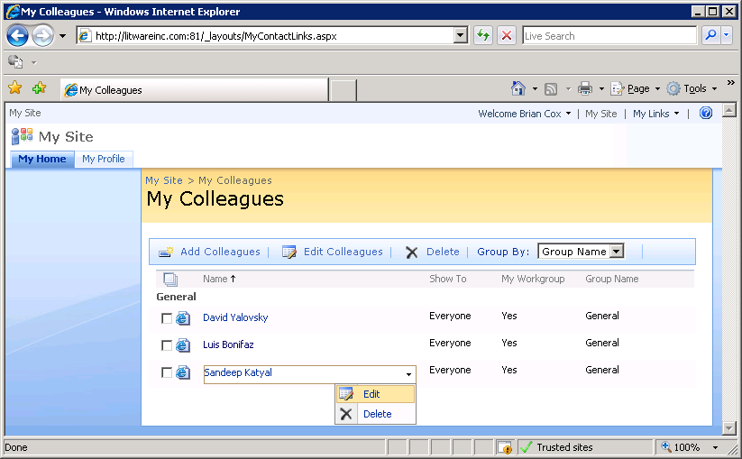
Colleagues

Slide 19
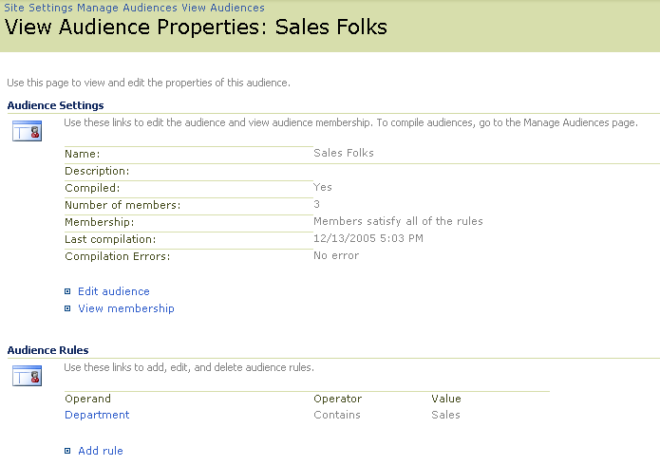
Audiences
Audience involves creating rules and then compiling
Rules define what user accounts should be included or excluded
Compilation process adds users to audience table in SQL Server
Notes:
Instructor Notes
Audiences and audience targeting provide a nice compliment to user profiles. The idea of an audience is that it provides a basis for targeting content on a WSS site page to one group of users. For example, suppose there is an announcement or weekly sales figures that only sales people would be interested in seeing on the home page of a portal site. Audience targeting allows you to add content to a page that is displayed to some users but not others.
First, you must create audiences through the SSP admin UI which involves defining criteria that can be AND-ed or OR-ed together. For example, one audience can be defined as all users in the Active Directory group named Sales. Another audience can be defines by defining criteria on user profile properties such as all users with the word "sales" in their Title or their Department as defined within their Active Directory profile.

Slide 20
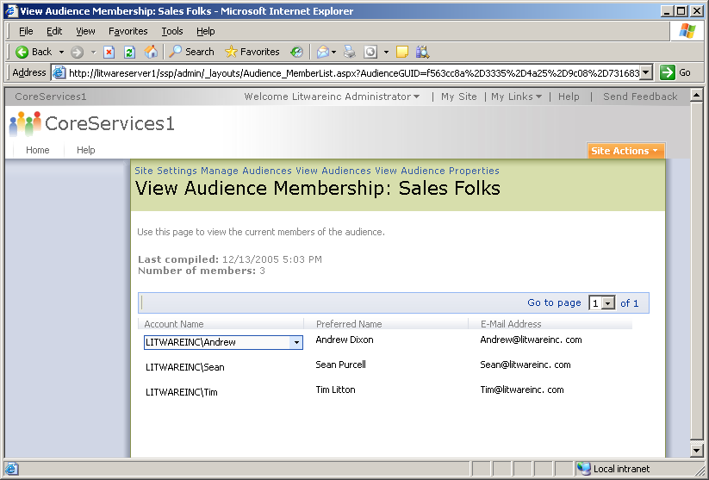
Compiled Audience
Compiled Audience defines list of users
Notes:
Instructor Notes
Make sure to explain why audiences must be compiled and that this compilation is typically scheduled in an on-going basis in a production environment. The compilation process is what populates the audience which is nothing more than rows in a SSP-maintained table in SQL Server.

Slide 21
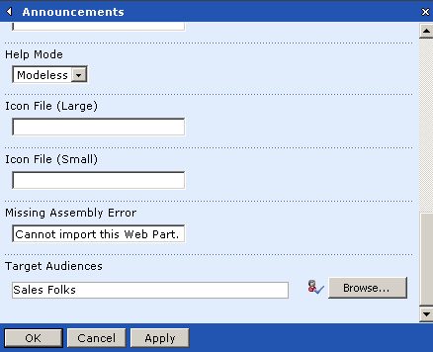
Audience Targeting
Web Part output can be targeted at audience
Web Part content shown to members of that audience
Web Part content not shown to users not in audience
Great way to get content to interested parties while filtering noise from those that are not interested
Notes:
Instructor Notes
The last aspect of using audiences is configuring Web Parts to use them. On a Web Application that's configured with MOSS and an SSP, each Web Part has an audience targeting setting at the bottom of the Advance settings section.
Of course, Web part do not provide the only means to make use of an audience. You can also write custom code against the MOSS object model to programmatically determine whether the current user is in a specific audience or not. From that information, you can create a custom Web Part whose output is customized depending on what audiences the current user is in.

Slide 22
WSS Verses Office Server Search
Windows SharePoint Services (WSS 3.0)
WSS search is a subset of MOSS search feature
Eases transition from WSS to MOSS
Indexing and query always on the same machine
Search over site content only
Microsoft Office SharePoint Server (MOSS)
Adds new search functionality over base WSS search
Indexer and query can be separated on different machines
Multiple catalog supported per indexer and query servers
Aggregated content - local + external
Notes:
Instructor Notes
WSS Search
One of the key investments this release is WSS (v3) will be using the same search technology as in MOSS as opposed to WSS(v2) that used sql full text search.
The WSS search functionality is a subset of MOSS search functionality
This adds ease of transition when you want to move from a WSS installation to a OSS installation.
Only local content gets indexed and search is available at the individual site scope.
MOSS Search
MOSS search has more enhanced functionality than WSS – richer search results UI and customization control, crawls of local and external content supported and management of search configuration.
One important thing to note is the topological concepts are same across WSS and MOSS with certain differences based on the usage patterns of the portals/sites

Slide 23
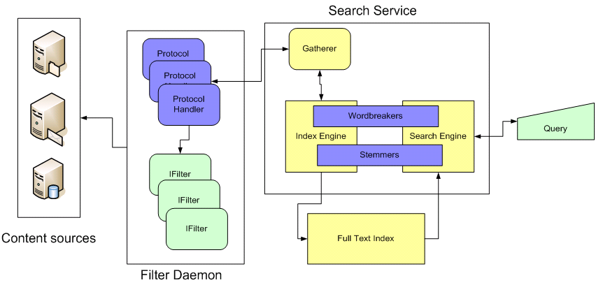
Search Architecture and Terminology
Key pieces to search infrastructure
The Gatherer
Content sources, protocol handlers and IFilters
Index Files
Notes:
Instructor Notes
Walk the students through the basic architecture of how search works with both WSS and MOSS. This will give you a chance to introduce the terminology and describe the process of building indexes from configured content sources.
Content source: This is the place where the content lives. A content source can be a WSS site or a Window File Share.
Protocol Handler: This is the code that allows the WSS/MOSS index service to reach across the network and retrieve the content to be indexed.
IFilter: A COM-based DLL able to parse a file and convert it into a UNICODE character array. You must have a IFilter for each type of file you want to search through. For example, Microsoft provides IFilters for Office documents and Adobe provides an IFilter for PDF files.
Gather: This is the main component responsible for retrieving content and moving it through the process to build indexes.
Workbreaker: Language-specific component that tokenizes text into words.
Stemmer: Language-specific component that find derivations of a word. For example, the stemmer will determine that running, runs and ran are all derivations of the word run that should be incorporated in search results.

Slide 24
Search Topologies
Base topology
Web front-end servers
App servers
Database servers
App servers
Indexer Service
Query Service
Notes:
Instructor Notes
The MOSS has some significant investments in their topology model. The base SharePoint topology consists of a load balanced web front end as well as application servers and backend databases. For Search specifically MOSS provides two application servers roles – indexer and query

Slide 25
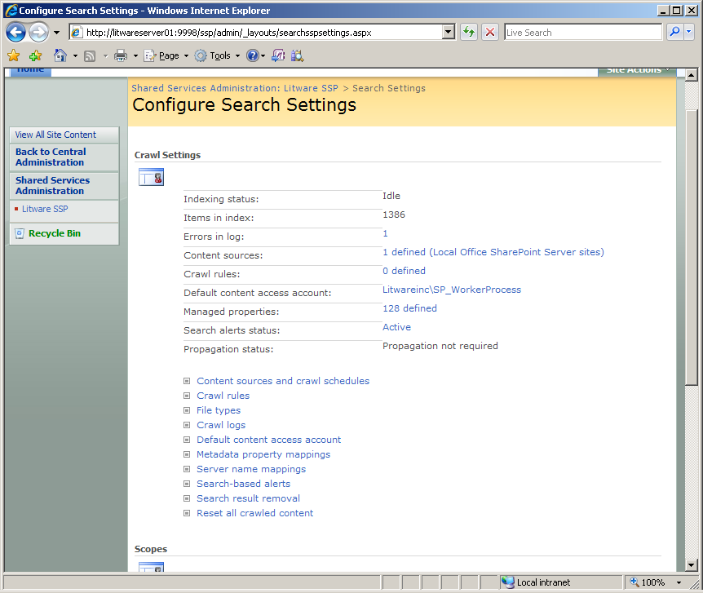
Configuring Search

Slide 26
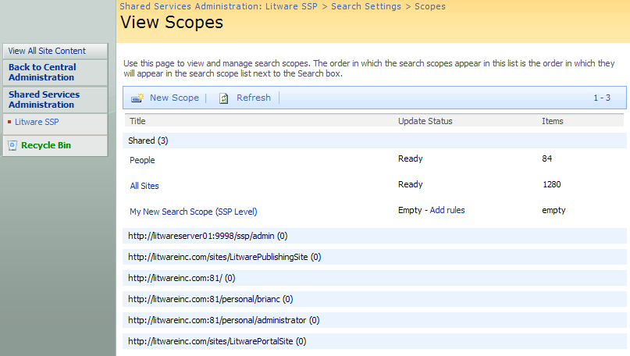
Search Scopes
Created at one of two different levels
Can be created within content of an SSP
Can be created within context of a site collection

Slide 27
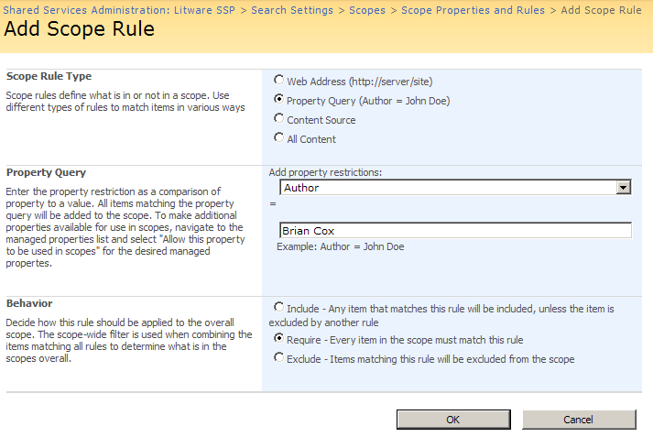
Adding Rules to a Search Scope
Each search scope has one or more rules
Rules define criteria to include/exclude content

Slide 28
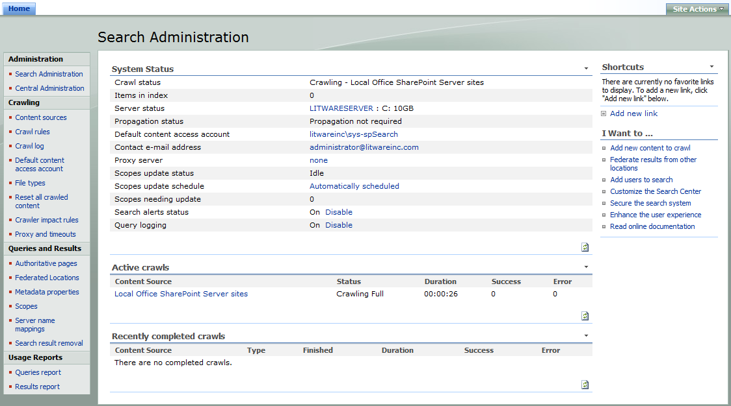
Search Administration

Slide 29
Search Center
Customize and extend Search Center
Modify query parameters
Add tabs
Modify XSLT, CSS on results
Custom search Web Parts

Slide 30
Search Web Parts
9 OOB web parts including
Search Box
Core Results
High Confidence
Statistics
Pagination
Action Links
Matching Keywords and Best Bets
Search Summary (Did you mean?)
Advanced Search
Share data through hidden object
Web Part properties such as
Formatting
From turning stemming on/off to the # of results returned
XSL

Slide 31
Search As An Extensible Service
Run search as a centralized enterprise service
Use in SharePoint sites and custom apps
Via shared services or query web service
New tools and frameworks
Coherent, comprehensive admin APIs
New query objects and syntax
Reusable, customizable UI controls
Index custom repositories
Notes:
Instructor Notes
If you have the time, it will prove to be a good demonstration to use the Search administration UI through the SSP to create and configure a content source. To save time you can have these set up before and just take a quick look at the admin UI for scheduling the crawls rebuild indexes at periodic intervals.
Also make sure to use the Search Center site to demonstrate how to search from the MOSS UI or a portal.
Make a final point that using the built-in UI of an MOSS portal or a WSS site is just one way to make sure of this powerful search infrastructure. You can also write custom code in a Web Part or even an a Windows Forms application across the network to leverage the powerful search capabilities of MOSS or even WSS by itself.

Slide 32
Summary
Collaboration Portals
Shared Service Provider (SSP) Architecture
Creating corporate portal sites
User Profiles
Audience Targeting
MySites
Extending Search

