Slide 1
Web Content Management
Managing Content within Internet-facing Sites
using MOSS Publishing Portals

Slide 2
Agenda
The Publishing Site template
The MOSS Approval Process
Creating custom page layouts
Converting Office documents
Content Translation using Variations
Optimization through Caching Profiles

Slide 3
MOSS WCM Features
Branding
Define the look, feel, and navigation of the site
Decentralized Authoring
Allow users to easily create and contribute content
Workflow/Scheduling
Supervisors approve content before it is posted.
Data Integrity
Enforce validation of content structure for publishing
Ensure content published/removed in timely manner
Notes:
Instructor Notes
Most important message here is:
Setting up an environment where the responsibility for the creation and maintenance of the content is delegated to non-IT/dev persons. For this we need a very flexible and rich infrastructure that strictly guides the content managers in their tasks.

Slide 4
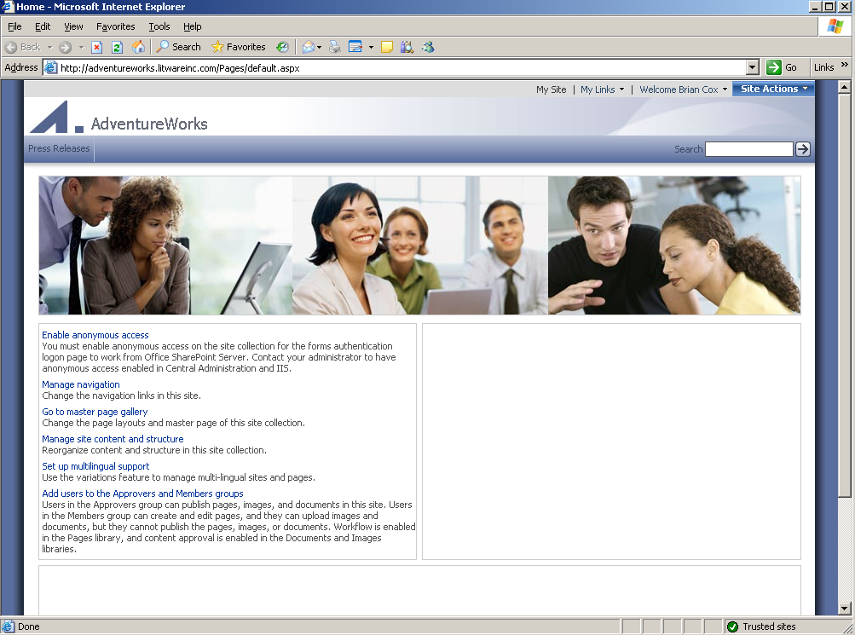
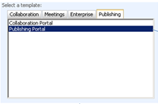

Creating A Publishing Portal
Creating with WSS Central Administration
Create a site collection based on Publishing Portal
Notes:
Instructor Notes
Creating an Internet presence site is as easy as creating a normal team site. There is no separate procedure. Except that at the end, you choose for the proper site definition. Recap site definitions again here and move to the folder where the site definition is stored. Go through the files and point out the different features that have to do with WCM.

Slide 5
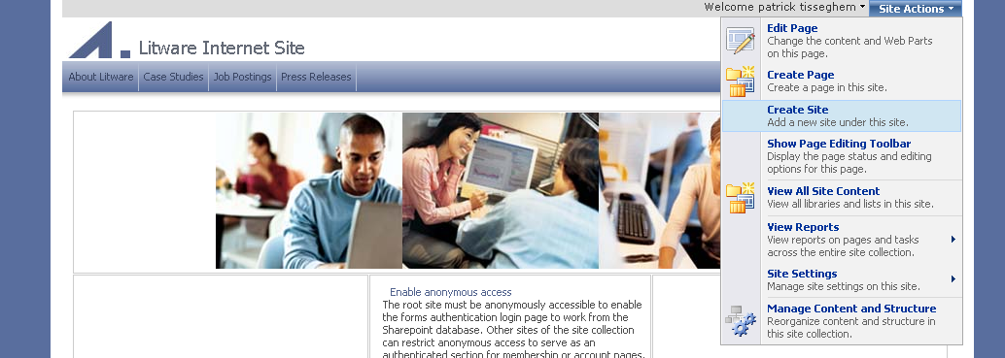
Site Hierarchy
In the past a lot of confusion
Windows SharePoint Services 2003 → sites
SharePoint Portal Server 2003 → areas
Content Management Server 2002 → channels
In SharePoint 2007 everything is a site
Notes:
Instructor Notes
Ask students if they know what a channel is. Point out that this concept no longer exists in MOSS and we are talking now about sites. So, creating the navigation infrastructure for your visitors is creating new sub-sites under your top level site.
But do know that if you went for an Internet Presence site, you are limited to the Publishing site as a possible candidate for a subsite.

Slide 6
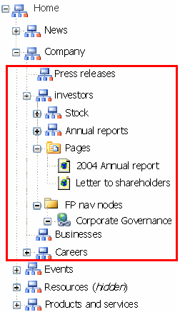
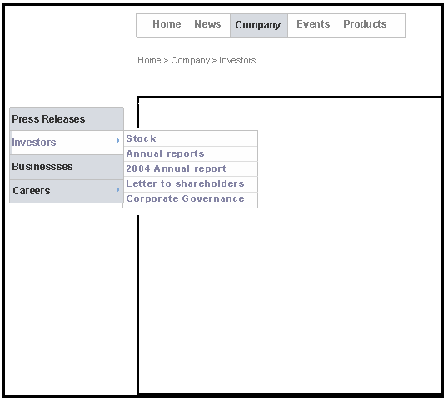
Navigation
Dynamic navigation based on site hierarchy
Includes webs, pages and authored links
Navigation links trimmed based on security, workflow state and publishing schedule
Notes:
Instructor Notes
If you have created a hierarchy of sites and sub-sites, OOB navigation controls will display that hierarchy. These can be replaced with your own navigation controls if needed. Don’t forget to point out that the navigation links are trimmed.

Slide 7
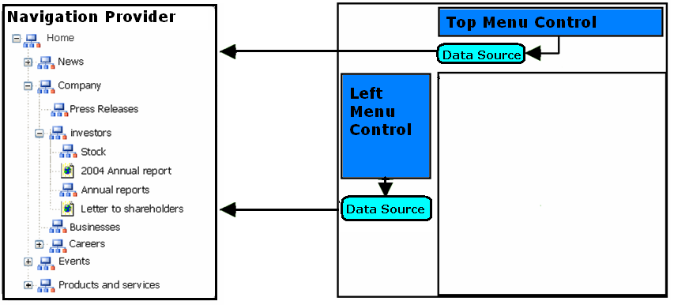
Navigation and ASP.NET
Based on the ASP.NET 2.0 navigation model
Works with standard ASP.NET 2.0 navigation controls
Out-of-the-box Hierarchy navigation provider
High performance: provider support runtime object caching
Notes:
Instructor Notes
Explain more the provider model available in ASP.NET 2.0 that allows developers to create additional navigation controls.

Slide 8
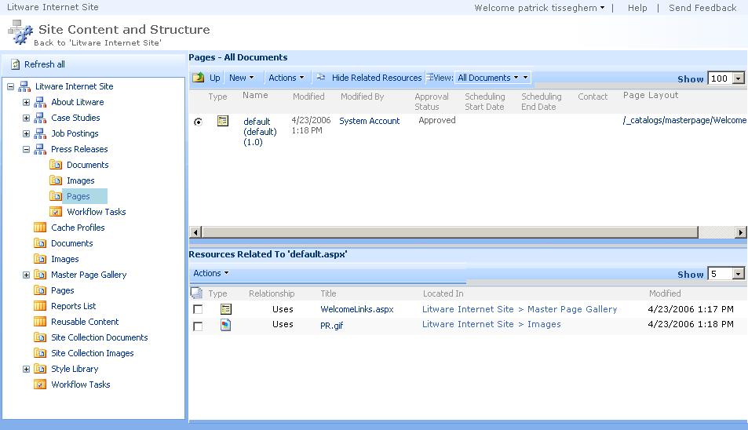
Site Content and Structure
Notes:
Instructor Notes
This page is a very important one. You can point to many features here:
seeing the content in the different lists and libraries
seenig the resources used by an item in these lists and libraries
seeing the sub-sites
being able to move sites in the hierarchy
Do not cover yet the concept of the master page gallery and the pages library.

Slide 9
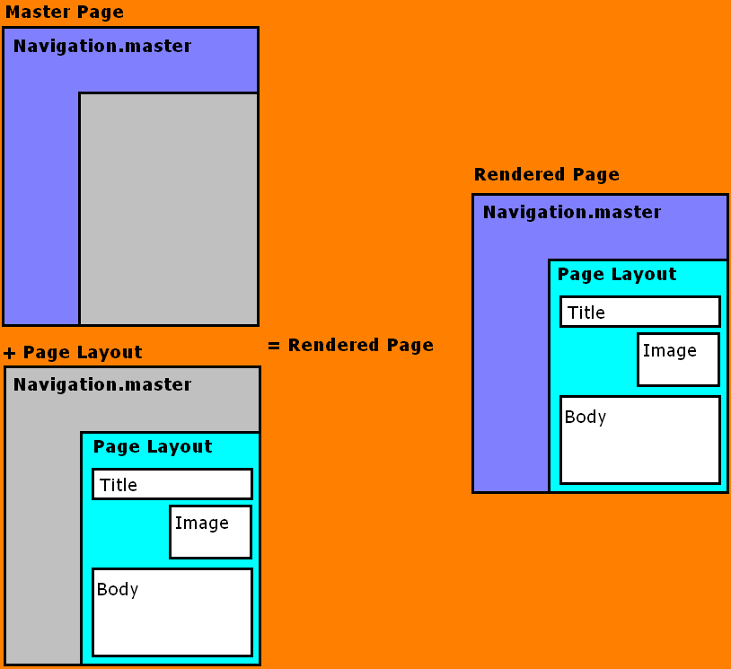
Page = Master Page + Page Layout
Master page defines banner and navigation
Page layout ASPX defines how page content is rendered
Possible scenario
1-3 Master pages
10-25 Page Layouts
10s of 1000s of Content Pages
Notes:
Instructor Notes
Let us now concentrate on the pages that will make up our site. Remember that the type of site we have created is completely based on the Windows SharePoint Services framework. And as a result, we have the same deep integration with ASP.NET 2.0 as with normal team sites.
So if you look at a pages making up the site, they are composed out of two parts: a master page and a content page that is based on a specific page layout.
The master page defines the general look and feel and host also the navigation controls. The page layout can be compared to the concept of templates we had in Content Management Server 2002. A page layout defines the way the page content is rendered. It is populated with field controls and Web Parts as we will discuss in more detail in a minute.
Together, the page based on the page layout and the master page render the full page you see in the browser.
If you navigate to the Master Page gallery you can review the various master pages. We have three or four master pages that are used within an Internet Presence Web Site. Typically you will have about a dozen page layouts and the amount of pages created by content managers based on the page layouts can of course be in the thousands.

Slide 10
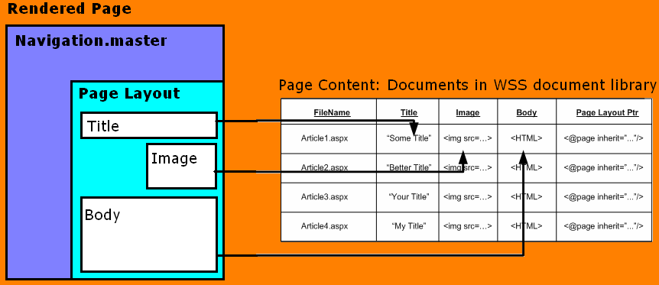

Page Layouts
Inherited from WSS:
Versioning,
Check-in/Check-out
Content types
Access control
Workflow
Page execution:
Page URL requested
Page layout executed in content of page
Content server controls bind to page fields
Rendered page returned
Notes:
Instructor Notes
Looking back at our Master Page gallery here, you see all of the currently available page layout files. All of these files are stored in a normal WSS document library. Versioning and check in /check out are enabled. You can organize the files into folders and also apply per-item security if needed for your Web site. Custom workflows can be associated with the document library and possible instantiated and started manually or automatically.
As you notice in the gallery, page layouts are actually the underlying templates of a WSS content type. Content types are a new concept in WSS 2007 and were discussed in Ted Patisson his webcast a couple of weeks ago. Please visit the http://www.betaoneservices.com to review that cast if you want to learn the details. Briefly, content types allow us to create a the site collection level a type of content we want to store in a list or library. Associated with it, you can have specific columns and specific behavior (such as workflow). It is possible to associated one or more content types to a document library.
You see that for example the articleleft and articleright page layouts are associated with the article page content type. If we click on the content type we end up in the definition page for it. You notice the different columns that are defined for the content type. Some of them are required columns, others are custom ones. These columns correspond to fields that can be made available on the page. A field is physically represented as a control on the page. This controls is able to represent itself in edit mode (when the content manager is editing the page) and in view mode (typically what a visitor of our site will see). Field controls are the 2007 version of the place holders we had in CMS 2002.
So when you open the page layout file in SharePoint Designer, you will see these field controls. If we click on one, we can review the properties. The toolbox in SharePoint Designer displays the different fields defined for the content type associated with the page layout.
When you now create a page as a content manager, first thing you do is the selection of the page layout you want to work with. An instance of the page is created and displayed in authoring mode. It means that all of the field controls that are available on the page and that are representing the value of the columns of the content type are editable.
Let us ignore the workflow for now and click the publish action. It will make the page available to all visitors to our site. But where is the page stored? The page is stored in the Pages document library – a very important one since it stores all of the dynamic pages that make up our site. Let us navigate to it via the Site Content and Structure page. Notice how all of the text we have added to the page is actually stored as values for the columns.
When we request the page, SharePoint uses the content server controls to represented these values in the browser.

Slide 11
Steps to Create a New Page Layout
Create shared columns
Create content type
Add created site columns to content type
In the Master Page Gallery
Create new Page Layout file
Check-out file and edit in SharePoint Designer
Populate the file with content fields
Check-in and approve
Use the new page layout file
Notes:
Instructor Notes
Go over these steps and explain that the next demo will cover this.
Ask also if people still have problems with the concept of the content type. It is extremely important that they understand this concept very well.

Slide 12
Steps to Create a New Page Layout
Create site columns
Create content type
Add created site columns to content type
In the Master Page Gallery
Create new Page Layout file
Check-out file and edit in SharePoint Designer
Populate the file with content fields
Check-in and approve
Use the new page layout file
Notes:
Instructor Notes
Go over these steps and explain that the next demo will cover this.
Ask also if people still have problems with the concept of the content type. It is extremely important that they understand this concept very well.

Slide 13
Publishing Cycle
Workflow based on Windows Workflow Foundation
Light-weight approval workflow is active OOB
Based on approval
Minor versions need to be approved to become major versions
Visitors only see the major (published) versions
Workflow can be replaced by custom workflow
OOB delivered with MOSS 2007
Designed using SharePoint Designer 2007
Created using Visual Studio.NET 2005
Notes:
Instructor Notes
OOB you have an approval workflow associated with the pages. But point out that students have learned how to create their own workflows so it is possible to replace the OOB workflow with a custom one.

Slide 14
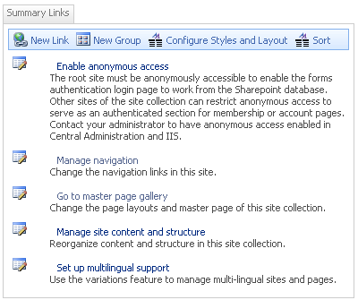

WCM Web Parts
Summary Links Web Part
Custom annotated, stylized links
Table of Contents Web Part
Displays navigation information of your site
Content Query Web Part
Displays a dynamic view of the content in your site
Notes:
Instructor Notes
Explain these Web Parts. Stress that they are tools that (non-it/developer) content managers can use to populate the pages.

Slide 15
Multilingual sites
Common pattern
Parallel sites in multiple languages
In concept, they are localized mirrors
In reality, there are exceptions and customizations for different regions
Modeled as variations
Admin creates multiple labels
System creates and maintains parallel versions of containers and items
Exceptions are allowed
Not just for language translations
Multilingual sites, multi-device sites, and multi-branded sites

Slide 16
Site Variations
Allow for publishing of related sites and pages
Multilingual scenario
Device targetting
Site
Variation A
Variation B
Variation C
Notes:
Instructor Notes
Explain that this is part of the multilingual story that we have in MOSS 2007 but it can also be used in other scenarios such as device targetting.
Explain that one of your variations can be done on the complete site or any of the sub sites you have created. One of the variations (e.g. Variation A) will be the source and all of the others will be synchronized with that one.

Slide 17
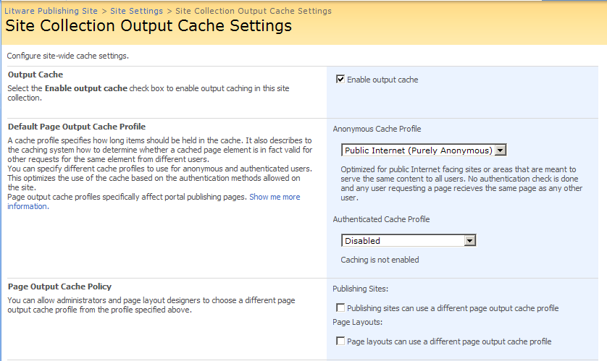
Profile Caches

Slide 18
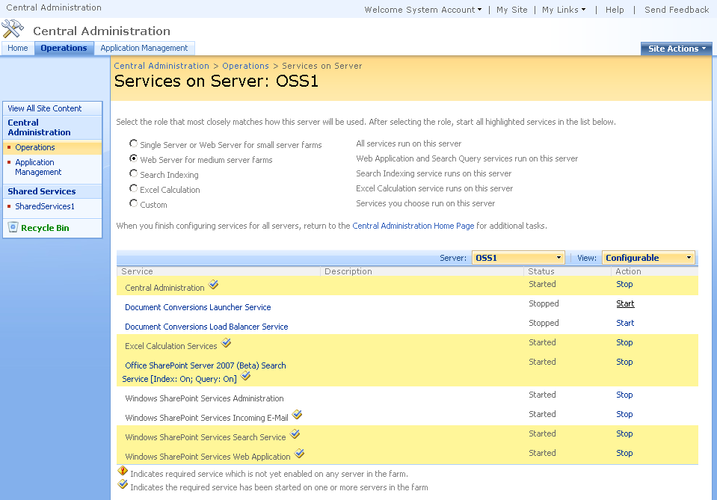
Configuring Document Conversion
Notes:
Instructor Notes
The browser is not the only place from where you can create content. An administrator can also prepare the environment so that content can be created using for example Word 2007 and then converted to an HTML page. In order for this to happen, the document conversion services need to be started.
Point out that in the real world, this can be a heavy task so you might want to isolate this on a separate machine.

Slide 19
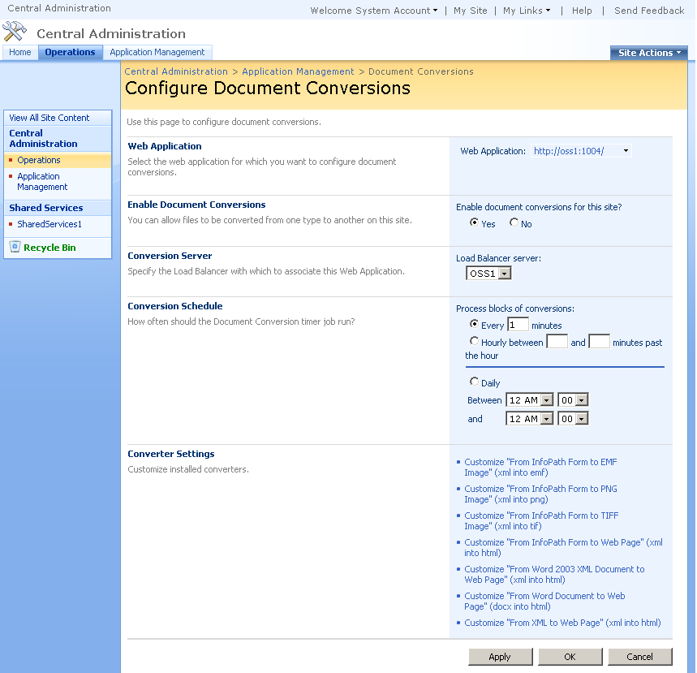
Configuring Document Conversion
Notes:
Instructor Notes
Here is the place where an admin can fine tune the document conversion process. At the bottom you see the various convertors that are available OOB. Clicking on each of these will bring you to a page where you can further detail the conversion.

Slide 20
Smart Client Authoring
Convert documents of different formats into web pages (server side)
Linkage between document and page preserved
Document Content Type stores info about how and where to create page
Pluggable converter model
Builds on document services conversion infrastructure
Out-of-the-box converter for Word documents
Notes:
Instructor Notes
Explain the process behind the smart client authoring. Point out that this is one of the areas were we see opportunities for ISVs.

Slide 21
Content Deployment
Transfers content from one site collection to another
Paths define the relationship between source and destination
Jobs define the content to deploy and a schedule

Slide 22
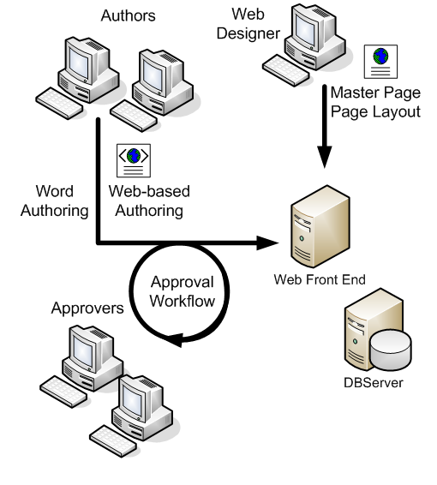
Multi-Farm Topology
Authoring Farm
Production Farm
Internet
Content
Deployment
Requests

Slide 23
Summary
The Publishing Site template
The MOSS Approval Process
Creating custom page layouts
Converting Office documents
Content Translation using Variations
Optimization through Caching Profiles

