Slide 1
The Business Data Catalog
Surfacing Data from Backend
Line of Business Systems

Slide 2
Agenda
Motivation for the BDC
Application Definition Files
Application, Entities, Methods and Associations
Using the built-in BDC Web Parts
BDC integration with MOSS search
Creating custom BDC Web Parts

Slide 3
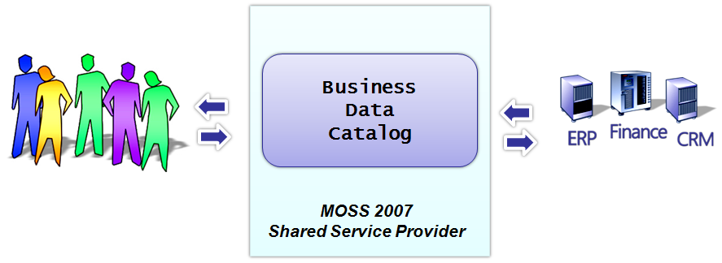
Why do we need the BDC?
Used to surface data from backend LOB systems
LOB data can be shown on any page in a MOSS farm
LOB data can be surfaced without writing code
Note: BDC only provides read-only access to LOB data

Slide 4
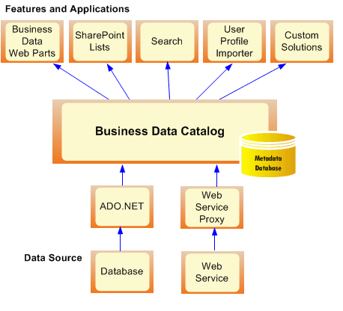
BDC Architecture

Slide 5
Application Definition Files
<?xml version="1.0" encoding="utf-8" standalone="yes"?>
<LobSystem xmlns:xsi="http://www.w3.org/2001/XMLSchema-instance"
xsi:schemaLocation="http://schemas.microsoft.com/office/sps/2005/bdcMetadata BDCMetadata.xsd"
Type="Database" Version="1.0.0.0" Name="AdventureWorksSample"
xmlns="http://schemas.microsoft.com/office/sps/2005/bdcMetadata">
<LobSystemInstances>
<LobSystemInstance Name="AdventureWorksSample">
<Properties>
<Property Name="AuthenticationMode" Type="System.String">PassThrough</Property>
<Property Name="DatabaseAccessProvider" Type="System.String">SqlServer</Property>
</Properties>
</LobSystemInstance>
</LobSystemInstances>
<Entities>
<Entity EstimatedInstanceCount="10000" Name="Product"/>
<Entity EstimatedInstanceCount="10000" Name="SalesOrder"/>
<Entity EstimatedInstanceCount="10000" Name="Customer"/>
</Entities>
<Associations>
<Association AssociationMethodEntityName="Customer"
AssociationMethodName="GetSalesOrdersForCustomer"
AssociationMethodReturnParameterName="SalesOrders"
Name="CustomerToSalesOrder" IsCached="true">
<SourceEntity Name="Customer" />
<DestinationEntity Name="SalesOrder" />
</Association>
</Associations>
</LobSystem>
Notes:
Instructor Notes
This slide shows an example of how BDC metadata is defined inside an XML file. If you have time to do a demonstration, you should consider showing students how to upload a predefined XML file with BDC metadata to create a new application.
Next, show them how to surface BDC data use the Business Data Web Parts such as the Business Data List Web Part. If you want to do one more thing, show students how to configure a BDC application as a content source and then demonstrate how MOSS search can find results from a BDC data source.

Slide 6
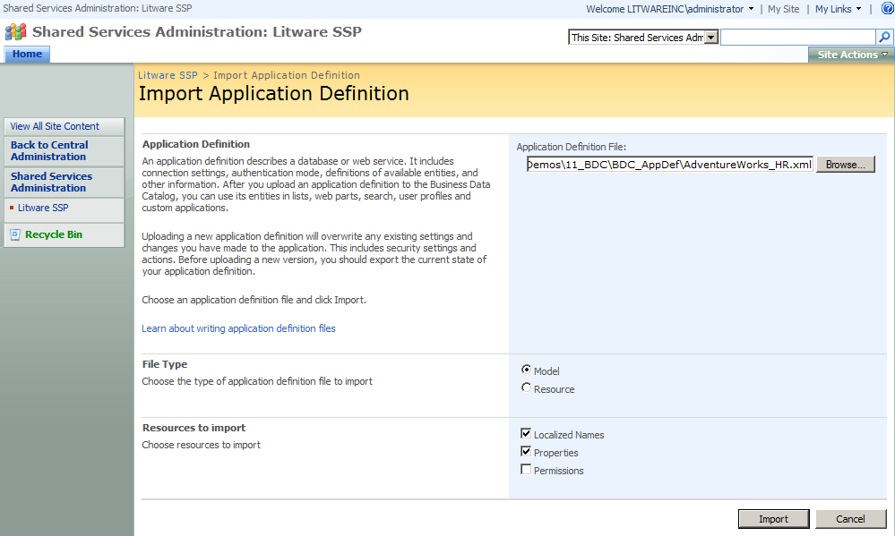
Importing Application Definition Files

Slide 7
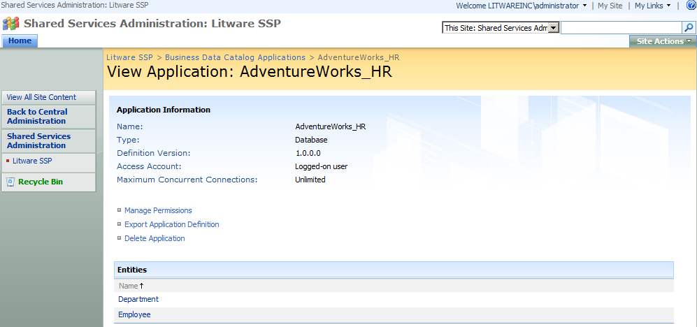
Administration of BDC Applications

Slide 8
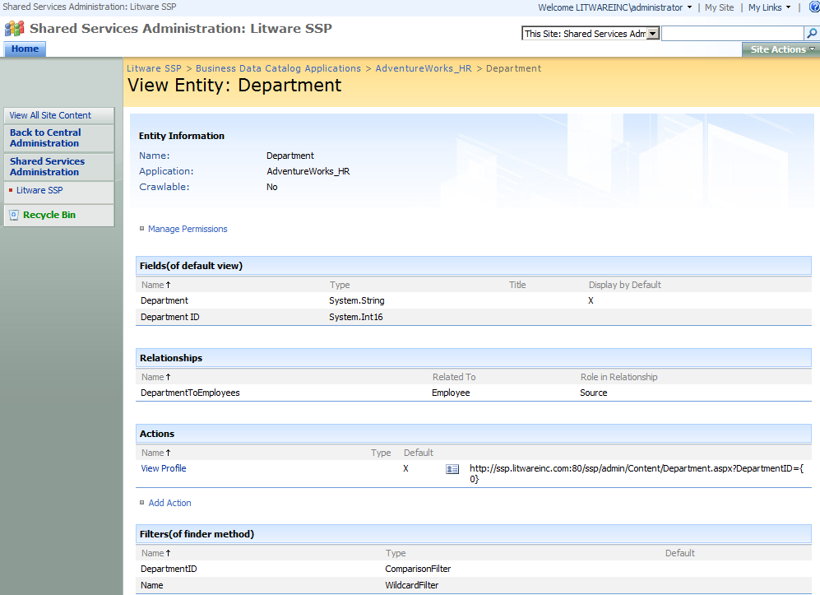
Examining BDC Application Entities

Slide 9
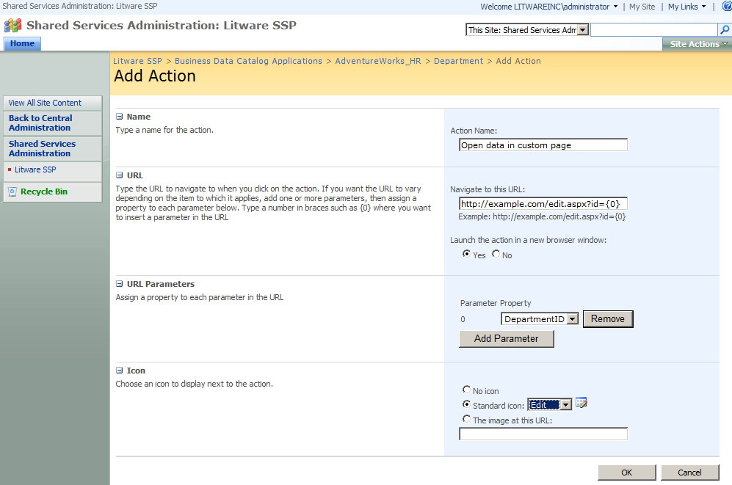
Adding Actions to an Entity

Slide 10
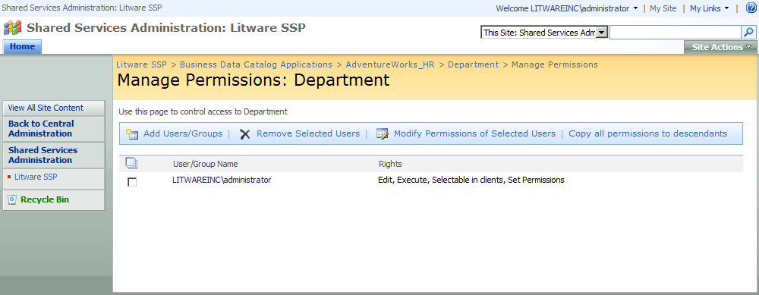
Administrating Security

Slide 11
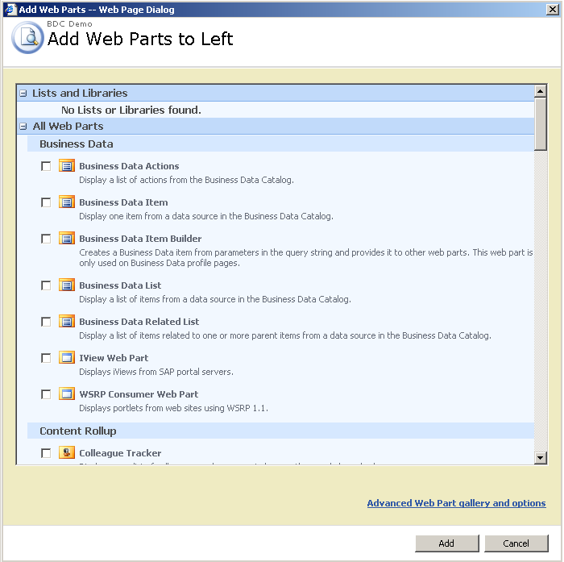
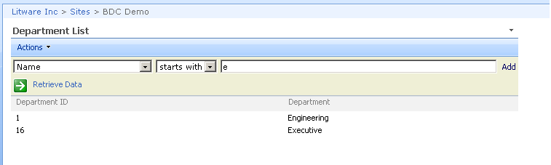
Using BDC Web Parts

Slide 12
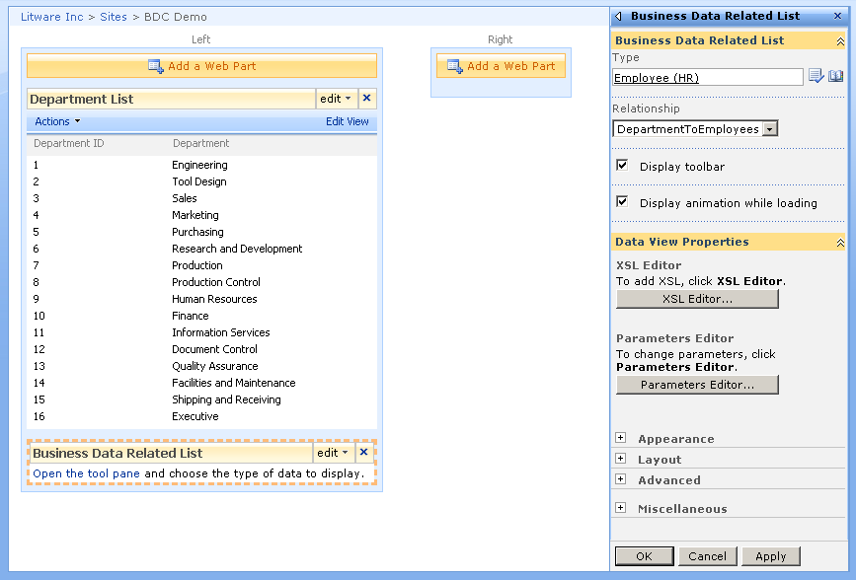
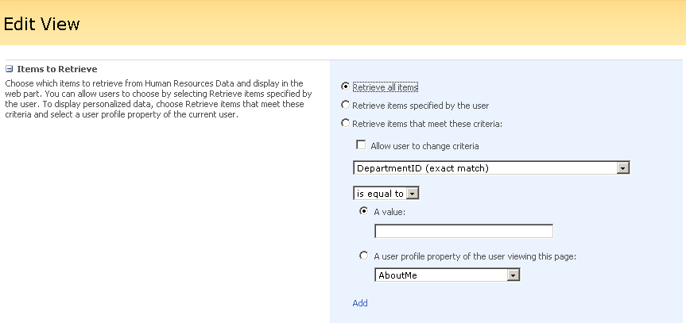
Editing BDC Web Parts

Slide 13
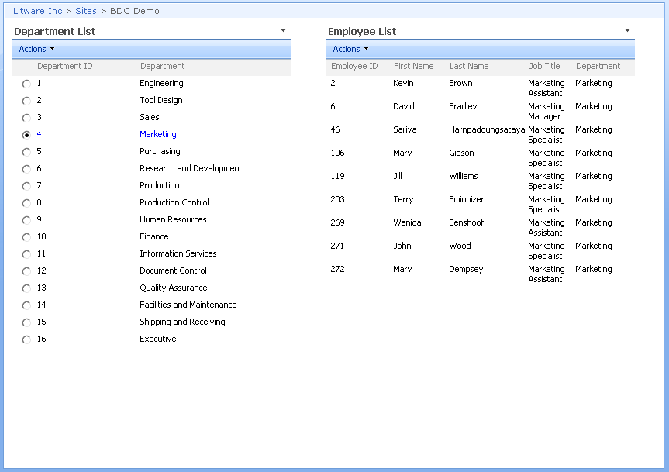
Connecting Web Parts with Associations

Slide 14
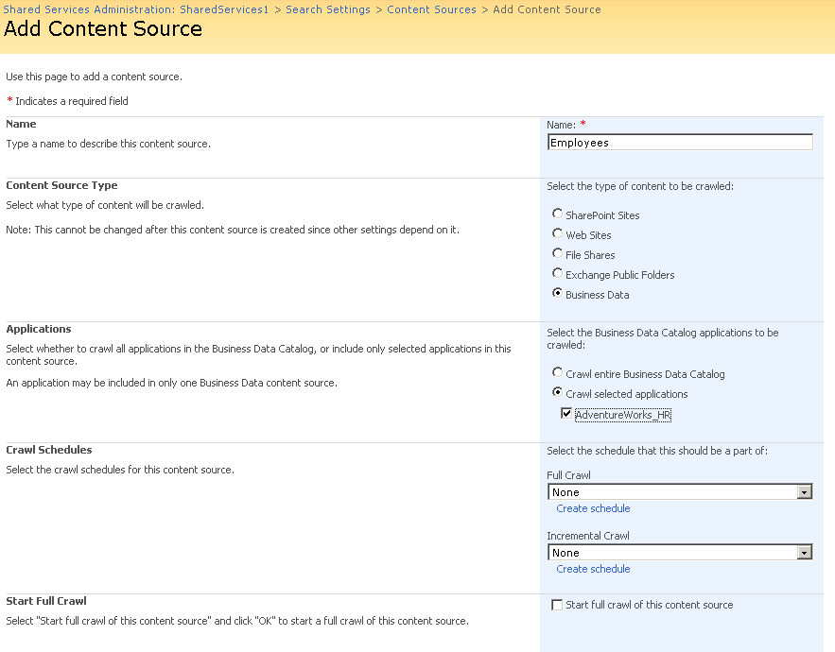
Searching through BDC Applications

Slide 15
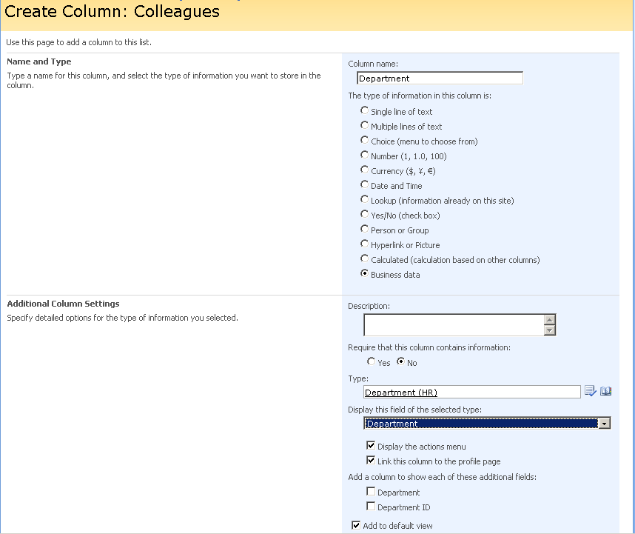
Adding BDC Columns to WSS Lists

Slide 16
Using the BDC API
The BDC provides two main APIs
One is to administrate BDC metadata
The other is for access BDC application data

Slide 17
Summary
Motivation for the BDC
Application Definition Files
Application, Entities, Methods and Associations
Using the built-in BDC Web Parts
BDC integration with MOSS search
Creating custom BDC Web Parts

