Slide 1
Excel Services and Report Center
Leveraging the BI features
of Office SharePoint Server

Slide 2
Agenda
Excel Services
Publishing spreadsheets that render in the browser
Configuring Trusted Locations
Connections
Using user-defined functions (UDFs)
Report Center
Creating Dashboards
Key Performance Indicators (KPIs)
Filters

Slide 3
Why Do We Need Excel Services?
Common customer requirements/complains
Distributing spreadsheets to users creates many copies
Excel doesn’t play well in the BI dashboard and reporting world
It’s difficult to protect proprietary information in spreadsheets
Incorporating Excel logic into applications is hard
Excel was designed as a desktop application (read: Excel really stinks as a server-side application)
Notes:
Instructor Notes
Try to interact with the audience here and ask questions that relate to the needs and challenges discussed on the slide.
What are you doing with Excel?
How do you collaborate on a spreadsheet (e.g. Some sales data) in your company?
Do you leverage the charting and calculation features of Excel?
Do you distribute Excel spreadsheets to your customers as part of your solution?

Slide 4

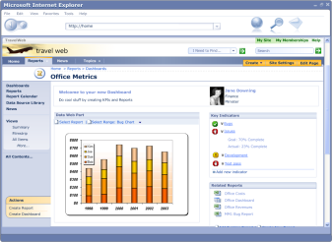



Excel Services
Browser
Excel 2007
Design and author
Calculated data and charts
Spreadsheets
Spreadsheets/snapshots
Spreadsheets/ Calculated data
Excel 2007
Office SharePoint Server & Excel Services
Custom Applications
Notes:
Instructor Notes
Overview of what Excel Services is all about:
Somebody creates an Excel spreadsheet
Publishes it to a SharePoint server where Excel Services is activated (point that Excel Services is a service provided by the Shared Service Provider)
Users can get a thin client view of the spreadsheet in their browser with the possibility of doing limited interaction with the spreadsheets
Via Web parts we can take snapshots (e.g a chart or a set of data) and use it somewhere else
A Web service can be consumed remotely by custom applications – these can interact (sending data, letting excel calculate, and getting results) with the spreadsheet in a programmatic way

Slide 5
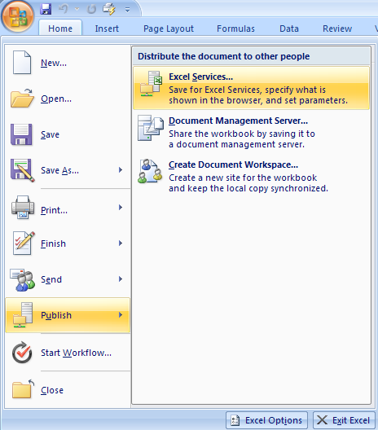
Walk Through of using Excel Services
Add the URL of the document library as trusted location
SharePoint Central Administration
In Application Management, configure the Farm’s core services
In Excel Services Management, add the URL of the doc lib as a trusted file location
In Excel 2007, publish to Office Server
Decide what worksheets to publish
Named ranges can be dynamically populated with values in the browser
Give the URL of a document library
Users now have Web access to the spreadsheet
Notes:
Instructor Notes
Here are the steps to enable a spreadsheet for Web Access
Before talking about the steps that need to be done in Excel itself, talk about step 2 where an administrator has to add the URL to the doc lib (or possibly to the entire site) as a trusted file location.
Next discuss what needs to be done in Excel

Slide 6
Excel 2007 Web Services
Using server-side Excel logic in applications
Author part of the business logic in Excel
Protect and maintain proprietary information
Automating spreadsheet updates on servers
Refresh external data and parameterize
Process generated spreadsheets
Create, store and deliver snapshots
Custom UI to server-side Excel calculation
Notes:
Instructor Notes
Accessing the spreadsheet remotely via the Web service. Here are the scenarios.

Slide 7
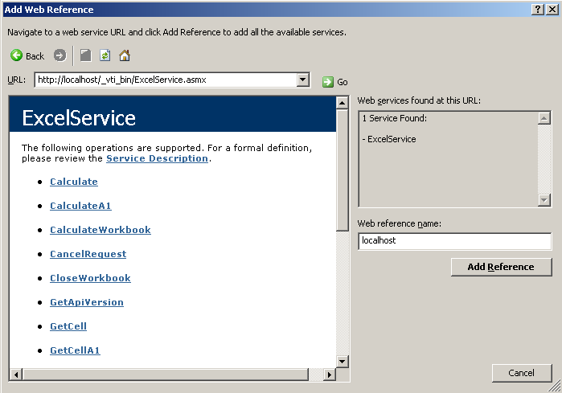
Excel 2007 Web Services
Follow the previous steps to publish a spreadsheet to Office Server
Add Web Reference to your .NET application
Notes:
Instructor Notes
Explain Web Reference if needed.

Slide 8
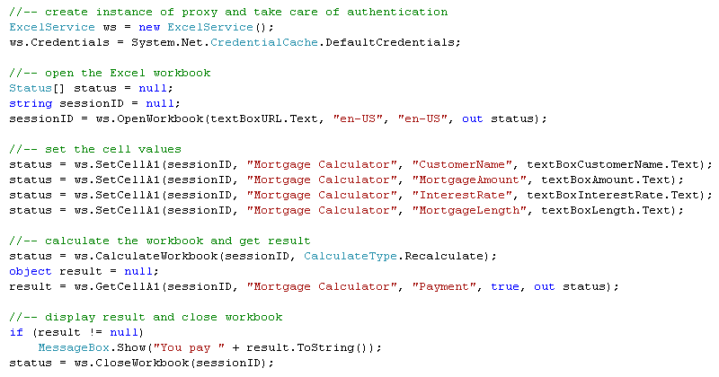
Excel 2007 Web Services
Notes:
Instructor Notes
Go over the code:
Creation of an instance of the proxy
Passing our credentials to the Web service
the Status array will be populated with non-critical errors and warnings
First method to call is the OpenWorkbook method. Provide it with the URL to the Excel spreadsheet stored in the document library, the language settings and then the empty array for the Status objects. The return value is a session id you have to pass every time now you call one of the Web service methods.
Setting the cell values can be done in a number of ways. Here we are using SetCellA1 because that allows us to work with the named ranges we defined in the spreadsheet. Just pass it the session id, the name of the spreadsheet, the name of the named range and then the value you want to pass.
Next, call the CalculateWorkbook so that the calculation is done
And retrieve the result of the calculation using the GetCellA1 method.
The final step is a call to the CloseWorkbook.

Slide 9
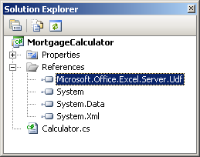
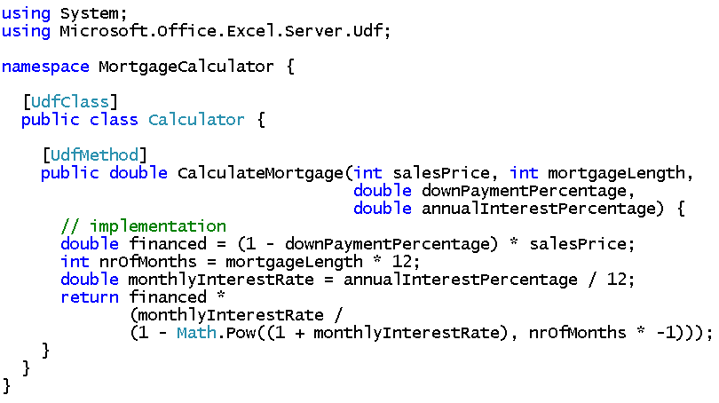
Using UDFs with Excel 2007 Services
UDF definition
Methods in .NET classes, callable from Excel formulas
Notes:
Instructor Notes
About this support for UDF. Not available in beta 1 but will be there in beta 2.

Slide 10
Report Center
With Office 2007, SharePoint Server become the hub for BI on the server
Excel Services and Reporting Services in the portal
Out-of-the-box BI portal experience
Dashboards, KPIs, and Report Libraries
Integrated with Portal, Collaboration, Enterprise Content Management and Workflow functionality
Notes:
Instructor Notes
Second part of the presentation.
Cover the goals here of the Report Center. Stress that it’s goal is to be the place to visit for anybody who wants to do reporting or business intelligence in Office 2007 server.
We deliver Report Center as a site template in Office 2007 server and we immediately create an instance of it and integrate it in the portal you can create.

Slide 11
SQL Server Reporting Services
Integrated with WSS to enable publishing, viewing, and management of reports
Microsoft Office SharePoint Server light up
Report library integration
Dashboards and filter Web Parts
Integration is interesting because…
New capabilities for Reporting Services users
Great example of deep integration for ISVs
Notes:
Instructor Notes
Reports can be created and delivered via SQL Server Reporting Services. How do we integrate in Office 2007 with Reporting Services?
Goal is full integration with WSS and Office 2007 Report Center.
Special library called the Report Library
Web part that can display a report and filter web parts that can be connected to it to slice the data

Slide 12
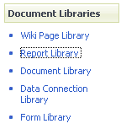
Storing Reports
Reports have more specific needs than documents
History is very important
Many instances of the same report can exist
Therefore, Office Server adds a Report Library template
Displays current spreadsheet / report by default
History available via search and list views
Custom profile page
Can be part of Report Center
A list template that can be used anywhere
Notes:
Instructor Notes
Reports (SQL Server Reporting Services, Excel-based, or somethingcompletelyelse) canbestored in a normal document library. However, there are somespecificneeds for reports. Maintaining a historyis important as well as the factthatyou probable want to store different instances of the same report. For example, youcan have a sales report generateddaily. The report is the same but the data changes.
Talk about how today reports canbestored in WSS v2 -> a document librarywith an entry per report instance ending up quickly to large document librariesthat are not easyanymore to maintain.
To meettheseneeds, weintroduce the Report Library in Office 2007 server - a librarycontaining the necessaryfunctionalities for storing, managing and making report instances available. By default, it shows the current version of the report, but the historyisavailableatany moment. Searchwilltakethese instances also in account. Views on these instances canbecreated.
Reports oftencontain a lot of metadatastoring the context of the report. A profile page can display thismetadatawhen the report instance isvisualized to the user.
The Report Center alreadycontainssuch a library, but youcanactuallycreate an instance of the listtemplateanywhere.

Slide 13
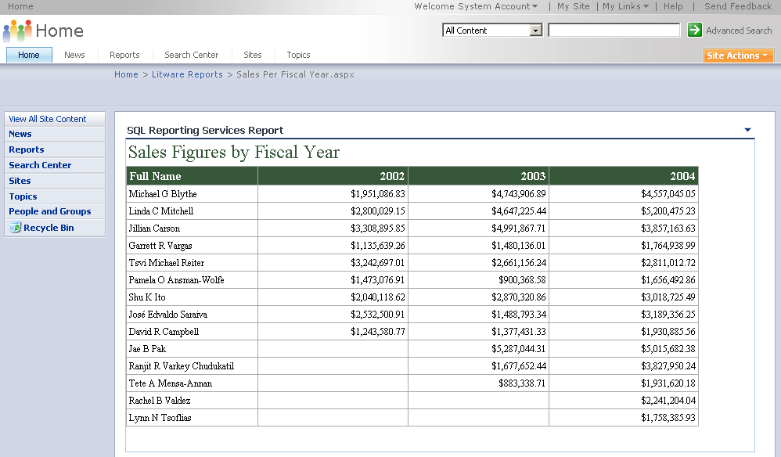
Viewing Reports
Works in both non-integrated mode (via IFRAME) as well as integrated mode
Remote render in response though callbacks via the click handler
.RDL files are registered in SharePoint Services
On rendering, callback to SharePoint Services object model to synchronize contents
Consumes filter part to part connection for specifying report parameter values
Notes:
Instructor Notes
There is a Web Part to view your SQL Server Reportings Services reports either directly from the report library or as a stand-alone Web Part dropped for example in a dashboard.

Slide 14
Key Performance Indicators
Goals
KPIs can be an important instrument in the organization, so let’s make it easier to create them
And let’s use the environment we already know – the portal and team sites
Support KPI types from simple to enterprise class
Types
Manually entered
SharePoint list
Excel workbook
SQL Server Analysis Services
Technologies
KPI web part & list
Customizable KPI profile page
Dashboard template focused on KPIs
Notes:
Instructor Notes
Introduce Key Performance indicators as instrument in organizations to visualize how well we are doing in various domains (sales, customer satisfaction, …)
OOB, we deliver an initial infrastructure with a KPI web part and list that can be further expanded with a profile page displaying associated metadata . KPI list instances can be parts of a dashboard.
Discuss the four types of KPIs

Slide 15
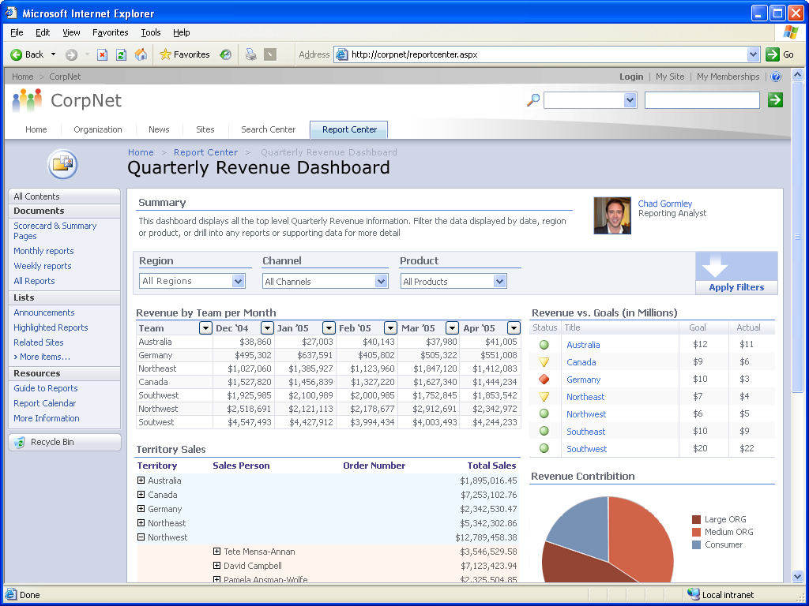
Dashboards
Dashboards are SharePoint pages
Dashboard pages are in same document library as spreadsheets and reports
Types
Generic dashboard
KPI focused
Notes:
Instructor Notes
Template to get you started – 2 types -> KPI / Generic
You fill up the zones with Web parts displaying all kinds of BI components (reports, excel snapshots, filter web parts, …)

Slide 16
Filtering
Filtering is the natural next step after building a dashboard
Filter for eastern region, last quarter
Automatically show just your customers when you load page
Accept values from query string
http://server/dashboard.aspx?Product=452
Notes:
Instructor Notes
Very important on a dashboard. Filtering can be explicit (initiated by the user - eg to drill down in data) or done behind the scenes (eg based on your user profile data - department, responsibilities, region, …)

Slide 17

Filtering Web Parts
Display options
Type in value
Pick from list
Tree view
Hidden
Filter value sources
User entered value
Manual list
SharePoint list
Analysis Services
Bus. Data Catalog
SharePoint profile
Query string
Extensibility
Custom providers & consumers
Standard interfaces that ship in WSS
Notes:
Instructor Notes
Discuss the various display options, possible value resources and then the extensibility.

Slide 18
Summary
Excel Services
Publishing spreadsheets that render in the browser
Configuring Trusted Locations
Connections
Using user-defined functions (UDFs)
Report Center
Creating Dashboards
Key Performance Indicators (KPIs)
Filters

