Slide 1
SharePoint Application Security
Securing Your SharePoint Business Solutions

Slide 2
Agenda
Authenticating users in WSS and MOSS
Configuring access control within a site collection
Configuring access control for Web Application
Using the MOSS single sign-on service (SSO)

Slide 3
Security 101
Authentication and Identity
Authentication based on an identity (i.e. Security Principal)
Authentication performed using credentials
Authentication produces some form of badge
Authorization and Access Control
A subsystem is used to define security policy
Privileged users to configure security policy on objects
Subsystem enforces policy at run time

Slide 4
WSS Identities
IIS Application Pool Identity
Configured with IIS or WSS administration tools
Authenticated when IIS worker process is launched
WSS System Identity
New concept introduced with WSS 3.0
Used by WSS to hide application pool identity
User Identity
Used for authorization and auditing
Authenticated by Windows or Forms Auth Provider

Slide 5
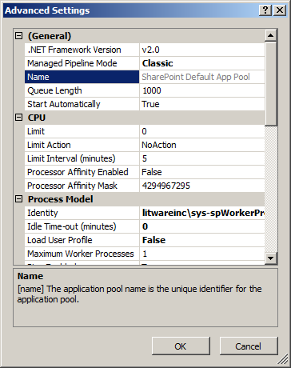
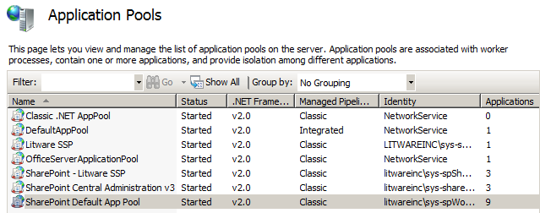
Application Pool Identity
WSS runtime is hosted by IIS Application Pools
Each WSS Web Application runs in a IIS Web site
Each IIS Web site runs with in a specific IIS application pool
Application pool identity configured with local or domain account
Domain account recommended in farms
of two or more servers

Slide 6
WSS Authentication with SQL Server
WSS system code must access SQL Server
WSS must create and access configuration database
WSS must create and access content databases
WSS must authenticate against SQL Server
Option #1: Integrated Windows Authentication (recommended)
Option #2: Standard SQL authentication

Slide 7
Accessing SQL Server
What Identity is used to access SQL Server?
WSS system code accesses configuration database and content databases with Application Pool Identity
Custom code (e.g. Web Parts) run with impersonation and access SQL Server database with user identity

Slide 8
SHAREPOINT\System Account
WSS V2 had issues with Application Pool Identity
WSS 3.0 introduces SHAREPOINT\system account
Hides IIS Application Pool Identity from users
Runs as God within WSS authorization system
Removes need to treat Application Pool Identity as site user
System account details for the super geek
SID as S-1-0-0 (Null SID)
User id as 1073741823 (0x3FFFFFFF)
Account is a internal WSS identity and NOT a Windows identity

Slide 9
WSS Identity versus Windows Identity
It’s important to understand the difference
Web Server
Pages, Lists & Documents
SharePoint content
Web Application Worker Process
Authorized using SharePoint Identity
Authorized using Windows Identity
Northwind Database
SQL Server
XML File
local file system

Slide 10
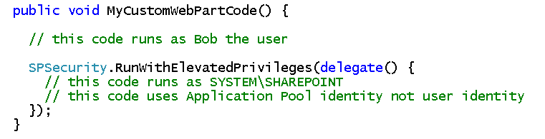
Elevation of Privledges
Code typically runs under identity of user
Authorization works as expected in SharePoint
Sometime code must do things which user cannot do
Custom code elevate privilege
Advantage: elevated code can do what it wants
Disadvantage: elevated code can do what it wants

Slide 11
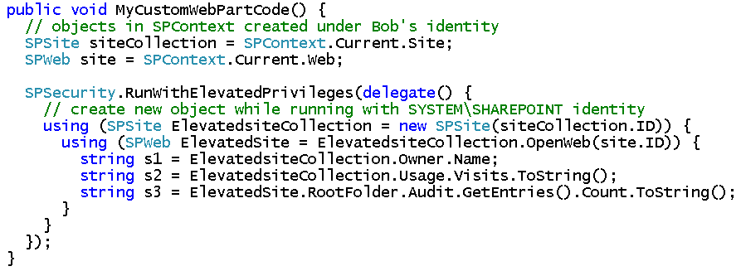
Accessing Sites with Elevated Privileges
Accessing sites with WSS object is tricky
Must create new SPSite object after elevating

Slide 12
WSS Authentication Providers
Windows Authentication
IIS performs authentication with client
Users authenticated to Windows account (AD or local)
Only type supported in WSS V2 and SPS 2003
ASP.NET Forms Authentication
Based on ASP.NET 2.0 authentication provider FX
IIS configured for anonymous access
Web Single Sign On
Based on Federation

Slide 13
Authentication And WSS Zones
WSS authentication configured in terms of zones
There is one zone per IIS Web site
Each zone has its own web.config file
Each zone has exactly one authentication provider
Web Application can be extended with multiple zones
Extended
Web Application
Zone 1
Intranet
User
http://inventory
Default Zone
Windows integrated
authentication
Content
Database
Zone 2
Internet
User
http://inventory.partners.Litwareinc.com
Internet Zone
Forms-based
authentication

Slide 14
Alternate Access Mapping
Ensures internal and public URL mappings work correctly
Main Web Application URL is mapped by default
Web Application and zones can be extended with additional URLs.
Alternate URLs can be mapped to one physical path
Access Mappings
Intranet
User
http://inventory
Intranet
User
http://inventory.litwareinc.com
WSS Site
Internet
User
http://inventory.partners.Litwareinc.com

Slide 15
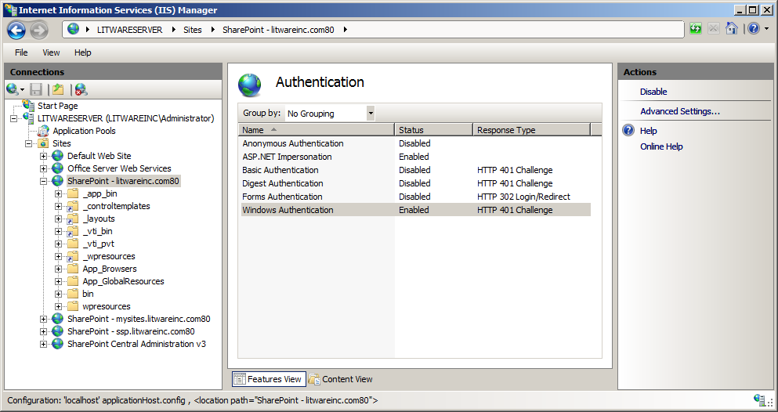
Configuring Windows Authentication
Authentication performed against Windows accounts
Local Accounts can be used in single-server configurations
Active Directory accounts are usually much better choice
Most popular Authentication types
Windows Integrated Authentication
Basic Authentication

Slide 16
Integrated Windows Authentication
Authentication using Windows protocols
Enhancements to WSS V3 enable Kerberos protocol
WSS V3 still uses NTLM protocol when necessary
Authentication results in creation of Windows security token
Domain Controller
Windows Server 2003
Active Directory
Login
PWD
Bob
xoxoxo
Mary
oxox
Wally
xoxox
Desktop
Windows XP
Application
Browser
Office 12
Custom App
Web Server
Windows Server 2003
WSS
token
Notes:
Instructor Notes
Integrated Windows Authentication is typically only used for users running in the same LAN as the server they are authenticating against. It becomes less practical for users on the other side of firewalls because the user must be able to communicate with the company's domain controller. However, it is the preferred style of authentication when available because it is the most secure and IE and Office applications can perform the authentication behind the scenes without intervention from a user who has already logged onto the network.
WSS V3 supports the two different Windows integrated authentication protocols: NTLM and Kerberos. Mention to students that Kerberos authentication did not work properly in WSS V2, so its support can be seen as an enhancement to WSS V3.
Kerberos is generally preferred over NTLM for the following reasons.
It cuts down roundtrips to the domain control increasing performance.
It enables delegation of a users identity across server machines.

Slide 17
Basic Authentication
Commonly used in Internet scenarios
Industry-standard, cross-browser, firewall-friendly protocol
No need for client to access Windows domain controller
Authenticates to Windows account and creates security token
User name and password passed in clear text
You must use HTTPS for any reliable level of security
Desktop
Windows XP
Web Server
Windows Server 2003
Domain Controller
Windows Server 2003
Application
Browser
Custom App
WSS
Active Directory
Internet
token
Login
PWD
Bob
xoxoxo
Mary
oxox
Wally
xoxox

Slide 18
Windows Authentication Zones
web.config file configures basic ASP.NET settings
Authentication specifies resolving to Windows accounts
Impersonation is set to true
WSS is the entity that adds authorization
ASP.NET configured to allow all user access to everything
<!-- selected snippets from web.config for integrated Windows auth -->
<configuration>
<system.web>
<!-- use Intergated Windows Authentication -->
<authentication mode="Windows" />
<!-- impersonate Windows user -->
<identity impersonate="true" />
<!-- configure ASP.NET to grant all access to resources -->
<authorization>
<allow users="*" />
</authorization>
</system.web>
</configuration>

Slide 19
Forms-based Authentication (FBA)
WSS 3.0 supports FBA introduced in ASP.NET 2.0
Decouples SharePoint from Active Directory
Based on pluggable authentication providers
Providers available out-of-box with ASP.NET 2.0
Companies can create their own providers as well
Desktop
Windows XP
Web Server
Windows Server 2003
Identity Mgmt App
Operating System
Application
Browser
Office App
Custom App
WSS
Identity Store
Internet
Authentication
Provider
Login
PWD
Bob
xoxoxo
Mary
oxox
Wally
xoxox

Slide 20
Forms Authentication Zones
web.config file configures basic ASP.NET settings
Authentication configured for Forms
Membership provider is configured
Impersonation is set to true (e.g. impersonated IUSR_XXX)
<!-- selected snippets from web.config for Forms auth -->
<configuration>
<system.web>
<!-- use Forms Authentication -->
<authentication mode="Forms">
<forms loginUrl="/_layouts/login.aspx" />
</authentication>
<!-- configure membership provider -->
<membership defaultProvider="AspNetSqlMembershipProvider" />
<!-- impersonate anonymous access user -->
<identity impersonate="true" />
<!-- configure ASP.NET to grant all access to resources -->
<authorization>
<allow users="*" />
</authorization>
</system.web>
</configuration>

Slide 21
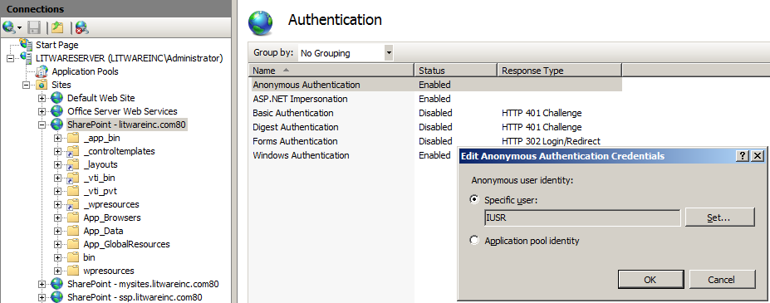
FBA and Windows Identity
Watch out for this guy

Slide 22
Assignment of User Rights
This is done at several different levels
Site Collection
Web Application
Farm

Slide 23
Site Collection-level Security
Site Collection Owner
People and Groups
Permissions and Permissions Levels
Securable objects

Slide 24
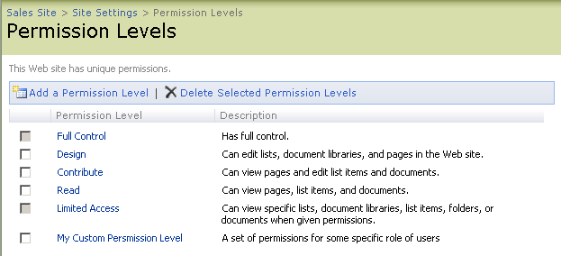
Permission Levels
WSS rights managed through permission levels
Each permission level consists of a set of rights
Permission level defines rights required by business roles
Defined on a per site basis
Permissions assigned to people and groups

Slide 25
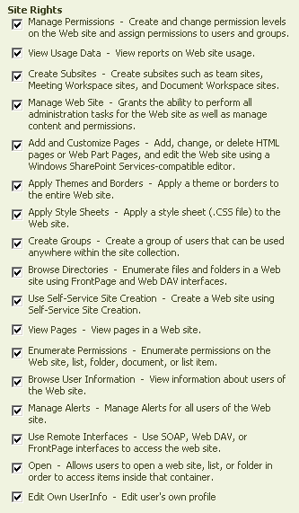
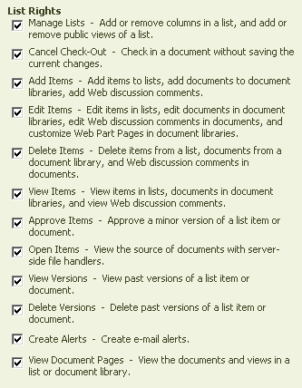
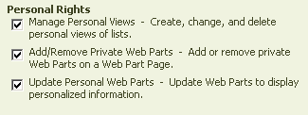
Permissions Managed Using Rights

Slide 26
Securable Objects
site collection
-- top-level site
-- list1
-- item1
-- item2
-- documentlibrary1
-- document1
-- document2
-- childsite1
-- list1
-- item1
-- item2

Slide 27
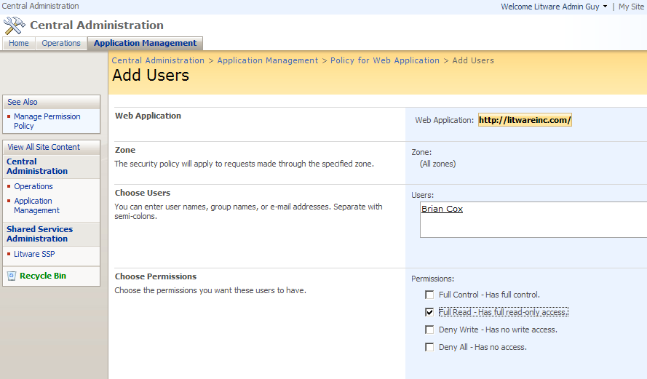
Web Application Security Policy
New with WSS 3.0
Allows farm administrator to grant or deny access
Web application policy overrides site collection

Slide 28
MOSS Single Sign-On Service
Provides credential mapping
Maps identities between identity management systems e.g. map authenticated Windows user to SAP credentials
Stores credentials in encrypted form in SSO database
Where is it used?
Custom Web Parts, BDC, Excel Services, etc.
MOSS Farm
Web Server
SAP
LOB System
Bob
Browser
BDC Web Parts
Custom Web Parts
SSO
database
DB2
some really old database

Slide 29
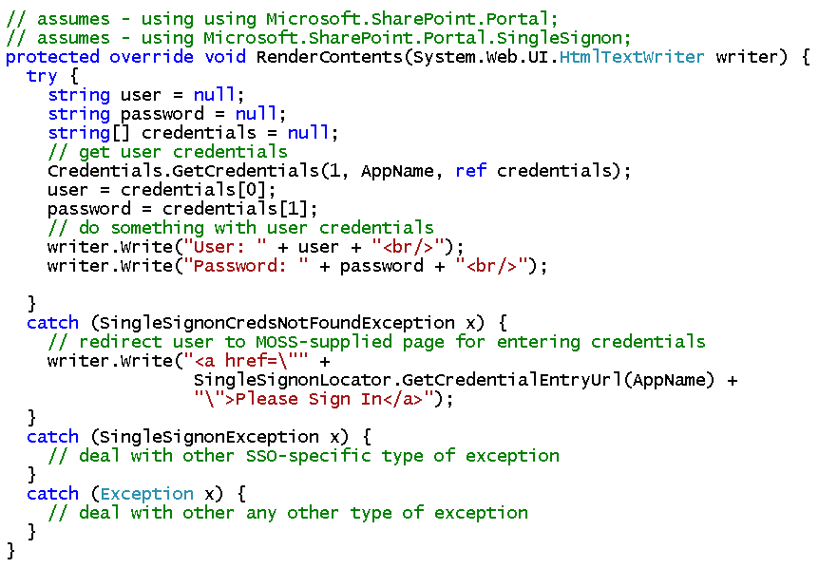

Programming SSO

Slide 30
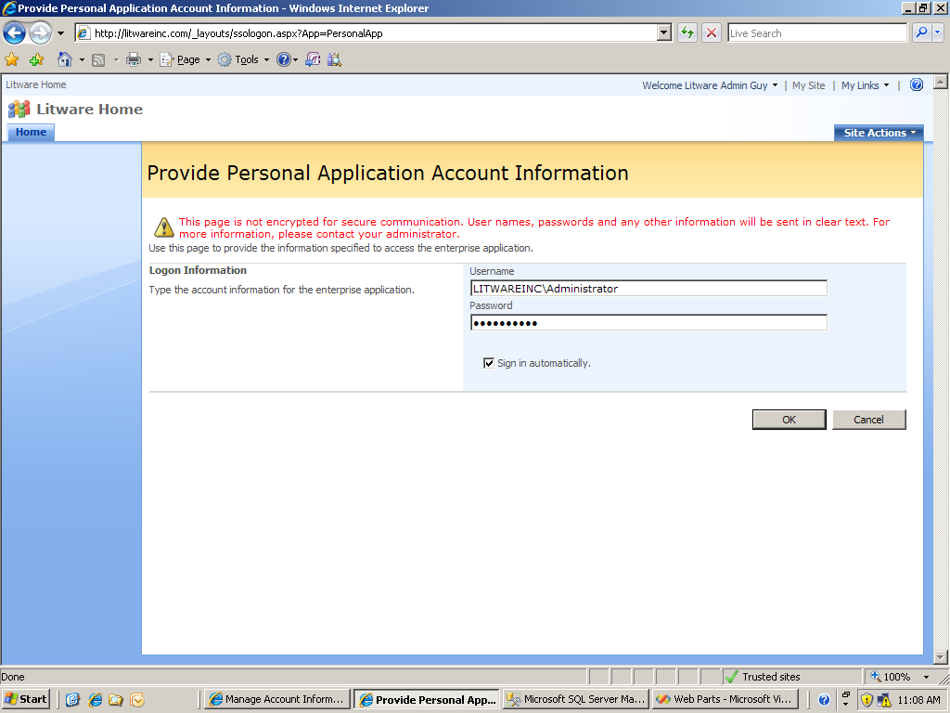
SSO Credential Entry Page

Slide 31
Summary
Authenticating users in WSS and MOSS
Configuring access control within a site collection
Configuring access control for Web Application
Using the MOSS single sign-on service (SSO)

