Slide 1
Introduction to SharePoint Branding
SharePoint sites don't have to look like SharePoint sites

Slide 2
Logistics
Daily Schedule
All times Eastern Time (GMT -0500)
Lecture: 12:00pm - 1:15pm
Q/A time: 1:15pm - 1:30pm
Break: 1:30pm - 2:00pm
Lecture: 2:00pm - 3:15pm
Q/A time: 3:15pm - 3:30pm
Notes:
12:00 – 3:30 EST

Slide 3
Student Questionnaire
What's Your Name and Company?
What languages have you used?
HTML, XHTML, CSS and JavaScript
XML, XPath and XSLT
C# or VB.NET, ASP.NET Master Pages
What design/branding tools have you used?
SharePoint Designer
Visual Studio and ASP.NET
Adobe Photoshop or Microsoft Expression
Legacy toolsets DreamWeaver, FrontPage, Visual InterDev, Visual Notepad, etc
Notes:
How do we feel about talking about some 2010 things especially big changes

Slide 4
Agenda
Introduction
WSS Fundamentals
Anatomy of a Team Site
Understanding the role of CSS and Themes
SharePoint Integration with Master Pages
Working with the SharePoint Designer
Understanding Features
WCM using the MOSS Publishing Features

Slide 5
What is does Branding Mean?
Branding:
The act of building a specific image or identity that people recognize in relation to your company
Website Branding:
The colors, fonts, logos, and supporting graphics that make up the general look and feel of a corporate website.
Branding for SharePoint:
Master pages, page layouts, CSS, web parts, XSLT, images, etc.
Notes:
Hopefully everyone knows this already

Slide 6
Why not “Design”
The word “design” can often be confused with Software Design (planning for software development)

Slide 7
SharePoint Editions
Windows SharePoint Services 3.0 (WSS) is the free version of SharePoint
Focused on collaboration with documents and light editing of web pages
Microsoft Offices SharePoint Server 2007 (MOSS) is the licensed version of SharePoint
Includes among other capabilities the Publishing Feature
Much better platform for creating a strongly branded web site

Slide 8
What is WSS?
Windows SharePoint Services 3.0 (WSS)
An engine for creating/running/managing sites
Architecture designed to scale to 10,000s of sites
Platform for building Web application and solutions
Collaboration services included out-of-the-box
Browser Clients
WSS Collaboration Services
SQL Server
SQL Server 2005
SQL Server 2000
SQL Express
Office 2007 Clients
Windows SharePoint Services 3.0 (WSS)
Core Site and Workspace Services
Office 2003 Clients
.NET FX 2.0 and ASP.NET 2.0
Internet Information Services 6.0 (or later)
Windows Server 2003 (or later)
Notes:
What does ted cover here

Slide 9
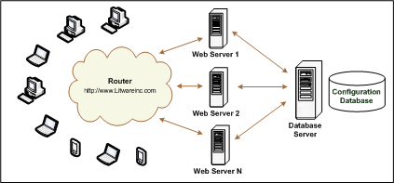
The WSS Farm
WSS deployment based on a farm
Farm requires Web server(s) and database server
Farm can be single server or multi-server
Each farm has exactly one configuration database
Notes:
Ted?

Slide 10
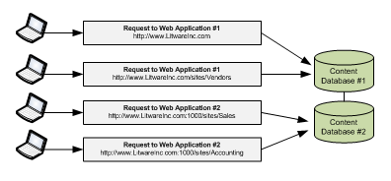
Web Applications
Web Applications provide HTTP entry points
Web Applications based on IIS Web sites
Web Application defines one or more URL spaces
Web Application security configured independently
Notes:
Creating an IIS Website each time, will hold site collections and sites. Can use ports or host name (may require edits to a host file or some setup on the network). Demo creating one?

Slide 11
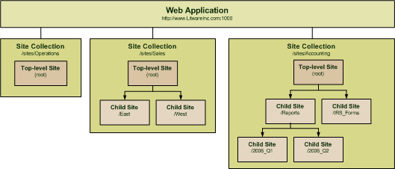
Site Collections and Sites
Sites are partitioned using Site Collections
Site collection is scope for administrative privileges
Site collection always contains top-level site
Site collection may contain hierarchy of child sites
Web application can support 1000s of site collections
Notes:
Site collections are often used to segment off security permissions or for data maintenance reasons. Demo creating one?

Slide 12
Team Sites
Sites in WSS are known as Team Sites
They are best suited for managing web based documents
Also includes the concept of Web Part Pages for creating traditional web page content

Slide 13
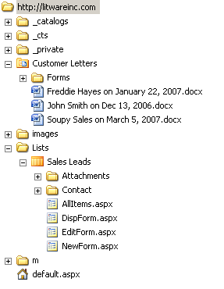
The Virtual File System of a Site
Site is a virtual file system
made up of folders and files
Pages are files
Documents are files
Stored in content database
How can you look at it?
SharePoint Designer
Windows Explorer (WebDav)
Notes:
Explain how this tripped me up, can’t look on the server for this
Demo in web UI and in SPD

Slide 14
The _layouts Virtual Directory
Files in _layouts directory accessible to all sites
_layouts provides access to common resources
_layouts contains files for images, CSS and JavaScript
_layouts contains Application Pages
All these URLS resolve to the same page
http://Litwareinc.com/_layouts/settings.aspx
http://Litwareinc.com/sites/Vendors/_layouts/settings.aspx
http://Litwareinc.com:1001/sites/Accounting/_layouts/settings.aspx
Notes:
Often referred to as application pages. Live in the 12 folder or root folder in sharepoint. Important concept, will come up later when we talking creating our brand because these pages in 2007 do not receive custom style the same way as other pages on site. Demo show 12 folder

Slide 15
Site Pages Versus Application Pages
Site Pages exist within virtual file system of site
They may or may not be ghosted (uncustomized)
They support customization via Web Parts
They support customization via SharePoint Designer
Customized pages impact performance and security
Application Pages are deployed once per farm
They do not support customization or Web Parts
They are parsed/compiled as classic ASP.NET pages
They run faster than Site Pages
They always support code behind
Notes:
Explain customization better, application pages are the pre baked functionality and settings pages you will see in SharePoint. Show?

Slide 16
SharePoint Integration with CSS
WSS supplies core.css
Several approaches to extend & override core.css
Notes:
Talk about importance of CSS in SharePoint and view source on the HTML

Slide 17
Understanding core.css
All styles in WSS initially defined by core.css
Located in \TEMPLATE\LAYOUTS\1033\STYLES
Contains over 4000 lines of CCS class definitions
Classes used throughout standard WSS UI elements
Extending core.css
Applying WSS styles (meant for end users)
Applying custom CCS files (meant for developers)
Notes:
Talk about core.css, open it up and show it off. SPD customize core, SPD make new css activate with code or SPD, customize core.css in 12

Slide 18
SharePoint Themes
WSS provides set of out-of-box themes
Collection of CSS file and graphics
Provide a means for applying simple to somewhat sweeping design changes
Out of the box themes are not very attractive and rarely match a corporate look and feel
Microsoft release 10 new themes recently
http://blog.drisgill.com/2009/03/microsoft-released-10-new-sharepoint.html

Slide 19
SharePoint Themes
Theme files are deployed to front-end Web server
WSS provides UI for users to apply themes
Changes to themes are made in the SharePoint root 12 folder
SharePoint Designer can be used to rapidly test changes to themes before making permanent
Notes:
Demo themes

Slide 20
Master Pages in WSS
Application pages (/_layouts) use application.master
Farm-wide master page
Cannot be customized on per-site basis
Site Pages use default.master by default
default.master is a page template
default.master instance created in Master Page Gallery
default.master can be customized on per-site basis
default.master can be replaced with different template
Notes:
Talk about how master pages work in sharepoint, every page has one, sites can have more than one, styles the shell of the branding and decides where SharePoint functional controls are located on the screen

Slide 21
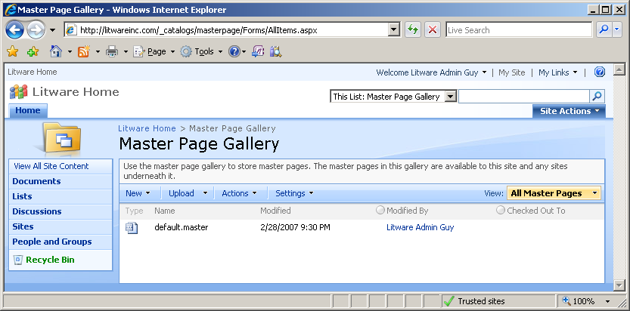
The Master Page Gallery
Each site has a Master Page Gallery
Instance of default.master automatically provisioned
default.master can be customized on per-site basis
Notes:
Demo master pages

Slide 22
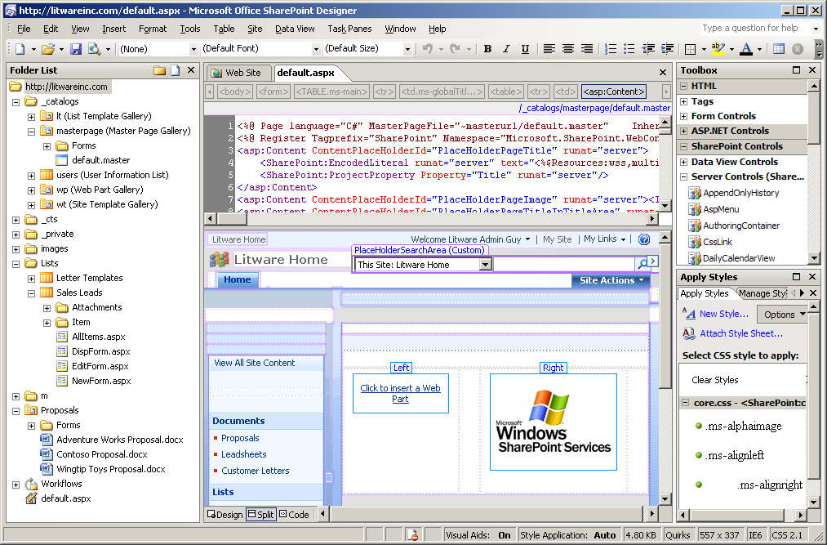
Customization with SharePoint Designer
Notes:
Explain customization more

Slide 23
What is a Feature?
A building block for creating SharePoint solutions
A unit of design, implementation and deployment
Features can contain elements
e.g. menu items, links, list types and list instances
Many other element types possible
Features can contain event handlers
You can add any code which used WSS object model

Slide 24
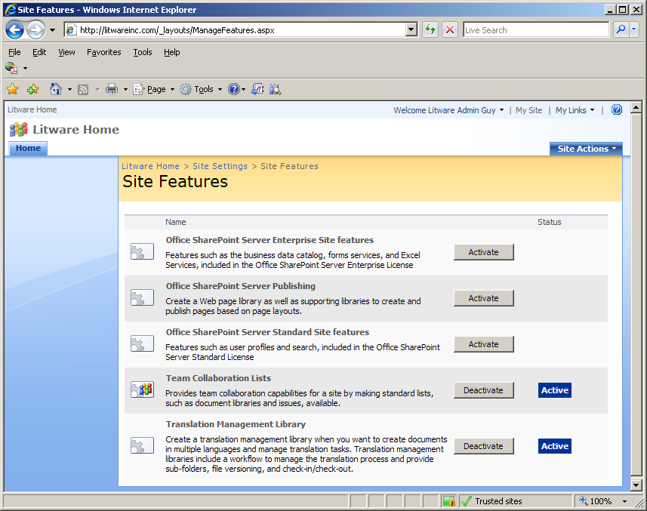
User’s View of Features
Features support concept of activation/deactivation
This is the site-level feature management page in a WSS farm where MOSS has been installed.
Much of the functionality of MOSS is enabled and disable by activating and deactivating features that have been developed by the MOSS team.

Slide 25
MOSS Support for WCM
Microsoft Office SharePoint Server 2007 (MOSS) supports WCM via its Publishing features
One feature is scoped at site-collection level
Other feature scoped to site
What do the MOSS Publishing features do?
Enable uploading and applying custom Alternate CCS files
Enable uploading and applying of Master Pages
Provide framework for content approval
Notes:
MOSS is generally a better platform for hosting web content. WSS is geared towards publishing documents on the web. Because of this many designers prefer MOSS for heavily branded SharePoint sites

Slide 26
The MOSS Approval Process
How does the MOSS approval process work?
Publishing Pages created on demand by users
Publishing Pages are created from Page Layouts
Page Layouts are templates stored in MPG
Publishing Pages are instances stored in Pages library
Styles Library enabled approval for other types of files e.g. GIF files, JPG files, CSS files, JavaScript files, etc
Notes:
Demo publishing approvals and page layouts

Slide 27
Anatomy of a MOSS Publishing site
Publishing feature (Site Collection Level)
Activated once per site collection
Publishing feature (Site Level)
Activated once for each site with publishing pages

Slide 28
Summary
WSS Fundamentals
Anatomy of a Team Site
Understanding the role of CSS and Themes
SharePoint Integration with Master Pages
Working with the SharePoint Designer
Understanding Features
WCM using the MOSS Publishing Features

