Slide 1
CSS Primer for SharePoint Designers
Working together with CSS and SharePoint

Slide 2
Agenda
Fundamentals CSS concepts
Overview of CSS rules defined in Core.CSS
Tools for Discovering CSS
Adding custom CSS to a master page
Doctypes and SharePoint

Slide 3
Fundamentals CSS concepts
Why is CSS important for web design?
Table and Font tags were popular a few years ago
Web design now separates design from functionality
Tables are better suited to tabular data
Should you use Table and Font tags in modern design?
Why is CSS important with SharePoint?
CSS used to override default SharePoint branding
OOTB SharePoint uses a LOT of CSS
Primary core.css file has over 4300 lines of CSS code
Notes:
Modern web design standards dictate that whenever possible tables are used only for data, not for page layout. In SharePoint 2007, because we are working with HTML written for IE5.5 we often find that table based branding is more efficient

Slide 4
How is CSS applied to HTML?
Inline Style
<p style="color: red;">The text is red</p>
Internal Style Sheets
<style type="text/css">
h1 { color: blue; }
</style>
External Style Sheets
<link href="customStyle.css" rel="stylesheet" type="text/css">

Slide 5
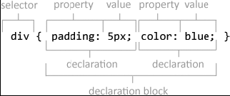
Style sheets are made up of Rules
Rules consist of
Selector – What HTML element is being styled
Declaration block - Sets of style properties and values
Declaration block can define multiple property/value pairs
Several selectors can be grouped together
div, p, h1 { color: blue; }

Slide 6
Types of Selectors
Type Selectors
p { font-family: arial; }
Class Selectors
.myClass { color: red; }
p.myClass { color: blue; }
ID Selectors
<div id="myID">
#myID { color: green; }
Descendent Selectors
<div>
<p>Hello</p> World
</div>
<style>
div p {
color: purple;
}
</style>
Notes:
ID’s are only used once, classes can be repeated throughout HTML

Slide 7
Types of Selectors
Pseudo-Classes
a:link {
color: red;
}
a:visited {
color: blue;
}
a:hover {
color: green;
}
The Universal Selector
* {
margin: 0px;
padding: 0px;
}

Slide 8
CSS Properties
Fonts
Font Family
font-family: Calibri, Arial, Helvetica, san-serif;
Font Size
font-size: 12px;
font-size: 1em;
Color
color: blue;
color: rgb(0,0,255);
color: #0000FF;
Text Decoration can be used to create interactivity on links
a {
text-decoration: none;
}
a:hover {
text-decoration: underline;
}

Slide 9
CSS Properties
Wrapping can be controlled with CSS
white-space: nowrap;
Display can be used control spacing and to hide elements
display: block;
display: none;

Slide 10
CSS Properties
Float
The normal flow of a web page is from top to bottom
Float can remove an element from this normal flow and move it to the far left or far right
float: right;
Position
By default elements have a position of static, and flow normally down the page
Relative Position - Causes the element to be positioned relatively based on where it normally would be in the flow
Absolute Position - Causes the element to be positioned absolutely based on its parent.
When position is set to relative or absolute you will want to set a top, bottom, left, or right value to control where the element moves.

Slide 11
CSS Properties
Backgrounds can be used to impart a lot of design change with little effort
Background Color
background-color: blue;
Background Image
background-image: url(‘/images/myimage.gif’);
Background Repeat
background-repeat: repeat-x;
Borders can be set all in one shortcut property or they can be set per side
border: 1px solid green;
border-left: 2px solid red;
border-right: 2px solid green;
border-top: 2px solid yellow;
border-bottom: 2px solid blue;

Slide 12
CSS Properties
Padding is the spacing between an element and its border,
background colors and images show in this area
padding-top: 1px;
Margin is the spacing past the border
It does not show background colors or images for the specific element
Note that parent backgrounds will show through
margin-top: 1px;

Slide 13
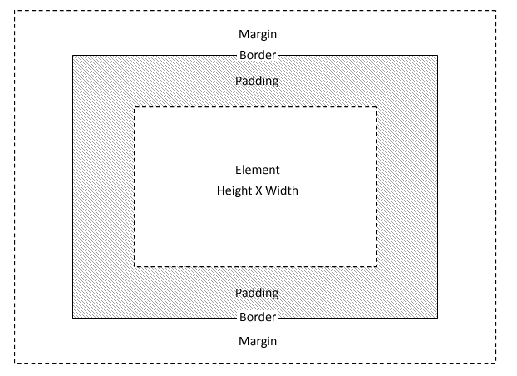
CSS Properties

Slide 14
Inheritance in CSS
Inheritance allows CSS values to apply to descendant elements
Not all of the CSS properties support inheritance
Typically, the ones that do are the ones that affect text styling
Reference for CSS properties that support inheritance
http://www.w3.org/TR/CSS21/propidx.html
!important rule can be really important!
!important rule takes precedence over standard cascade rules
div {
color: red !important;
}

Slide 15
Understanding the Cascade
Find all style declarations applied to the element
Sort by origin and importance (including !important)
If origin and importance is the same,
Specificity is used to determine what wins the cascade
Specificity is determined via the following equation:
([The number of ID selectors] x 100) +
([The number of Class selectors] x 10) +
([The number of HTML selectors] x 1)
Finally, if all other steps are equivalent, the rule that is declared last is the winner
Notes:
2. Origin refers to local browser / user style sheets

Slide 16
Tools for Discovering CSS
Firebug
http://getfirebug.com
IE Developer tools
Built-into IE 8
IE Developers Toolbar
Free download used with IE7
What do these allow you to do
Visually explore CSS class names, IDs, etc.

Slide 17
Adding custom CSS to a master page
Where should CSS live in SharePoint?
Style Library for MOSS
Your own folder or _layouts (12 root) for WSS
Setting an Alternate CSS URL
Site Actions>Site Settings>Modify All Site Settings
Look and Feel > Master page
Inline and Internal style sheets can be applied in the master page or page layouts
<asp:Content ContentPlaceHolderId="PlaceHolderAdditionalPageHead" runat="server">

Slide 18
Adding custom CSS to a master page
For branding that is more advanced include it manually in the master page
<SharePoint:CssRegistration>
<SharePoint:CssRegistration name="<% $SPUrl:∼SiteCollection/Style%20Library/zz1_blue.css%>" runat="server“ />
Can be problematic for overriding the OOTB styles. SharePoint tends to put it’s own CSS last
To be absolutely certain your CSS is called last, use an HTML CSS include
<link rel="stylesheet"
type="text/css" href="<%$SPUrl:∼sitecollection/Style%20Library/∼language/Custom%20Styles/x.css %>“ />
Notes:
Much nicer in 2010

Slide 19
Overview of CSS rules defined in Core.CSS
Overview of CSS used in SharePoint
http://msdn.microsoft.com/en-us/library/ms438349.aspx

Slide 20
Top Navigation Areas
ms-globalbreadcrumb
ms-globalleft
ms-globalright
ms-globallinks
ms-sitetitle
ms-globalTitleArea
ms-siteaction
ms-siteactionsmenu
ms-topNavContainer
ms-banner
ms-topnav + ms-topNavSelected
ms-bannerframe
ms-bannerContainer
ms-topnav

Slide 21
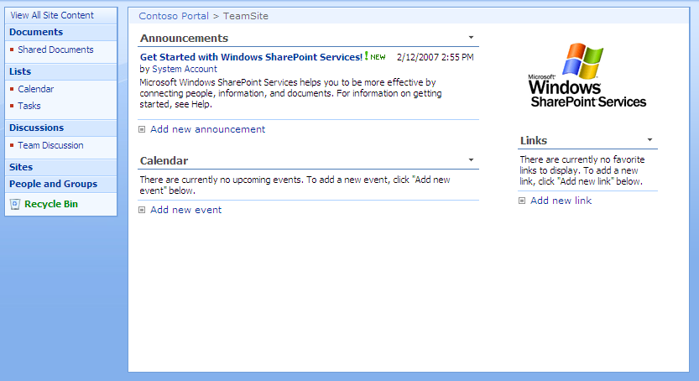
Body Structure
ms-titlearealeft
ms-pagetitleareaframe
ms-titlearearight
ms-titleareaframe
ms-pagetitle
ms-titleareaframe
ms-leftareacell
ms-navframe
ms-pagemargin
ms-pagebottommargin
ms-pagebottommarginright
ms-pagemargin
ms-pagebottommarginleft
ms-bodyareapagemargin
ms-rightareacell

Slide 22
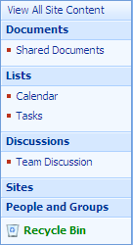
Quick Launch
ms-quicklaunchouter
ms-quickLaunch
ms-standardheader
ms-navSubMenu1
ms-quicklaunchheader
ms-navheader
ms-navSubMenu2
ms-navitem
ms-recyclebin

Slide 23
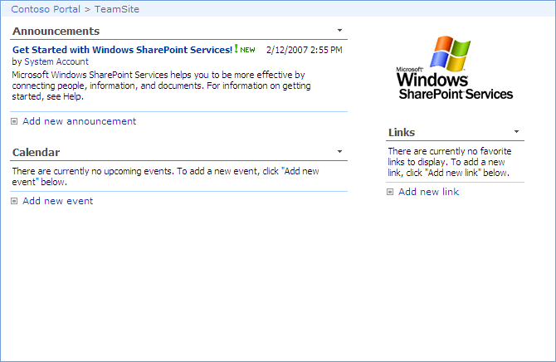
Page Body
ms-bodyareacell
ms-propertysheet
ms-pagebreadcrumb
ms-bodyareaframe
ms-sitemapdirectional

Slide 24
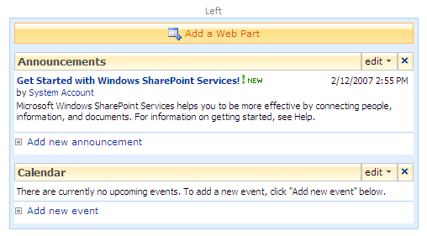
Web Parts
used in edit mode only
ms-SPZone
ms-SPZoneLabel
ms-HoverCellInActive
ms-SPButton ms-WPAddButton
ms-WPEditText
ms-WPHeader
ms-standardheader ms-WPTitle
ms-HoverCellInActive
ms-summarycustombody
ms-addnew
list view web part only
ms-vb

Slide 25
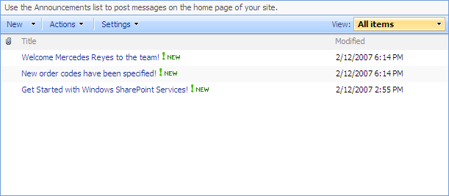
List Views
ms-listdescription
ms-menutoolbar
ms-viewselectorhover
ms-toolbar
ms-listheaderlabel
ms-vh-icon
ms-splitbuttonhover
ms-separator
ms-vh2
ms-unselectedtitle
ms-vb
ms-alternating
ms-vb-title
ms-unselectedtitle
ms-vb
ms-vb2

Slide 26
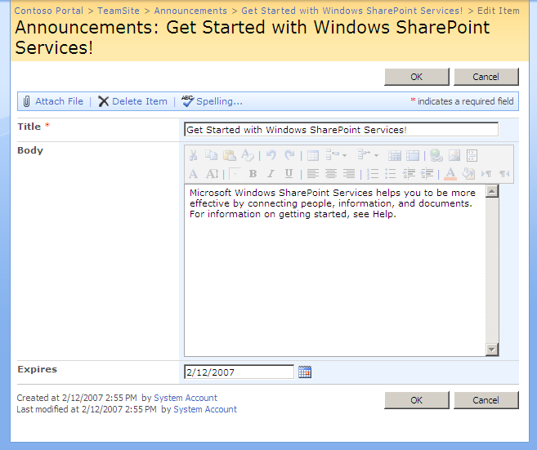
Forms
ms-areaseparatorleft
ms-areaseparatorright
ms-areaseparator
ms-titlearea
ms-pagetitle
ms-sitemapdirectional
ms-formtoolbar
ms-toolbar
ms-ButtonHeightWidth
ms-formtable
ms-formlabel
ms-formbody
ms-formtoolbar
ms-toolbar
ms-descriptiontext

Slide 27
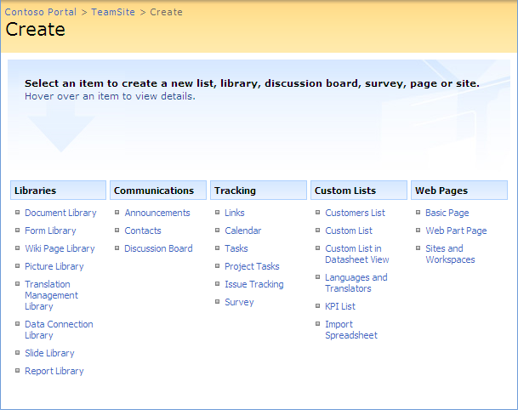
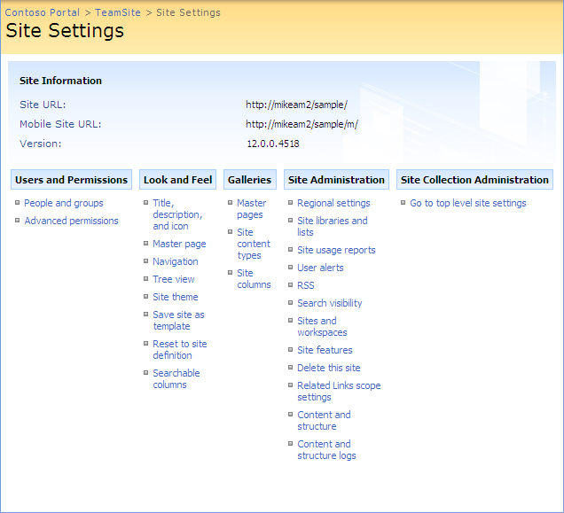
Application Pages (Landing Pages)
ms-settingsframe
ms-createpageinformation
ms-informationtablestatic
ms-pageinformation
ms-linksectionheader
ms-standardheader
ms-propertysheet
ms-descriptiontext

Slide 28
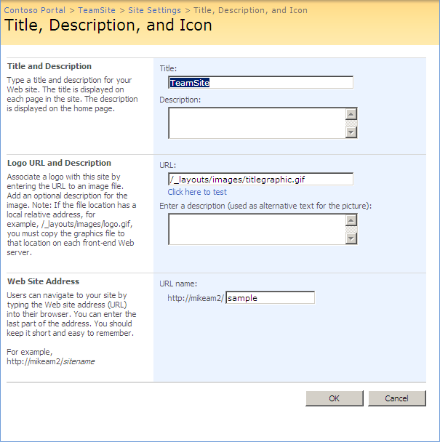
Application Pages (Form Pages)
ms-formareaframe
ms-propertysheet
ms-descriptiontext
ms-sectionheader
ms-standardheader
ms-descriptiontext ms-inputformdescription
ms-authoringcntrols ms-inputformcontrols

Slide 29
DocTypes
What is a DocType?
Standard W3C instruction for browsers
tells browser to use specific language to interpret HTML/XML
pages without DocType render in Quirks mode (pre IE5.5)
Strict versus Transitional
Strict prohibits legacy code (e.g. no Font tags, tags must be closed)
<!DOCTYPE HTML PUBLIC "-//W3C//DTD HTML 4.01//EN” "http://www.w3.org/TR/html4/strict.dtd">
Transitional allows pages with legacy code to be W3C compliant
<!DOCTYPE HTML PUBLIC "-//W3C//DTD HTML 4.01 Transitional//EN” "http://www.w3.org/TR/html4/loose.dtd">

Slide 30
DocTypes and SharePoint
What DocType does SharePoint use
default.master does not define a DocType
BlueBand.master (and its relatives) use HTML 4.01 Transitional
SharePoint is not W3C compliant with HTML or XHTML
Tools for checking W3C compliance
https://addons.mozilla.org/en-US/firefox/addon/249
Notes:
2010 story

Slide 31
Browsers and Support
All modern browsers support CSS styling though they sometimes handle CSS slightly differently
Testing in all of your target browsers is crucial
For testing old versions of IE use IETester or SuperPreview
http://www.my-debugbar.com/wiki/IETester/HomePage
http://expression.microsoft.com/en-us/dd565874.aspx

Slide 32
Summary
Fundamentals CSS concepts
Overview of CSS rules defined in Core.CSS
Tools for Discovering CSS
Adding custom CSS to a master page
Doctypes and SharePoint

